Slide 1
Evolution of the spliceosome in fungi

Slide 2
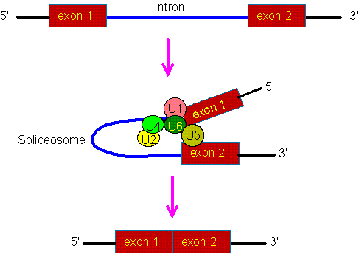
The biochemistry of splicing

Slide 3
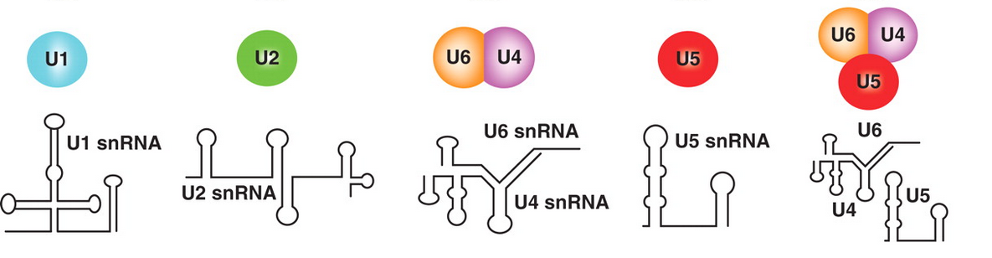
Five small nuclear ribonucleic proteins are involved in splicing

Slide 4
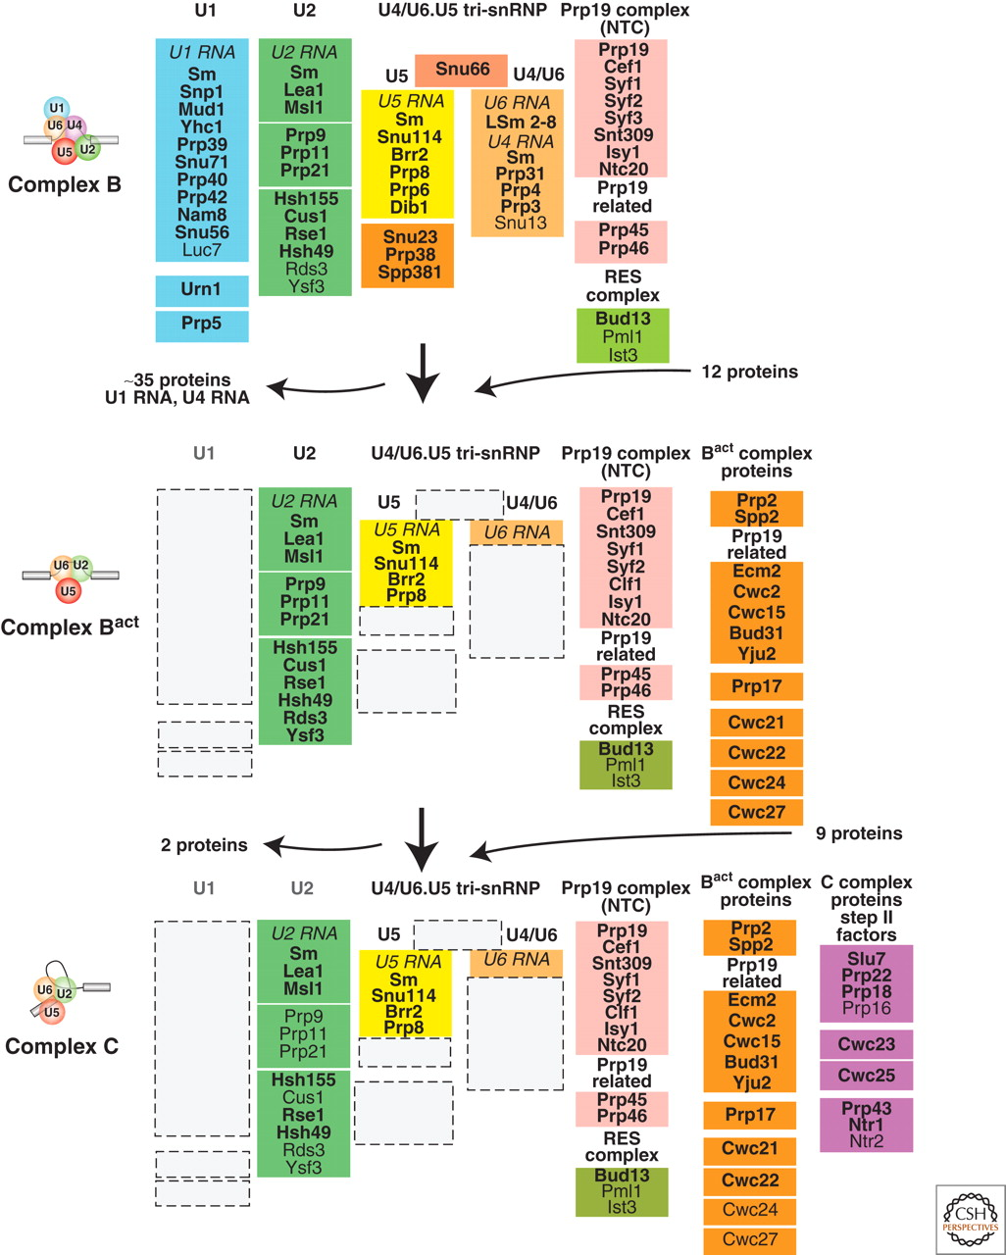

Slide 5
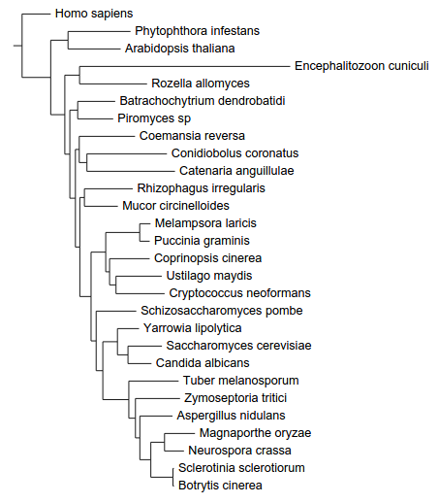
The phylogeny of fungi
Basidiomycota
Saccharomycotina
Ascomycota
Pezizomycotina
Based on five proteins: Actin, GAPDH, HSP70, RBP1 and TEF1

Slide 6
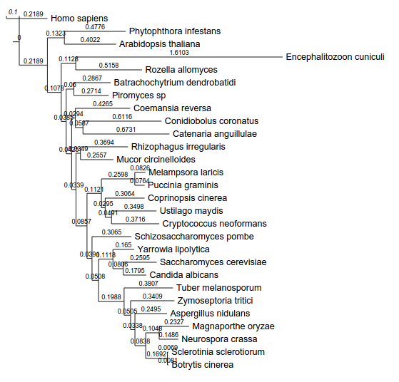
In E. cuniculi and the saccharomycotina the spliceosome evolved faster
Based on five proteins: Actin, GAPDH, HSP70, RBP1 and TEF1

Slide 7
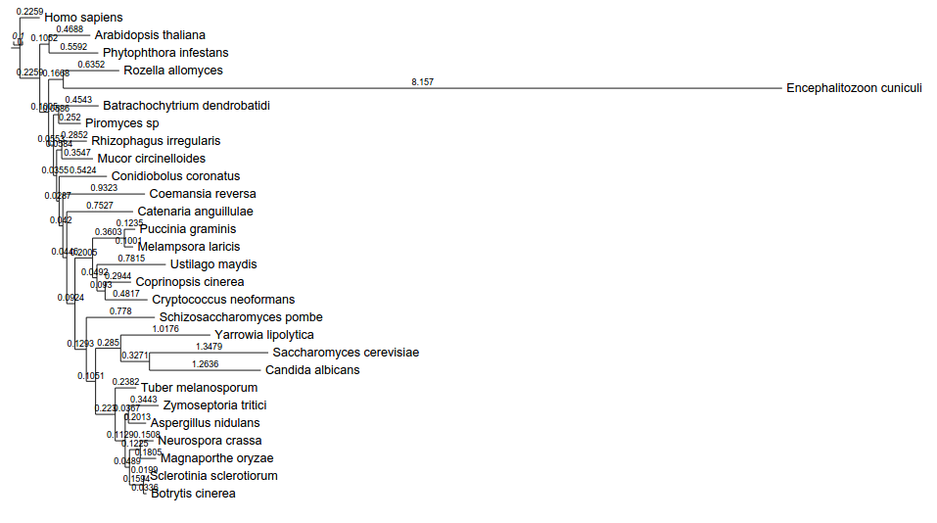
In E. cuniculi and the saccharomycotina the spliceosome evolved faster
Based on seven proteins: HSH155, CUS1, PRP9, PRP8, LSM7, CEF1, BUD31

Slide 8
In E. cuniculi and the saccharomycotina the spliceosome evolved faster

Slide 9
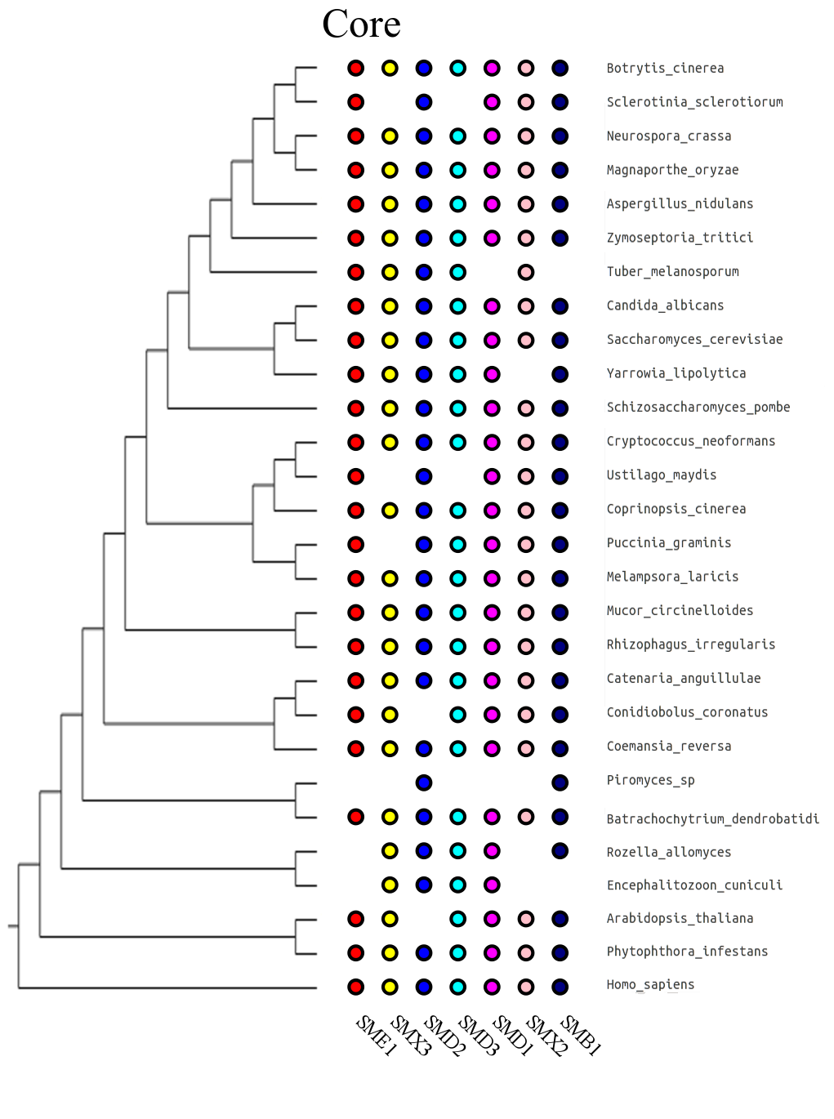
Proteins orthologs

Slide 10
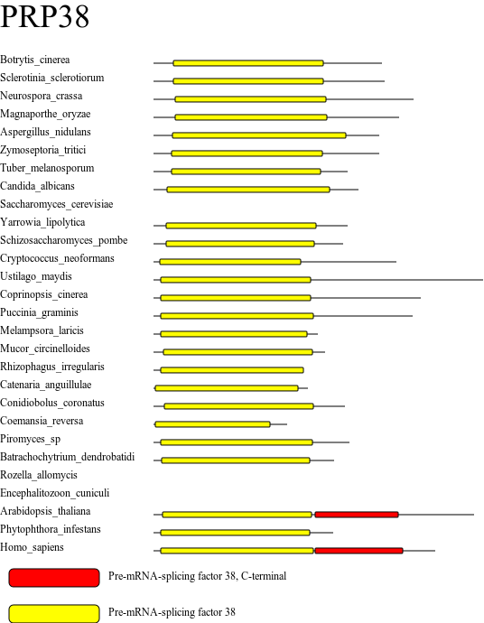
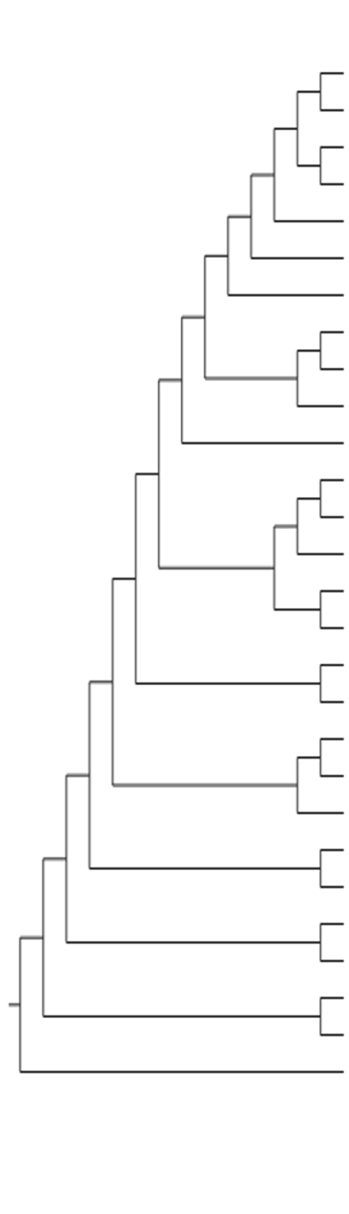
Domain organization

Slide 11
The number of genes containing introns strongly reduced in E. cuniculi and yeasts

Slide 12
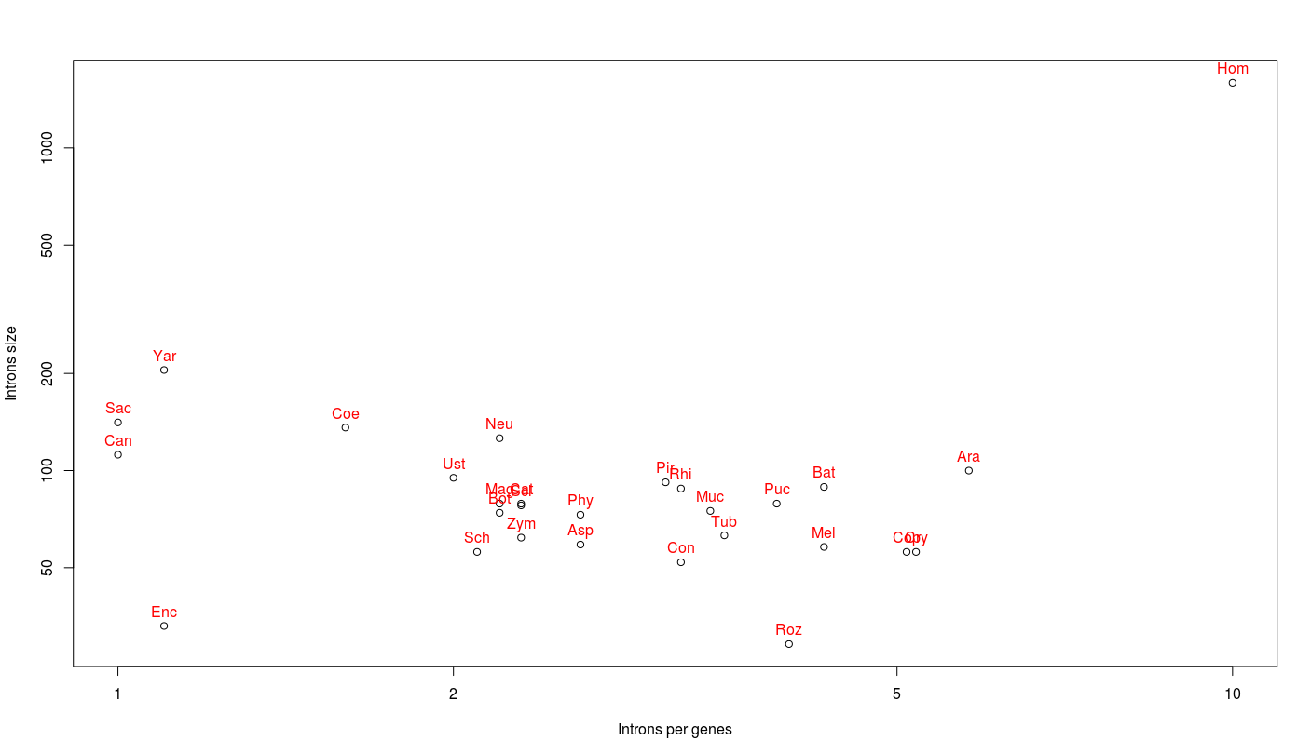
Saccharomycotina have few, large introns

Slide 13
In fungi, introns usually represent less than 30% of genes length

Slide 14
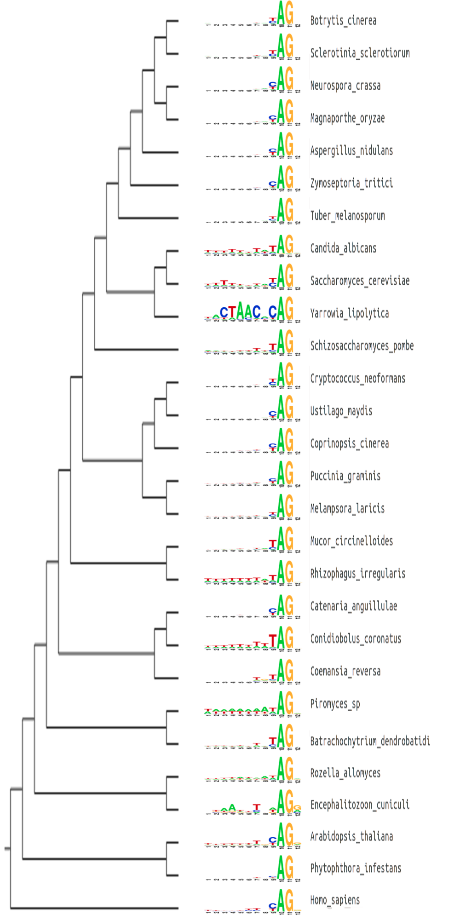
In many fungi, the TAG acceptor is preferred over CAG

Slide 15
In many fungi, the TAG acceptor is preferred over CAG

Slide 16
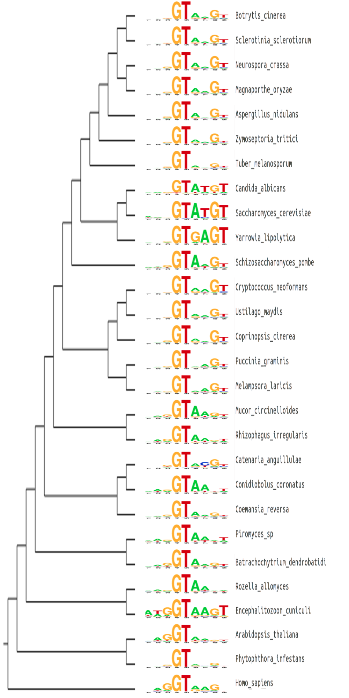
The donor site show high uniformity in Saccharomycotina

Slide 17
The donor site show high uniformity in Saccharomycotina

Slide 18
The donor site show high uniformity in Saccharomycotina

