Slide 1
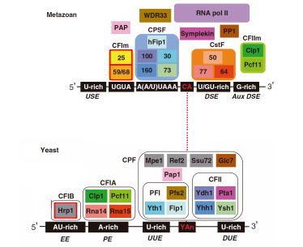
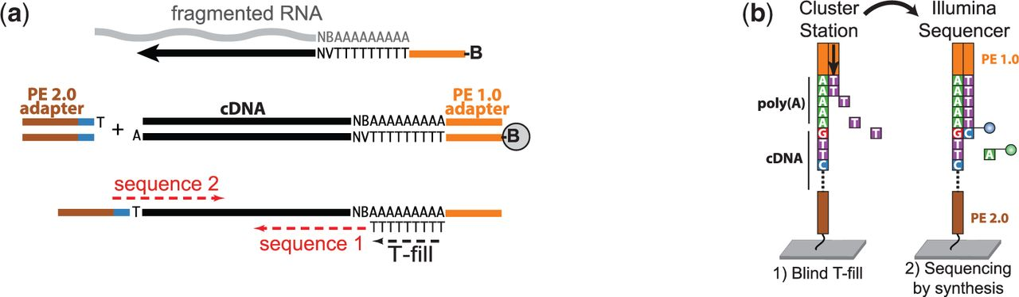
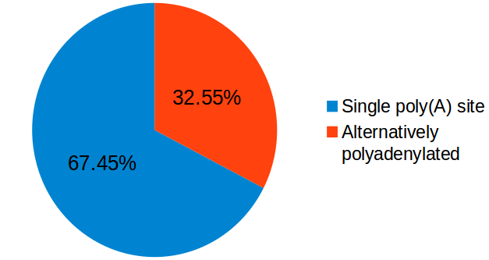
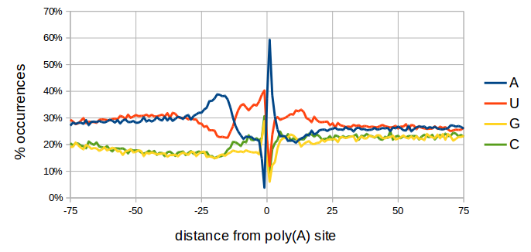
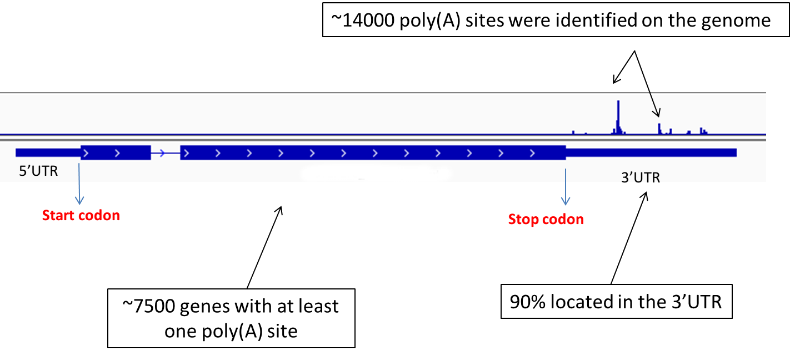
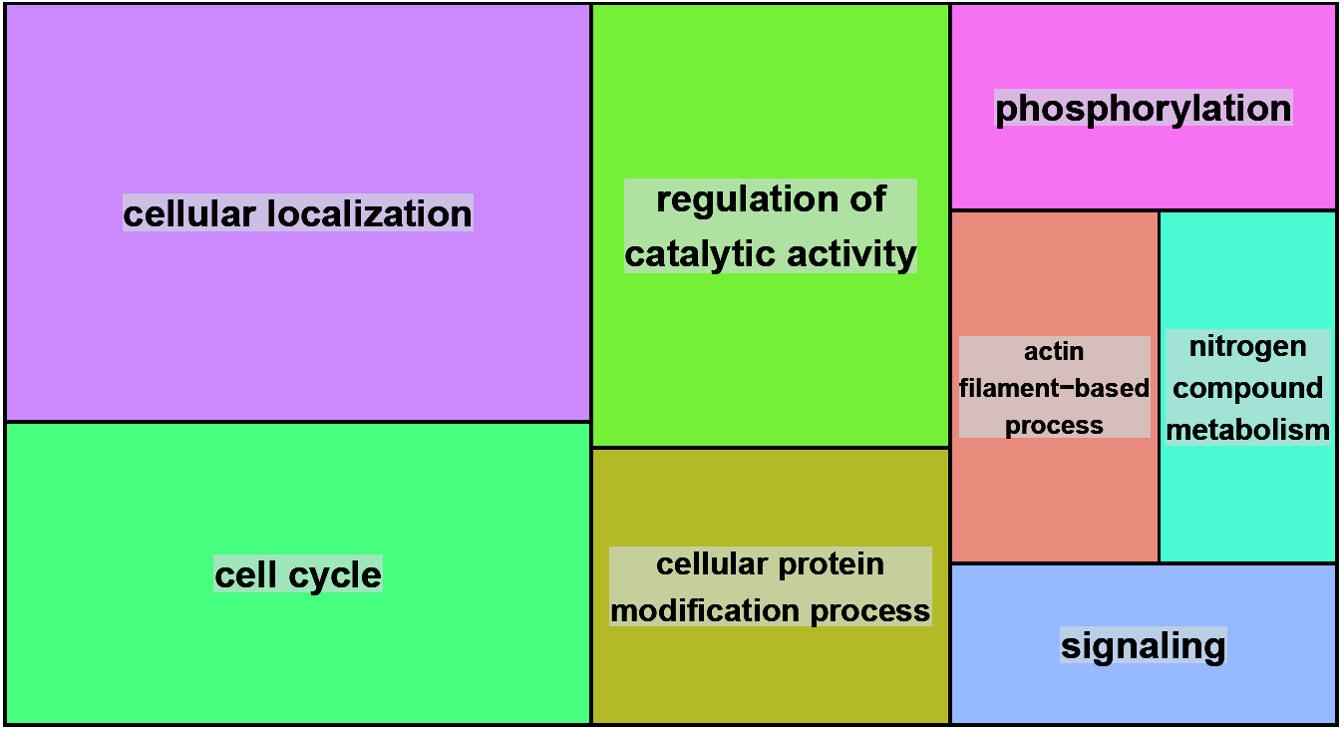
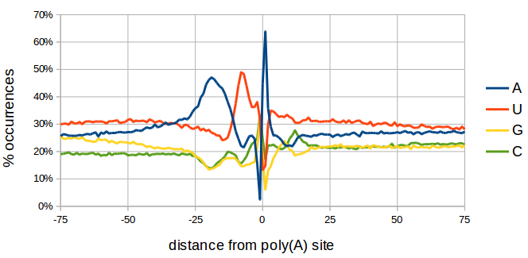
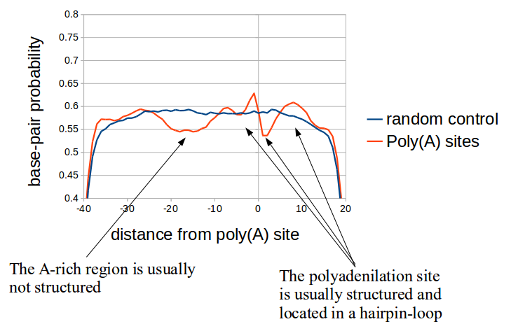
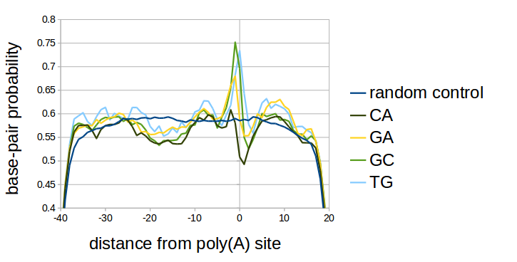
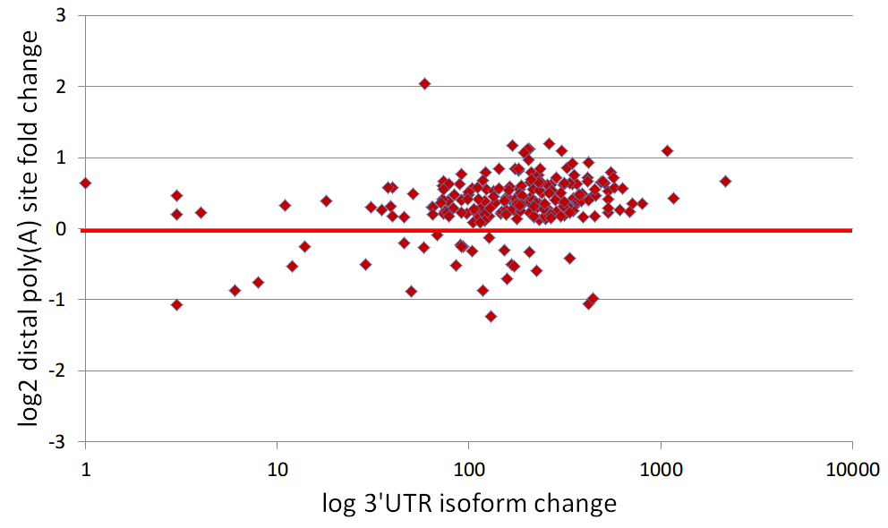
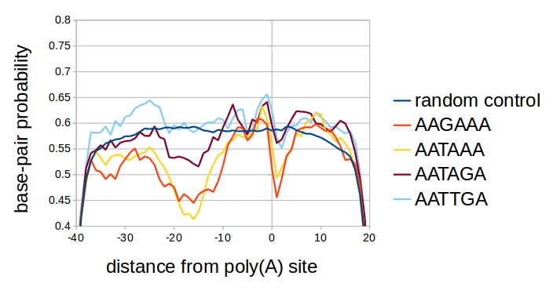
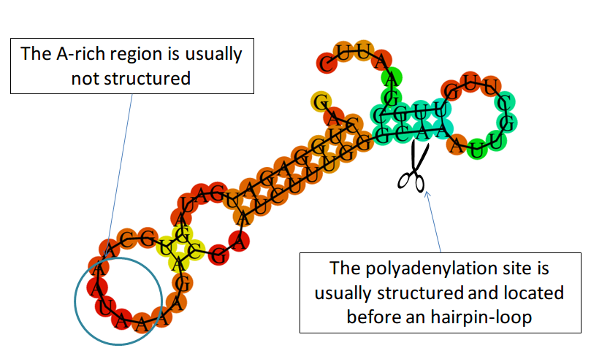
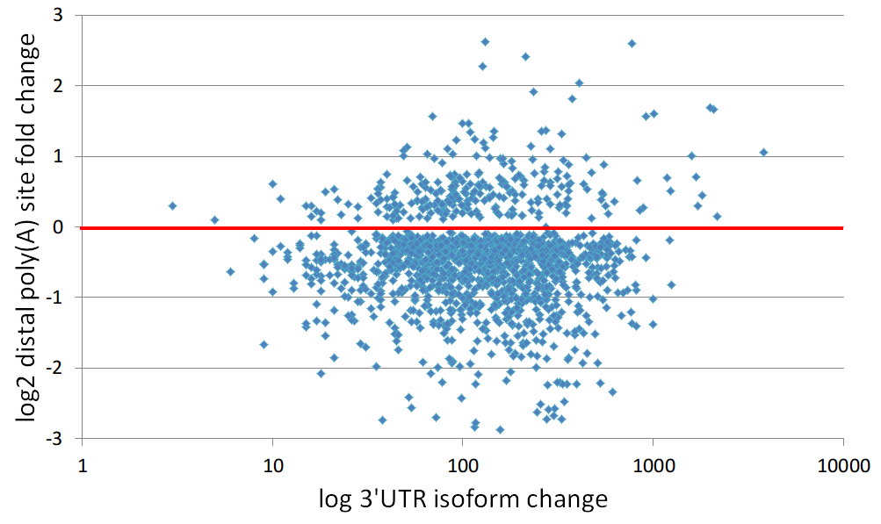
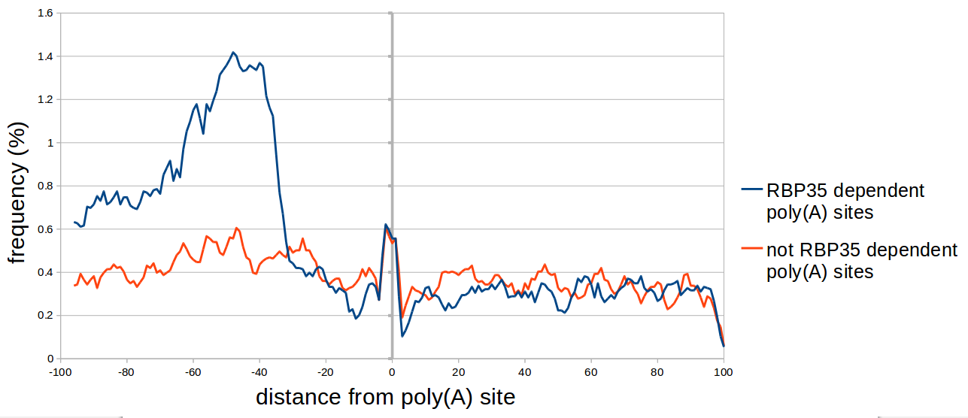
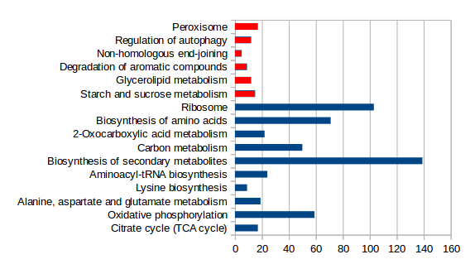
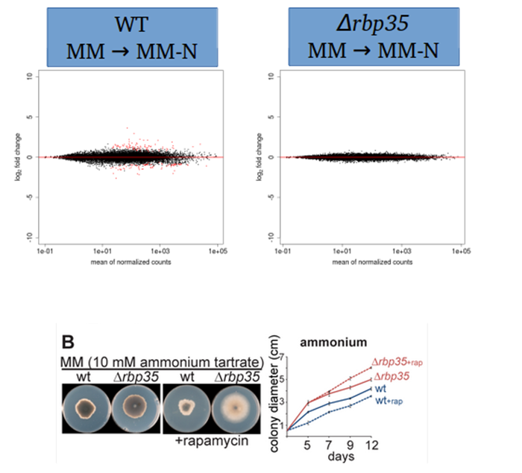

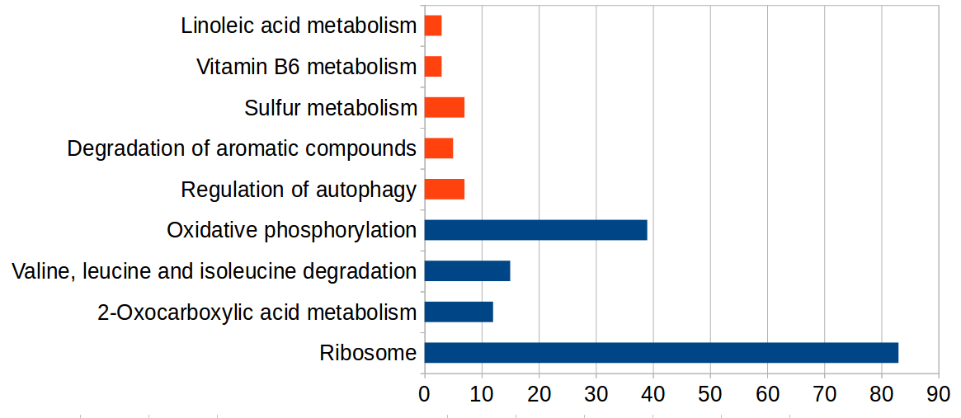


Bioinformatic analysis of Magnaporthe oryzae polyadenylation sites from next generation sequencing data
Background
Several proteins have been shown to regulate alternative polyadenylation (APA), including Cleavage Factor I (CFIm) in metazoan. The ascomycetous fungus Magnaporthe oryzae, also known as rice blast, is a plant-pathogenic fungus that causes a serious disease affecting rice. Rbp35 is the functional M. oryzae equivalent of Human CFIm68. ∆rbp35 knock-out mutant is viable indicating that Rbp35 is not an essential components of the polyadenylation machinery in the rice blast fungus. However, Δrbp35 mutants shows developmental and virulence defects.
Results
Using a novel sequencing protocol, we mapped the polyadenylation sites of M. oryzae in four different growing conditions and identified more than 14000 high-confidence polyadenylation sites, accounting for more than 7,000 protein coding genes
30% of M. oryzae genes are alternatively polyadenylated, and grouped in specific functional groups.
The nucleotide context and protein-binding regions differ from budding yeast.
Polyadenylation sites possess a specific predicted RNA secondary structure, also depending on the elements defining the polyadenylation site.
Under carbon starvation, polyadenylation site selection is altered in more than 400 genes, producing longer 3'UTR isoforms.
25% of the alternatively-polyadenylated transcripts found in the wild type were affected in the Δrbp35 mutant, which indicated that alternative site selection was Rbp35-dependent. Lack of Rbp35 in Δrbp35 affects poly(A) site selection by promoting proximal cuts, resulting in a global shortening of 3'UTRs.
A UGUAH motif is enriched in Rbp35-dependent poly(A) sites, suggesting that these are the ribonucleotides recognized by Rbp35.
The Δrbp35 mutant seems to have lost the ability to adapt to nitrogen starvation.
RBP35 ortholog found in animals,
but not in yeast
!
More than 14000 poly(A) sites were identified using a novel sequencing protocol
Alternative polyadenylation seems to be involved in specific biological processes
Nucleotide Profile of poly(A) site slightly differs from yeast
Most alternative polyadenylation events are located in the 3’UTR and are composed of 2 alternatives only
S. cerevisiae
Wilkening, S. et al. An efficient method for genome-wide polyadenylation site mapping and RNA quantification. Nucleic acids research 1–8 (2013).doi:10.1093/nar/gks1249
UGUA
AU-rich
A-rich
U-rich
Y A
U-rich
UAGA
A-rich
U-rich
S A
C peak
M.oryzae
Supek F, Bošnjak M, Škunca N, Šmuc T. "REVIGO summarizes and visualizes long lists of Gene Ontology terms" PLoS ONE 2011. doi:10.1371/journal.pone.0021800
Gruber AR, Lorenz R, Bernhart SH, Neuböck R, Hofacker IL The Vienna RNbsuite. Nucleic Acids Res. 2008
The polyadenylation site region has a defined predicted secondary structure
Carbon starvation medium and Δrbp35 gene deletion affect poly(A) site selection
A) RNA structure prediction reveals a defined pattern
B) Different cut sites have different conformations
Longer 3’UTR
Carbon starvation usually lengthens 3’UTRs in Wild-type (455 genes affected)
CM
MM-C
Shorter 3’UTR
MGG_01058 3’UTR
C) Different polyadenylation signals have different conformations
D) An example, the poly(A) site of 40S ribosomal protein S15 (MGG_10370)
Longer 3’UTR
Deletion of Δrbp35 gene usually shortens 3’UTRs (%25 of genes affected)
WT
Shorter 3’UTR
Δrbp35
Gruber AR, Lorenz R, Bernhart SH, Neuböck R, Hofacker IL The Vienna RNA Websuite. Nucleic Acids Res. 2008
MGG_01620 3’UTR
UG
Rbp35/CfI25 complex recognizes the UGUAH motif
Frequency of UGUAH motif
Carbon starvation presents a big number of genes differentially expressed, while nitrogen starvation recognition is inhibited in the mutant
Wild-type
Δrbp35 mutant
CM -> MM-C
Most metabolic pathways are down-regulated in carbon starvation
Wild type strain (common situation)
Wild type strain (alternative poly(A) site)
Δrbp35 mutant
CM -> MM-N
5’
Rbp35/CFI25
5’
Rbp35/CFI25
5’
Rbp35/CFI25
GATA genes are up-regulated in nitrogen starvation
UGUA
UGUA
UGUA
-45
3’
-45
3’
-45
3’
Poly(A) site
Poly(A) site “occluded” by Rbp35
Poly(A) site “revealed” in the mutant
Both RNA-seq and plate growing display failed adaptation to nitrogen lacking medium
Marco Marconi, Julio Rodriguez-Romero, Ane Sesma and Mark Wilkinson
Centre for Plant Biotechnology and Genomics (CBGP), Universidad Politécnica de Madrid, Campus Montegancedo 28223 Madrid – Spain marco.marconi@gmail.com

