Slide 1
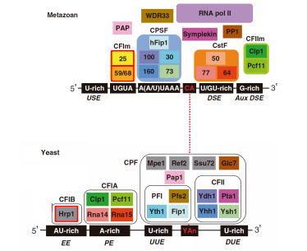
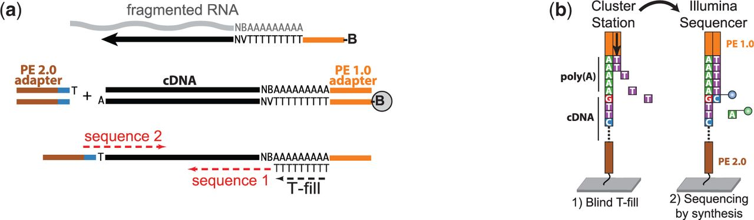
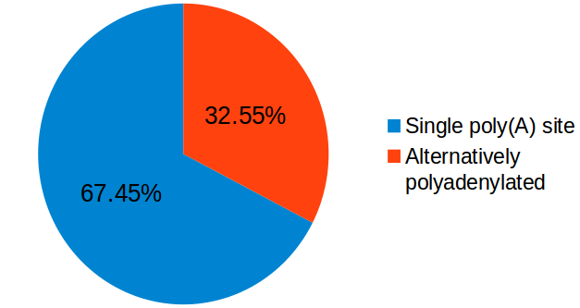
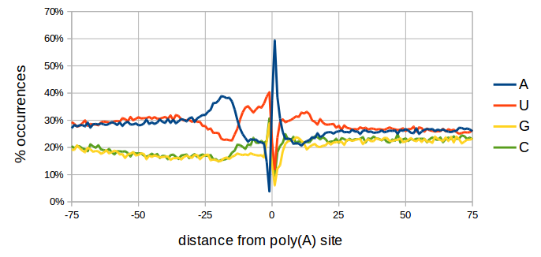
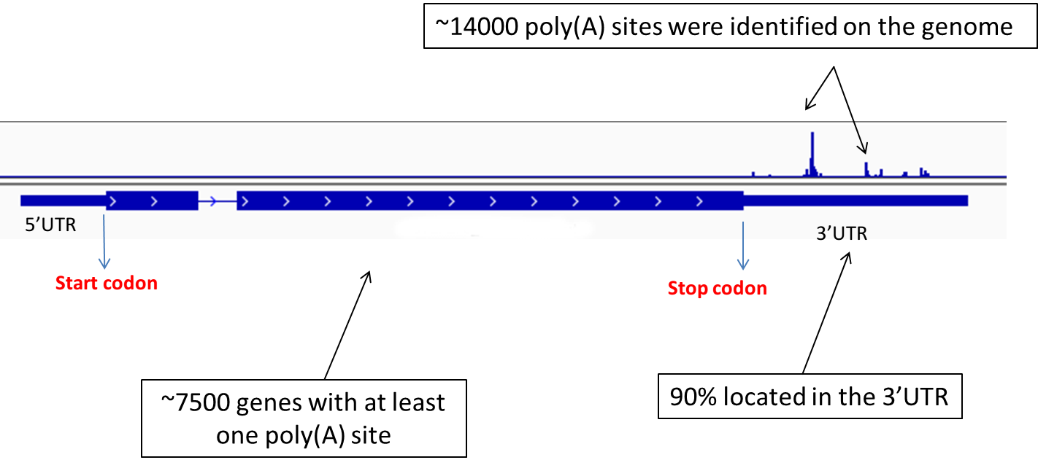
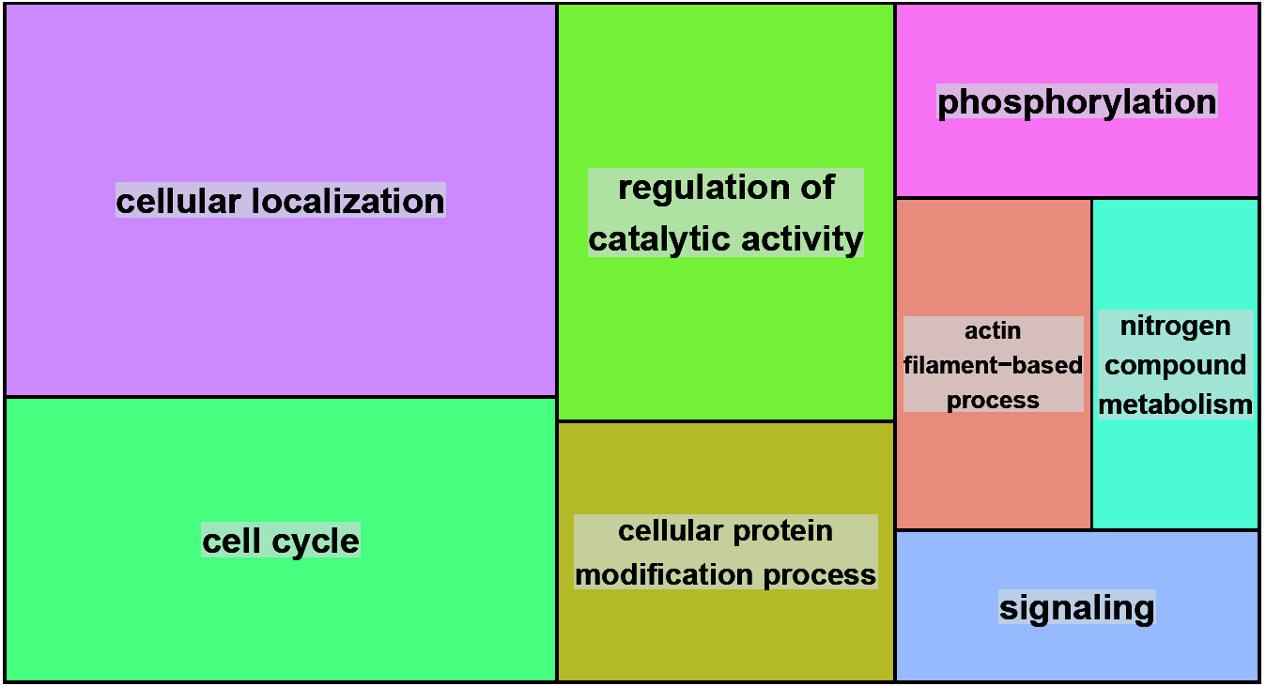
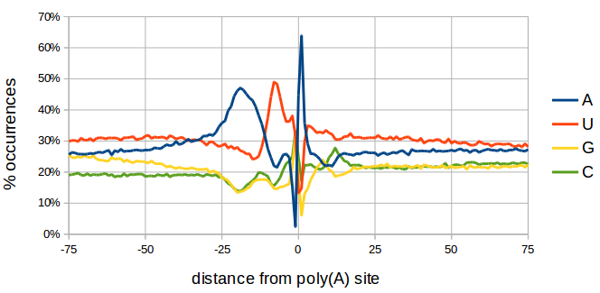
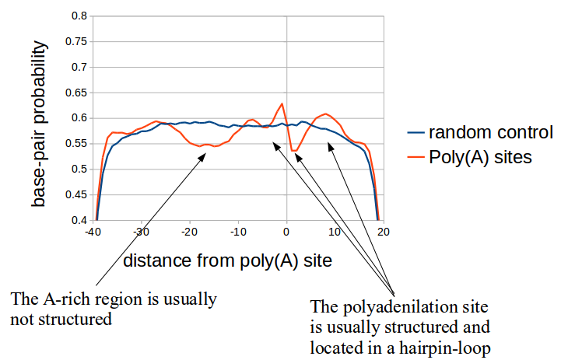
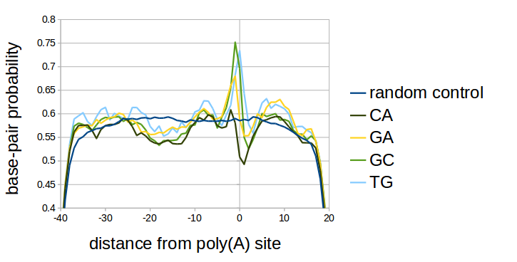
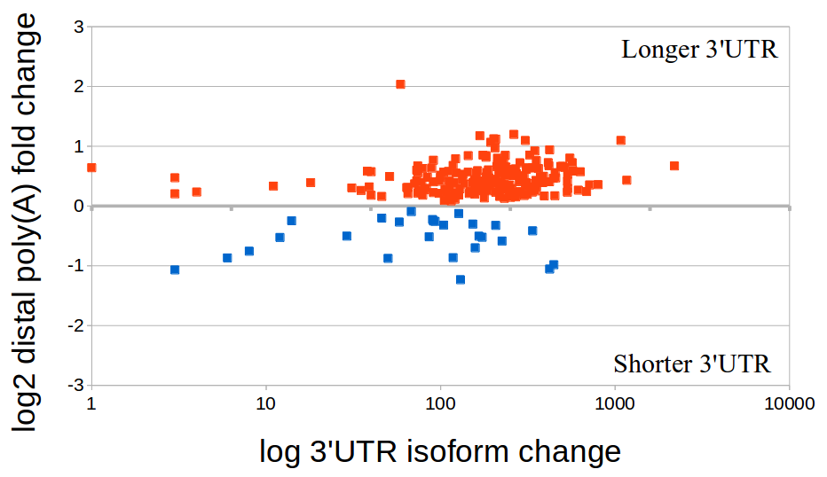
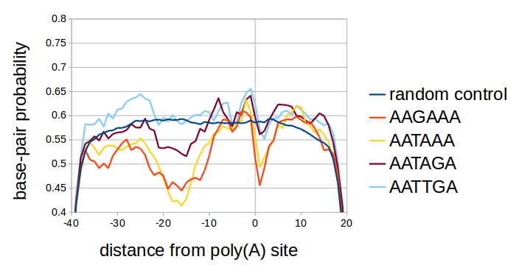
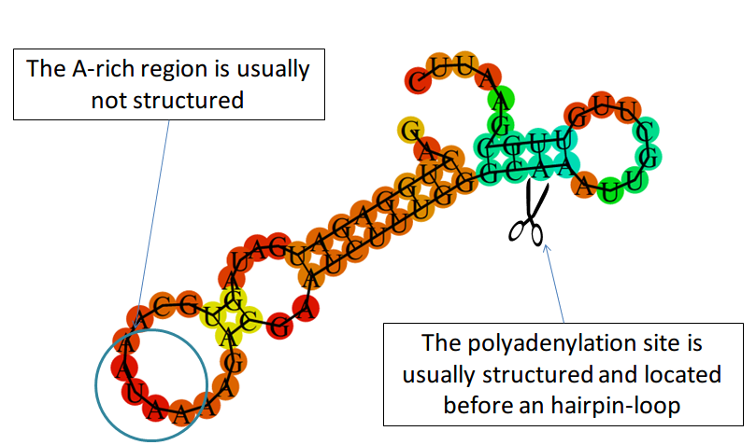
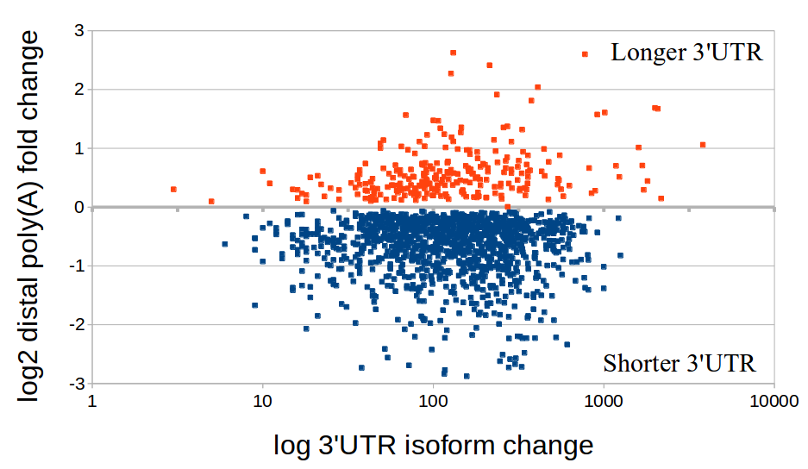
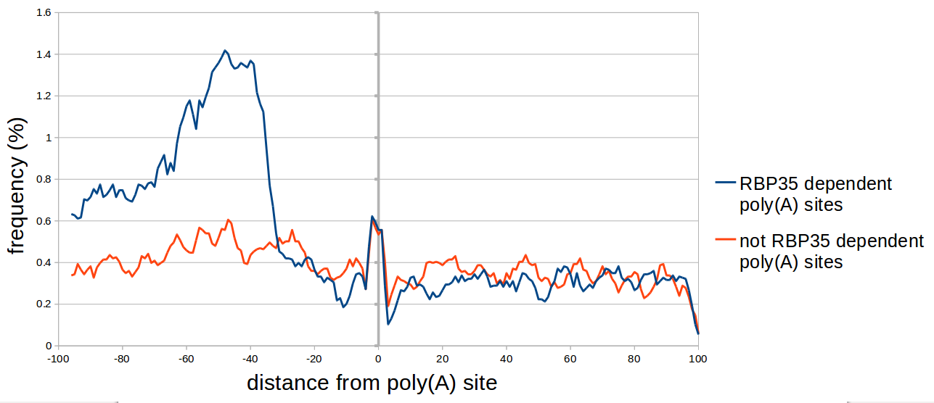
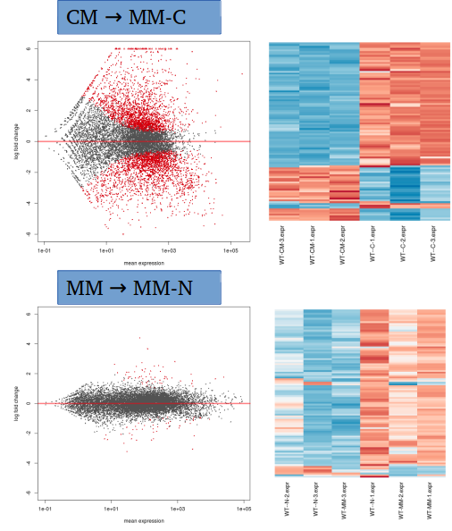
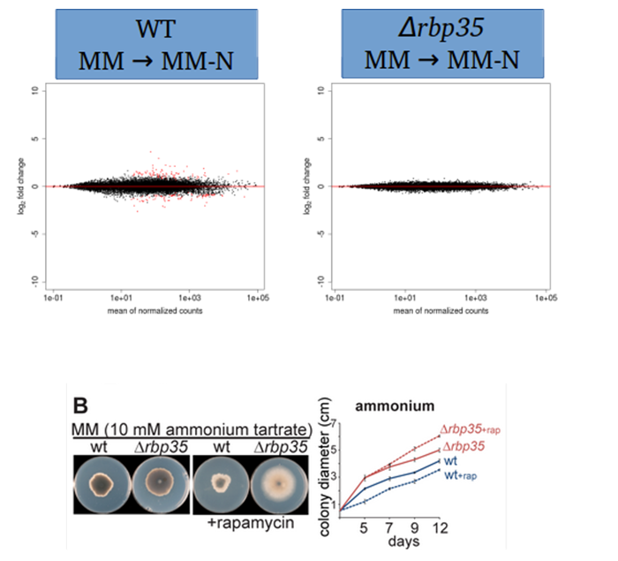


Bioinformatic analysis of Magnaporthe oryzae polyadenylation sites from next generation sequencing data
Background
Several proteins have been shown to regulate alternative polyadenylation (APA), including Cleavage Factor I (CFIm) in metazoan. The ascomycetous fungus Magnaporthe oryzae, also known as rice blast, is a plant-pathogenic fungus that causes a serious disease affecting rice. Rbp35 is the functional M. oryzae equivalent of CFIm68. ∆rbp35 is viable indicating that Rbp35 is not essential components of the polyadenylation machinery in the rice blast fungus. However, Δrbp35 mutants shows developmental and virulence defects.
Results
We mapped the polyadenylation sites of M. oryzae in four different growing conditions and identified more than 14000 high-confidence poly(A) sites, accounting for more than 7,000 protein coding genes. 30% of M. oryzae genes are alternatively polyadenylated, and grouped in specific functional groups. We also identified the nucleotide context, protein-binding regions and RNA secondary structure of poly(A) sites, and demonstrated that these differ from budding yeast. Under carbon starvation, alternative poly(A) site selection is observed in more than 400 genes, producing longer 3'UTR isoforms. , ~25% of the alternatively-polyadenylated transcripts found in the wild type were affected in the Δrbp35 mutant, which indicated that alternative site selection was Rbp35-dependent. Lack of Rbp35 in Δrbp35 affects poly(A) site selection by promoting proximal cuts, resulting in a global shortening of 3'UTRs. A UGUAH motif is enriched in Rbp35-dependent poly(A) sites, suggesting that these are the ribonucleotides recognized by Rbp35.
RBP35 ortholog found in animals,
but not in yeast!
!
More than 14000 poly(A) sites were identified using a novel sequencing protocol
Alternative polyadenylation seems to be involved in specific biological processes
Nucleotide Profile of poly(A) site slightly differs from yeast
Most of alternative polyadenylation events are located in the 3’UTR and are composed of 2 alternatives only
S. cerevisiae
UGUA
AU-rich
A-rich
U-rich
Y A
U-rich
UAGA
A-rich
U-rich
S A
C peak
M.oryzae
The polyadenylation site region has a defined structure
Carbon starvation medium and Δrbp35 gene deletion affect poly(A) site selection
A) RNA structure prediction reveals a defined pattern
B) Different cutsites have different conformations
Carbon starvation usually lengthens 3’UTRs in Wild-type (455 genes affected)
MGG_01058 3’UTR
B) Different motifs have different conformations
D) An example, the poly(A) site of 40S ribosomal protein S15 (MGG_10370)
Deletion of Δrbp35 gene usually shortens 3’UTRs (%25 of genes affected)
UG
MGG_01620 3’UTR
Rbp35/CfI25 complex recognizes the UGUAH motif
Frequency of UGUAH motif
Carbon starvation presents a big number of genes differentially expressed, while nitrogen starvation is inhibited in the mutant
Wild-type
Δrbp35 mutant
Wild type strain (common situation)
Wild type strain (alternative poly(A) site)
The mutant
Rbp35/CFI25
Rbp35/CFI25
5’
Rbp35/CFI25
5’
5’
GATA genes upregulated in nitrogen starvation
UGUA
UGUA
UGUA
-45
3’
-45
3’
-45
3’
Poly(A) site
Poly(A) site “occluded” by Rbp35
Poly(A) site “revealed” in the mutant
Marco Marconi, Julio Rodriguez-Romero, Mark Wilkinson and Ane Sesma
Centre for Plant Biotechnology and Genomics (CBGP), Universidad Politécnica de Madrid, Campus Montegancedo 28223 Madrid – Spain marco.marconi@gmail.com

