Slide 1
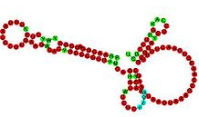

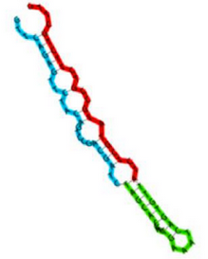



Magnaporthe oryzae small-RNA sequencing

Slide 2
Magnaporthe oryzae small-RNA sequencing

Slide 3




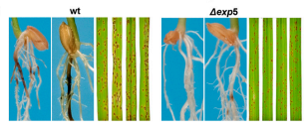
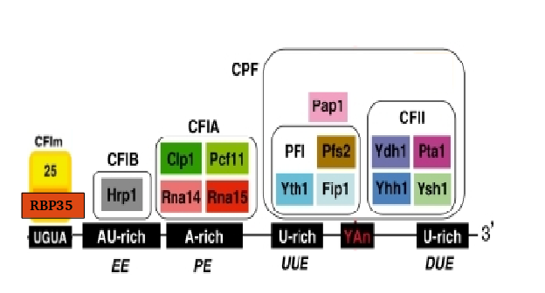
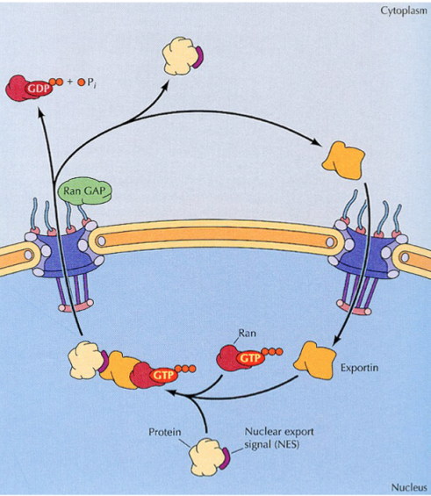
Introduction
RBP35
EXP5

Slide 4
Introduction – RBP35
We performed a poly(A) specific RNA-seq
Alternative polyadenylation is altered in ∆rbp35 in 25% of genes, belonging to specific functional groups
UTR are usually shortened in ∆rbp35
∆rbp35 probably binds to UGUA motif
….(previous work)

Slide 5
Introduction – EXP5
In yeast, involved in nuclear import and export of several proteins, and required for re-export of mature tRNAs after their retrograde import from the cytoplasm
In mammals also mediates the nuclear export of micro-RNA precursors, and double-strand RNA-bearing proteins

Slide 6
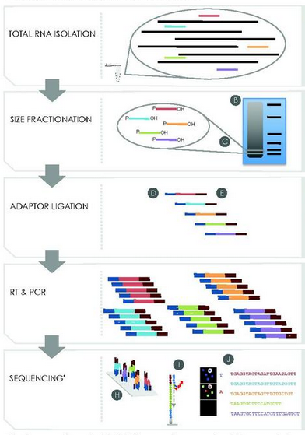
Small RNA library preparation and sequencing

Slide 7
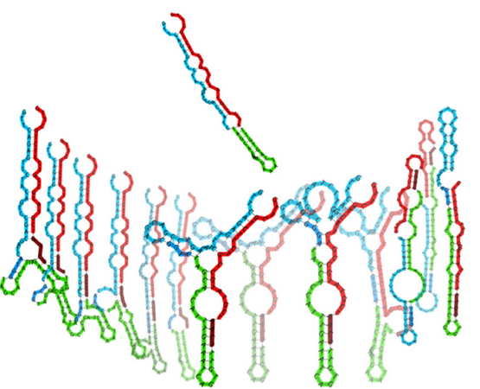
Standard small RNA-seq adapters have been shown to be biased for certain RNA structures

Slide 8


Our library was prepared with HD adapters (Prof. Tamas Dalmay lab, Norwich, UK)
Regular smallRNA-seq
sequencing
HD smallRNA-seq
x256 combinations
sequencing

Slide 9
Sequencing resume
sample | total reads | Filtered read | Filtered read % | unique | Unique %
∆exp5 _1 | 25580902 | 23975309 | 6.28% | 2033390 | 8.48%
∆exp5 _2 | 39423030 | 37653701 | 4.49% | 2707372 | 7.19%
∆exp5 _3 | 16606918 | 12769671 | 23.11% | 1325098 | 10.38%
∆rbp35 _1 | 14107800 | 7722707 | 45.26% | 892168 | 11.55%
∆rbp35 _2 | 25965551 | 23087772 | 11.08% | 2513756 | 10.89%
∆rbp35 _3 | 32233131 | 23138541 | 28.22% | 2601845 | 11.24%
WT_1 | 13826696 | 11009290 | 20.38% | 1130421 | 10.27%
WT_2 | 21412622 | 18120959 | 15.37% | 1679584 | 9.27%
WT_3 | 14168509 | 12287418 | 13.28% | 1364946 | 11.11%
* No 3’ adapter found, too short after trimming (<16) or low quality/artifacts

Slide 10
Replicate 1 of ∆rbp35 is slightly less correlated

Slide 11


Adapters contamination is variable
60 nt
60 nt

Slide 12
Insert size is between 18-25 bp

Slide 13
There is an overall U preference as 1st nucleotide

