Slide 1
Sequencing resume
2 strains (WT, Δrbp35) x 4 conditions (CM, MM, -N, -C) x 3 replicates
4751592 – 11517077 total reads database
~62% - ~82% successfully mapped reads
43 bp mean read length
~92% - ~98% replicates correlation
~100bp mean pair ended distance
~400x coverage per poly(A) site*
* assuming an amount of 22000 mRNA molecules per cell

Slide 2





Workflow
Program and details
Procedure
% of data left
Illumina sequencing
100%
fasta-mcf, adapter trimming
Data prepping
96%
gsnap, default parameters
Alignment
96%
Low quality mapping (<30))
High A/T content (>90%)
Internal priming
Filtering
Assign reads to known features,
Including all intergenic space up
to 400 bp from gene end
75%
Assignment
65%
Clustering of most significant poly(A) sites (at least 5 supporting reads and p-value < 0.05 over
global gene expression) at 33 bp
poly(A) sites detection
27%
Example: Actin, single cut poly(A):
whole gene expression ~7000 reads
poly(A) site expression ~3000 reads

Slide 3
Pair ended reads distance

Slide 4


~2.5% of poly(A) sites are internal priming
Some poly(A) sites are just a side effect of poly(A) genomic regions
reads
stretches of As

Slide 5
~8500 genes are expressed, out of a total of 13218 annotated genes (WT)
7662 genes are expressed in every condition (WT only)
3979 genes are never expressed (WT only)
A gene is considered as expressed when has at least 10 supporting reads in a least 2 replicates

Slide 6
~8500 genes are expressed, out of a total of 13218 annotated genes (Δrbp35)
7993 genes are expressed in every condition (Δrbp35 only)
3757 genes are never expressed (Δrbp35 only)
A gene is considered as expressed when has at least 10 supporting reads in a least 2 replicates

Slide 7


Not every expressed gene has a recognizable poly(A) site
Expressed gene with a recognizable poly(A) site:
Expressed gene without a recognizable poly(A) site:

Slide 8
Only ~85% of genes expressed have a recognizable poly(A) site

Slide 9
~13000 poly(A) site could be assigned to annotated genes

Slide 10
~13000 poly(A) site could be assigned to annotated genes (Δrbp35)

Slide 11
~20% of genes are alternatively polyadenilated
* calculated over the global number of expressed genes with a recognizable poly(A) site

Slide 12
>90% of APA is located in the 3'UTR

Slide 13
>80% of APA is composed of two cleveage sites

Slide 14
>90% of poly(A) sites are located in the 3'UTR

Slide 15
261 highly expressed (>100 reads) poly(A) sites could not be assigned to any annotated gene

Slide 16
261 orphan poly(A) sites highly expressed in WT (>100 reads)
14 hits against other gene copies in M.oryzae
44 hits against Uniprot nt/nr database
4 hits against Rfam(ncRNA) database
81 overlapping annotated genes antisense
63 matching CPA-sRNA sequences
16 matching retrotransposons
7 located in telemeric avirulence regions

Slide 17
3165 orphan poly(A) sites expressed in WT (>10 reads)
102 hits against other gene copies in M.oryzae
438 hits against Uniprot nt/nr database
10 hits against Rfam(ncRNA) database
1098 overlapping annotated genes antisense
253 matching CPA-sRNA sequences
129 matching retrotransposons
57 located in telemeric avirulence regions

Slide 18
Orphans differentially expressed in WT
(>100 reads)
CM → MM-C | 167
CM → MM | 36
CM → MM-N | 51
MM → MM-C | 129
MM → MM-N | 0
(>10 reads)
CM → MM-C | 1499
CM → MM | 177
CM → MM-N | 285
MM → MM-C | 1110
MM → MM-N | 0

Slide 19
Antisense poly(A) are usually located in the 3'UTR, most of antisense poly(A) are differentially expressed in any condition

Slide 20
1365 genes expressed in plant are never expressed in vitro
CM
7075
plant
1829
7291
5246
-N
MM
7061
1844
5217
1365
5181
1781
6962
5707
2047
-C
7572
Sage + mosquera = 8171 genes, 7291 still found in current annotation
1365 of these last ones. never found in our experiment

Slide 21
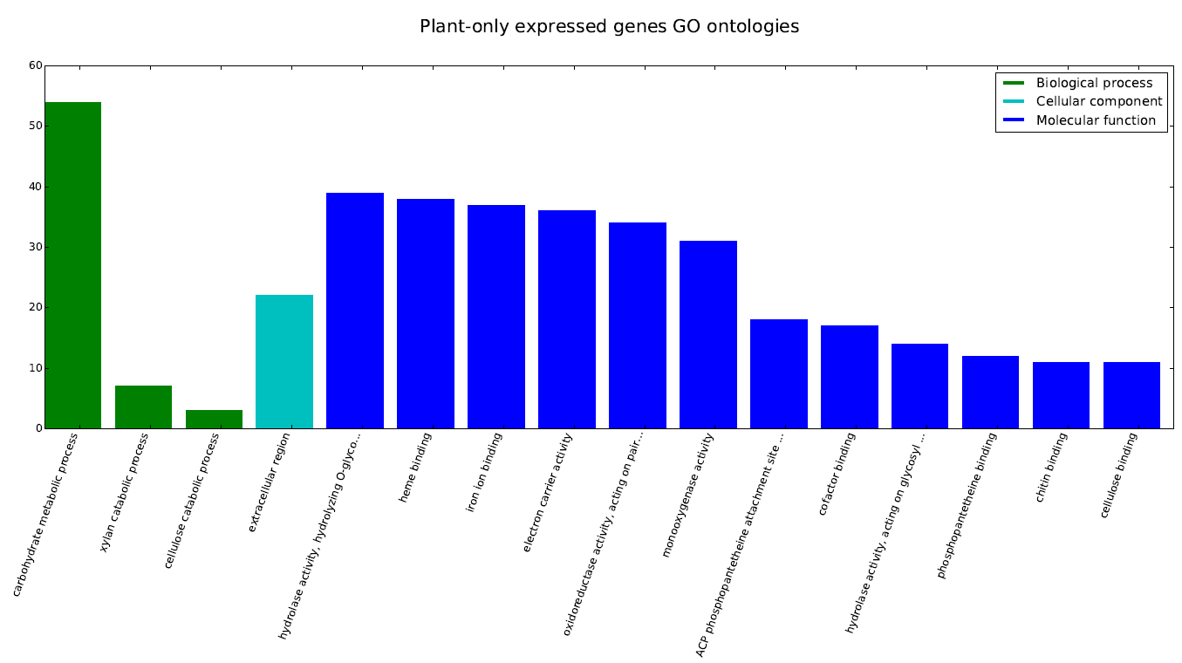
1365 genes expressed in plant are never expressed in vitro

Slide 22
The CM → -C condition presents the highest number of differentially expressed genes, while MM → -N the lowest
DIFFERENTIALLY EXPRESSED GENES IN THE WT
 | DOWN | UP | TOTAL
CM → MM | 314 | 559 | 873
CM → MM-N | 630 | 874 | 1504
CM → MM-C | 2307 | 2342 | 4649
MM → MM-N | 48 | 59 | 107
MM → MM-C | 1882 | 1589 | 3471

Slide 23
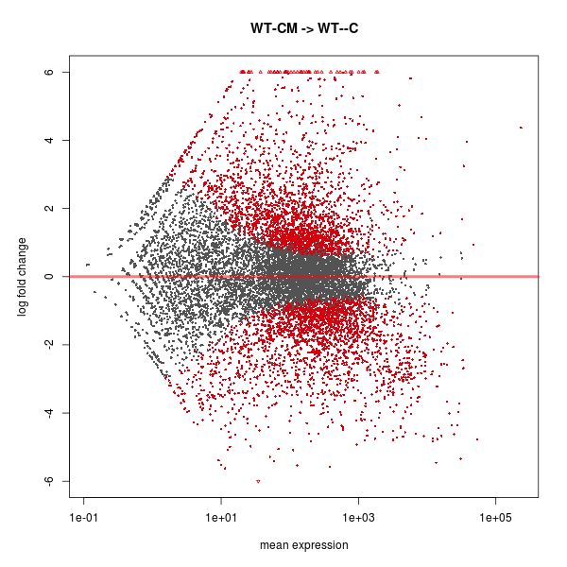
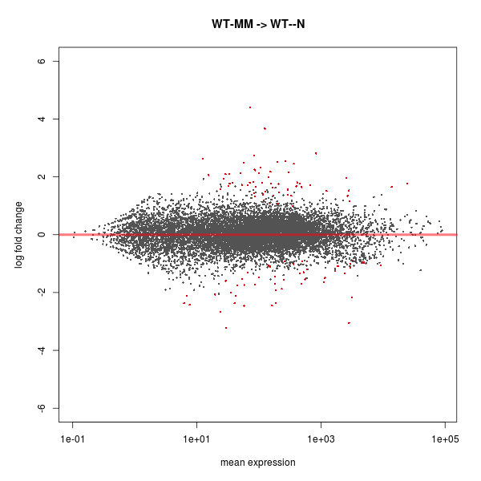
The CM → -C condition presents the highest number of differentially expressed genes, while MM → -N the lowest

Slide 24
The CM → -C condition presents the highest number of differentially expressed genes, while MM → -N the lowest
TOP 20 HIGHEST DIFFERENTIALLY EXPRESSED GENES CM → -C
gene | log2foldChange | description
MGG_09072 | 8.1538523515 | Alcohol oxidase
MGG_00244 | 8.0070871451 | 15-hydroxyprostaglandin dehydrogenase
MGG_07210 | 7.9942521054 | Putative uncharacterized protein
MGG_09607 | 7.4595914704 | Maltose permease MAL31
MGG_01367 | 7.2171221376 | Putative uncharacterized protein
MGG_07253 | 7.1375757829 | Putative uncharacterized protein
MGG_11289 | 7.0894568362 | Putative uncharacterized protein
MGG_08937 | 7.0375631939 | Quinate permease
MGG_15267 | 6.9971932885 | Putative uncharacterized protein
MGG_03793 | 6.8988221238 | 2,3-dihydroxybenzoic acid decarboxylase
MGG_06828 | 6.872238681 | Putative uncharacterized protein
MGG_05941 | 6.8217314329 | Maltose permease MAL31
MGG_02245 | 6.7008914884 | Endoglucanase type F
MGG_00659 | 6.6866120353 | Glucan 1,3-beta-glucosidase
MGG_10663 | 6.4805171445 | cAMP-regulated D2 protein
gene | log2foldChange | description
MGG_17996 | -5.6066608795 | no_description
MGG_07973 | -5.3026451979 | Surface protein 1
MGG_08019 | -5.156698481 | F-box domain-containing protein
MGG_06234 | -5.0149833139 | Putative uncharacterized protein
MGG_04258 | -4.9786465581 | Putative uncharacterized protein
MGG_01952 | -4.8319947186 | Putative uncharacterized protein
MGG_17706 | -4.7704849827 | Putative uncharacterized protein
MGG_10456 | -4.7234757359 | Putative uncharacterized protein
MGG_09015 | -4.700976561 | Putative uncharacterized protein
MGG_17103 | -4.6464513062 | Putative uncharacterized protein
MGG_08360 | -4.6275010826 | Putative uncharacterized protein
MGG_17677 | -4.5723814478 | Putative uncharacterized protein
MGG_11608 | -4.5509909646 | Laccase-2
MGG_05344 | -4.5356873581 | SnodProt1
MGG_07966 | -4.5297712533 | Phosphate transporter

Slide 25
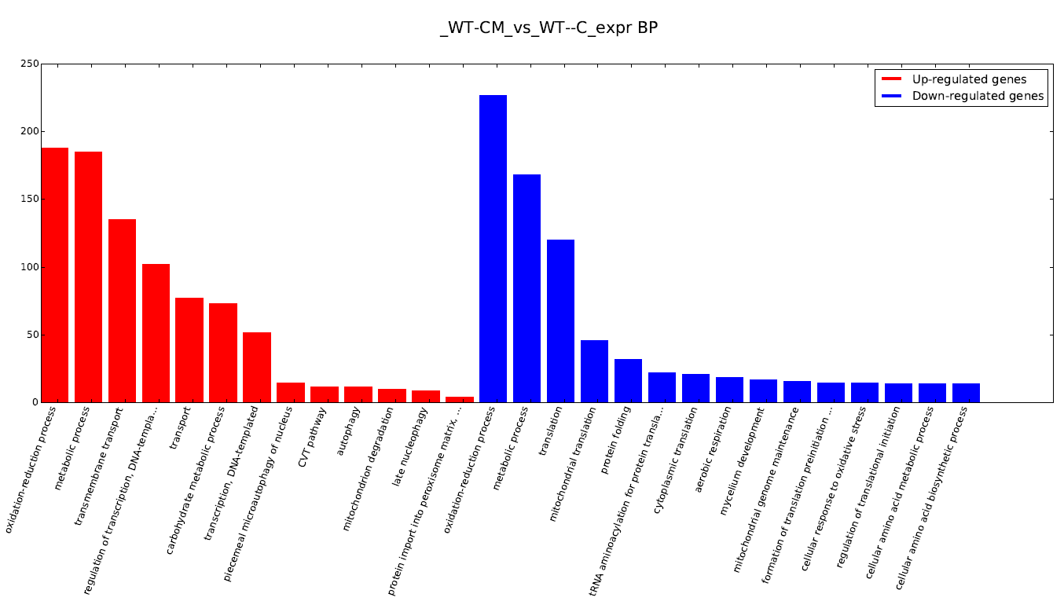
The CM → -C condition presents the highest number of differentially expressed genes, while MM → -N the lowest
AFFECTED GO ONTOLOGIES CM → -C

Slide 26
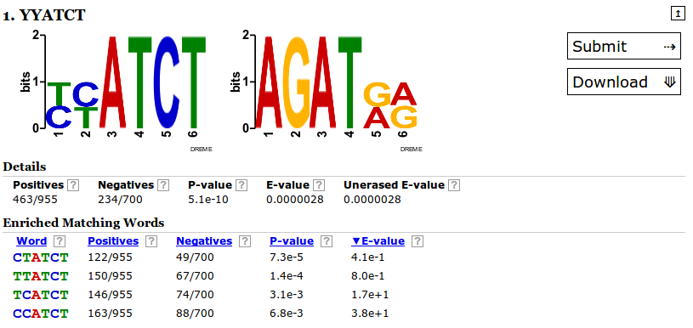
Up-regulated genes in nitrogen starvation show the typical GATA motif in the promoter region
None of the known GATA-binding transcription factors is found to be significantly up-regulated
in our 12h NS experiment
NUT1, the important nitrogen-related TF is found to be generally down-regulated in
Carbon-starvation
30 of the 51 top up-regulated genes listed in www.ncbi.nlm.nih.gov/pubmed/16731015
are confirmed in our experiment
Only two Transcription factors, MGG_05829 and MGG_01486, probably related with purine
Regulation, are found to be up-regulated in MM → -N, MGG_05829 is down-regulated
in the mutant

Slide 27
Up-regulated genes between conditions
MM
2295
-N
1836
194
151
CM
2602
-C
2886
681
246
283
928
2068
787
317
0
45
57
7
13
141

Slide 28
Down-regulated genes between conditions
MM
2035
-N
1716
206
113
CM
2858
-C
2996
579
129
367
977
2001
842
184
0
77
60
4
35
344

Slide 29
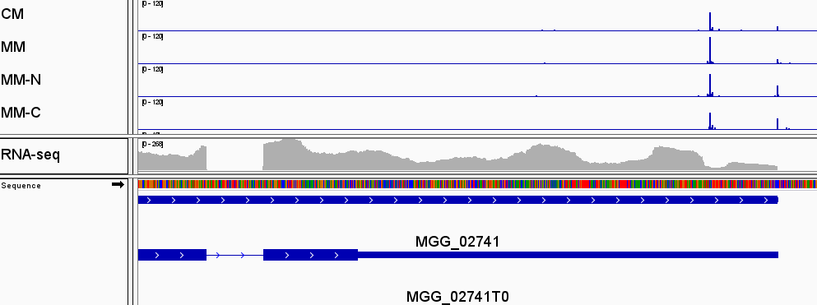
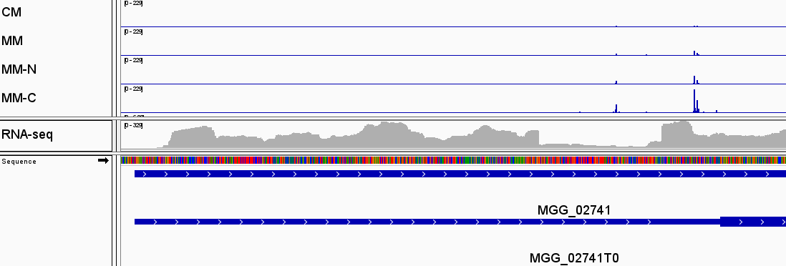
RBP35 shows different polyadenilation in each medium, with strong differencies in MM-C

Slide 30
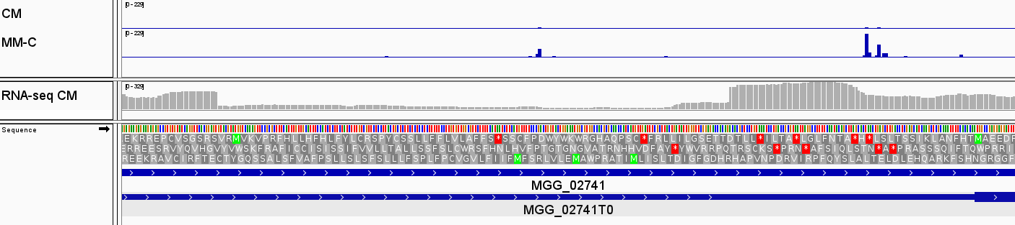
RBP35 shows an alternative polyadenylated 5'UTR, putatively enconding a small peptide
GTACGT
Intron splicing signals
CAG
Small 36aa peptide
Poly(A) site used after splicing, when
The small petide is not transcribed
Up-regulated poly(A) site in MM-C
Poly(A) site used in absense of splicing,
when the small petide is transcribed

Slide 31
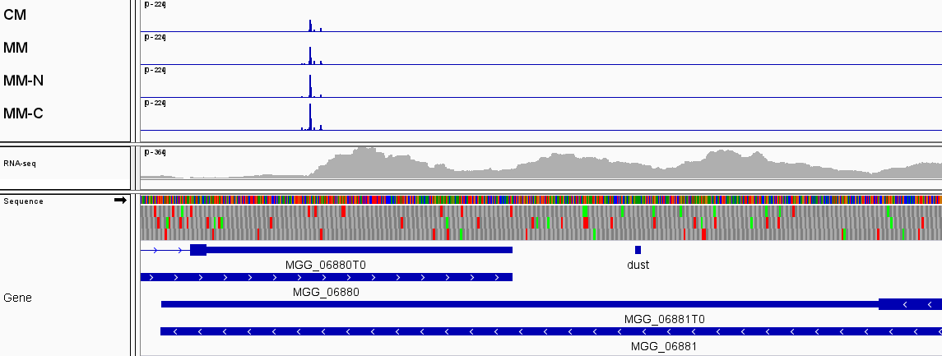
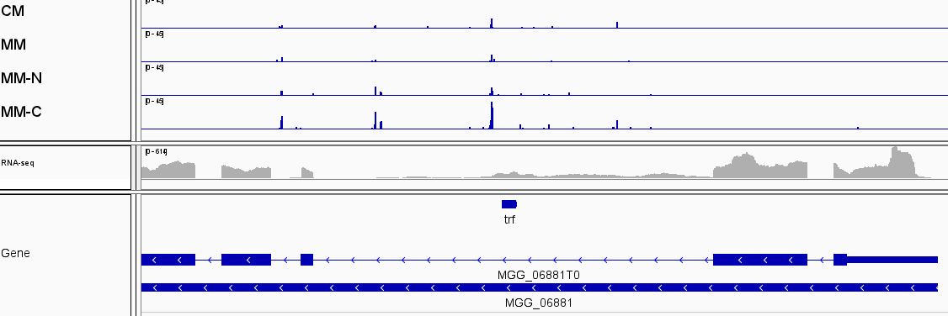
HRP1 shows an up-regulated intronic poly(A) site in MM-C

Slide 32
MM-C affects a great number of poly(A) sites

Slide 33
MM-C affects poly(A) sites usage, preferring distal cuts - percentages

Slide 34
MM-C affects poly(A) sites usage, preferring distal cuts - foldChange
Longer 3'UTR
Shorter 3'UTR

Slide 35
MM-C dependent genes are usually differentially expressed
Differentially expressed gene are equally distributed between up & down regulated (data not shown)

Slide 36
Δrbp35 affects poly(A) sites number

Slide 37
Δrbp35 affects number of cut sites per gene

Slide 38
MM is the most affected condition in ∆rbp35, MM-C the least affected
 | down regulated genes | up regulated gene | total
WT → Δrbp35 CM | 224 | 201 | 425
WT → Δrbp35 MM | 529 | 369 | 898
WT→ Δrbp35 MM-N | 272 | 135 | 407
WT→ Δrbp35 MM-C | 136 | 92 | 228

Slide 39
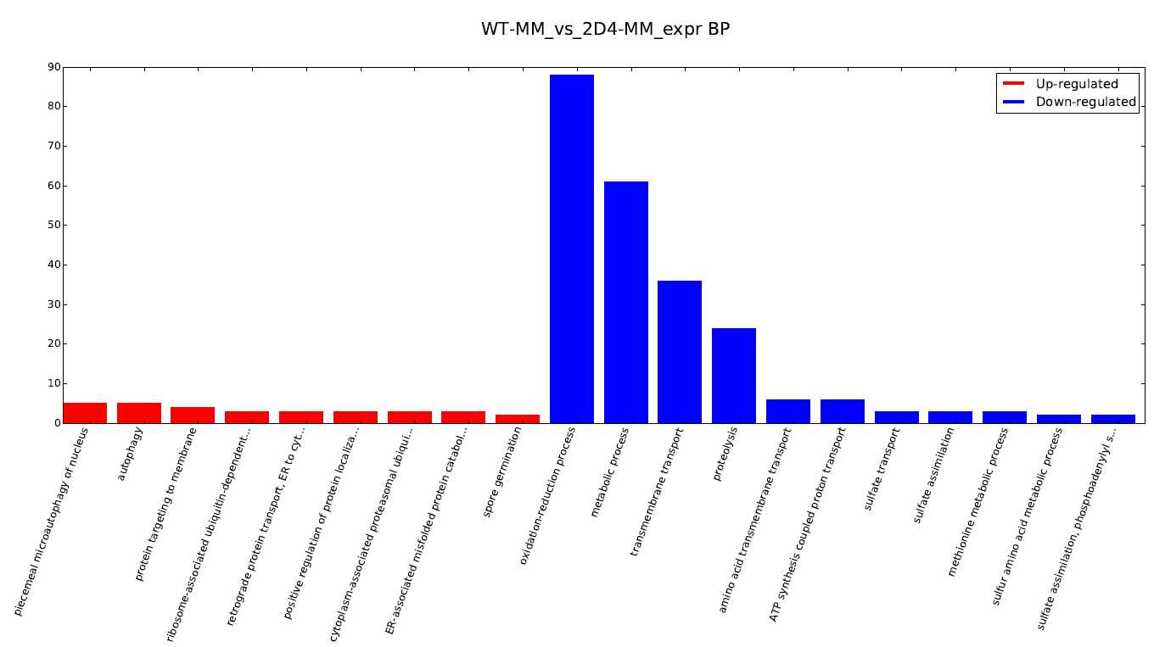
MM is the most affected condition in ∆rbp35, MM-C the least affected

Slide 40
Up-regulated genes WT → ∆rbp35
MM
369
-N
135
242
45
CM
201
-C
92
39
18
5
95
30
21
9
25
9
11
3
4
5

Slide 41
Down-regulated genes WT → ∆rbp35
MM
529
-N
272
299
97
CM
224
-C
136
55
79
8
84
56
34
9
26
8
11
0
7
10

Slide 42
Δrbp35 appears to inhibit medium recognition in MM-N
DIFFERENTIALLY EXPRESSED GENES IN Δrbp35
 | DOWN | UP | TOTAL
CM → MM | 508 | 405 | 913
CM → MM-N | 461 | 404 | 865
CM → MM-C | 1241 | 1136 | 2377
MM → MM-N | 0 | 0 | 0
MM → MM-C | 475 | 493 | 968

Slide 43
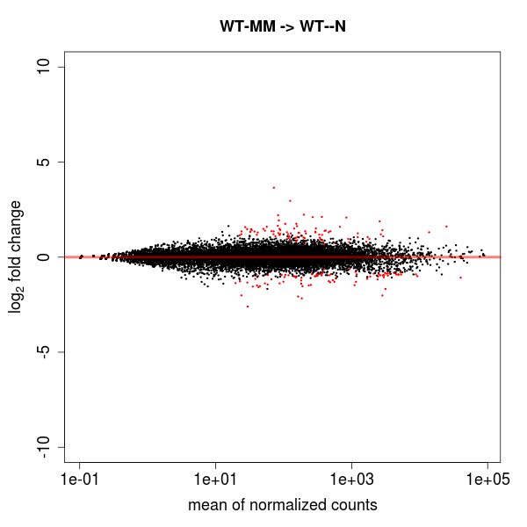
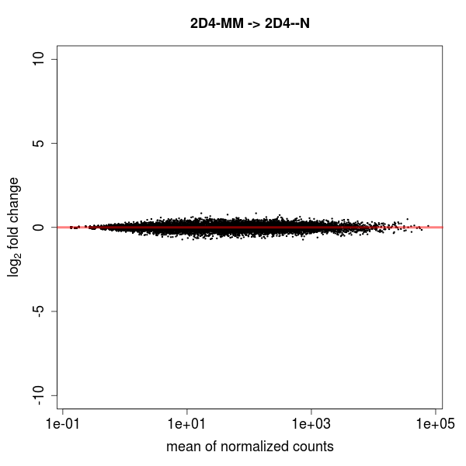
Δrbp35 appears to inhibit medium recognition in MM-N

Slide 44



Terminology
pRBP35dep: poly(A) sites that show a differential expression between wild-type and Δrbp35. We call it “RBP35 dependent poly(A) sites”
pRBP35dep_down: a down-regulated RBP35 dependent poly(A):
pRBP35dep_up: an up-regulated RBP35 dependent poly(A):
A gene is defined “RBP35 dependent gene” (or simply RBP35dep) when one or more of its poly(A) belong to the previous groups
WT
Δrbp35
WT
Δrbp35

Slide 45
25%-28% of poly(A) sites are dependent from RBP35 in all media

Slide 46
~20% of genes are dependent from RBP35 in all media

Slide 47
RBP35 dependant genes
MM
1584
-N
1609
161
113
CM
1681
-C
1813
95
58
88
239
387
161
112
819
72
87
114
91
90

Slide 48
There is no correlation between RBP35 dependance and differential expression

Slide 49
Δrbp35 affects poly(A) sites usage, preferring proximal cuts - percentages

Slide 50
Δrbp35 affects poly(A) sites usage, preferring proximal cuts
Longer 3'UTR
Shorter 3'UTR

Slide 51
Δrbp35 affects 3'UTR length

Slide 52
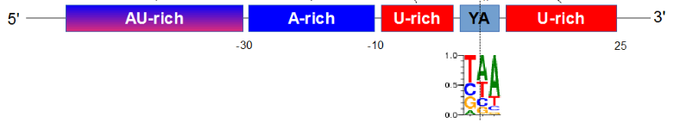
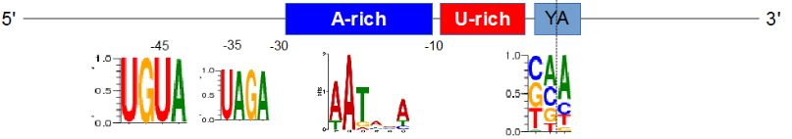
Nucleotides profile of poly(A) sites slighty differs from S.cerevisae

Slide 53
Nucleotides profile of poly(A) sites resembles N. crassa

Slide 54
Nucleotides profile of poly(A) of ncRNA and CDS poly(A) is different

Slide 55

The A-RICH region is located -30 -10 bp upstream

Slide 56
The A-RICH region is located -30 -10 bp upstream

Slide 57
UAGA & UGUA motifs

Slide 58
Polyadenilation signals in common genes
MPG1
...GGUAGAGAAGUCUCUUCUCGUUCCACUCAUUUAAUAAAACCCCUUCCAGACCUA...
PMK1
...CGUUUAGAAUGUGCAGGAGACACGAGUGGGAAAAUGAAUACAUGGAUGCCAGCA...
MST12
...CAGUGGCAUAAAAUCACAAAAUCUUUAGAAAGAUCACAGAAAACCUUUUGUCCA...

Slide 59
poly(A) sites dependent from RBP35 are low in the canonical AATAAA signal

Slide 60
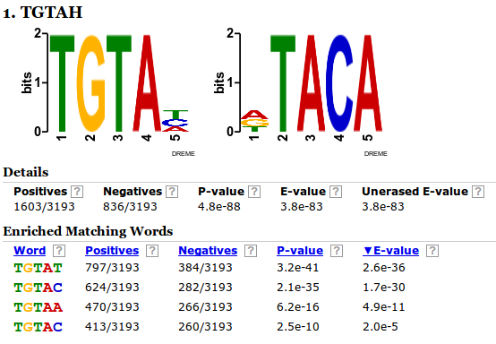
UGUAH motif is enriched in poly(A) sites dependent from RBP35 down-regulated in Δrbp35, in the region -100 -30
- Output of DREME, pRBP35dep as positive sequences list versus not-pRBP35dep negative list

Slide 61
UGUAH motif – pRBP35dep vs not pRBP35dep
In the first graph, we want to show how poly(A) sites dependent from RBP35 display a different profile for the UGUAH motif in the respect to “regular” poly(A) sites
We therefore plot down-regulated RBP35 dependent poly(A) sites against two groups of poly(A) not dependent from RBP35 of the same size, one group of poly(A) sites belonging to the same genes and one group of poly(A) sites belonging to other genes

Slide 62
UGUAH is enriched at -45 in poly(A) sites dependent from RBP35

Slide 63
UGUAH motif – RBP35 dependent poly(A) sites (up vs down regulated)

Slide 64
UAGH is impoverished at -35 in poly(A) sites dependent from RBP35

Slide 65
M. oryzae prefers SA as cutting-site instead of YA

Slide 66
The HRP1 binding motif TAYRTA from S.cerevisae in not found in M.oryzae
Maybe in M.oryzae CFIm binds to UGUA and Hrp1 binds to UAGA?

Slide 67
The polyadenylation site region has a defined structure - 1
The A-rich region is usually
not structured
The polyadenilation site is usually structured and located in a hairpin-loop

Slide 68
The polyadenylation site region has a defined structure - 2
Different A-rich motifs results in different degrees of conformation, with
AAUAAA the most unstructured

Slide 69
The polyadenylation site region has a defined structure – 3
Different cutsites have different base pais probabilites, with TG and CG the most
structured. The most common poly(A) site CA has a average conformation

Slide 70
The polyadenylation site region has a defined structure – 4
In S.cerevisiae, the poly(A) site is not clearly structured

