Slide 1
Sequencing resume
2 strains (WT, 2D4) x 4 conditions (CM, MM, -N, -C) x 3 replicates
4751592 – 11517077 total reads database
~63% - ~83% successfully mapped reads
43 bp mean read length
~92% - ~98% replicates correlation
~100bp mean pair ended distance
~400x coverage per poly(A) site*
* assuming an amount of 22000 mRNA molecules per cell

Slide 2





Workflow
Program and details
Procedure
% of data left
Illumina sequencing
100%
fasta-mcf, adapter trimming
Data prepping
96%
gsnap, default parameters
Alignment
96%
Low quality mapping (<30))
High A/T content (>90%)
Internal priming
Filtering
75%
Assign reads to known features,
Including all intergenic space up
to 400 bp from gene end
Assignment
65%
Clustering of most significant poly(A) sites (p-value < 0.05 over
global gene expression) at 33 bp
poly(A) sites detection
27%
Example: Actin, single cut poly(A):
whole gene expression ~7000 reads
poly(A) site expression ~3000 reads

Slide 3
Pair ended reads distance

Slide 4


~2.5% of poly(A) sites are internal priming
Some poly(A) sites are just a side effect of poly(A) genomic regions
reads
stretches of As

Slide 5
~10000 genes are expressed, out of a total of 13218 annotated genes (WT)
9546 genes are expressed in every condition (WT only)
2166 genes are never expressed (WT only)

Slide 6
~10000 genes are expressed, out of a total of 13218 annotated genes (2D4)
9918 genes are expressed in every condition (2D4 only)
1964 genes are never expressed (2D4 only)

Slide 7


Not every expressed gene has a recognizable poly(A) site
Expressed gene with a recognizable poly(A) site:
Expressed gene without a recognizable poly(A) site:

Slide 8
Only ~75% of genes expressed have a recognizable poly(A) site

Slide 9
~15000 poly(A) site could be assigned to annotated genes

Slide 10
~15000 poly(A) site could be assigned to annotated genes (2D4)

Slide 11
~20% of genes are alternatively polyadenilated
* calculated over the global number of expressed genes with a recognizable poly(A) site

Slide 12
>90% of APA is located in the 3'UTR

Slide 13
>80% of APA is composed of two cleveage sites

Slide 14
Gene expression between WT conditions
CM
10286
192
219
184
9691
150
288
269
-N
-C
10348
10432

Slide 15
>90% of poly(A) sites are located in the 3'UTR

Slide 16
261 highly expressed (>100 reads) poly(A) sites could not be assigned to any annotated gene

Slide 17
261 orphan poly(A) sites highly expressed in WT (>100 reads)
14 hits against other gene copies in M.oryzae
44 hits against Uniprot nt/nr database
4 hits against Rfam(ncRNA) database
81 overlapping annotated genes antisense
63 matching CPA-sRNA sequences
16 matching retrotransposons
7 matching avirulence genes

Slide 18
3165 orphan poly(A) sites expressed in WT (>10 reads)
102 hits against other gene copies in M.oryzae
438 hits against Uniprot nt/nr database
10 hits against Rfam(ncRNA) database
1098 overlapping annotated genes antisense
253 matching CPA-sRNA sequences
129 matching retrotransposons
57 matching avirulence genes

Slide 19
Orphans differentially expressed
 | up | down | total
(>100 reads)
WT-CM → WT--C | 64 | 73 | 137
WT-CM → WT-MM | 4 | 2 | 6
WT-CM → WT--N | 11 | 13 | 24
WT-MM → WT--C | 37 | 54 | 91
WT-MM → WT--N | 0 | 0 | 0
WT--N → WT--C | 24 | 31 | 55
(>10 reads)
WT-CM → WT--C | 344 | 109 | 453
WT-CM → WT-MM | 8 | 1 | 9
WT-CM → WT--N | 8 | 7 | 15
WT-MM → WT--C | 181 | 62 | 243
WT-MM → WT--N | 0 | 0 | 0
WT--N → WT--C | 115 | 23 | 138

Slide 20
Antisense poly(A) are usually located in the 3'UTR, most of antisense poly(A) are differentially expressed in any condition

Slide 21
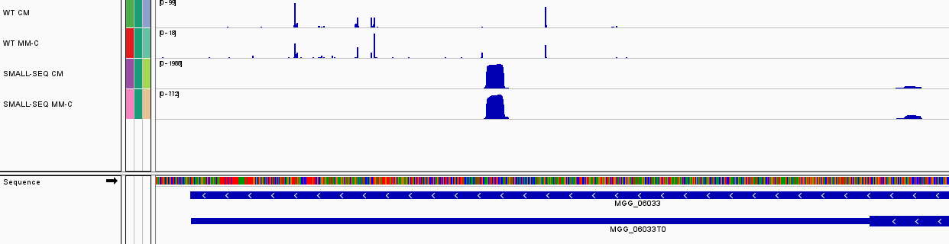
Small RNA expression and alternative polyadenylation
TO BE REVIEWED
72 gene in CM with peaks of small RNA expression in intra-APA regions
36 gene in -C with peaks of small RNA expression in intra-APA regions

Slide 22
859 genes expressed in plant are never expressed in vitro
CM
7511
plant
2289
6830
5222
-N
MM
7629
2379
5250
859
5257
2267
7524
5493
2514
-C
8007

Slide 23
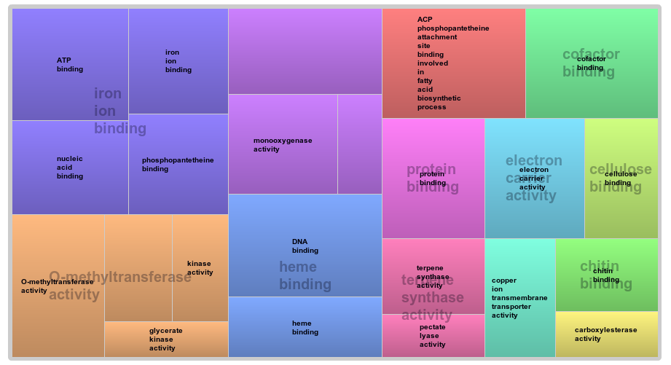
Plant specific genes functional analysis
Only 341 out of 859 genes represented here

Slide 24
The CM → -C condition presents the highest number of differentially expressed genes, while MM → -N the lowest
DIFFERENTIALLY EXPRESSED GENES IN THE WT
 | DOWN | UP | TOTAL
CM → MM-C | 1586 | 1617 | 3203
CM → MM | 151 | 285 | 436
CM → MM-N | 177 | 347 | 524
MM → MM-C | 601 | 608 | 1209
MM → MM-N | 1 | 5 | 6
MM-N → MM-C | 216 | 313 | 529

Slide 25
Up-regulated genes between conditions
MM
800
-N
486
72
44
CM
1652
-C
1714
356
98
89
1136
1412
105
137
0
11
32
2
0
42

Slide 26
Down-regulated genes between conditions
MM
728
-N
469
67
30
CM
1782
-C
1750
274
22
60
1119
1470
258
83
0
16
22
2
0
113

Slide 27
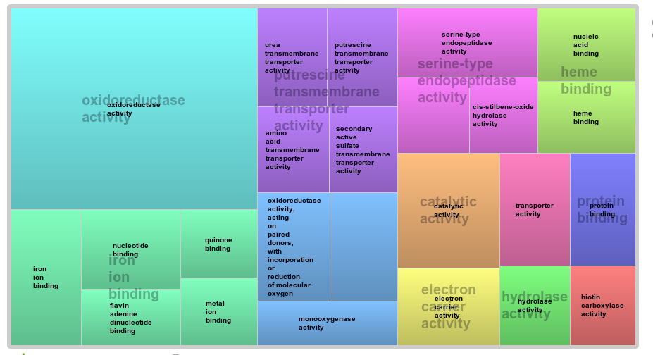
CM → MM functional analysis
p-value = 0.1

Slide 28
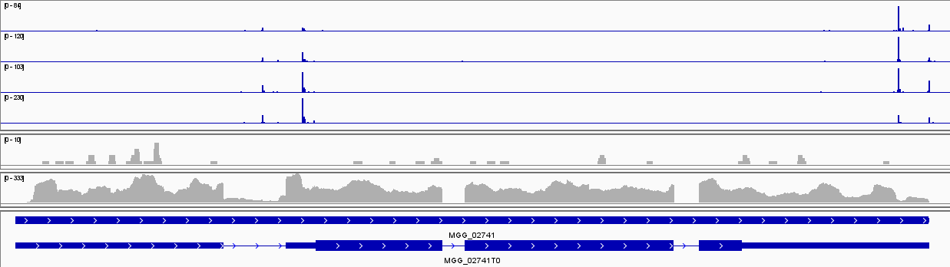
rbp35 shows different polyadenilation in each medium, with strong differencies in MM-C
CM
MM
-N
-C
SMALL
RNA-SEQ
Intronic expression

Slide 29
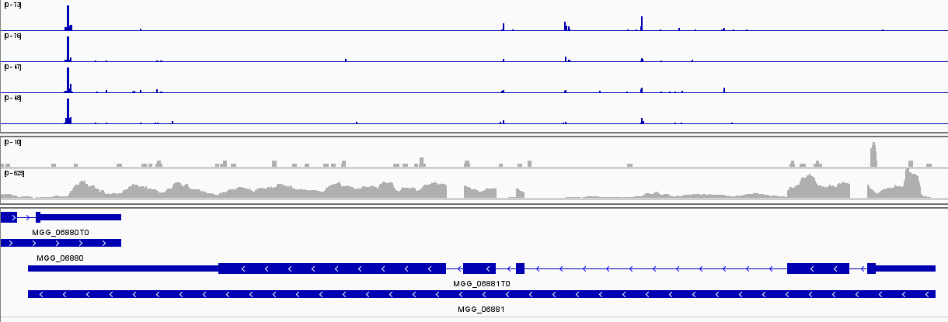
hrp1 shows an up-regulated intronic poly(A) site in MM-C
CM
MM
-N
-C
SMALL
RNA-SEQ
Intronic expression

Slide 30
MM-C affects a great number of poly(A) sites

Slide 31
MM-C affects poly(A) sites usage, preferring distal cuts - percentages

Slide 32
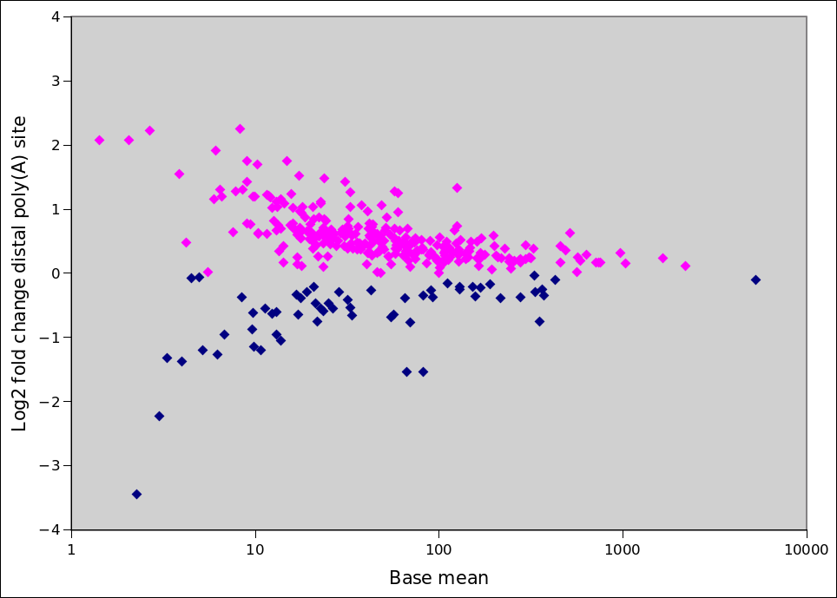
MM-C affects poly(A) sites usage, preferring distal cuts - foldChange
Long UTR (298 genes)
Short UTR (63 genes)

Slide 33
MM-C dependent genes are not always differentially expressed
Differentially expressed gene are equally distributed between up & down regulated (data not shown)

Slide 34
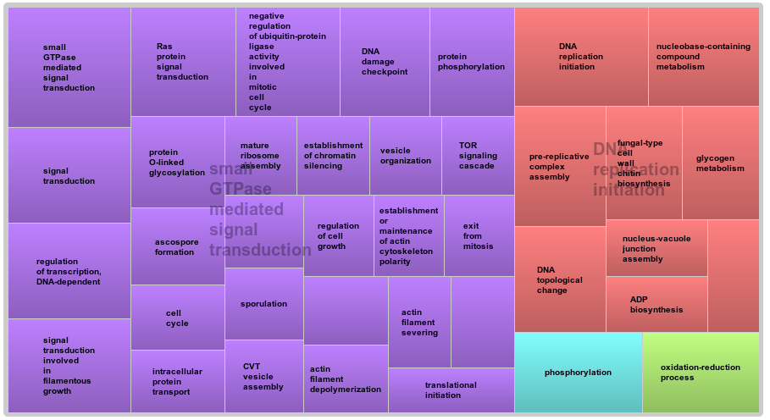
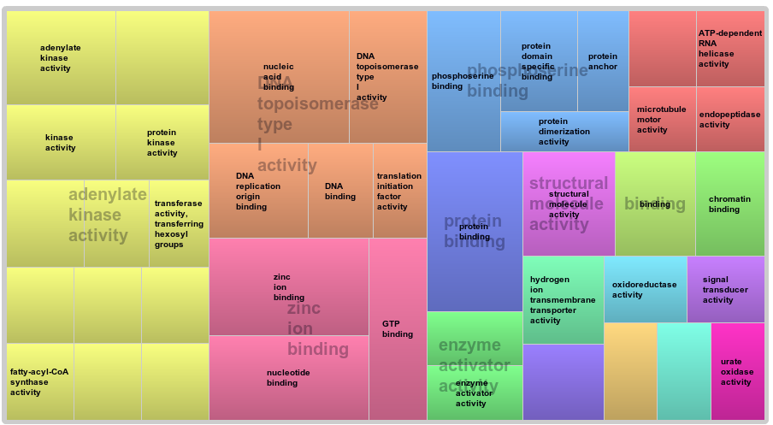
MM-C dependent genes GO
CM → MM-C only
Biological process
Molecular function
236 of 361 genes represented

Slide 35
Δrbp35 affects poly(A) sites number

Slide 36
Δrbp35 affects number of cut sites per gene

Slide 37
Differentially expressed genes WT → ∆rbp35
MM
146
-N
66
78
24
CM
114
-C
53
19
20
0
71
23
4
5
11
1
6
1
3
4

Slide 38
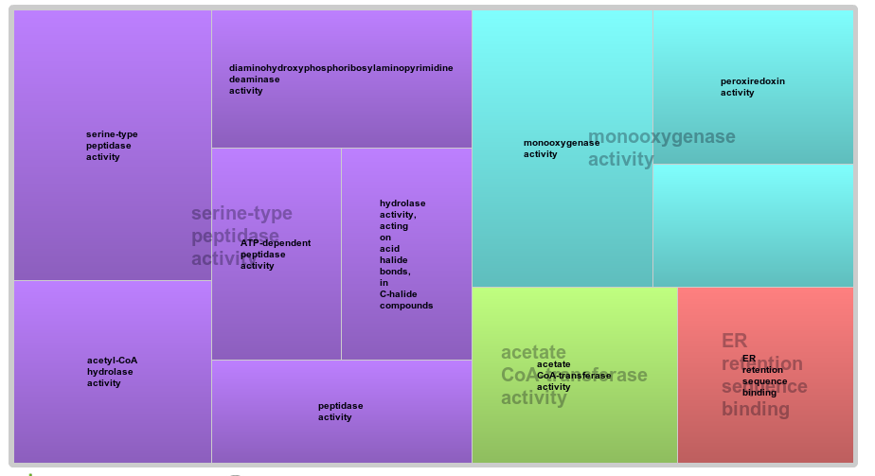
WT → 2D4 functional analysis
p-value = 0.05

Slide 39



Terminology
pRBP35dep: poly(A) sites that show a differential expression between wild-type and Δrbp35. We call it “RBP35 dependent poly(A) sites”
pRBP35dep_down: a down-regulated RBP35 dependent poly(A):
pRBP35dep_up: an up-regulated RBP35 dependent poly(A):
A gene is defined “RBP35 dependent gene” (or simply RBP35dep) when one or more of its poly(A) belong to the previous groups
WT
Δrbp35
WT
Δrbp35

Slide 40
22%-25% of poly(A) sites are dependent from RBP35 in all media

Slide 41
17%-19% of genes are dependent from RBP35 in all media

Slide 42
RBP35 dependant genes
MM
1487
-N
1537
168
158
CM
1580
-C
1695
96
53
117
223
360
142
111
761
86
74
109
82
81

Slide 43
RBP35 dependant Pathogenic genes (CAMBIAR)
MM
15
-N
11
0
0
CM
24
-C
38
2
0
2
5
17
2
1
4
0
3
2
3
6

Slide 44
There is no correlation between RBP35 dependance and differential expression

Slide 45
Δrbp35 affects poly(A) sites usage, preferring proximal cuts - percentages

Slide 46
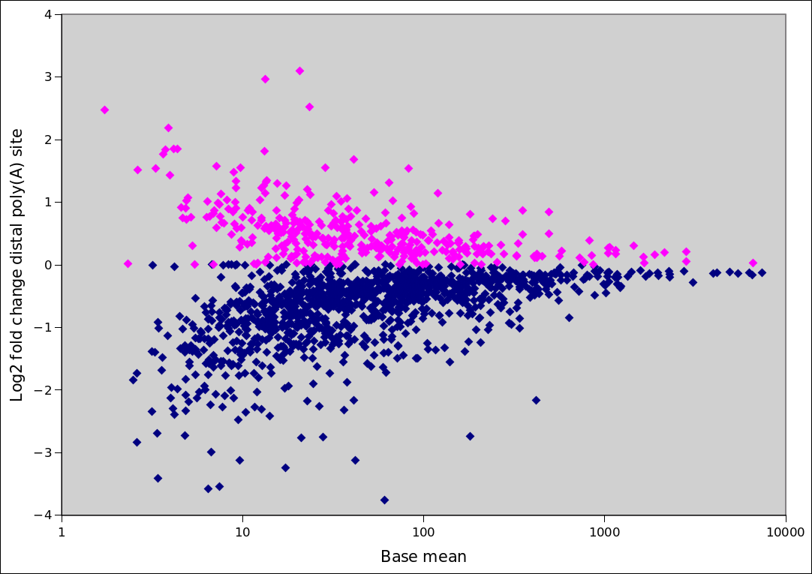
Δrbp35 affects poly(A) sites usage, preferring proximal cuts
Long UTR (376 genes)
Short UTR (1204 genes)

Slide 47
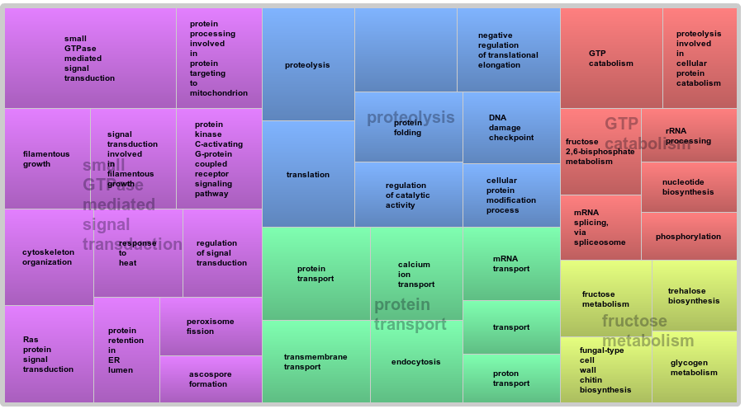
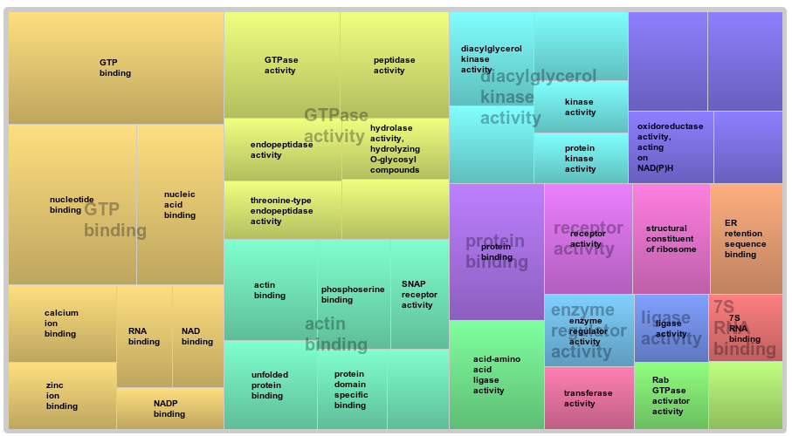
RBP35 dependent genes GO
761 genes RBP35 dependent in every condition
Biological process
Molecular function
494 of 761 genes represented

Slide 48
Δrbp35 affects 3'UTR length

Slide 49
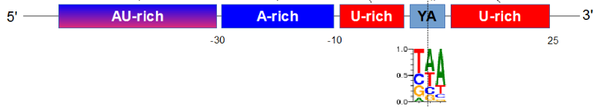
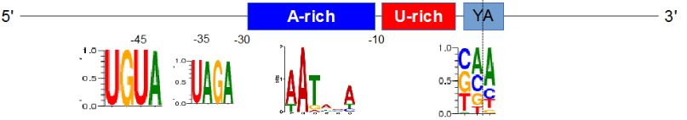
Nucleotides profile of poly(A) sites slighty differs from S.cerevisae

Slide 50
Nucleotides profile of poly(A) sites resembles N. crassa

Slide 51
Nucleotides profile of poly(A) of ncRNA and CDS poly(A) is different

Slide 52

The A-RICH region is located -30 -10 bp upstream

Slide 53
UAGA & UGUA motifs

Slide 54
Polyadenilation signals in common genes
MPG1
...GGUAGAGAAGUCUCUUCUCGUUCCACUCAUUUAAUAAAACCCCUUCCAGACCUA...
PMK1
...CGUUUAGAAUGUGCAGGAGACACGAGUGGGAAAAUGAAUACAUGGAUGCCAGCA...
MST12
...CAGUGGCAUAAAAUCACAAAAUCUUUAGAAAGAUCACAGAAAACCUUUUGUCCA...

Slide 55
poly(A) sites dependent from RBP35 show a less pronunced A-rich region

Slide 56
poly(A) sites dependent from RBP35 are low in the canonical AATAAA signal
Post-transcriptional pathogenicity-related motifs in U. maydis

Slide 57
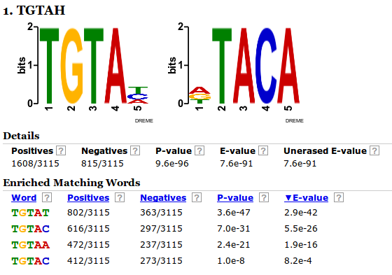
UGUAH motif is enriched in poly(A) sites dependent from RBP35 down-regulated in Δrbp35, in the region -100 -30
- Output of DREME, pRBP35dep as positive sequences list versus not-pRBP35dep negative list

Slide 58
UGUAH motif – pRBP35dep vs not pRBP35dep
In the first graph, we want to show how poly(A) sites dependent from RBP35 display a different profile for the UGUAH motif in the respect to “regular” poly(A) sites
We therefore plot down-regulated RBP35 dependent poly(A) sites against two groups of poly(A) not dependent from RBP35 of the same size, one group of poly(A) sites belonging to the same genes and one group of poly(A) sites belonging to other genes

Slide 59
UGUAH is enriched at -45 in poly(A) sites dependent from RBP35

Slide 60
UGUAH motif – RBP35 dependent poly(A) sites (up vs down regulated)

Slide 61
DUAG is enriched at -35 in poly(A) sites not dependent from RBP35

Slide 62
The HRP1 binding motif TAYRTA from S.cerevisae in not found in M.oryzae
Maybe in M.oryzae CFIm binds to UGUA and Hrp1 binds to UAGA?

