Slide 1




Bioinformatics approaches to understand RNA biology in the rice blast fungus
Marco Marconi
Center for Plant Biotechnology and Genomics Technical University of Madrid

Slide 2
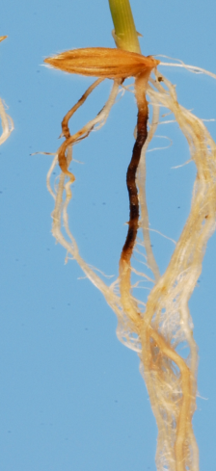
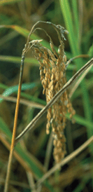
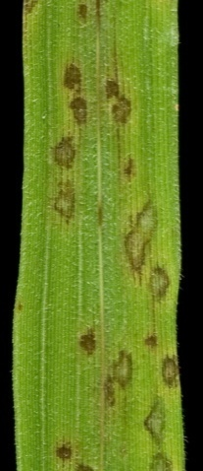
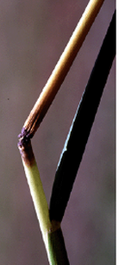
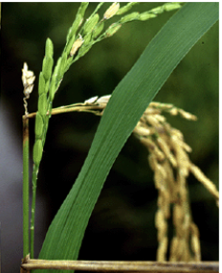
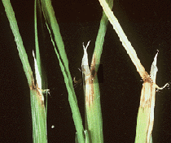
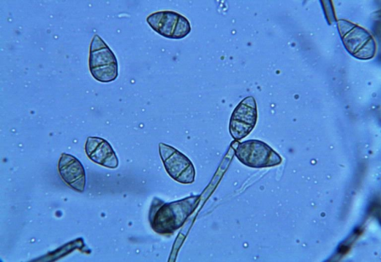
Magnaporthe oryzae is an ascomycete fungus that infects rice
root
panicle
node
leaf
Sesma&Osbourn Nature (2004)
neck
collar

Slide 3
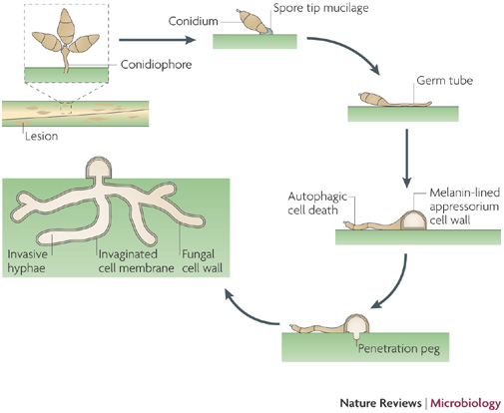
Magnaporthe oryzae life cycle
Richard A. Wilson & Nicholas J. Talbot
Nature Reviews Microbiology 7, 185-195 (March 2009)

Slide 4


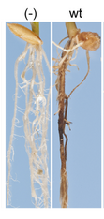

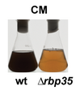
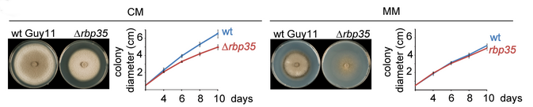
We are interested in two pathogenic-defective mutants…
Δrbp35

Slide 5
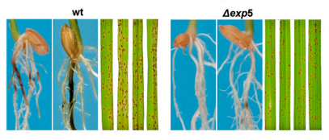
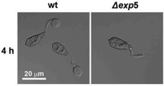
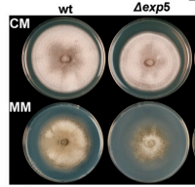
We are interested in two pathogenic-defective mutants…
Δexp5

Slide 6
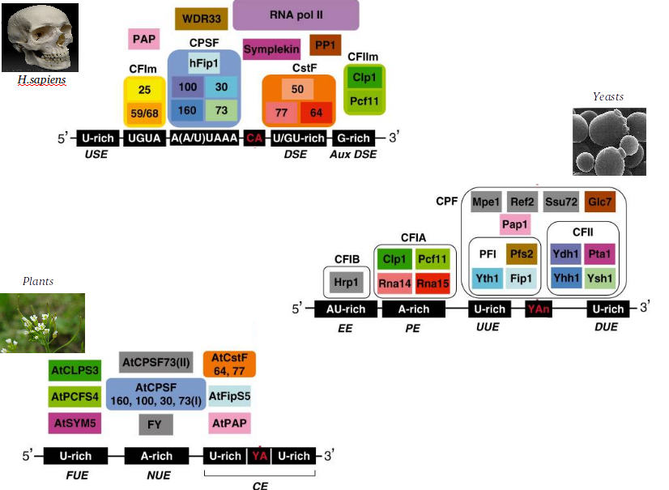
RBP35 is a member of the polyadenylation machinery

Slide 7
RBP35 is a member of the polyadenylation machinery
RBP35 ortholog found in animals,
but not in yeast!
!

Slide 8
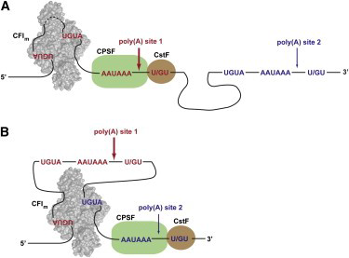
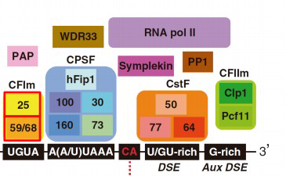
Human RBP35 orthologue bind to UGUA elements to regulate the selection of alternative polyadenylation sites (APA)
Yang Q, Coseno M, Gilmartin GM, Doublie S (2011) Crystal structure of a human cleavage factor CFI(m)25/CFI(m)68/RNA complex provides an insight into poly(A) site
recognition and RNA looping. Structure 19: 368–377. doi: 10.1016/j.str.2010.12.021

Slide 9
EXP5 is a kariopherin involved in the nuclear import/export of proteins and RNAs
METAZOAN
YEAST
double-stranded RNAs
binding proteins
tRNAs
aminoacyl-tRNA
re-export
ILF3, EF1A, JAZ…
EXP5
(metazoan)
MSN5
(yeast)
Some transcription factors
micro-RNA
precursors
RanGTP
RanGTP
NUCLEUS

Slide 10

We want to shed light on the role of RBP35 and EXP5 in M.oryzae:
Perform a RNA-seq designed to sequence the polyadenylation sites, in order to understand the effect of Δrbp35 on alternative polyadenylation:
AAAAAAAAAAAAAAAAAAAA
AAAAAAAAAA

Slide 11
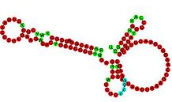


We want to shed light on the role of RBP35 and EXP5 in M.oryzae:
Perform a RNA-seq designed to sequence the polyadenylation sites, in order to understand the effect of Δrbp35 on alternative polyadenylation:
Perform a small RNA-seq, in order to understand the effect of Δexp5 (and Δrbp35) on the non-coding RNAs population:
?
?
?
?

Slide 12
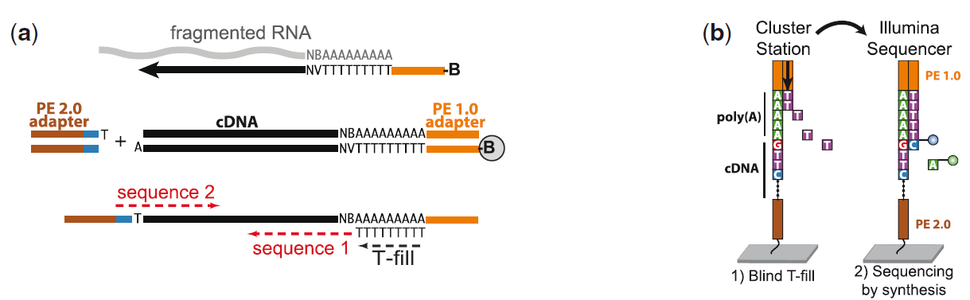
Polyadenylation sites mapping is performed with a 3’ T-filling method
(Wilkening et al., Nucleic Acids Res. 2013 , 1–8. An efficient method for genome-wide polyadenylation site mapping and RNA quantification)

Slide 13
Sequencing details
Four nutrient conditions:
Complete medium
Minimal medium
Nitrogen starvation
Carbon starvation
Two strains:
WT
∆rbp35
3 Replicates:
#1, #2, #3
Coverage:
400x poly(A) site
Typical on-plant situations

Slide 14
Comparative poly(A) sites mapping using WT and ∆rbp35 strains in four different growth conditions
1. poly(A) site mapping analysis
1a. Results in wild-type
2a. Results in the ∆rbp35 mutant
2. Gene expression analysis
1a. Results in wild-type
2a. Results in the ∆rbp35 mutant
Notes:
APA -

Slide 15
Comparative poly(A) sites mapping using WT and ∆rbp35 strains in four different growth conditions
1. poly(A) site mapping analysis
1a. Results in wild-type
2a. Results in the ∆rbp35 mutant
2. Gene expression analysis
1a. Results in wild-type
2a. Results in the ∆rbp35 mutant
Notes:
APA -

Slide 16
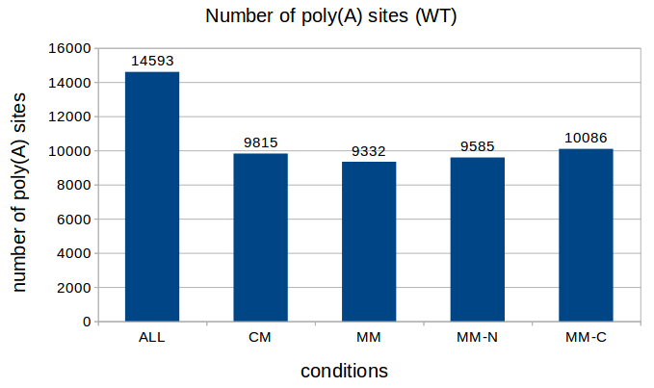

About 14000 poly(A) site could be assigned to annotated genes
(M.oryzae genome has 13216 annotated genes)
Poly(A) sites
5’UTR
3’UTR
Start codon
Stop codon

Slide 17
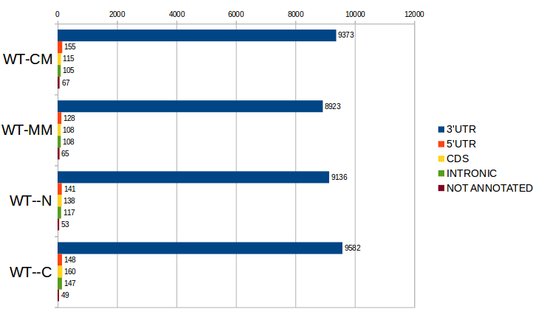
>90% of poly(A) sites are located in the 3'UTR
Poly(A) sites
5’UTR
3’UTR
Start codon
Stop codon

Slide 18
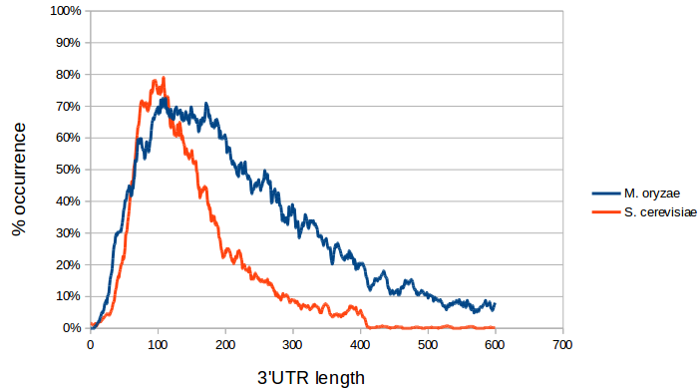
Magnaporthe oryzae 3’ UTR lengths are usually longer than Yeast

Slide 19
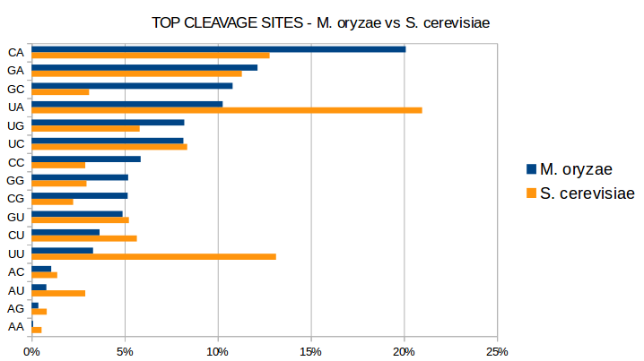
M. oryzae prefers a different polyadenylation cleavage site than yeast
S. cerevisiae
Y AAAAAAAAA
Y = U or C
M. oryzae
S AAAAAAAAA
S = G or C

Slide 20
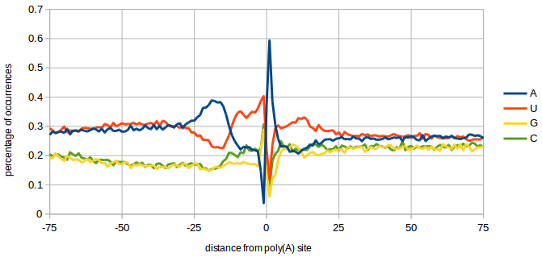
Nucleotide Profile of poly(A) site differs slightly from Yeast
YEAST
AU-rich
A-rich
U-rich
Y A
U-rich

Slide 21
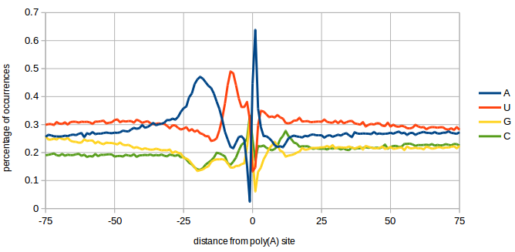
Nucleotide Profile of poly(A) site differs slightly from Yeast
YEAST
AU-rich
A-rich
U-rich
Y A
U-rich
UGUA
UAGA
A-rich
U-rich
S A
C peak
M.oryzae

Slide 22
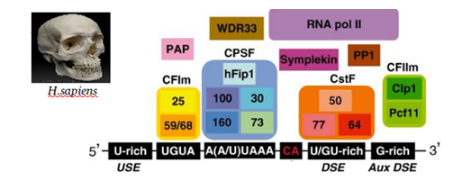
Contrary to metazoan, fungal canonical AAUAAA polyadenylation signal is highly degenerated
Polyadenylation
signal

Slide 23
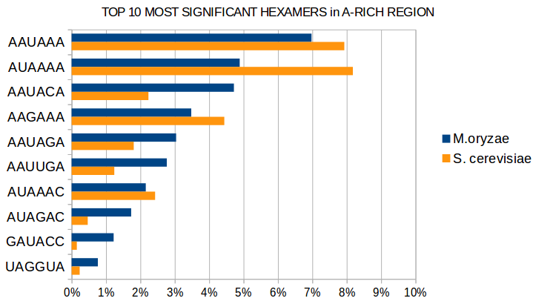
Contrary to metazoan, fungal canonical AAUAAA polyadenylation signal is highly degenerated
Polyadenylation
signal
Only 7% in fungi!

Slide 24
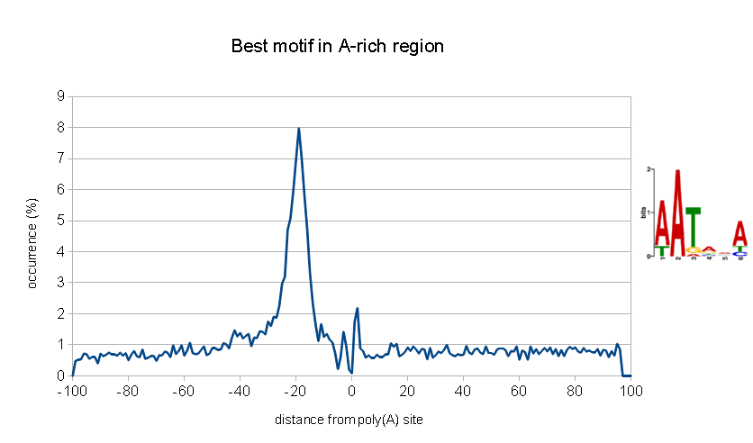
Contrary to metazoan, fungal canonical AAUAAA polyadenylation signal is highly degenerated
Polyadenylation
signal
Only 7% in fungi!
Very degenerated!

Slide 25
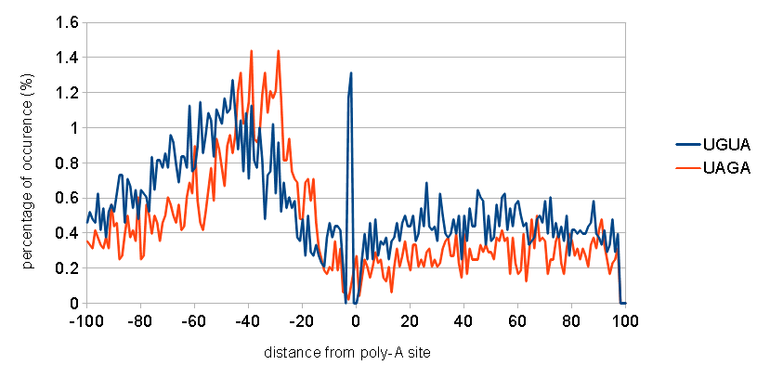
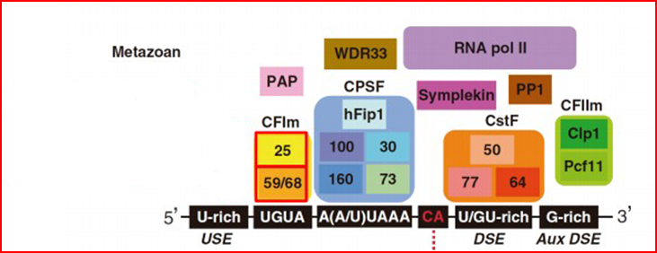
As in metazoan, M. oryzae has a UGUA motif,
together with a new UAGA motif
RBP35
Notes:
Follow only the blue line – the orange is a different story that I wont be telling.

Slide 26
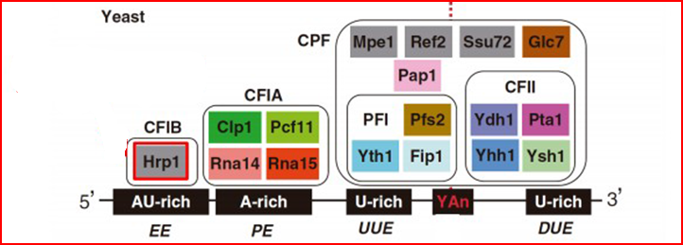
The mofif bound by Hrp1 in yeast is missing is M. oryzae
M. oryzae has this
protein, Hrp1
Notes:
This is interesting because there IS an orthologue of HRP1 in M. oryzae. We will be looking at this more closely in the future, as we have some ideas of what might be happening.

Slide 27
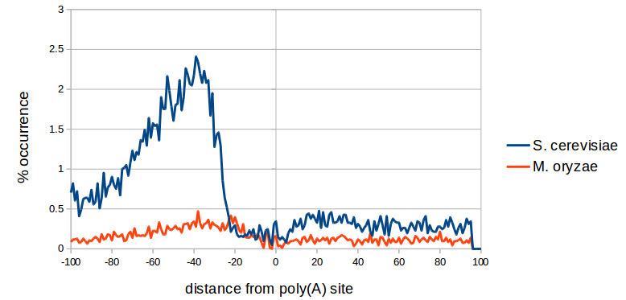
The mofif bound by Hrp1 in yeast is missing is M. oryzae
But the AU-rich element it binds in yeast is missing here!
M. oryzae has this
protein, Hrp1
Notes:
This is interesting because there IS an orthologue of HRP1 in M. oryzae. We will be looking at this more closely in the future, as we have some ideas of what might be happening.

Slide 28
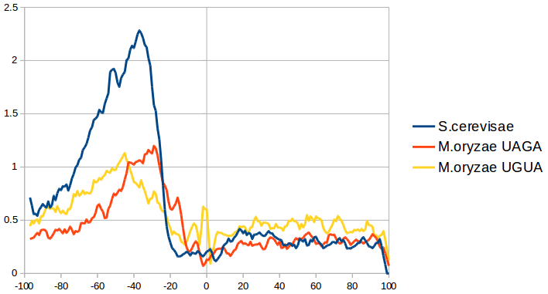
The mofif bound by Hrp1 in yeast is missing is M. oryzae
But the AU-rich element it binds in yeast is missing here!
Maybe the AU-rich element is the “fusion” of UGUA and UAGA, when the CFI complex was lost in yeast
M. oryzae has this
protein, Hrp1
Notes:
This is interesting because there IS an orthologue of HRP1 in M. oryzae. We will be looking at this more closely in the future, as we have some ideas of what might be happening.

Slide 29
What about alternative polyadenylation?
AAAAAAAAAAAAAAAAAAAA
Different cleavage sites produce
Alternative mRNA isoforms
AAAAAAAAAA

Slide 30
What about alternative polyadenylation?
AAAAAAAAAAAAAAAAAAAA
Different cleavage sites produce
Alternative mRNA isoforms
AAAAAAAAAA
Subcellular
localisation
???
Translation
efficiency
degradation

Slide 31

In M. oryzae ~30% of genes are alternatively polyadenylated
* alternative polyadenylation

Slide 32
In M. oryzae ~30% of genes are alternatively polyadenylated
* alternative polyadenylation
90% of APA events occur in the 3’UTR
80% of APA events are made of 2 alternatives only

Slide 33
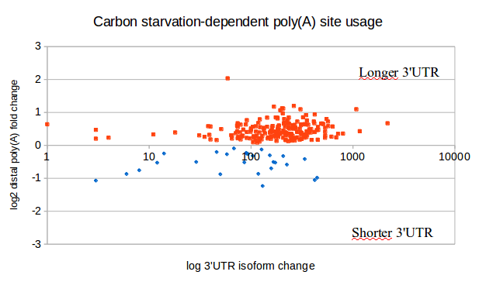
Carbon Starvation affects poly(A) selection in 455 genes
Notes:
The way to read this is that “there are 745 PolyA sites that are affected by a change from Complete to Complete – C, and these affected sites are associated with 455 genes.”

Slide 34
Carbon Starvation affects poly(A) selection in 455 genes
Complete medium
AAAAAAAAAAAAAAAAAAAA
In carbon starvation longer UTRs are usually produced
Carbon starvation
AAAAAAAAAA
Notes:
The way to read this is that “there are 745 PolyA sites that are affected by a change from Complete to Complete – C, and these affected sites are associated with 455 genes.”

Slide 35
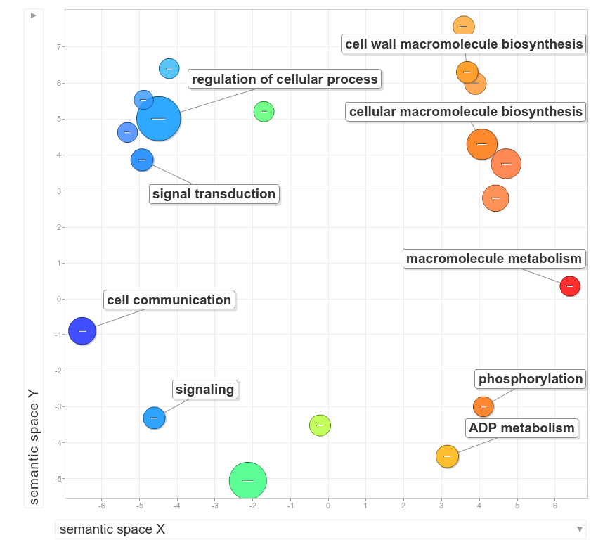

Slide 36
Comparative poly(A) sites mapping using WT and ∆rbp35 strains in four different growth conditions
1. poly(A) site mapping analysis
1a. Results in wild-type
2a. Results in the ∆rbp35 mutant
2. Gene expression analysis
1a. Results in wild-type
2a. Results in the ∆rbp35 mutant
Notes:
APA -

Slide 37
∆rbp35 affects the overall number of Poly-A sites (generally increases)

Slide 38
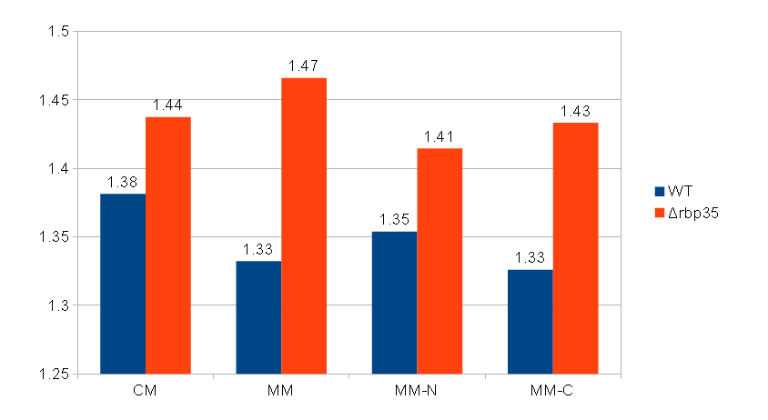
∆rbp35 affects number of poly-A sites per gene

Slide 39
~25% of genes have RBP35-dependent poly-A sites
in all media

Slide 40
Δrbp35 affects poly(A) site usage preferring proximal cuts
RBP35-dependent genes will tend to have more proximal poly-A in Δrbp35 (this is the opposite of carbon starvation)

Slide 41
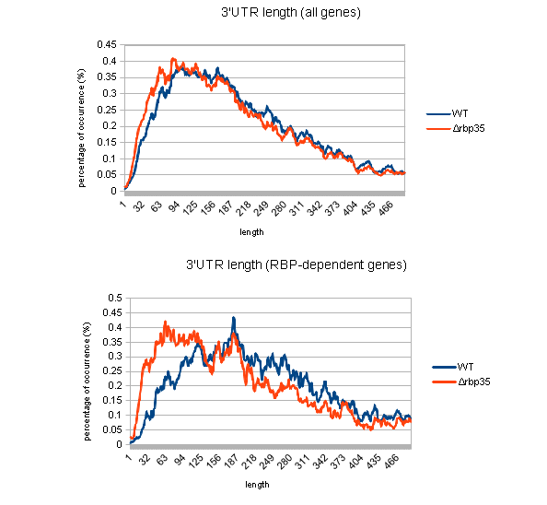
Δrbp35 UTR length
Notes:
If you push all data together, the signal is hard to see, but if you only look at the genes that have an RBP35 dependent site, you can see the difference much more strongly

Slide 42
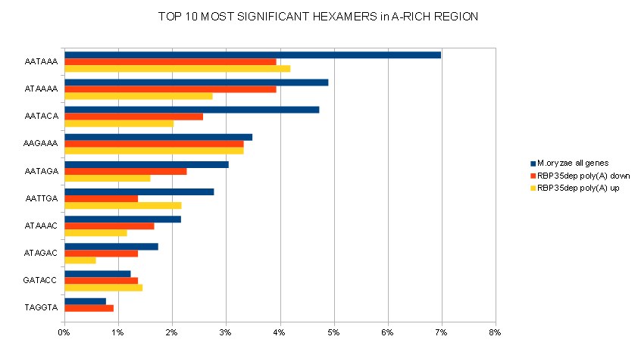
RBP35-dependent sites are less likely to possess the canonical AAUAAA sequence
Notes:
This is an interesting result, but we don’t know what it means…. It may mean that RBP35 is somehow epistatic to the main Poly-A signal sequence?
Is there a binding site for RBP35 (as there is in Metazoans)?

Slide 43
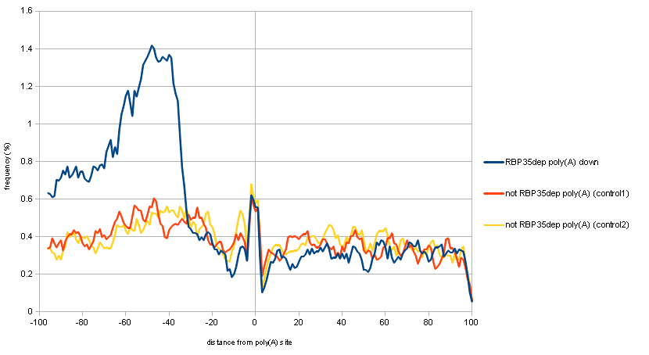
UGUA enrichment at nt-45 in RBP35-dependent down-regulated poly-A
UGUA motif in…
Controls: poly-A in same gene vs non-affected genes

Slide 44
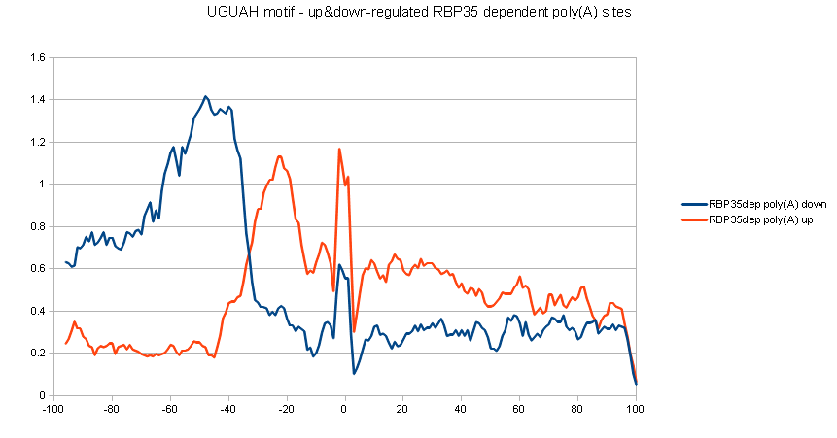
UGUA motif in RBP35-dependent poly-A sites comparison of increased vs. decreased poly-A site usage

Slide 45
UGUA motif in RBP35-dependent poly-A sites comparison of increased vs. decreased poly-A site usage
We just saw this result in the last slide

Slide 46
UGUA motif in RBP35-dependent poly-A sites comparison of increased vs. decreased poly-A site usage
Loss of RBP35 ENHANCES selection of poly-A site, if the UGUA motif is closer to the cut site

Slide 47
UGUA motif in RBP35-dependent poly-A sites comparison of increased vs. decreased poly-A site usage
Possible Interpretation: Occlusion of a “cryptic” cut site by RBP35 binding;
site becomes “visible” in rbp35 mutants

Slide 48
The recognition of a proper UGUA motif by Rbp35 is essential for the cleavage reaction.
∆rbp35 mutant
Wild type strain
1. LOSS OF PRECISION IN POLY(A) SITE SELECTION
Rbp35/CFI25
Rbp35/CFI25
5’
UGUA
-45
3’
Poly(A) site
5’
UGUA
-45
3’

Slide 49
The recognition of a proper UGUA motif by Rbp35 is essential for the cleavage reaction.
∆rbp35 mutant
Wild type strain
1. EXPOSURE OF “CRYPTIC” Poly-A SITES
Rbp35/CFI25
5’
Rbp35/CFI25
UGUA
-20
3’
‘Cryptic’ Poly(A) site
Occluded by RBP35
5’
UGUA
-20
3’

Slide 50
Comparative poly(A) sites mapping using WT and ∆rbp35 strains in four different growth conditions
1. poly(A) site mapping analysis
1a. Results in wild-type
2a. Results in the ∆rbp35 mutant
2. Gene expression analysis
1a. Results in wild-type
2a. Results in the ∆rbp35 mutant
Notes:
APA -

Slide 51
Comparative poly(A) sites mapping using WT and ∆rbp35 strains in four different growth conditions
1. poly(A) site mapping analysis
1a. Results in wild-type
2a. Results in the ∆rbp35 mutant
2. Gene expression analysis
1a. Results in wild-type
2a. Results in the ∆rbp35 mutant
Notes:
APA -

