Slide 1
Sequencing resume
2 strains (WT, 2D4) x 4 conditions (CM, MM, -N, -C) x 3 replicates
4751592 – 11517077 total reads database
~63% - ~83% successfully mapped reads
43 bp mean read length
~92% - ~98% replicates correlation
~100bp mean pair ended distance
~400x coverage for poly(A) site*
* assuming an amount of 22000 mRNA molecules per cell

Slide 2

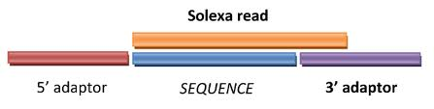
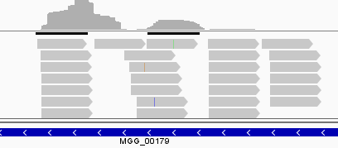
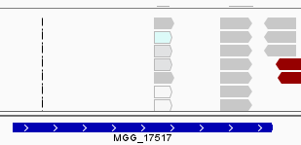

Workflow
Program and details
Procedure
% of data left
Illumina sequencing
100%
fasta-mcf, adapter trimming
Data prepping
96%
gsnap, default parameters
Alignment
96%
Low quality mapping (<30))
High A/T content (>90%)
Internal priming
Filtering
75%
Assign reads to known features,
Including all intergenic space up
to 400 bp from gene end
Assignment
65%
Clustering of most significant poly(A) sites (p-value < 0.05 over
global gene expression) at 33 bp
poly(A) sites detection
27%
Example: Actin, single cut poly(A):
whole gene expression ~7000 reads
poly(A) site expression ~3000 reads

Slide 3
Pair ended reads distance

Slide 4
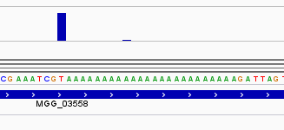
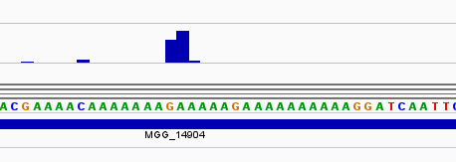
~2.5% of poly(A) sites are internal priming
Some poly(A) sites are just a side effect of poly(A) genomic regions
reads
stretches of As

Slide 5
Results of the polyadenylatoin sites by Illumina sequencing
 | CM WT/Δrbp35 | MM WT/Δrbp35 | MM-N WT/Δrbp35 | MM-C WT/Δrbp35
Number of genes with a recognizable poly(A) site | 7511 / 7715 | 7524 / 8091 | 7629 / 7888 | 8007 / 8281
Genes with APA in CDS | 56 / 71 | 53 / 90 | 75 / 94 | 78 / 87
Genes with APA in 5'UTR | 66 / 82 | 66 / 81 | 77 / 89 | 63 / 97
Genes with APA in 3'UTR | 1429 / 1600 | 1271 / 1753 | 1342 / 1608 | 1463 / 1725
Number of genes with APA in WT but not in Δrbp35 | 633 | 509 | 621 | 682
Number of genes with APA in Δrbp35 but not in WT | 833 | 1038 | 906 | 994
Notes:
ESTs from NCBI, NIAS (M. oryzae), …

Slide 6
~10000 genes are expressed, out of a total of 13218 annotated genes (WT)
9546 genes are expressed in every condition (WT only)
2166 genes are never expressed (WT only)

Slide 7
~10000 genes are expressed, out of a total of 13218 annotated genes (2D4)
9918 genes are expressed in every condition (2D4 only)
1964 genes are never expressed (2D4 only)

Slide 8
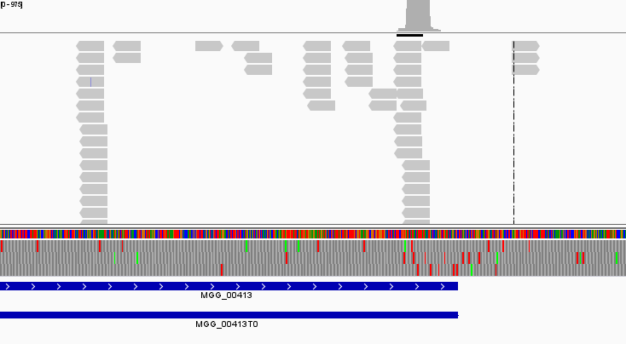
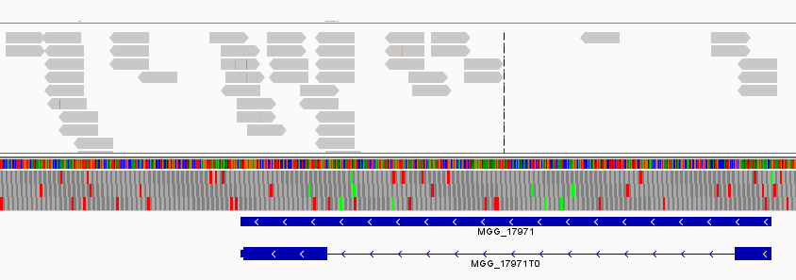
Not every expressed gene has a recognizable poly(A) site
Expressed gene with a recognizable poly(A) site:
Expressed gene without a recognizable poly(A) site:

Slide 9
Only ~75% of genes expressed have a recognizable poly(A) site

Slide 10
~15000 poly(A) site could be assigned to annotated genes

Slide 11
~15000 poly(A) site could be assigned to annotated genes (2D4)

Slide 12
17%-19% of poly(A) sites could not be assigned to any annotated gene

Slide 13
261 orphans poly(A) sites highly expressed in WT (>100 reads)
46 hits against Uniprot nt/nr database
4 hits against Rfam(ncRNA) database
80 overlapping annotated genes antisense
DIFFERENTIALLY EXPRESSED ORPHANS IN THE WT
CM → MM-C | 137
CM → MM | 6
CM → MM-N | 24
MM → MM-C | 91
MM → MM-N | 0
MM-N → MM-C | 55

Slide 14
>90% of poly(A) sites are located in the 3'UTR

Slide 15
~20% of genes are alternatively polyadenilated
* calculated over the global number of expressed genes with a recognizable poly(A) site

Slide 16
~90% of APA is located in the 3'UTR

Slide 17
Gene expression between WT conditions
CM
10286
192
219
184
9691
150
288
269
-N
-C
10348
10432

Slide 18
589 genes expressed in plant are never expressed in vitro
CM
10286
plant
3784
7339
6502
-N
MM
10348
3813
6535
589
6519
3696
10215
6588
3844
-C
10432

Slide 19
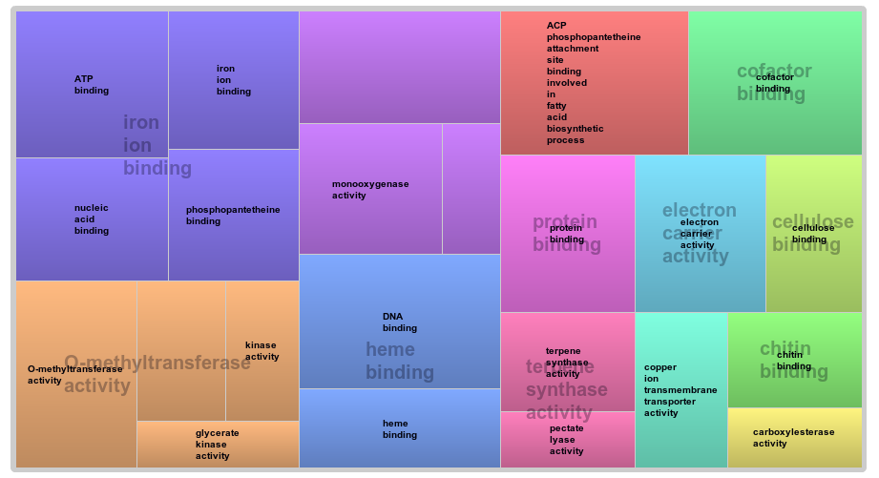
Plant specific genes functional analysis
p-value = 0.05

Slide 20
The CM → -C condition presents the highest number of differentially expressed genes, while MM → -N the lowest
DIFFERENTIALLY EXPRESSED GENES IN THE WT
 | DOWN | UP | TOTAL
CM → MM-C | 1586 | 1617 | 3203
CM → MM | 151 | 285 | 436
CM → MM-N | 177 | 347 | 524
MM → MM-C | 601 | 608 | 1209
MM → MM-N | 1 | 5 | 6
MM-N → MM-C | 216 | 313 | 529

Slide 21
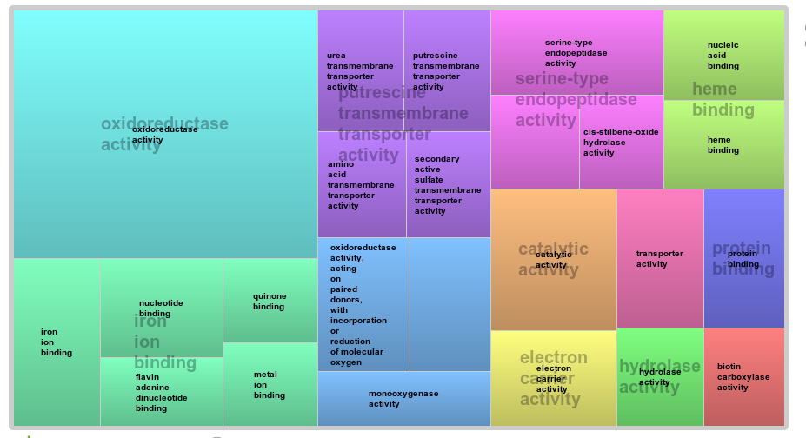
CM → MM functional analysis
p-value = 0.1

Slide 22
Δrbp35 affects poly(A) sites number

Slide 23
Δrbp35 affects number of cut sites per gene

Slide 24
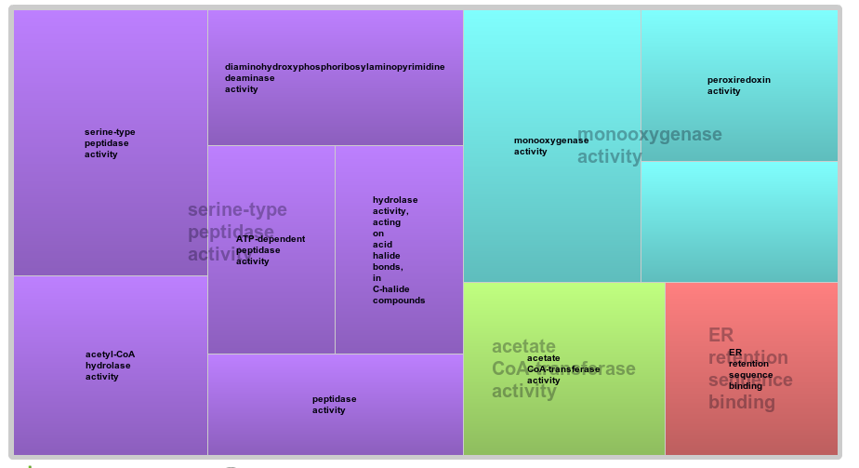
WT → 2D4 functional analysis
p-value = 0.05

Slide 25

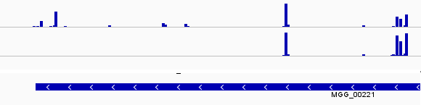
Terminology - 1
group P1: Down-regulated poly(A) sites in Δrbp35 (polyA site RBP35 dependent):
Group G1: genes containing group P1 poly(A) sites
Group P1-2D4: every poly(A) sites in G1 genes from 2D4
WT
2D4

Slide 26
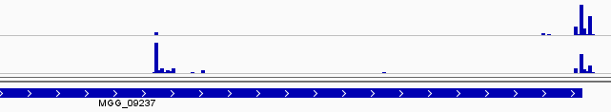
Terminology - 2
group P2: Up-regulated poly(A) sites in Δrbp35 (unspecific polyA site-not RBP35 dependent):
Group G2: genes containing group P2 poly(A) sites
Group P2-WT: every poly(A) sites in G2 genes from WT
WT
2D4

Slide 27
Terminology - 3
Group P3: poly(A) sites union from P1 and P2 groups
Group G3: Union of G1 and G2 genes groups, genes whose poly(A) sites are up or down-regulated

Slide 28
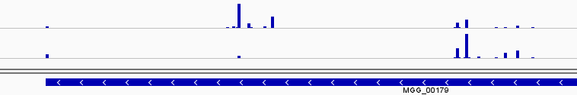
Terminology - 4
Group P4: poly(A) sites from P1 and P2 groups appearing on the same genes
Group G4: Genes with change position (both down and up-regulated) poly(A) sites in Δrbp35 (positional RBP35 dependent), a specific case from G1 and G2 (intersection of G1 and G2):
WT
2D4

Slide 29
~7% of poly(A) sites and ~9% of genes are targeted by RBP35 in CM

Slide 30
APA in RBP35 dependant genes in WT

Slide 31
There is no correlation between RBP35 dependance and differential expression

Slide 32
Δrbp35 affects 3'UTR length

Slide 33
Nucleotides profile of poly(A) sites slighty differs from S.cerevisae

Slide 34
Nucleotides profile of poly(A) sites resembles N. crassa

Slide 35
Nucleotides profile of poly(A) of ncRNA is different

Slide 36
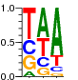

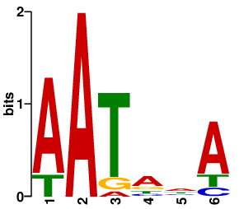
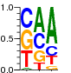

Nucleotides profile of poly(A) sites differs from S.cerevisae
S.cerevisae
5'
AU-rich
A-rich
U-rich
YA
U-rich
3'
-30
-10
25
M. oryzae
5'
A-rich
U-rich
YA
3'
-45
-35
-30
-10

Slide 37
The A-RICH region is located -30 -10 bp upstream

Slide 38
Top 10 hexamers in A-rich region

Slide 39
UAGA & UGUA motifs

Slide 40
Polyadenilation signals in common genes
MPG1
...GGUAGAGAAGUCUCUUCUCGUUCCACUCAUUUAAUAAAACCCCUUCCAGACCUA...
PMK1
...CGUUUAGAAUGUGCAGGAGACACGAGUGGGAAAAUGAAUACAUGGAUGCCAGCA...
MST12
...CAGUGGCAUAAAAUCACAAAAUCUUUAGAAAGAUCACAGAAAACCUUUUGUCCA...

Slide 41
poly(A) sites targeted by RBP35 show a less pronunced A-rich region

Slide 42
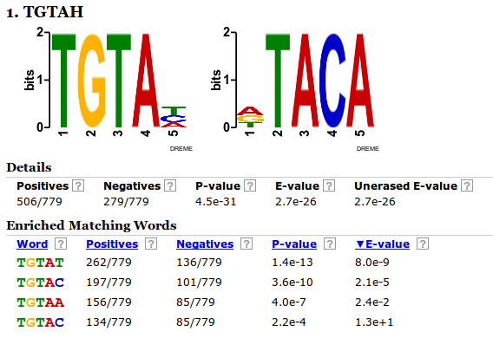
UGUAH motif is enriched in poly(A) sites targeted by RBP35
- Output of DREME, P1 as positive sequences list versus not-P1 negative list

Slide 43
UGUAH motif – P1 vs not P1
In the first graph, we want to show how poly(A) sites targeted by RBP35 display a different profile for the UGUA motif in the -100 -36 region respect to “regular” poly(A) sites
We therefore plot P1 group poly(A) sites against two control groups of poly(A) sites of identical size not belonging to P1 group in WT

Slide 44
UGUAH is enriched at -45 in poly(A) sites targeted by RBP35

Slide 45
UGUAH motif – P1 vs P1-2D4
In the second graph, we want to show how genes targeted by RBP35 are affected in the mutant, using P1 group
We therefore plot P1 group poly(A) sites against P1-2D4 group poly(A) sites, which are poly(A) sites from 2D4 in the same genes affected of P1 group

Slide 46
UGUAH – P1 vs P1-2D4

Slide 47
UGUAH motif – P2 vs P2-WT
In the second graph, we want to show how genes targeted by RBP35 are affected in the mutant, using P2 group
We therefore plot P2 group poly(A) sites against P2-WT group poly(A) sites, which are poly(A) sites from WT in the same genes affected of P2 group

Slide 48
UGUAH – P2 vs P2-WT

Slide 49
UAGA– P1 vs not P1
The gap in P1 set at -45 is probably due to UGUAH enrichment, as seen before

Slide 51
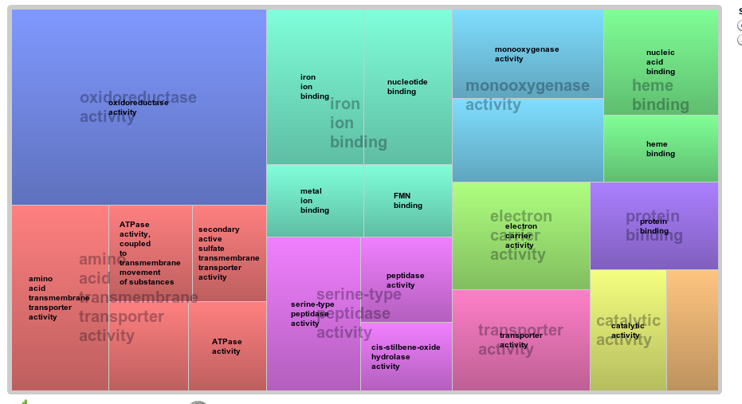
CM → -N functional analysis

Slide 52
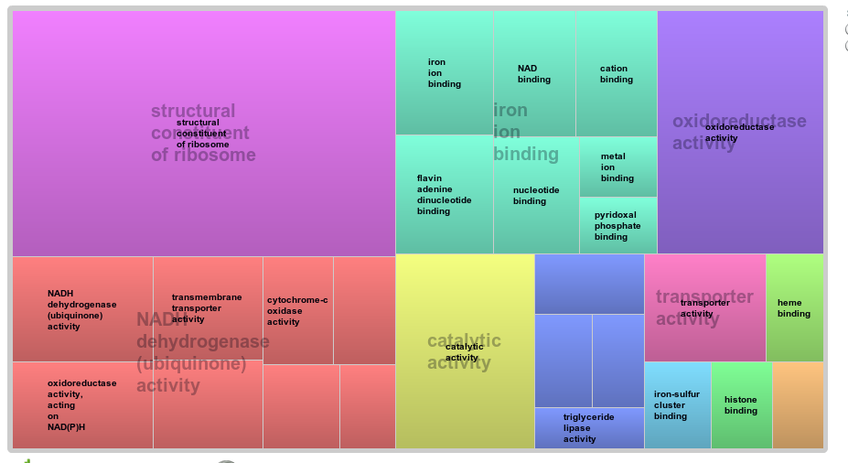
CM → -C functional analysis

Slide 53
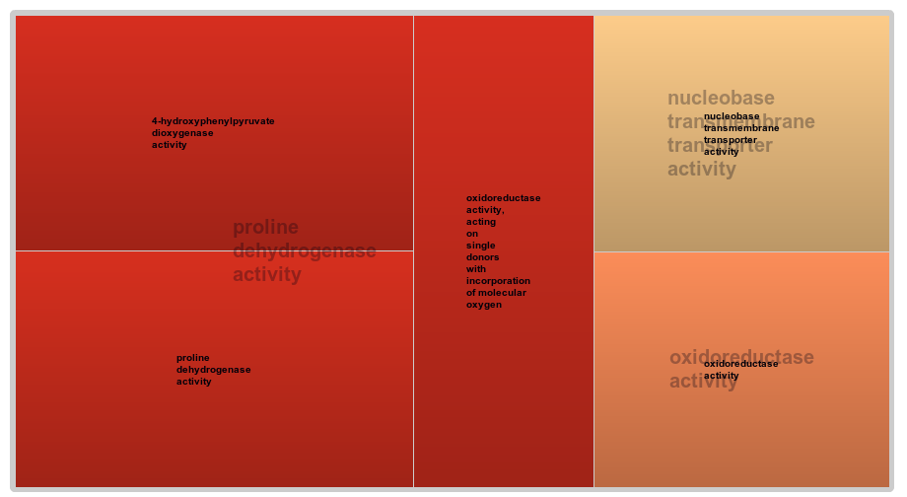
MM → -N functional analysis

Slide 54
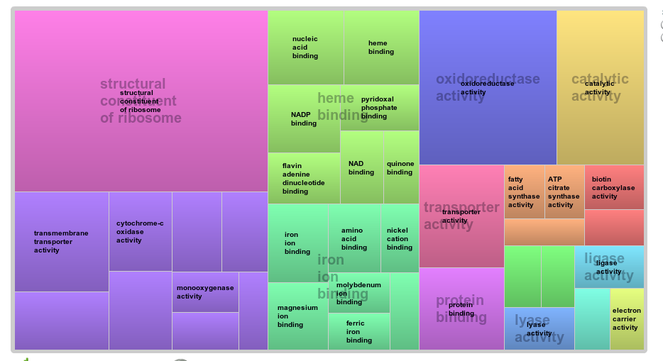
MM → -C functional analysis

Slide 55
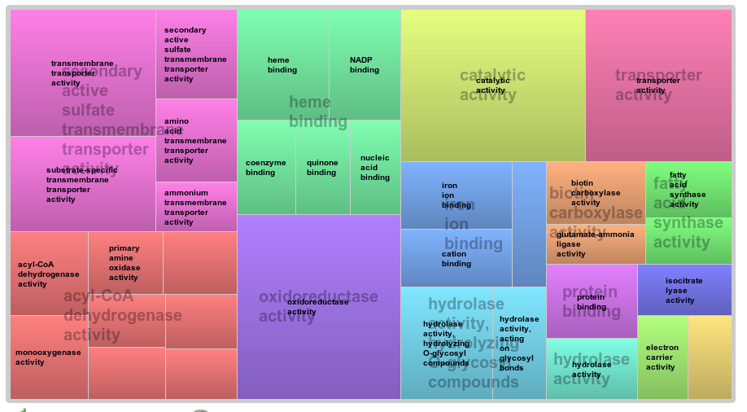
-N → -C functional analysis

