Slide 1
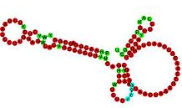

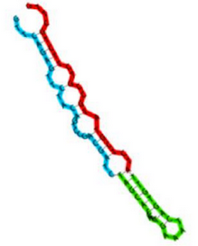



Magnaporthe oryzae small-RNA sequencing

Slide 2




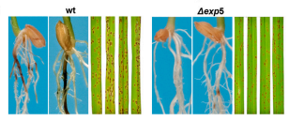
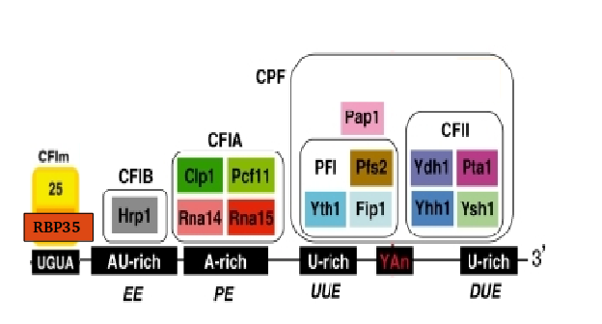
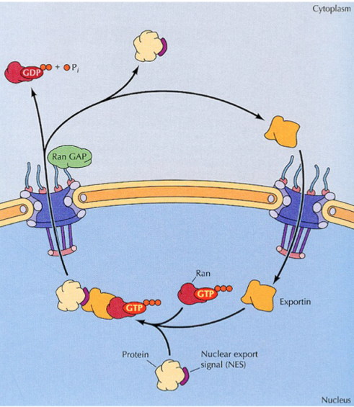
Introduction
RBP35
EXP5

Slide 3
Introduction – RBP35
We performed a poly(A) specific RNA-seq
Alternative polyadenylation is altered in ∆rbp35 in 25% of genes, belonging to specific functional groups
UTR are usually shortened in ∆rbp35
∆rbp35 probably binds to UGUA motif
….(previous work)

Slide 4
Introduction – EXP5
In yeast, involved in nuclear import and export of several proteins, and required for re-export of mature tRNAs after their retrograde import from the cytoplasm
In mammals also mediates the nuclear export of micro-RNA precursors, and double-strand RNA-bearing proteins

Slide 5
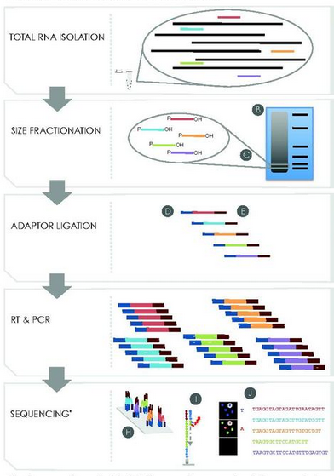
Small RNA library preparation and sequencing

Slide 6
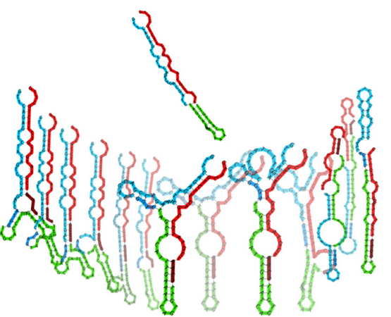
Standard small RNA-seq adapters have been shown to be biased for certain RNA structures

Slide 7


Our library was prepared with HD adapters (Prof. Tamas Dalmay lab, Norwich, UK)
Regular smallRNA-seq
sequencing
HD smallRNA-seq
x256 combinations
sequencing

Slide 8
Sequencing resume
sample | total reads | Filtered read | Filtered read % | unique | Unique %
∆exp5 _1 | 25580902 | 23662841 | 7.50% | 1962459 | 8.29%
∆exp5 _2 | 39423030 | 37346923 | 5.27% | 2625645 | 7.03%
∆exp5 _3 | 16606918 | 12293728 | 25.97% | 1242286 | 10.11%
∆rbp35 _1 | 14107800 | 7261472 | 48.53% | 835354 | 11.50%
∆rbp35 _2 | 25965551 | 22122147 | 14.80% | 2346343 | 10.61%
∆rbp35 _3 | 32233131 | 21309230 | 33.89% | 2314513 | 10.86%
WT_1 | 13826696 | 10577152 | 23.50% | 1067465 | 10.09%
WT_2 | 21412622 | 17398315 | 18.75% | 1559790 | 8.97%
WT_3 | 14168509 | 11826616 | 16.53% | 1266876 | 10.71%
* No 3’ adapter found, < 18nt, or low quality/artifacts

Slide 9


Adapters contamination is variable
60 nt
60 nt

Slide 10
Read length after adapters removal is between 18-25 bp

Slide 11
Bias of adapter sequence between WT and mutants

Slide 12
More than 70% of unique reads do not align on the genome (GUY11)

Slide 13
Unique reads are mostly from transposable elements

Slide 14
Classification of unique reads: ∆rbp35 produces more reads from cDNA

Slide 15
Expression levels VS unique reads: transposable elements and viruses produce most of expression in WT
WT expression
WT unique reads

Slide 16
Expression levels VS unique reads

Slide 17
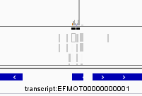
Three approaches to identify changes in expression
Loci detection in the genome
Small transcriptome assembly
Single read sequence analysis
GGCAACGTGCCTGAGTGGTTAAA
ACGACCATACCCACTG
TCCGGTATGGTGTAGGGGTTAGCATAC
. . .
Locus found!
DIFFERENTIAL EXPRESSION

Slide 18
Most of genomic sRNA loci (2019) are located in transposable elements

Slide 19
Genomic loci differential expression

Slide 20
Three approaches to identify changes in expression
Loci detection in the genome
Small transcriptome assembly
Single read sequence analysis
GGCAACGTGCCTGAGTGGTTAAA
ACGACCATACCCACTG
TCCGGTATGGTGTAGGGGTTAGCATAC
. . .
Locus found!
DIFFERENTIAL EXPRESSION

Slide 21
45367 contigs assembled from all the samples

Slide 22
Differentially expressed contigs

Slide 23
Three approaches to identify changes in expression
Loci detection in the genome
Small transcriptome assembly
Single read sequence analysis
GGCAACGTGCCTGAGTGGTTAAA
ACGACCATACCCACTG
TCCGGTATGGTGTAGGGGTTAGCATAC
. . .
Locus found!
DIFFERENTIAL EXPRESSION

Slide 24
The majority of differentially expressed unique reads are of unknown origin, but there is transcriptional evidence (∆exp5)

Slide 25
The majority of differentially expressed unique reads are of unknown origin, but there is transcriptional evidence (∆rbp35)

Slide 26
Up-regulated sRNAs in ∆rbp35 are ~19 nt, down-regulated sRNAs in ∆exp5 are 10-15 nt

Slide 27
The very short down-regulated ∆exp5 sequences are related with rRNA and cDNA, the longest with naESTs

Slide 28
In ∆rbp35 ~19 nt up-regulated sequences and ~23 nt down-regulated sequence are related with transposable and cDNAs. ~20 nt sequences are related with naESTs

Slide 29
There is an overall U preference as 1st nucleotide, in reads with length 16-25 nt

Slide 30
There is an overall U preference as 1st nucleotide, in reads with length 16-26 nt

Slide 31
There is an overall U preference as 1st nucleotide, in transposable elements and cDNAs

Slide 32
∆rbp35 produces small RNAs with 1st nucleotide U-preference…

Slide 33
….in tranposables and cDNA

Slide 34
∆rbp35 produces small RNAs with 1st nucleotide U-preference in the range 16-22 nt

Slide 35
There is an overall A preference as last nucleotide, in reads with length 17-29

Slide 36
There is an overall A preference as last nucleotide, in reads with length 17-29

Slide 37
Last adenine preference is variable among mutants

Slide 38
Up-regulated reads in ∆rbp35 do not possess the last adenine

Slide 39
The last adenine is probably post-transcriptional modification
Let’s trim the reads that originally did not align on the genome,
and see if we can align them now

Slide 40
The last adenine is probably post-transcriptional modification
The modification is usually an adenine addition

Slide 41
The last adenine is probably post-transcriptional modification
Transposable elements and viruses’ small RNAs are usually A-edited

Slide 42
The last adenine is probably post-transcriptional modification
Up-regulated sequence in ∆rbp35 are especially adenine-added,
even if they were not usually ending in adenine (why?)

Slide 43
Transposable elements and viruses present a higher degree of antisense transcription

Slide 44
In-depth analysis of specific classes

Slide 45
19nt U-beginning up-regulated in ∆rbp35 They come mostly from transposable elements

Slide 46
19nt U-beginning up-regulated in ∆rbp35 Usually, antisense to some specific retrotransposons

Slide 47
19nt U-beginning up-regulated in ∆rbp35
Just protein-coding genes overlapping transposons

Slide 48
19nt U-beginning up-regulated in ∆rbp35
Sense to 18s and 26s

Slide 49
A virus in M.oryzae GUY11?
A transcript 2840 nt long, not aligning on the genome
RdRp
63
1937
RNA-dependent RNA polymerase
Similar to S. scleorinorum mitovirus
Confirmed in GUY11 ESTs, probably two different molecules
Not found in 70-15 rna seq
Highly transcribed in WT (up to 20%), affected in rbp35 mutant, not sure in exp5
Very A-modified
Highly polyadenylated in the polyA experiment

Slide 50
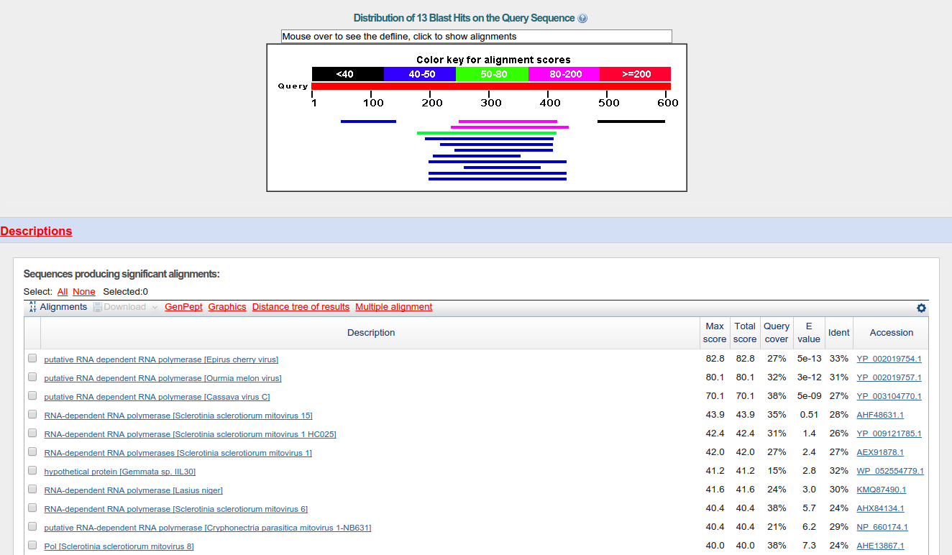
A virus in M.oryzae GUY11?

Slide 51
Probes proposals

Slide 52
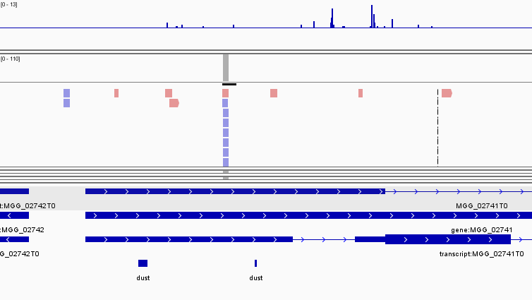
Rbp35 antisense 5’UTR
TACCTGGACCTGGATCGTT

Slide 53
ITS2 antisense up-regulated in rbp35
NTS
18S
ITS1
5.8S
ITS2
28S
TGAACTTGGGGGCCCCGGG

Slide 54
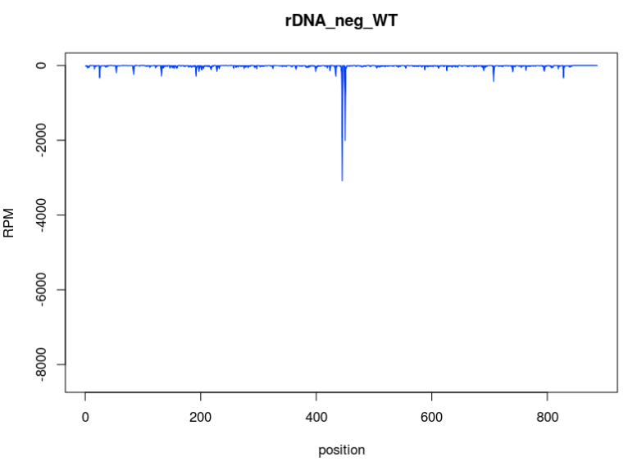
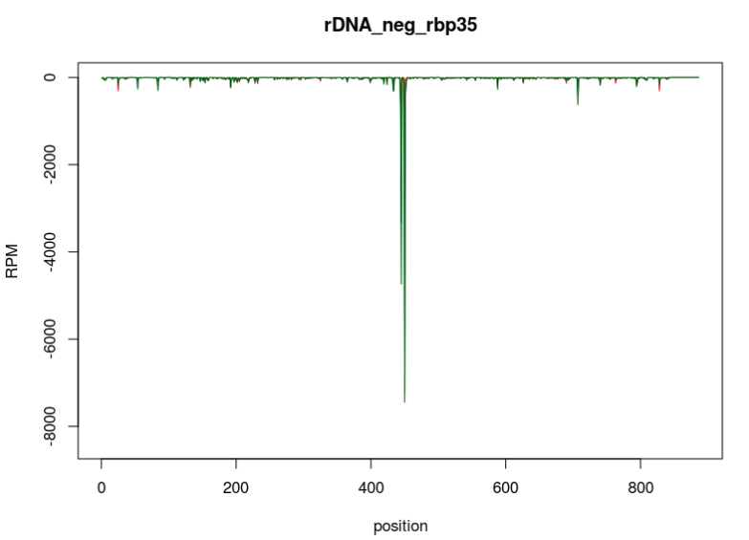
ITS2 antisense up-regulated in rbp35

Slide 55
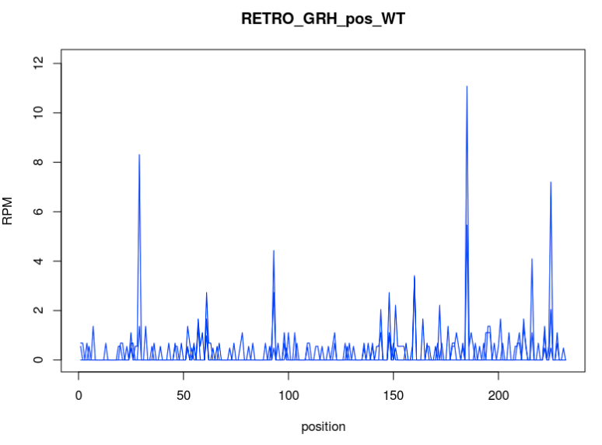
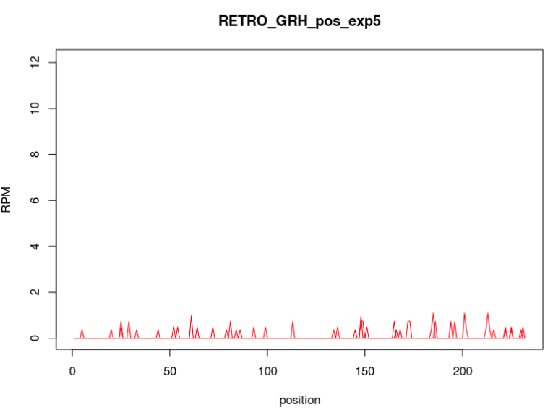
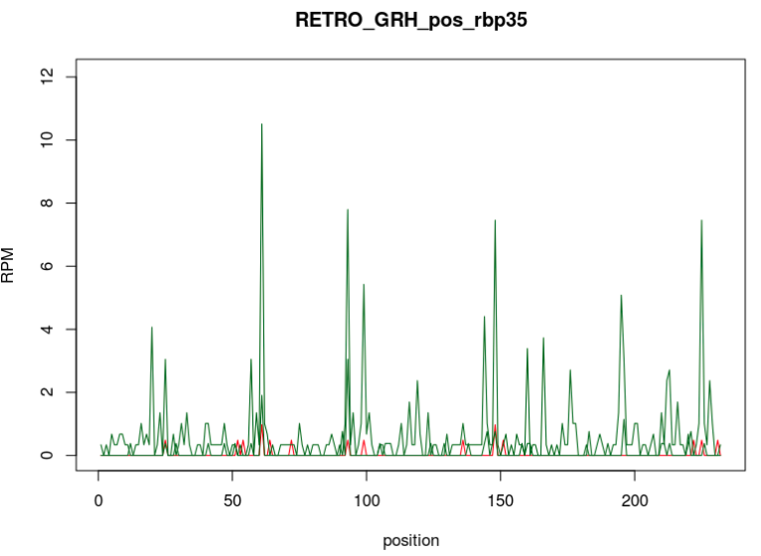
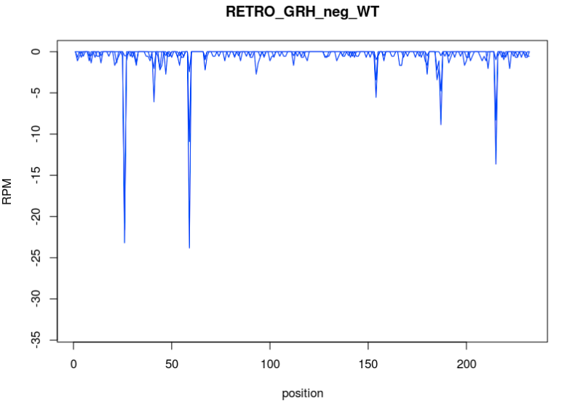
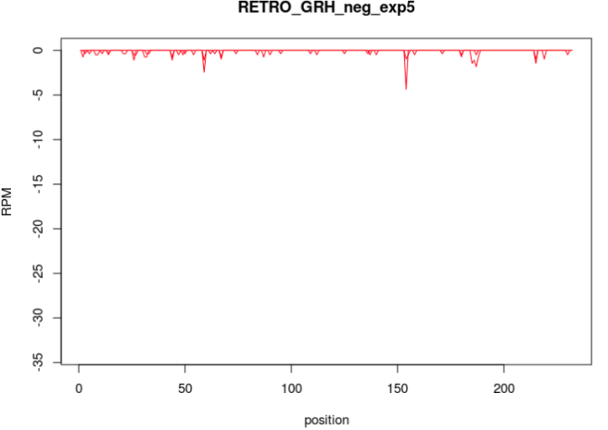
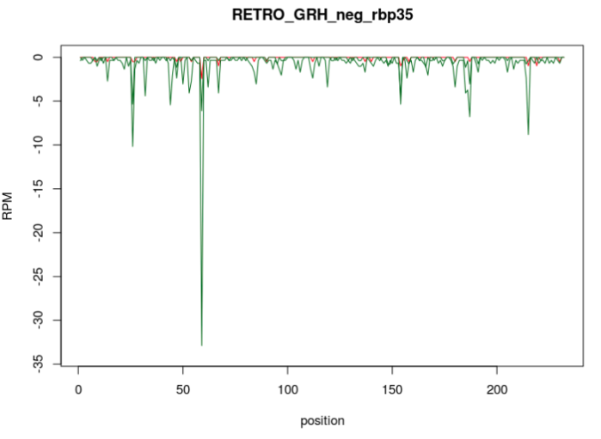
GRH retro

Slide 56
Other retros?
Maggy
Retro5(interesting for exp5)
Pyret
…

Slide 57
tRNA
They are all up in rbp35 and down in exp5
tRNA-glu looks good for both

Slide 58
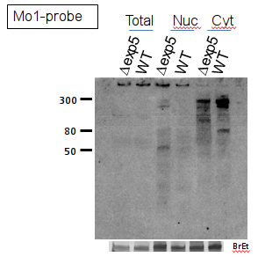
A new class of protein-coding related small RNA is found
Protein-coding gene
Unknown
smallRNA!
At least 12 protein-coding genes
Identified with an upstream unknown smallRNA
Same situation conserved in other
filamentous fungi!
(but not yeasts)

Slide 59
Any gene? (MGG_15866, MGG_01240) The unknown EST?

