Slide 1
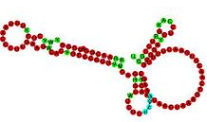

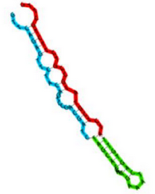



Magnaporthe oryzae small-RNA sequencing

Slide 2




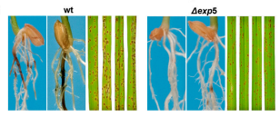
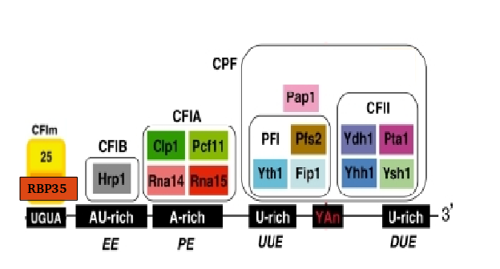
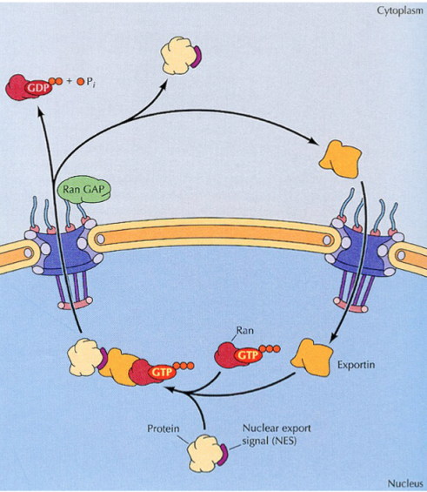
Introduction
RBP35
EXP5

Slide 3
Introduction – RBP35
We performed a poly(A) specific RNA-seq
Alternative polyadenylation is altered in ∆rbp35 in 25% of genes, belonging to specific functional groups
UTR are usually shortened in ∆rbp35
∆rbp35 probably binds to UGUA motif
….(previous work)

Slide 4
Introduction – EXP5
In yeast, involved in nuclear import and export of several proteins, and required for re-export of mature tRNAs after their retrograde import from the cytoplasm
In mammals also mediates the nuclear export of micro-RNA precursors, and double-strand RNA-bearing proteins

Slide 5
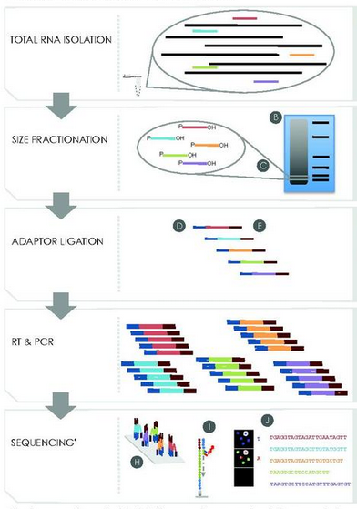
Small RNA library preparation and sequencing

Slide 6
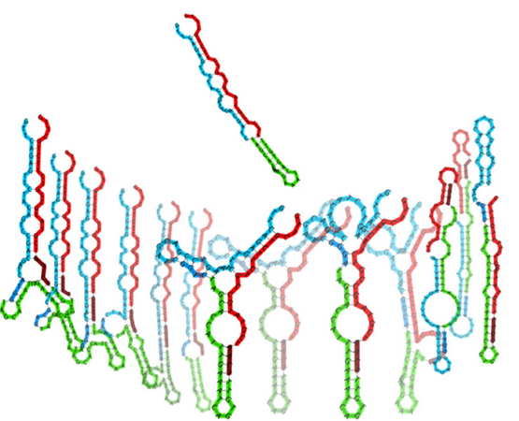
Standard small RNA-seq adapters have been shown to be biased for certain RNA structures

Slide 7


Our library was prepared with HD adapters (Prof. Tamas Dalmay lab, Norwich, UK)
Regular smallRNA-seq
sequencing
HD smallRNA-seq
x256 combinations
sequencing

Slide 8
Sequencing resume
sample | total reads | Filtered read | Filtered read % | unique | Unique %
∆exp5 _1 | 25580902 | 24087237 | 5.84% | 2059695 | 8.55%
∆exp5 _2 | 39423030 | 37807985 | 4.10% | 2757129 | 7.29%
∆exp5 _3 | 16606918 | 12971720 | 21.89% | 1358508 | 10.47%
∆rbp35 _1 | 14107800 | 8351051 | 40.81% | 928906 | 11.12%
∆rbp35 _2 | 25965551 | 23961924 | 7.72% | 2636396 | 11.00%
∆rbp35 _3 | 32233131 | 26039242 | 19.22% | 2974243 | 11.42%
WT_1 | 13826696 | 11280697 | 18.41% | 1164766 | 10.33%
WT_2 | 21412622 | 19757242 | 7.73% | 1819474 | 9.21%
WT_3 | 14168509 | 12950535 | 8.60% | 1472274 | 11.37%
* No 3’ adapter found, too short after trimming (<16) or low quality/artifacts

Slide 9
Replicate 1 of ∆rbp35 is slightly less correlated
(based on genomic loci)

Slide 10


Adapters contamination is variable
60 nt
60 nt

Slide 11
Read length after adapters removal is between 18-25 bp

Slide 12
Bias of adapter sequence between WT and mutants

Slide 13
More than 70% of reads do not aligned perfectly on the genome

Slide 14
∆rbp35 defects alter alignments but not in ∆exp5

Slide 15
Unique reads are mostly from transposable elements and protein-coding genes

Slide 16
Classification of unique reads: ∆rbp35 produces more reads from cDNA

Slide 17
Expression levels of unique reads: transposable elements produce most of expression
WT expression
WT unique reads

Slide 18
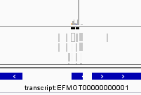
Three approaches to identify changes in expression
Loci detection in the genome
Small transcriptome assembly
Single read sequence analysis
GGCAACGTGCCTGAGTGGTTAAA
ACGACCATACCCACTG
TCCGGTATGGTGTAGGGGTTAGCATAC
. . .
Locus found!
DIFFERENTIAL EXPRESSION

Slide 19
The majority of differentially expressed unique reads are of unknown origin, but there is transcriptional evidence (∆exp5)

Slide 20
The majority of differentially expressed unique reads are of unknown origin, but there is transcriptional evidence (∆rbp35)

Slide 21
Up-regulated sRNAs in ∆rbp35 are ~19 nt, down-regulated sRNAs in ∆exp5 are 10-15 nt

Slide 22
The very short down-regulated ∆exp5 sequences are related with rRNA and cDNA, the longest with naESTs

Slide 23
In ∆rbp35 ~19 nt up-regulated sequences and ~23 nt down-regulated sequence are related with transposable and cDNAs. ~20 nt sequences are related with naESTs

Slide 24
There is an overall U preference as 1st nucleotide, in reads with length 16-25 nt

Slide 25
There is an overall U preference as 1st nucleotide, in reads with length 16-26 nt

Slide 26
There is an overall U preference as 1st nucleotide, in transposable elements and cDNAs

Slide 27
∆rbp35 produces small RNAs with 1st nucleotide U-preference…

Slide 28
….in tranposables and cDNA

Slide 29
∆rbp35 produces small RNAs with 1st nucleotide U-preference in the range 16-22 nt

Slide 30
There is an overall A preference as last nucleotide, in reads with length 17-29

Slide 31
There is an overall A preference as last nucleotide, in reads with length 17-29

Slide 32
Last adenine preference is variable among mutants

Slide 33
Up-regulated reads in ∆rbp35 do not possess the last adenine

Slide 34
The last adenine is probably post-transcriptional modification
Let’s trim the reads that originally did not align on the genome,
and see if we can align them now

Slide 35
The last adenine is probably post-transcriptional modification
The modification is usually an adenine addition

Slide 36
The last adenine is probably post-transcriptional modification
Mostly aligning to transposables and cDNAs

Slide 37
The last adenine is probably post-transcriptional modification
Up-regulated sequence in ∆rbp35 are especially adenine-added,
even if they were not usually ending in adenine (why?)

Slide 38
Transposable elements and naEST present a higher degree of antisense transcription

Slide 39
Up-regulated sequences in ∆rbp35 related with transposable elements tend to be more antisense, same with ∆exp5 related with naEST

Slide 40
Three approaches to identify changes in expression
Loci detection in the genome
Small transcriptome assembly
Single read sequence analysis
GGCAACGTGCCTGAGTGGTTAAA
ACGACCATACCCACTG
TCCGGTATGGTGTAGGGGTTAGCATAC
. . .
Locus found!
DIFFERENTIAL EXPRESSION

Slide 41
Most of genome sRNA loci (4131) are located in mRNAs

Slide 42
In ∆exp5, a lot of protein-coding related loci are down regulated

Slide 43
In ∆rbp35, a lot of transposable elements related loci are down regulated, and many ncRNA related loci are up regulated

Slide 44
34 endogenous short RNAs mapping to protein-coding genes were identified
MGG_00083 |  | Putative uncharacterized protein
MGG_00174 |  | Putative uncharacterized protein
MGG_00259 |  | Putative uncharacterized protein
MGG_00354 |  | Nuclear transcription factor Y subunit A-7
MGG_00504 |  | Zinc finger protein 740
MGG_00868 |  | Global transactivator
MGG_01240 |  | RING-8 protein
MGG_01579 |  | Pre-mRNA branch site protein p14
MGG_01754 |  | Putative uncharacterized protein
MGG_01824 | NMA111 | Pro-apoptotic serine protease NMA111
MGG_01842 |  | Putative uncharacterized protein
MGG_02160 |  | Putative uncharacterized protein
MGG_02489 |  | Branched-chain-amino-acid aminotransferase
MGG_02741 |  | RRM domain-containing protein
MGG_02925 |  | Putative uncharacterized protein
MGG_02926 |  | Putative uncharacterized protein
MGG_03367 |  | Putative uncharacterized protein
MGG_03537 |  | Importin subunit beta-3
MGG_03670 | SPM1 | Subtilisin-like proteinase Spm1 | PHI:2117
MGG_04538 |  | Putative uncharacterized protein | PHI:786
MGG_05116 |  | Malic acid transporter
MGG_05218 |  | Putative uncharacterized protein
MGG_05638 |  | Putative uncharacterized protein
MGG_05764 |  | Putative uncharacterized protein
MGG_05765 |  | Putative uncharacterized protein
MGG_05883 |  | Putative uncharacterized protein
MGG_06500 |  | WD repeat-containing protein
MGG_07190 |  | Dolichyl-phosphate-mannose-protein mannosyltransferase 2
MGG_09408 |  | Cyclic nucleotide-binding domain-containing protein
MGG_09850 |  | GYF domain-containing protein
MGG_10968 |  | Putative uncharacterized protein
MGG_16062 |  | Putative uncharacterized protein
MGG_17005 |  | Putative uncharacterized protein
MGG_17324 |  | Putative uncharacterized protein | PHI:879

Slide 45
Three approaches to identify changes in expression
Loci detection in the genome
Small transcriptome assembly
Single read sequence analysis
GGCAACGTGCCTGAGTGGTTAAA
ACGACCATACCCACTG
TCCGGTATGGTGTAGGGGTTAGCATAC
. . .
Locus found!
DIFFERENTIAL EXPRESSION

Slide 46
76592 transcripts assembled from all the samples

Slide 47
Most of differentially expressed transcripts are of unknown origin

Slide 48
In-depth analysis of specific classes

Slide 49
19nt U-beginning up-regulated in ∆rbp35 They come mostly from transposable elements

Slide 50
19nt U-beginning up-regulated in ∆rbp35 Usually, antisense to some specific retrotransposons

Slide 51
19nt U-beginning up-regulated in ∆rbp35
Just protein-coding genes overlapping transposons

Slide 52
19nt U-beginning up-regulated in ∆rbp35
Sense to 18s and 26s

Slide 53
A-modified reads They usually come from transposables and naEST

Slide 54
A-modified reads Usually, to some specific retrotransposons

Slide 55
A virus in M.oryzae GUY11?
A transcript 2840 nt long, not aligning on the genome
RdRp
63
1937
RNA-dependent RNA polymerase
Similar to S. scleorinorum mitovirus
Confirmed in GUY11 ESTs
Not found in 70-15 rna seq
Similar found in collochtritum: https://pag.confex.com/pag/xxiii/recordingredirect.cgi/id/1651 (but we can’t find an ORF for the capsid protein)
Highly transcribed in WT, affected in rbp35 mutant, not sure in exp5
Very A-modified
Highly polyadenylated in the polyA experiment

Slide 56
Probes proposals

Slide 57
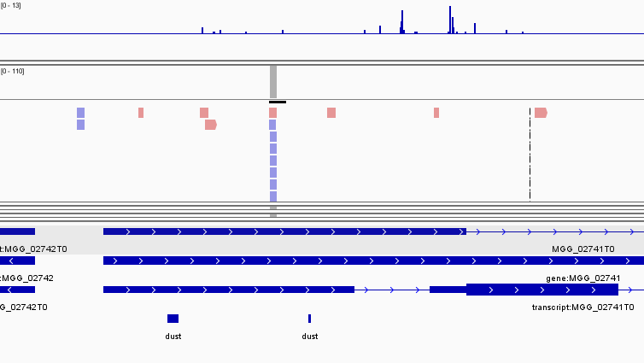
Rbp35 antisense 5’UTR
TACCTGGACCTGGATCGTT

Slide 58
ITS2 antisense up-regulated in rbp35
NTS
18S
ITS1
5.8S
ITS2
28S
TGAACTTGGGGGCCCCGGG

Slide 59
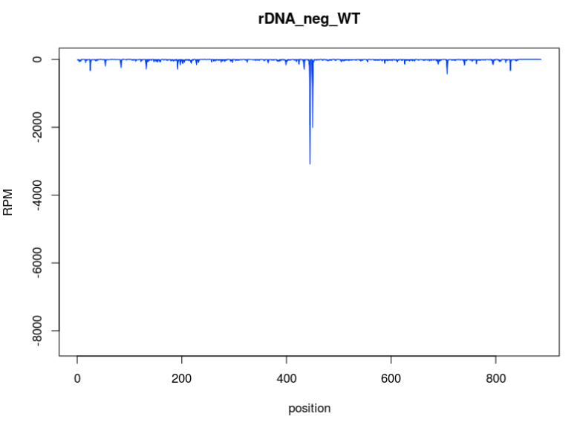
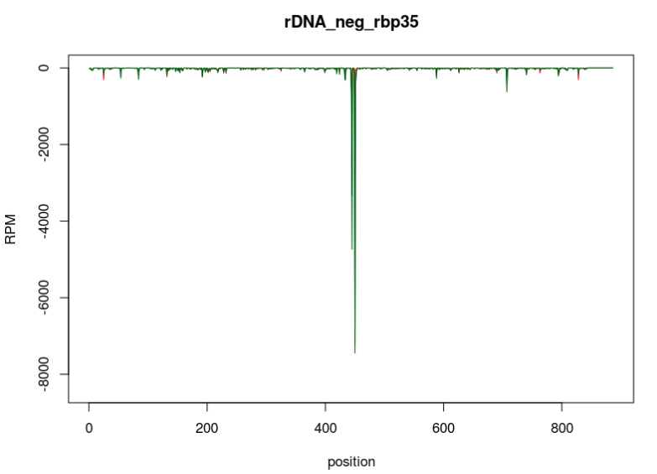
ITS2 antisense up-regulated in rbp35

Slide 60
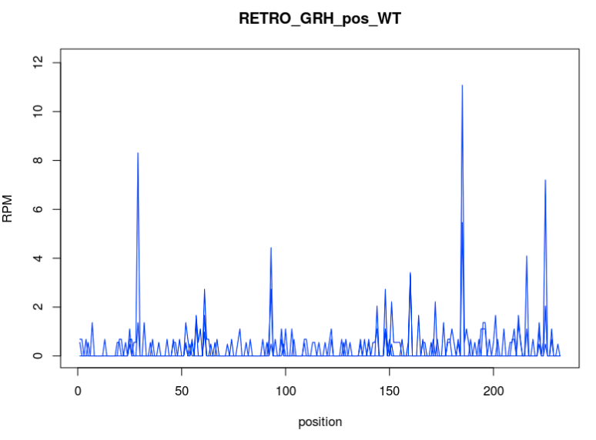
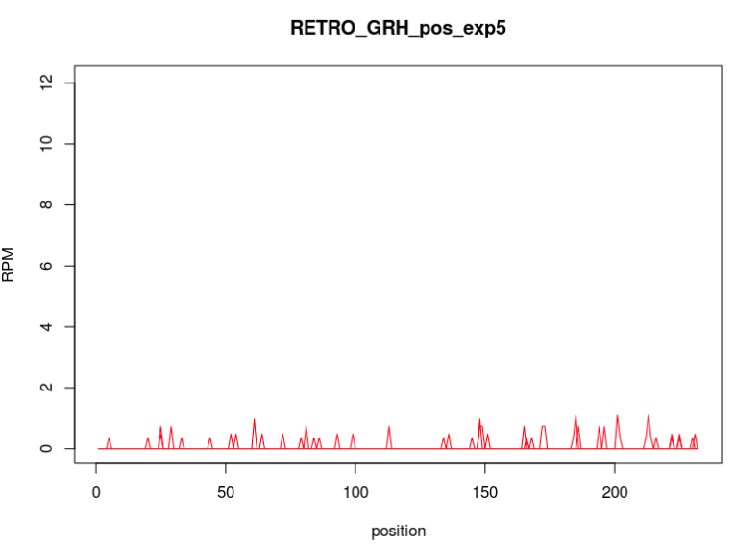
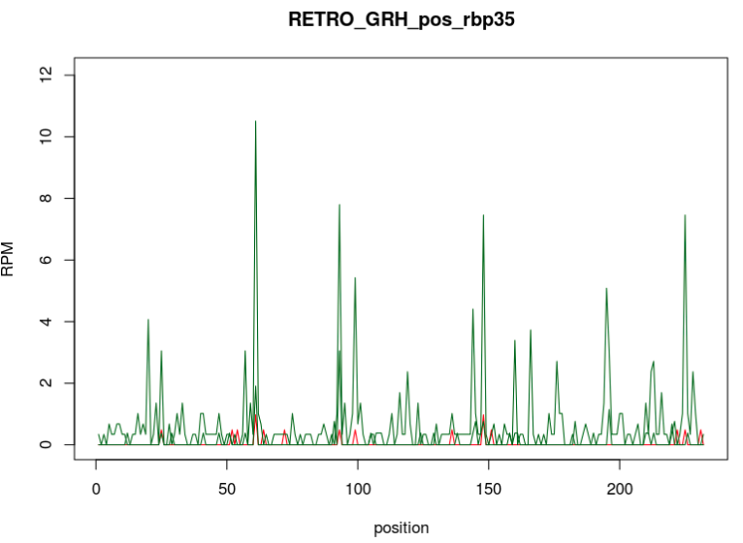
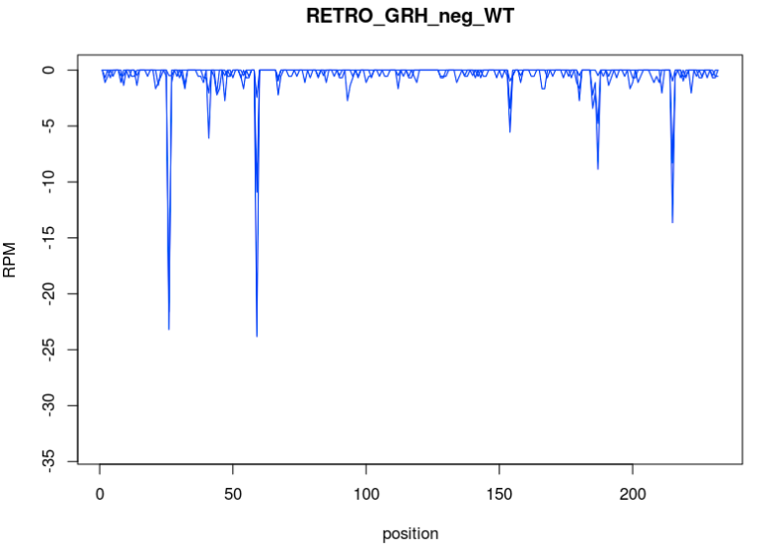
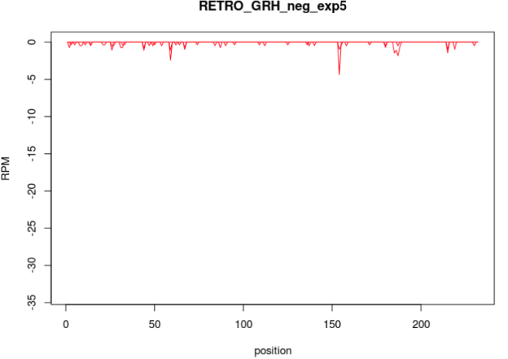
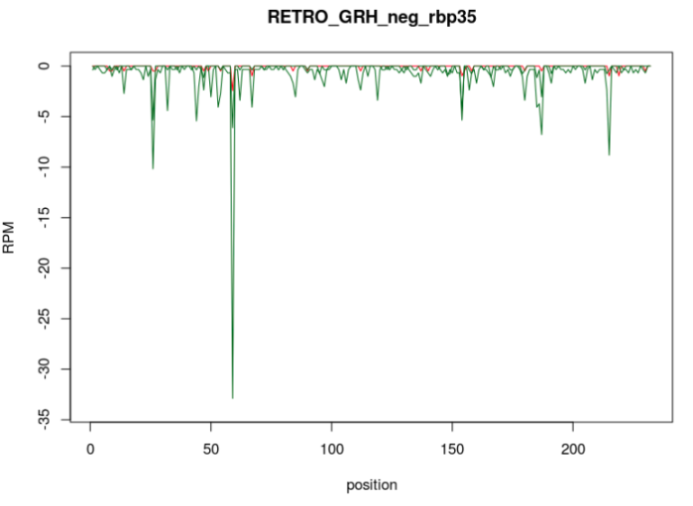
GRH retro

Slide 61
Other retros?
Maggy
Retro5(interesting for exp5)
Pyret
…

Slide 62
tRNA
They are all up in rbp35 and down in exp5
tRNA-glu looks good for both

Slide 63
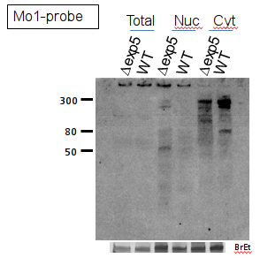
A new class of protein-coding related small RNA is found
Protein-coding gene
Unknown
smallRNA!
At least 12 protein-coding genes
Identified with an upstream unknown smallRNA
Same situation conserved in other
filamentous fungi!
(but not yeasts)

Slide 64
Any gene? (MGG_15866, MGG_01240) The unknown EST?

