Slide 1
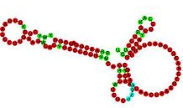

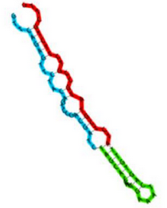



Magnaporthe oryzae small-RNA sequencing

Slide 2




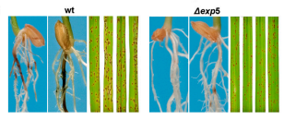
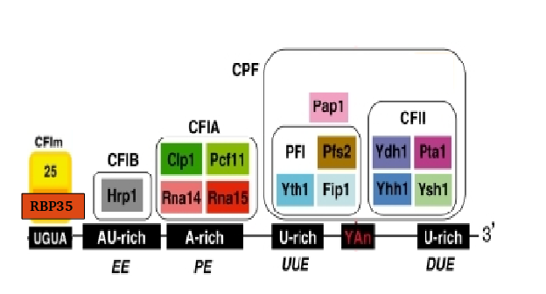
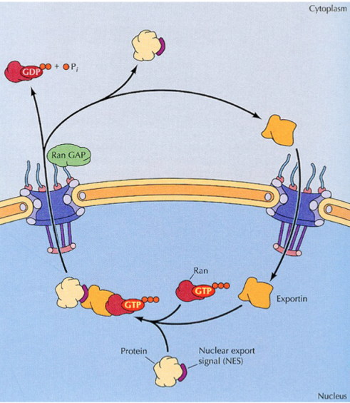
Introduction
RBP35
EXP5

Slide 3
Introduction – RBP35
We performed a poly(A) specific RNA-seq
Alternative polyadenylation is altered in ∆rbp35 in 25% of genes, belonging to specific functional groups
UTR are usually shortened in ∆rbp35
∆rbp35 probably binds to UGUA motif
….(previous work)

Slide 4
Introduction – EXP5
In yeast, involved in nuclear import and export of several proteins, and required for re-export of mature tRNAs after their retrograde import from the cytoplasm
In mammals also mediates the nuclear export of micro-RNA precursors, and double-strand RNA-bearing proteins

Slide 5
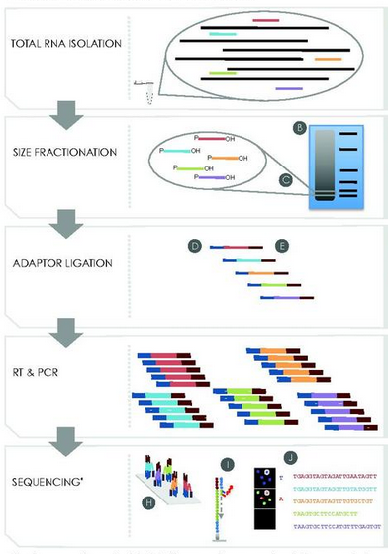
Small RNA library preparation and sequencing

Slide 6
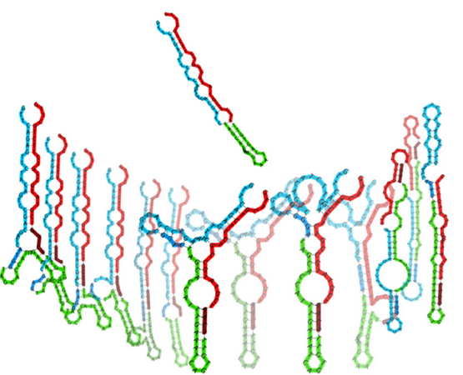
Standard small RNA-seq adapters have been shown to be biased for certain RNA structures

Slide 7


Our library was prepared with HD adapters (Prof. Tamas Dalmay lab, Norwich, UK)
Regular smallRNA-seq
sequencing
HD smallRNA-seq
x256 combinations
sequencing

Slide 8
Sequencing resume
sample | total reads | Filtered read | Filtered read % | unique | Unique %
∆exp5 _1 | 25580902 | 23975309 | 6.28% | 2033390 | 8.48%
∆exp5 _2 | 39423030 | 37653701 | 4.49% | 2707372 | 7.19%
∆exp5 _3 | 16606918 | 12769671 | 23.11% | 1325098 | 10.38%
∆rbp35 _1 | 14107800 | 7722707 | 45.26% | 892168 | 11.55%
∆rbp35 _2 | 25965551 | 23087772 | 11.08% | 2513756 | 10.89%
∆rbp35 _3 | 32233131 | 23138541 | 28.22% | 2601845 | 11.24%
WT_1 | 13826696 | 11009290 | 20.38% | 1130421 | 10.27%
WT_2 | 21412622 | 18120959 | 15.37% | 1679584 | 9.27%
WT_3 | 14168509 | 12287418 | 13.28% | 1364946 | 11.11%
* No 3’ adapter found, too short after trimming (<16) or low quality/artifacts

Slide 9
Replicate 1 of ∆rbp35 is slightly less correlated
(based on genomic loci)

Slide 10


Adapters contamination is variable
60 nt
60 nt

Slide 11
Read length after adapters removal is between 18-25 bp

Slide 12
There is an overall U preference as 1st nucleotide

Slide 13
Bias of adapter sequence between WT and mutants

Slide 14
More than 70% of reads do not aligned perfectly on the genome
exactly one
More than one
No alignments

Slide 15
∆rbp35 defects alter alignments but not in ∆exp5

Slide 16
Unique reads are mostly from transposable elements and protein-coding genes

Slide 17
Classification of unique reads: ∆rbp35 produces more reads from cDNA

Slide 18
Expression levels of unique reads: transposable elements produce most of expression
WT expression
WT unique reads

Slide 19
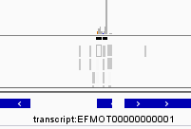
Three approaches to identify changes in expression
Loci detection in the genome
Small transcriptome assembly
Single read sequence analysis
GGCAACGTGCCTGAGTGGTTAAA
ACGACCATACCCACTG
TCCGGTATGGTGTAGGGGTTAGCATAC
. . .
Locus found!
DIFFERENTIAL EXPRESSION

Slide 20
The majority of differentially expressed unique reads are of unknown origin, but there is transcriptional evidence (∆exp5)

Slide 21
The majority of differentially expressed unique reads are of unknown origin, but there is transcriptional evidence (∆rbp35)

Slide 22
Up-regulated sRNAs in ∆rbp35 are shorter (18-21 nt)

Slide 23
∆rbp35 produces small RNAs with 1st nucleotide U-preference

Slide 24
Three approaches to identify changes in expression
Loci detection in the genome
Small transcriptome assembly
Single read sequence analysis
GGCAACGTGCCTGAGTGGTTAAA
ACGACCATACCCACTG
TCCGGTATGGTGTAGGGGTTAGCATAC
. . .
Locus found!
DIFFERENTIAL EXPRESSION

Slide 25
Most of genome sRNA loci (3486) are located in mRNAs

Slide 26
In ∆exp5, a lot of protein-coding related loci are down regulated

Slide 27
In ∆exp5, tRNA-lys is downregulated, retro5 loci are upregulated
tRNA-lys
retro5

Slide 28
In ∆rbp35, a lot of transposable elements related loci are down regulated, and many ncRNA related loci are up regulated

Slide 29
In ∆rbp35, a lot of transposable elements related loci are down regulated, and many ncRNA related loci are up regulated
ncRNA:
tRNA-Ala
tRNA-Arg
tRNA-Asn
tRNA-Asp
tRNA-Cys
tRNA-Gln
tRNA-Gly
tRNA-His
tRNA-Ile
tRNA-Leu
tRNA-Lys
tRNA-Met
tRNA-Phe
tRNA-Pro
tRNA-Pseudo
tRNA-Ser
tRNA-Thr
tRNA-Trp
tRNA-Undet
tRNA-Val
U6
A. fumigatus snoRNA Afu_300
fumigatus snoRNA Afu_335
Transposable:
MINE
Pyret
MGRL-3
MGL
Transposable:
MAGGY
INAGO 1
INAGO 2
Pyret
POT2
MGRL-3

Slide 30
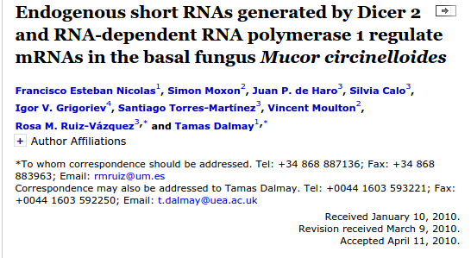
4 classes of siRNAs were discovered in Mucor
Dicer1
Dicer2
RdP1
Rdp2

Slide 31
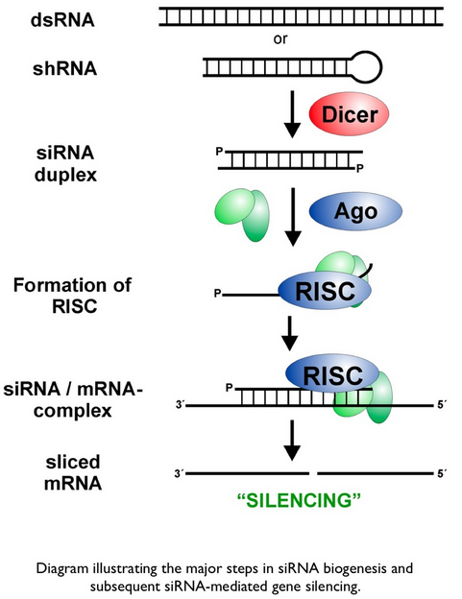
This is how siRNAs supposedly work…
RdP1/2

Slide 32
Out of the 3486 loci, 71 endogenous short RNAs from the three strains were identified
Endogenous short RNA: a locus <100 nt that contains at least 1 read per million, in which more than 50% of the reads is composed by an identical read

Slide 33
Some siRNAs are differentially expressed in the mutants
∆exp5
MGG_03173 |  | RuvB-like helicase 2
MGG_08043 |  | Putative uncharacterized protein
MGG_04904 |  | Protein of unknown function DUF1769
MGG_08299 |  | Flavoprotein transmembrane component
MGG_03670 | SPM1 | Subtilisin-like proteinase Spm1 (PHI:2117)
∆rbp35
MGG_01870 | Zn(2)-C6 fungal-type DNA-binding domain protein
MGG_05218 | LPXTG-motif cell wall anchor domain protein
MGG_00504 | Zinc finger protein 740
MGG_05883 | Putative uncharacterized protein
MGG_02489 | Branched-chain-amino-acid aminotransferase

Slide 34
Three approaches to identify changes in expression
Loci detection in the genome
Small transcriptome assembly
Single read sequence analysis
GGCAACGTGCCTGAGTGGTTAAA
ACGACCATACCCACTG
TCCGGTATGGTGTAGGGGTTAGCATAC
. . .
Locus found!
DIFFERENTIAL EXPRESSION

Slide 35
77807 transcripts assembled from all the samples

Slide 36
Most of differentially expressed transcripts are of unknown origin

