Slide 1
Sequencing resume
2 strains (WT, 2D4) x 4 conditions (CM, MM, -N, -C) x 3 replicates
4751592 – 11517077 total reads database
~63% - ~83% successfully mapped reads
43 bp mean read length
~92% - ~98% replicates correlation
~100bp mean pair ended distance
~400x coverage for poly-A site*
* assuming an amount of 22000 mRNA molecules per cell

Slide 2
Workflow
Program and details
Procedure
% of data left
Illumina sequencing
100%
Data prepping
fasta-mcf, adapter trimming
96%
gsnap, default parameters
Alignment
Low quality mapping (<30))
High A/T content (>90%)
Internal priming
Filtering
75%
Assign reads to known features,
Including all intergenic space up
to 400 bp
Assignment
65%
Clustering of most significant poly(A) sites (p-value < 0.05 over
global gene expression) at 33 bp
poly(A) sites detection

Slide 3
Pair ended reads distance

Slide 4


~2.5% of poly-A sites are internal priming
Some poly-A sites are just a side effect of poly-A genomic regions
reads
stretches of As

Slide 5
Results of the polyadenylatoin sites by Illumina sequencing
 | CM WT/Δrbp35 | MM WT/Δrbp35 | MM-N WT/Δrbp35 | MM-C WT/Δrbp35
Number of genes with a recognizable poly(A) site | 7511 / 7715 | 7524 / 8091 | 7629 / 7888 | 8007 / 8281
Genes with APA in CDS | 56 / 71 | 53 / 90 | 75 / 94 | 78 / 87
Genes with APA in 5'UTR | 66 / 82 | 66 / 81 | 77 / 89 | 63 / 97
Genes with APA in 3'UTR | 1429 / 1600 | 1271 / 1753 | 1342 / 1608 | 1463 / 1725
Number of genes with APA in WT but not in Δrbp35 | 633 | 509 | 621 | 682
Number of genes with APA in Δrbp35 but not in WT | 833 | 1038 | 906 | 994
Notes:
ESTs from NCBI, NIAS (M. oryzae), …

Slide 6
~10000 genes are expressed, out of a total of 13218 annotated genes (WT)
9546 genes are expressed in every condition (WT only)
2166 genes are never expressed (WT only)

Slide 7
~10000 genes are expressed, out of a total of 13218 annotated genes (2D4)
9918 genes are expressed in every condition (2D4 only)
1964 genes are never expressed (2D4 only)

Slide 8


Not every expressed gene has a recognizable poly-A site
Expressed gene with a recognizable poly-A site:
Expressed gene without a recognizable poly-A site:

Slide 9
Only ~75% of genes expressed have a recognizable poly-A site

Slide 10
~15000 poly-A site could be assigned to annotated genes

Slide 11
~15000 poly-A site could be assigned to annotated genes (2D4)

Slide 12
17%-19% of poly-A sites could not be assigned to any annotated gene

Slide 13
261 orphans poly(A) sites highly expressed in WT (>100 reads)
46 hits against Uniprot nt/nr database
4 hits against Rfam(ncRNA) database
80 overlapping annotated genes antisense
DIFFERENTIALLY EXPRESSED ORPHANS IN THE WT
CM → MM-C | 137
CM → MM | 6
CM → MM-N | 24
MM → MM-C | 91
MM → MM-N | 0
MM-N → MM-C | 55

Slide 14
>90% of poly-A sites are located in the 3'UTR

Slide 15
~20% of genes are alternatively polyadenilated
* calculated over the global number of expressed genes with a recognizable poly-A site

Slide 16
~90% of APA is located in the 3'UTR

Slide 17
Gene expression between WT conditions
CM
10286
192
219
184
9691
150
288
269
-N
-C
10348
10432

Slide 18
589 genes expressed in plant are never expressed in vitro
CM
10286
plant
3784
7339
6502
-N
MM
10348
3813
6535
589
6519
3696
10215
6588
3844
-C
10432

Slide 19
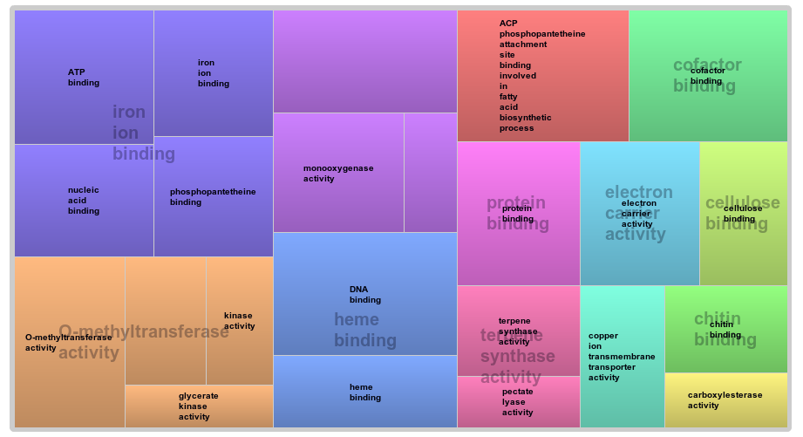
Plant specific genes functional analysis
p-value = 0.05

Slide 20
The CM → -C condition presents the highest number of differentially expressed genes, while MM → -N the lowest
DIFFERENTIALLY EXPRESSED GENES IN THE WT
 | DOWN | UP | TOTAL
CM → MM-C | 1586 | 1617 | 3203
CM → MM | 151 | 285 | 436
CM → MM-N | 177 | 347 | 524
MM → MM-C | 601 | 608 | 1209
MM → MM-N | 1 | 5 | 6
MM-N → MM-C | 216 | 313 | 529

Slide 21
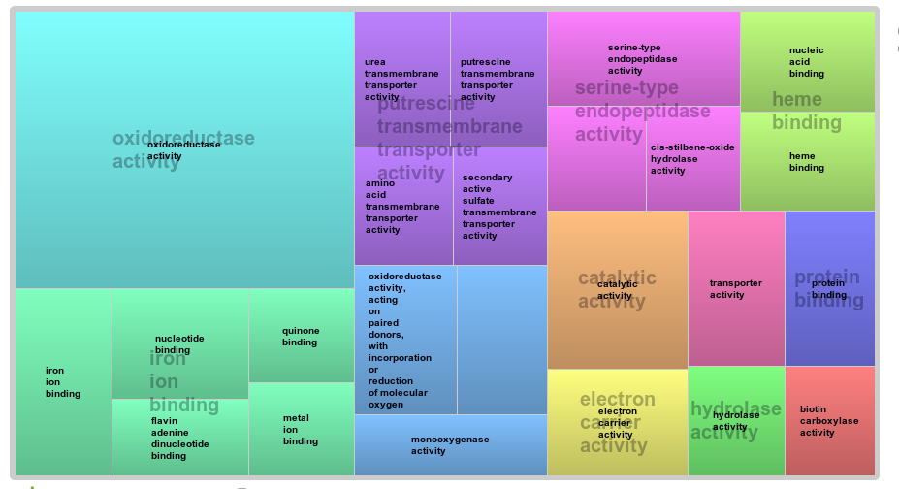
CM → MM functional analysis
p-value = 0.1

Slide 22
Δrbp35 affects poly-A sites number

Slide 23
Δrbp35 affects number of cut sites per gene

Slide 24
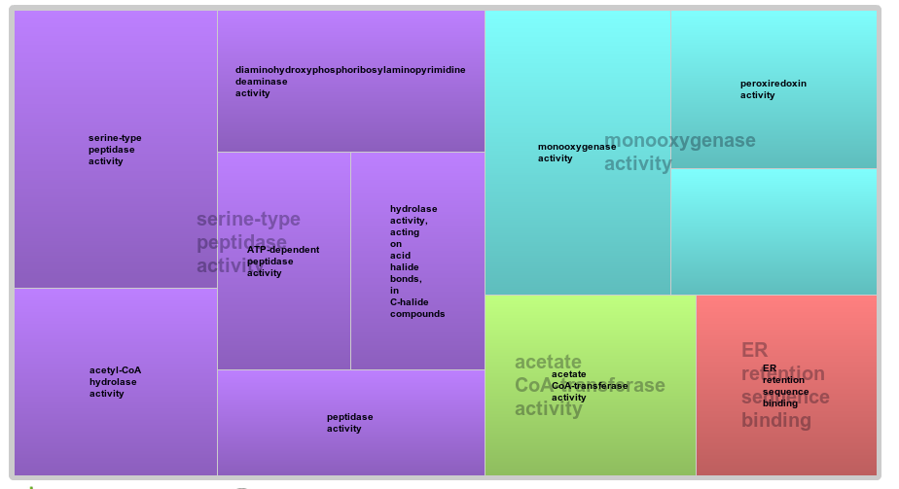
WT → 2D4 functional analysis
p-value = 0.05

Slide 25


Terminology - 1
group P1: Lost polyA sites in Δrbp35 (polyA site RBP35 dependent):
Group G1: genes containing group P1 poly-A sites
Group P1-2D4: every poly-A sites in G1 genes from 2D4

Slide 26

Terminology - 2
group P2: Appeared new polyA sites in Δrbp35 (unspecific polyA site-not RBP35 dependent):
Group G2: genes containing group P2 poly-A sites
Group P2-WT: every poly-A sites in G2 genes from WT

Slide 27

Terminology - 3
Group G3: Genes with change position (lost and appeared) polyA sites in Δrbp35 (positional RBP35 dependent), a specific case from P1 and P2:

Slide 28
~5% of poly-A sites and ~6% of genes are targeted by RBP35 in CM

Slide 29
Δrbp35 affects 3'UTR length

Slide 30
Nucleotides profile of poly-A sites slighty differs from S.cerevisae

Slide 31
Nucleotides profile of poly-A sites resembles N. crassa

Slide 32
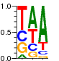


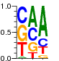

Nucleotides profile of poly-A sites differs from S.cerevisae
S.cerevisae
5'
AU-rich
A-rich
U-rich
YA
U-rich
3'
-30
-10
25
M. oryzae
5'
A-rich
U-rich
YA
3'
-45
-35
-30
-10

Slide 33
The A-RICH region is located -30 -10 bp upstream

Slide 34
Top 10 hexamers in A-rich region

Slide 35
UAGA & UGUA motifs

Slide 36
Polyadenilation signals in common genes
MPG1
...GGUAGAGAAGUCUCUUCUCGUUCCACUCAUUUAAUAAAACCCCUUCCAGACCUA...
PMK1
...CGUUUAGAAUGUGCAGGAGACACGAGUGGGAAAAUGAAUACAUGGAUGCCAGCA...
MST12
...CAGUGGCAUAAAAUCACAAAAUCUUUAGAAAGAUCACAGAAAACCUUUUGUCCA...

Slide 37
Poly-A sites targeted by RBP35 show a less pronunced A-rich region

Slide 38
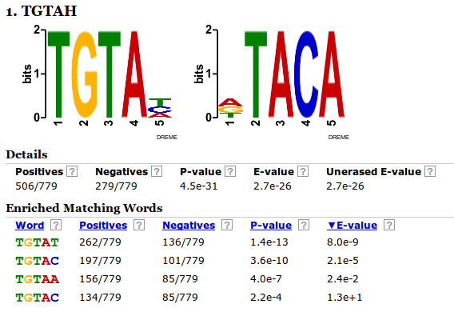
UGUAH motif is enriched in poly-A sites targeted by RBP35
- Output of DREME, P1 as positive sequences list versus not-P1 negative list

Slide 39
UGUAH motif – P1 vs not P1
In the first graph, we want to show how poly-A sites targeted by RBP35 display a different profile for the UGUA motif in the -100 -36 region respect to “regular” poly-A sites
We therefore plot P1 group poly-A sites against two control groups of poly-A sites of identical size not belonging to P1 group in WT

Slide 40
UGUAH is enriched at -45 in poly-A sites targeted by RBP35

Slide 41
UGUAH motif – P1 vs P1-2D4
In the second graph, we want to show how genes targeted by RBP35 are affected in the mutant, using P1 group
We therefore plot P1 group poly-A sites against P1-2D4 group poly-A sites, which are poly-A sites from 2D4 in the same genes affected of P1 group

Slide 42
UGUAH – P1 vs P1-2D4

Slide 43
UGUAH motif – P2 vs P2-WT
In the second graph, we want to show how genes targeted by RBP35 are affected in the mutant, using P2 group
We therefore plot P2 group poly-A sites against P2-WT group poly-A sites, which are poly-A sites from WT in the same genes affected of P2 group

Slide 44
UGUAH – P2 vs P2-WT

Slide 45
UAGA– P1 vs not P1
The gap in P1 set at -45 is probably due to UGUAH enrichment, as seen before

Slide 47
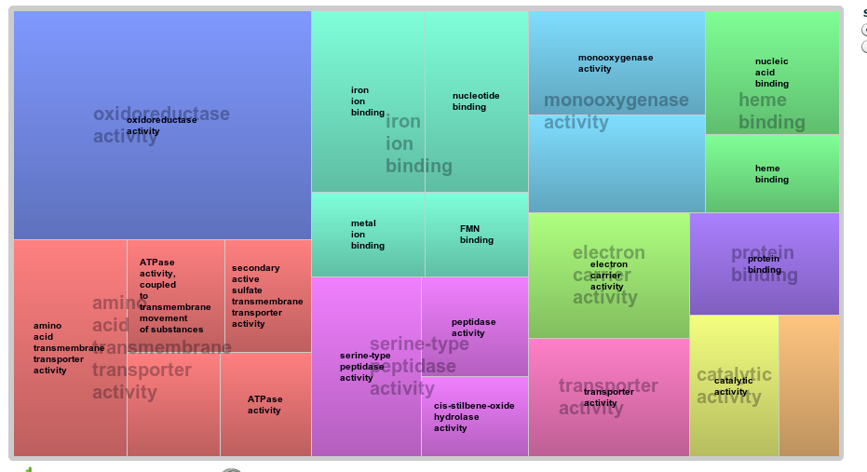
CM → -N functional analysis

Slide 48
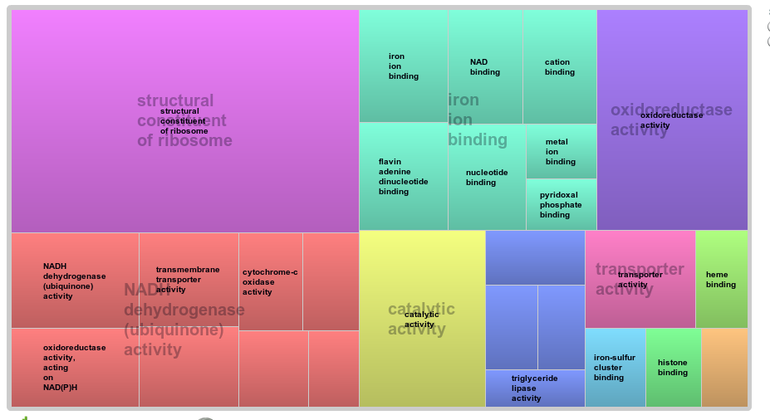
CM → -C functional analysis

Slide 49
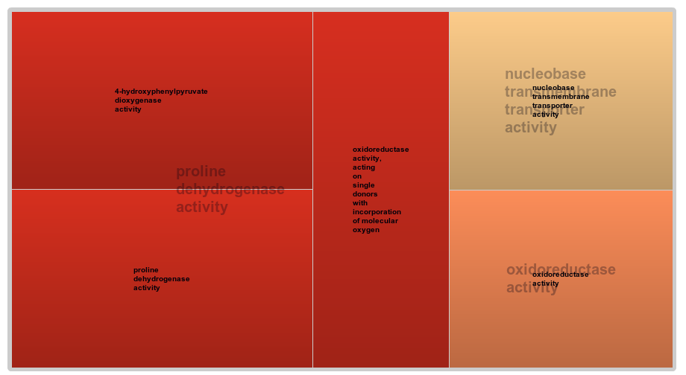
MM → -N functional analysis

Slide 50
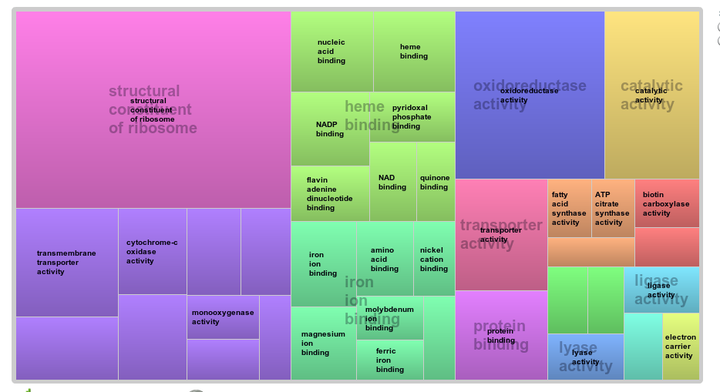
MM → -C functional analysis

Slide 51
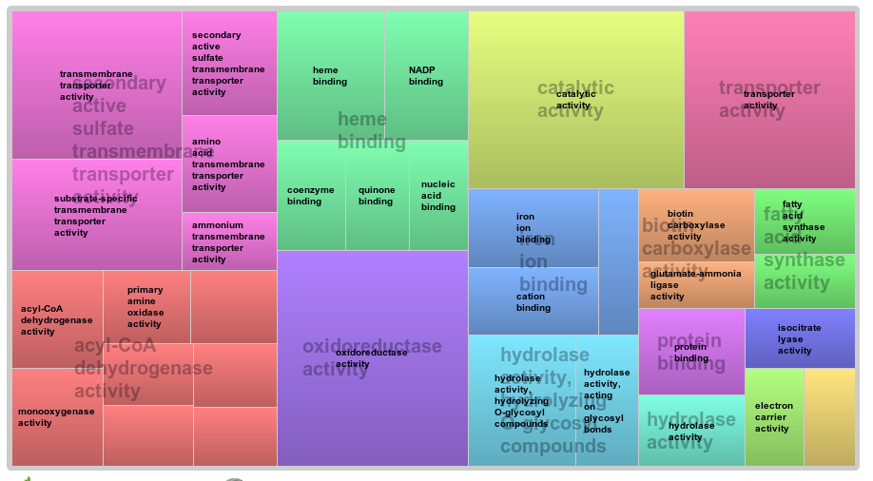
-N → -C functional analysis

