Slide 1
Evolution

Slide 2
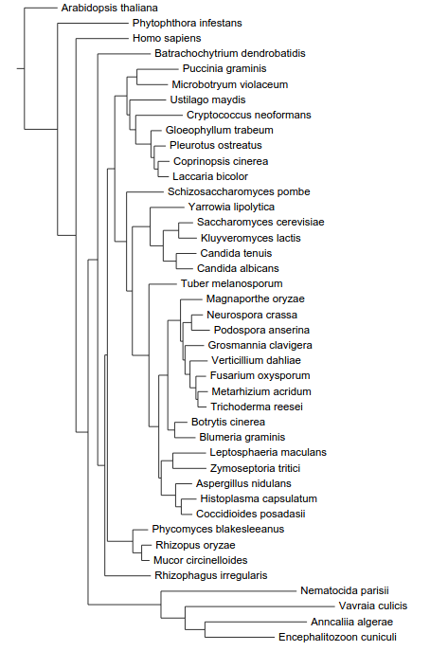
The phylogeny of fungi
Actin
Diphthine synthase
Glutamine tRNA synthetase
RNA polymerase III
Transcription factor TFIIH
DNA topoisomerase III
Exportin 1
Chytridiomycota
Basidiomycota
Taphrinomycotina
“Yeasts”
Ascomycota
“Filamentous Ascomycota”
Mucorales
Zygomycota
Microsporidia

Slide 3
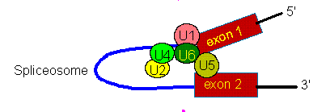
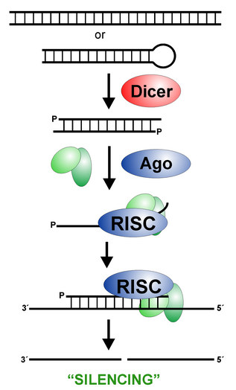
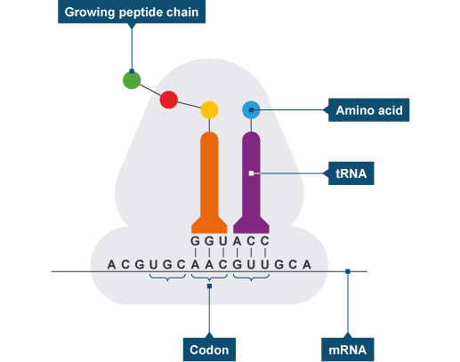
Four machineries

