Slide 1
Evolution of the spliceosome in fungi

Slide 2
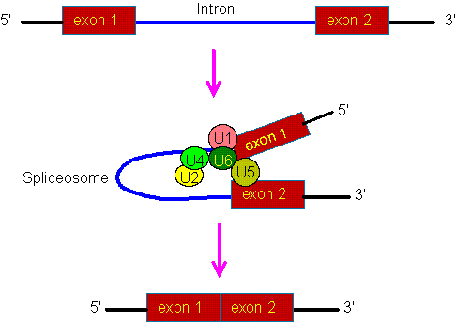

The biochemistry of splicing

Slide 3
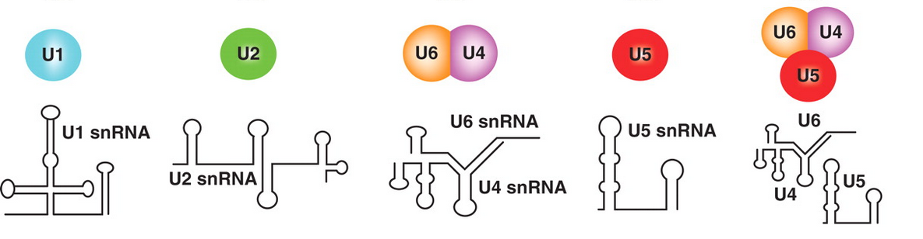
Five small nuclear ribonucleic proteins are involved in splicing

Slide 4
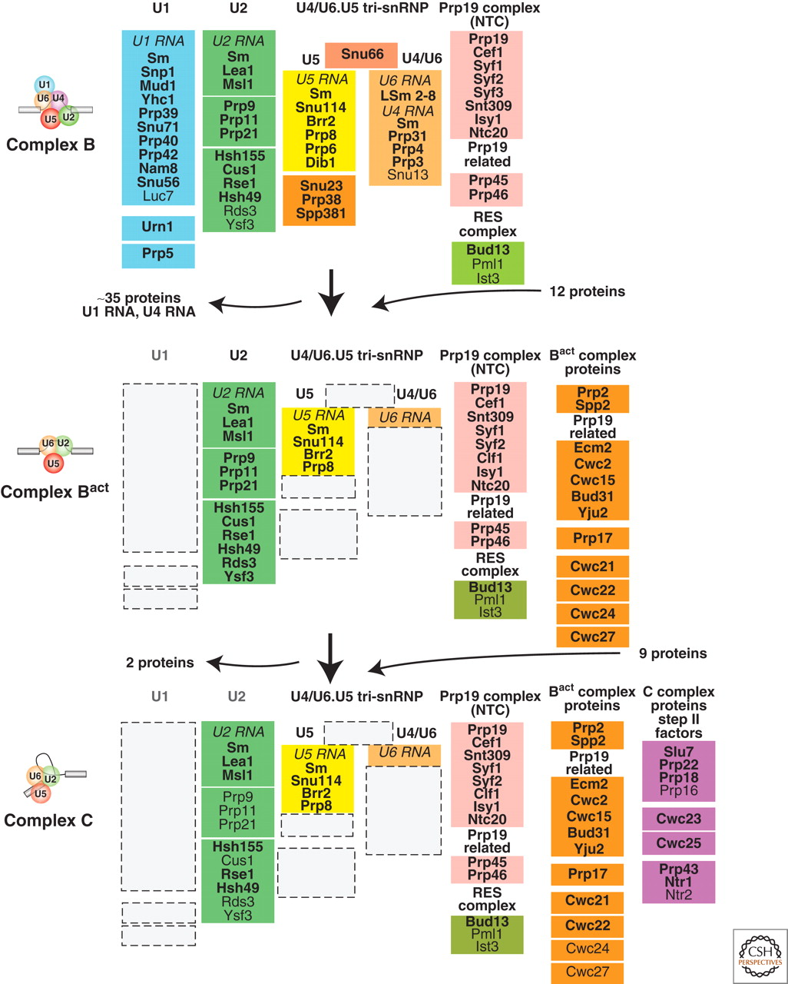
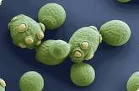
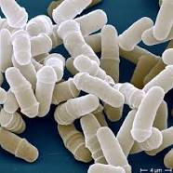
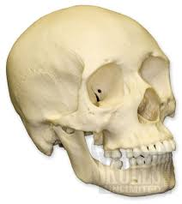
S. cerevisiae
S. pombe
H. sapiens

Slide 6
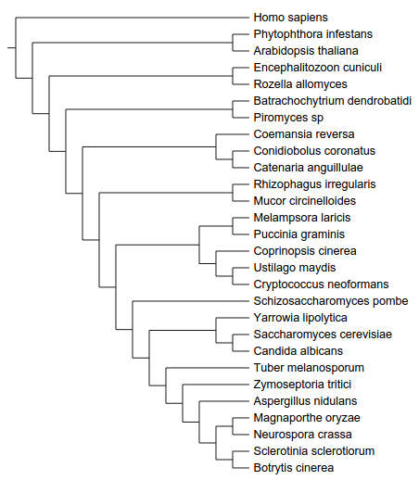
The phylogeny of fungi
Microsporidia
Cryptomycota
Chytridiomycota
Neocallimastigomycota
Zygomycota
Basidiomycota
Ascomycota
Saccharomycotina
Pezizomycotina
Based on five proteins: Actin, GAPDH, HSP70, RBP1 and TEF1

Slide 7
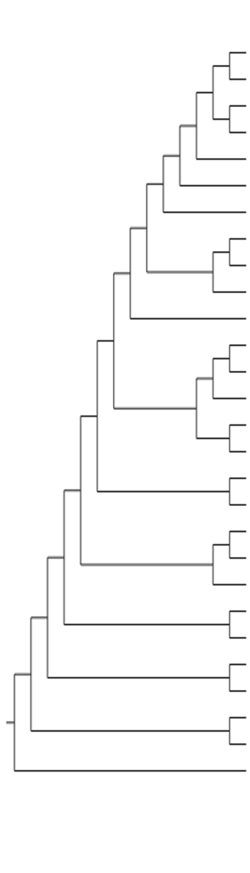
Proteins identified
64 Homo_sapiens
60 Phytophthora_infestans
63 Arabidopsis_thaliana
22 Encephalitozoon_cuniculi
65 Batrachochytrium_dendrobatidi
45 Piromyces_sp
62 Coemansia_reversa
59 Conidiobolus_coronatus
60 Catenaria_anguillulae
66 Rhizophagus_irregularis
66 Mucor_circinelloides
63 Melampsora_laricis
58 Puccinia_graminis
66 Coprinopsis_cinerea
62 Ustilago_maydis
63 Cryptococcus_neoformans
64 Schizosaccharomyces_pombe
64 Yarrowia_lipolytica
57 Saccharomyces_cerevisiae
58 Candida_albicans
63 Tuber_melanosporum
67 Zymoseptoria_tritici
67 Aspergillus_nidulans
67 Magnaporthe_oryzae
67 Neurospora_crassa
64 Sclerotinia_sclerotiorum
66 Botrytis_cinerea

Slide 8
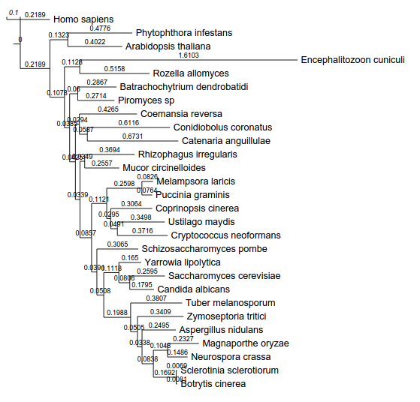
In E. cuniculi and the saccharomycotina the spliceosome evolved faster
Based on five proteins: Actin, GAPDH, HSP70, RBP1 and TEF1

Slide 9
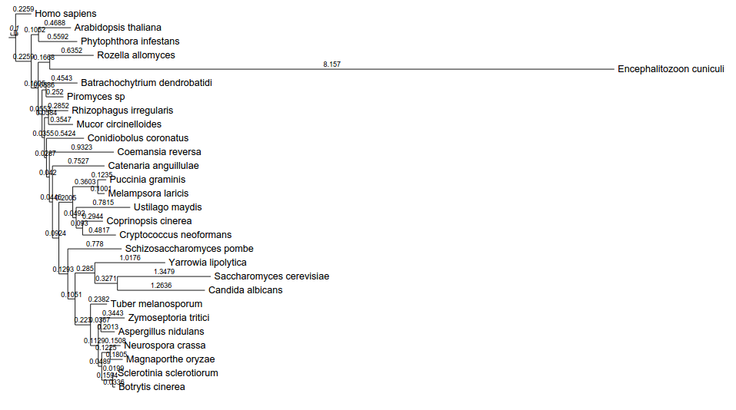
In E. cuniculi and the saccharomycotina the spliceosome evolved faster
Based on seven proteins: HSH155, CUS1, PRP9, PRP8, LSM7, CEF1, BUD31

Slide 10
In E. cuniculi and the saccharomycotina the spliceosome evolved faster than the rest of the genome

Slide 11
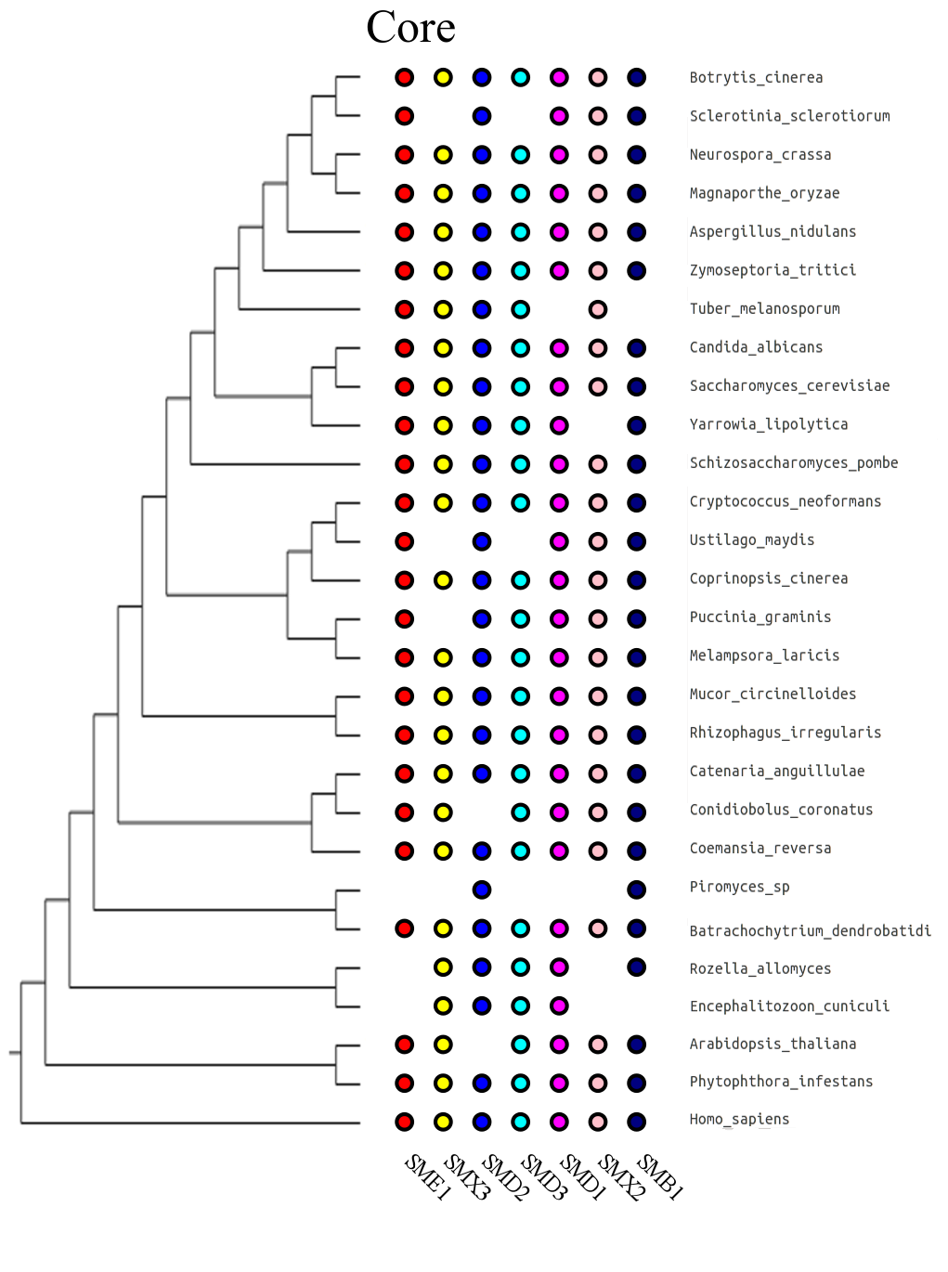
Proteins orthologs

Slide 12
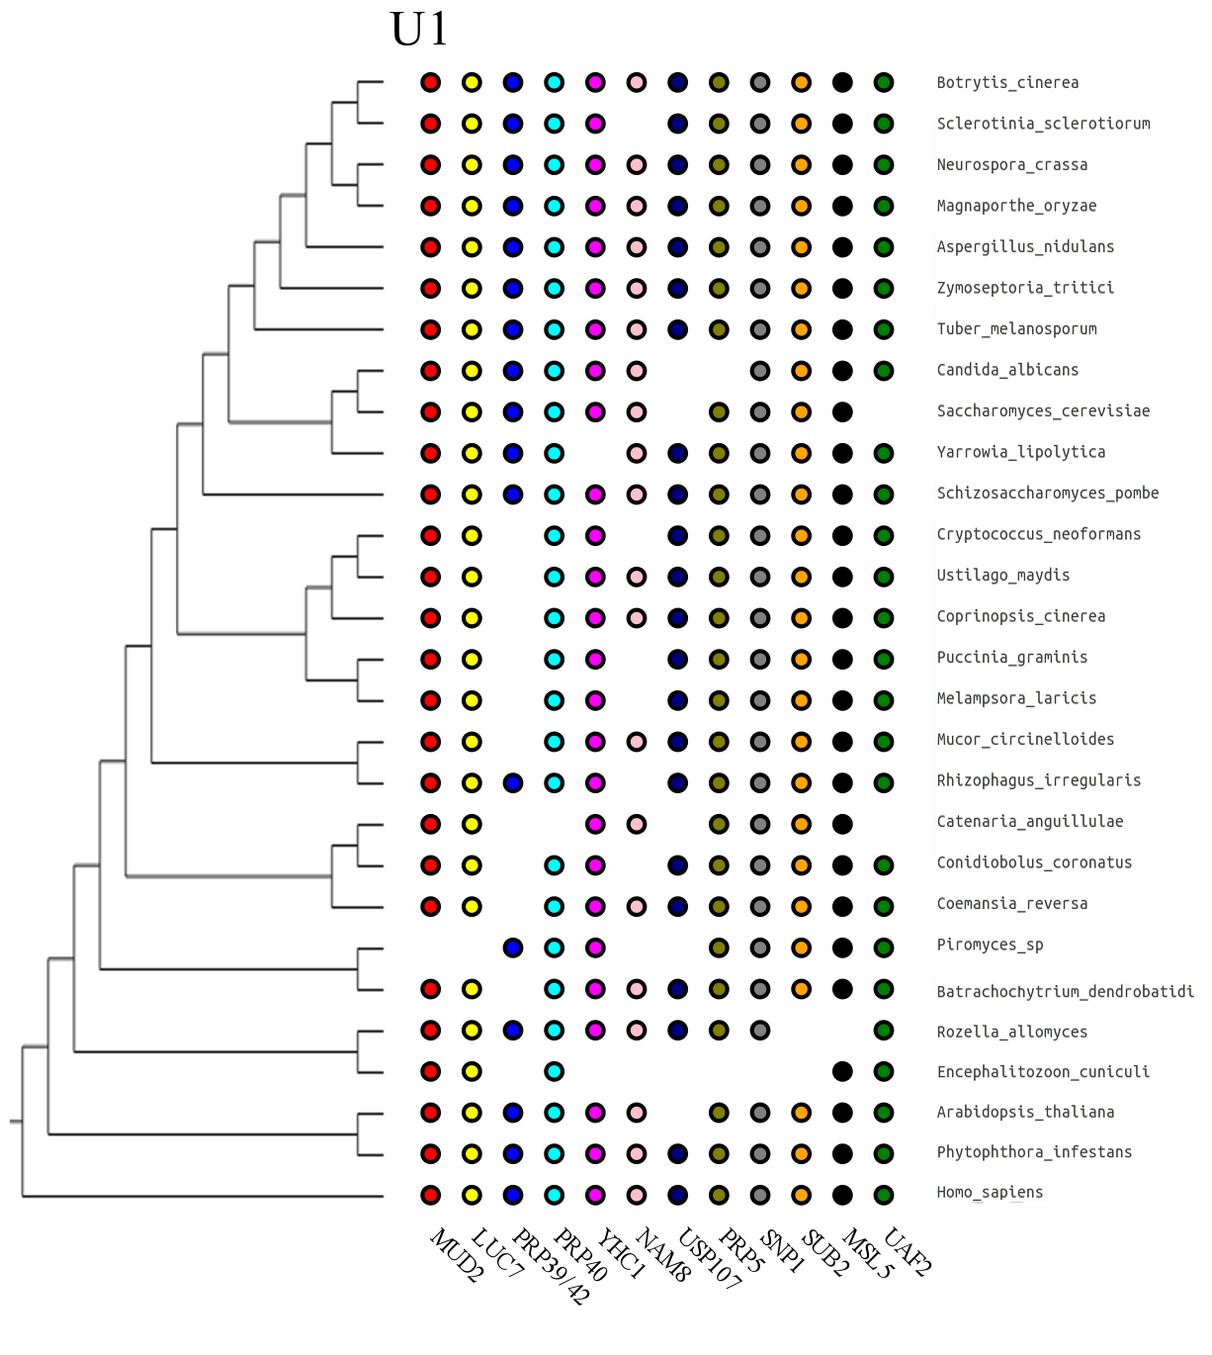
Proteins orthologs

Slide 13
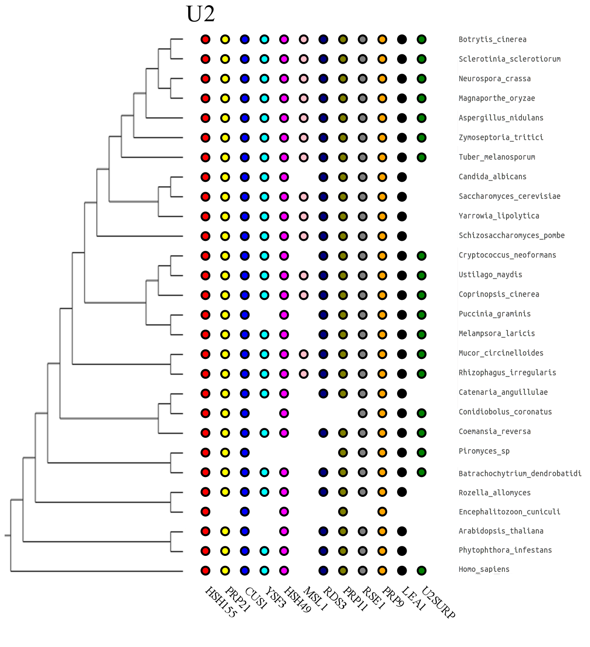
Proteins orthologs

Slide 14
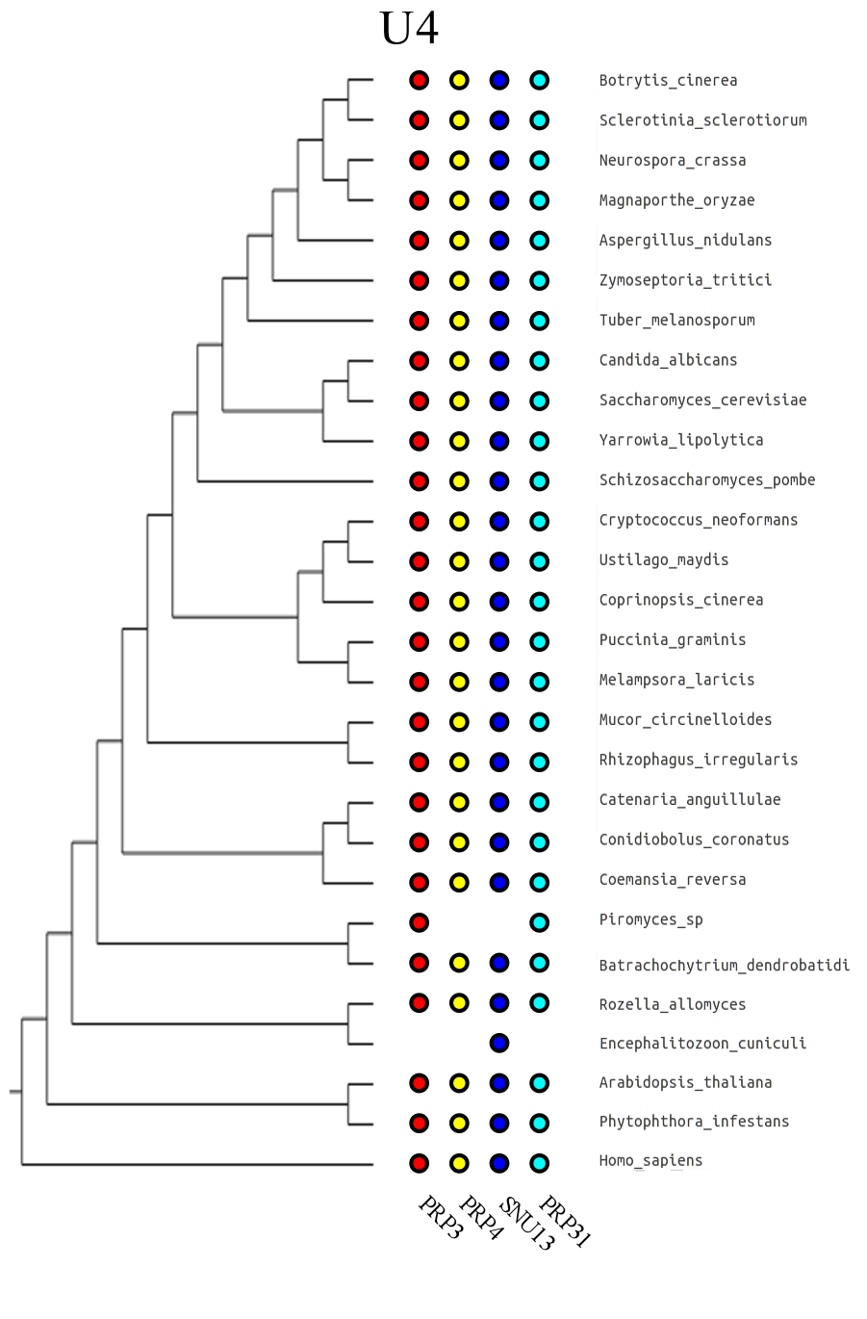
Proteins orthologs

Slide 15
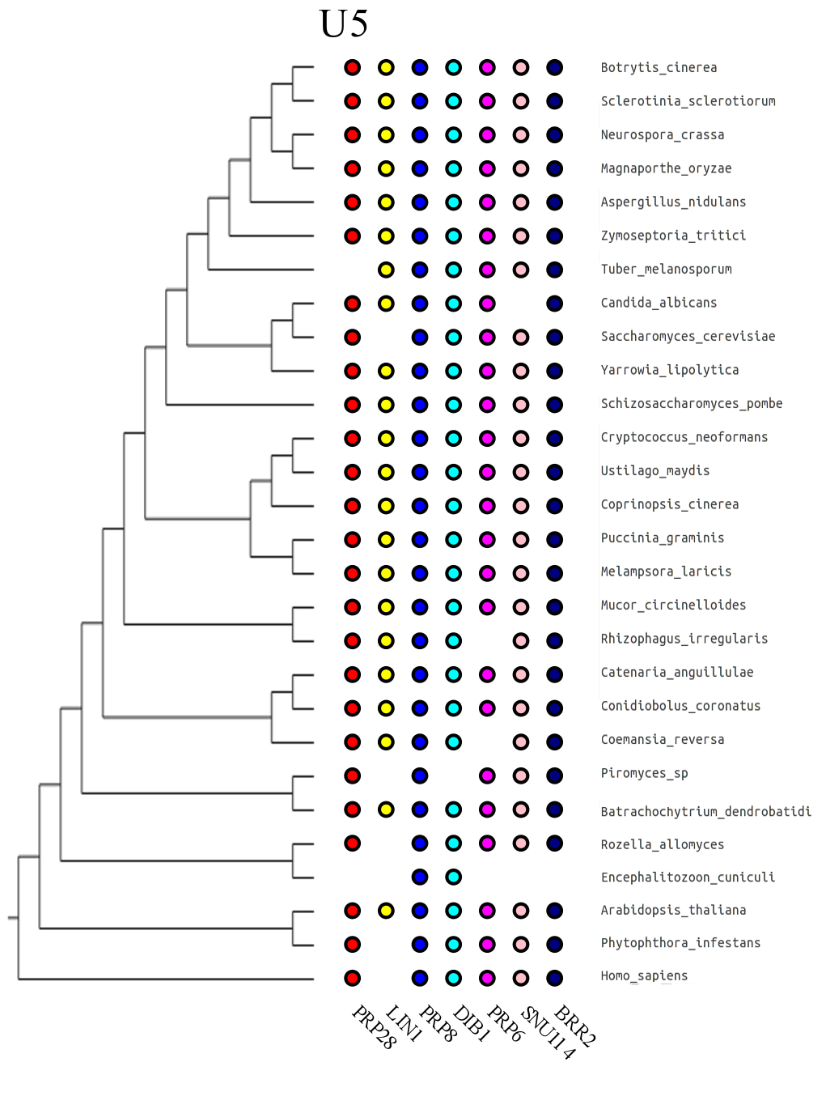
Proteins orthologs

Slide 16
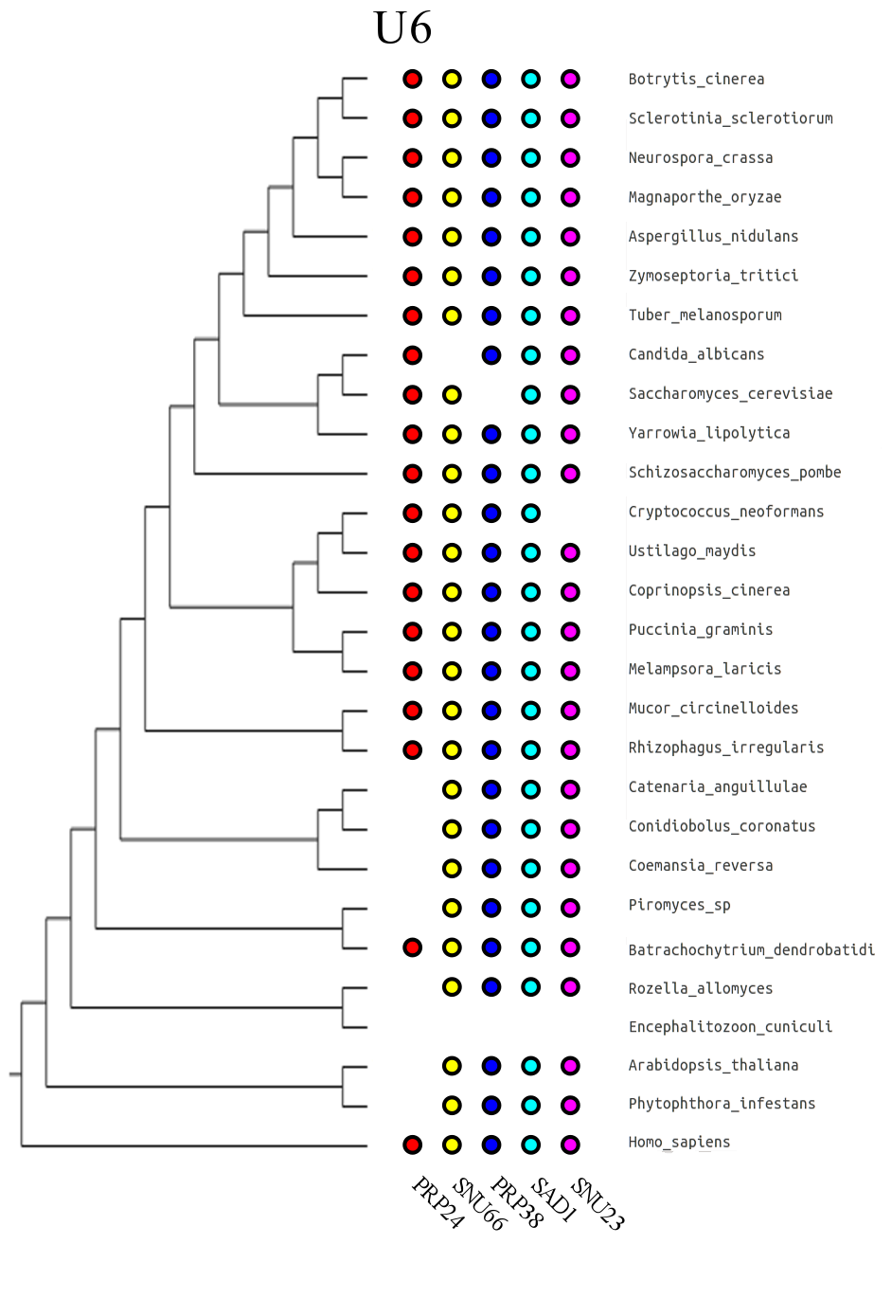
Proteins orthologs

Slide 17
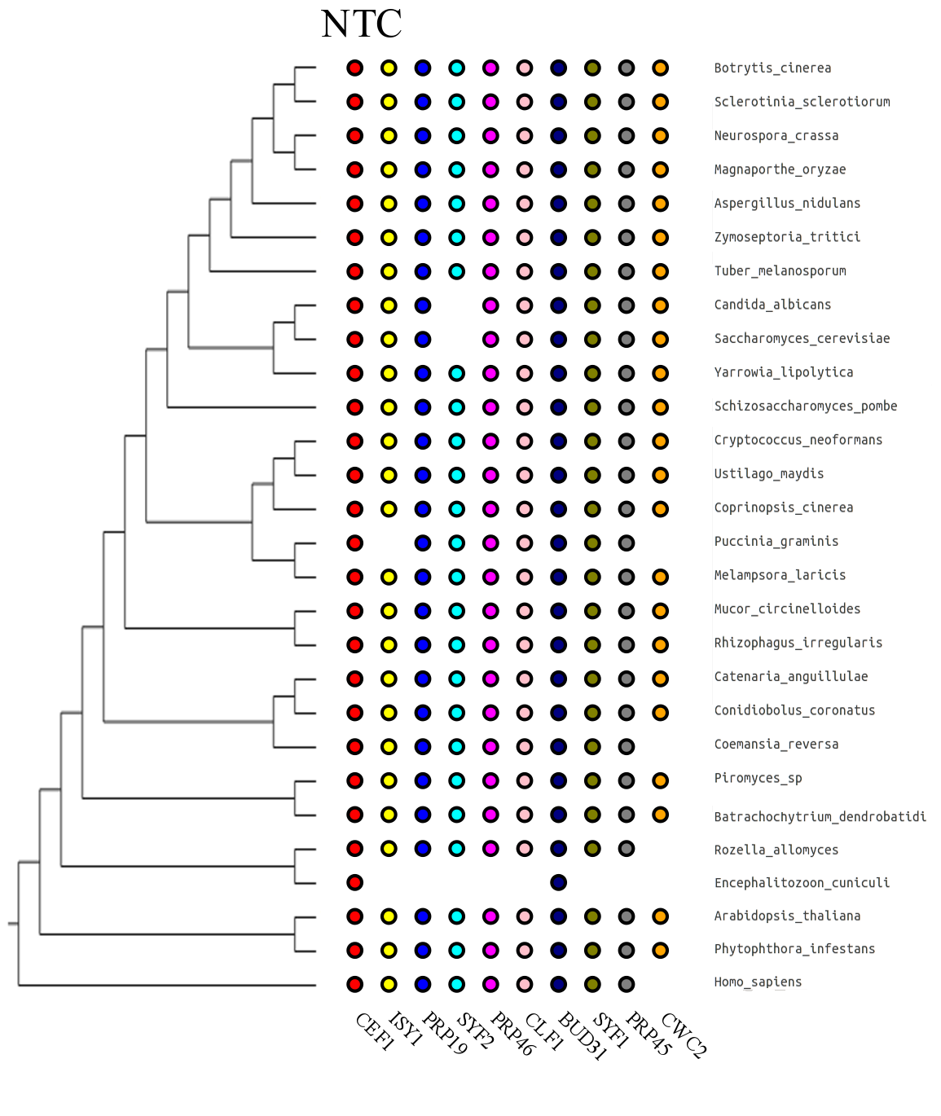
Proteins orthologs

Slide 18
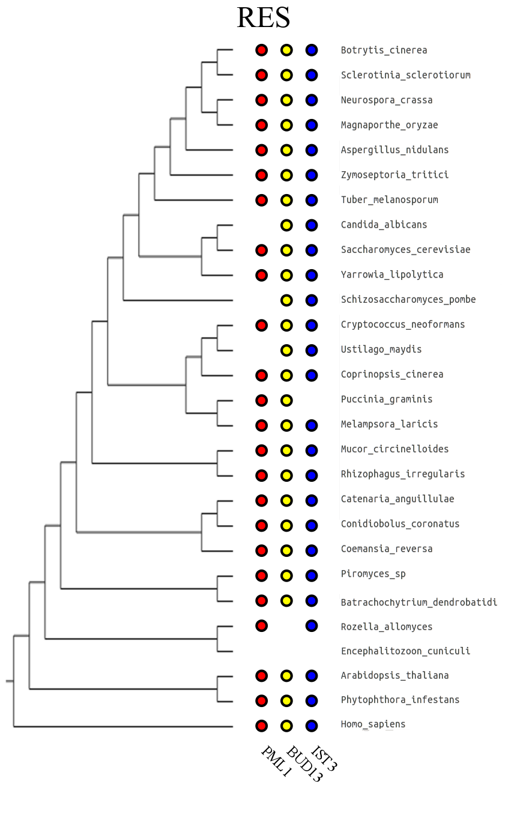
Proteins orthologs

Slide 19
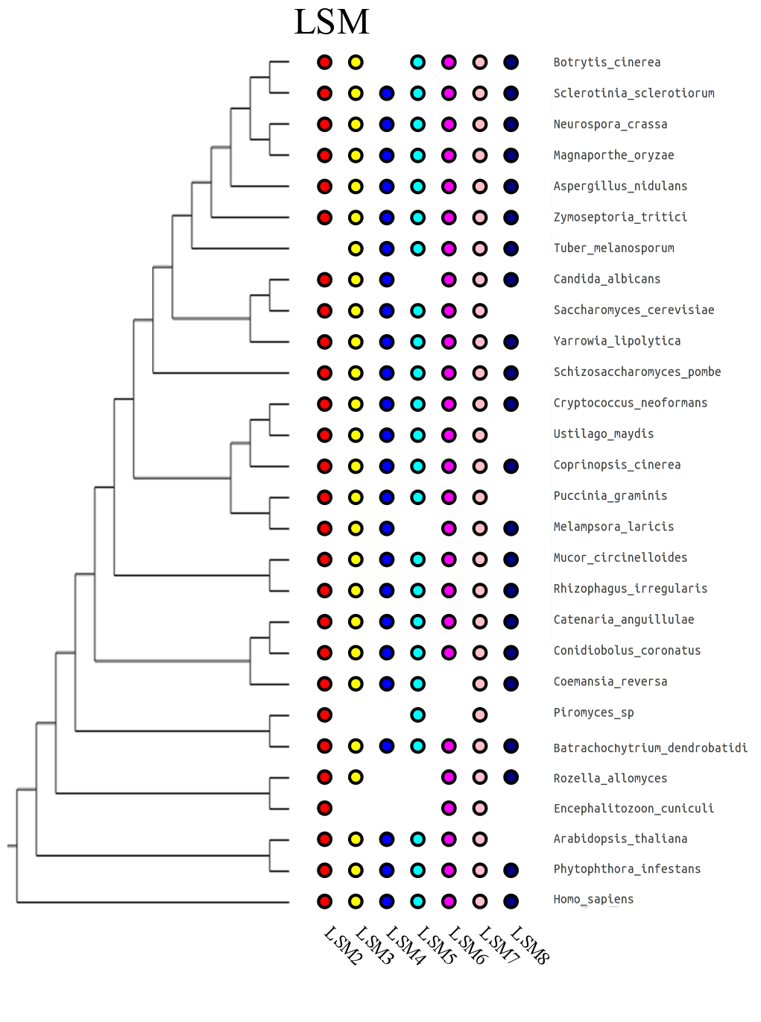
Proteins orthologs

Slide 20
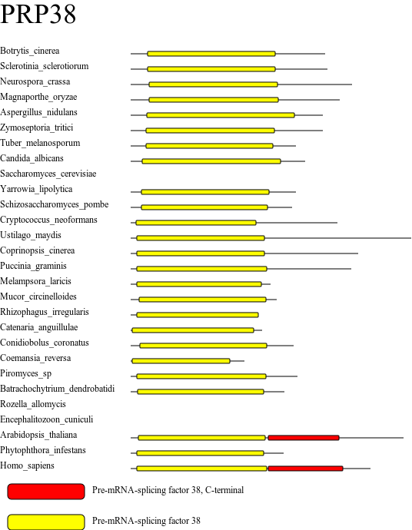
Domain organization

Slide 21
The number of genes containing introns strongly reduced in E. cuniculi and yeasts

Slide 22
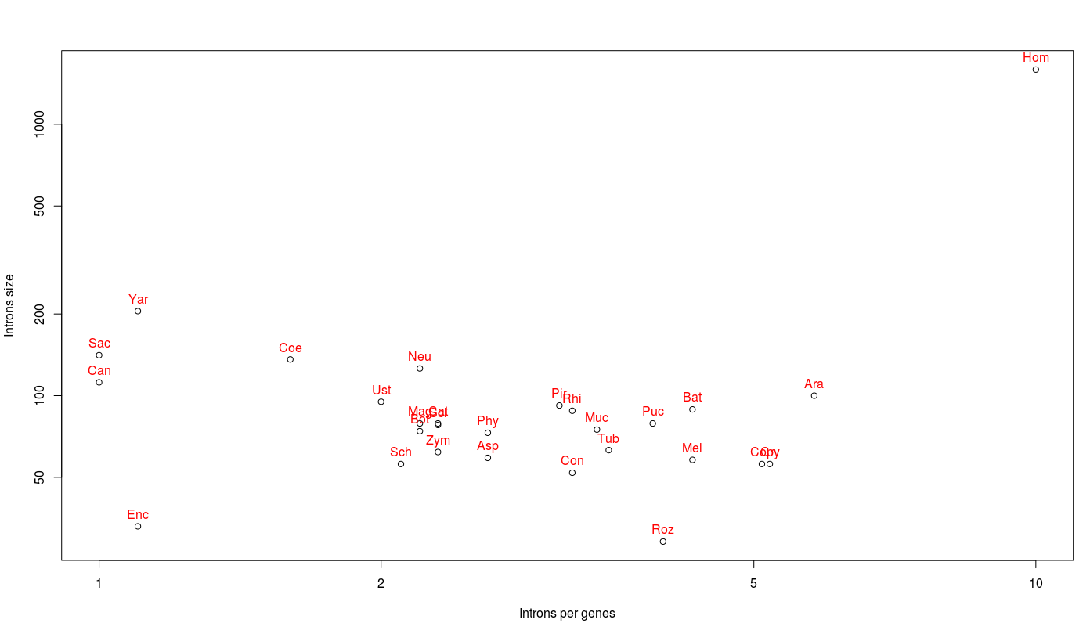
Saccharomycotina have few, large introns

Slide 23
In fungi, introns usually represent less than 30% of genes length

Slide 24
Introns length distribution can vary among species

Slide 25
Spliceosome binding points
Donor site
Acceptor site
Branch site
PPT trait

Slide 26
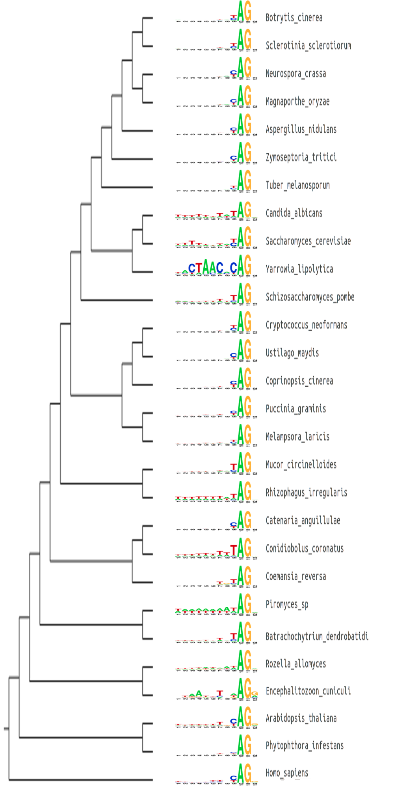
In many fungi, the TAG acceptor is preferred over CAG

Slide 27
In many fungi, the TAG acceptor is preferred over CAG

Slide 28
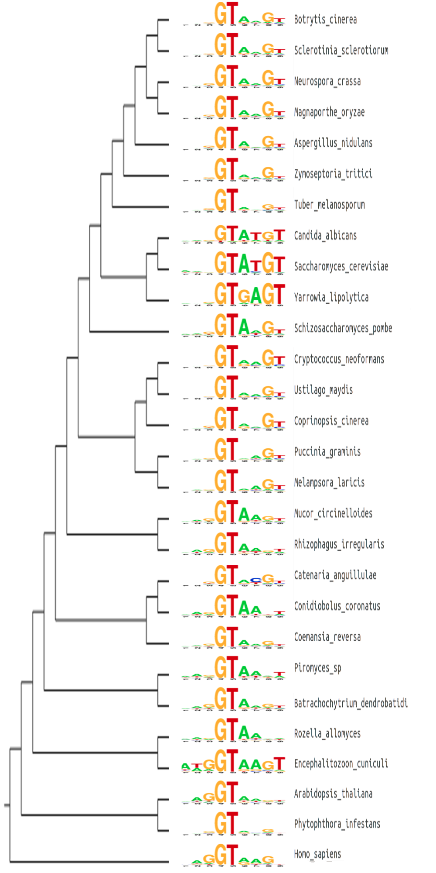
The donor site show high uniformity in Saccharomycotina

Slide 29
C. albicans presents alternatives to the canonical GT donor

Slide 30
The donor site show high uniformity in Saccharomycotina

Slide 31
The donor site show high uniformity in Saccharomycotina

Slide 32
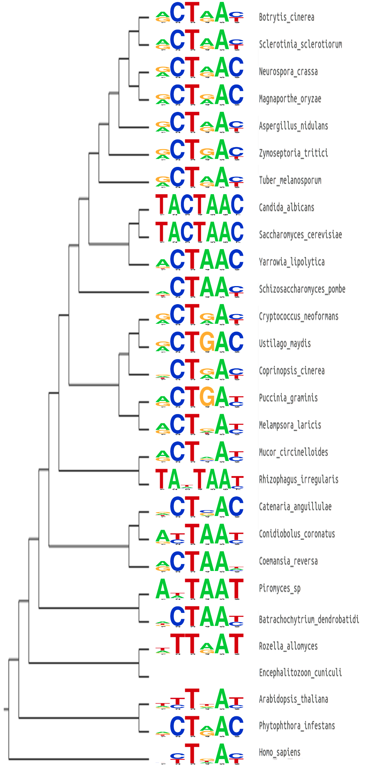
The branch site is very conserved in fungi, except Saccharomycotina, and other subdivision

Slide 33
S. cerevisiae and C. albicans have the most uniform branches site, among their introns

Slide 34
Branch site location is conserved....

Slide 35
...except for Y. lipolytica

Slide 36
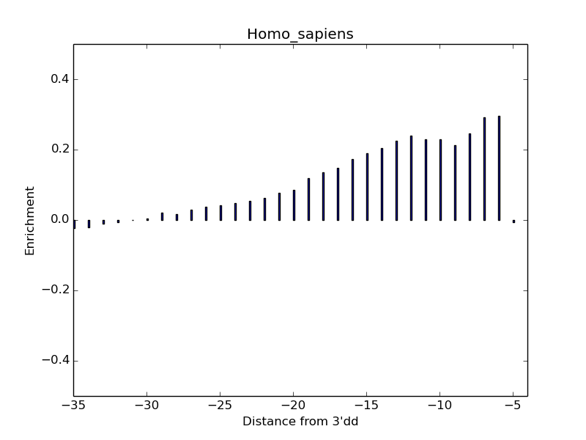
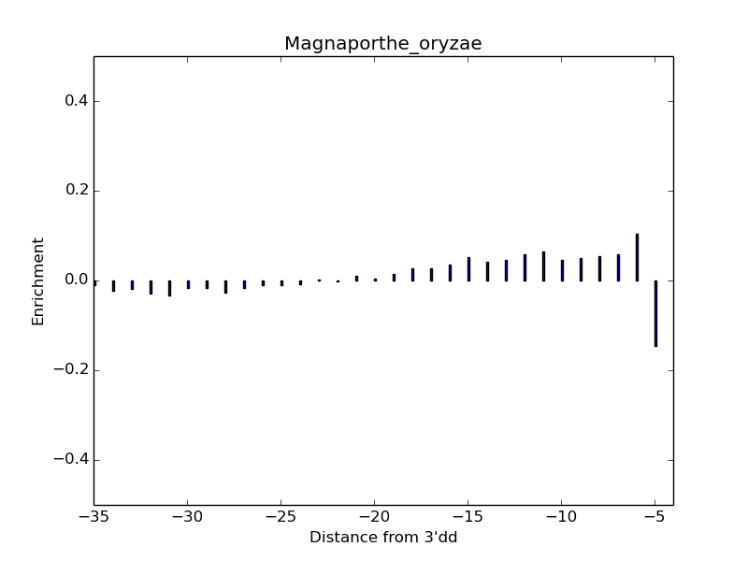
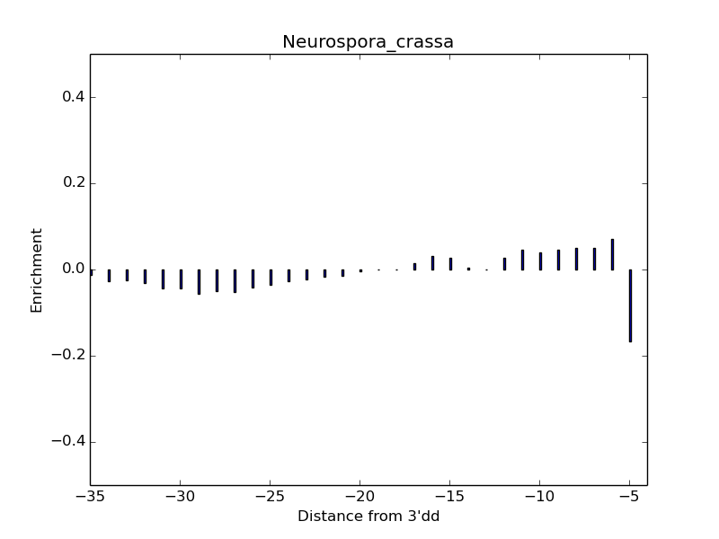
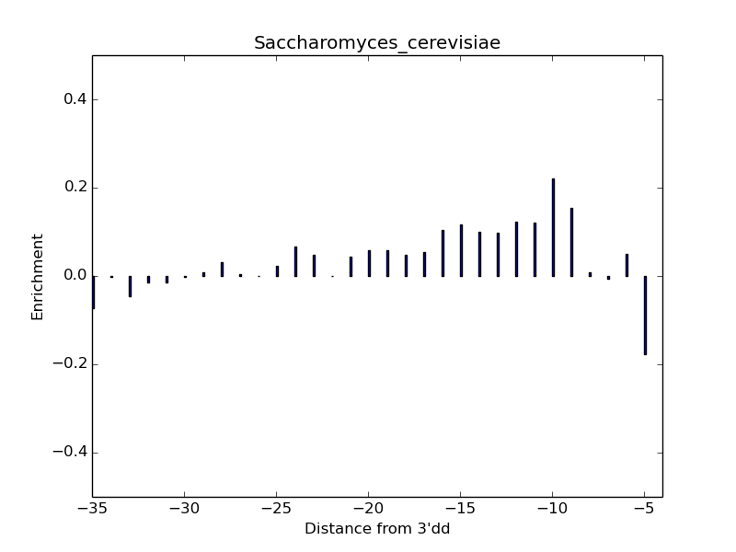
The PPT trait is not always visible

Slide 37
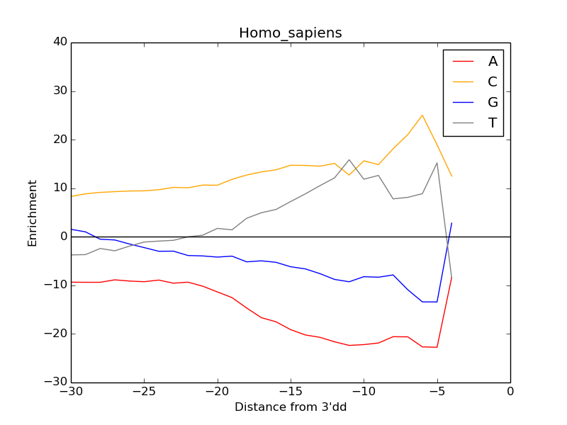
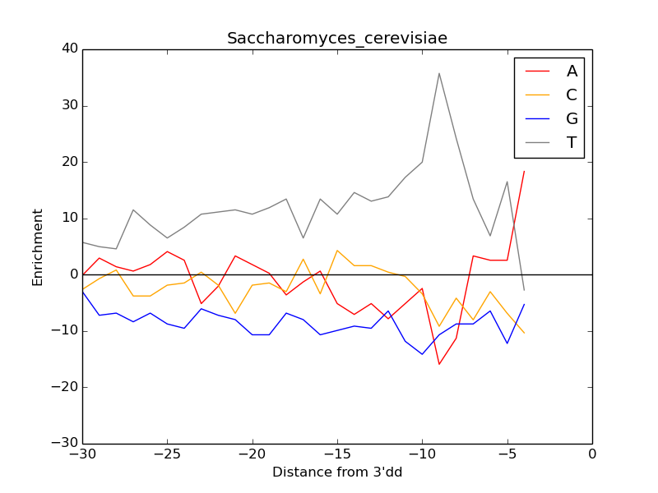
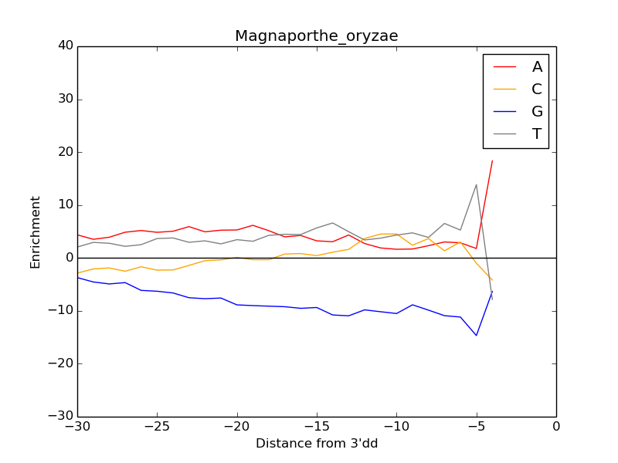
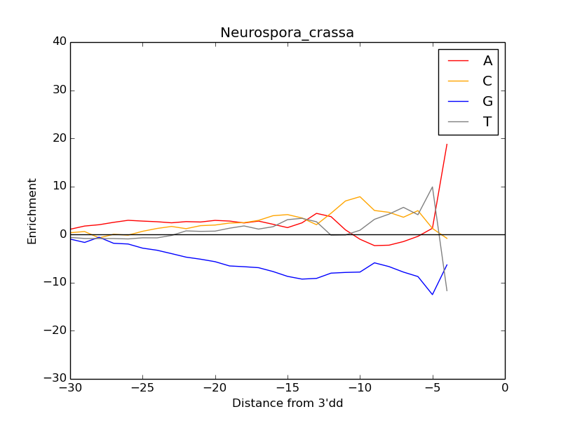
The PPT trait is not always visible

Slide 38
The PPT trait is not always visible

Slide 39
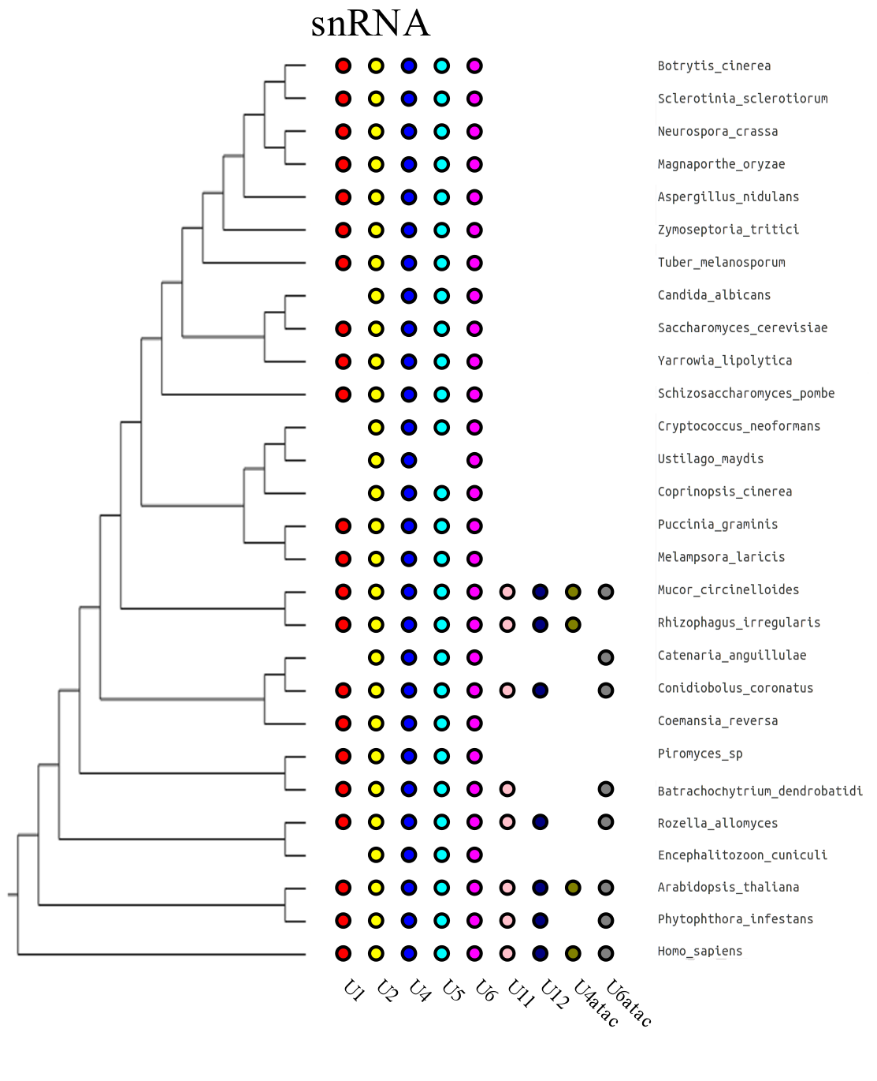
Evidence for minor spliceosome in fungi?

Slide 40
Evidence for minor spliceosome in fungi?

Slide 41
Alternative splicing in fungi in variable

Slide 42
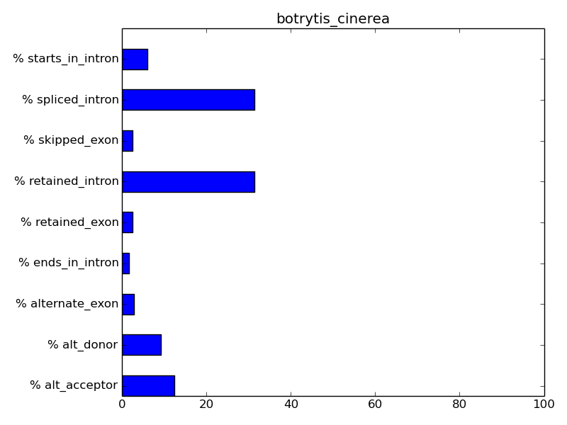
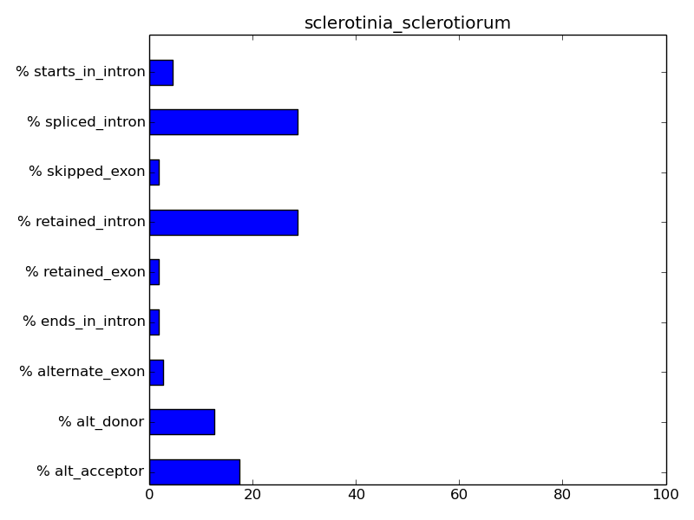
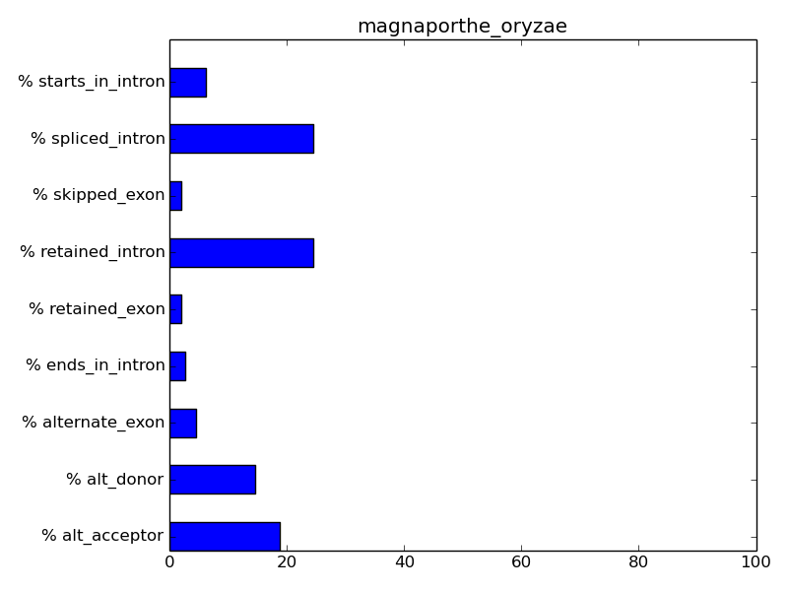
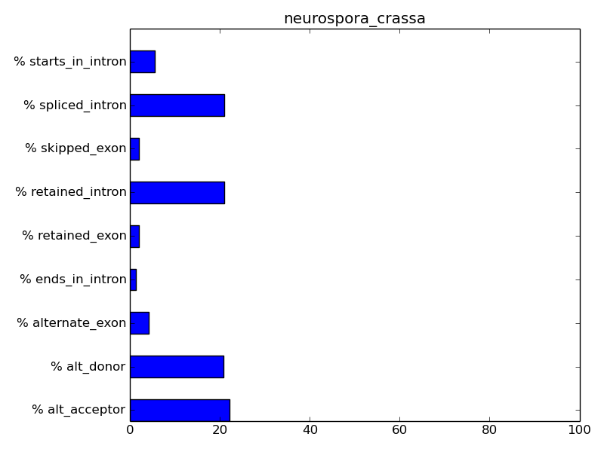
Alternative splicing types in fungi are conserved

Slide 43
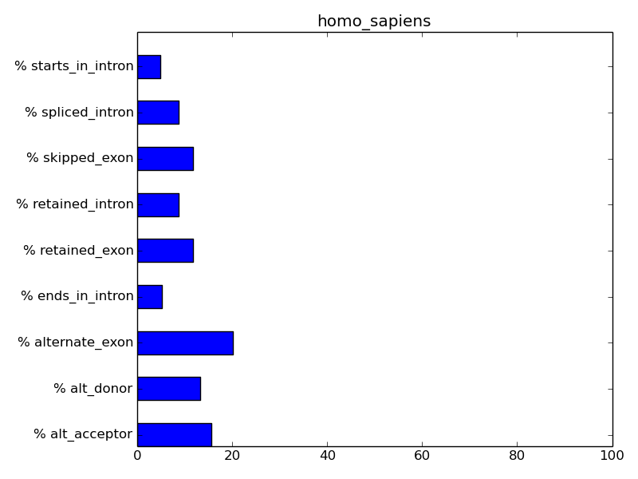
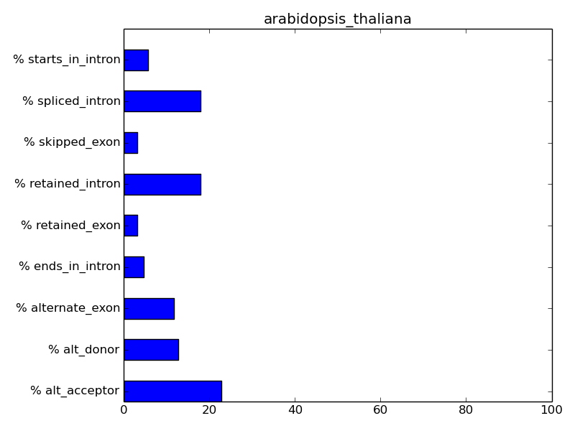
Alternative splicing types in fungi differ from metazoan

Slide 44
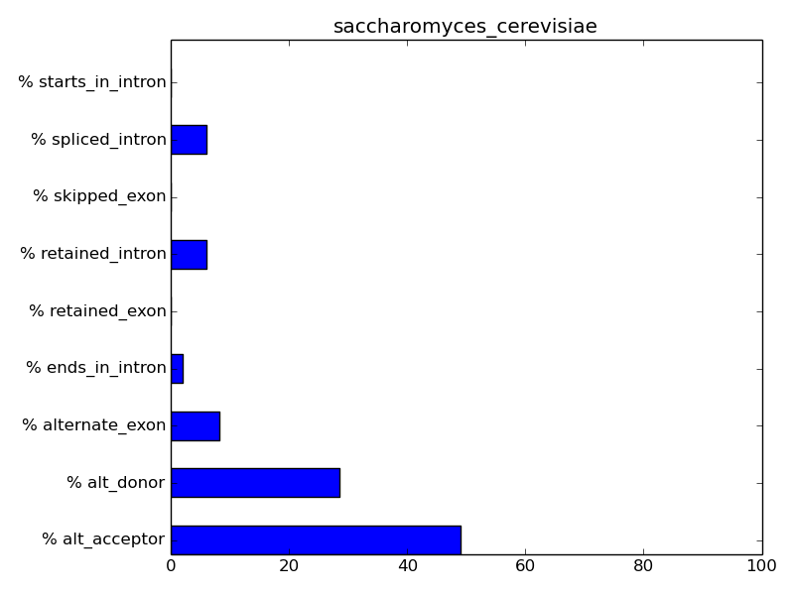
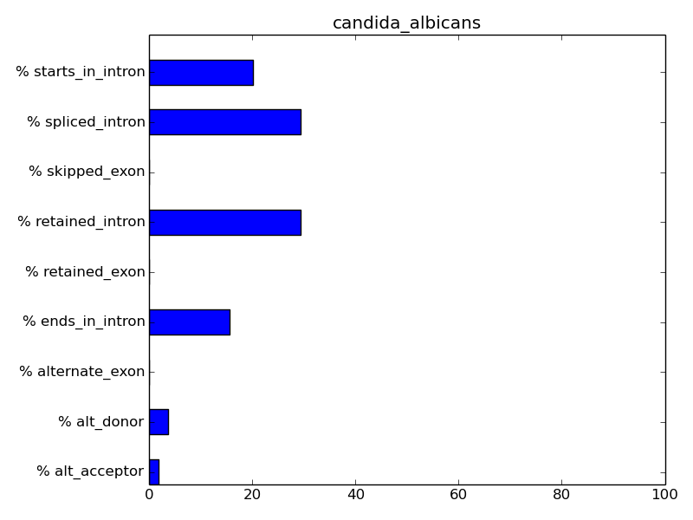
Except in saccharomycotina

Slide 45
Conclusions and future works
Saccharomyces cerevisiae is a bad model for RNA processing
Magnaporthe oryzae is not special in any way
Focus on some interesting points and expand over that species level

