Slide 1



Bioinformatics analysis of the protein architecture and evolution of the fungal 3'end mRNA processing machinery
Alejandro Rodríguez Iglesias & Marco Marconi
Lab meeting September ‘15

Slide 2
Machineries studied at the moment
Polyadenylation (18 proteins).
Splicing (107 proteins).
Silencing (18 proteins).
Translation (201 proteins).

Slide 3
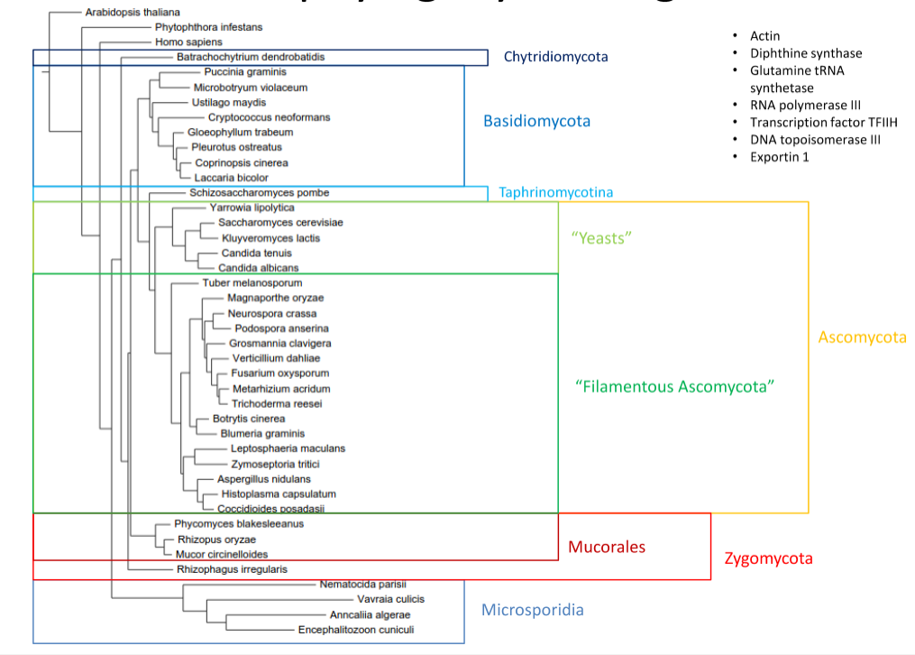
Species included in the study
Actin
Diphthine synthase
Glutamine tRNA synthetase
RNA pol III
Transcription factor TFIIH
DNA topoisomerase III
Exportin 1

Slide 4




Workflow design
Orthologues and paralogues network extraction from:
42 fungal species + 3 outgroups
FASTA sequence automatic extraction
Protein domain architecture analysis
Machinery complexes conservation
Phylogenetic studies

Slide 5
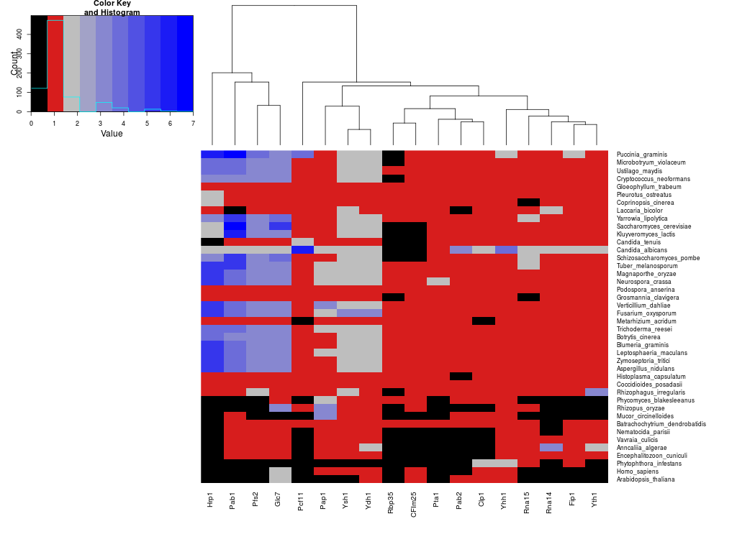
Poly(A)machinery orthologues / paralogues abundance
High number of orthologues for these proteins in Basidio and Ascomycetes
Missing in Microsporidia
Missing in Mucorales

Slide 6
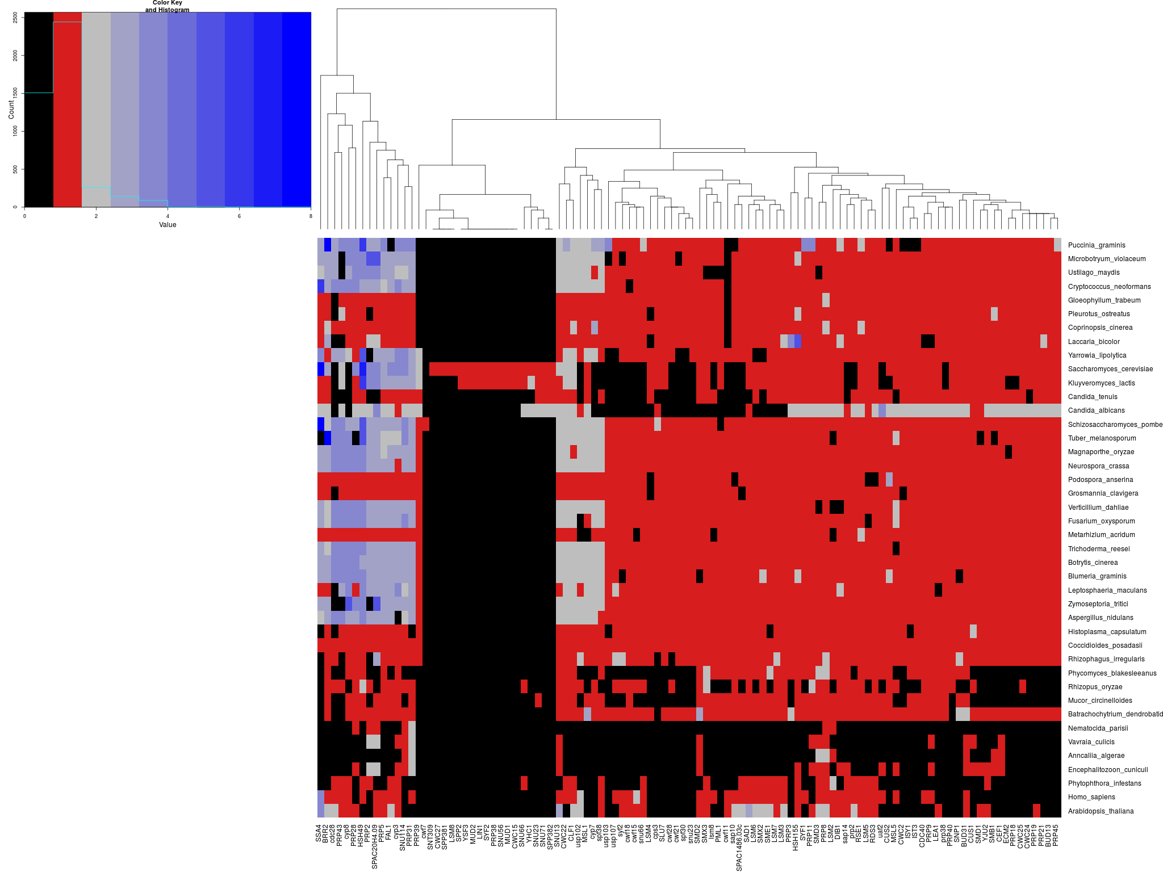
Splicing machinery orthologues / paralogues abundance
Yeasts-exclusive components

Slide 7
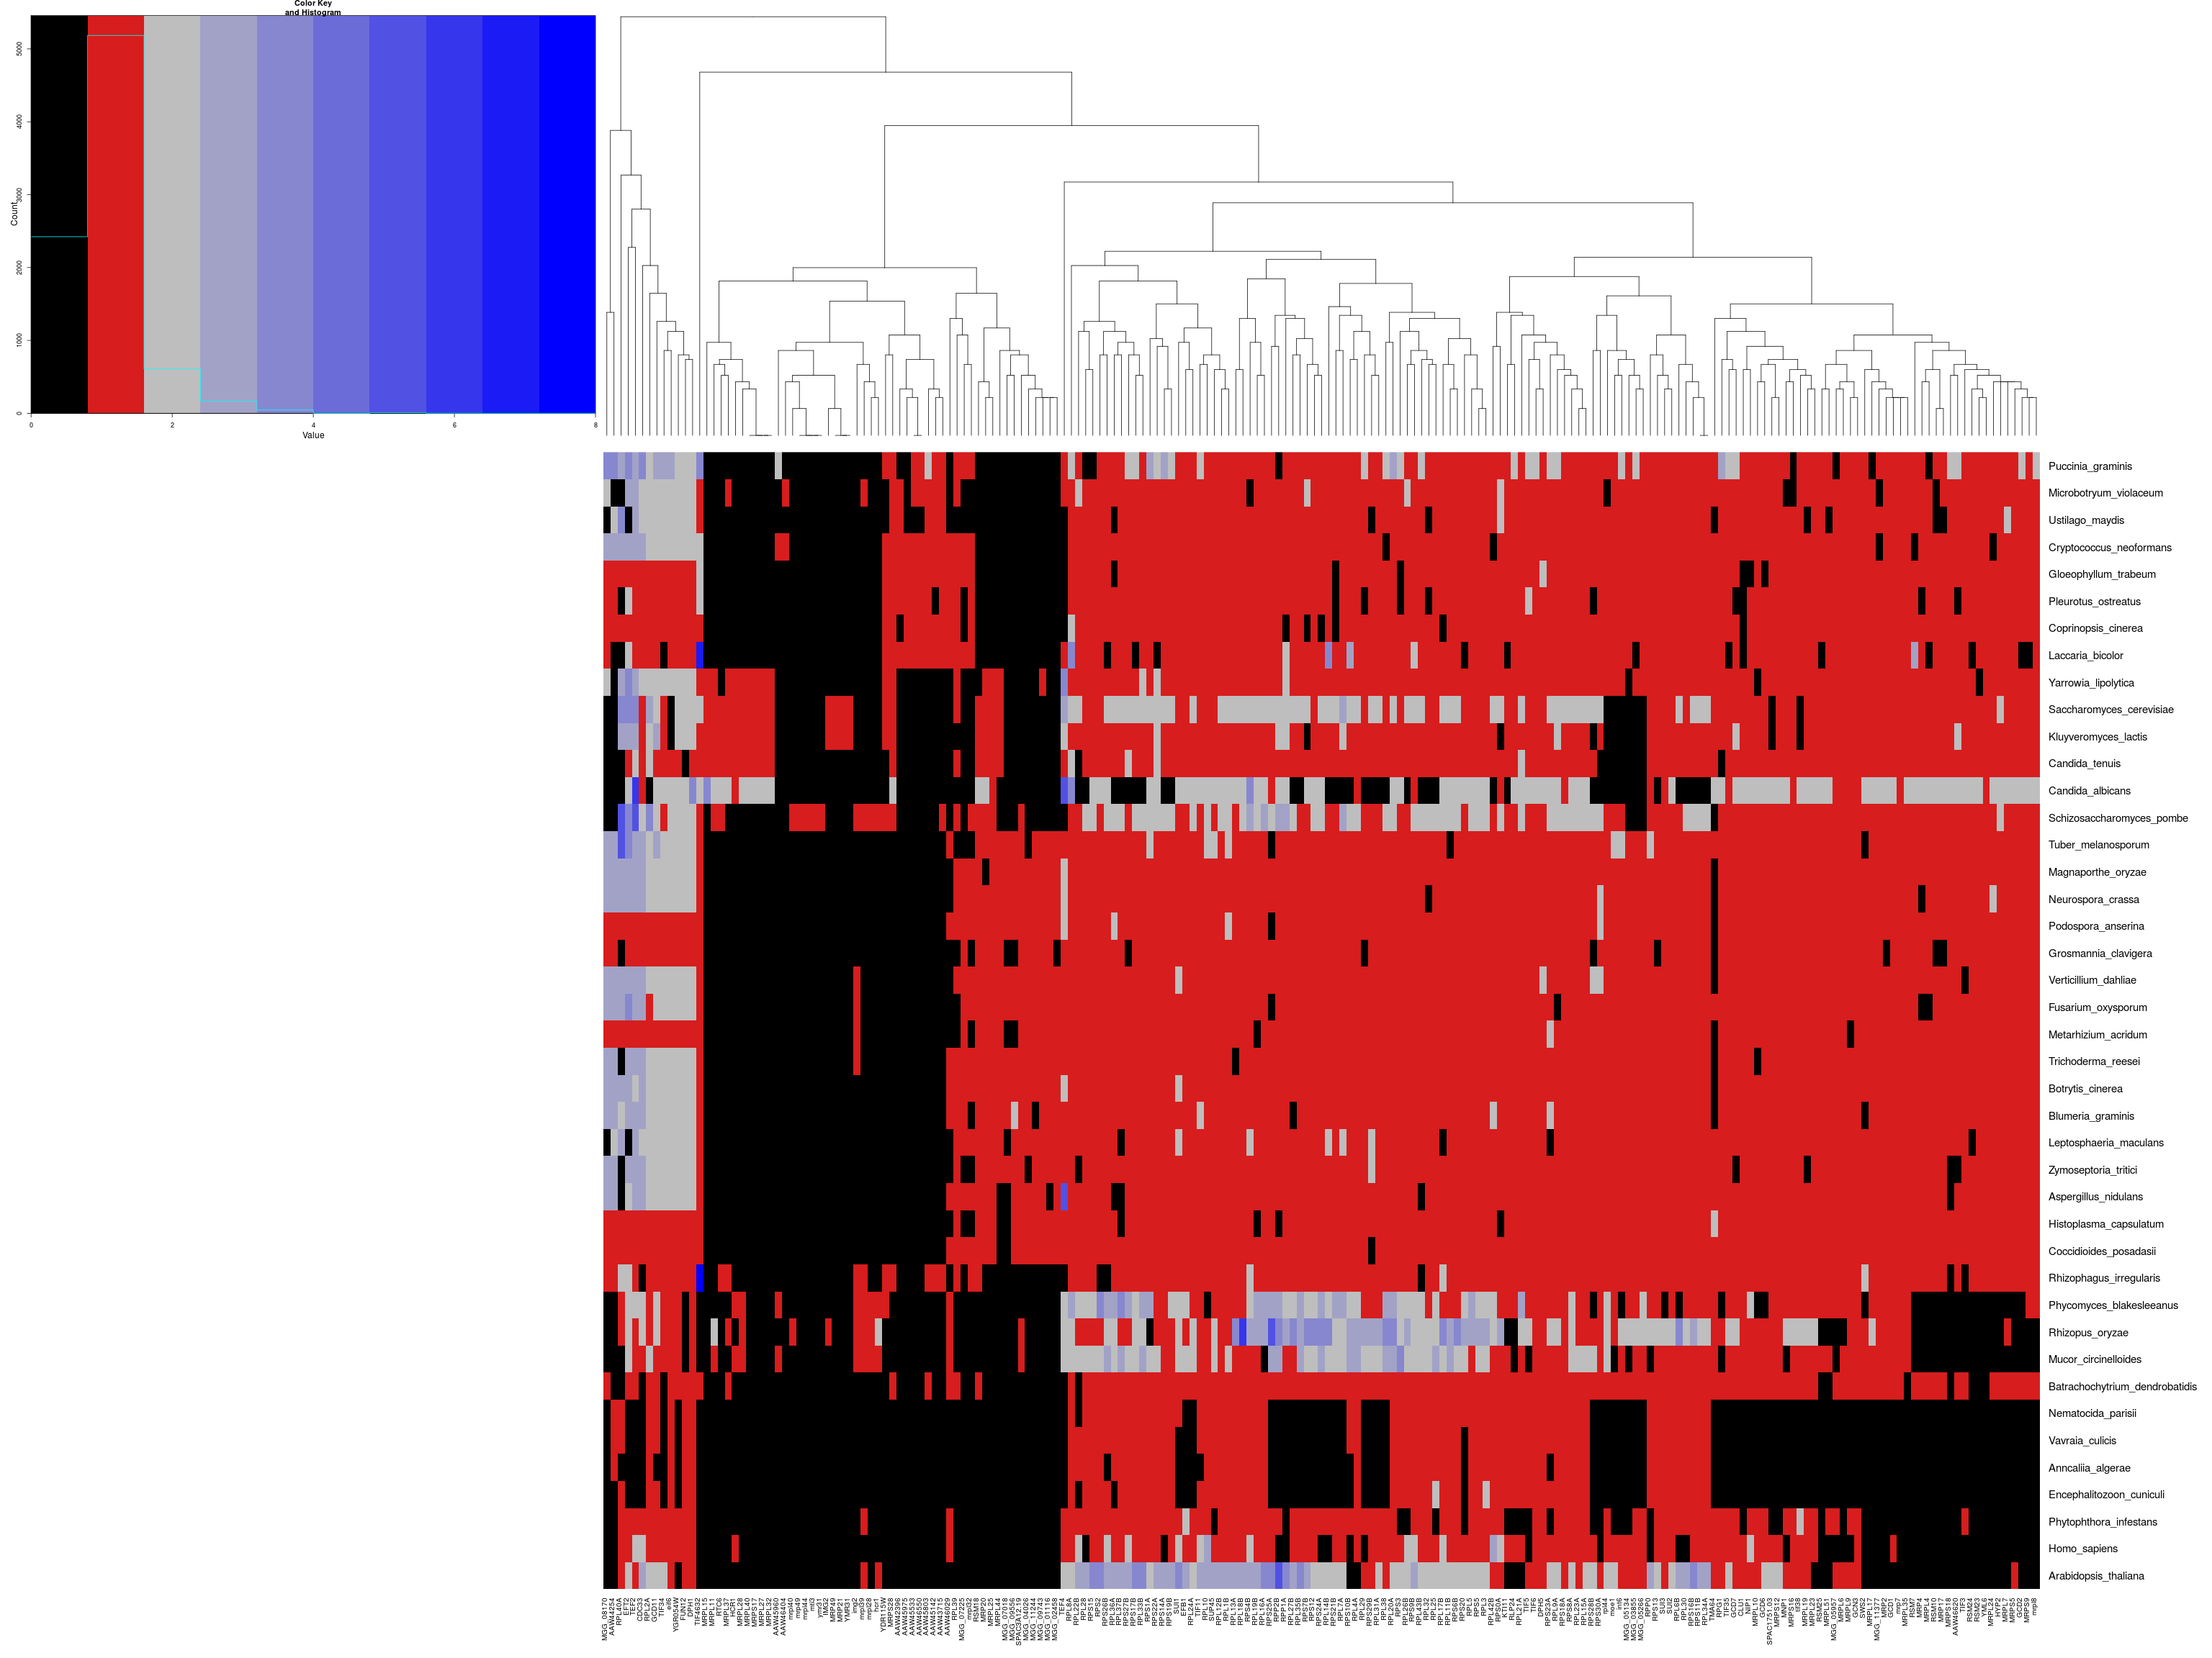
Translation machinery orthologues / paralogues abundance

Slide 8
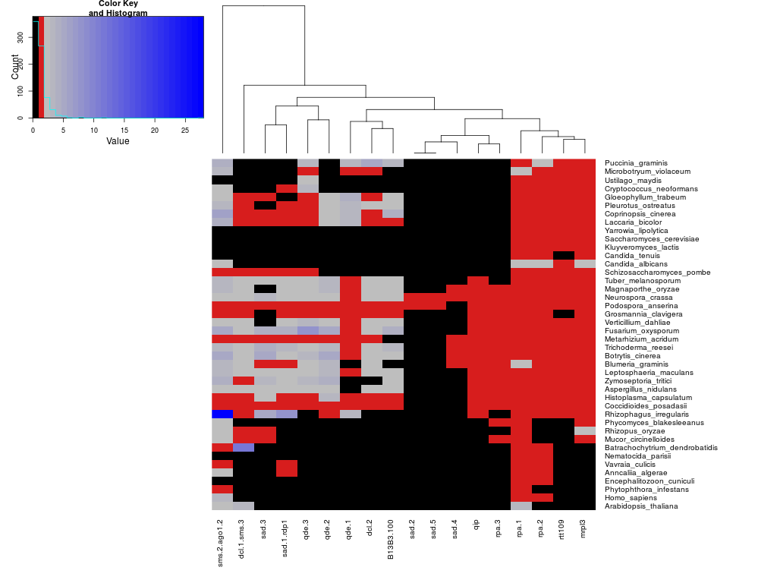
Silencing machinery orthologues / paralogues abundance
Missing in Basidiomycota
Missing in “yeasts”

Slide 9
Polyadenylation relative evolutionary rate
Chytridiomycota
Basidiomycota
Taphrinomycotina
“Yeasts”
Ascomycota
“Filamentous Ascomycota”
Mucorales
Zygomycota
Microsporidia

Slide 10
Spliceosome relative evolutionary rate
Chytridiomycota
Basidiomycota
Taphrinomycotina
“Yeasts”
Ascomycota
“Filamentous Ascomycota”
Mucorales
Zygomycota
Microsporidia

Slide 11
Translation relative evolutionary rate
Chytridiomycota
Basidiomycota
Taphrinomycotina
“Yeasts”
Ascomycota
“Filamentous Ascomycota”
Mucorales
Zygomycota
Microsporidia

Slide 12
Apart from this…
All the trees for every protein/machinery/species are computed.
All the protein domain comparison for every protein/machinery/species are computed.

Slide 13
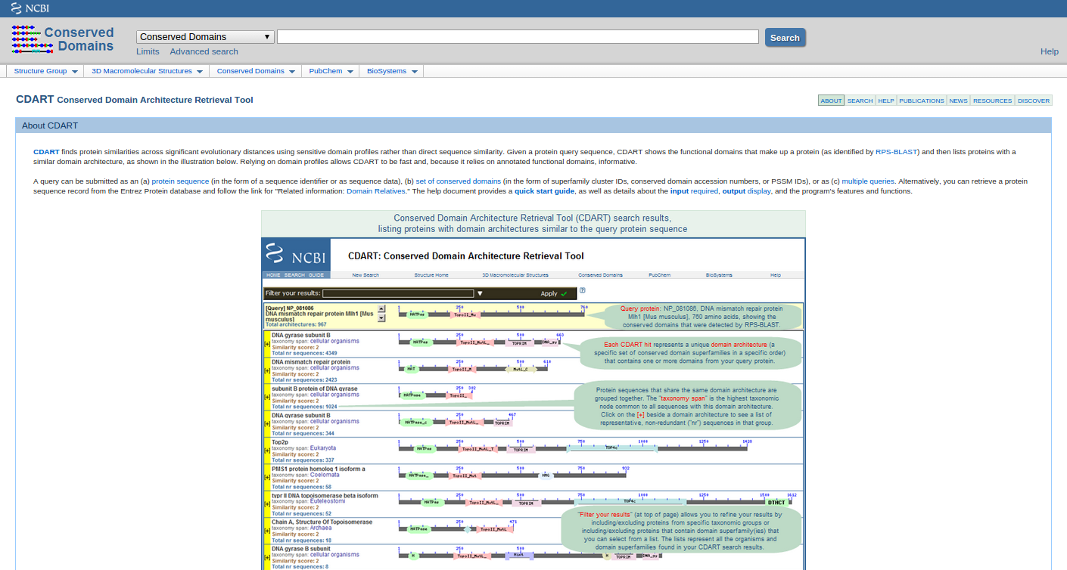
Take a look at CIDART

Slide 14
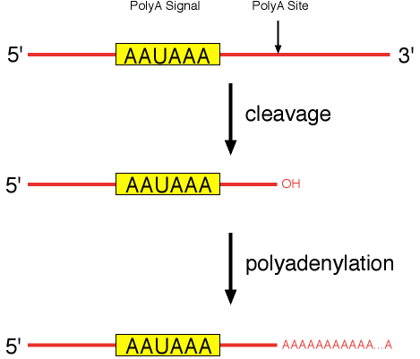
Polyadenylation

Slide 15
Cutsite is variable

Slide 16
Canonical AAUAAA is frequent in basal fungi and microsporidia

Slide 17
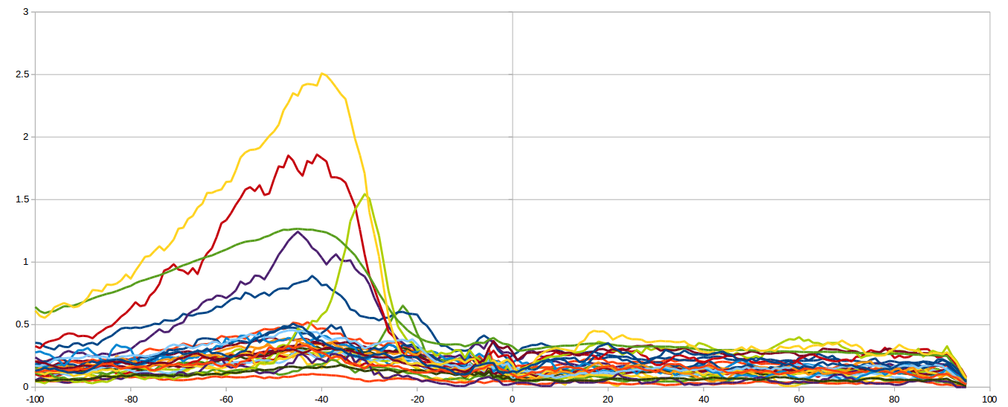
Hrp1 binding site (TAYRTA) is absent outside yeasts clade
Yeasts

Slide 18
3’UTR are longer in filamentous ascomycota
Chytridiomycota
Basidiomycota
Taphrinomycotina
“Yeasts”
Ascomycota
“Filamentous Ascomycota”
Zygomycota
Mucorales
Microsporidia

Slide 19
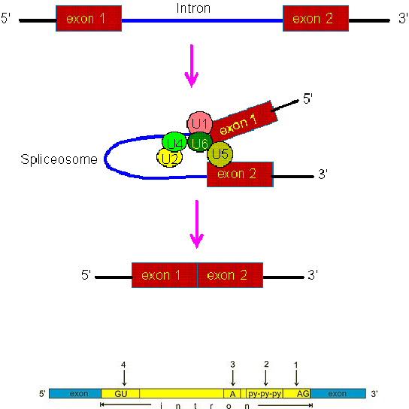
The biochemistry of splicing

Slide 20
Yeast and microsporidia have few genes containing introns
Chytridiomycota
Basidiomycota
Taphrinomycotina
“Yeasts”
Ascomycota
“Filamentous Ascomycota”
Mucorales
Zygomycota
Microsporidia

Slide 21
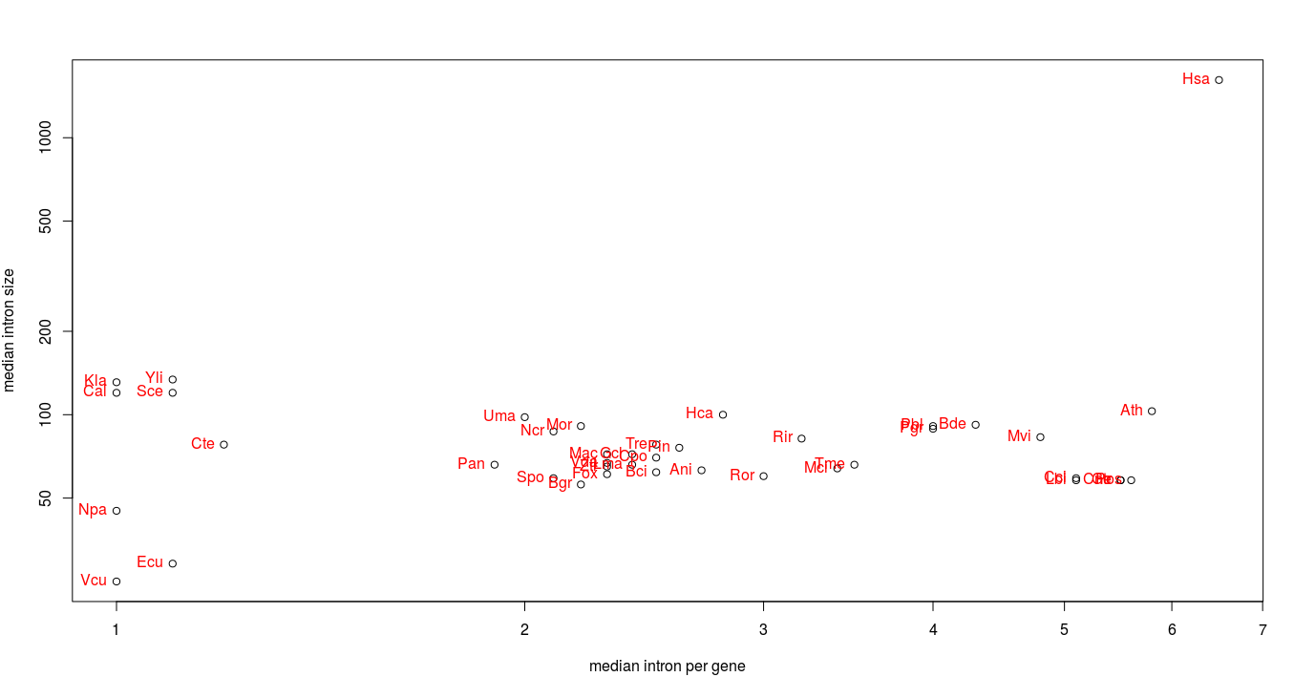
Yeasts have few, big introns
“Yeasts”
Basidiomycota
(except U. maydis)
Microsporidia

Slide 22
Acceptor site is variable
arabidopsis_thaliana
phytophthora_infestans
homo_sapiens
batrachochytrium_dendrobatidis
puccinia_graminis
microbotryum_violaceum
ustilago_maydis
cryptococcus_neoformans
gloeophyllum_trabeum
pleurotus_ostreatus
coprinopsis_cinerea
laccaria_bicolor
schizosaccharomyces_pombe
yarrowia_lipolytica
saccharomyces_cerevisiae
kluyveromyces_lactis
candida_tenuis
candida_albicans
tuber_melanosporum
magnaporthe_oryzae
neurospora_crassa
podospora_anserina
grosmannia_clavigera
verticillium_dahliae
fusarium_oxysporum
metarhizium_acridum
trichoderma_reesei
botrytis_cinerea
blumeria_graminis
leptosphaeria_maculans
zymoseptoria_tritici
aspergillus_nidulans
histoplasma_capsulatum
coccidioides_posadasii
phycomyces_blakesleeanus
rhizopus_oryzae
mucor_circinelloides
rhizophagus_irregularis

Slide 23
Acceptor site is variable, TAG preference in basal fungi, non-canonical presence in yeasts

Slide 24
Donor site is more uniform is some species
arabidopsis_thaliana
phytophthora_infestans
homo_sapiens
batrachochytrium_dendrobatidis
puccinia_graminis
microbotryum_violaceum
ustilago_maydis
cryptococcus_neoformans
gloeophyllum_trabeum
pleurotus_ostreatus
coprinopsis_cinerea
laccaria_bicolor
schizosaccharomyces_pombe
yarrowia_lipolytica
saccharomyces_cerevisiae
kluyveromyces_lactis
candida_tenuis
candida_albicans
tuber_melanosporum
magnaporthe_oryzae
neurospora_crassa
podospora_anserina
grosmannia_clavigera
verticillium_dahliae
fusarium_oxysporum
metarhizium_acridum
trichoderma_reesei
botrytis_cinerea
blumeria_graminis
leptosphaeria_maculans
zymoseptoria_tritici
aspergillus_nidulans
histoplasma_capsulatum
coccidioides_posadasii
phycomyces_blakesleeanus
rhizopus_oryzae
mucor_circinelloides
rhizophagus_irregularis

Slide 25
Branch site is more uniform is yeasts
arabidopsis_thaliana
phytophthora_infestans
homo_sapiens
batrachochytrium_dendrobatidis
puccinia_graminis
microbotryum_violaceum
ustilago_maydis
cryptococcus_neoformans
gloeophyllum_trabeum
pleurotus_ostreatus
coprinopsis_cinerea
laccaria_bicolor
schizosaccharomyces_pombe
yarrowia_lipolytica
saccharomyces_cerevisiae
kluyveromyces_lactis
candida_tenuis
candida_albicans
tuber_melanosporum
magnaporthe_oryzae
neurospora_crassa
podospora_anserina
grosmannia_clavigera
verticillium_dahliae
fusarium_oxysporum
metarhizium_acridum
trichoderma_reesei
botrytis_cinerea
blumeria_graminis
leptosphaeria_maculans
zymoseptoria_tritici
aspergillus_nidulans
histoplasma_capsulatum
coccidioides_posadasii
phycomyces_blakesleeanus
rhizopus_oryzae
mucor_circinelloides
rhizophagus_irregularis

