Slide 1



Bioinformatics approaches to understand RNA biology in the rice blast fungus
Marco Marconi
Center for Plant Biotechnology and Genomics Technical University of Madrid

Slide 2
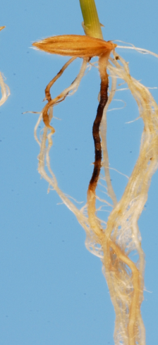
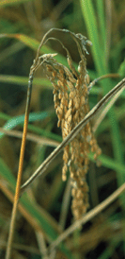
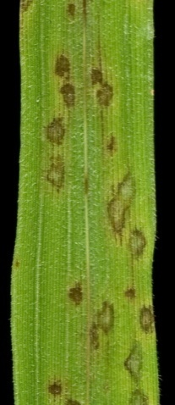
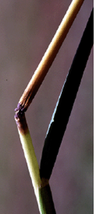
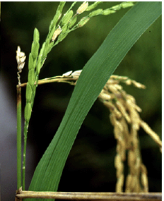
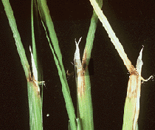
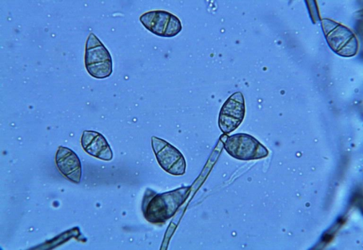
Magnaporthe oryzae is an ascomycete fungus that infects rice
root
panicle
node
leaf
Sesma&Osbourn Nature (2004)
neck
collar
Notes:
Magnaporthe oryzae is an ascomycete fungus that infects rice, it is worldwide speard and can infect different rice tissues

Slide 3
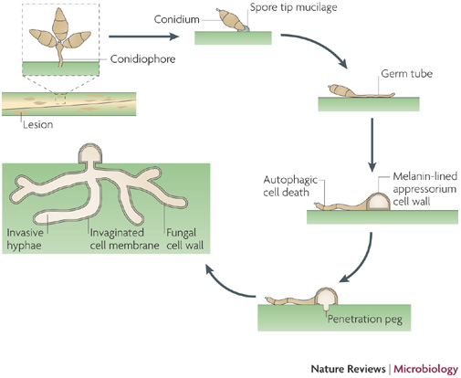
Magnaporthe oryzae life cycle
Richard A. Wilson & Nicholas J. TalbotNature Reviews Microbiology 7, 185-195 (March 2009)
Notes:
Magnaporthe life cycle starts with a spore landing on the plant, from where a puncturing structure called “appressorium” is developed. The fungus then penetrate the cells, reproduces and the cycle starts over again

Slide 4
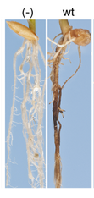



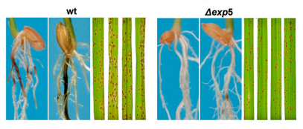
We are interested in two pathogenic-defective mutants…
Δrbp35
Δexp5
Tucker SL1, Besi MI, Galhano R, Franceschetti M, Goetz S, Lenhert S, Osbourn A, Sesma A. 2010
Marina Franceschetti , Emilio Bueno , Richard A. Wilson, Sara L. Tucker, Concepción Gómez-Mena, Grant Calder, Ane Sesma 2011
Notes:
We are interested in two mutants, one is the rbp35 gene, you can see here it’s defective in pathogenicity and development

Slide 5

Rbp35 is a member of the polyadenylation machinery
Pre-mRNA
CDS
Cleavage
CDS
Polyadenylation
CDS
AAAAAAAAAA
Notes:
Rbp35 is a member on the polyadenylation machinery. As you all probably already know, polyadenylation is the process where a nascent messenger RNA is cleaved and added with adenines

Slide 6
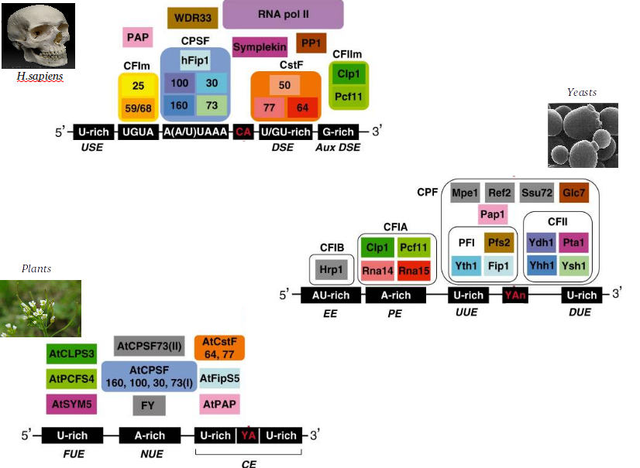
Rbp35 is a member of the polyadenylation machinery
S Millevoi et al. ‎2010
Notes:
The polyadenylation machinery is conserved in all eukariotic organisms

Slide 7
Rbp35 is a member of the polyadenylation machinery
RBP35 functional ortholog found in animals,
but not in yeast!
!
S Millevoi et al. ‎2010
Notes:
But the orthologs of rbp35 is not found in yeast, while it is present in animals

Slide 8
Human Rbp35 ortholog binds to UGUA element to regulate the selection of alternative polyadenylation sites (APA)
AAAAAAAAAAAAAAAAAAAA
Poly(A) site
CFI25
Rbp35
UGUA
AAAAAAAAAA
Alternative poly(A) site
Notes:
RBP35 is involved in alternative polyadenylation, a process where different polyadenylation sites can be selected on the same transcript, depending on specific binding elements

Slide 9
Exp5 is a kariopherin involved in the nuclear import/export of proteins and RNAs
METAZOAN
YEAST
double-stranded RNAs
binding proteins
tRNAs
aminoacyl-tRNA
re-export
ILF3, EF1A, JAZ…
EXP5
(metazoan)
MSN5
(yeast)
Some transcription factors
micro-RNA
precursors
RanGTP
RanGTP
NUCLEUS
Notes:
EXP5 is a kariopherin involved in the nuclear import/export. In animals it exports mostly double stranded RNAs and a few proteins, in yeast, it is involved in tRNA re-export and some transcription factors export

Slide 10
We want to shed light on the role of Rbp35 and Exp5 in M.oryzae:
RNA-seq on polyadenylation sites
AAAAAAAAAAAAAAAAAAAA
AAAAAAAAAA
Notes:
So, we want to know something more about these mutants. We have performed a poyadenylation sites sequencing, in order to know the role of Rbp35 in alternative polyadenylation

Slide 11
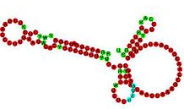


We want to shed light on the role of Rbp35 and Exp5 in M.oryzae:
RNA-seq on polyadenylation sites
Small RNA-sequencing
?
?
?
?
Notes:
And a smallRNA sequencing, in order to know how exp5 and rbp35 regulate the non-coding RNA population in magnaporthe oryzae

Slide 12
We want to shed light on the role of Rbp35 and Exp5 in M.oryzae:
RNA-seq on polyadenylation sites
Small RNA-seq
Evolutionary analysis of polyadenylation/splicing/translation machineries
Notes:
We are also studing the evolutionary history of several protein complexes in fungi, but we are not seeing this in this today

Slide 13
We want to shed light on the role of Rbp35 and Exp5 in M.oryzae:
RNA-seq on polyadenylation sites
AAAAAAAAAAAAAAAAAAAA
AAAAAAAAAA

Slide 14

Sequencing details
Two strains:
WT
∆rbp35
Four nutrient conditions:
Complete medium
Minimal medium
Nitrogen starvation
Carbon starvation
3 Replicates:
#1, #2, #3
Coverage:
400x poly(A) site
Typical on-plant conditions
Julio Rodríguez-Romero
(Wilkening et al., Nucleic Acids Res. 2013 , 1–8. An efficient method for genome-wide polyadenylation site mapping and RNA quantification)

Slide 15
Poly(A) site mapping analysis
Results in wild-type
Results in the ∆rbp35 mutant
Notes:
APA -

Slide 16
Poly(A) site mapping analysis
Results in wild-type
Results in the ∆rbp35 mutant
Notes:
APA -

Slide 17

5’UTR
3’UTR
Start codon
Stop codon
Notes:
This is how a typical mapping on a gene look like

Slide 18
~14000 poly(A) sites were identified on the genome
5’UTR
3’UTR
Start codon
Stop codon

Slide 19
5’UTR
3’UTR
Start codon
Stop codon
90% located in the 3’UTR

Slide 20
5’UTR
3’UTR
Start codon
Stop codon
~7500 genes with at least one poly(A) site

Slide 21
5’UTR
3’UTR
Start codon
Stop codon
3’UTRs in M. oryzae are ~200 nt, on average longer then yeast

Slide 22
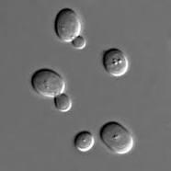
M. oryzae’s polyadenylation sites differ slightly from yeast
AU-rich
A-rich
U-rich
T A
U-rich
AU-rich
A-rich
U-rich
T
AAAAAAAAAAAAAAAAAAAA
Notes:
Also, the nucleotide profile around the poly(A) site is different. Here you can see the yeast elements well described in the literature

Slide 23

M. oryzae’s polyadenylation sites differ slightly from yeast
AU-rich
A-rich
U-rich
T A
U-rich
AU-rich
A-rich
U-rich
T
AAAAAAAAAAAAAAAAAAAA
UGUA
UAGA
A-rich
U-rich
C A
C peak
Notes:
Also, the nucleotide profile around the poly(A) site is different. Here you can see the yeast elements well described in the literature

Slide 24
Contrary to metazoan, canonical AAUAAA polyadenylation signal is highly degenerated
Very uniform
in animals:
AAUAAA
UGUA
UAGA
A-rich
U-rich
C A
C peak

Slide 25
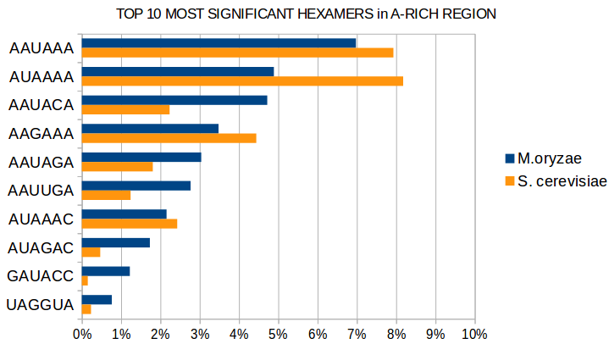
Contrary to metazoan, canonical AAUAAA polyadenylation signal is highly degenerated
Only 7% in fungi!
UGUA
UAGA
A-rich
U-rich
C A
C peak

Slide 26
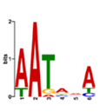
Contrary to metazoan, canonical AAUAAA polyadenylation signal is highly degenerated
Only 7% in fungi!
Very degenerated!
UGUA
UAGA
A-rich
U-rich
C A
C peak

Slide 27
What about alternative polyadenylation?
AAAAAAAAAAAAAAAAAAAA
Different cleavage sites produce
Alternative mRNA isoforms
AAAAAAAAAA

Slide 28
What about alternative polyadenylation?
AAAAAAAAAAAAAAAAAAAA
Different cleavage sites produce
Alternative mRNA isoforms
AAAAAAAAAA
Subcellular
localisation
???
Translation
efficiency
degradation

Slide 29

In M. oryzae ~30% of genes are alternatively polyadenylated
3’UTR

Slide 30
3’UTR
90% of APA events occur in the 3’UTR

Slide 31
80% of APA events are made of 2 alternatives only
3’UTR

Slide 32
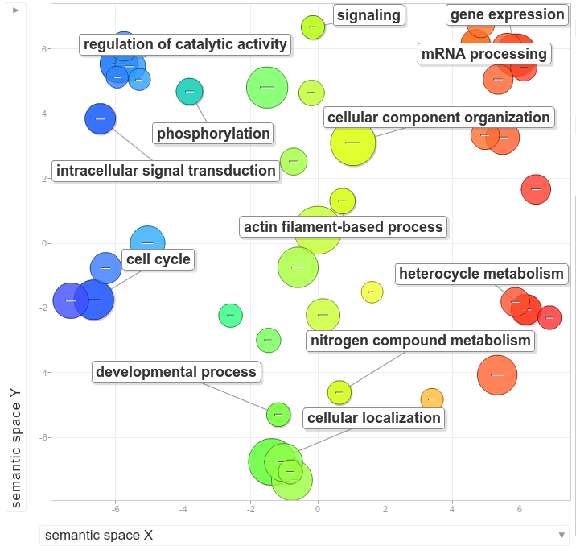
Alternative polyadenylation seems to be involved in specific biological processes
"REVIGO summarizes and visualizes long lists of Gene Ontology terms“ PLoS ONE 2011

Slide 33
Carbon Starvation affects poly(A) selection in 455 genes, preferring distal poly(A) sites
Complete medium
AAAAAAAAAAAAAAAAAAAA
In carbon starvation longer UTRs are usually produced
Carbon starvation
AAAAAAAAAA
Notes:
And this results in the fungus having longer 3’UTRs

Slide 34
Poly(A) site mapping analysis
Results in wild-type
Results in the ∆rbp35 mutant
Notes:
APA -

Slide 35
~25% of M. oryzae’s genes prefer a different poly(A) ∆rbp35
Wild type
AAAAAAAAAA
In the mutant, shorter UTRs are usually preferred
∆rbp35
AAAAAAAAAAAAAAAAAAAA

Slide 36
UGUA motif is very enriched in poly(A) sites regulated by Rbp35
UGUA
UAGA
A-rich
U-rich
C A
C peak

Slide 37
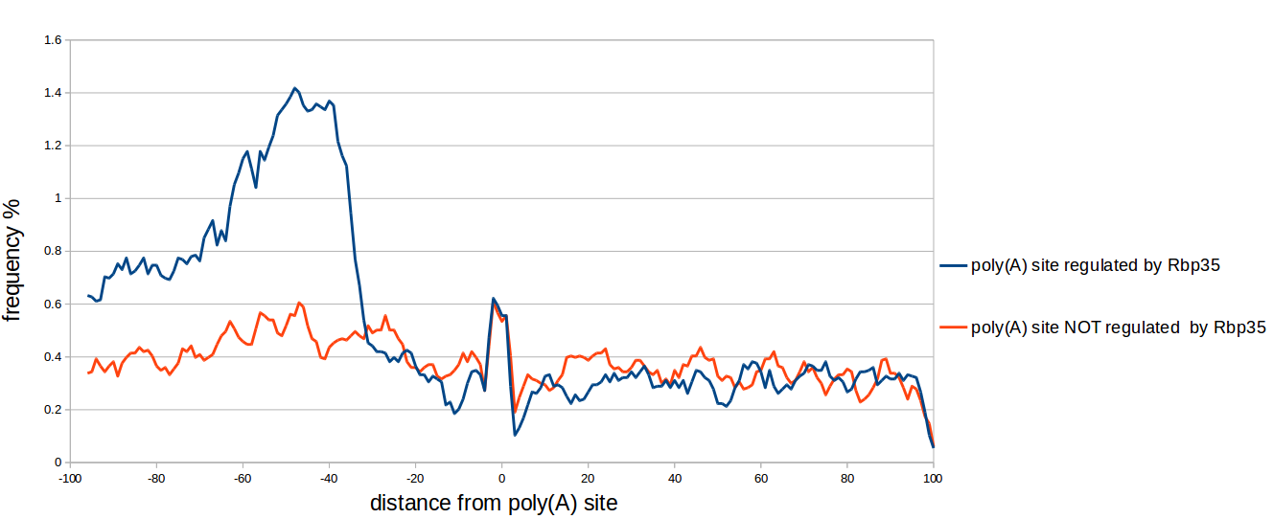
UGUA motif is very enriched in poly(A) sites regulated by Rbp35
E-value: 5.3e-103
UGUA
UAGA
A-rich
U-rich
C A
C peak

Slide 38
Can we devise an hypothetical role for Rbp35?

Slide 39
The recognition of a proper UGUA motif by Rbp35 is essential for the cleavage reaction.
Wild type strain (common situation)
Rbp35/CFI25
5’
UGUA
-45
3’
Poly(A) site
Notes:
The recognition of a proper UGUA motif by Rbp35 is essential for the cleavage reaction.

Slide 40
The recognition of a proper UGUA motif by Rbp35 is essential for the cleavage reaction.
Wild type strain (common situation)
Wild type strain (alternative poly(A) site)
Rbp35/CFI25
Rbp35/CFI25
5’
5’
UGUA
UGUA
-45
3’
-45
3’
Poly(A) site
Poly(A) site “occluded” by RBP35
Notes:
Also, Rbp35 can help to occlude an alternative poly(A) site

Slide 41
The recognition of a proper UGUA motif by Rbp35 is essential for the cleavage reaction.
Wild type strain (common situation)
Wild type strain (alternative poly(A) site)
Rbp35/CFI25
Rbp35/CFI25
5’
5’
UGUA
UGUA
-45
3’
-45
3’
Poly(A) site
The mutant
Poly(A) site “occluded” by RBP35
Rbp35/CFI25
5’
UGUA
-45
3’
Poly(A) site “revealed”
Notes:
When the protein is missing, the occluded poly(A) site becomes visible and it is cleaved

Slide 42
Part 1 - Conclusions
Polyadenylation in M. oryzae differs from S. cerevisiae
Alternative polyadenylation in M. oryzae is common and related with specific functional groups
Carbon starvation induces longer 3’UTRs
RBP35 (probably) interacts with the UGUA element, to select distal poly(A) sites

Slide 43
We want to shed light on the role of RBP35 and EXP5 in M.oryzae:
RNA-seq on polyadenylation sites
Small RNA-sequencing
?
?
?
?

Slide 44
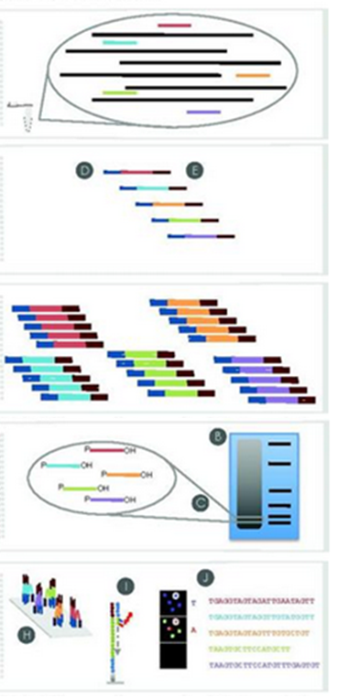
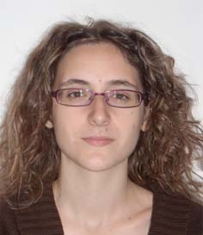
Small RNA library preparation and sequencing
Total RNA isolation
HD Adaptor ligation
Adriana Illana Otero,
in Norwich
RT & PCR
Size fractionation
Sequencing
Notes:
The library preparation was performed by adriana in norwich

Slide 45
Sequencing details
Three strains:
WT
∆exp5
∆rbp35
3 Replicates:
#1, #2, #3

Slide 46
Read length after adapters removal is between 18-25 bp

Slide 47
More than 70% of unique reads do not align on the genome (GUY11)

Slide 48
Most of genomic sRNA loci (2019) are located in transposable elements

Slide 49
What happens in the mutants?

Slide 50

Δexp5
18s
5.8s
28s
Protein-coding
The fungus produces very short RNA fragments mostly from rDNA and some protein-coding genes
10-15 nt

Slide 51
Δexp5
18s
5.8s
28s
Protein-coding
The fungus produces very short RNA fragments mostly from rDNA and some protein-coding genes
Which are strongly down-regulated in Δexp5
10-15 nt

Slide 52
Δexp5
18s
5.8s
28s
Protein-coding
The fungus produces very short RNA fragments mostly from rDNA and some protein-coding genes
Which are strongly down-regulated in Δexp5
10-15 nt
tRNAs

Slide 53
Δexp5
Unknown EST
antisense
The fungus produces a great amount of antisense small RNA from unclassified transcripts
20 nt

Slide 54
Δexp5
Unknown EST
antisense
The fungus produces a great amount of antisense small RNA from unclassified transcripts
A
20 nt
Usually post-transcriptionally modified with an adenine
(target for degradation?)

Slide 55
Δexp5
Unknown EST
antisense
The fungus produces a great amount of antisense small RNA from unclassified transcripts
Which are strongly up-regulated in Δexp5
A
20 nt
Usually post-transcriptionally modified with an adenine
(target for degradation?)

Slide 56
Δrbp35
Transposable element
Transposable elements produces a great amount of small RNA of ~23nt
A
~23 nt

Slide 57
Δrbp35
Transposable element
Transposable elements produces a great amount of small RNA of ~23nt
Which are strongly down-regulated in Δrbp35
A
~23 nt

Slide 58
Δrbp35
Transposable element
antisense
Transposable elements produces a great amount of antisense small RNA of ~19 nt
U
~19 nt

Slide 59
Δrbp35
Transposable element
antisense
Transposable elements produces a great amount of antisense small RNA of ~19 nt
U
~19 nt
Beginning with a uracile
(RNA-interference?)

Slide 60
Δrbp35
Transposable element
antisense
Transposable elements produces a great amount of antisense small RNA of ~19 nt
Which are strongly up-regulated in Δrbp5
U
~19 nt
Beginning with a uracile
(RNA-interference?)

Slide 61
Δrbp35
Transposable element
antisense
Transposable elements produces a great amount of antisense small RNA of ~19 nt
Which are strongly up-regulated in Δrbp5
U
~19 nt
Beginning with a uracile
(RNA-interference?)
tRNAs

Slide 62
A virus in M.oryzae GUY11?
A transcript 2840 nt long, not aligning on the genome
RdRp
63
1937
RNA-dependent RNA polymerase
Similar to S. scleorinorum mitovirus
Confirmed in GUY11 ESTs, probably two different molecules
Not found in 70-15 rna seq
Highly transcribed in WT (up to 20%), affected in rbp35 mutant, not sure in exp5
Very A-modified
Highly polyadenylated in the polyA experiment

Slide 63
We want to shed light on the role of Rbp35 and Exp5 in M.oryzae:
RNA-seq on polyadenylation sites
Small RNA-seq
Evolutionary analysis of polyadenylation/splicing/translation machineries
Notes:
We are also studing the evolutionary history of several protein complexes in fungi, but we are not seeing this in this today

Slide 64
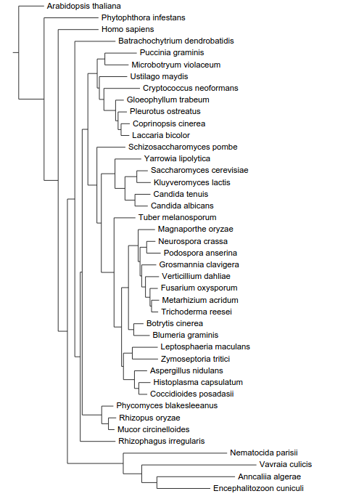
The phylogeny of fungi
Actin
Diphthine synthase
Glutamine tRNA synthetase
RNA polymerase III
Transcription factor TFIIH
DNA topoisomerase III
Exportin 1
Chytridiomycota
Basidiomycota
Taphrinomycotina
“Yeasts”
Ascomycota
“Filamentous Ascomycota”
Mucorales
Zygomycota
Microsporidia

