Slide 1
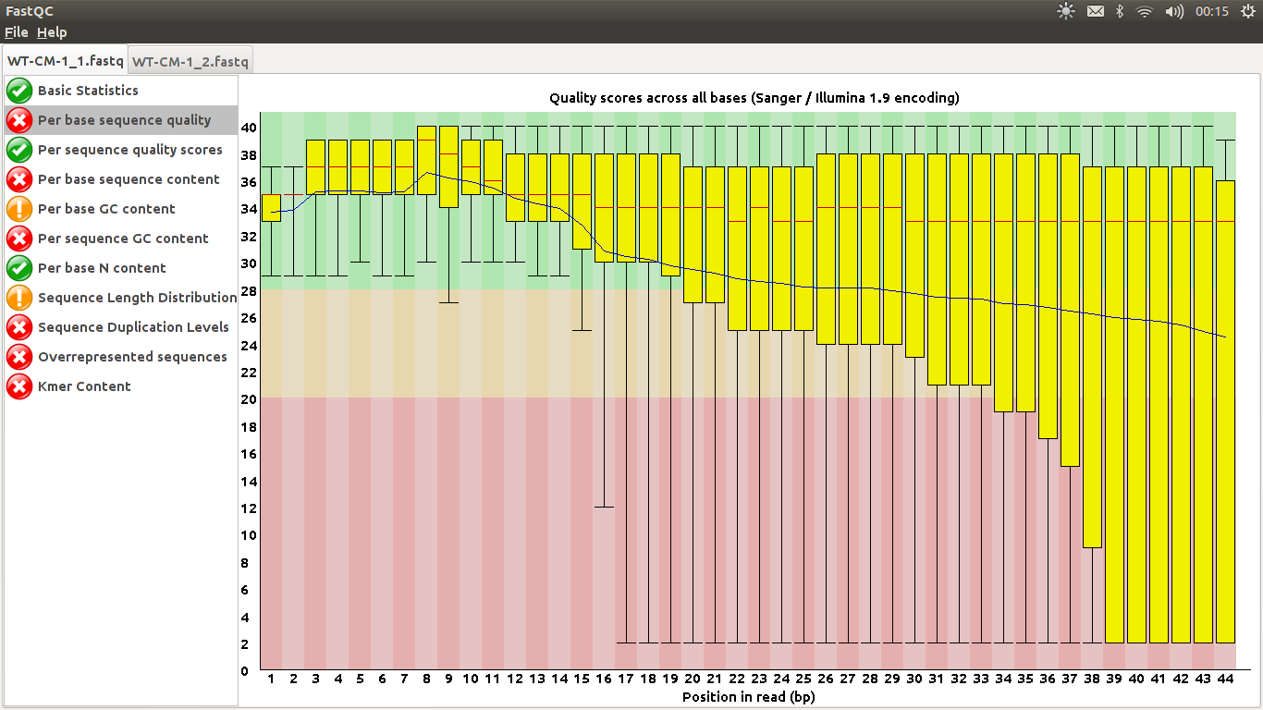
FastQ Quality

Slide 2
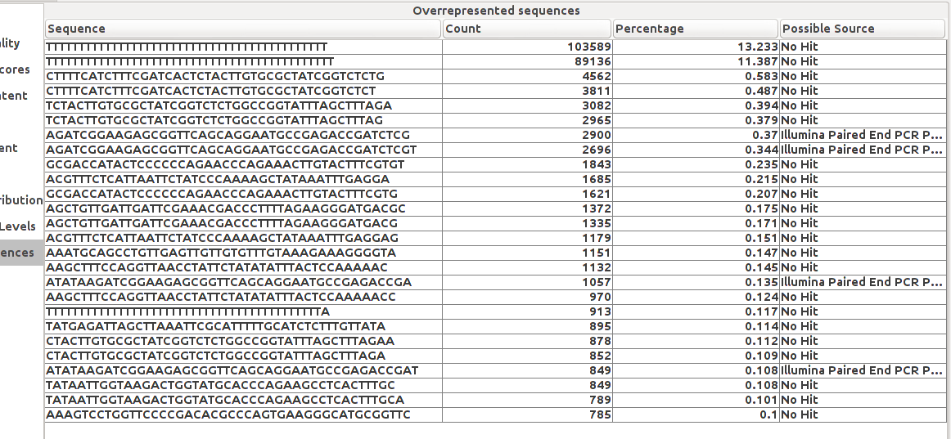
FastQ Overrepresented

Slide 3
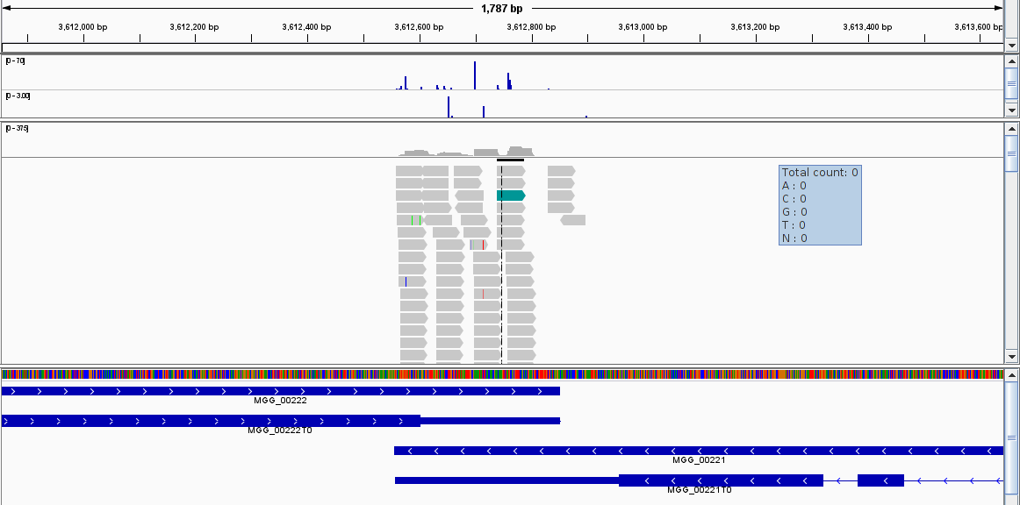
GSNAP
Reads are assigned to transcripts, +-200 from 3UTR end

Slide 4
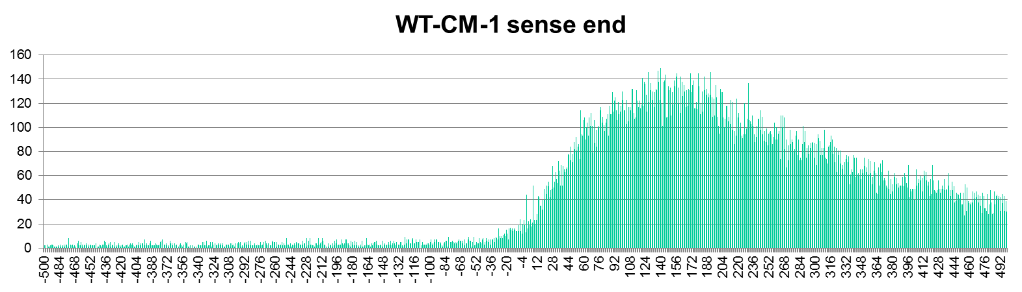
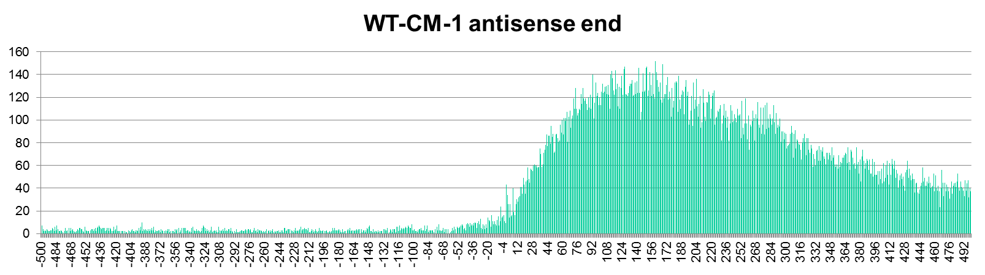
Relative to stop codon

Slide 5
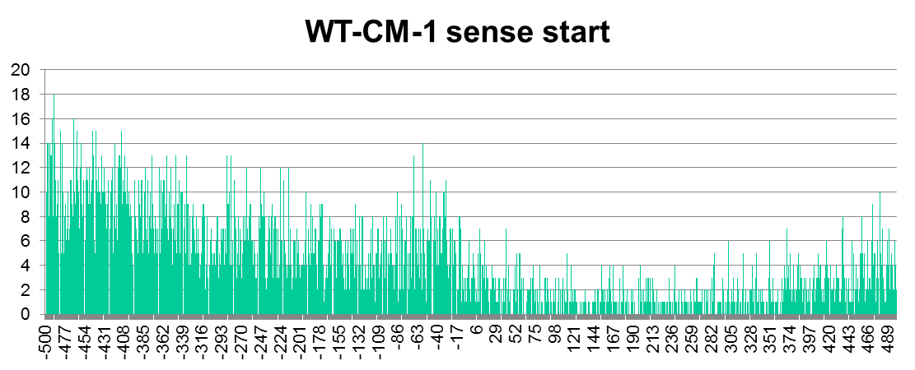
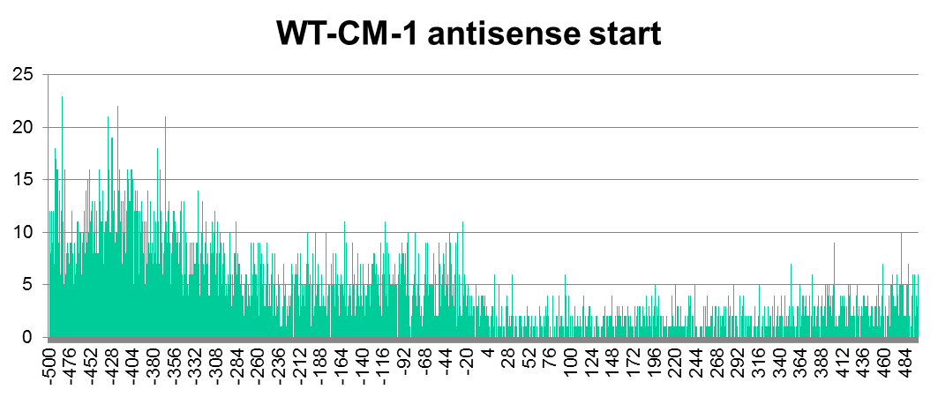
Relative to start codon

Slide 6
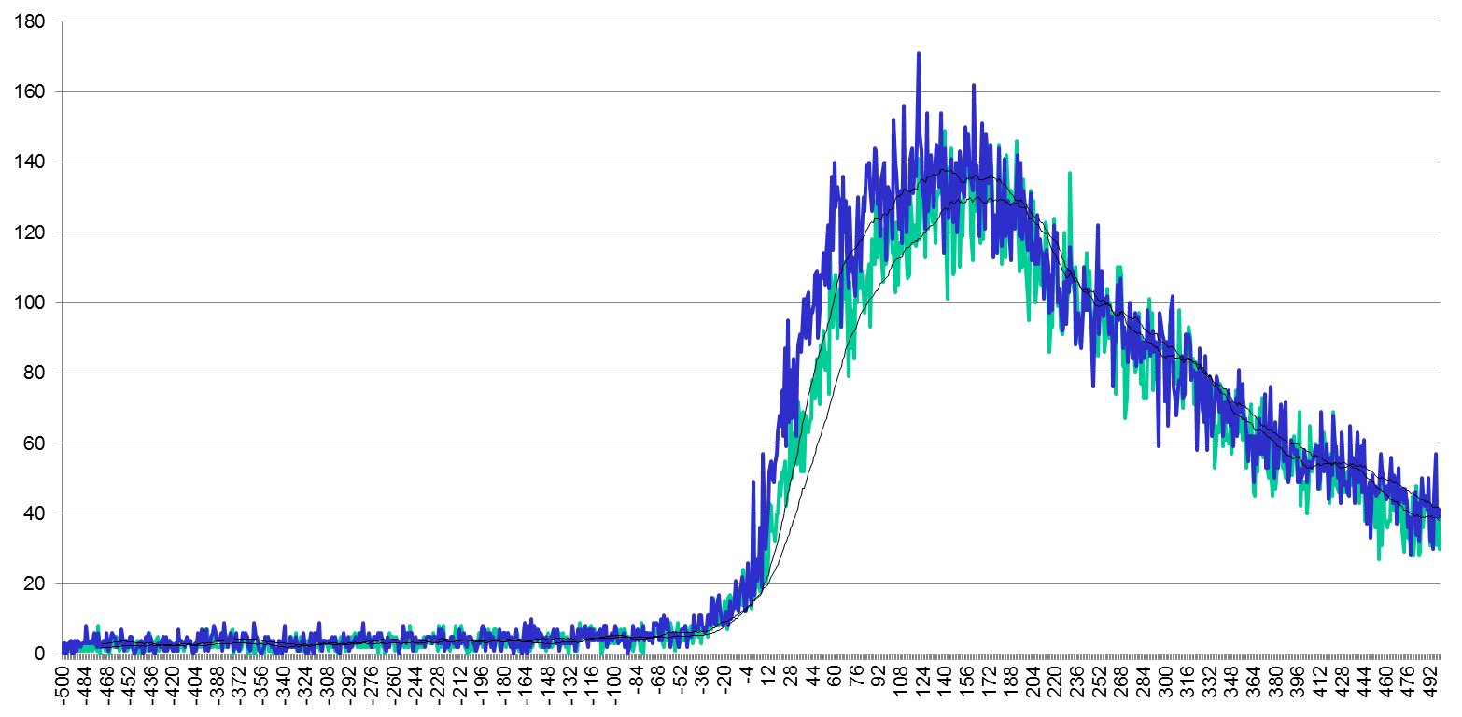
WT vs 2D4 3UTR length

Slide 7
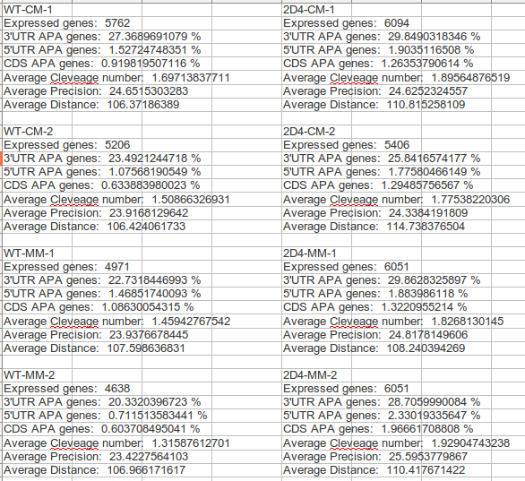
General info

Slide 8
Number of cleveage sites

Slide 9
Precision of cut

Slide 10
Distance between polyA sites

Slide 11
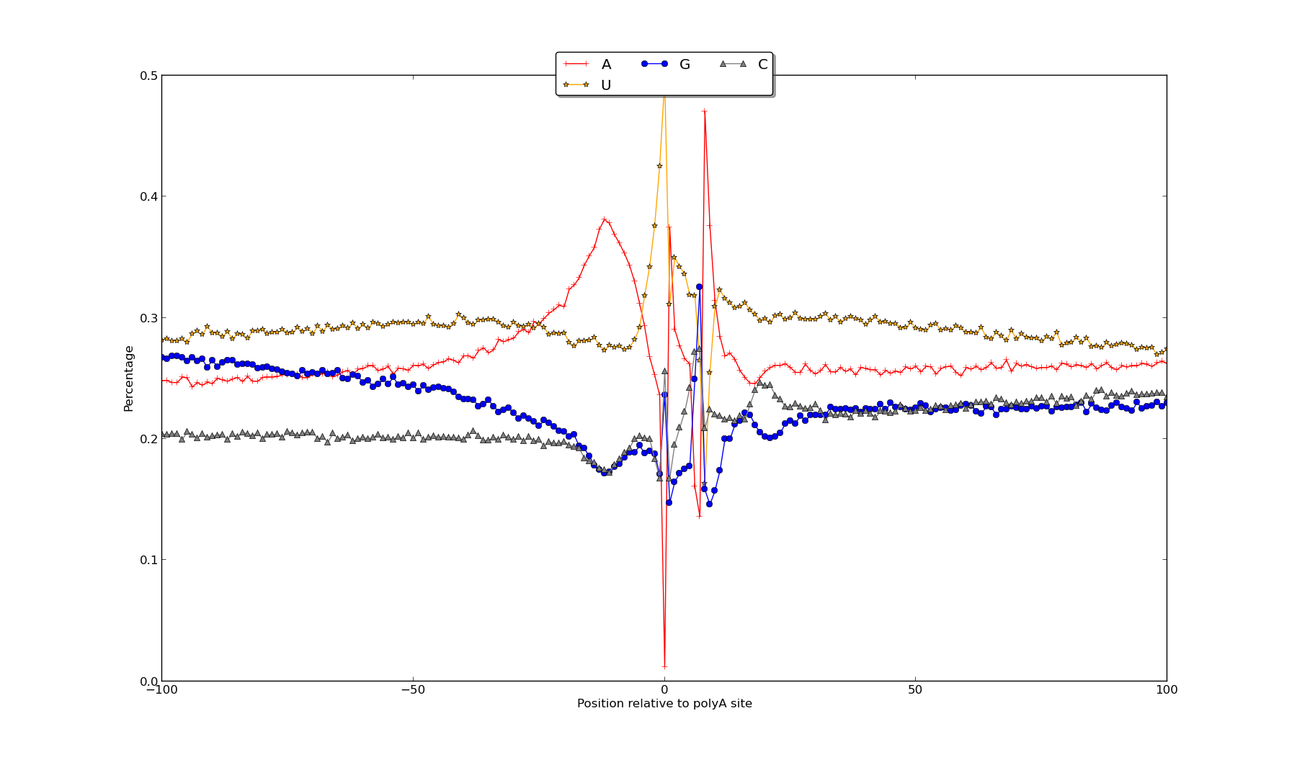
Nucleotide composition

Slide 12
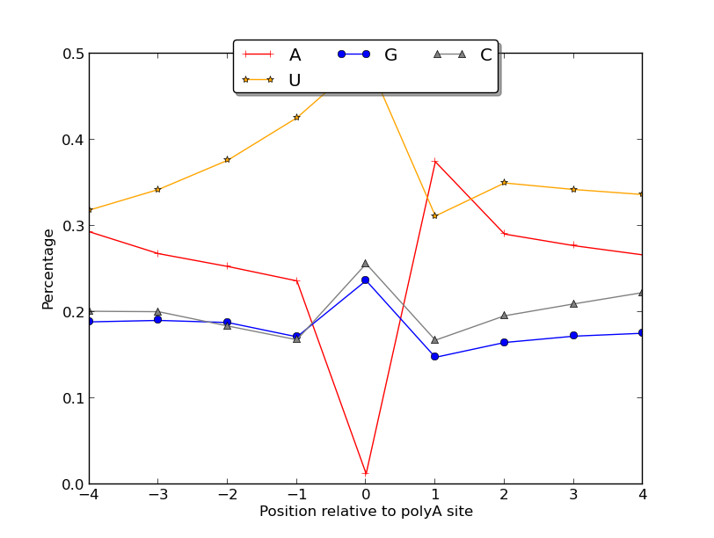
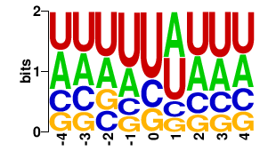
Nucleotide composition

Slide 13
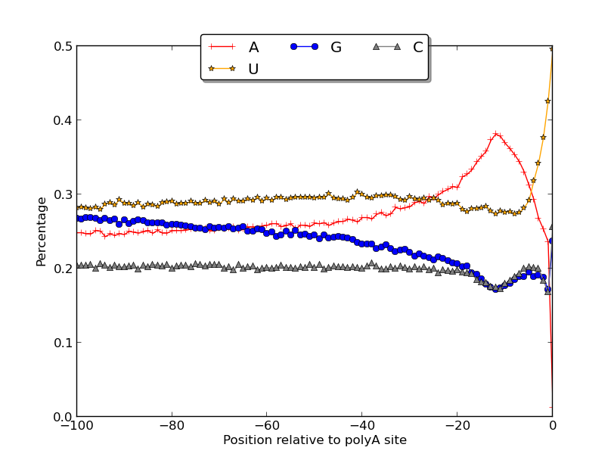
Nucleotide composition

Slide 14
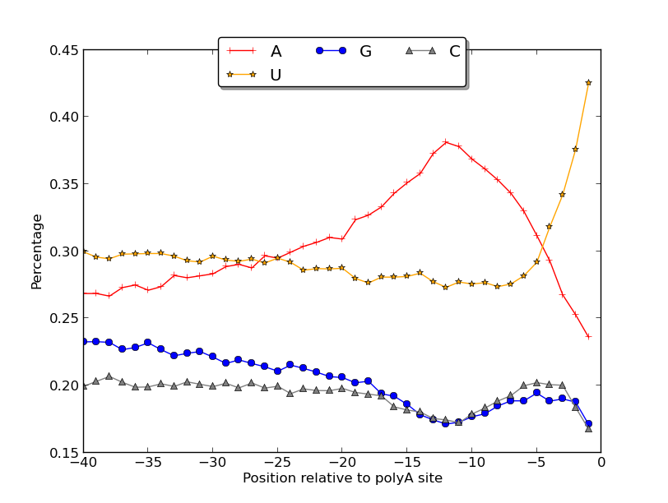
Nucleotide composition

Slide 15
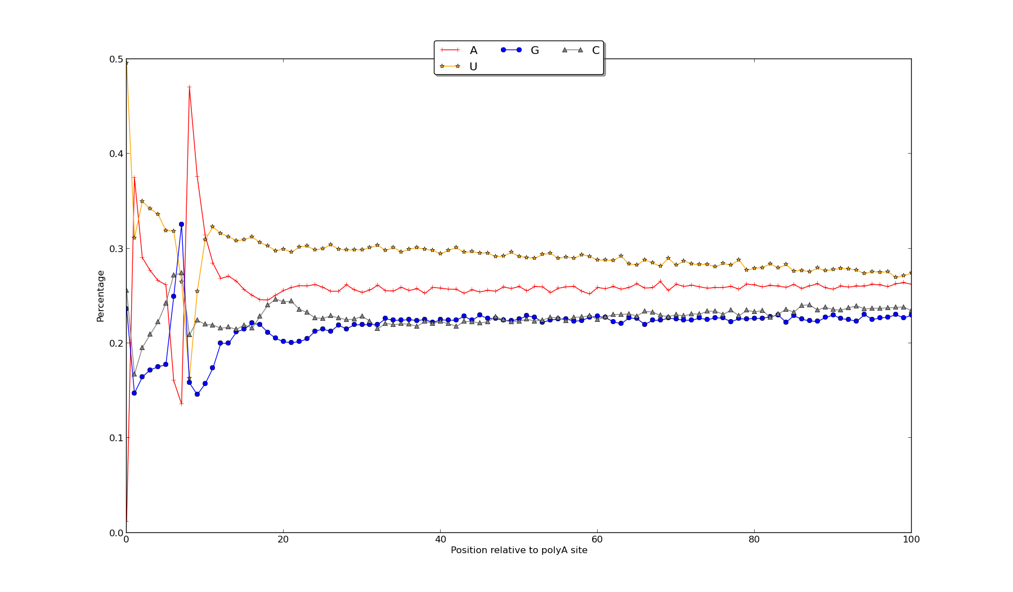
Nucleotide composition

Slide 16
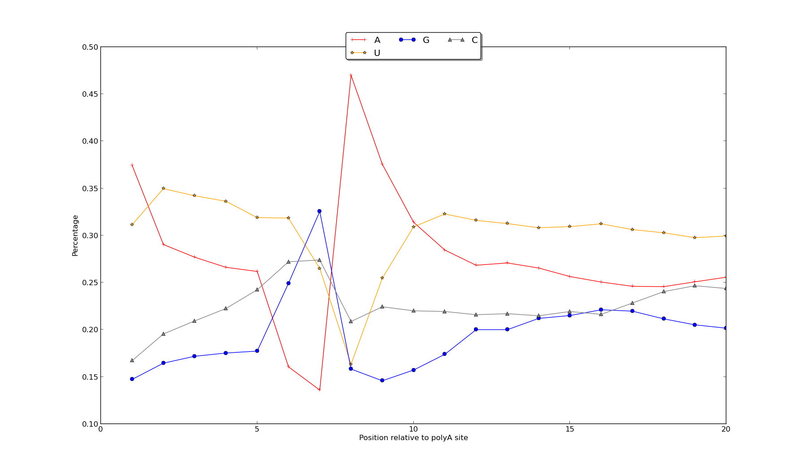
Nucleotide composition

Slide 17
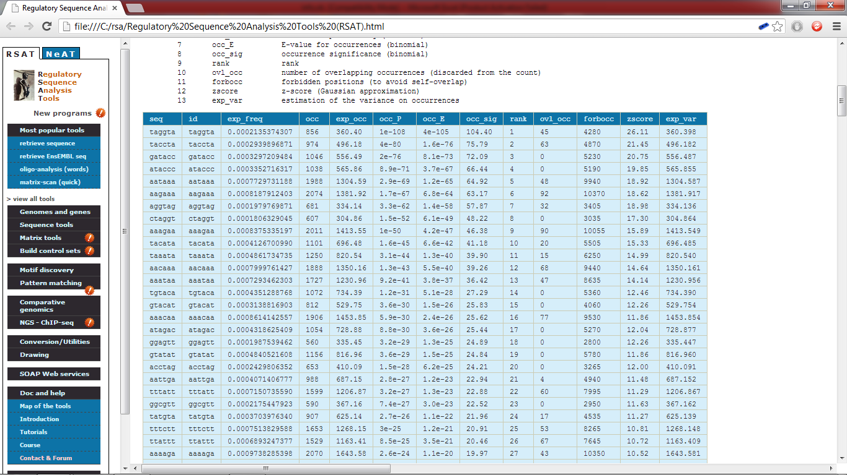
Motifs – oligo discovery

Slide 18
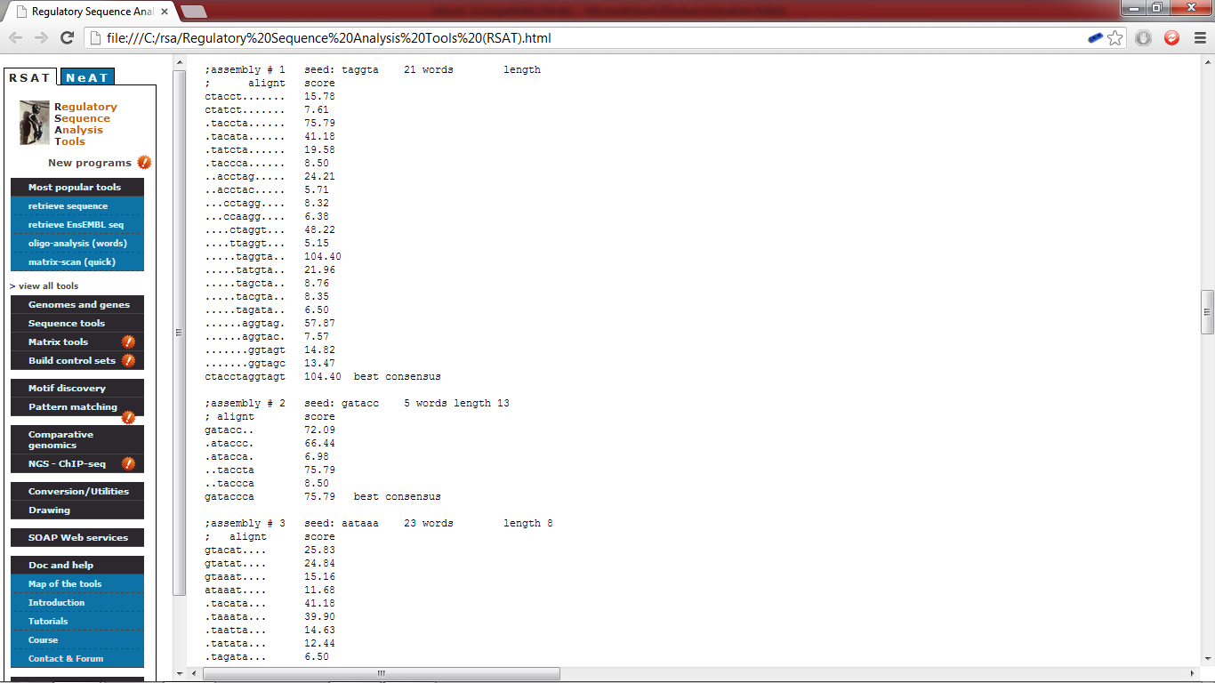
Motifs – pattern assembly

Slide 19
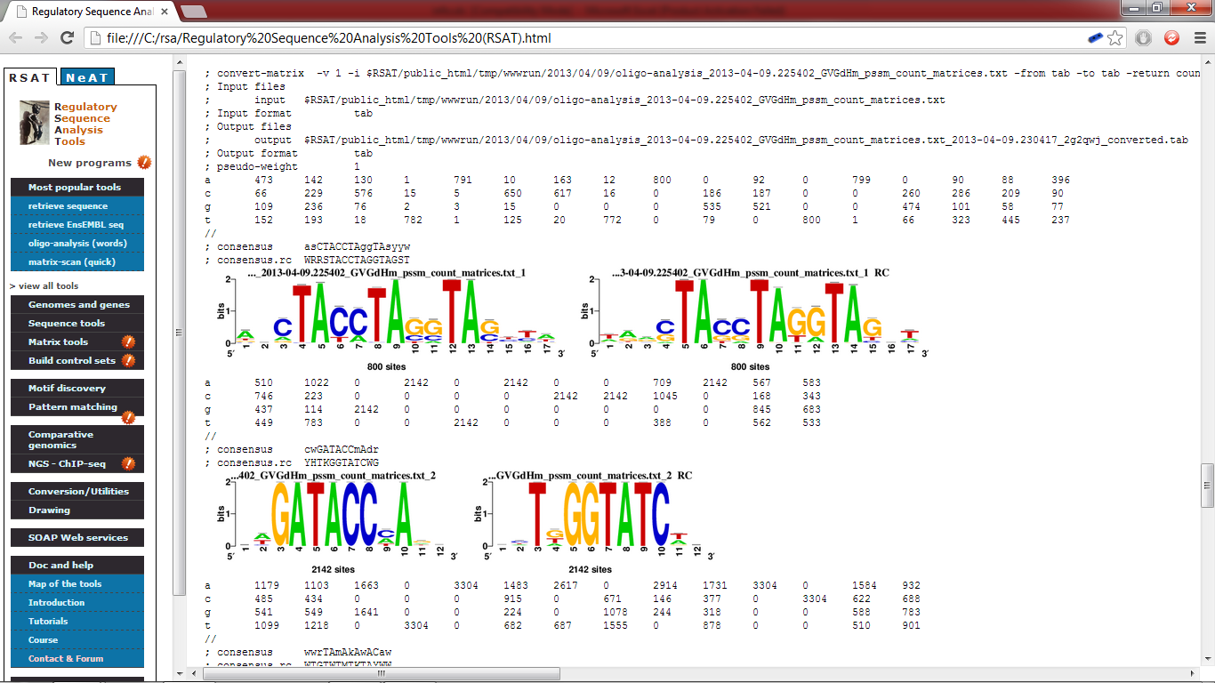
Motifs – matrixes

Slide 20
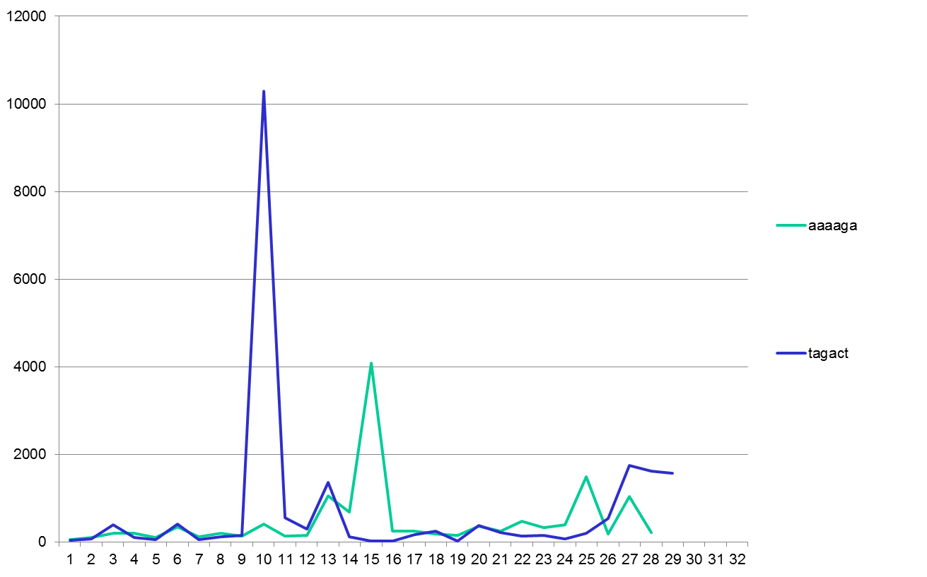
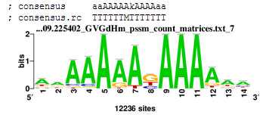
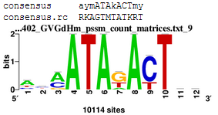
Motifs – cis-elements

