Slide 1
~9% of read could not be assigned to any annotated transcript

Slide 2
~80% of alternative polyadenilation occurs in 3'UTR

Slide 3
Δrbp35 affects poly-A sites number

Slide 4
~8% of poly-A sites are differentially expressed

Slide 5
Δrbp35 affects number of cut sites per gene

Slide 6
Δrbp35 affects alternative poliadenilation

Slide 7
Δrbp35 affects 3'UTR length

Slide 8
Nucletide profile of poly-A sites differs from S.cerevisae

Slide 9
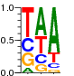

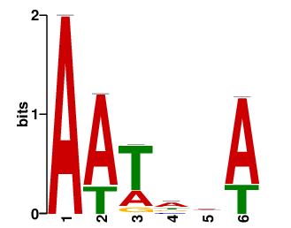
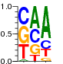
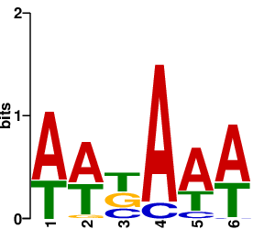
Nucletide profile of poly-A sites differs from S.cerevisae
5'
AT-rich
A-rich
T-rich
YA
T-rich
3'
5'
A-rich
T-rich
VA
3'
-30
-10
-50
-30

Slide 10
Δrbp35 affects poly-A site nucleotide composition

Slide 11
Δrbp35 affects TGTA motif location

