Slide 1
Sequencing resume
2 strains (WT, 2D4) x 4 conditions (CM, MM, -N, -C) x 3 replicates
4751592 – 11517077 total reads database
~63% - ~83% successfully mapped reads
43 bp mean read length
~92% - ~98% replicates correlation
~100bp mean pair ended distance
~600x coverage for poly-A site

Slide 2
Pair ended reads distance

Slide 3


~2.5% of poly-A sites are fake
Some poly-A sites are just a side effect of poly-A genomic regions
We suppose that also GU pairing can produce fake poly-A sites

Slide 4
Results of the polyadenylatoin sites by Illumina sequencing
CM
MM
MM-N
MM-C
WT/∆rbp35
WT/∆rbp35
WT/∆rbp35
WT/∆rbp35
Total nº genes expressed
10292 / 10486
10223 / 10675
10357 / 10549
10451 / 10776
Genes with APA in CDS
44 / 57
44 / 75
61 / 82
65 / 75
Genes with APA in 5‘ UTR
84 / 105
80 / 105
104 / 107
90 / 122
Genes with APA in 3‘ UTR
1433 / 1595
1272 / 1753
1346 / 1610
1496 / 1730
Number of genes with APA in WT but not in RBP
632
502
619
691
Number of genes with APA in RBP but not in WT
826
1036
901
996
RBP35 regulates APA of XXX genes in Mo
???why did we remove the APA slide last time???
Notes:
ESTs from NCBI, NIAS (M. oryzae), …

Slide 5
~10000 genes are expressed, out of a total of 13218 annotated genes
9369 genes are expressed in every condition
1786 genes are never expressed

Slide 6
Gene expression between conditions
CM
10292
9920
9892
9711
10357
9999
10451
-N
-C

Slide 7
Gene expression in plant
CM
10292
6503
plant
8219
6536
6588
10357
10451
-C
-N

Slide 8
486 genes never expressed in vitro are expressed in plant
Never expressed
In vitro
plant
1786
486
8219
* of 8219 plant genes described, only 7339 are found in MG8 assembly

Slide 9
The CM → -C condition presents the highest number of differentially expressed genes, while MM → -N the lowest
DIFFERENTIALLY EXPRESSED GENES IN THE WT
 | DOWN | UP | TOTAL
CM → MM-C | 1595 | 1619 | 3214
CM → MM | 153 | 286 | 439
CM → MM-N | 179 | 347 | 526
MM → MM-C | 614 | 607 | 1221
MM → MM-N | 1 | 6 | 7
MM-N → MM-C | 220 | 318 | 538

Slide 10
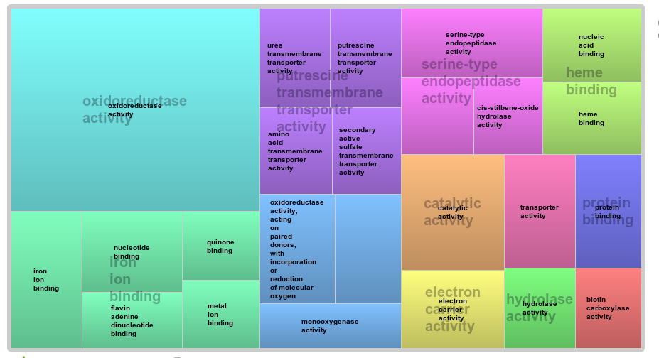
CM → MM functional analysis

Slide 11
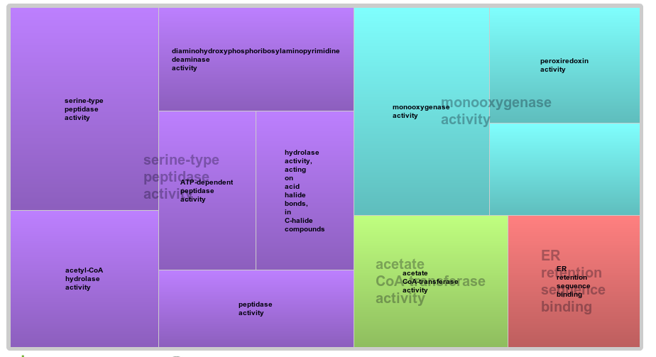
WT → 2D4 functional analysis*
* p-value = 0.05

Slide 12
~9000-1000 poly-A site could be assigned to annotated genes

Slide 13
17%-19% of poly-A sites could not be assigned to any annotated gene

Slide 14
131 orphans poly-A sites highly expressed in CM (>100 reads)
30 hits against Uniprot nt/nr database
4 hits against Rfam(ncRNA) database
36 overlapping annotated genes antisense
127 orphans differentially expressed CM → -C

Slide 15
>90% of poly-A sites are located in the 3'UTR

Slide 16
~75% of genes expressed have a recognizable poly-A site

Slide 17
~20% of genes are alternatively polyadenilated
* calculated over the global number of expressed genes with a recognizable poly-A site

Slide 18
Δrbp35 affects poly-A sites number

Slide 19
Δrbp35 affects number of cut sites per gene

Slide 20


Terminology - 1
group P1: Lost polyA sites in Δrbp35 (polyA site RBP35 dependent):
Group G1: genes containing group P1 poly-A sites
Group P1-2D4: every poly-A sites in G1 genes from 2D4

Slide 21

Terminology - 2
group P2: Appeared new polyA sites in Δrbp35 (unspecific polyA site-not RBP35 dependent):
Group G2: genes containing group P2 poly-A sites
Group P2-WT: every poly-A sites in G2 genes from WT

Slide 22

Terminology - 3
Group G3: Genes with change position (lost and appeared) polyA sites in Δrbp35 (positional RBP35 dependent), a specific case from P1 and P2:

Slide 23
~5% of poly-A sites and ~6% of genes are targeted by Δrbp35 in CM

Slide 24
Δrbp35 affects 3'UTR length

Slide 25
Nucleotides profile of poly-A sites slighty differs from S.cerevisae

Slide 26
Nucleotides profile of poly-A sites resembles N. crassa

Slide 27
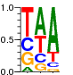


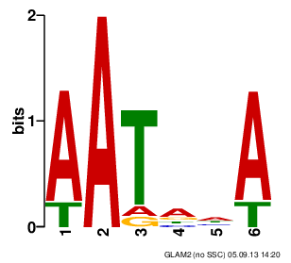
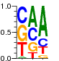
Nucleotides profile of poly-A sites differs from S.cerevisae
S.cerevisae
5'
AU-rich
A-rich
U-rich
YA
U-rich
3'
-30
-10
25
M. oryzae
5'
A-rich
U-rich
YA
3'
-45
-35
-30
-10

Slide 28
The A-RICH region is located -30 -10 bp upstream

Slide 29
Top 10 hexamers in A-rich region

Slide 30
UAGA & UGUA motifs

Slide 31
Polyadenilation signals in common genes
MPG1
...GGUAGAGAAGUCUCUUCUCGUUCCACUCAUUUAAUAAAACCCCUUCCAGACCUA...
PMK1
...CGUUUAGAAUGUGCAGGAGACACGAGUGGGAAAAUGAAUACAUGGAUGCCAGCA...
MST12
...CAGUGGCAUAAAAUCACAAAAUCUUUAGAAAGAUCACAGAAAACCUUUUGUCCA...

Slide 32
Poly-A sites targeted by rbp35 show a less pronunced A-rich region

Slide 33
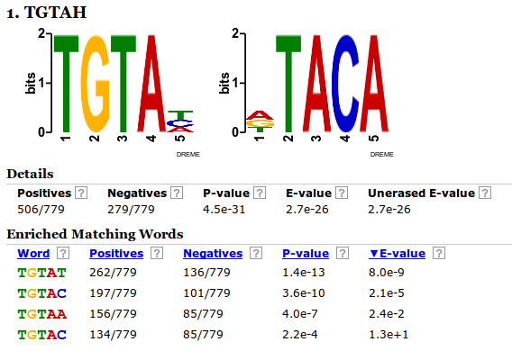
UGUAH motif is enriched in poly-A sites targeted by rbp35
- Output of DREME, P1 as positive sequences list versus not-P1 negative list

Slide 34
UGUAH motif – P1 vs not P1
In the first graph, we want to show how poly-A sites targeted by rbp35 display a different profile for the UGUA motif in the -100 -36 region respect to “regular” poly-A sites
We therefore plot P1 group poly-A sites against two control groups of poly-A sites of identical size not belonging to P1 group in WT

Slide 35
UGUAH is enriched at -45 in poly-A sites targeted by rbp35

Slide 36
UGUAH motif – P1 vs P1-2D4
In the second graph, we want to show how genes targeted by rbp35 are affected in the mutant, using P1 group
We therefore plot P1 group poly-A sites against P1-2D4 group poly-A sites, which are poly-A sites from 2D4 in the same genes affected of P1 group

Slide 37
UGUAH – P1 vs P1-2D4

Slide 38
UGUAH motif – P2 vs P2-WT
In the second graph, we want to show how genes targeted by rbp35 are affected in the mutant, using P2 group
We therefore plot P2 group poly-A sites against P2-WT group poly-A sites, which are poly-A sites from WT in the same genes affected of P2 group

Slide 39
UGUAH – P2 vs P2-WT

Slide 40
UAGA– P1 vs not P1
The gap in P1 set at -45 is probably due to UGUAH enrichment, as seen before

Slide 42
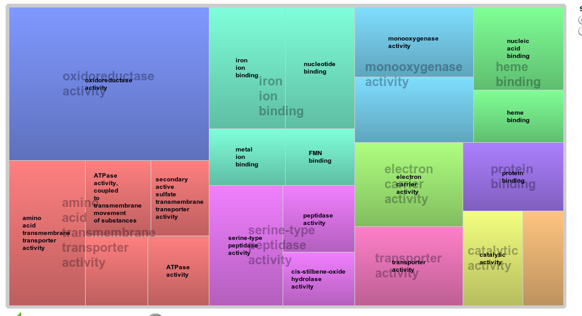
CM → -N functional analysis

Slide 43
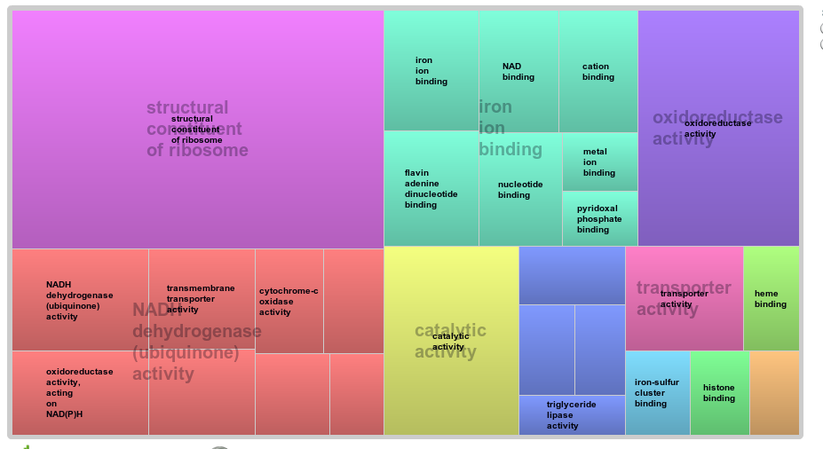
CM → -C functional analysis

Slide 44
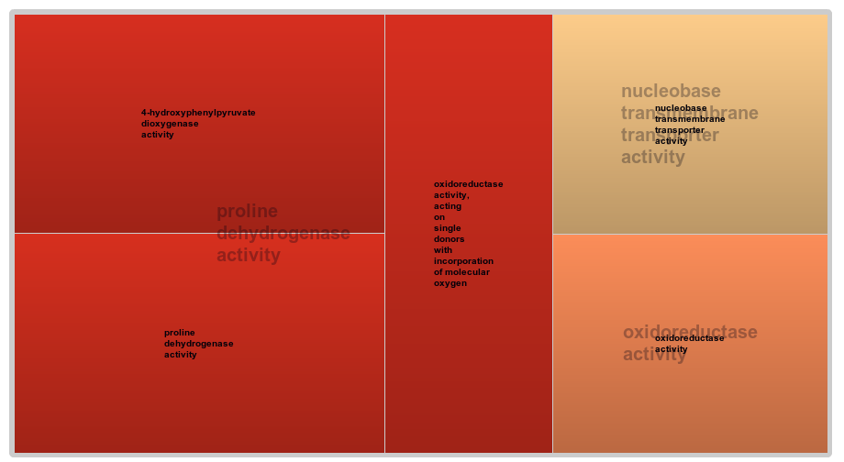
MM → -N functional analysis

Slide 45
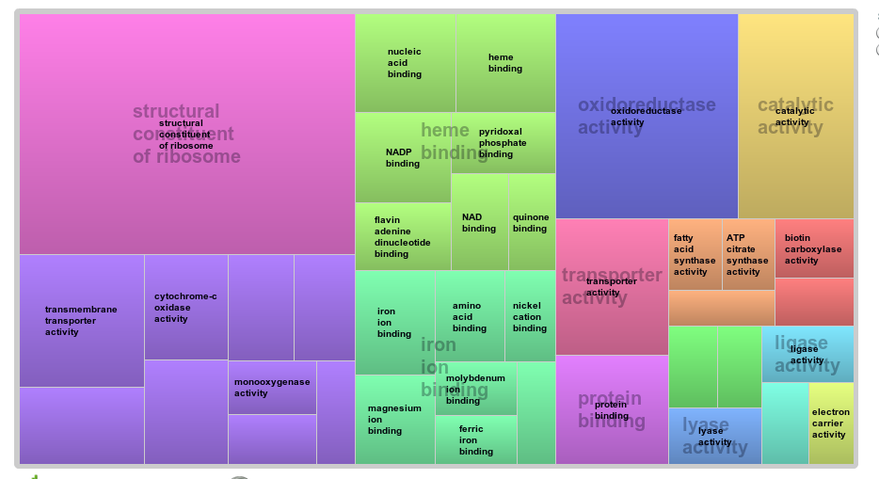
MM → -C functional analysis

Slide 46
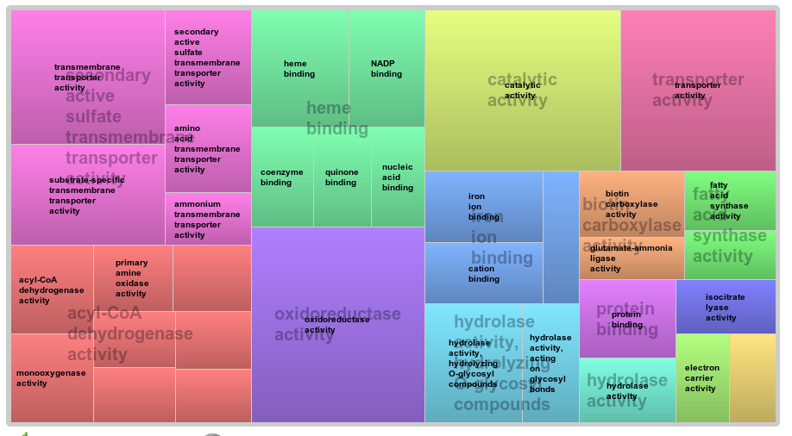
-N → -C functional analysis

