Slide 1




Bioinformatic approaches to understand RNA biology in the rice blast fungus
Marco Marconi
marco.marconi@upm.es
Supervisor:
Mark Wilkinson
Co-Supervisor:
Ane Sesma
October 15, 2014

Slide 2
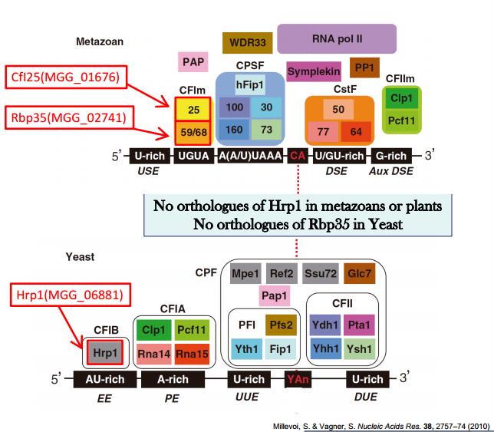
M. oryzae contains metazoan CFI (Rbp35/CfI25) and yeast CFI (Hrp1) protein complexes

Slide 3
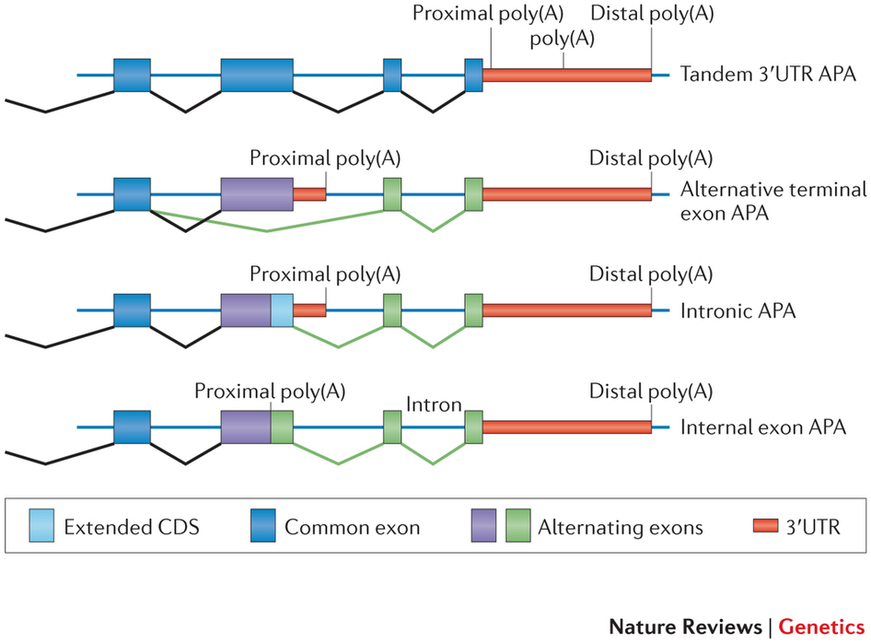
Alternative polyadenylation is common is many organisms
Elkon R, Ugalde AP, Agami R. Alternative cleavage and polyadenylation: extent, regulation and function. Nat Rev Genet. 2013;14:496–506

Slide 4
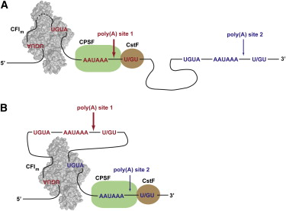
In human, RBP35 binds to UGUA motifs and affects alternative polyadenylation
Yang Q, Coseno M, Gilmartin GM, Doublie S (2011) Crystal structure of a human cleavage factor CFI(m)25/CFI(m)68/RNA complex provides an insight into poly(A) site recognition and RNA looping. Structure 19: 368–377. doi: 10.1016/j.str.2010.12.021

Slide 5
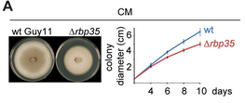


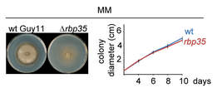

Δrbp35 is defective in pathogenicity and growth
Franceschetti M, Bueno E, Wilson RA, Tucker SL, Gómez-Mena C, et al. (2011) Fungal virulence and development is regulated by alternative pre-mRNA 3′ end processing inMagnaporthe oryzae. PLoS Pathog 7: e1002441. doi: 10.1371/journal.ppat.1002441

Slide 6
Sequencing resume
2 strains (WT, Δrbp35) x 4 conditions (CM, MM, -N, -C) x 3 replicates
HiSeq 2000 (Illumina) sequencing – poly(A) sites selection
4751592 – 11517077 total reads database
~95% replicates correlation
~73% successfully mapped reads
~400x coverage per poly(A) site*
* assuming an amount of 22000 mRNA molecules per cell

Slide 7





Workflow
Program and details
Procedure
% of data left
Illumina sequencing
100%
fasta-mcf, adapter trimming
Data prepping
96%
gsnap, default parameters
Alignment
96%
Low quality mapping (<30))
High A/T content (>90%)
Internal priming
Filtering
75%
Assign reads to known features,
Including all intergenic space up
to 400 bp from gene end
Assignment
65%
Clustering of most significant poly(A) sites (at least 5 supporting reads and modified z-score > 1) at 33 bp distance
poly(A) sites detection
27%

Slide 8
M. oryzae has longer 3'UTRs than S. cerevisiae

Slide 9
~85% of genes expressed have a recognizable poly(A) site

Slide 10
~14000 poly(A) site could be assigned to annotated genes

Slide 11
>90% of poly(A) sites are located in the 3'UTR

Slide 12
Nucleotides profile of poly(A) sites slighty differs from S.cerevisae
AU-rich
A-rich
U-rich
YA
U-rich
UGUA
UAGA
A-rich
U-rich
SA

Slide 13
M. oryzae prefers SA as cutting-site instead of YA

Slide 14
CA is the preferred cut-site in filamentous fungi, TA in yeasts

Slide 15
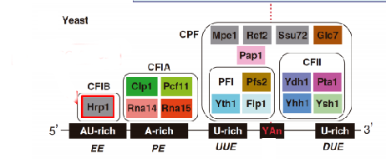
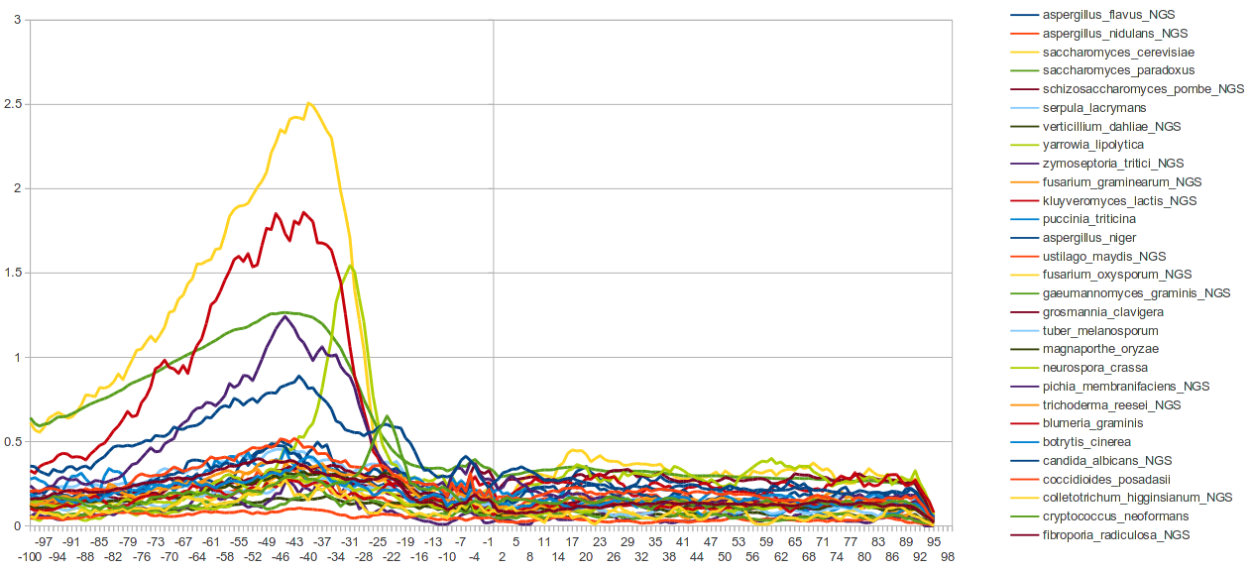
The motif bound by HRP1 in yeast is missing in filamentous fungi
yeasts
filamentous

Slide 16
The canonical metazoan AAUAAA motif has a frequency of only 7% in M. oryzae

Slide 17

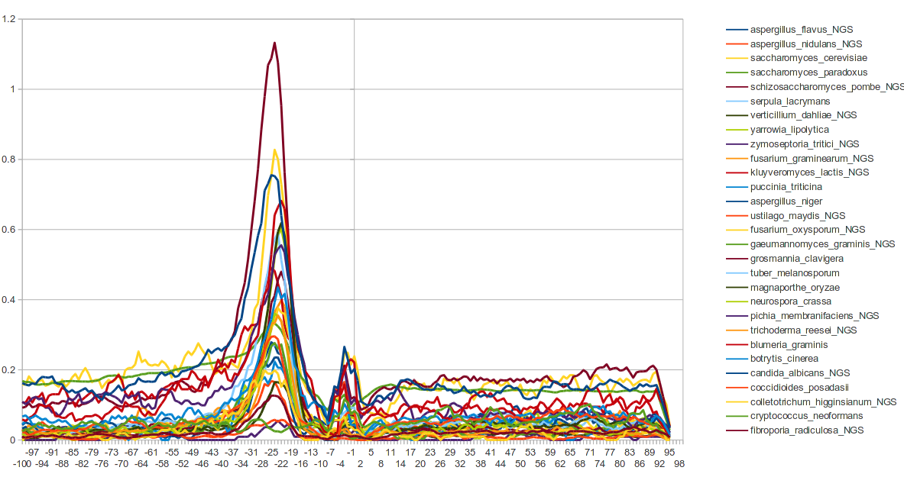
The A-RICH region is located -30 -10 bp upstream in most fungi
The canonical AAUAAA motif among fungi
70% is AAUAAA is vertebrates
Basidiomycota?

Slide 18
~30% of genes are alternatively polyadenylated
* calculated over the global number of expressed genes with a recognizable poly(A) site

Slide 19
>80% of APA is composed of two cleavage sites

Slide 20
>90% of APA are tandem poly(A) sites in the 3'UTR

Slide 21
APA is related with specific functional groups
(CM only)
Biological processes

Slide 22
APA is related with specific functional groups
(CM only)
Cellular components

Slide 23
APA is related with specific functional groups
(CM only)
Molecular functions

Slide 24
The most conserved APA genes are related with some metabolic processes
MGG_08078 Minor isoform of tropomyosin
MGG_06721 60S ribosomal protein L28
MGG_16201 CMD1 Calmodulin
MGG_08084 Cell wall biogenesis protein phosphatase Ssd1
MGG_04438 ADP-ribosylation factor
MGG_02872 40S ribosomal protein S27
MGG_13782 60S ribosomal protein L19
MGG_08006 Transmembrane nucleoporin
MGG_01079 Ras-like protein Rab-11A
MGG_16739 Eukaryotic translation initiation factor 5A
MGG_12122 CMGC/GSK protein kinase
...
cytoplasm
intracellular organelle
macromolecular complex
structural molecule activity
protein metabolic process
ribosome
Translation
….

Slide 25
261 highly expressed (>100 reads) poly(A) sites could not be assigned to any annotated gene

Slide 26
Antisense poly(A) are usually located in the 3'UTR

Slide 27
Δrbp35 affects poly(A) sites number

Slide 28

Δrbp35 affects poly(A) selection in ~25% of genes
WT
Δrbp35

Slide 29
RBP35 dependent genes are usually not differentially expressed

Slide 30
Δrbp35 affects 3'UTR length

Slide 31
Δrbp35 affects poly(A) sites usage, preferring proximal cuts

Slide 32
Δrbp35 affects poly(A) sites usage, preferring proximal cuts
Longer 3'UTR
Shorter 3'UTR

Slide 33
UGUAH is enriched at -45 in poly(A) sites dependent from RBP35

Slide 34
Δrbp35 dependent genes are related with specific functional groups
(CM only)
Biological processes

Slide 35
Δrbp35 dependent genes are related with specific functional groups
(CM only)
Cellular components

Slide 36
Δrbp35 dependent genes are related with specific functional groups
(CM only)
Molecular functions

Slide 37
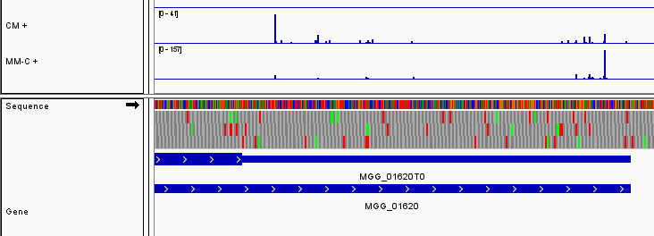
Carbon starvation affects a great number of poly(A) sites

Slide 38
Carbon starvation affects poly(A) sites usage, preferring distal cuts

Slide 39
Carbon starvation affects poly(A) sites usage, preferring distal cuts
Longer 3'UTR
Shorter 3'UTR

Slide 40
The polyadenylation site region has a defined secondary structure
Average MFE for poly(A) sites
Is significantly lower (-7.48089)
than random poly(A) sites (p-value =1.608E-015)
The polyadenylation site is usually structured and located in a hairpin-loop
The A-rich region is usually
not structured

Slide 41
The polyadenylation site region has a defined structure
Different cutsites have different base pais probabilites, with TG and CG the most
structured. The most common poly(A) site CA has a average conformation

Slide 42
The polyadenylation site region has a defined structure
Different A-rich motifs results in different degrees of conformation, with
AAUAAA the most unstructured

Slide 43
The polyadenylation site region has a defined structure
In S.cerevisiae, the poly(A) site is not clearly structured

Slide 44
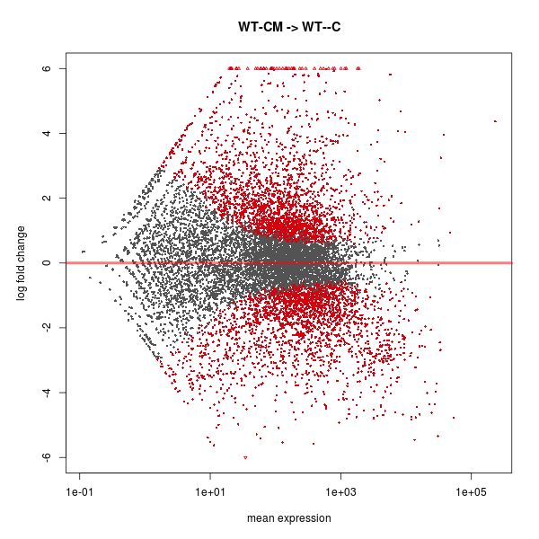
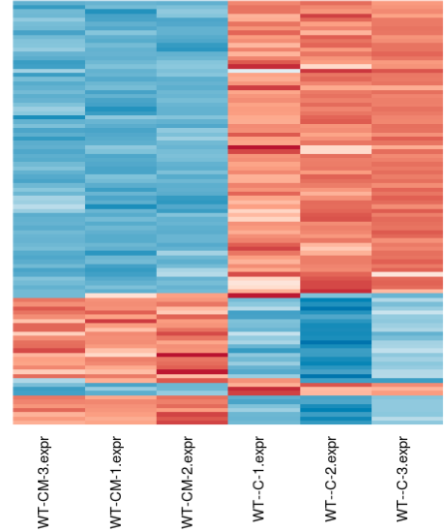
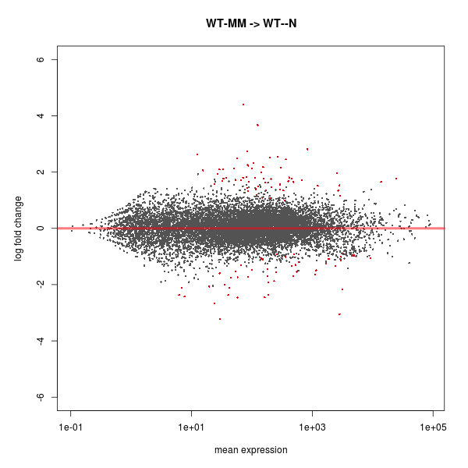
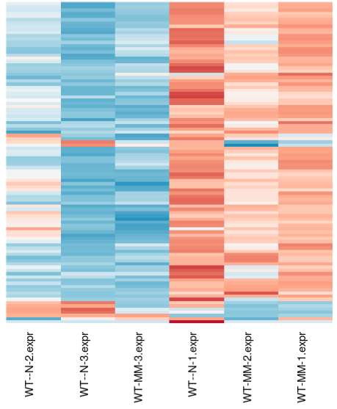
In the Wild-type The CM → MM-C condition presents the highest number of differentially expressed genes, while MM → MM-N the lowest
CM → MM-C
DIFFERENTIALLY EXPRESSED GENES IN THE WT
 | DOWN | UP | TOTAL
CM → MM | 314 | 559 | 873
CM → MM-N | 630 | 874 | 1504
CM → MM-C | 2307 | 2342 | 4649
MM → MM-N | 48 | 59 | 107
MM → MM-C | 1882 | 1589 | 3471
MM → MM-N

Slide 45
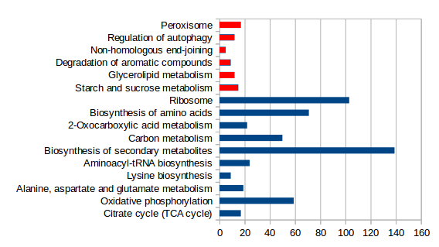

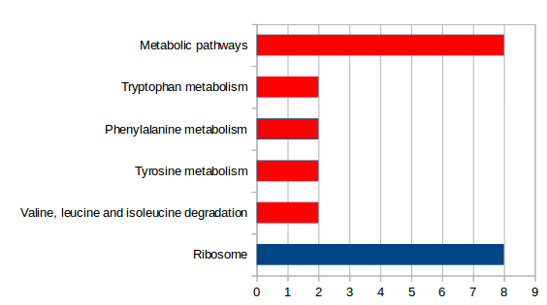
In the Wild-type The CM → MM-C condition presents the highest number of differentially expressed genes, while MM → MM-N the lowest
CM → MM-C
MM → MM-N

Slide 46
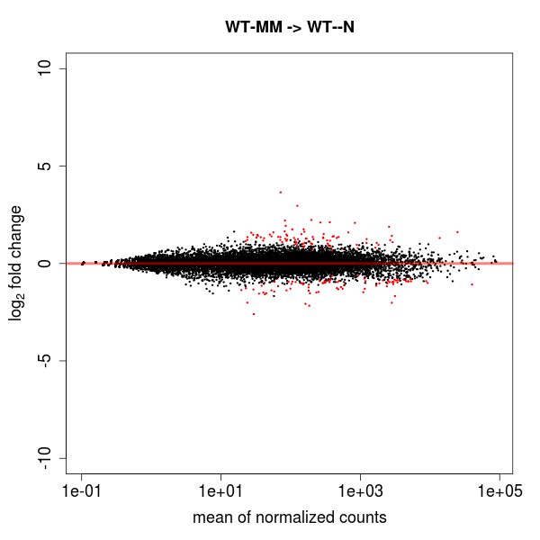
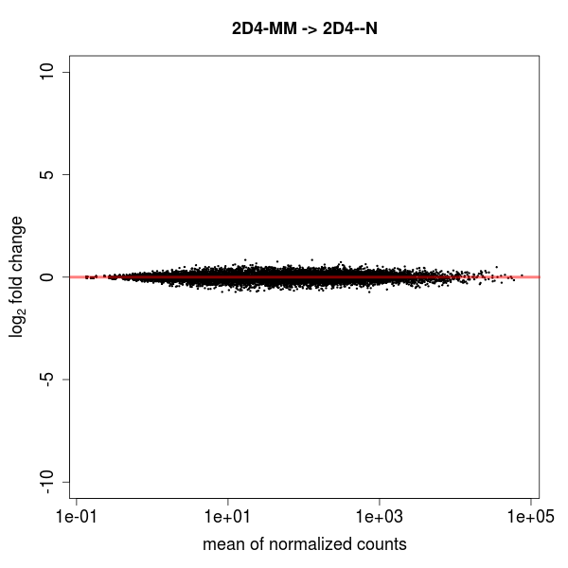
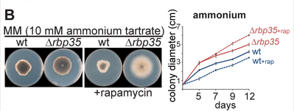
Δrbp35 appears to inhibit medium recognition in MM-N
WT
MM → MM-N
Δrbp35
MM → MM-N
DIFFERENTIALLY EXPRESSED GENES IN Δrbp35
 | DOWN | UP | TOTAL
CM → MM | 508 | 405 | 913
CM → MM-N | 461 | 404 | 865
CM → MM-C | 1241 | 1136 | 2377
MM → MM-N | 0 | 0 | 0
MM → MM-C | 475 | 493 | 968
Several genes of the mTOR pathway are
also affected!

