Slide 1
Evolution

Slide 2
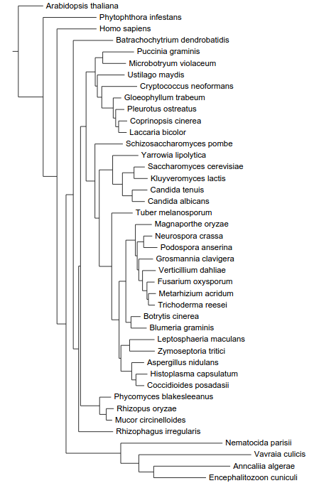
The phylogeny of fungi
Actin
Diphthine synthase
Glutamine tRNA synthetase
RNA polymerase III
Transcription factor TFIIH
DNA topoisomerase III
Exportin 1
Chytridiomycota
Basidiomycota
Taphrinomycotina
“Yeasts”
Ascomycota
“Filamentous Ascomycota”
Mucorales
Zygomycota
Microsporidia

Slide 3
Polyadenylation relative evolutionary rate
Chytridiomycota
Basidiomycota
Taphrinomycotina
“Yeasts”
Ascomycota
“Filamentous Ascomycota”
Mucorales
Zygomycota
Microsporidia

Slide 4
Spliceosome relative evolutionary rate
Chytridiomycota
Basidiomycota
Taphrinomycotina
“Yeasts”
Ascomycota
“Filamentous Ascomycota”
Mucorales
Zygomycota
Microsporidia

Slide 5
Translation relative evolutionary rate
Chytridiomycota
Basidiomycota
Taphrinomycotina
“Yeasts”
Ascomycota
“Filamentous Ascomycota”
Mucorales
Zygomycota
Microsporidia

Slide 6
Yeast and microsporidia have few genes containing introns
Chytridiomycota
Basidiomycota
Taphrinomycotina
“Yeasts”
Ascomycota
“Filamentous Ascomycota”
Mucorales
Zygomycota
Microsporidia

Slide 7
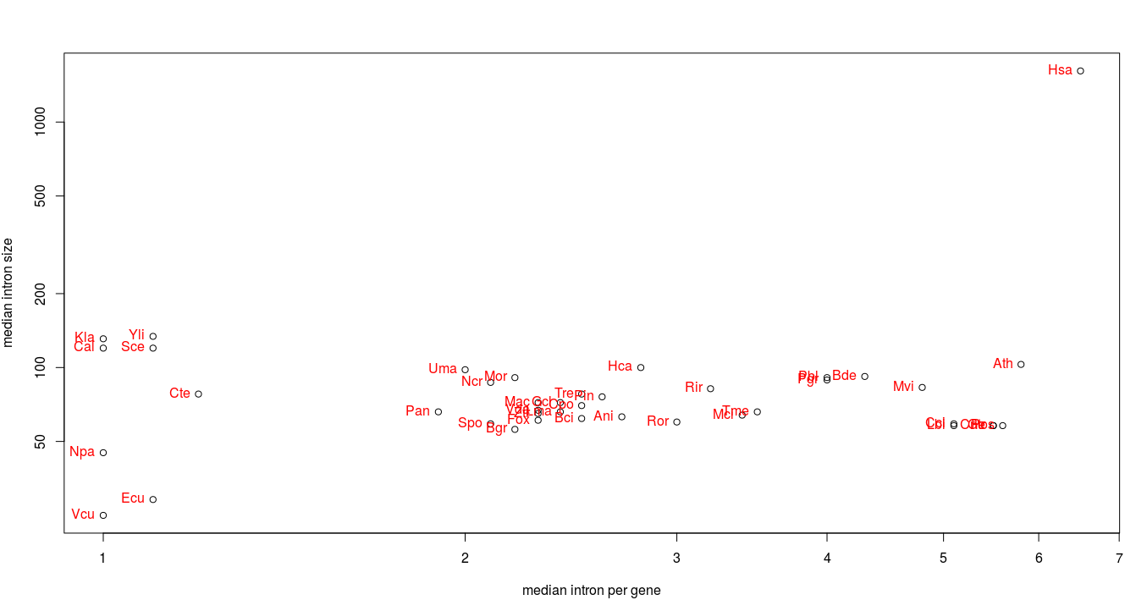
Yeasts have few, big introns
“Yeasts”
Basidiomycota
(except U. maydis)
Microsporidia

Slide 8
Acceptor site is variable
arabidopsis_thaliana
phytophthora_infestans
homo_sapiens
batrachochytrium_dendrobatidis
puccinia_graminis
microbotryum_violaceum
ustilago_maydis
cryptococcus_neoformans
gloeophyllum_trabeum
pleurotus_ostreatus
coprinopsis_cinerea
laccaria_bicolor
schizosaccharomyces_pombe
yarrowia_lipolytica
saccharomyces_cerevisiae
kluyveromyces_lactis
candida_tenuis
candida_albicans
tuber_melanosporum
magnaporthe_oryzae
neurospora_crassa
podospora_anserina
grosmannia_clavigera
verticillium_dahliae
fusarium_oxysporum
metarhizium_acridum
trichoderma_reesei
botrytis_cinerea
blumeria_graminis
leptosphaeria_maculans
zymoseptoria_tritici
aspergillus_nidulans
histoplasma_capsulatum
coccidioides_posadasii
phycomyces_blakesleeanus
rhizopus_oryzae
mucor_circinelloides
rhizophagus_irregularis

Slide 9
Acceptor site is variable, TAG preference in basal fungi, non-canonical presence in yeasts

Slide 10
Donor site is more uniform is some species
arabidopsis_thaliana
phytophthora_infestans
homo_sapiens
batrachochytrium_dendrobatidis
puccinia_graminis
microbotryum_violaceum
ustilago_maydis
cryptococcus_neoformans
gloeophyllum_trabeum
pleurotus_ostreatus
coprinopsis_cinerea
laccaria_bicolor
schizosaccharomyces_pombe
yarrowia_lipolytica
saccharomyces_cerevisiae
kluyveromyces_lactis
candida_tenuis
candida_albicans
tuber_melanosporum
magnaporthe_oryzae
neurospora_crassa
podospora_anserina
grosmannia_clavigera
verticillium_dahliae
fusarium_oxysporum
metarhizium_acridum
trichoderma_reesei
botrytis_cinerea
blumeria_graminis
leptosphaeria_maculans
zymoseptoria_tritici
aspergillus_nidulans
histoplasma_capsulatum
coccidioides_posadasii
phycomyces_blakesleeanus
rhizopus_oryzae
mucor_circinelloides
rhizophagus_irregularis

Slide 11
Branch site is more uniform is yeasts
arabidopsis_thaliana
phytophthora_infestans
homo_sapiens
batrachochytrium_dendrobatidis
puccinia_graminis
microbotryum_violaceum
ustilago_maydis
cryptococcus_neoformans
gloeophyllum_trabeum
pleurotus_ostreatus
coprinopsis_cinerea
laccaria_bicolor
schizosaccharomyces_pombe
yarrowia_lipolytica
saccharomyces_cerevisiae
kluyveromyces_lactis
candida_tenuis
candida_albicans
tuber_melanosporum
magnaporthe_oryzae
neurospora_crassa
podospora_anserina
grosmannia_clavigera
verticillium_dahliae
fusarium_oxysporum
metarhizium_acridum
trichoderma_reesei
botrytis_cinerea
blumeria_graminis
leptosphaeria_maculans
zymoseptoria_tritici
aspergillus_nidulans
histoplasma_capsulatum
coccidioides_posadasii
phycomyces_blakesleeanus
rhizopus_oryzae
mucor_circinelloides
rhizophagus_irregularis

