Slide 1
Vehicle Policy Part 1 Signals Access
VIN-1001 Shift Signals
VIN-3001 Shift Signals
VIN-1001 Door Signals
…
VIN-3001 Door Signals
VIN-1001 Window Signals
VIN-3001 Window Signals
VIN-1001 Trip Signals
VIN-3001 Trip Signals
Trip Signals
Window Signals
Door Signals
Shift
Signals
OEM employee 1
Sebastian
Ana
Owner Accessible
Signals
{r,w}
OEM Accessible
Signals
Vehicle OEM
{r}
Vehicle Owners
Signals Access

Slide 2
Vehicle Policy Part 2 Vehicle Ownership
Sebastian
Ana
VIN-1001 Door Signals
VIN-1002 Door Signals
…
…
VIN-1001 Trip Signals
VIN-1002 Trip Signals
…
…
VIN-1001
VIN-2001
VIN-1002
VIN-3001
Correia Family Vehicles
Correia Family
{o,r}
Scholze Family Vehicles
Scholze Family
{o,r}
Owners
Vehicles
Vehicle Ownership

Slide 3
Notional “Combined” Vehicle Policy
VIN-1001 Shift Signals
VIN-1002 Shift Signals
VIN-2001 Shift Signals
VIN-3001 Shift Signals
Sebastian
Ana
VIN-1001 Door Signals
VIN-1002 Door Signals
VIN-2001 Door Signals
VIN-3001 Door Signals
VIN-1001 Window Signals
VIN-1002 Window Signals
VIN-2001 Window Signals
VIN-3001 Window Signals
VIN-1001 Trip Signals
VIN-1002 Trip Signals
VIN-2001 Trip Signals
VIN-3001 Trip Signals
Shift
Signals
Door Signals
Window Signals
Trip Signals
VIN-1001
VIN-1002
VIN-2001
VIN-3001
Scholze Family Vehicles
Scholze Family
{o,r}
Correia Family Vehicles
Correia Family
{o,r}
OEM employee 1
Owner Accessible
Signals
Owners
{r}
Vehicles
OEM Accessible
Signals
Vehicle OEM
{w}
o - own
r – read w - write
Vehicle Ownership
Signals Access
PM

Slide 4
Example of Simple Role-Based Access Control (RBAC) Policy*
Users: jones, smith
Roles
Intern
Doctor
Objects: Medical Records
Doctor role has all access rights of Intern role plus write access to Medical Records
*From PM User Guide, Figure 1

Slide 5
Declarative Coding of Simple Role-Based Access Control (RBAC) Policy
policy('Policy3','rbac', [
user('jones'),
user('smith'),
user_attribute('Doctor'),
user_attribute('Intern'),
object(mrec1,’File’,no,musial,’E:\PM\Examples\MedRecords\mrec1.rtf’,object_attribute,’Medical Records’),
object_attribute('Medical Records'),
policy_class('rbac'),
operation(read, 'File'),
operation(write, 'File'),
connector('PM'),
assign('jones','Intern'),
assign('smith','Doctor'),
assign('Doctor','Intern'),
assign('mrec1','Medical Records'),
assign('Intern','rbac'),
assign('Medical Records','rbac'),
assign('rbac','PM'),
associate('Doctor',[write],'Medical Records'),
associate('Intern',[read],'Medical Records')
]).

Slide 6
Example ‘Policy4’: ‘Privileged-Access’
policy('Policy4','Privileged-Access', [
user(u1),
user(u2),
user(u3),
user_attribute(ordinary_user),
user_attribute(administrative_user),
user_attribute(all_users),
object(o1),
object(o2),
object(o3),
object(o4),
object_attribute(unrestricted_object),
object_attribute(restricted_object),
object_attribute(all_objects),
policy_class('Privileged-Access'),
connector('PM'),
assign(u1,ordinary_user),
assign(u2,ordinary_user),
assign(u3,administrative_user),
assign(ordinary_user,all_users),
assign(administrative_user,all_users),
assign(o1,unrestricted_object),
assign(o2,unrestricted_object),
assign(o3,restricted_object),
assign(o4,restricted_object),
assign(unrestricted_object,all_objects),
assign(restricted_object,all_objects),
assign(all_users,'Privileged-Access'),
assign(all_objects,'Privileged-Access'),
assign('Privileged-Access','PM'),
associate(ordinary_user,[read],unrestricted_object),
associate(administrative_user,[read,write],all_objects)
]).

Slide 7
Example ‘Policy4’: ‘Privileged-Access’
u1
u2
u3
o1
o2
o3
o4
ordinary_user
{read}
unrestricted_object
administrative_user
restricted_object
{read,write}
all_users
all_objects
‘Privileged-Access’
‘PM’

Slide 8
SoS Cloud-of-Clouds
Local Clouds
lc1
lc2
p13
p22
c11
c21
c12
c22
p11
g1
g2
c23
Cloud of Clouds
p12
p21
lc3
g3
GG Policy
c32
p31
g_a( g1, {invoke}, g3 ).
g_a( g1, {invoke}, g2 ).
Gateway for cloud N
gN
c31
Consumer m in cloud N
CC Policy
cNm
p32
Provider m in cloud N
c_a( ea11, {invoke}, ea31 ).
c_a( ea12, {invoke}, ea21 ).
pNm
p33
Enterprise connectivity

Slide 9
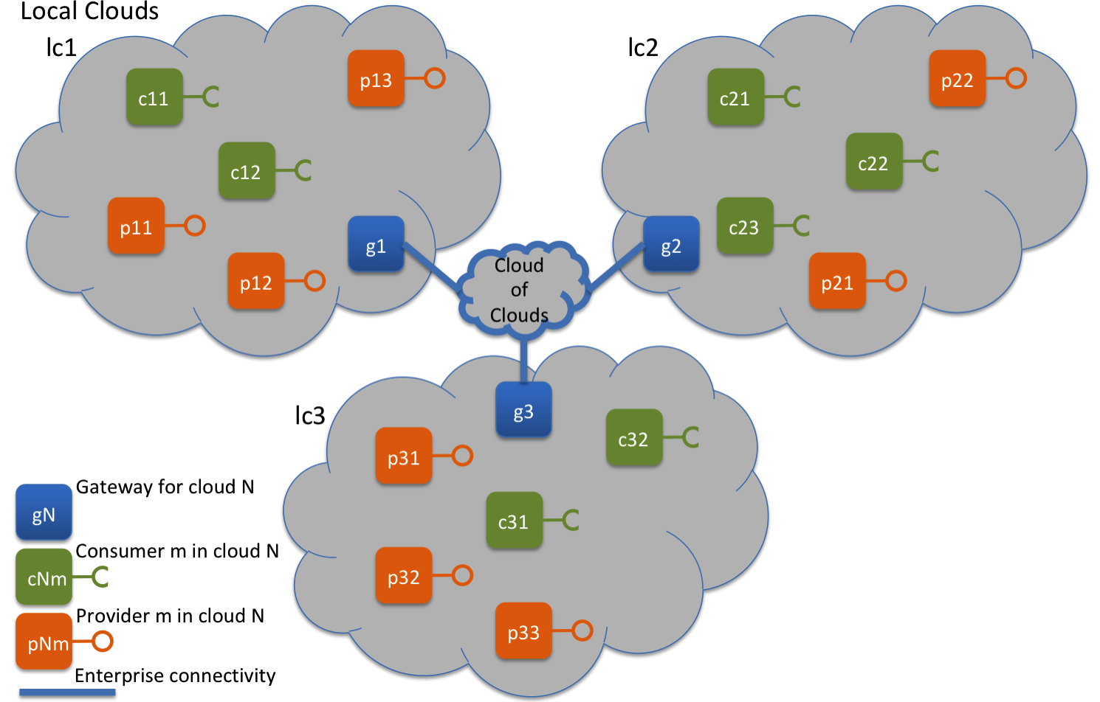
SoS Cloud-of-Clouds policies
policy(lc1_policy, , [
. . .
assign( c11, cgroup1 ),
assign( c12, cgroup2 ),
assign( p11, pgroup1 ),
assign( p12, pgroup1 ),
assign( p13, pgroup2 ),
. . .
assoc( cgroup1, {invoke}, pgroup1 ),
assoc( cgroup2, {invoke}, pgroup2 ),
. . . ] ).
Gateway-Gateway Policy
g_a( g1, {invoke}, g3 ).
g_a( g1, {invoke}, g2 ).
Cloud-Cloud Policy
c_a( ea11, {invoke}, ea31 ).
c_a( ea12, {invoke}, ea21 ).

Slide 10
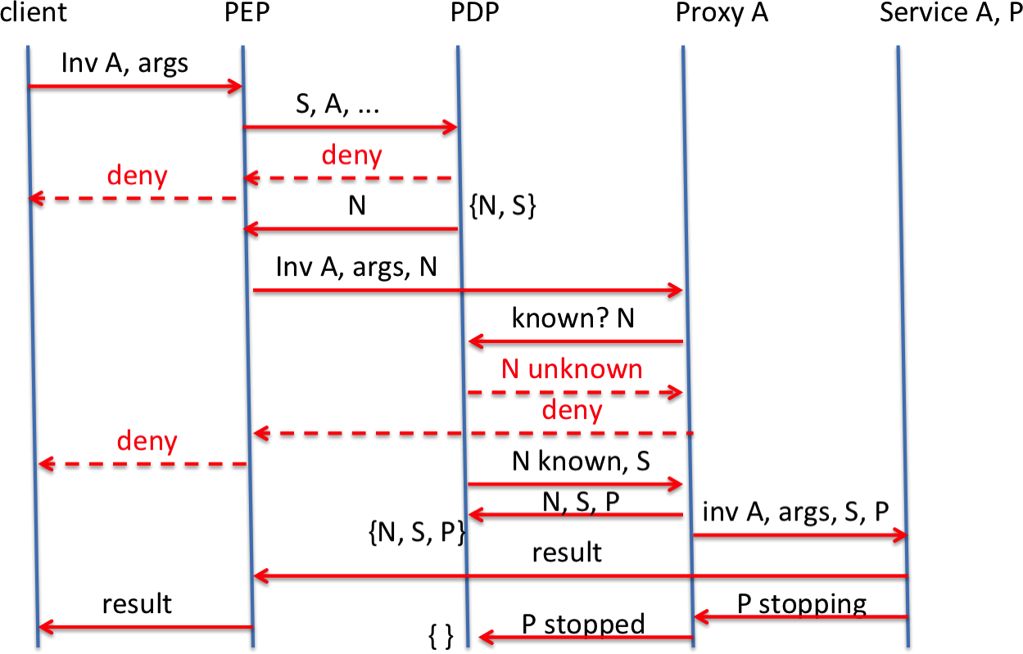
Web service protocol - succeed

Slide 11
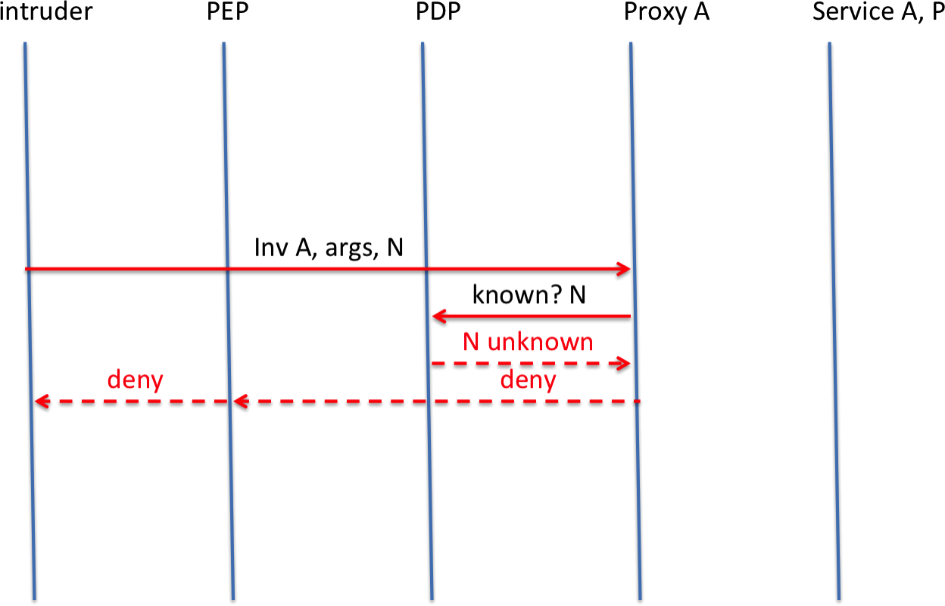
Web service protocol - fail

