Slide 1
Why Audience Ratings Differ from Critic Ratings
Wilson Kung

Slide 2
Overview
Question:
What explains the difference between a movie’s audience rating and critic rating?
Data Source:
Internet Movie Database (IMDB)
Universe of Movies:
Movies released in 2013 and 2014 (~ 20,000 movies)
Approach:
Linear Regression

Slide 3
Data
Response Variable:
Rating Spread: User Rating minus Metacritic Rating
> 0: Audience liked movie more than Critics
< 0: Critics liked movie more than Audience
Predictors:
Budget
MPAA Rating
Genres

Slide 4
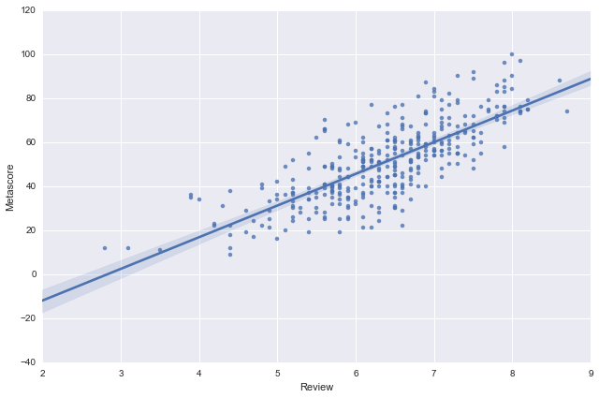
Exploratory Data Analysis: Audience vs. Critic Rating
Clear Relationship between Critic and Audience Rating

Slide 5
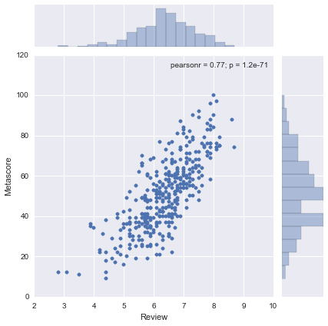
Exploratory Data Analysis: Audience vs. Critic Rating
Both distributions are relatively normal

Slide 6
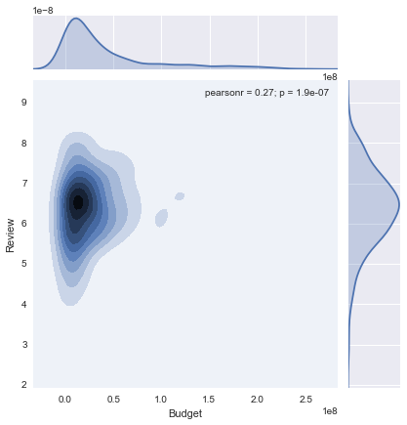
Exploratory Data Analysis: Budget vs. Audience Rating
Budget has a long right tail

Slide 7
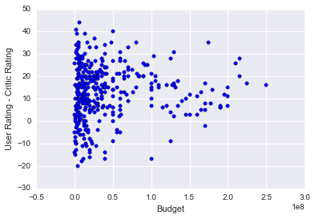
Exploratory Analysis: Budget vs. Rating Spread
More dots above 0 -> Audience generally rate movies better than critics
Higher Budget = Lower Variance of spread (Heteroscedasticity)

Slide 8
Model Results
Training Set: 75% of data points
Test Set: 25% of data points
Used fitted coefficients to predict difference in movie ratings on Test Set
Two-fold Cross Validation
Train Test
RMSE
Cross Validation 1 2.98 3.04
Cross Validation 2 2.94 3.18
R-Squared
Cross Validation 1 15% 4%
Cross Validation 2 16% 3%
Cross Validation shows that R-squared is stable
Test vs. Training results show that we over-fit the training data
Model can explain out of sample rating differences by ~3%!!!

Slide 9
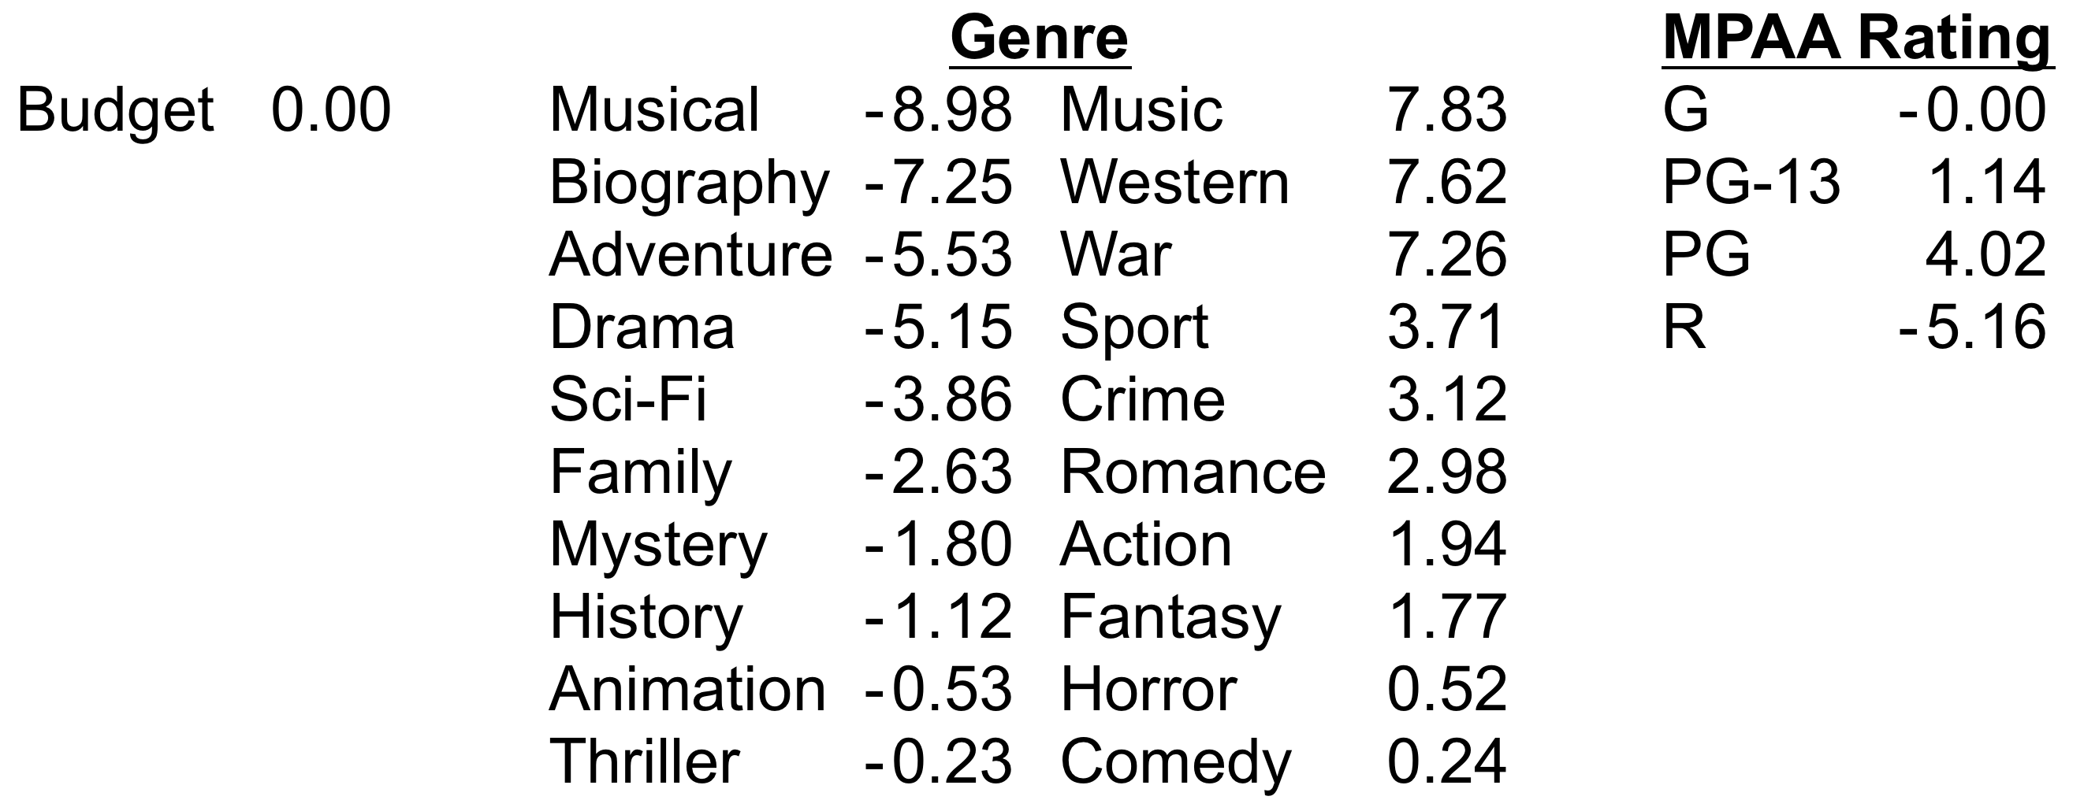
Model Estimation
Intercept: 16.99 -> Confirms the fact that the audience rates movies better
Coefficients:
Critics liked Musicals and Biographies more than the audience
Audience liked Music and Westerns more than critics
Critics liked R rated movies more than the audience
Budget surprisingly had little effect

Slide 10
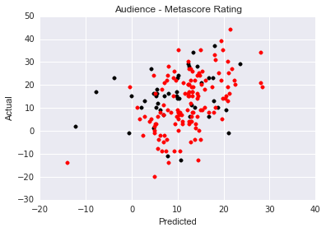
Predicted vs. Actual Rating Spread on both Training and Test data
Training set (red dots) are overfit
Test set (black dots) less well predicted

Slide 11
Ways to Improve R-squared
Use higher order features
Remove insignificant predictors
Add runtime and director as predictors
Use regularization to reduce overfitting
Normalize budget feature

