Slide 1
Using MTA Turnstile Data to Allocate Street Teams July 2015
Darius Audryc
Alison Cossette
Wilson Kung

Slide 2

Women Tech Women Yes
WTWY short term’s objective:
To increase WTWY’s annual Gala attendance
WTWY long term’s objective:
To increase awareness of WTWY
Request:
To find 8 – 10 stations with the highest volumes for both weekdays and weekends in order to optimize the placement of our street teams
Data Source:
Use MTA subway data

Slide 3
Our Proposal
Utilize the MTA turnstile data to prepare a 4 day street team:
Publicize their organization and gala event.
Gain the most signatures/e-mails
Our Work:
High volume locations
Highest lunchtime traffic
Weekends Rain contingency.

Slide 4
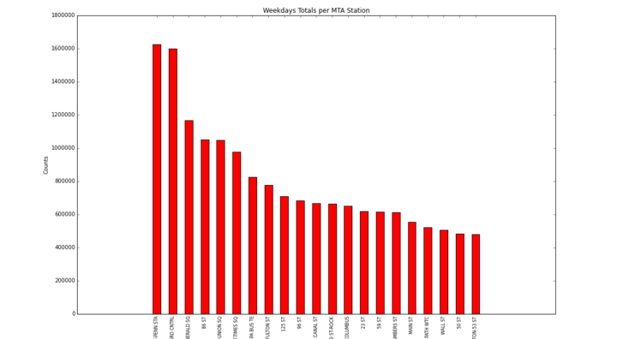
High Volume Locations Weekdays

Slide 5
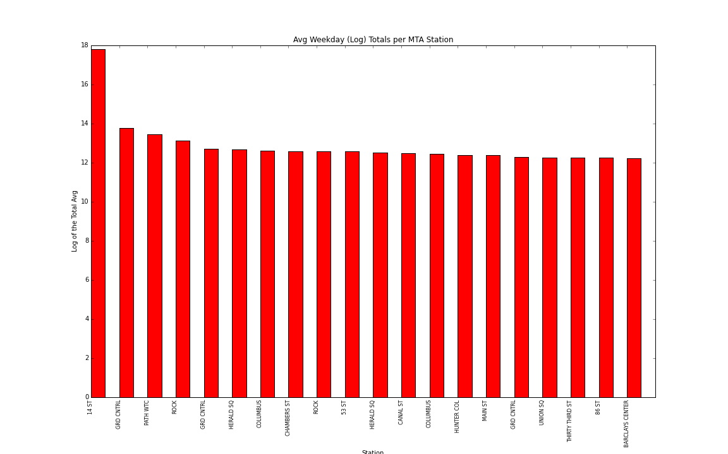
Highest Lunchtime Density

Slide 6
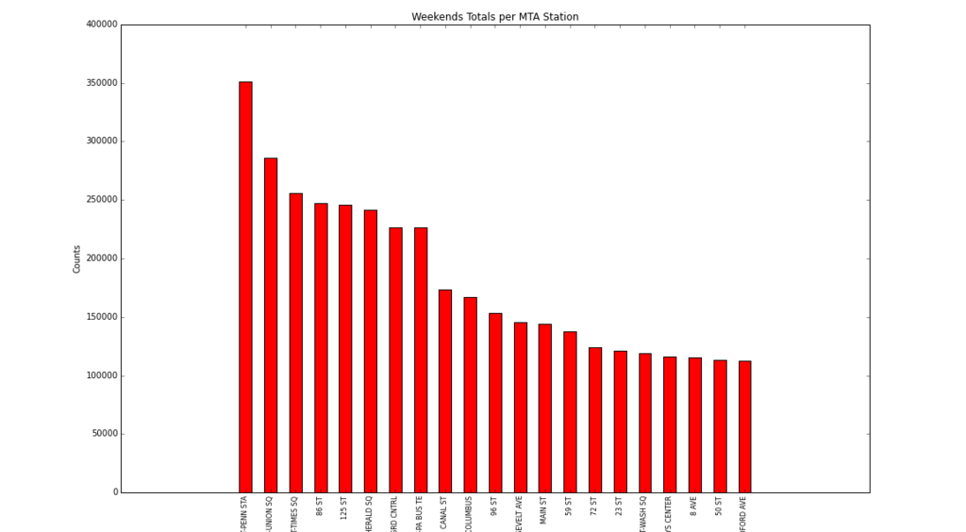
High Volume Locations Weekends

Slide 7
Conclusion
Weekday Volume
Penn Station, Grand Central, Herald Square, Union Square, Times Square, Port Authority
Lunchtime Density
Union Square, Grand Central, Path WTC, Rock Center
Weekend Volume
Penn Station, Union Square, Times Square, 86 St, 125 St, Herald Square, Grand Central, Canal St, Columbus Circle

