Slide 1
Predicting Financial Markets with Supervised Learning Algorithms
Wilson Kung
September 2015

Slide 2
Background
Financial markets are hard to predict
Markets are susceptible to human emotions such as overreaction to news
Constant stream of information effecting markets
Market regimes are constantly changing
Discovered patterns disappear
How can we overcome these difficulties?

Slide 3
Use computer algorithms to make investing decisions
Can nearly instantly ingest a large amount of information
Will not trade based on emotions

Slide 4
Overview
Goal
Overcome these difficulties by using computers to assess a lot of economic data when released by the source
Predict the next day’s market direction using macroeconomic and financial time series data
Compare the accuracy of different neural networks /deep learning structures
To find the most inefficient or predictable financial market

Slide 5
Data Source and Issues
~ 2,500 financial and macroeconomic time series from the St. Louis Fed’s FRED database
Data Issues:
Inconsistent starting dates
Inconsistent frequency
Inconsistent release day of week for weekly data
Timestamps of weekly data was not date of release but last date of data coverage

Slide 6
Markets to Predict
S&P 500
Gold
Oil
US Treasury Yields

Slide 7
Methodology
Find the market that is most predictable using standard classification algorithms
Calculate accuracy of best performing algorithm on most predictable market
Compare to accuracy of using various forms of neural nets

Slide 8
Data Preprocessing
Market prices from Yahoofinance
Used pandas
Calculated daily differences
Standardized data
Rolling training with one day prediction
Solutions:
Used daily data only
Cut out data prior to a start date of the feature with the latest start date
Only 500 features remained to be used

Slide 9
Add to presentation
Heatmap of accuracy of different models
Put nice background on title like alison cossette
Interpretation of weights?
Use different activation functions
Feature importance: try adding noise to each feature and see what happens to accuracy

Slide 10
Methodology
Feed Forward Neural Networks
Data only goes forward starting from input nodes to output nodes
Used Nolearn/Lasagne/Theano
Recurrent Neural Networks
Loops exist within the layers such that outputs can be inputs to nodes at the same layer or to prior layers
Can be thought of as a way to introduce a kind of memory into the system
Works well for sequential data such as time series and text data
Used PyBrain

Slide 11
Accuracy Visualizations
Graph of Accuracy vs. various number of layers of a Feed Forward Neural Net Structure
Graph of Accuracy vs. various number of nodes for two hidden layers
Graph of Accuracy for Feed Forward vs. Recurrent Neural Networks

Slide 13
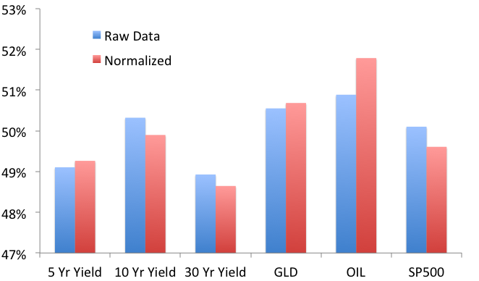
Average Accuracy By Market Across All Algorithms

Slide 14
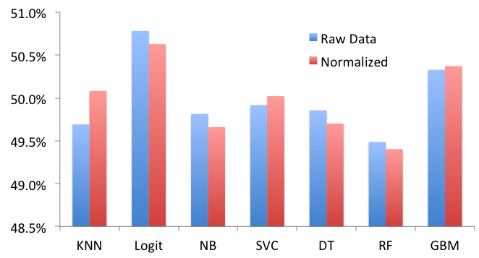
Average Accuracy By Algorithm Across All Markets

Slide 15
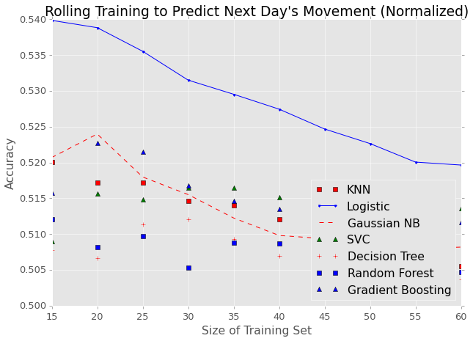
Prediction Accuracy for Oil Prices

Slide 16
Can we do Better with Neural Networks / Deep Learning?

Slide 17
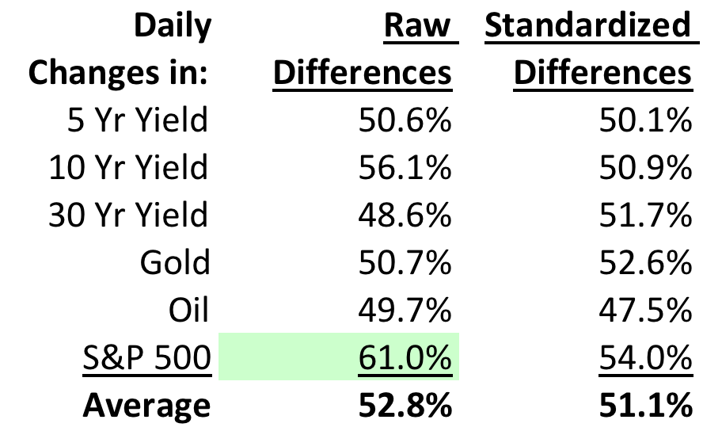
Neural Network Accuracies for Different Markets
* Feed Forward: 2 Layers with 500 and 50 Nodes

Slide 18
Conclusion
Explain the feasibility of using neural networks to predict financial markets
Explain general accuracy trends observed for various number of hidden layers and number of nodes per hidden layer
Explain general observations for accuracy between feedforward vs. recurrent neural networks

