Slide 1
Predicting Financial Markets with Supervised Learning Algorithms
Wilson Kung
September 2015

Slide 2
Background
Financial markets are hard to predict
Human psychology affects markets
Constant stream of information effecting markets
Market regimes are constantly changing
How can we overcome these difficulties?

Slide 3
Use computer algorithms to make trading decisions
Can nearly instantly ingest a large amount of information
Will not trade based on emotions

Slide 4
Goal
Predict the next day’s market direction using a macroeconomic and financial time series data
To find the most predictable financial market using standard supervised learning algorithms
Calculate the accuracy of best performing algorithm
See if neural networks can outperform

Slide 5
Data
Market Prices
US Treasury Yields
S&P 500
GLD
OIL
Yahoofinance
Features
500 daily financial and macroeconomic time series
St. Louis Fed’s FRED database
10 years of data: 2006 – Present

Slide 6
Data Issues and Preprocessing
Avoid Look-Ahead Bias:
Shifted market movement by 1 day to predict market movement by day before’s feature movements
Trained on various rolling windows and tested on next one day only
mimics a trading strategy that updates model on a daily basis to make trading decision for the next day
Standardized data
Subtracting mean and dividing by standard deviation

Slide 7
Training and Testing Methodology

Slide 8
Methodology
Find the market that is most predictable using standard classification algorithms
Calculate accuracy of best performing algorithm on most predictable market
Compare to accuracy of using various forms of neural nets

Slide 9
Supervised Learning Prediction Accuracies

Slide 10
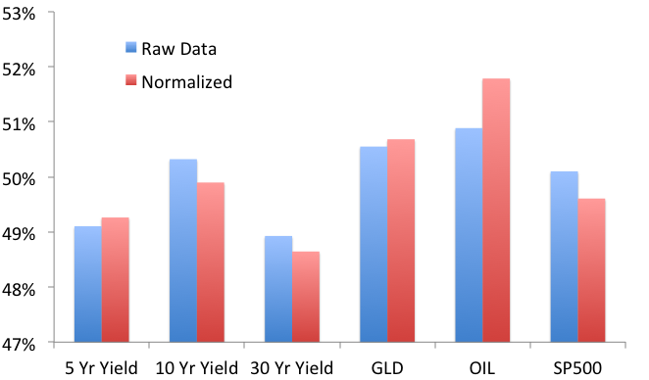
Average Accuracy By Market Across All Algorithms

Slide 11
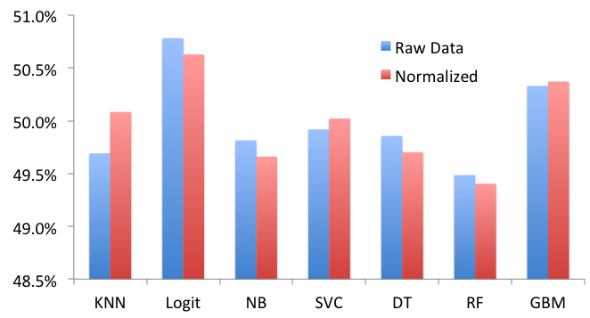
Average Accuracy By Algorithm Across All Markets

Slide 12
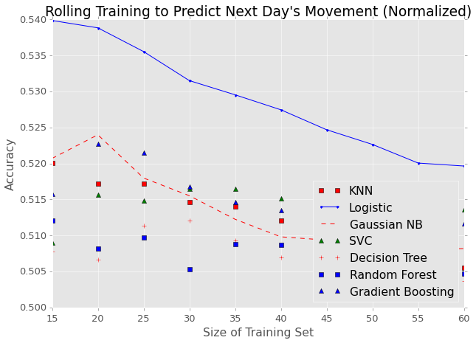
Prediction Accuracy for OIL ETF
Training on less data produces better results since picks up on changes in the market more quickly

Slide 13
Can We Do Better with
Neural Networks?

Slide 14
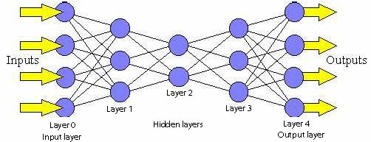
Feed Forward Neural Networks
Used Nolearn to implement Feed Forward Neural Networks
Notes:
http://cs.stanford.edu/people/eroberts/courses/soco/projects/neural-networks/Architecture/images/feedforward.jpg

Slide 15
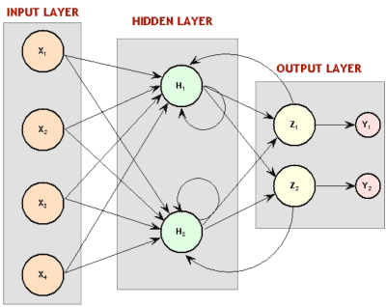
Recurrent Neural Networks
Used PyBrain to implement Recurrent Neural Networks
Reputation for good performance with time series data

Slide 16
Neural Network Accuracies for OIL prediction
Implemented one, two, and three hidden layer Feed Forward Neural Networks with 200 through 800 nodes per layer
84 different structures
On average, they all performed about the same
Highest accuracy was 54.48%.
Slight outperformance over Logistic Regression of 54.0%

Slide 17
Neural Network* Accuracies for Different Markets
* Feed Forward: 2 Layers

Slide 18
Conclusion
Explain the feasibility of using neural networks to predict financial markets
Explain general accuracy trends observed for various number of hidden layers and number of nodes per hidden layer
Explain general observations for accuracy between Feed Forward vs. recurrent neural networks

Slide 19
Add to presentation
Heatmap of accuracy of different models
Put nice background on title like alison cossette
Interpretation of weights?
Use different activation functions
Feature importance: try adding noise to each feature and see what happens to accuracy

