Slide 1
Predicting Financial Markets: New Modeling Paradigms
Wilson Kung
September 2015

Slide 2
Goal
Predict the financial market direction using macroeconomic and financial time series data

Slide 3
Data
Predicting Next Day’s Movement:
US Treasury Yields
S&P 500
GLD ETF
OIL ETF
Features
500 daily financial and macroeconomic time series
Source: St. Louis Federal Reserve FRED database
10 years of data: 2006 – Present

Slide 4
Data Issues and Preprocessing
Avoid Look-Ahead Bias:
Shifted market movement by 1 day to predict market movement by day before’s feature movements
Trained on various rolling windows and tested on next one day only
mimics a trading strategy that updates model on a daily basis to make trading decision for the next day
Standardized data
Subtracting mean and dividing by standard deviation

Slide 5
Training and Testing Methodology

Slide 6
Methodology
Find the market that is most predictable using standard classification algorithms
Calculate accuracy of best performing algorithm on most predictable market
Compare to accuracy of using various forms of neural nets

Slide 7
Supervised Learning Prediction Accuracies

Slide 8
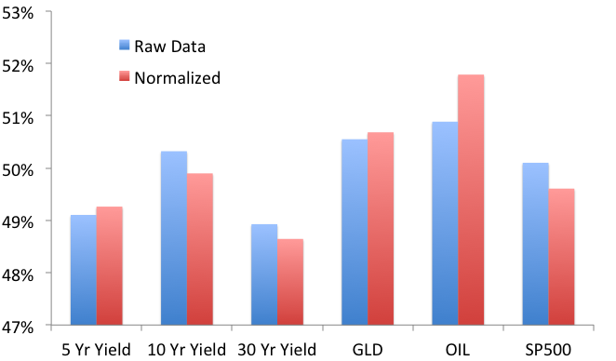
Average Accuracy By Market Across All Algorithms

Slide 9
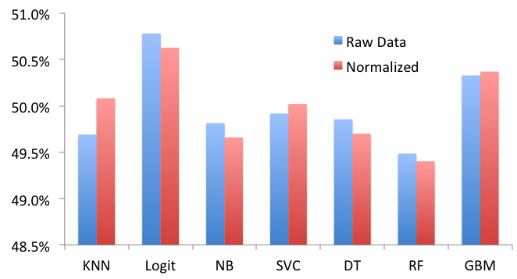
Average Accuracy By Algorithm Across All Markets

Slide 10
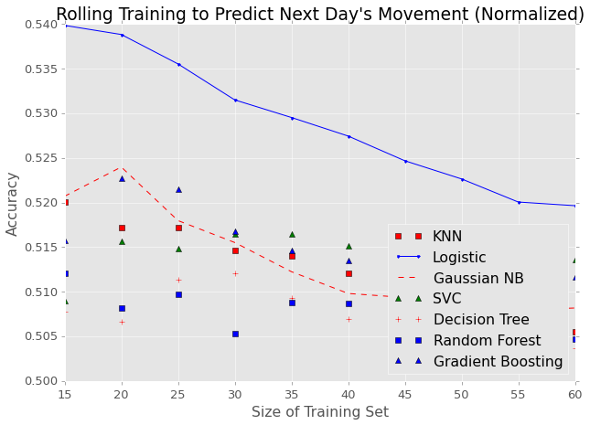
Prediction Accuracy for OIL ETF
Training on less data produces better results since picks up on changes in the market more quickly

Slide 11
Can We Do Better with
Neural Networks?

Slide 12
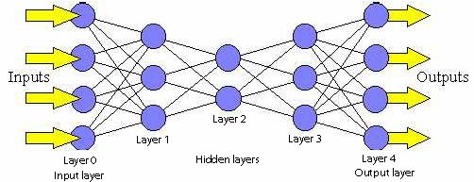
Feed Forward Neural Networks
Used Nolearn to implement Feed Forward Neural Networks
Notes:
http://cs.stanford.edu/people/eroberts/courses/soco/projects/neural-networks/Architecture/images/feedforward.jpg

Slide 13
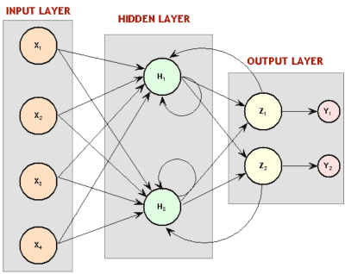
Recurrent Neural Networks
Used PyBrain to implement Recurrent Neural Networks
Reputation for good performance with time series data

Slide 14
Neural Network Accuracies for OIL prediction
Feed Forward Neural Networks:
One, two, and three hidden layers
200 through 800 nodes per layer
84 different structures
Results:
They all performed about the same
Highest accuracy was 54.48% vs. 54% for Logistic Regression

Slide 15
Recurrent Neural Network Accuracies for OIL prediction
Recurrent Neural Networks:
Two hidden layers
25 through 400 nodes per layer
28 different structures
Results:
They all performed about the same
Highest accuracy was 54.28% vs. 54.48% for Feed Forward Neural Networks

Slide 16
Neural Network* Accuracies for Different Markets
* Feed Forward: 2 Layers

