Slide 1
Predicting Financial Markets: New Modeling Horizons
Wilson Kung
September 2015

Slide 2
Overview
Predicting Next Day’s Movement:
US Treasury Yields
S&P 500
GLD
OIL
Features:
500 daily time series
2006 – Present
Source: St. Louis Federal Reserve

Slide 3
Data Issues and Preprocessing
Avoid Look-Ahead Bias
Trained on various rolling windows and predicted next day’s market movement
Normalized features
Notes:
Shifted market movement by 1 day to predict market movement by day before’s feature movements
mimics a trading strategy that updates model on a daily basis to make trading decision for the next day
Subtracting mean and dividing by standard deviation

Slide 4
Methodology
Using traditional classifiers:
Find the best-performing algorithm
Find the most predictable market
Develop neural net architectures competitive with the state of the art

Slide 5
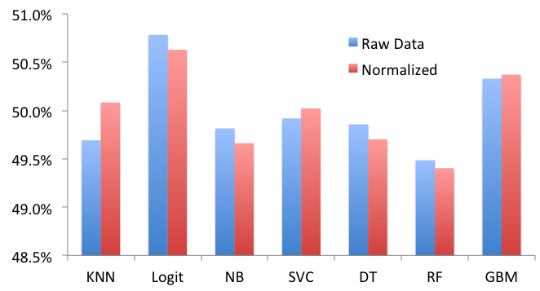
Average Accuracy By Algorithm Across All Markets

Slide 6
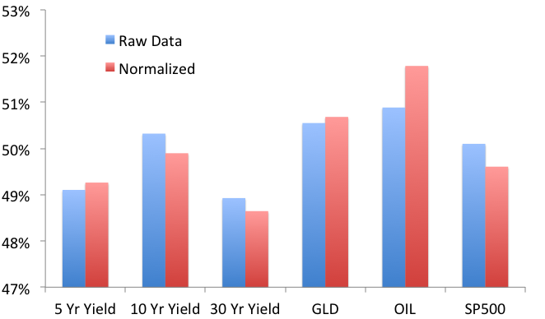
Average Accuracy By Market Across All Algorithms

Slide 7
Can We Do Better with
Neural Networks?

Slide 8
Feed Forward Neural Networks for OIL prediction
Used Nolearn to implement Feed Forward Neural Networks
84 different architectures
Results:
Highest accuracy was 54.48% vs. 54% for Logistic

Slide 9
Recurrent Neural Networks for OIL prediction
Used PyBrain to implement Recurrent Neural Networks
28 different architectures
Results:
Highest accuracy was 54.28% vs. 54.48% for Feed Forward Neural Networks

Slide 10
Average Accuracy By Market Across All Algorithms

Slide 11
Average Accuracy By Algorithm Across All Markets

