Slide 1
Predicting Direction of Next Day’s VIX Movement
Wilson Kung

Slide 2
Response Variable: Direction in Movement in VIX
What is VIX?
Implied volatility of options on S&P 500 with 30 day maturity
What the market believes the volatility of stocks will be over the next 30 days
“Fear index”
What can I do if I can predict VIX?
Trade VIX futures
Hedge portfolio better
Protect your retirement money better

Slide 3
Features
Yesterday’s Change in Closing Prices and Trading Volume of the following:
S&P 500
VIX
Treasury Yields: 13 week, 5, 10, 30 Year
Oil
Gold
U.S. Dollar Index
Change in Garmin Klass Volatility:

Slide 4
Time Series Issues
5 years of data
January 1, 2010 to Present
Trained on various rolling windows and tested on next one day only
mimics a trading strategy that updates model on a daily basis to make trading decision for the next day
Averaged the accuracy of all the one day predictions

Slide 5
Training and Testing Methodology

Slide 6
Time Series Issues
Avoid Look-Ahead Bias:
Shifted VIX movement by 1 day so that we are predicting VIX movement by day before’s factor movements
Ignored Precision Recall
Benefits of correct predictions are equally balanced*
Correctly predicted up or down equally good
Costs of mistakes are equally balanced
Incorrectly predicted up or down equally bad
Used Accuracy as measure of goodness of model
* Assuming shorting is allowed

Slide 7
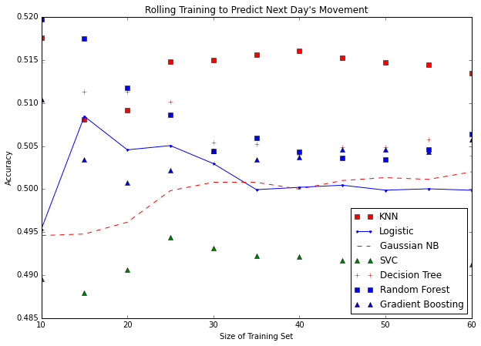
Focus on KNN and Random Forest
Training on less data produces better results since picks up on changes in the market more quickly

Slide 8
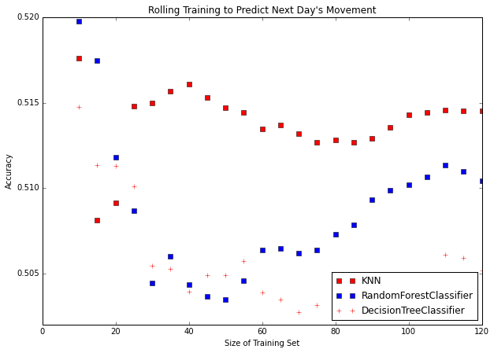
KNN: high, stable accuracy
Picked KNN even though RM had slightly higher accuracy at 10 day window
Random Forest and DT sensitive to training period

Slide 9
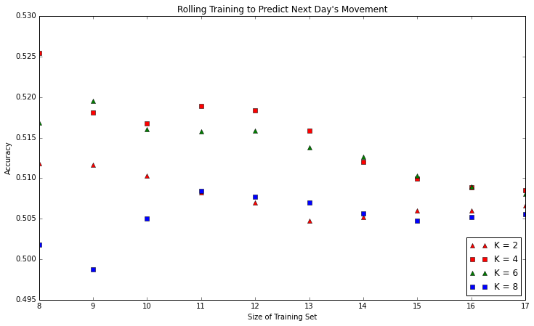
Highest Accuracy = 52.5%
K = 4, Training Period = 8

Slide 10
Accuracy as a function of K and Training Days in Excel

