Slide 1
Real-World Deployment
Notes:
Remember to talk slowly!
Questions are welcome at any time and are to be encouraged, even if they have nothing to do with the talk!

Slide 2
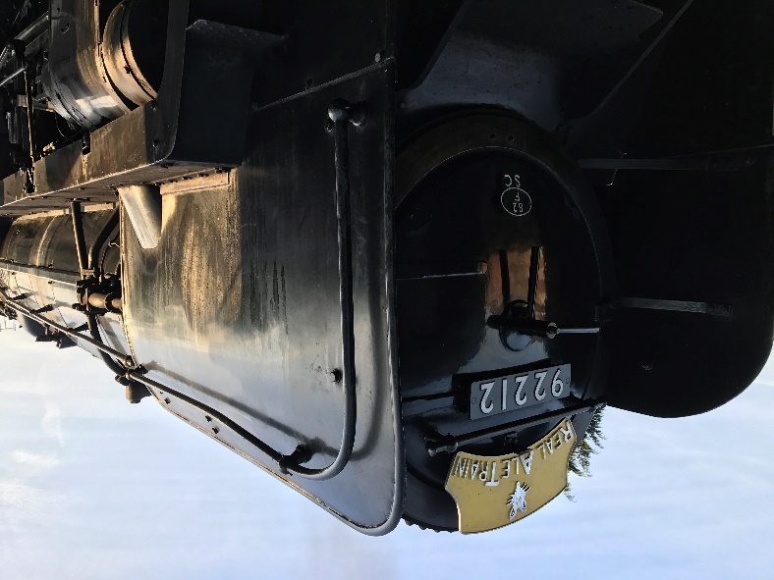
About Me
Will Tomlinson - Infrastructure / DevOps Engineer at Vanquis Bank
Spent over 8 years working at an MSP in various roles
Using PowerShell since 2011… with various levels of success!
Automation enthusiast
Volunteer at the Watercress Line – its always good to have non-tech hobbies ;)

Slide 3
Why this topic?
I decided a while ago that I wanted to give something back to the community after attending my fair-share of meet-ups, so I thought it would be good to have a topic that was interesting, relevant and that I could talk about with some confidence.
In the end, I decided on talking about my experiences with a large, real-world deployment that I’ve spent the majority of 2019 working on. It also would show that whilst tech demos in meet-ups are cool, they rarely in my experience translate into what happens when you need to implement something in the day job.
Hopefully I’ve chosen my topic wisely…

Slide 4
The Usual Approach
provider "azurerm" {
version = "~> 1.36"
}
resource "azurerm_resource_group" "resourceGroup" {
name = "RG-${var.BaseName}-${var.Environment}"
location = "${var.Location}"
}
resource "azurerm_app_service_plan" "webAppPlan" {
name = "ASP-${var.BaseName}-${var.Environment}"
location = "${var.Location}"
resource_group_name = "${azurerm_resource_group.resourceGroup.name}"
sku {
tier = "${var.AppTier}"
size = "${var.AppSize}"
}
}
resource "azurerm_app_service" "webApp" {
name = "WA-${var.BaseName}-${var.Environment}"
location = "${var.Location}"
resource_group_name = "${azurerm_resource_group.resourceGroup.name}"
app_service_plan_id = "${azurerm_app_service_plan.webAppPlan.id}"
connection_string {
name = "${azurerm_sql_database.sqlDatabase.name}"
type = "SQLServer"
value = "Server=${azurerm_sql_server.sqlServer.fully_qualified_domain_name},1433;Initial Catalog=${azurerm_sql_database.sqlDatabase.name};User ID=${var.SqlAdmin}; Password=${var.SqlPassword};"
}
https_only = "${var.AppHttpsOnly}"
site_config {
ftps_state = "${var.AppFtpState}"
}
}
…
So we all know the drill, turn up at a meet-up to hear about some random, cool new thing somebody has been playing with recently. Its great for getting a basic grasp, but that’s normally it. Maybe they do a “complex” demo, e.g. deploy a website in Azure using Terraform…
Notes:
Full example in code folder (ComplexExample).
Normally in a meet-up, the demo is picked to show a particular feature or idea, in an overly simplified environment.
Very rare to get the context on how/where/when it can/should be used in the real-world

Slide 5
But what about the real world?
This brings us to my main subject: migrating “legacy” websites into Azure
Sounds simple enough, after all its not that much more complex than the demo we just saw
But as always, there are a few differences when dealing with the real world
Can we re-architect the infrastructure, to improve resiliency and “be best practice”?
Since we’re changing the infrastructure, why don’t we switch over to Terraform for the entire project?
If we’re going to be doing Infrastructure-as-Code, then why not put it with the website code for ease of management? Even better, we could modularise our code and simply store the configuration with the website code!
Hey, doesn’t using IaC let us make use of a CI/CD pipeline to build the environment? That’s pretty rad, we should do that!
In fact, why don’t we automate the release of the website code as well in the same pipeline, since we’re all fed up of doing manual releases anyway?
Now just replace all occurrences of “we” with “you”!
Notes:
Taken individually, all these things are good ideas. The only issue with this free-form development approach is that whilst not all of these steps are big in themselves, performing all these changes at once *is*… and that’s something that isn’t always obvious to project sponsors upfront

Slide 6
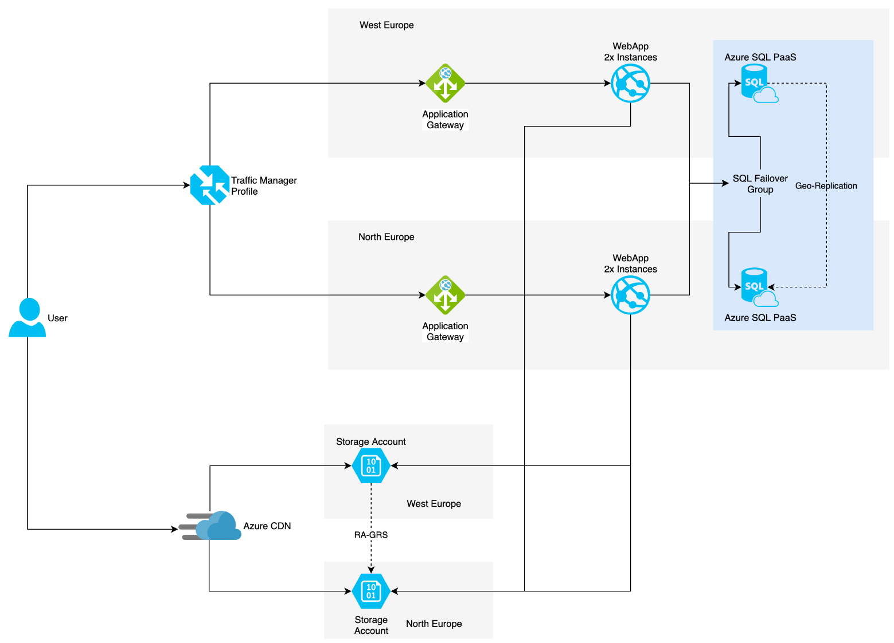
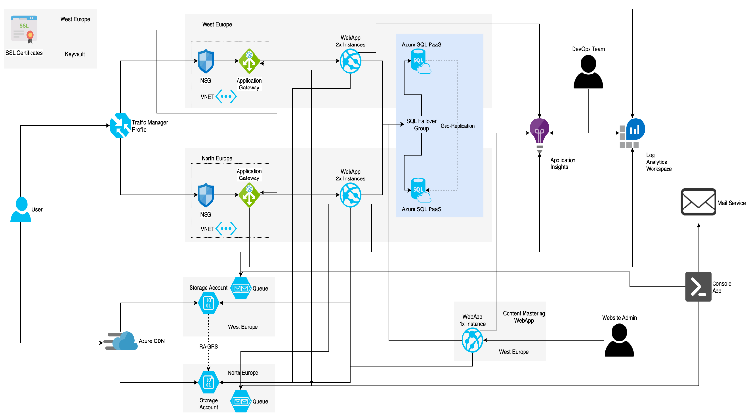
The Design
The initial design was simple, with a focus on Highly-Available components and Multi-Region for resilience
However, it was maybe too simple and forgot all the ancillary services that actually makes the system work. And boy did this get complicated…
Notes:
Made using draw.io – cheaper than Visio, but just as fiddly!

Slide 7
So what happened?

Slide 8
Problem: Resource Dependencies
One of the first issues came when we changed from the monolithic approach to using modules for our Terraform
We ended up with a Mexican standoff of sorts…
The Application Gateways won’t deploy without the FQDN of the WebApps
The WebApps won’t deploy without the Public IP being assigned
The Public IP isn’t allocated until the Application Gateways are deployed
So how did we break the dependency loop without giving up on modules?

Slide 9
Solution: Resource Dependencies
Initially, things weren’t looking good for the modular approach – after all, we hadn’t encountered this problem with the monolithic design we’d initially used.
In the end though we came up with a two-pronged approach to break the deadlock:
Hard-code the FQDNs for the Application Gateway using the expected values
Come up with a mechanism for delaying the WebApp deployment until after the Public IPs were allocated

Slide 10
Example: Resource Dependencies
[CmdletBinding()]
param (
[Parameter(Mandatory)]
[string]
$TenantId,
[Parameter(Mandatory)]
[string]
$SubscriptionId,
[Parameter(Mandatory)]
[string]
$ClientId,
[Parameter(Mandatory)]
[string]
$ClientSecret,
[Parameter(Mandatory)]
[string]
$PublicIp
)
function Test-IpAllocation {
[CmdletBinding()]
param (
[Parameter(Mandatory)]
[string]
$PublicIp,
[Parameter()]
[UInt32]
$Timeout = 5
)
process {
$allocated = $false
$start = Get-Date
while (!$allocated) {
$ip = (Get-AzPublicIpAddress -Name $PublicIp).IpAddress
if ($ip -ne "Not Assigned") {
$allocated = $true
} elseif ($start.AddMinutes($Timeout) -gt (Get-Date)) {
Start-Sleep -Seconds 10
} else {
break
}
}
if (!$allocated) {
Write-Information "Function terminated due to timeout" -InformationAction Continue
Write-Output $false
} else {
Write-Output $true
}
}
}
try {
$credentials = [System.Management.Automation.PSCredential]::new($ClientId,(ConvertTo-SecureString $ClientSecret -AsPlainText -Force))
Disable-AzContextAutosave -Scope process | Out-Null
Connect-AzAccount -Tenant $TenantId -Subscription $SubscriptionId -Credential $credentials -ServicePrincipal | Out-Null
Test-IpAllocation -PublicIp $PublicIp
} catch {
Write-Error $error[0]
exit 1
}
This is the script we came up with to check for the allocated IP in the end.
There are a few features worth noticing:
It needs to authenticate with Azure using the same Service Principal that Terraform uses
We need to wrap the body in a try…catch block that sends exit code 1 if there is an error – Terraform doesn’t read stderr (on Windows)
Notes:
Full code in .\code\PublicIp

Slide 11
Lesson: Resource Dependencies
Sometimes you have to do things you don’t like, e.g. Hard-Coding values
Modularisation isn’t always the be-all & end-all it’s made out to be
Some designs are just inherently tightly-coupled

Slide 12
Problem: Scope Creep
Another problem that I’m sure everyone is familiar with is scope creep. As you may remember from earlier, this project had a load to start with and it only got worse!
The main issue here was the addition of extra resources and services, as they’d been “forgotten” during the initial design. Look at the original diagram and you’ll wonder where the >70 resources we deployed came from!
One of the biggest headaches was the requirement to perform some URL redirections that had been previously handled by a couple of old IIS servers in the legacy environment
Notes:
A lot of the complexity of the second diagram was already in place for the legacy system and got forgotten/ignored when designing the new solution

Slide 13
Solution: Scope Creep
Application Gateways are powerful resources in Azure and can be configured to do the redirections we need as part of their backend settings. There were a few challenges with implementing them though…
We were already using old standards by the time we got this far in the project, namely Application Gateway V1 and Terraform 0.11
This meant longer deployments and no fancy syntax to make our code DRY
So we ended up adding all 30 redirects in to the module by hand (with variables), meaning deployments for this one resource type took upwards of half an hour AND the main file in the module was now roughly 1,200 lines of code – hardly the re-usable, maintainable modular dream!
Notes:
.\code\RedirectOverload
No awesome for_each looping here ☹

Slide 14
Better Solution: Scope Creep
In many, many ways the first solution made everything worse. Sure the redirection worked, but at what cost? We’d increased deployment times massively, made the module tightly-bound to this project and made everything a lot harder to troubleshoot. There had to be another way!
Simple – don’t do it!
We actually realised that the DNS provider could do the forwarding for us, since it was for entire domains. Why not embrace the “offload it to the cloud” idea even more and get someone else to do the work for us?
So we just reverted our module and made the DNS changes. Easy!

Slide 15
Lesson: Scope Creep
Sometimes you have to say “No” when asked to additional work in a project
And sometimes you really need to say “No!”
For the stuff you do need to do, look out for ways to offload it from your system to help keep complexity down

Slide 16
Problem: InfoSec
Whilst we know DevOps should really be DevSecOps, it is very rare for “Sec” to be working at that level. Normally there is just a list of security requirements your project must meet and someone you need to explain it to so they can approve.
The first issue was unfortunate – over the course of 8 months there were 7 different InfoSec representatives assigned to the project. Each time we had to explain
The project goals and Design
Terraform / IaC
Azure
The second issue was due to the list of requirements. We needed to use the latest OWasp ruleset in our WAF. Turns out that this wasn’t on the legacy setup, as it killed performance in the CMS backend… in detection-only mode!

Slide 17
Solution: InfoSec
[CmdletBinding()]
param (
[Parameter(Mandatory)]
[string]
$TenantId,
[Parameter(Mandatory)]
[string]
$SubscriptionId,
[Parameter(Mandatory)]
[string]
$ClientId,
[Parameter(Mandatory)]
[string]
$ClientSecret,
[Parameter(Mandatory)]
[string]
$ResourceGroup
)
$InformationPreference = "Continue"
Disable-AzContextAutosave -Scope Process | Out-Null
Import-Module Az.Accounts, Az.Resources, Az.Network
$creds = [System.Management.Automation.PSCredential]::new($ClientId, (ConvertTo-SecureString $ClientSecret -AsPlainText -Force))
Connect-AzAccount -Tenant $TenantId -Subscription $SubscriptionId -Credential $creds -ServicePrincipal | Out-Null
$rulesToDisables = @(
[PSCustomObject]@{ruleGroupName = "REQUEST-931-APPLICATION-ATTACK-RFI"; rules = @("931130");},
[PSCustomObject]@{ruleGroupName = "REQUEST-942-APPLICATION-ATTACK-SQLI"; rules = @("942260","942330","942340","942370");}
)
$appGateways = Get-AzApplicationGateway -ResourceGroupName $ResourceGroup
foreach ($appGw in $appGateways) {
$resource = Get-AzResource -Name $appGw.Name -ResourceType "Microsoft.Network/applicationGateways" -ResourceGroupName $ResourceGroup -ApiVersion "2018-07-01"
$resource.Properties.webApplicationFirewallConfiguration.disabledRuleGroups = $rulesToDisables
$resource | Set-AzResource -Force -ApiVersion "2018-07-01"
}
Unfortunately there wasn’t much we could do about the revolving door of team members…
For the OWasp ruleset issue though, we did manage to make some headway using Log Analytics in Azure. This let us comb the WAF logs and identify individual rules being triggered.
All that was left was a PowerShell script to disable them
Notes:
Full code in .\code\OWaspTweaks

Slide 18
Lesson: InfoSec
Don’t rely too much on any individual team members – they could be moved off the project at any time
Try to keep knowledge in a central repository that is accessible to the entire team
Performance test your application against security requirments!

Slide 19
Problem: Automating Build/Release
One of the project goals was to create an automated CI/CD pipeline for doing all the builds and releases. There was an existing build pipeline in Azure DevOps, but it was very basic – just compiling and publishing application code.
So we made a new one, that built the code, performed some validation on the Terraform config and then set about building the infrastructure and pushing the application code on to the WebApps. Simple, right?
Wrong! This grossly understated how many extra bits were necessary to get the websites to actually run. In the end we had to do the following extra steps:
For each instance, there are 4 scripts we need to run, post-deployment to handle known issues
To deal with issues introduced by Azure, there are another 6 tasks
And one of the databases can’t be deployed from DACPAC for some reason…

Slide 20
Solution: Automating Build/Release
[CmdletBinding()]
param
(
[Parameter(Mandatory)]
[string]
$Uri,
[Parameter(Mandatory)]
[string]
$Username,
[Parameter(Mandatory)]
[string]
$Password,
[Parameter()]
[string]
$ParameterSet
)
try {
$AsciiBytes = [Text.Encoding]::ASCII.GetBytes("$($Username):$($Password)")
$credentials = [Convert]::ToBase64String($AsciiBytes)
$headers = @{
Authorization = ("Basic {0}" -f $credentials)
}
$params = @{
Uri = $Uri
Headers = $headers
Method = "Post"
ContentType = "application/json"
}
if ($ParameterSet) {
$params.Uri = "$Uri`?arguments=$ParameterSet"
}
Invoke-RestMethod @params
} catch {
$scriptError = $_ -split '\n'
if ($scriptError.count -gt 1) {
foreach ($item in $scriptError) {
Write-Error $item
}
} else {
Write-Error $scriptError
}
exit 1
}
It turns out that Azure WebApps support running PowerShell scripts as WebJobs. The only issue is how to get them on the WebApps.
Well, we can use PowerShell for that too. And we can use it to run all of our other scripts from the pipeline to get the websites to run.
So by throwing enough PowerShell at the problem, we solved it… right?
Notes:
Full code in .\code\PipelineFixers

Slide 21
New Problem: Pipeline Sprawl
Each stage of the pipeline now has over 60 steps in it!
Most of them are for deploying and running these fixer scripts
And each time another intricacy of deployment is uncovered, another series of steps are added!
At the moment though, there isn’t really a solution for this. Complex systems tend to have complicated processes and this is no exception!

Slide 22
Lesson: Pipelines
It can be easy to get carried away with new & interesting technology
Sometimes you need to accept complexity for what it is
Consider what consolidation of tasks can be done
Notes:
We could probably have combined some of those post-deployment scripts without too much issue after the initial development was completed

Slide 23
Problem: Testing
Testing is a crucial part of any modern, well managed system, particularly when interfacing with external APIs, etc. These 3rd party systems often come with restrictions on how they’re accessed.
OK, nothing major there you say? But this is the real-world, so there’s always a snag…
One of our largest suppliers provide an API that we make a lot of use of. It can be accessed from any of our wired networks, but not the Wi-Fi
Then we have our security team, who’ve decided that outbound access to Azure is only allowed on the Wi-Fi and not the wired network
We have a regression suite that needs to talk to both of these systems… and needs to be run manually
There’s also the little matter of testing all of our IaC modules and scripts
Notes:
For reasons that I’m yet to fathom there is also no outbound SQL connectivity from the PCs… if you know why blocking outbound traffic by default is a good idea, please let me know!

Slide 24
Solution: Testing
Again, an item without a clear solution – at least for Terraform
Work has started on re-designing the test suite to run from a pipeline, but we still have issues accessing 3rd party systems
This is another case of trying to automate a manual process and will no doubt spawn it’s own set of issues!
Pester is being used for script modules, but is yet to be done for stand-alone ones or those in a Terraform module

Slide 25
So what happened?

Slide 26

Sophie
This little one joined the world in August, taking me out of the office for the second half of the month. Work on the project came to a halt and it was officially put on hiatus just before my return. Turns out that no matter how hard you try, sometimes someone is crucial to a project!

Slide 27
Disaster Strikes
Shortly after I returned to work, I was tasked with seeing what could be progressed outside of the formal project in terms of its original goal – get off of legacy systems and into Azure.
During my absence, some work had been done on the remaining CI/CD issues in a fork of the original repo, using it’s own pipeline. This was not popular with everyone, so we had to merge it back in and get the existing pipeline to create another environment.
So we cloned the Dev stage, changed all the variables that suddenly had no value and…
Deleted our Dev/Test environments.
Do not pass go.
Do not collect £200…
Notes:
We’re up to 5 stages now for those of you counting at home, with just over 300 tasks.
State file shared between pairs of stages – so not flagged as something that needed updating when we cloned the stage.

Slide 28
Recovery
Despite the major setback, it was felt that something could still be salvaged from the wreckage.
The original project goal had been to migrate the websites, mostly as a cost-saving exercise. Due to the nature of the legacy environment, we could potentially migrate some of the services to Azure and still power down VMs to reduce costs.
So we re-deployed the SQL and CDN/Storage Account components from the original design to a new Dev/Test environment and started work on incorporating their use into the existing websites.
That change was successfully completed back in October and we’re now also looking at restarting the project in the New Year

Slide 29
Learnings: What would I change?
When the project starts up again, there are certainly some changes I’d like to make:
Release pipeline as code – makes managing large, complex pipelines easier and would have almost certainly avoided the issue with deleting environments!
Replace the Application Gateways – they’re slow and relatively expensive for a PaaS component. Either the improved V2 SKU or, more likely, Azure Frontdoor
Tidy-up of the application code repository – lots of issues with App Settings, Connection Strings and the like came about because of Devs building the solution locally and then committing dodgy configurations back
Proof of Concept – a huge amount of work in the project was spent on testing ideas out and resolving issues with the proposed design, because no one did any exploratory work before the design was signed off

Slide 30
Any Questions?

