Slide 1

A Historical View of Programming Languages
A presentation by Bisola Akinkugbe

Slide 2

Python
Image source: pinclipart.com

Slide 3


History
The name “Python” came from a TV show called “Monty Python’s Flying Circus”, which the creator of the language greatly enjoyed.
Source: JavaTPoint, “Python History and Versions”
Python was invented as a successor to the ABC programming language, which was invented in 1987 by Geurts, Meertens & Pemberton.
Python itself was invented by Dutch scientist Guido van Rossum at CWI
Its implementation began in 1989 and the first stable build was released in 1991.
Since then, multiple builds have been released, the latest of them being on October 4, 2021.
What is Python?
Python is an interpreted high-level general purpose code.
It is an object oriented language, which enables programmers to write concise, logical code for projects of any size.
Source: Wikipedia, “Python (programming language)”
Founder
Python was invented by renowned scientist Guido van Rossum, born on January 31, 1956.
He originates from the Netherlands and has since moved to California with his family.
He developed Python while working at the Centrum Wiskunde & Informatica (abbr. CWI) of the Netherlands Organization for Scientific Research.
Source: Wikipedia, “Guido van Rossum”
“Guido van Rossum”
Image source: Wikipedia, “Guido van Rossum”

Slide 4



Applications that can be made with Python
Games, such as: Doki Doki Literature Club, Toontown Online, Battlefield 2, etc.
Hardware, such as: Robots, Machines, Motion sensors, etc.
Applications, such as: Instagram, Spotify, Reddit, Google, etc.
IDEs for Python
Pycharm
PyDev
Spyder
Scite
Sublime Text, etc.
Why I Chose Python
I chose Python because I have an extensive history with it.
During the pandemic, I used it to create small scrolling games and edit some of the games I already had.
It is my go-to language when I think of coding.
Related Languages
ABC
Haskell
Modula-3
Smalltalk
ALGOL 68, etc.
Image sources: stickpng.com

Slide 5

BASIC
Image source: Abbreviations.com

Slide 6
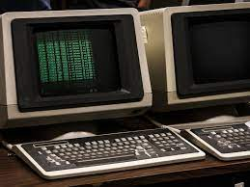
History
BASIC was designed by Thomas Kurtz and John Kemeny at Dartmouth College, New Hampshire in May 1964.
It drew inspiration from FORTRAN II, which had many confusing commands, and simplified them to an easily understandable degree.
It was used mainly as an avenue for undergraduate students to write their own computer programs.
Source: techterms.com, thoughtco.com
What is BASIC?
BASIC stands for Beginners’ All-Purpose Symbolic Instruction Code.
It is a general-purpose, high-level programming language.
Source: Wikipedia, “BASIC”
BASIC encompasses a family of languages, including: Atari BASIC, Microsoft BASIC, QuickBASIC, Visual BASIC, etc.
Image source: Getty Images, “Tim Martin”

Slide 7
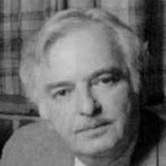
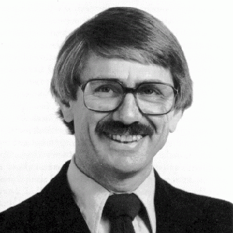
Founders
John Kemeny
He was born in Hungary in May 31, 1926.
Due to being Jewish, he moved to the USA with his family in 1940, following the rise of antisemitic sentiments.
He is a computer scientist and mathematician and was the 13th President of Dartmouth College.
He is said to have pioneered the use of computers in education.
Source: Wikipedia, “John G. Kemeny”
He co-developed BASIC in 1964.
He died in December 1992.
Thomas Kurtz
He was born in Illinois, USA in February 22, 1928.
He is a Ph.D holder and specialized in the area of mathematics and computer science.
He was a professor at Dartmouth College, before his retirement from the tech field all together.
He co-developed BASIC in 1964.
Source: Wikipedia, “Thomas E. Kurtz”
John Kemeny
Image source: peoplepill.com
Thomas Kurtz
Image source: IEEE Computer Society

Slide 8
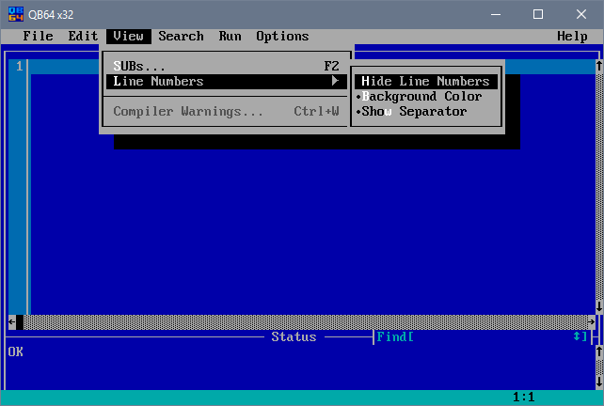
Why I chose BASIC
I chose BASIC because it was my first introduction to the world of prgramming.
We started to learn about it in JS1, and it gave me my first taste of Software Engineering.
Applications that can be made with BASIC
Games, such as: Gorillas, Nibbles, etc
Applications, such as: Calculators, Clients, etc.
QB64
Image source: ionhax.com
IDEs for BASIC
Qbasic
QB64
BASIC256
Visual Basic .NET, etc.
Related languages
FORTRAN II
JOSS
ALGOL 60
Source: Wikipedia, “BASIC”

Slide 9
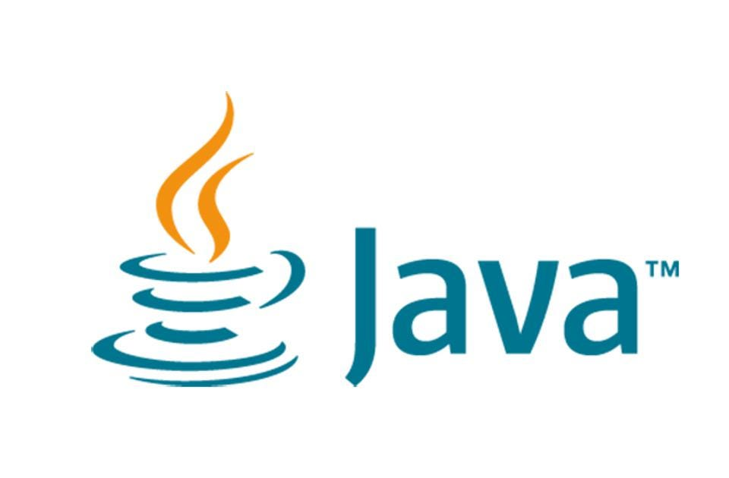
Java
Image source: forbes.com

Slide 10
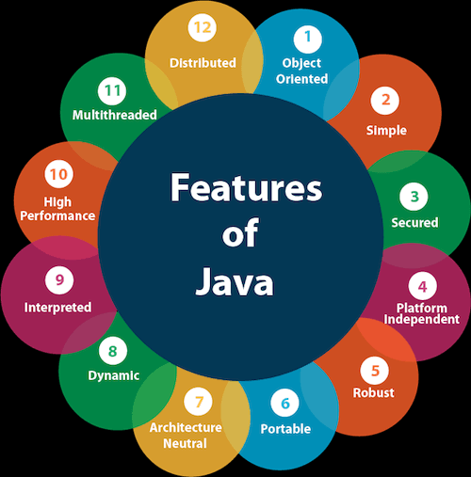
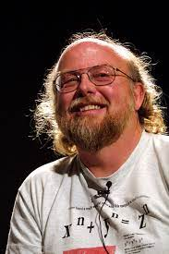
What is Java?
Java is a general-purpose, high-level, class-based, object-oriented language.
Source: guru99.com
It is used to develop applications and scripts in the .json format.
It is a server-side language for a lot of back-end developments.
Source: blogs.oracle.com
Image sources: javatpoint.com, nighthacks.com
History
Java was designed by James Gosling in 1995 and was published by Sun Microsystems, which is now a part of Oracle.
They began working on the language in 1991, though it was published four years later.
Founder
James Gosling was born in Alberta, Canada, in May 19, 1955.
He is a computer scientist by trade.
He was elected as a member of the National Academy of Engineering in 2004 for his creation of Java
Source: Wikipedia, “James Gosling”

Slide 11
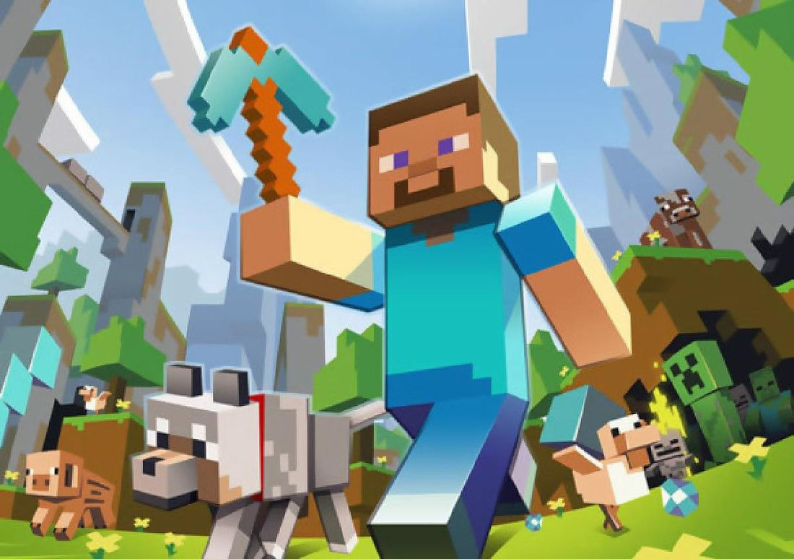
IDEs for Java
BlueJ
Jdeveloper
Eclipse
NetBeans
Microsft Visual Studio, etc.
Applications that can be made with Java
Games such as: Minecraft, God of War, etc.
Applications, such as: GUI, Web apps, LinkedIn, Uber, etc.
Software, such as: Operating Systems, etc.
Related languages
Lisp
Smalltalk
C++, etc.
Why I chose Java
I chose Java because one of my favorite games, Minecraft, was created with Java.
Also, I hope to someday learn Java so I can make my own modifications to the game.
Minecraft
Image source: theverge.com

Slide 12
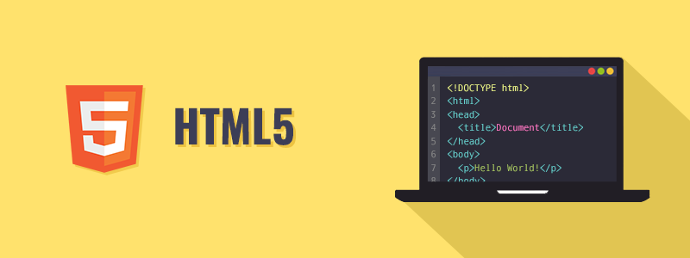
HTML
Image source: tutorialrepublic.com

Slide 13

What is HTML?
HTML stands for Hypertext Markup Language.
It is the computer language that is used to make most webpages and online applications.
It is used to create and edit the apperance of the text, images, fonts, colors and hyperlinks we see on webpages.
Founder
Tim Berners-Lee, aka TimBL, was born in London on June 8, 1995.
He is a computer scientist and the Father of the World Wide Web.
He has won multiple awards for his pioneering work on the Internet, as without it, the Web as we know it today would be non-existent.
He is currently a professor at the Massachusetts Institute of Technology (abbr. MIT) in the USA.
History
HTML was created in 1991 by Tim Berners-Lee, following his creation of the World Wide Web.
It was created with the aim of sharing information on the Internet.
It was then published in 1995 as HTML 2.0
The latest version is HTML 5, which was released in 2012.
Tim Berners-Lee
Image source: Wikipedia, “Tim Berners-Lee”

Slide 14
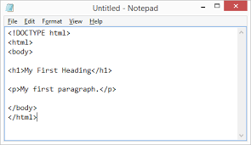
Related Languages
XML
XHTML
JSX
CSS, etc.
Applications made with HTML
Webpages
Client-side storage
Web documents
Internet applications, etc.
IDEs for HTML
Notepad
Albloom Prosite
Flazio
IM Creator, etc.
Source: blog.capterra.com
Why I chose HTML
I chose HTML because I have previous experience working with the language and I would like to eventually master it.
I aspire to create my own webpages using HTML.
Image source: w3schools.com

Slide 15
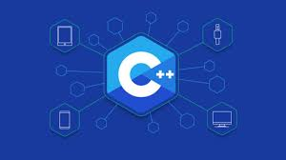
C++
Image source: dev.to

Slide 16

History
It was developed by Bjarne Stroustrup in 1982, at Bell Laboratories. It was meant to be a successor to “C”, then known as “C with Classes”.
He added new features to the language, including: constants, allocation, single-line comments, etc.
Source: Wikipedia, “C++”
It was first released commercially in 1985 as Cfront.
Since then, multiple versions of the language have been released, the latest being C++20 in December 2020.
What is C++ ​​?
C++, aka CXX, is a general-purpose, object-oriented language.
It is an extension of the “C” language.
It is a compiled language, and is provided as a compiler by vendors such as Oracle, Free Software Foundation, etc
Source: Wikipedia, “C++”
Bjanre Stroustrup
Image source: stroustrup.com
Founder
Bjanre Stroustrup was born in Aarhus, Denmark on December 30, 1950.
He graduated from university with a Master’s in computer science and mathematics. He later received a PhD in computer science.
He has won multiple awards for his work on C++.
Source: Wikipedia, “Bjarne Stroustrup”

Slide 17

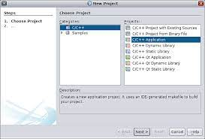
Applications that can be made with C++
Web browsers, such as: Mozilla Firefox, Google Chrome, etc.
Games, such as: Hollow Knight, Doom 3, etc.
Operating systems, such as: Windows 95, 98, XP, etc.
IDEs for C++
Visual Studio
Eclipse CDT
NetBeans
Xcode, etc.
Why I Chose C++
I chose C++ because I am interested in learning the C family of languages, especially C++.
This is because one of my favorite games, Hollow Knight, was made with a C language.
Related Languages
BCPL
C
C#
Ratfor, etc.
Hollow Knight
Image source: nintendo.com
NetBeans
Image source: netbeans.apache.org

