Slide 1
Biased algorithms and the criminal justice system
Will Merhige – Career Semester – Fall 2020

Slide 2
Understanding the problem
Correctional Offender Management Profiling for Alternative Sanctions (COMPAS) is an algorithm used by judges and parole officers in the criminal justice system to score a defendant's likelihood of reoffending… known as recidivism
COMPAS algorithm is developed by a for-profit company, Northpointe
Analysis conducted by ProPublica proved that the algorithm is biased against blacks
A system that has the power to influence a defendant’s sentence must be equal to men and women who identify with any race

Slide 3
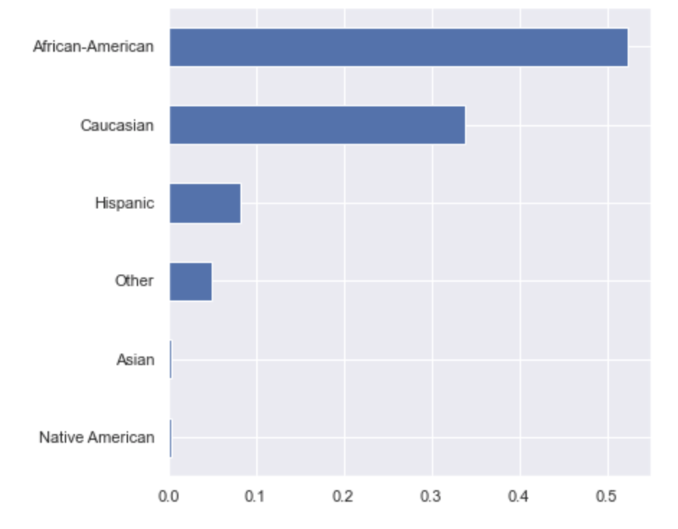
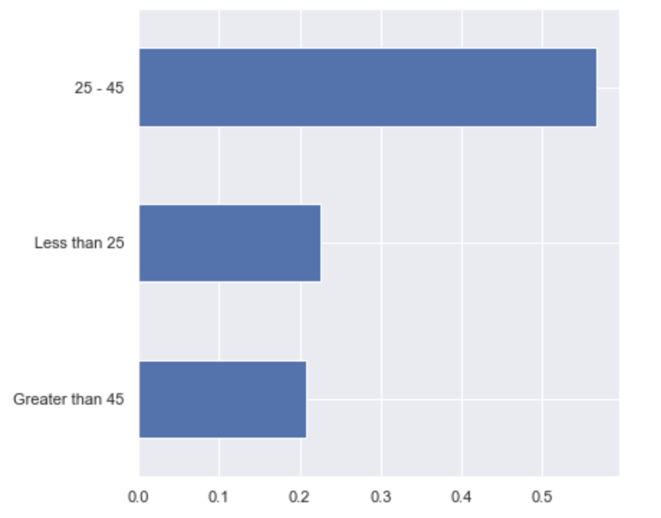
Exploring the data
Racial breakdown of defendants
Age breakdown of defendants

Slide 4
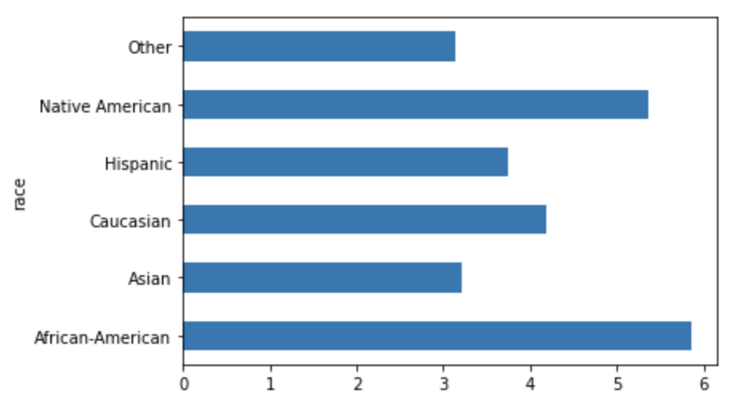
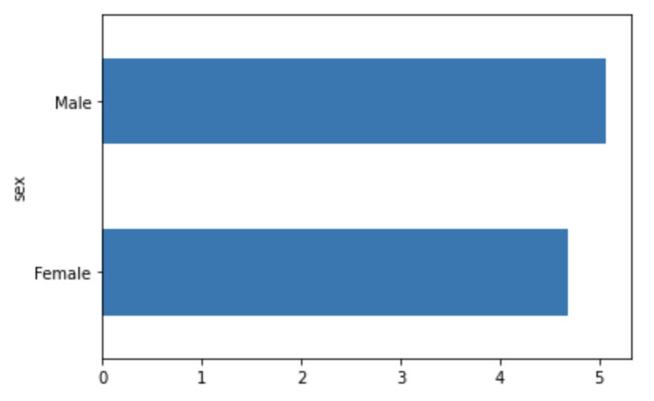
Exploring the data
Average Recidivism score by race
Average recidivism score by sex
Recidivism scores on a scale from 1-10
Recidivism scores on a scale from 1-10

Slide 5
Modeling
Using the cox-violent-parsed filtered dataset

Slide 6
Independent Variables
Juvenile felony count
Juvenile misdemeanor count
Priors count
Is recidivism
Is violent recidivism
Sex (male or female)
Age category (under 25, between 25 and 45, over 45’)
Race (African-American, Asian, Caucasian, Hispanic, Native American, Other)
Charge Degree (CO3, CT, F1, F2, F3, F5, F6, F7, M1, M2, MO3, NI0, TCX, X)
My models use these nine variables from the dataset to predict the COMPAS decile score… or the likelihood of recidivism measured on a 1-10 scale

Slide 7
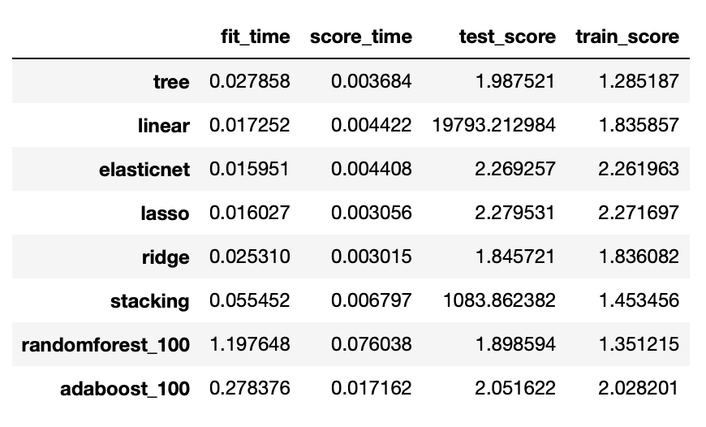
Scoring
Table with the scores for different types of models using “negative mean absolute error” as the error metric
Note: linear and stacking models have very large test scores… cross validation of linear model showed that error values are typically in an expected region (around 2.00) but occasionally get very large. I was not able to determine why this happens

Slide 8
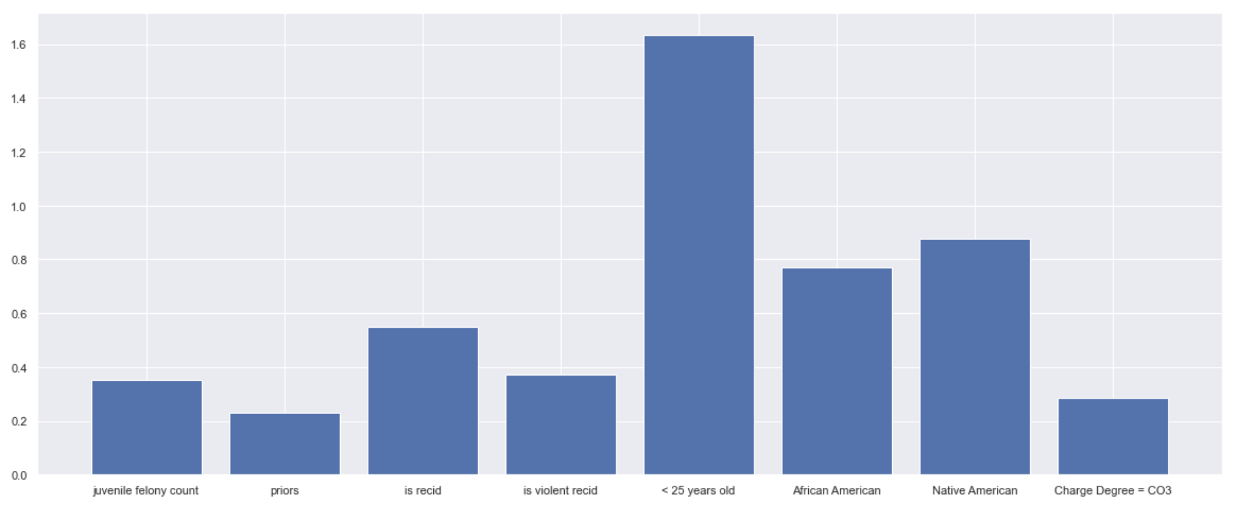
Feature importance for linear regression model

Slide 9
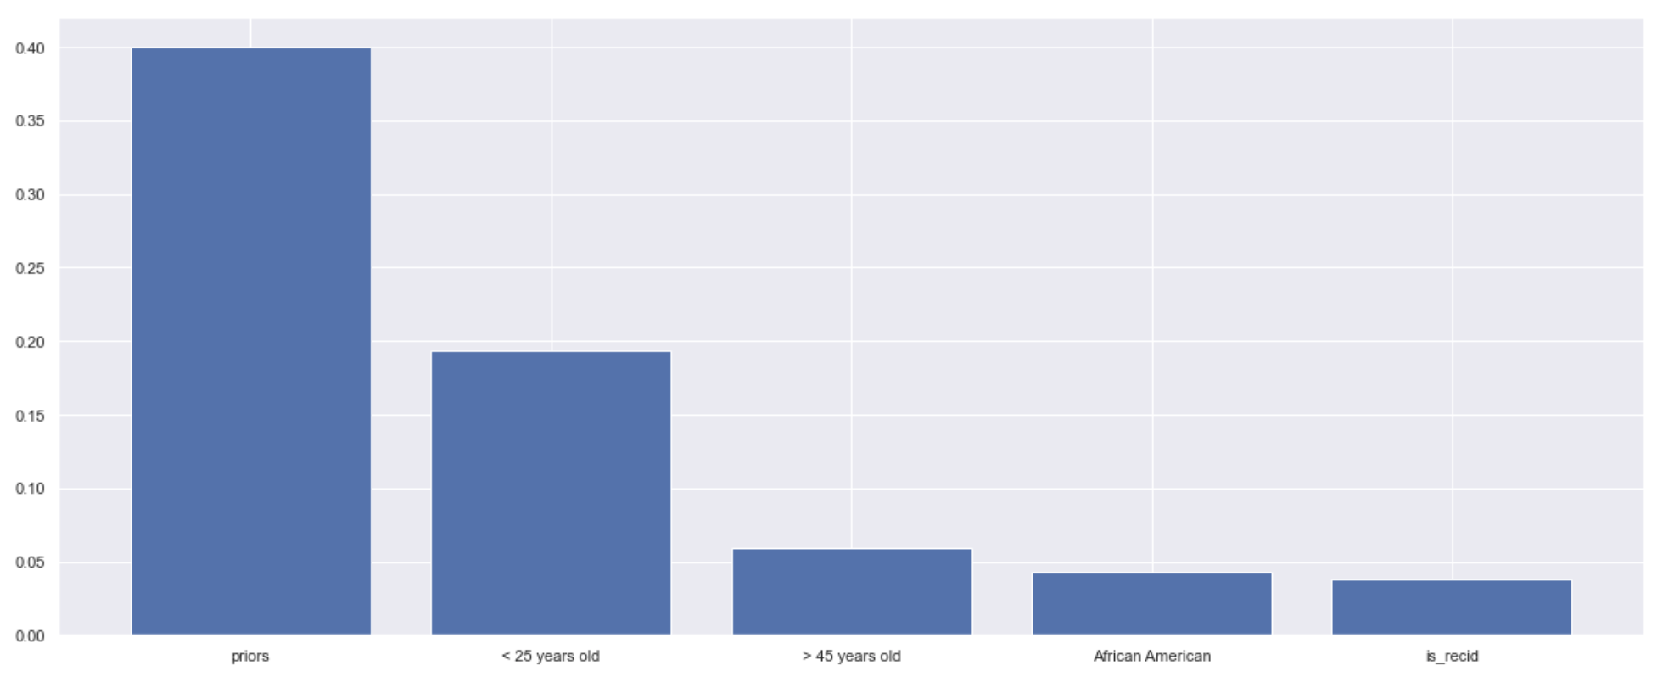
Feature importance for random forest model

Slide 10
Being under the age of 25 drastically increases a defendant’s chances of receiving a high recidivism score
The African American and Native American features are significantly more important in determining the recidivism score than the Caucasian feature in my models
The number of priors and is recidivism feature are both very important across all models

