Slide 1
ARL RFE APPLICATION
Cedric Charly| William Truong

Slide 2
Git Repo
https://github.com/william-truong/F15A4

Slide 3
Conceptual Model

Slide 4
Logical Model
F15A4_contact
rfe_id
Employee_id

Slide 5
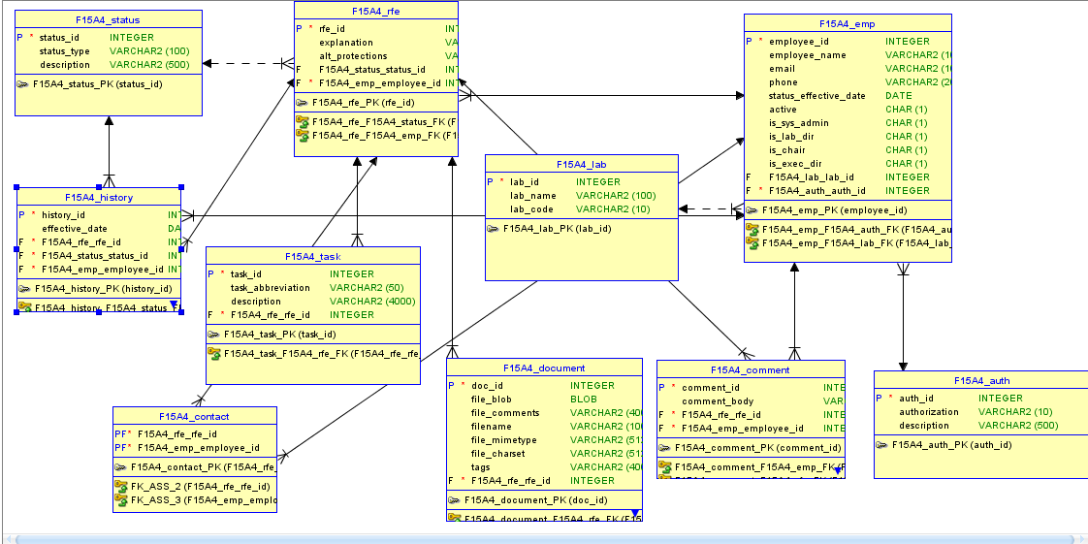
Relational Model

Slide 6
Some Features
Authorization to access pages
Only SA and above can access Approvals Page
Only admins can use Admin Panel
Conditional Based Rendering
RFE view: Same page, users only see available actions relevant to their scope
Admin Panel
Admins can add/edit labs and employees
Have access to all RFEs through their own view

Slide 7
Showcase Screenshots

Slide 8
Showcase: Authentication

Slide 9
Showcase: Adding RFE

Slide 10
Showcase: Conditional Rendering

Slide 11
Showcase: Admin Panel

Slide 12
Part II: Mobile App
http://catalog.data.gov/dataset/births-by-age-of-mother-1960-2013
https://cdph.data.ca.gov/api/views/n8g4-4ufi/rows.json
Open dataset
Creates report and visualizations for each category based on the year chosen

Slide 13
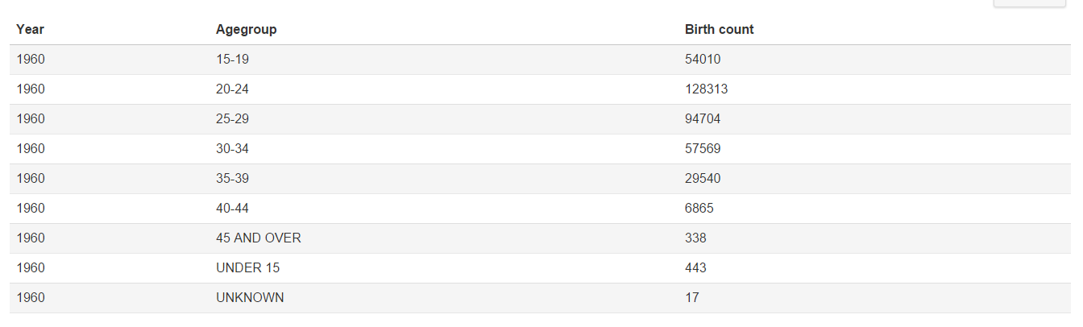
1960

Slide 14
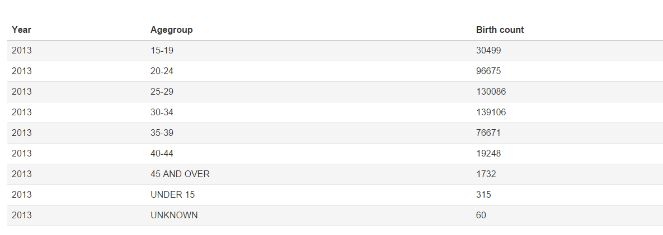
2013

Slide 15
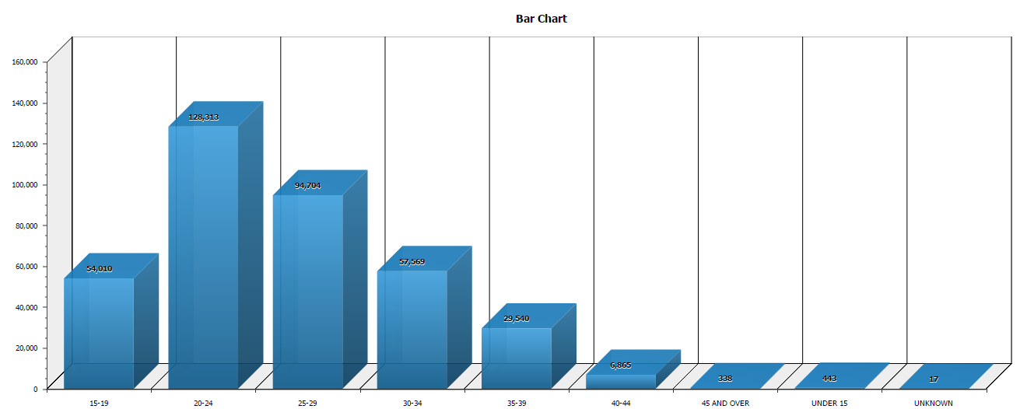
1960

Slide 16
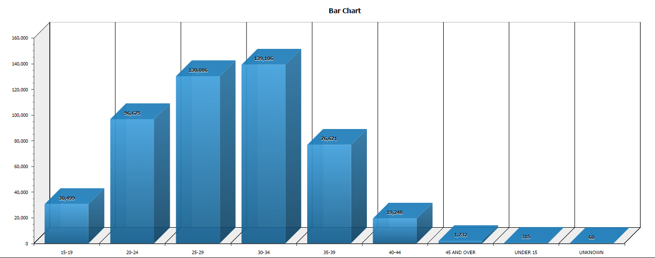
2013

