Slide 1
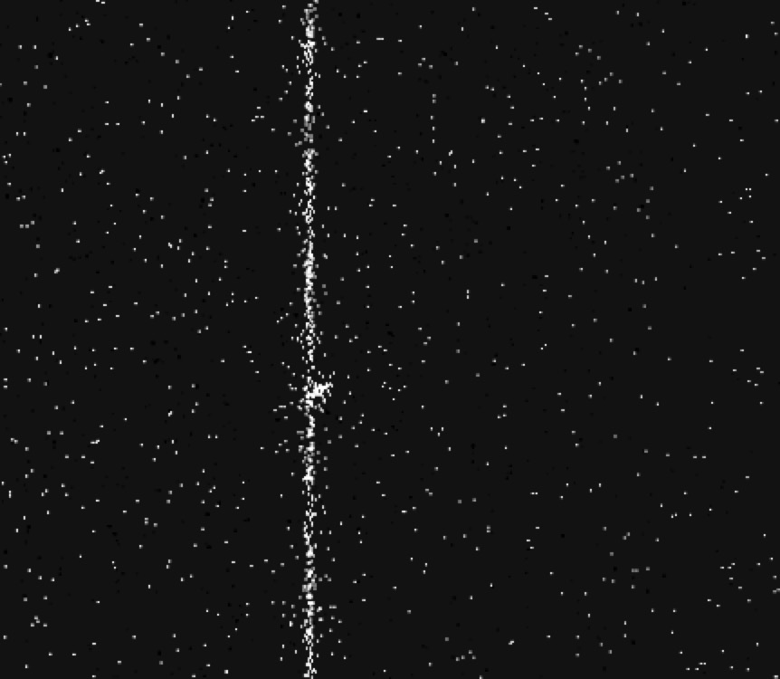
Geocoronal Emission
Background window
Target Star (with extraction window)
Position along slit
Wavelength
1215 Å
1216 Å
1217 Å

