Slide 1
CD based on Agile

Slide 2
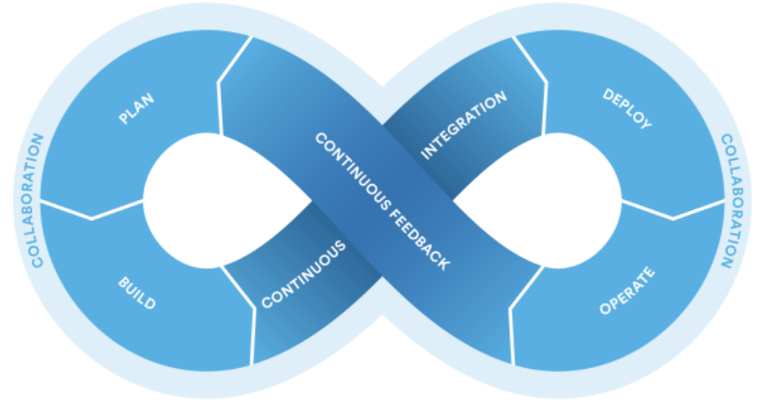
Agile Software Development Process
reference: http://wiki.csdn.net/pages/viewpage.action?pageId=3014736

Slide 3
CI Principle
Createa repeatable, reliable process for releasing software.
Automate almost everything.
Keep everything in version control.
If it hurts, do it more frequently and bring the pain forward.
Build quality in.
Done means released.
Everybody is responsible for the delivery process.
Continuous Improvement.

Slide 4
Tools selection
Issue_id
Changeset_id
version
Plan
Agile management: JIRA
Version Control: Git (branch strategy, version definition)
Environment Configuration: Puppet
Build
For example: Maven
CI
Jenkins
Deployment
Docker
Operate
?
Feedback
HipChat, Email, …

Slide 5
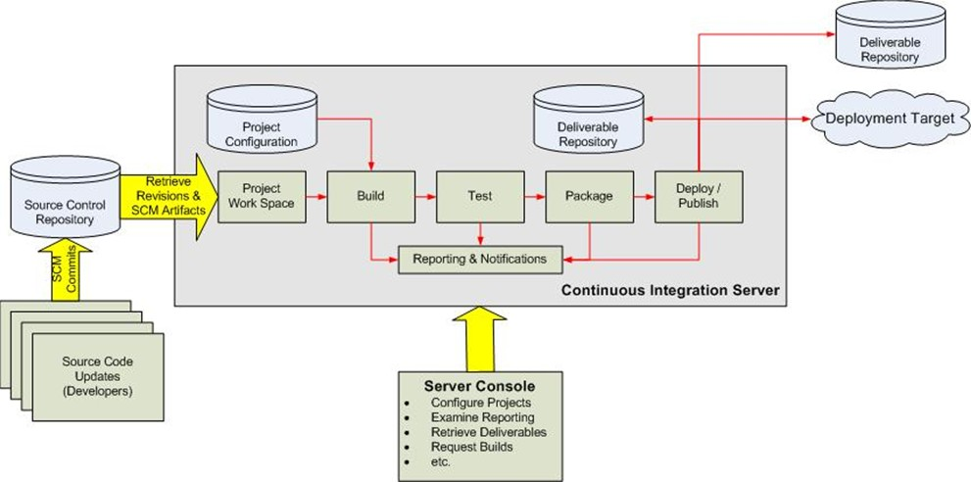
Continuous Integration Process

Slide 6
版本控制模型（多团队）必须达成的目标
快速失败
代码冲突和集成问题应该可以被迅速发现
经常修复小问题要胜过不常修复大问题
一直可发布
即使经历了一个混乱的Sprint，也要保证至少有些可以发布的内容。
简单
所有的团队成员每天都会使用这些模式，所以相关规则和程序必须要简单明了。

Slide 7
Continuous Delivery
持续交付
软件一直处在可发布状态
发布周期
月-周-日
持续发布成熟度模型https://www.infoq.com/articles/Continuous-Delivery-Maturity-Model

Slide 8
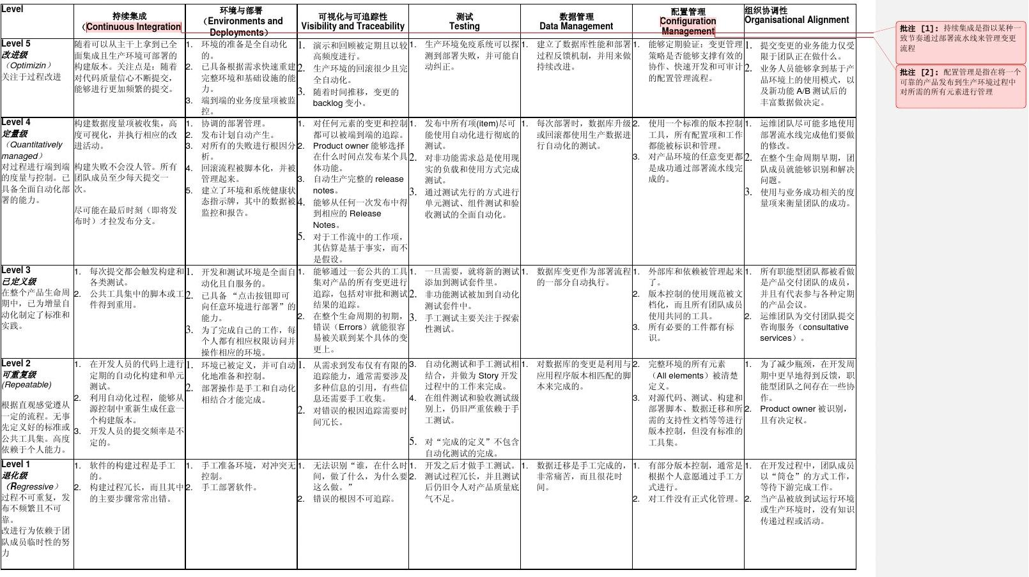
持续发布成熟度模型

Slide 9
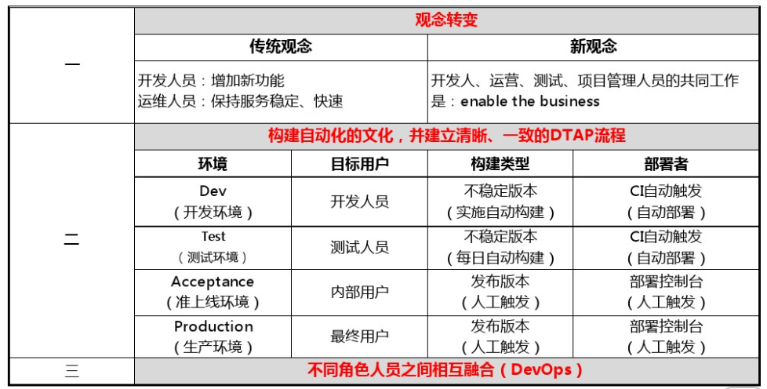
持续交付-组织架构

Slide 10
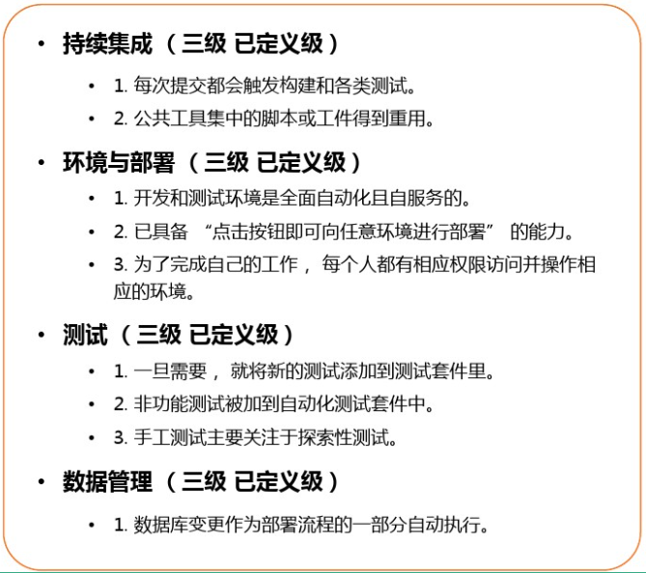
目标状态

Slide 11
持续交付团队位置及成员角色
持续交附团队定位
持续交付方法的提供者和传播者。
持续交付服务的提供者。
持续交付团队成员
CD工程师 – 自动化构建
负责自动化构建系统的设计与建设、自动化脚本的设计与编写。
CD工程师 – 自动化测试
负责自动化测试系统的设计与建设、自动化测试用例与脚本的设计与编写。
CD工程师 – 自动化部署
负现自动化部署系统的设计与建设、自动化部署脚本的设计与编写。
版本控制
分支策略设计，版本定义，版本库管理

Slide 12
Essential Practices
Don’t check in on a broken build.
Test locally first.
Wait for commit tests before next task.
Never go home on a broken build.
Be ready to revert.

Slide 13
Envrionment
Keep them all the same – test to production.
Standard development environment.

Slide 14
Dependencies
Central store of external libraries.
Manage our own NXG components.

Slide 15
Configuration
Application, software and environment.
Do it at deployment time.
Automate it.
Use SVN.

Slide 16
Deploy to Production
Same process as used in test.
Frequently tested.
Controlled.
Should be able to undo changes.

Slide 17
Best practices
Only build the binaries once.
Deploy the same way to every environment.
Smoke Test the deployment.
Deploy into a copy of production.
Each change should move all the way along the pipeline.
If anything failed – stop.

Slide 18
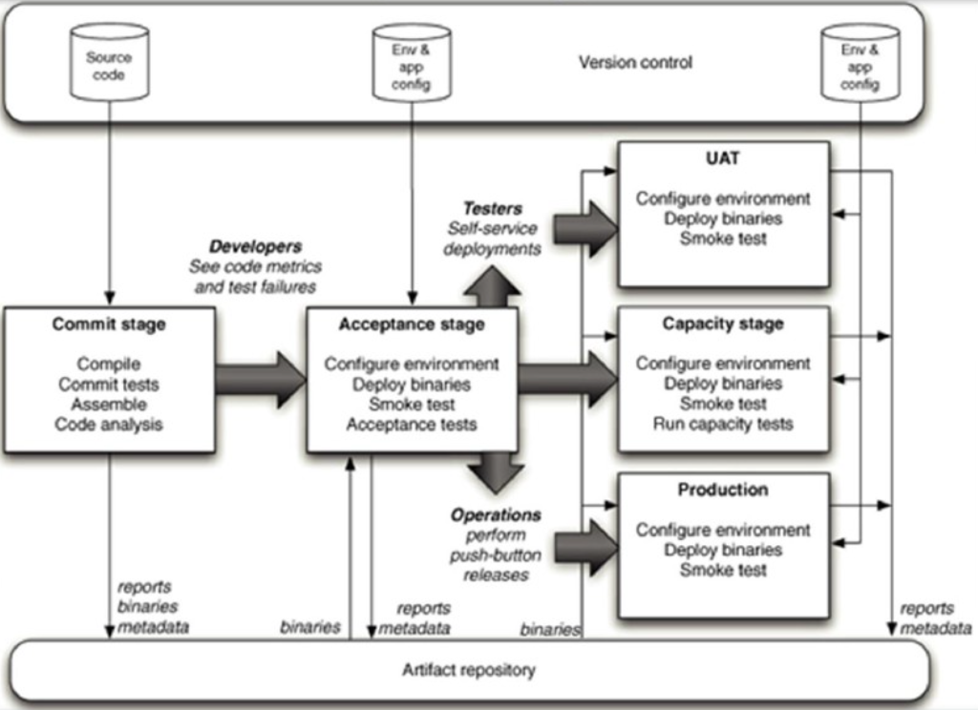
A

