Slide 1
Pointers [and Pals]
Lecture 4

Slide 2
Outline
Pointers
Dynamic Arrays
Multidimensional Arrays

Slide 3
Quick Recap of Memory
Address
byte 0
(000)
01101100
byte 1
(001)
11100010
3 bytes at address 0 (000)
byte 2
(010)
01010100
byte 3
(011)
11110000
2 bytes at address 3 (011)
byte 4
(100)
00000001
byte 5
(101)
111111100
byte 6
(110)
01010110
3 bytes at address 5 (101)
byte 7
(111)
00000011
…
Notes:
8 bits = 1 byte
RA = random access = can get to contents of any address equally fast
Fixed size address: 3 bits = 8 addresses (above)

Slide 4
What is a Pointer?
A pointer is a variable whose value is a memory address [of another variable]
It “points” to objects in memory
int *my_pointer;
If you output the value of a pointer, you will get a memory address, typically represented in hexadecimal (prefixed with 0x; 0-9, A-F)

Slide 5
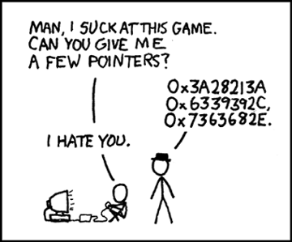
Reinforcing Humor ala XKCD

Slide 6
Useful Operators
&variable = “address of” variable
*pointer = “value at” address
Termed dereferencing the pointer

Slide 7
Pointer Representation
Memory
address:
0
1
2
3
4
5
6
7
8
9
10
11
contents:
?
?
?
?
?
?
?
?
?
?
?
?
5
2
variable:
x
p
int x;
x = 5;
cout << x;
cout << &x;
int *p;
p = &x;
cout << p;
cout << &p;
cout << *p;
5
2
2
8
5

Slide 8
Pointer Representation
Memory
address:
0
1
2
3
4
5
6
7
8
9
10
11
?
?
5
?
?
?
?
?
2
?
?
?
contents:
4
7
variable:
x
p
x = 7;
cout << x;
cout << &x;
cout << p;
cout << &p;
cout << *p;
*p = 4;
cout << x;
cout << &x;
cout << p;
cout << &p;
cout << *p;
7
4
2
2
2
2
8
8
7
4

Slide 9
The new and delete Operators
The new operator produces a new, nameless variable and returns a pointer to this new variable
int *p = new int;
Variables created this way are termed dynamic (others are automatic/ordinary)
Any variable created this way must be later de-allocated via delete (variables not created this way must not be deallocated using delete)
delete p;
Do not call delete on memory that has already been deallocated

Slide 10
Memory Leak
Anytime you lose track of memory you allocated, it can no longer be used by your or other programs
Example
int *p = new int;
p = new int;

Slide 11
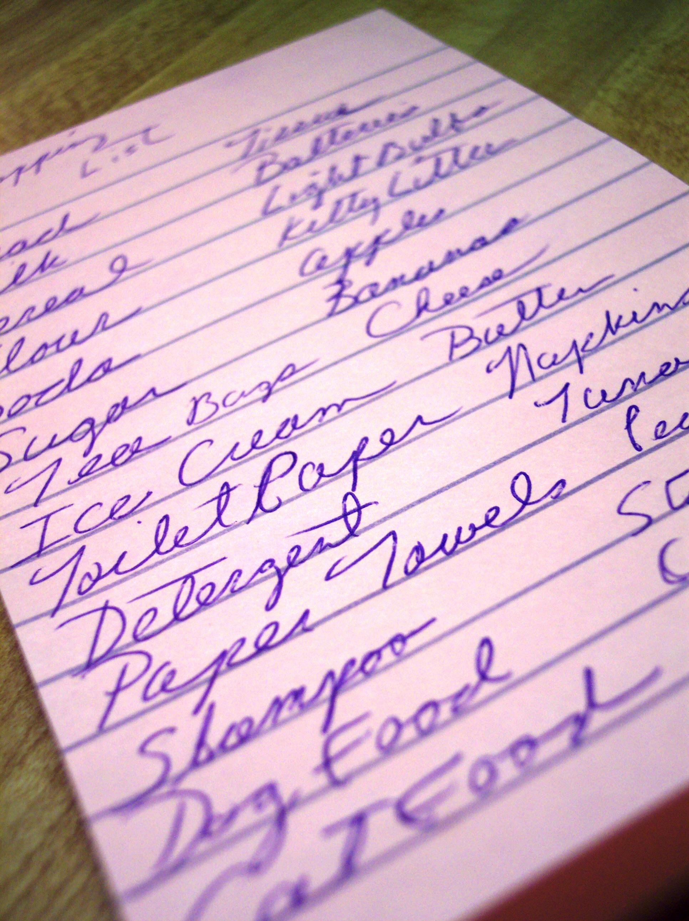
Why Dynamic Allocation?
Statically allocated variables are automatically managed by C++ via the stack
Memory [de]allocation is fast!
Memory is released once the function is done
But sometimes you don’t know how much memory you are going to need until the program runs!
Typical with user interaction/external data
Memory allocated via the heap and remains until released

Slide 12
Different Sources of Memory
I’m done!
Stack
Heap
Statically Allocated Variables
Parameters
Return Address
F2
Statically Allocated Variables
Parameters
Return Address
F3
Statically Allocated Variables
Parameters
Return Address
F1
Space for something with k bits?
…

Slide 13
NULL
The memory address 0 is a special address and never indicates valid memory
Many libraries (e.g. cstdlib, cstdio) provide the constant NULL for this address
This use of NULL is a memory address, and shouldn’t be confused with the NULL character for C strings
Dereferencing NULL always results in a segmentation fault (segfault)

Slide 14
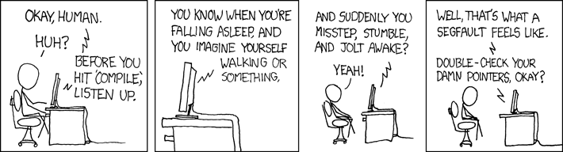
More Reinforcing Humor ala XKCD

Slide 15
Pointer-Array Duality
In C++, an array variable is actually a pointer that points to the first indexed variable of the array
Each array element has a unique address
&arr[0] for element a[0]
&arr[1] for element a[1]
…
But C++ has a shortcut
a is the same as &a[0]
(a+1) is the same as &a[1]
…

Slide 16
Array Element Values
The bracket operators ([]) are a shortcut for dereferencing array element values
a[0] for *(a)
a[1] for *(a+1)
a[2] for *(a+2)
…

Slide 17
Arrays as Parameters
Formerly we learned one way to pass arrays as arguments
void func(int arr[], int size);
You can also use pointer notation
void func(int *arr, int size);

Slide 18
Exercise
Memory
address:
0
1
2
3
4
5
6
7
8
9
10
11
?
?
5
?
?
?
?
?
?
?
?
?
contents:
4
8
0
?
9
1
5
variable:
a[0]
a[1]
a[2]
a[3]
a[4]
int a[] = {4,8,1,0,5};
cout << a;
cout << (a+3);
cout << *(a+4);
*(a+1) = 9;
cout << a[1];
cout << (a+1);
cout << *(a+1);
2
5
9
5
3
9

Slide 19
Dynamic Arrays
So far we’ve only been able to create arrays of a fixed size
Could be too small or too large for a given problem
The new operator allows you to create a dynamically sized array
int x;
cin >> x;
int *p = new int[x];

Slide 20
Deallocating Dynamic Arrays
Use the delete [] operator to release a dynamic array
delete [] p;
Forgetting the [] only releases the first element, resulting in a memory leak
Do not use the [] on an address that was not allocated as an array
Do not use delete [] with statically allocated arrays

Slide 21
Exercise
Ask the user for an integer from the keyboard. Create an array of that size and populate it with the numbers 2-2n, where n was the entered number. Then output the contents of the array to the screen and deallocate the dynamic memory. Do NOT use the brackets ([]) to get/set array values.

Slide 22
Answer
#include <iostream>
using namespace std;
int main()
{
int size;
int *x;
cin >> size;
x = new int[ size ];
for ( int i=0; i<size; i++ )
*( x + i ) = ( 2 * ( i + 1 ) );
for ( int i=0; i<size; i++ )
cout << *( x + i ) << endl;
delete [] x;
return 0;
}

Slide 23
Multidimensional Arrays
C++ allows you to have an array with more than one index
int arr[ x ][ y ];
In the example above, arr is an array of size x, where each element is an array of y integers

Slide 24
Example
#include <iostream>
using namespace std;
int main()
{
double arr[3][4] = {
{ 0.0, 0.1, 0.2, 0.3 },
{ 1.0, 1.1, 1.2, 1.3 },
{ 2.0, 2.1, 2.2, 2.3 }
};
for ( int row=0; row<3; row++ )
{
for ( int col=0; col<4; col++ )
{
cout << "row=" << row
<< ", col=" << col
<< ": " << arr[ row ][ col ]
<< endl;
}
}
return 0;
}
row=0, col=0: 0
row=0, col=1: 0.1
row=0, col=2: 0.2
row=0, col=3: 0.3
row=1, col=0: 1
row=1, col=1: 1.1
row=1, col=2: 1.2
row=1, col=3: 1.3
row=2, col=0: 2
row=2, col=1: 2.1
row=2, col=2: 2.2
row=2, col=3: 2.3

Slide 25
Multidimensional Array Parameters
When passing multidimensional arrays as arguments, you must leave the first set of brackets empty (as with regular arrays), but provide sizes for each additional dimension
void func(int arr[][100], int s1, int s2);

Slide 26
Example (1)
#include <iostream>
using namespace std;
void output(int arr[][2], int rows, int cols);
void m_add(int arr1[][2], int arr2[][2], int r[][2], int rows, int cols);
int main()
{
int m1[2][2] = { { 1, 2 }, { 3, 4 } };
int m2[2][2] = { { 5, 5 }, { 6, 6 } };
int m3[2][2] = { { 0, 0 }, { 0, 0 } };
output( m1, 2, 2 );
cout << "PLUS" << endl;
output( m2, 2, 2 );
cout << "EQUALS" << endl;
m_add( m1, m2, m3, 2, 2 );
output( m3, 2, 2 );
return 0;
}

Slide 27
Example (2)
void m_add(int arr1[][2], int arr2[][2], int r[][2], int rows, int cols)
{
for ( int i=0; i<rows; i++ )
for ( int j=0; j<cols; j++ )
r[i][j] = arr1[i][j] + arr2[i][j];
}
void output(int arr[][2], int rows, int cols)
{
for ( int i=0; i<rows; i++ )
{
for ( int j=0; j<cols; j++ )
cout << arr[i][j] << " ";
cout << endl;
}
}

Slide 28
Multidimensional Dynamic Arrays
To create multidimensional arrays, first allocate memory for the first dimension, then loop for the second (and additional nested looping for any additional dimensions)
Don’t forget to delete [] at each level when you are done!
Function arguments can be all *’s or one can be left as []
int *arr[] same as int **arr
int **arr[] same as int ***arr

Slide 29
Revisiting Program Arguments
You can now reinterpret the arguments to the main function
int main(int argc, char *argv[]);
This can be equivalently written with only pointers
int main(int argc, char **argv);
Why is there not a second size argument?

Slide 30
Example
#include <iostream>
using namespace std;
void output(int **arr, int rows, int cols);
int main()
{
int rows, cols;
cin >> rows >> cols;
int **m = new int*[ rows ];
for ( int i=0; i<rows; i++ )
{
m[i] = new int[ cols ];
for ( int j=0; j<cols; j++ )
{
cin >> m[i][j];
}
}
output( m, rows, cols );
for ( int i=0; i<rows; i++ )
delete [] m[i];
delete [] m;
return 0;
}
void output(int **arr, int rows, int cols)
{
for ( int i=0; i<rows; i++ )
{
for ( int j=0; j<cols; j++ )
cout << arr[i][j] << " ";
cout << endl;
}
}
> 2 2
> 1 2 3 4
1 2
3 4

Slide 31
Putting It All Together!
Make a matrix addition program. At the command line, require two integer arguments (first=# rows, second=# cols). Now input two matrices with these dimensions and store them in 2D arrays. Finally, add them together and output the result. Example:
> ./a 2 2
1 2 3 4
5 5 9 8
1 2
3 4
PLUS
5 5
9 8
EQUALS
6 7
12 12

Slide 32
Answer (1)
#include <iostream>
#include <cstdlib>
using namespace std;
void m_add(int **m1, int **m2, int **r, int rows, int cols)
{
for ( int i=0; i<rows; i++ )
for ( int j=0; j<cols; j++ )
r[i][j] = m1[i][j] + m2[i][j];
}
void output(int **m, int rows, int cols)
{
for ( int i=0; i<rows; i++ )
{
for ( int j=0; j<cols; j++ )
cout << m[i][j] << " ";
cout << endl;
}
}

Slide 33
Answer (2)
int main(int argc, char **argv)
{
if ( argc != 3 )
{
cout << "Usage: " << argv[0] << " <rows> <cols>" << endl;
return 0;
}
int rows = atoi( argv[1] );
int cols = atoi( argv[2] );
if ( ( rows < 1 ) || ( cols < 1 ) )
{
cout << "Usage: " << argv[0] << " <rows> <cols>" << endl;
return 0;
}
int **m[3];
for ( int i=0; i<3; i++ )
{
m[i] = new int*[ rows ];
for ( int j=0; j<rows; j++ )
{
m[i][j] = new int[ cols ];
if ( i != 2 )
for ( int k=0; k<cols; k++ )
cin >> m[i][j][k];
}
}

Slide 34
Answer (3)
m_add( m[0], m[1], m[2], rows, cols );
output( m[0], rows, cols );
cout << "PLUS" << endl;
output( m[1], rows, cols );
cout << "EQUALS" << endl;
output( m[2], rows, cols );
for ( int i=0; i<3; i++ )
{
for ( int j=0; j<rows; j++ )
delete [] m[i][j];
delete [] m[i];
}
return 0;
}

Slide 35
Wrap Up
Pointers are variables that store memory addresses [of variables]
The new operator dynamically allocates memory from the heap, delete releases that memory
Array variables are actually pointers with some useful shortcuts
Dynamically sized arrays can be created via new, released via delete []
Multidimensional arrays can be accessed via multiple indexes via brackets

