Slide 1
C++ Review
Lecture 1

Slide 2
Your Responsibility
This review is NOT exhaustive
Just brushing away some cobwebs from the break
All COMP128 material is fair game for any assignment/exam
See BB for slides
Review chapters in the book

Slide 3
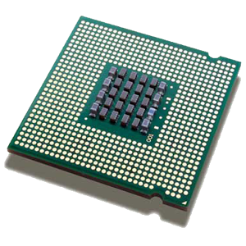
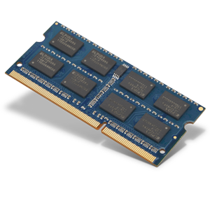


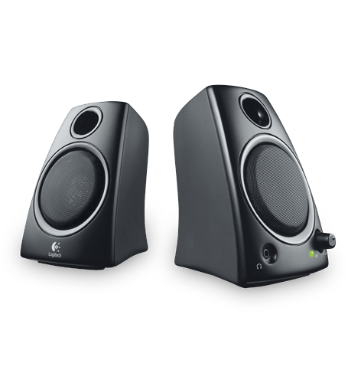
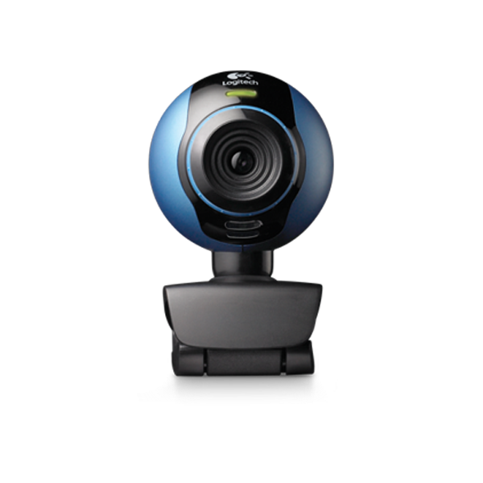

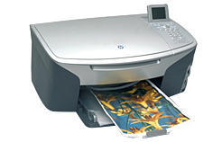
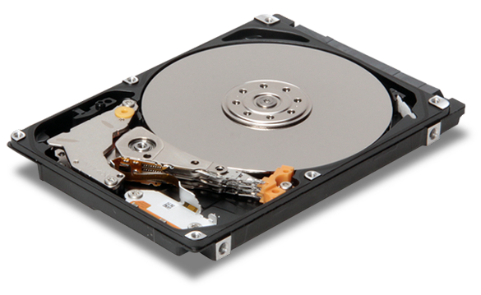


High-Level View of Hardware
Processor/CPU
Input Device(s)
Main Memory (RAM)
Output Device(s)
…
Secondary Memory

Slide 4
Main Memory (RAM)
Address
byte 0
(000)
01101100
byte 1
(001)
11100010
3 bytes at address 0 (000)
byte 2
(010)
01010100
byte 3
(011)
11110000
2 bytes at address 3 (011)
byte 4
(100)
00000001
byte 5
(101)
111111100
byte 6
(110)
01010110
3 bytes at address 5 (101)
byte 7
(111)
00000011
…
Notes:
8 bits = 1 byte
RA = random access = can get to contents of any address equally fast
Fixed size address: 3 bits = 8 addresses (above)

Slide 5
Build and Run (1)
Processor/CPU
Main Memory (RAM)
C++ Source Code
Object Code
…
Compiler

Slide 6
Build and Run (2)
Object Code
Processor/CPU
Main Memory (RAM)
C++ Source Code
Executable
Compiler
Object Code
…
Object Code
Linker

Slide 7
Build and Run (3)
Object Code
Processor/CPU
Main Memory (RAM)
Object Code
Input/Data
Executable
Linker
Output
…
Object Code

Slide 8
Build Errors
Compiler
Typically syntax errors
Forgot a semi-colon
Mistyped a command
Forgot an argument
Incorrect type
Forgot #include
Couldn’t find library (more later)
Linker
Undefined symbols
Declared a function, forgot to define (or changed args)
Forgot namespace
Cannot write executable (usually still running)
Couldn’t find library (more later)

Slide 9
Output
Write a program that prints “Hello World” to the screen (sans quotes)

Slide 10
Answer
#include <iostream>
using namespace std;
int main()
{
cout << "hello world" << endl;
return 0;
}

Slide 11
I/O, Variables, Expressions
Write a program that asks the user for an integer and then prints out that number to the screen, a tab, and then that number plus five. For example:
Please enter a number: 5
5 10

Slide 12
Answer
#include <iostream>
using namespace std;
int main()
{
int x;
cout << "Please enter a number: ";
cin >> x;
cout << x << "\t" << ( x+5 ) << endl;
return 0;
}

Slide 13
Flow Control
What is wrong with the following code, why?
#include <iostream>
using namespace std;
int main()
{
int x, y;
y = x + 5;
cout << "Please enter a number: ";
cin >> x;
cout << x << "\t" << y << endl;
return 0;
}

Slide 14
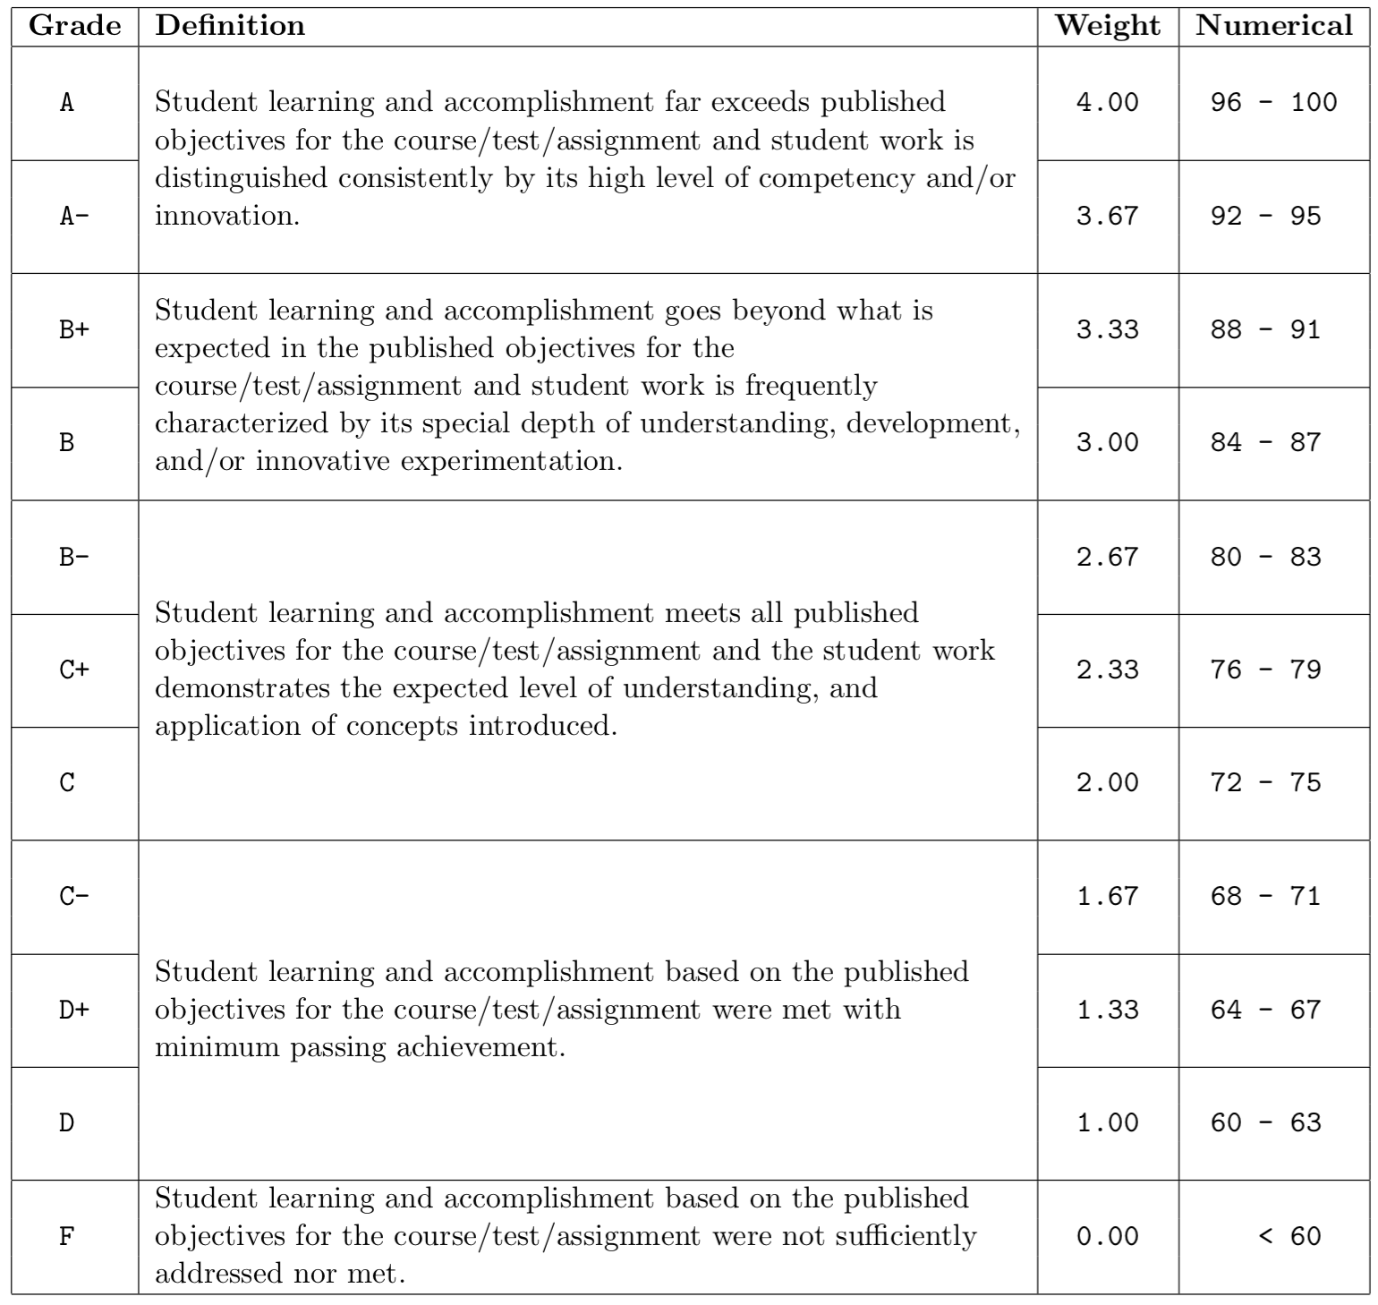
If/Else
Write a program that asks the user for a numeric grade (could be a fraction) and outputs the Wentworth letter grade (no rounding).

Slide 15
Answer
#include <iostream>
using namespace std;
int main()
{
double grade;
cout << "Please enter a grade: ";
cin >> grade;
if ( grade >= 96 )
{
cout << "A" << endl;
}
else if ( grade >= 92 )
{
cout << "A-" << endl;
}
else if ( grade >= 88 )
{
cout << "B+" << endl;
}
else if ( grade >= 84 )
{
cout << "B" << endl;
}
else if ( grade >= 80 )
{
cout << "B-" << endl;
}
else if ( grade >= 76 )
{
cout << "C+" << endl;
}
else if ( grade >= 72 )
{
cout << "C" << endl;
}
else if ( grade >= 68 )
{
cout << "C-" << endl;
}
else if ( grade >= 64 )
{
cout << "D+" << endl;
}
else if ( grade >= 60 )
{
cout << "D" << endl;
}
else
{
cout << "F" << endl;
}
return 0;
}

Slide 16
Functions, Loops
Write a function named nums that takes two integer arguments: upper_bound and per_line and prints to the screen each number from 1 to upper_bound, per_line numbers on a line.
nums( 12, 5 );
1 2 3 4 5
6 7 8 9 10
11 12

Slide 17
Answer
void nums(int upper_bound, int per_line)
{
int num_on_line = 0;
for ( int i=1; i<=upper_bound; i++ )
{
cout << i << " ";
num_on_line++;
if ( num_on_line >= per_line )
{
num_on_line = 0;
cout << endl;
}
}
}

Slide 18
Functions, Arrays, Pass by Reference
Write a function min_max_avg that takes as arguments an array of double variables (arr) and two double variables, by reference (minval, maxval). The function sets these variables to be the smallest and largest values in the array and returns the average of all the numbers.

Slide 19
Answer
double min_max_avg(double arr[], int count, double& minval, double& maxval)
{
minval = arr[0];
maxval = arr[0];
double sum = arr[0];
for ( int i=1; i<count; i++ )
{
if ( arr[i] < minval )
minval = arr[i];
if ( arr[i] > maxval )
maxval = arr[i];
sum += arr[i];
}
return ( sum / count );
}

Slide 20
Files, Loops
Write a program that reads a file of characters named “chars.txt” and, whenever it encounters a letter, outputs the uppercase version of that letter, one per line, and ignores all other characters.

Slide 21
Answer
#include <iostream>
#include <fstream>
using namespace std;
int main()
{
ifstream f;
f.open( "chars.txt" );
if ( f.fail() )
{
cout << "Error opening chars.txt" << endl;
return 1;
}
char c;
while ( f >> c )
{
if ( c >= 'a' && c <= 'z' )
c -= ( 'a' - 'A' );
if ( c >= 'A' && c <= 'Z' )
cout << c << endl;
}
f.close();
return 0;
}

Slide 22
Wrap Up
These exercises should have been easy; if you had difficulties, please look back to your COMP128 materials, the book, and/or come to office hours
This review didn’t cover classes; there will be dedicated lectures reviewing and expanding on them in a couple weeks (continuing for much of the semester!)
All of this material (and more) is fair game for any assignment/exam

