Slide 1


The State of Aspen Land
The State of Aspen Land
or How Aspen became a Real Boy
or How Aspen became a Real Boy
Notes:
Bryan: Hi y’all, I’m Bryan!
Sierra/Bob:
[whatever you want to say]

Slide 2
Meet your ALSF Board of Directors:
Bryan Neil Jones
President
Nashville Public Library
Sierra Chastain-Rittue
Vice President
C/W MARS
Bob Bennhoff
Treasurer
CLIC
Linda Kramer
Secretary
Martin Luther College
Daniel Barden
Member At-Large
Cuyahoga Public Library
George Williams
Member At-Large
NEKLS
Kris Becker
Member At-Large
Jackson County Library Services
Desiree Saunders
Member At-Large
WYLD
Melissa Brenneman
Member At-Large
Knox County Library
Notes:
Starting with top left, introduce ourselves:
- Who you are
- Your role on the Board
- Where you work
- What you care about (Aspen-relative)

Slide 3

It takes a lot of work to
become a Real Boy.
2024
2025
Oct
Nov
Jan
Nov
• Aspen Governance Task Force
representatives selected: Andrew
Auld, Bob Bennhoff, Brendan
Gallagher, Bryan Jones, George
Williams, Jordan Fields, and Sierra
Chastain-Rittue.
• Aaron Skog serves as moderator.
Dec
Jan
• First Governance Task
Force meeting on
November 4th, 2024.
• Research and review
potential governance
structures for the project,
looking at other open source
communities.
Notes:
Sierra -1
Bryan - NOV This represents an on-going experiment. Employees at one company leave and form their own company. Neither company wants to fork the software. How can this project continue despite technical disagreements both major and minor, and personal animosity? There can be a library-directed non-profit to manage the project. That’s the experiment that we are living right now. First meeting of interim Governance Task Force on Nov. 4th 2024.
Bryan - JAN Research and review potential governance structures looking at other open source communities

Slide 4
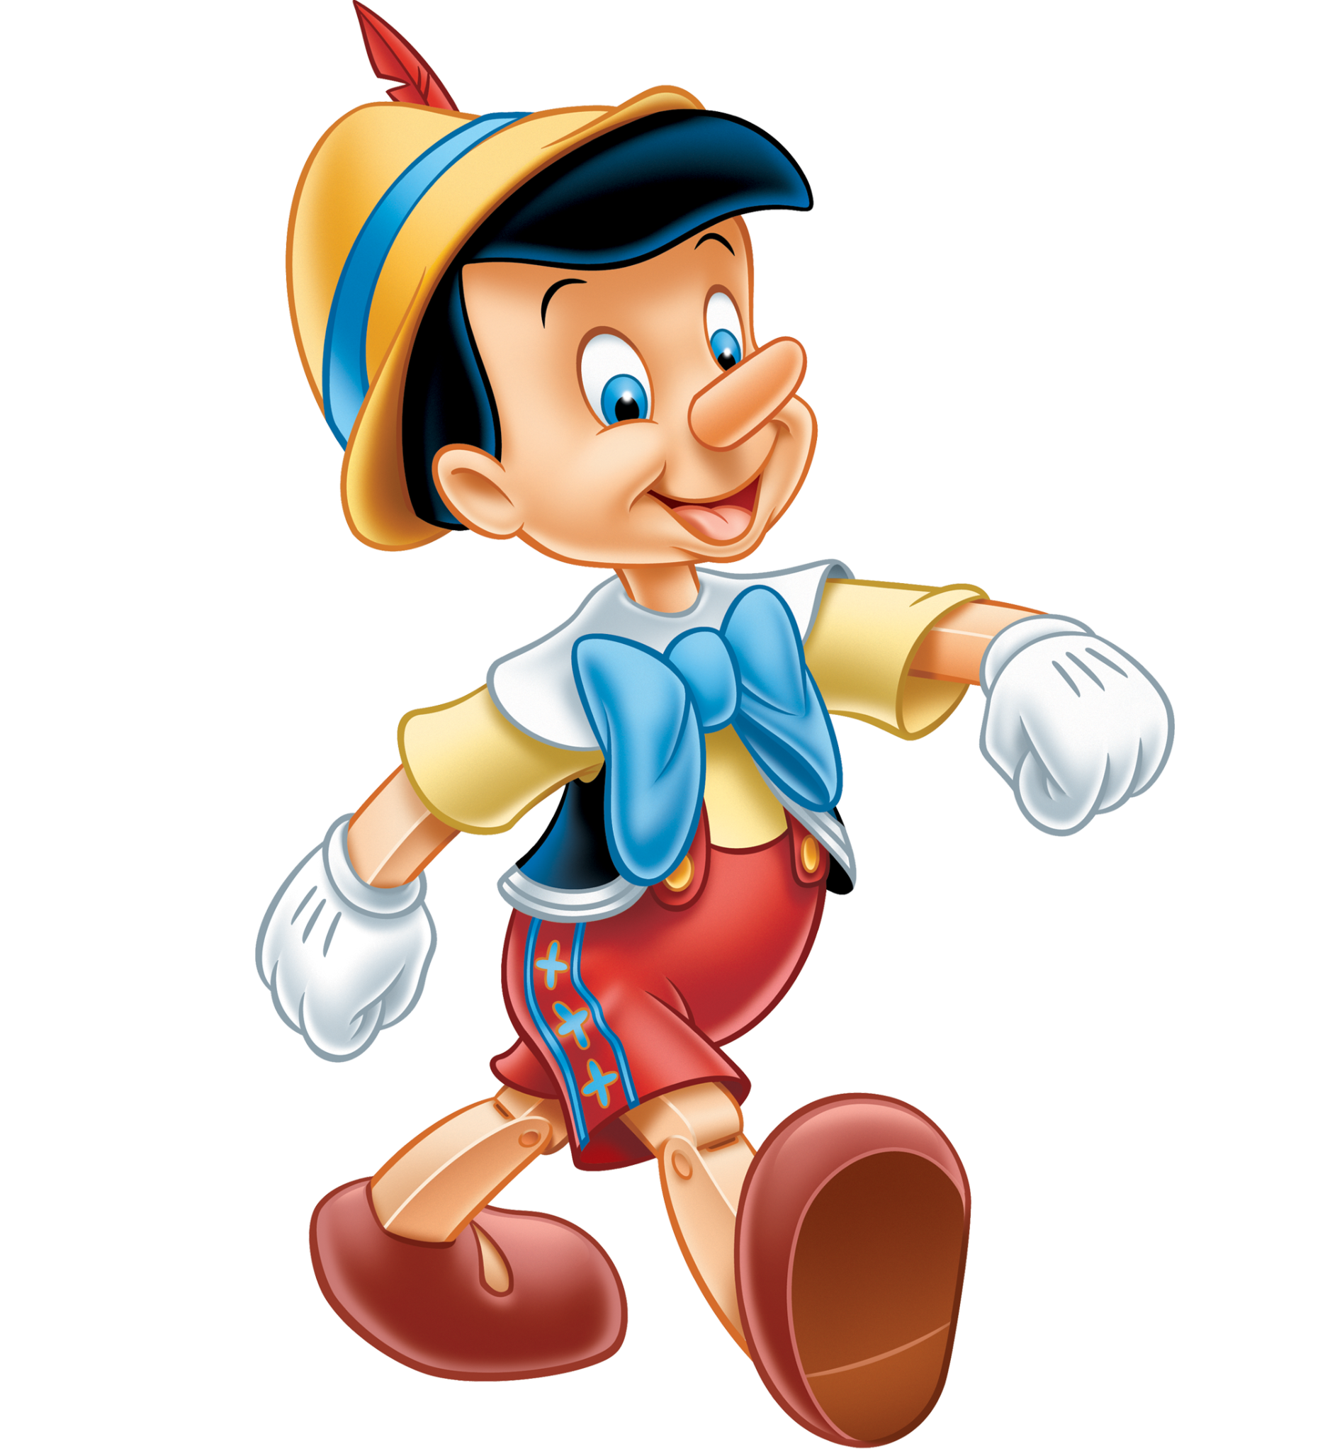
It takes a lot of work to
become a Real Boy.
Apr
Aug
Sep
Nov
Dec
Jan
• Aaron, Bryan, and Sierra
begin drafting initial bylaws.
• The task force revises
various drafts of bylaws
through the summer.
• The 10th draft of the initial
bylaws is presented at the
Community Gathering to ask
for community feedback
and approval.
• George and Bob draft an
initial Community Code of
Conduct, based on the
Contributor Covenant V3.
• Nominations are opened for
initial Board Members.
Notes:
Sierra - APR
Bryan - AUG 2025 after 10 drafts, bylaws were presented at Community Gathering for approval
Sierra - SEP

Slide 5
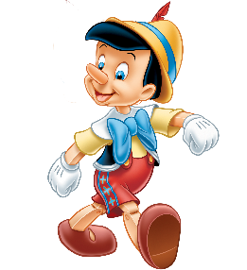
It takes a lot of work to
become a Real Boy.
AspenCon 2
Oct
• Community approval on
proposed initial bylaws
received.
• Plan for the transition from
Task Force to initial Board
and recommended actions.
• Task Force discusses
nominations and members
for initial Board.
• Discuss potential members
for the initial Technical
Committee (TC), with a
focus on including roles
beyond just developers.
Nov
• Initial Board: Bryan Jones, Sierra Chastain-Rittue,
Bob Bennhoff, Linda Kramer, Daniel Barden,
Melissa Brenneman, Desiree Saunders,
Kellie Stephens, and George Williams.
Notes:
Bryan - AspenCon 2 + first bullet point. AspenCon 2025 happens in Nashville, TN. Shortly after that bylaws approved by the community.
Sierra - 2
Bryan - Task Force discusses nominations for the initial Board
Sierra - 4
Bryan - Task Force discusses the initial nominations for TC

Slide 6
OPEN
OPEN
LIBRARY
FOUNDATION
Notes:
Bryan – we skipped a step. It was agreed that we would join Open Library Foundation as a member project. This would essentially let us operate like a non-profit here in the states without filing the paperwork. This creates the frame of the rest of presentation.

Slide 7

It takes a lot of work to
become a Real Boy.
2026
Nov
Jan
Nov
Jan
• ALSF Board has their first meeting on Nov 17th, 2025
• Appoints officers.
• Appoints initial TC chair and membership
• Informally asks to join the Open Library Foundation
(OLF)
• Formal letter of intent sent
to OLF.
Notes:
Sierra - 1
Bryan - 2026! We sent a formal letter of intent. Within the context of Aspen, who’s the whale?

Slide 8
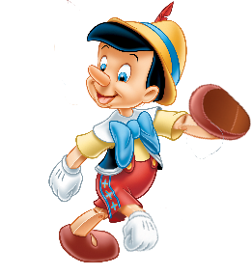
It takes a lot of work to
become a Real Boy.
Feb
Mar
Apr
Nov
Dec
Jan
• George Williams named
Social Media Liaison for the
Board.
• Kellie Stephens resigns from
the Board.
• ALSF is unofficially
accepted into OLF.
• Kris Becker named to Board
as member at-large.
• Internally discussed OLF
service offerings and
community needs.
• Formalize TC Chair’s term to
the calendar year.
Notes:
Sierra - FEB
Bryan - MAR Unofficially accepted into the OLF. Kris Becker named to Board as replacement for Kellie. Kellie is the Open Sourcerer and can be replaced.
Sierra - APR

Slide 9

It takes a lot of work to
become a Real Boy.
May
Jun
Jul
Nov
Dec
Jan
• Met with Chris Spalding of
OLF to discuss available
service offerings.
• OLF paperwork signed and
submitted (Real Boy?)
• Begin working with OLF and
PNC bank to get a checking
account (Real Boy?)
• Social media policy
approved.
Notes:
Bryan - MAY Met with Chris Spalding of OLF. This was an important meeting. We verified their suite of services would meet our needs. That really made a lot decisions easy. We won’t have to metaphorically go to RPF for each service: chat, video, email, cloud. Caveat: we haven’t migrated things yet so they hypothetically work.
Sierra - JUN this is a big deal!
Bryan - JULY we approved a social media policy. This was necessary because we were using socials to market AspenCon.

Slide 10

It takes a lot of work to
become a Real Boy.
AspenCon 3
Aug
Sep
Oct
Nov
Dec
Jan
• Formalized the project’s
mailing address.
• Solicited commercial
support vendors to cover
initial OLF fees.
• Formalized the URL for the
project.
• Prepare additional
documentation as
requested by the bank.
• You are here!
• Group and individual ALSF
Focus Groups with libraries
• Open nominations for new
Board members
Notes:
Sierra - AUG
Bryan - SEP Formalized URL for the project. aspenlibrarysoftwarefoundation.org Invigorating! Bank asked for more formal documentation of our officers.
Sierra - OCT

Slide 11
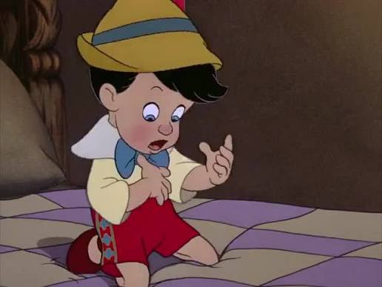
The category is
non-profit Realness.
2027
Nov
Dec
Jan
Nov
Dec
Jan
• ALSF Focus Groups with
vendors
• Aspen Community Survey
• New Board members seated
• ALSF Website?
• New Officers
(Secretary,Vice-President /
President-elect) elected
• New TC Chair seated
Notes:
Bryan - NOV October we had focus groups with libraries. November we will have focus groups with vendors. We will also be releasing what we hop will become an annual tradition: the Aspen Land community survey.
Sierra - DEC
Bryan - JAN new officers will be elected within ALSF Board. New TC Chair will be seated.

Slide 12
The future is unwritten.
Time
Real Boy stuff?
Yes
Yes
Yes
Nov
Dec
Jan
• Migrated Slack, Zoom,
G-Suite
• Bank account established
• Website!
• Membership model?
• A membership voting
mechanism?
• New release info originates
from ALSF
• ALSF is owner of repo
Notes:
Sierra - 1
Bryan - Perhaps a membership model? Perhaps a voting mechanism based on that membership model?
Sierra - 3

Slide 13

Final slide that says stuff.
WOLFcon
AspenCon X
Yes
Yes
Yes
Nov
Dec
Jan
• Things are boring!
• Questions about development
resolved.
• Folks outside Aspen Land
want to move here.
• PichmanAI becomes the first
copyleft, AI driven discovery
layer.
• It dominates the market.
• Dolly Parton AI becomes
emperor of the known
universe.
Notes:
Bryan!
Y1 - Things are boring. Questions about dev have been resolved. Why wouldn’t people want to move here? Occasionally, a few individuals have been rude and unprofessional in community spaces. There is no place for abusive behaviour in the community. If you can’t be professional and polite, we will leave you behind and build this beautiful thing without.
Folks outside of Aspen Land want to move here.
Y2 - PichmanAI becomes the first copyleft, AI driven discovery layer. It dominates the market.
Y3 - Dolly Parton AI becomes emperor of the known universe.

Slide 14
Final slide that says stuff.
ALMOST
Notes:
Bryan: Well, that was ALMOST the final slide.

Slide 15
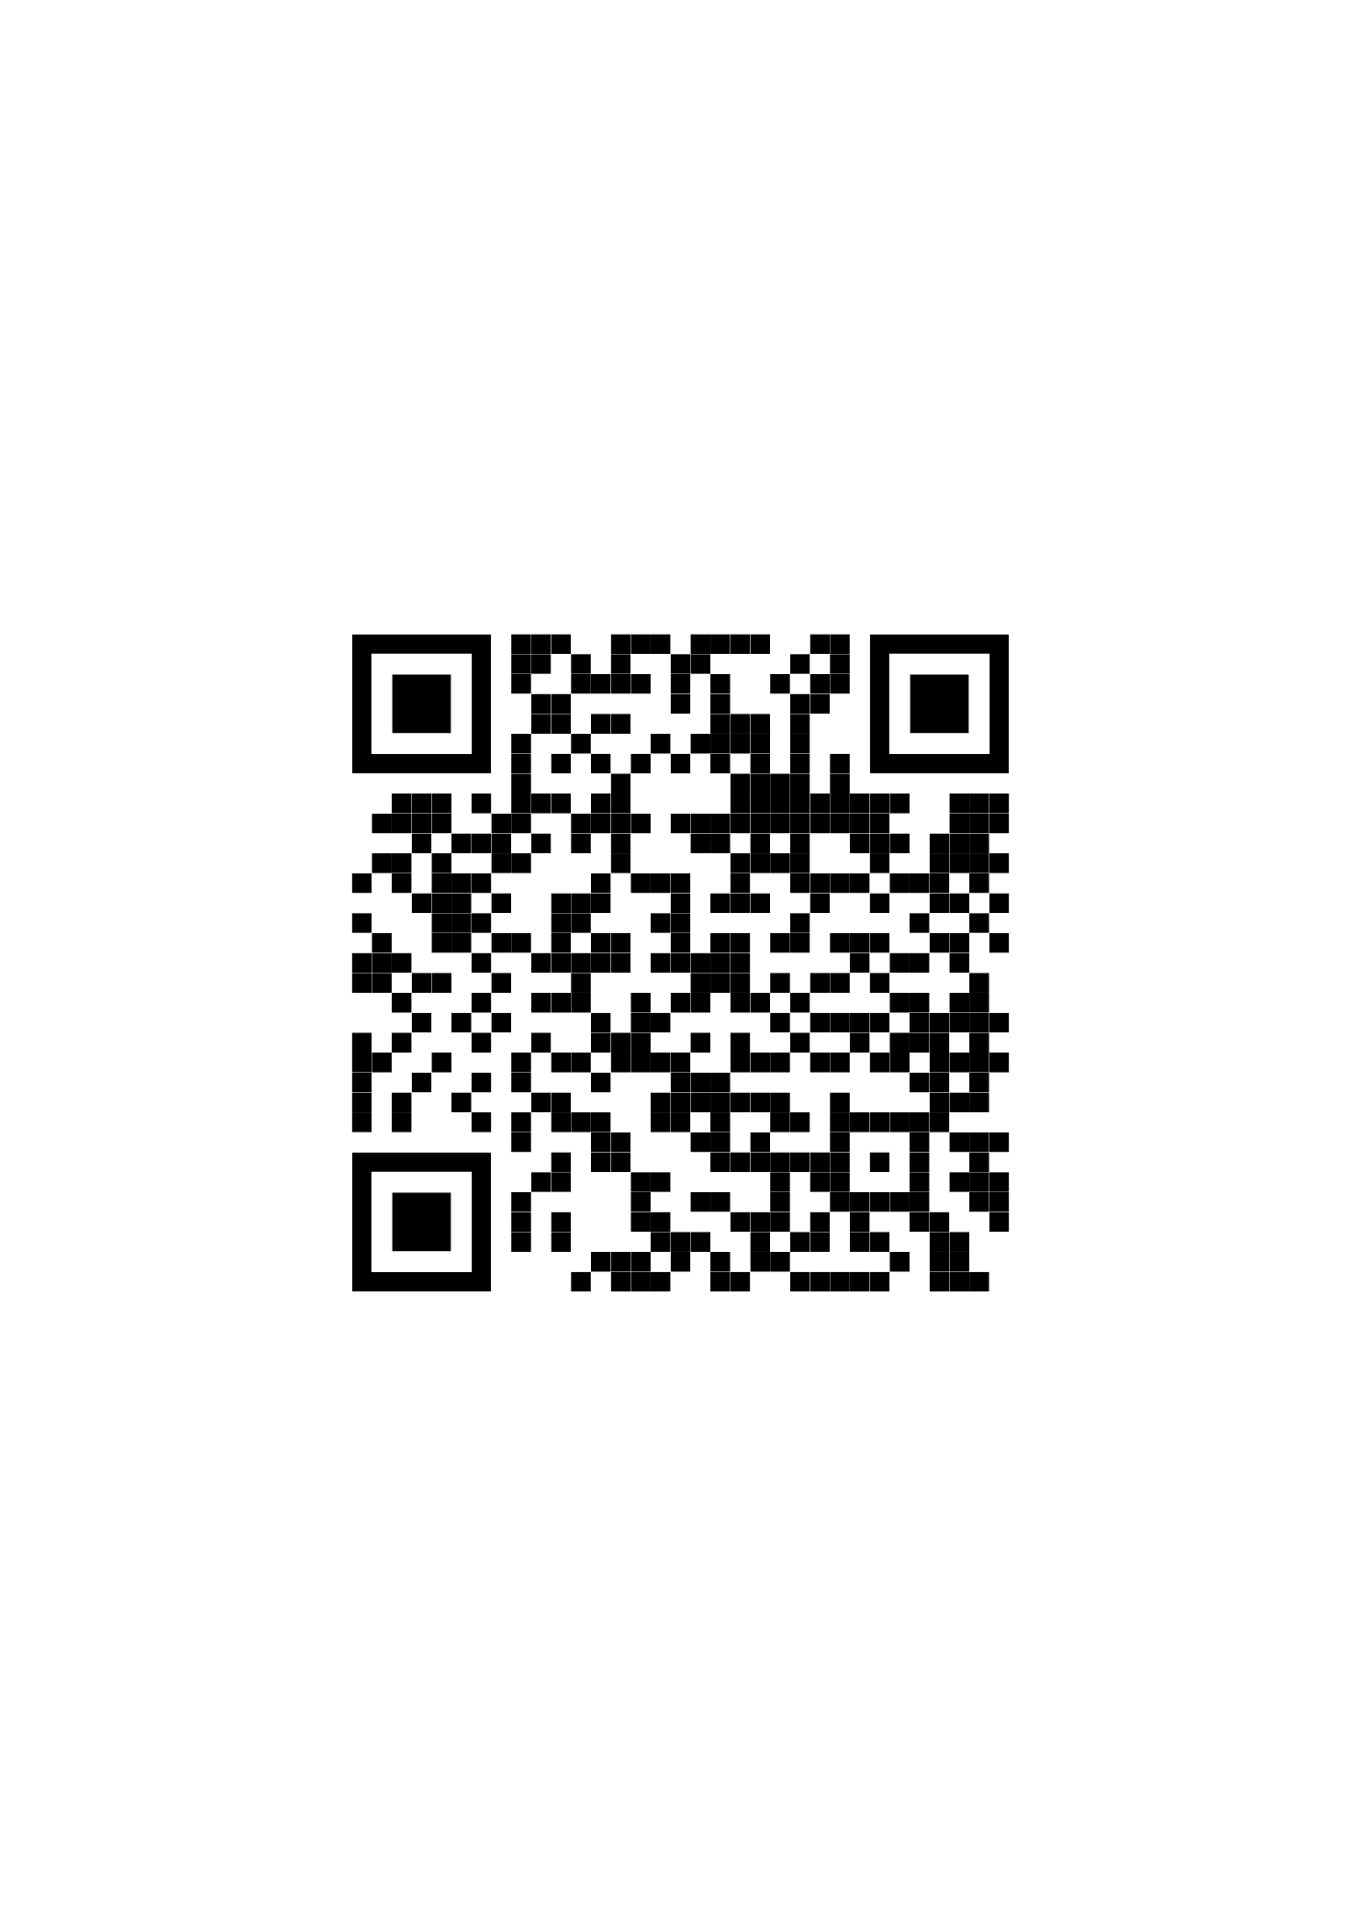
ALSF Board Member Nominations &
Aspen Community Survey
Board Member Nominations
  Deadline November 30th @ 11:59PM ET
  Scan the QR code to access the form!
Community Survey
  Deadline December 10th @ 11:59PM ET
  Results will be anonymized & shared in an annual report from the ALSF Board, to be released next year
ALSF Board Nominations
Notes:
Sierra

Slide 16
Aspen Town Hall
+
Q&A
Notes:
Ask us things

