Slide 1
Find Your Place in the Aspen Community
Linda Kramer, Martin Luther College

Slide 2
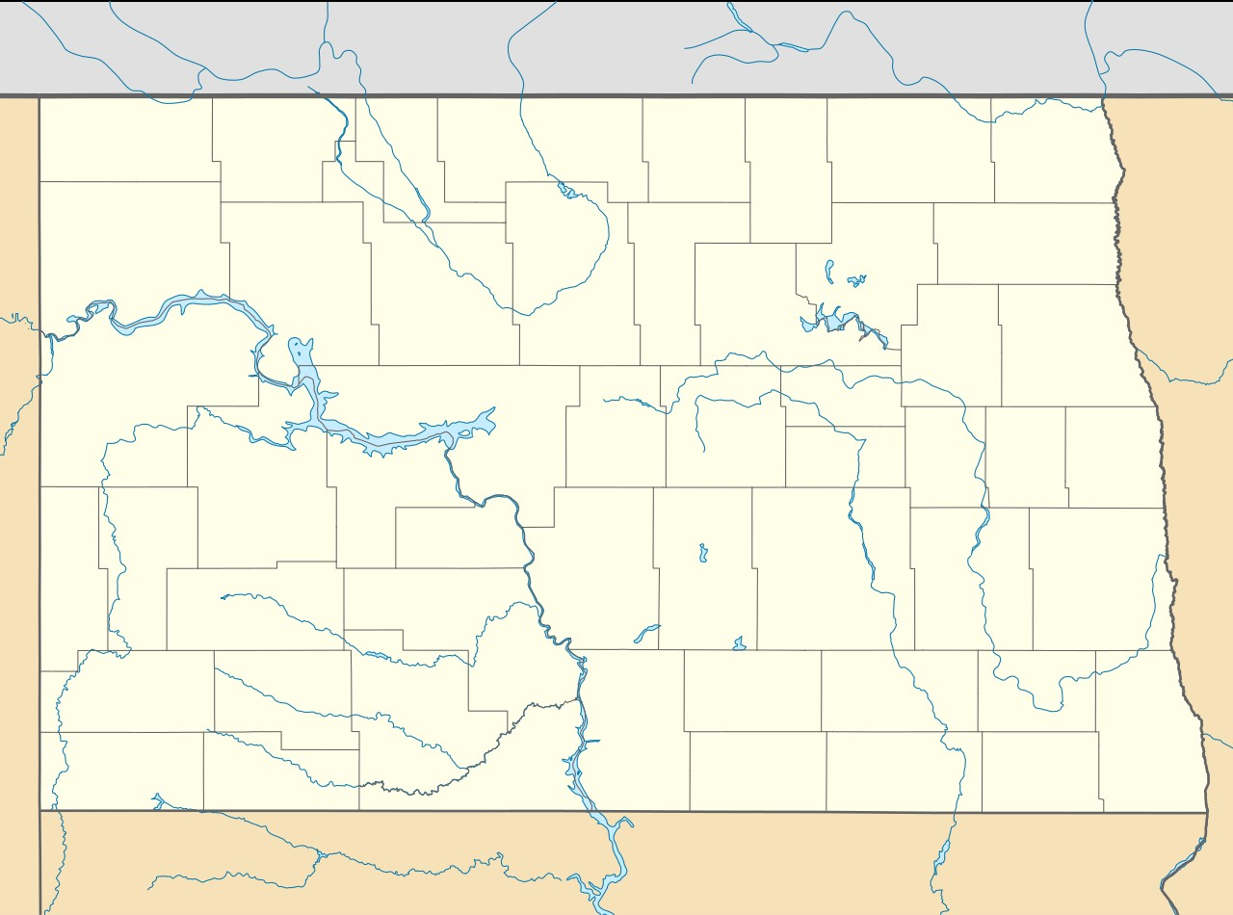
Alexrk2, CC BY 3.0 <https://creativecommons.org/licenses/by/3.0>, via Wikimedia Commons

Slide 3
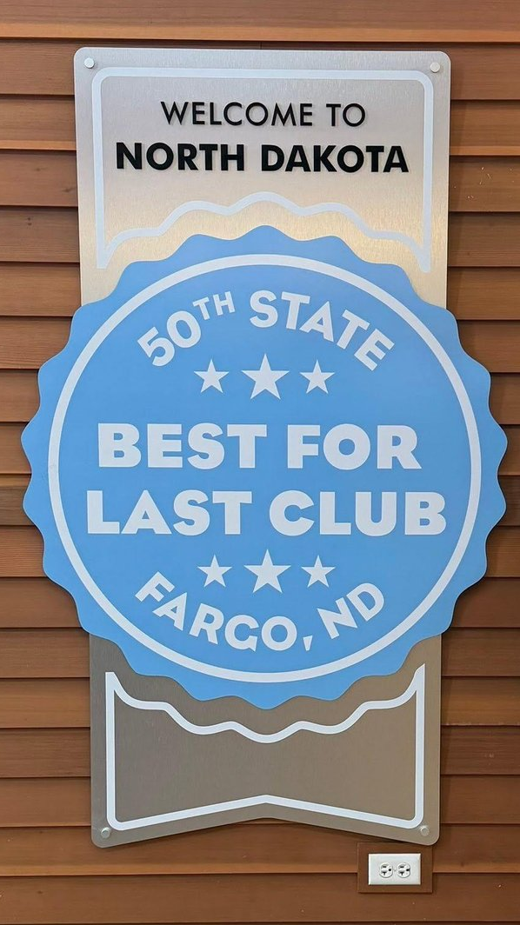
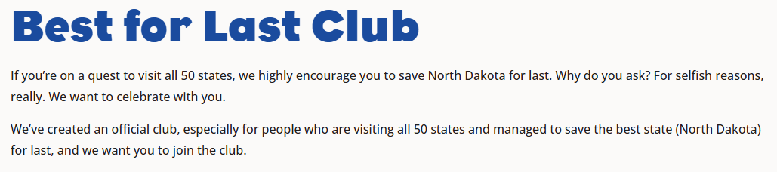
https://www.fargomoorhead.org/best-for-last-club/

Slide 4
Alexrk2, CC BY 3.0 <https://creativecommons.org/licenses/by/3.0>, via Wikimedia Commons

Slide 5
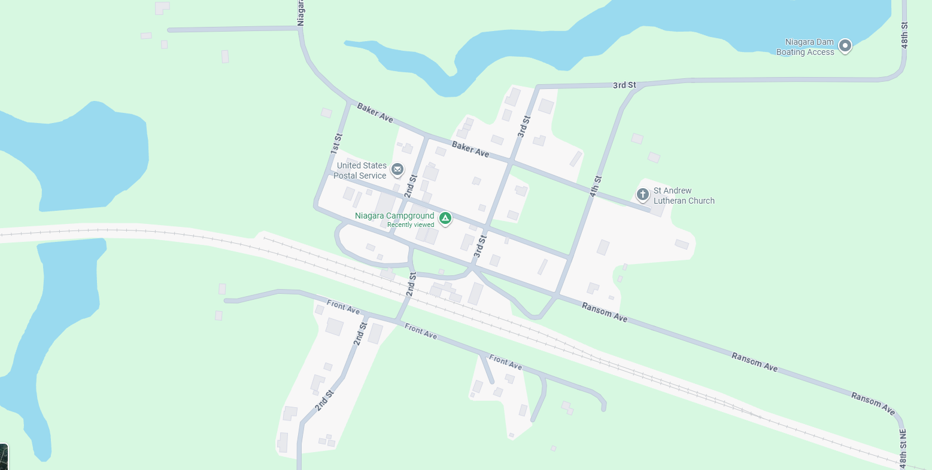
Map Data © 2026 Google

Slide 6
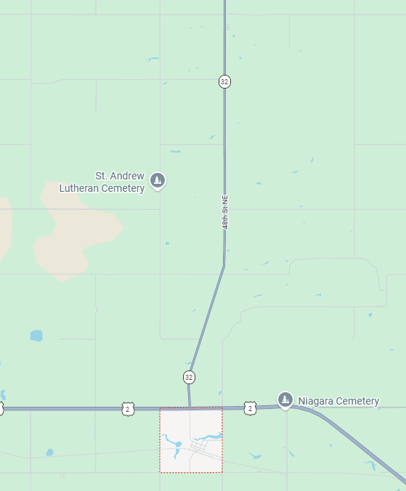
Community
Family
Neighbors
Businesses
Organizations
  Township Board
  Church
  Community Club
  Historical Society
Map Data © 2026 Google

Slide 7
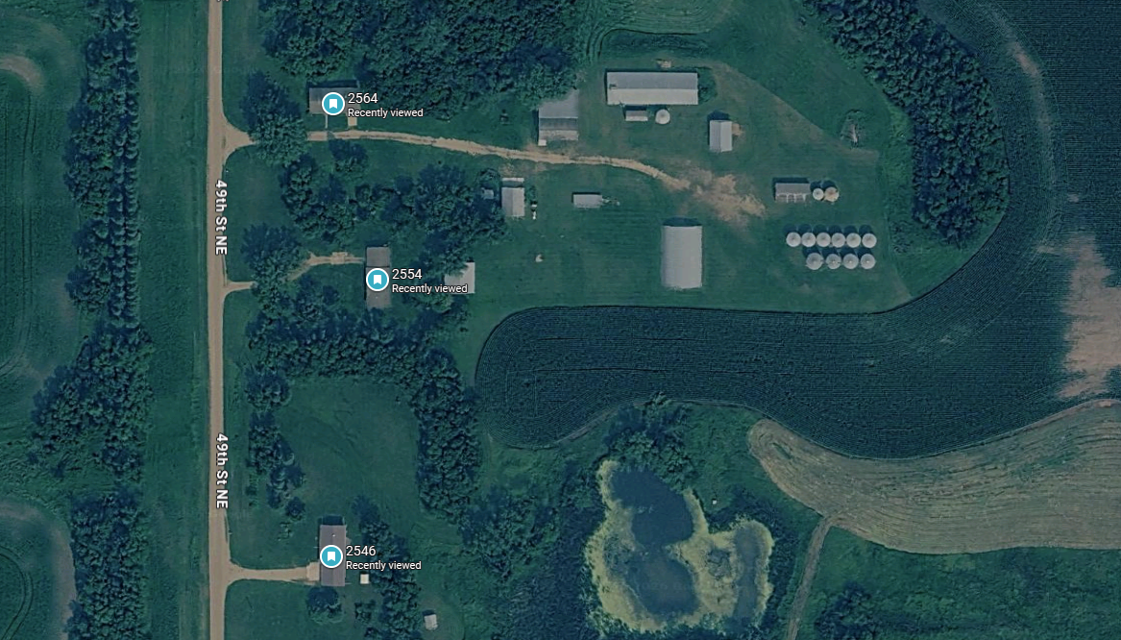

Slide 8
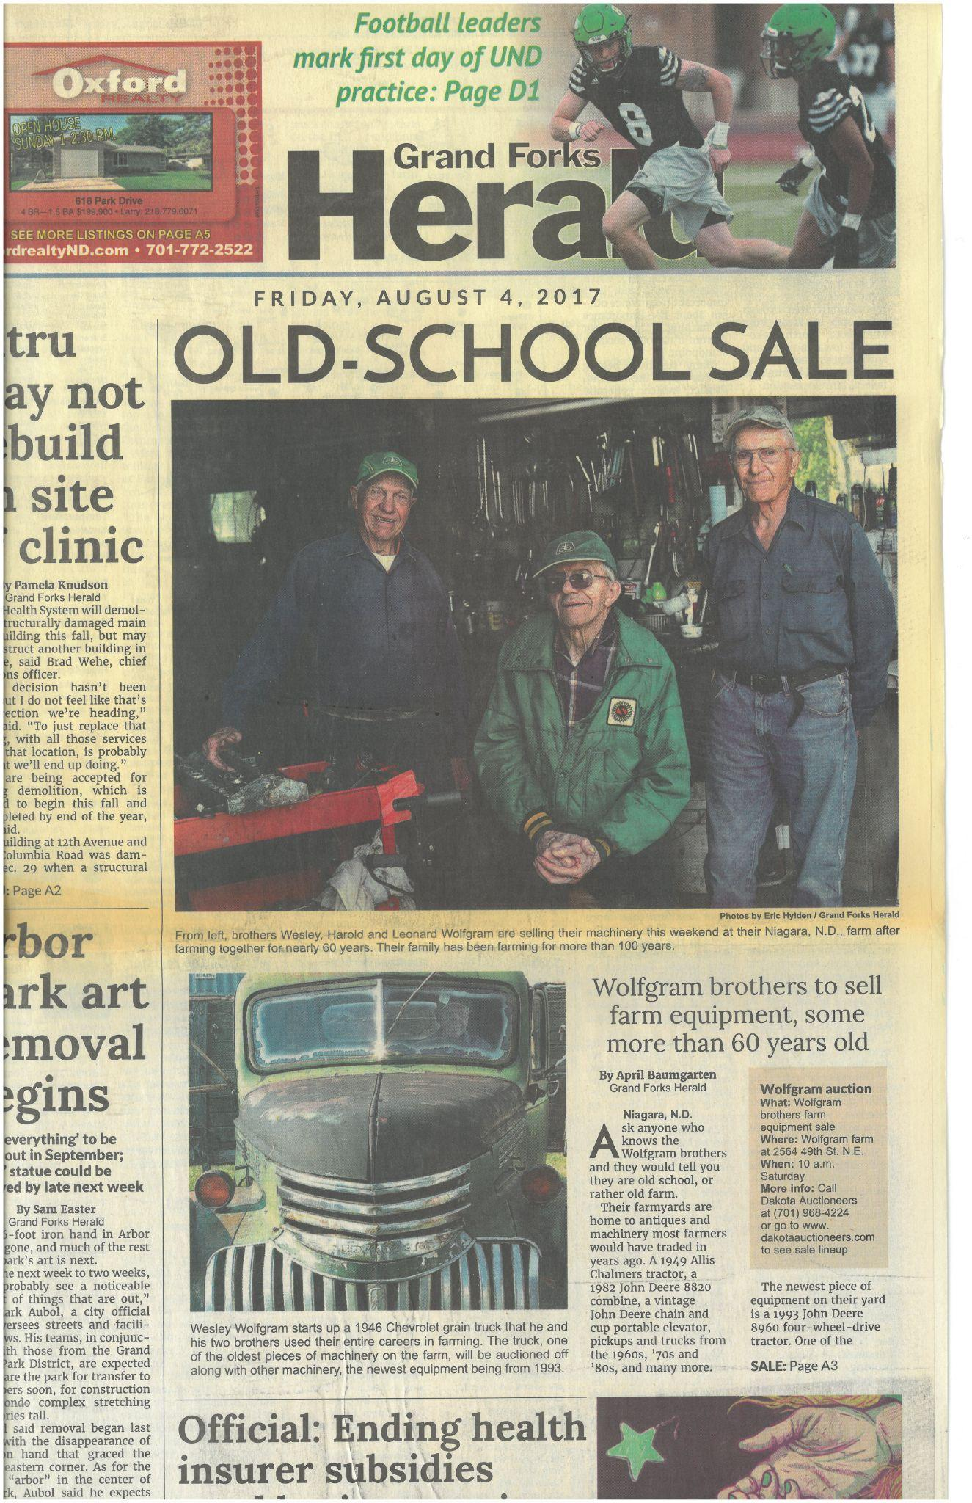
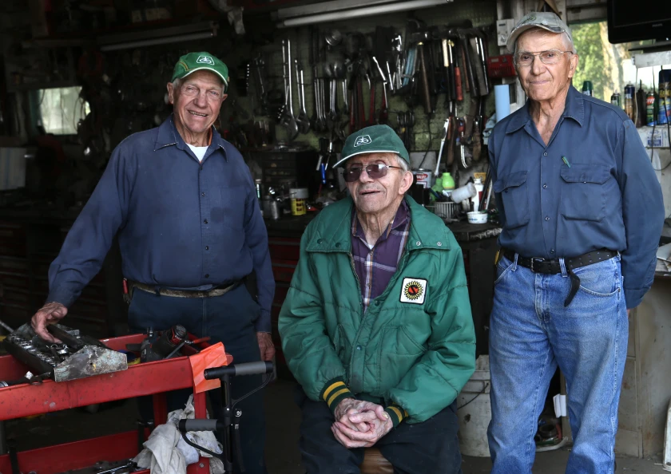
When brothers Leonard and Wesley Wolfgram finally decide to retire from the fields, they will be able to look back on many years filled with commitment to their vocation and their community.
Because of this, the 50-year-plus farmers...have been selected as Grand Forks County's co-honorees of the NDSU Agriculturist Recognition award.
It was through…hard times, though, that many communities banded together and actually became stronger. This same principle has been handed down through the Wolfgram family.
It is so second nature to them, in fact, that they were struggling to guess why they were nominated for this year's award. To their way of thinking, they just do what their family and community always have done. "Around here," he says, "everybody helps."
Even recently, this has been one of the hallmarks of a strong community, regardless of its size. The brothers feel that this is far from a fading tradition. "I personally think it is more common now than it was years ago." The brothers also have served on many local boards, helping to build their community.
Agweek, November 2007
https://www.grandforksherald.com/newsmd/niagara-n-d-brothers-retire-after-decades-on-the-farm
https://www.agweek.com/news/commitment-to-community-commitment-to-agriculture

Slide 9
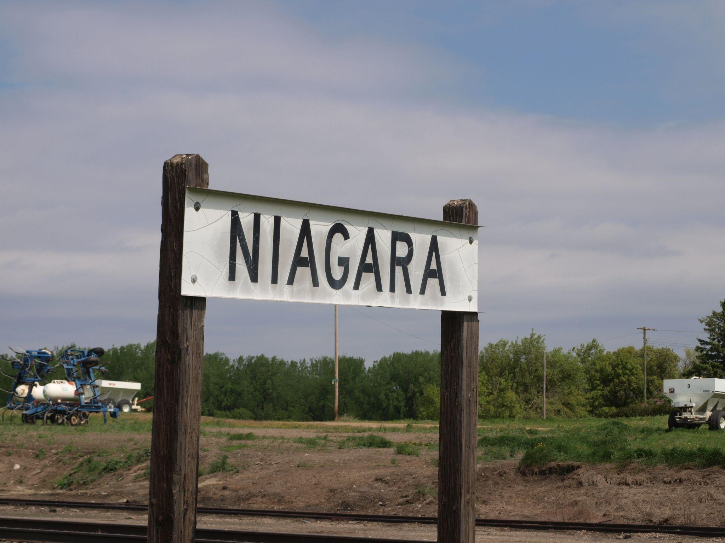
Mom
Dad
Music Club
4-H Leader
Church
Community Club
Historical Society
Township Clerk
School Board
Church
Community Club
Historical Society

Slide 10
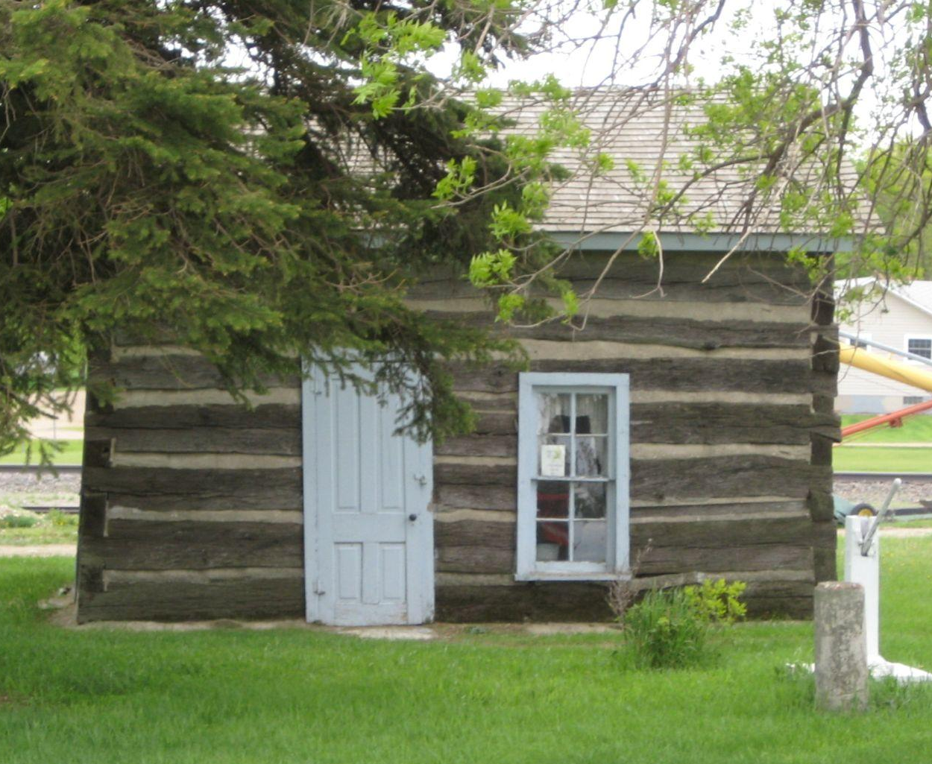
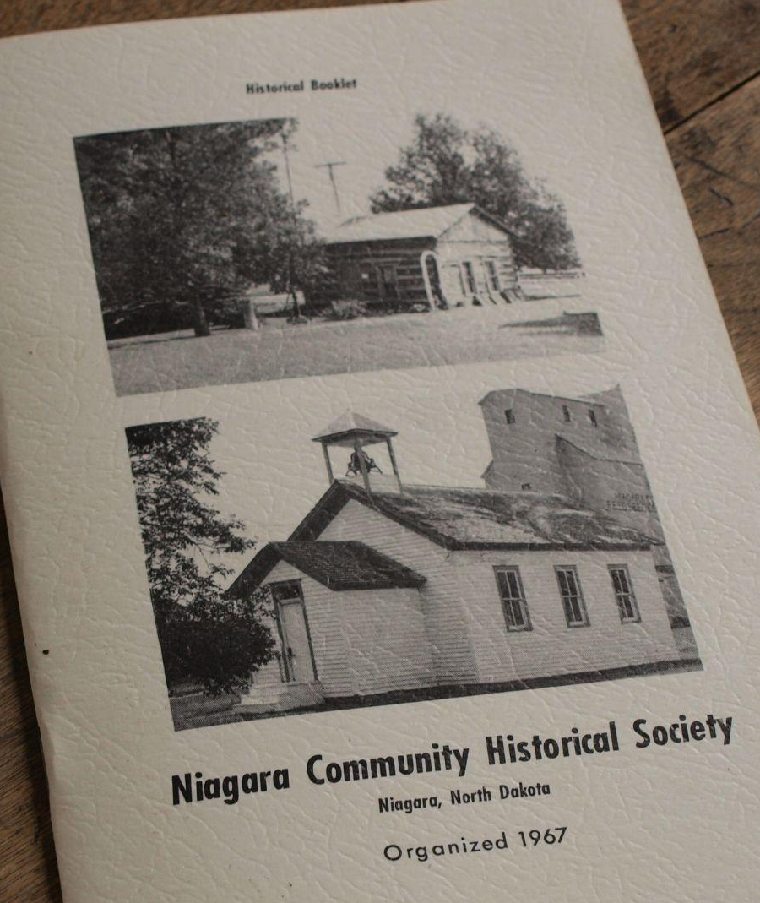
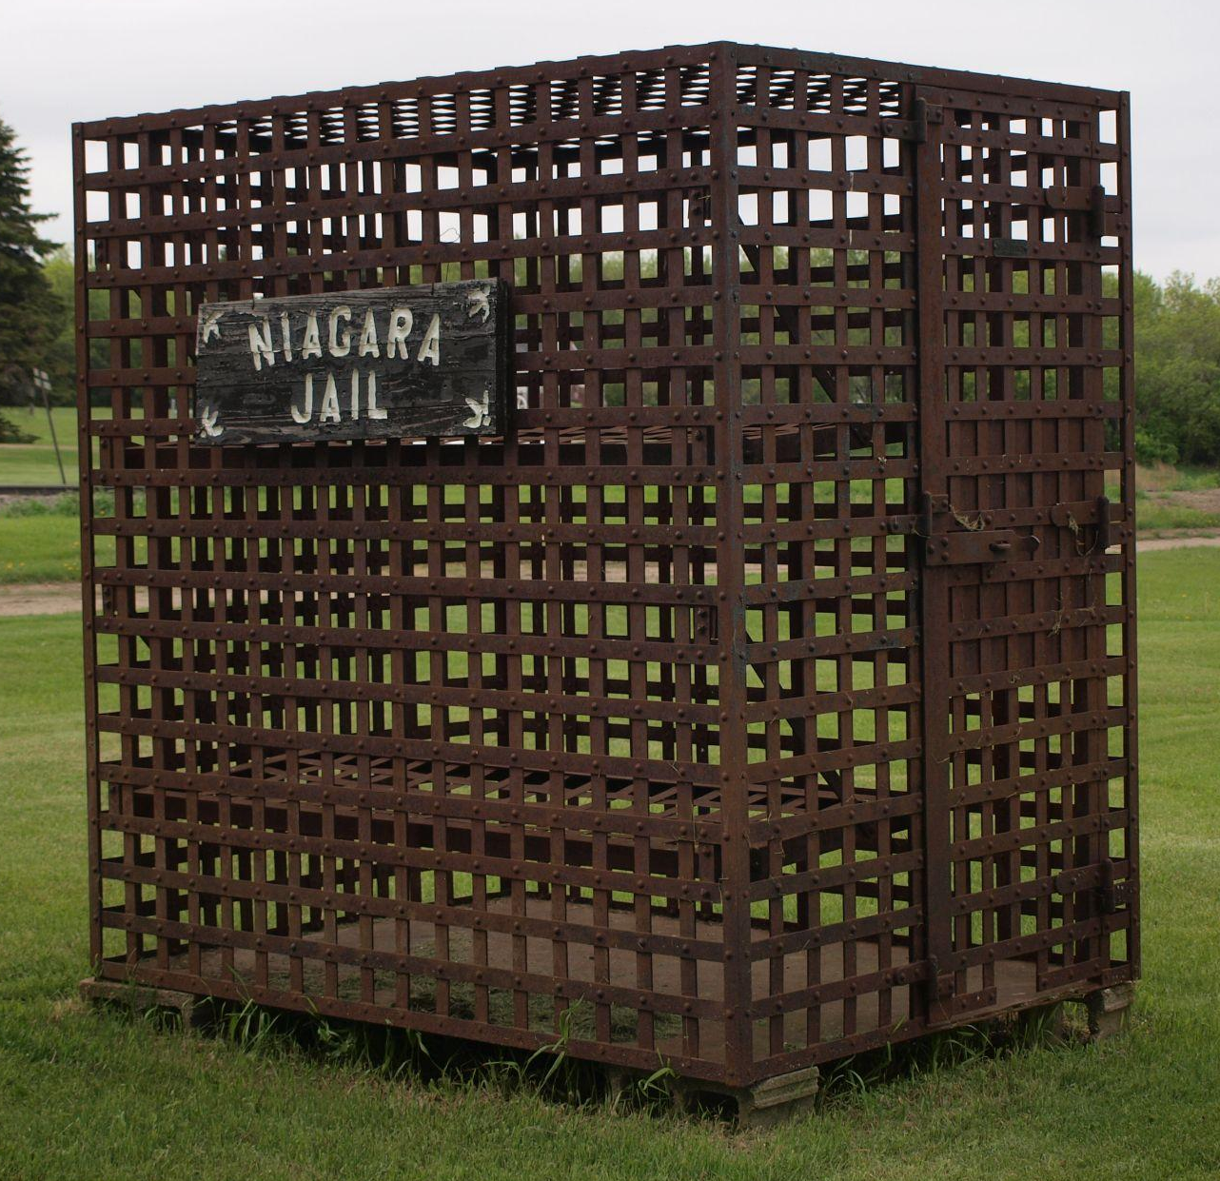
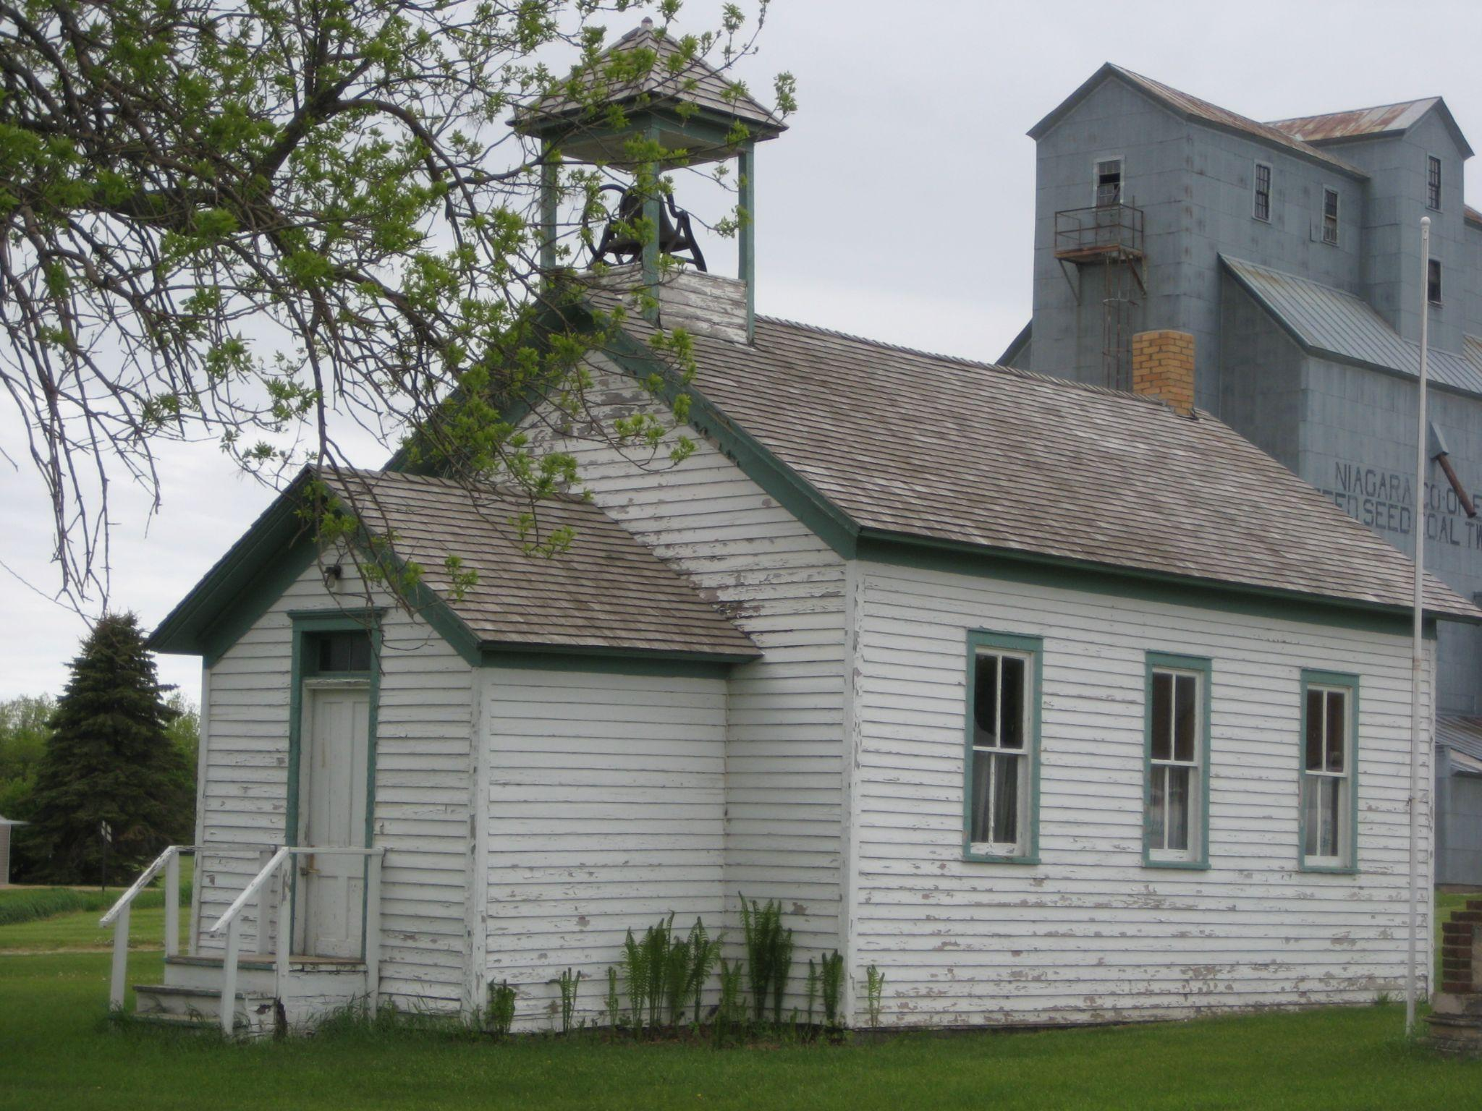

Slide 11
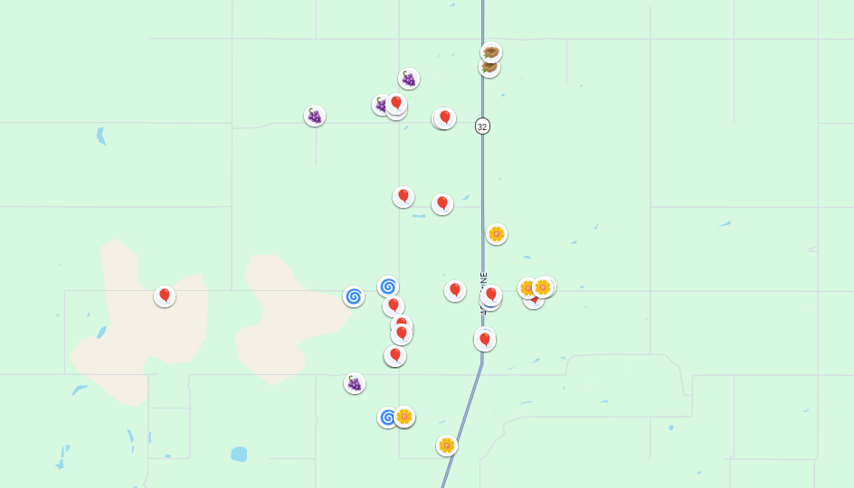
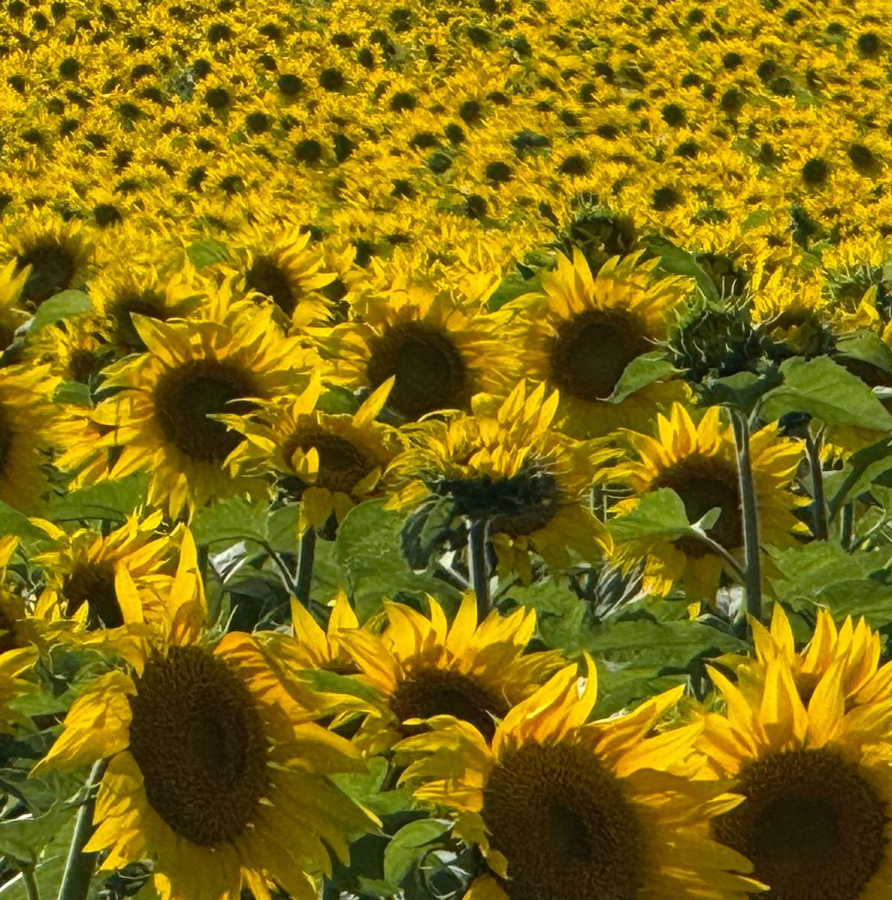
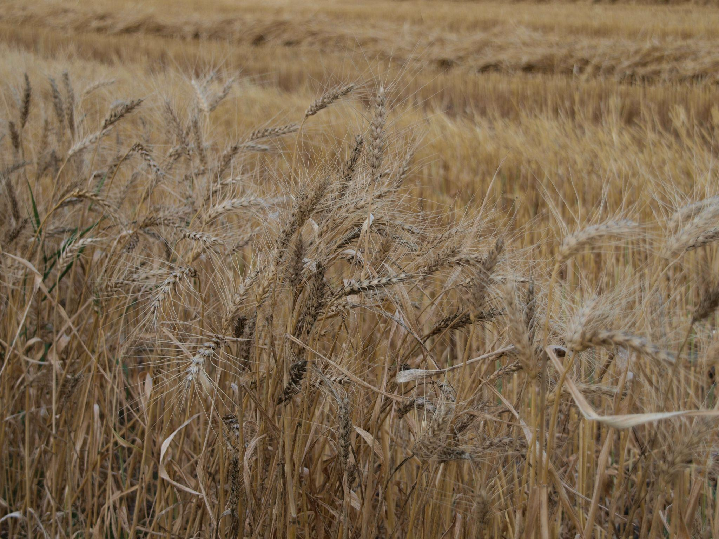
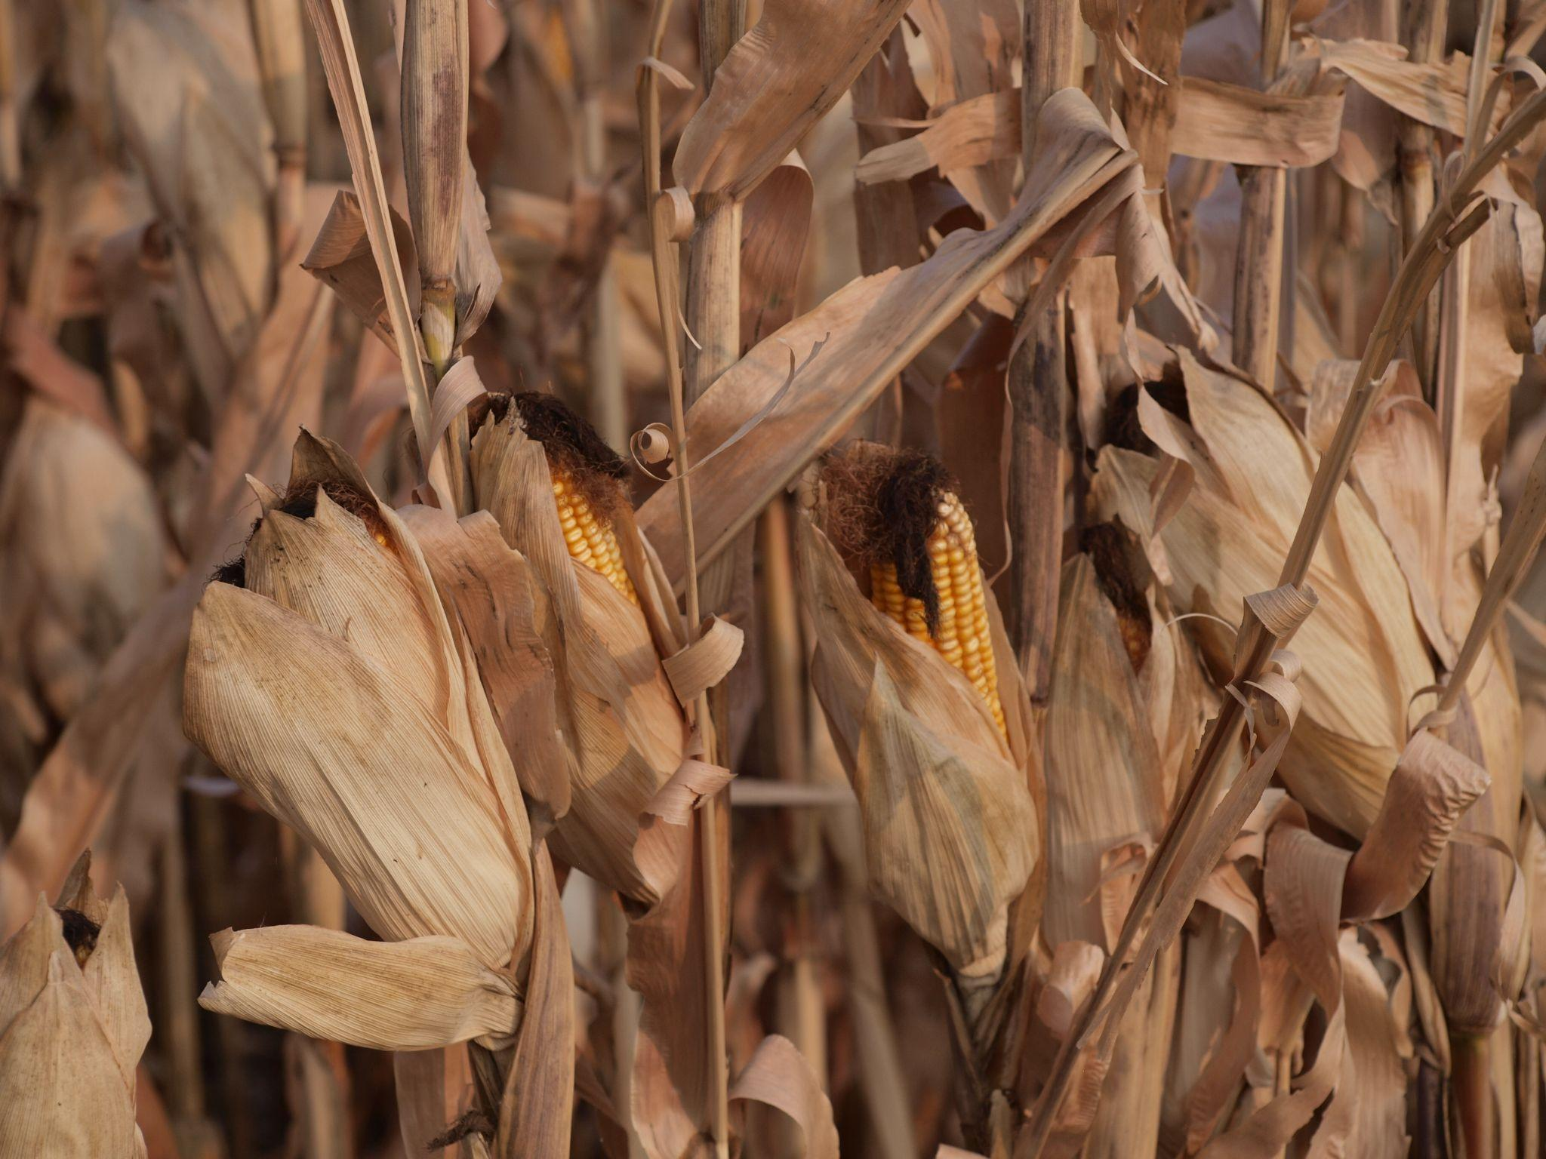
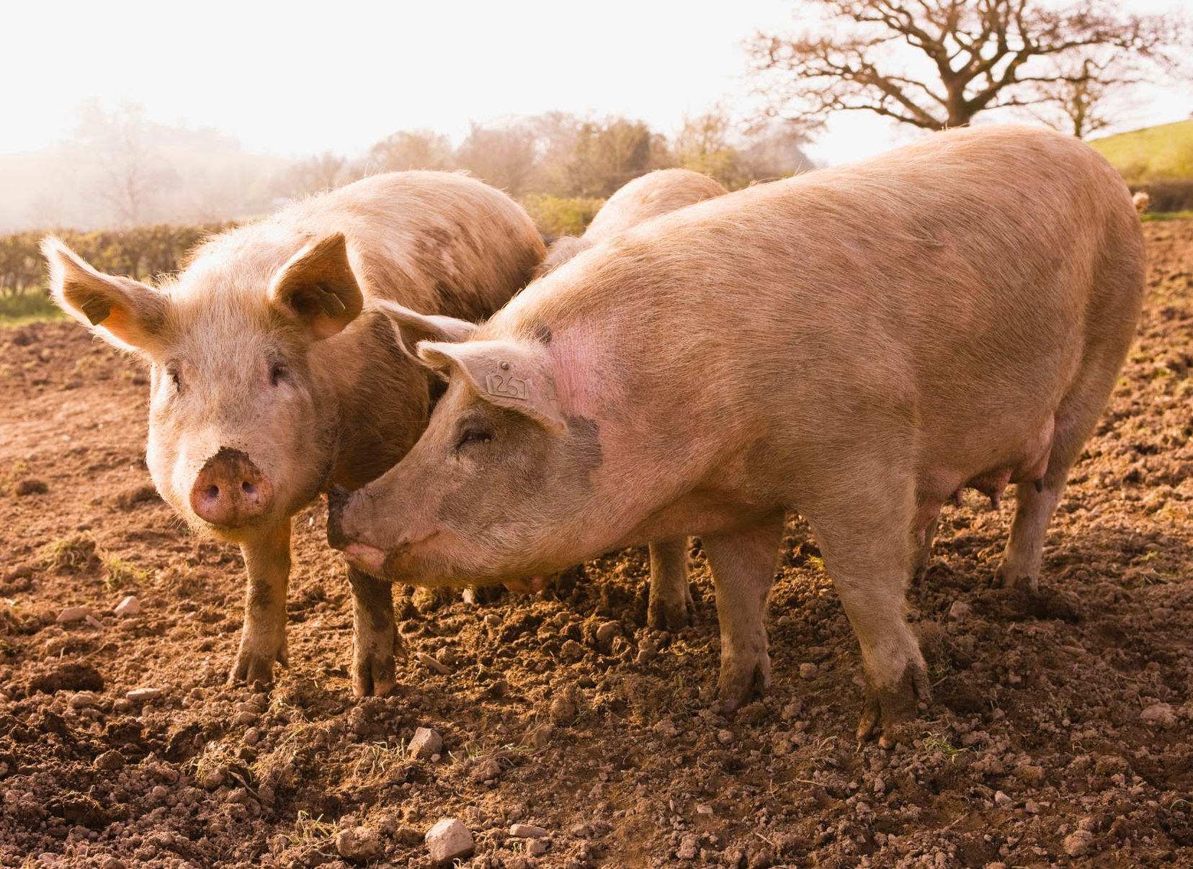

Slide 12
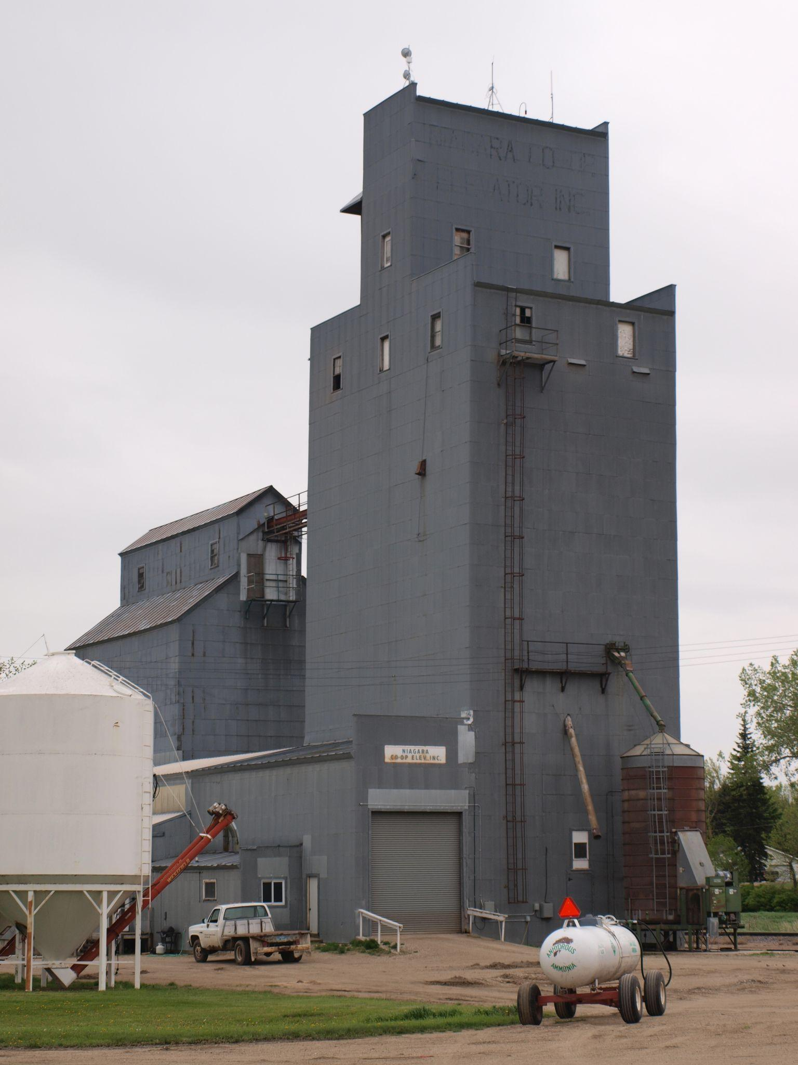
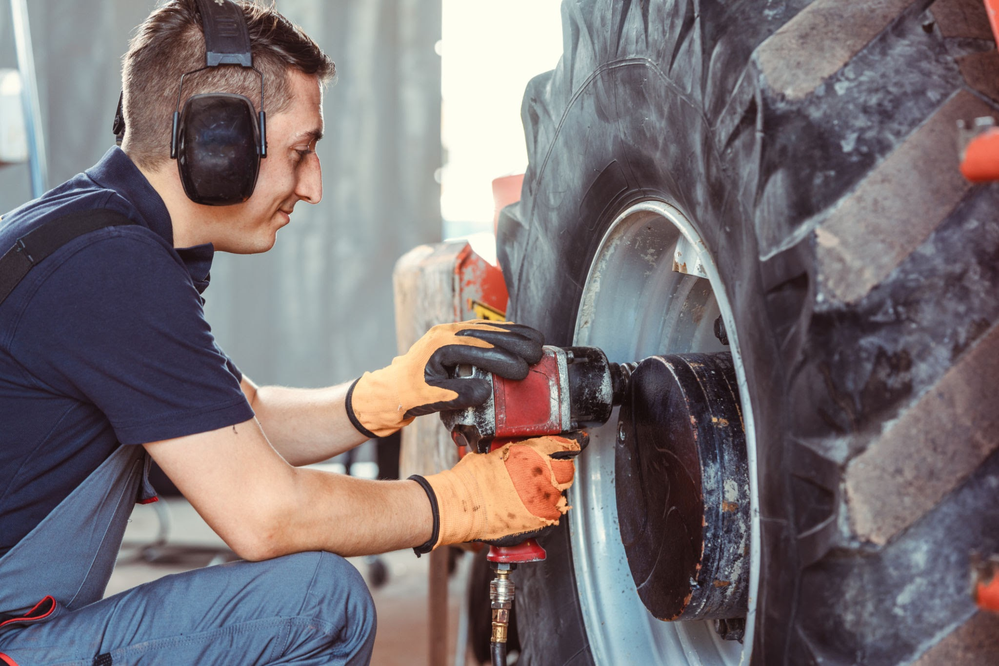
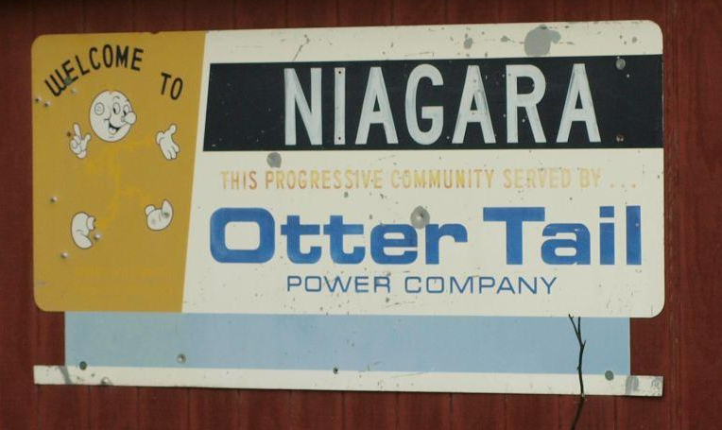

Slide 14
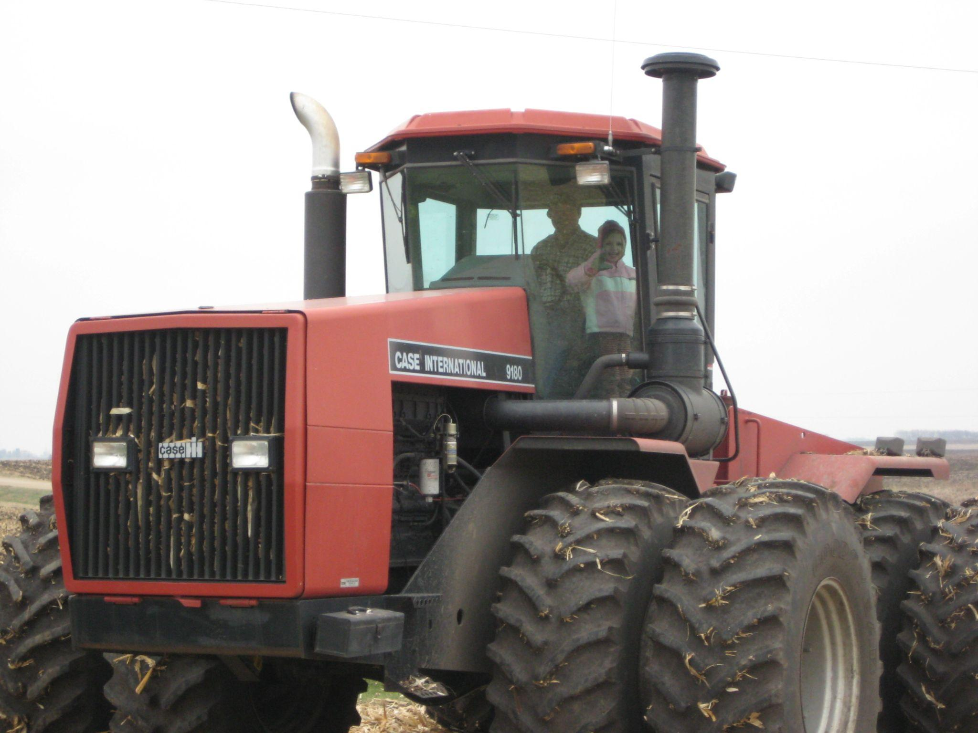
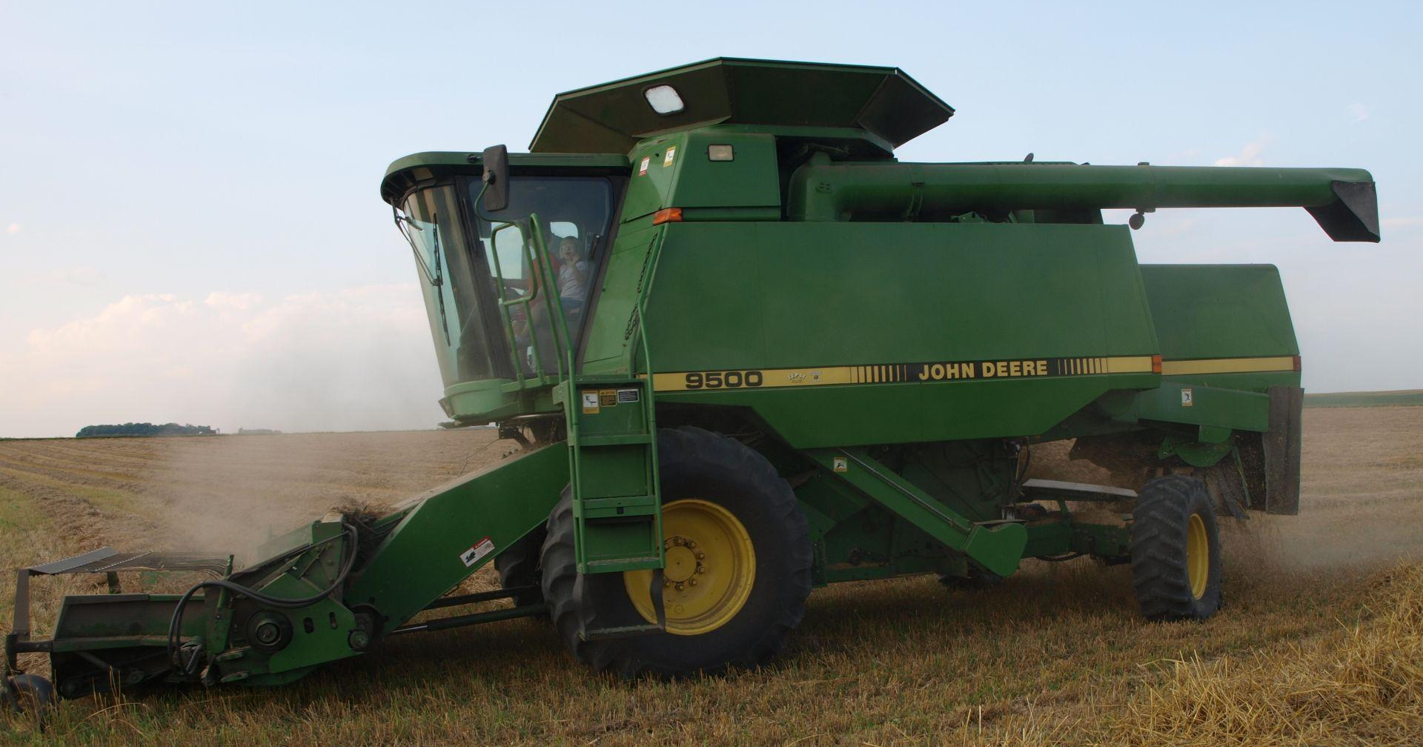
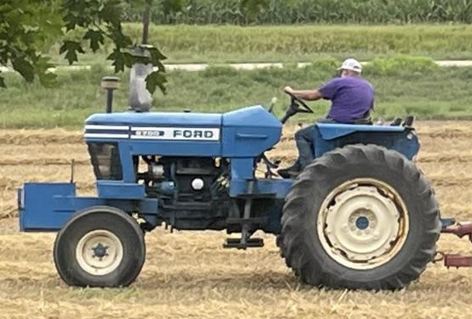

Slide 15
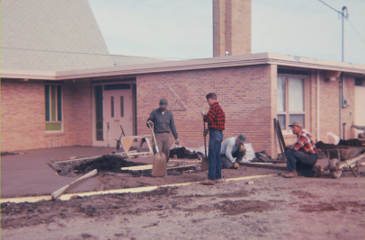
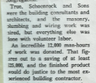
“True, Schoenrock and Sons were the building consultants and architects, and the masonry, plumbing, and wiring work was hired, but everything else was done with volunteer labor. An incredible 12,000 man-hours of work was donated.”

Slide 17
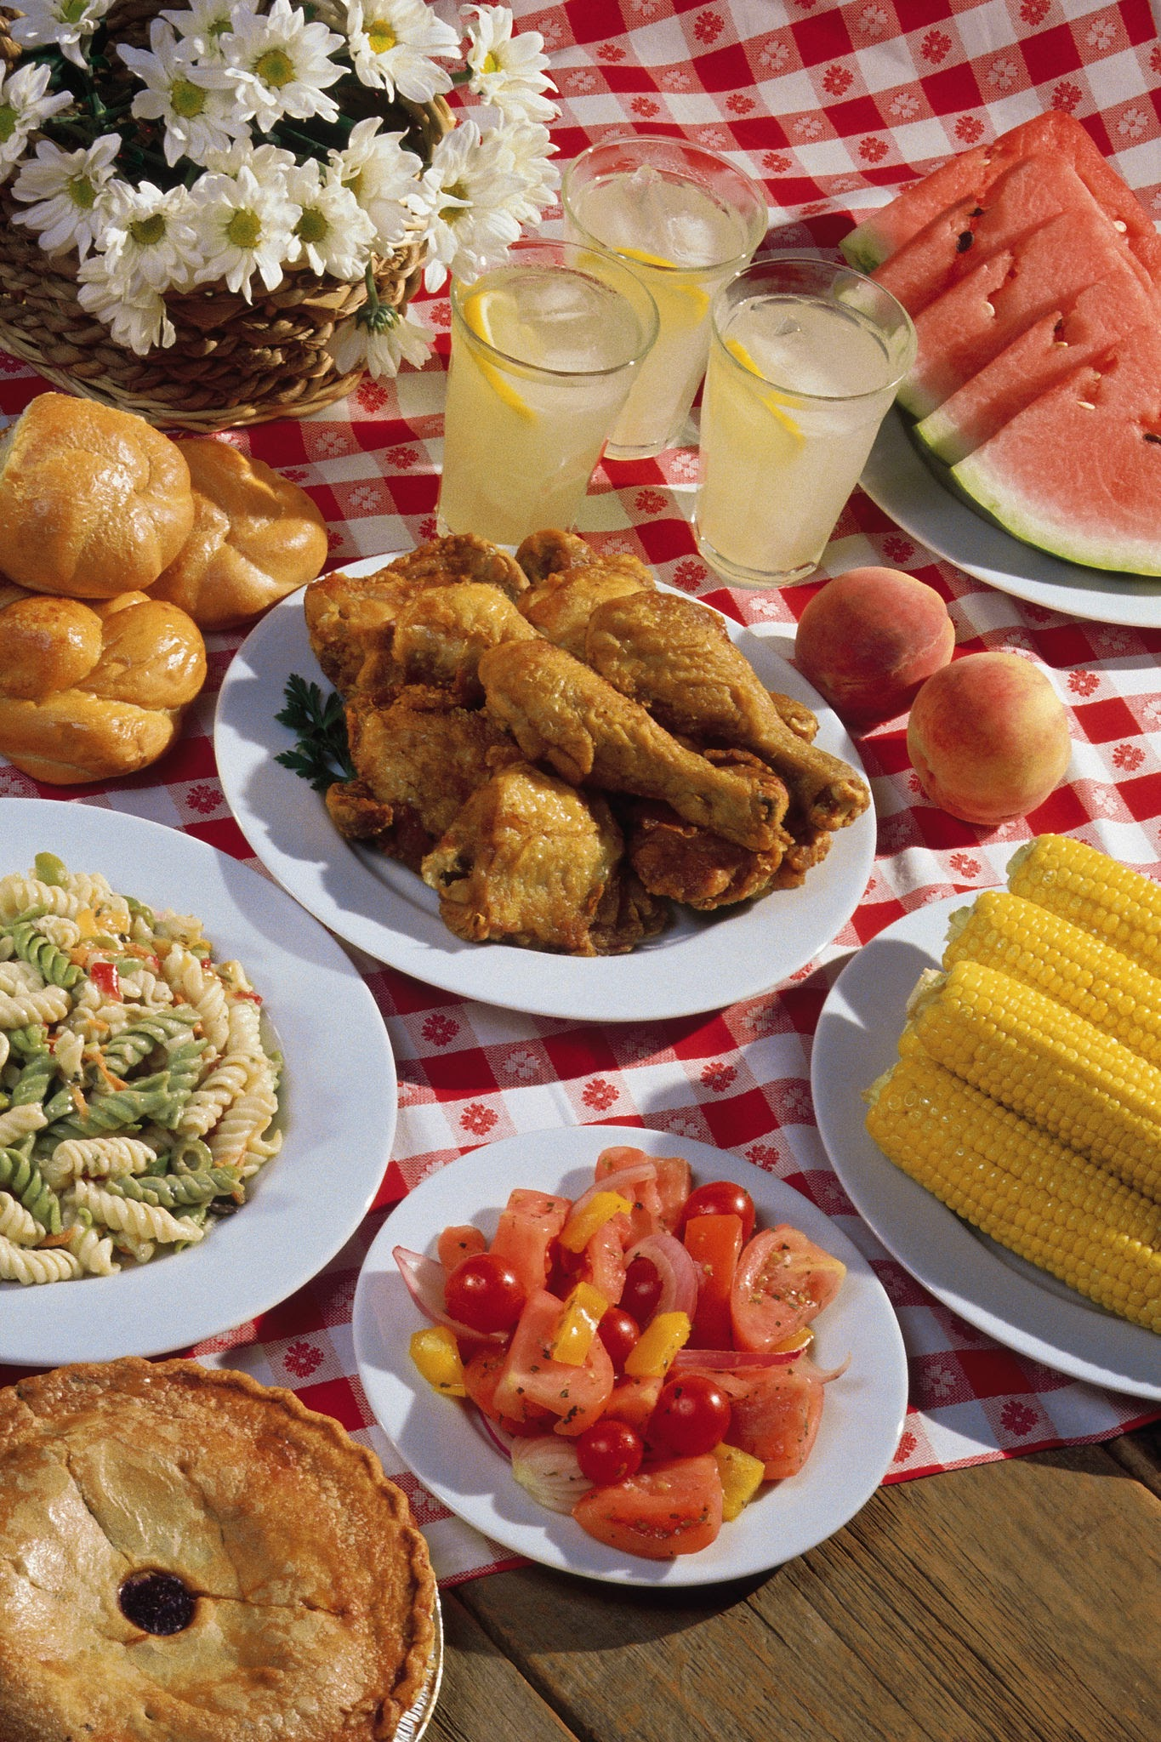



Slide 18
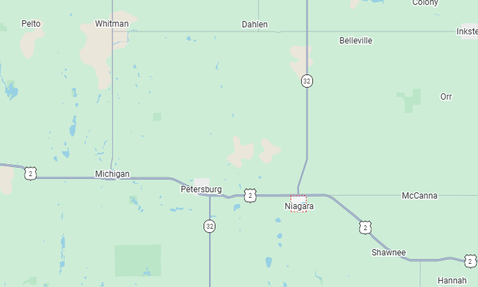

Slide 19
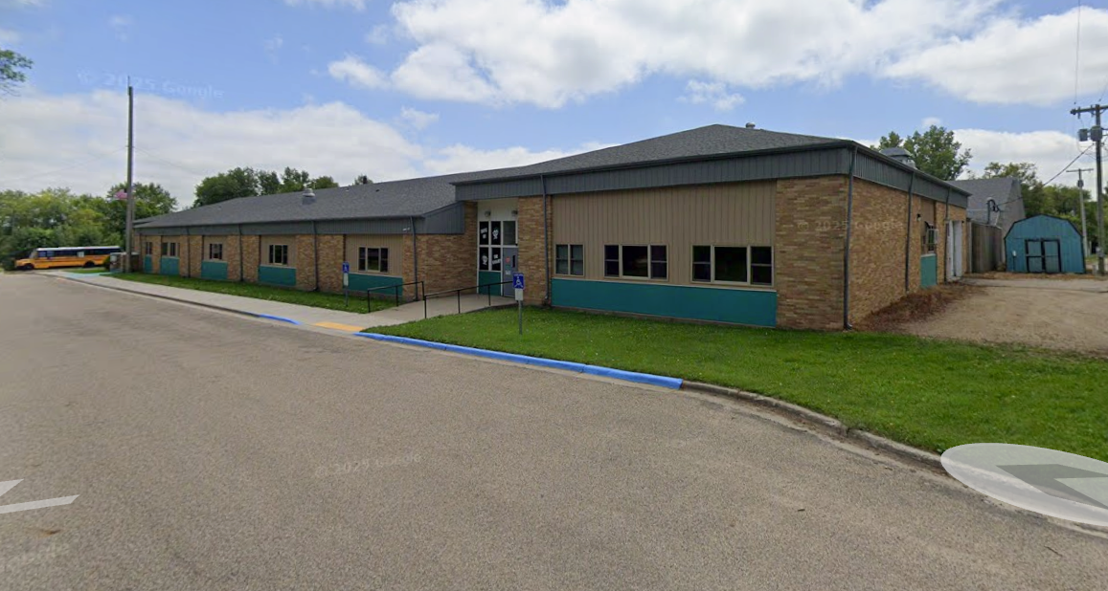
Image Capture: Aug 2025 © 2026 Google

Slide 20
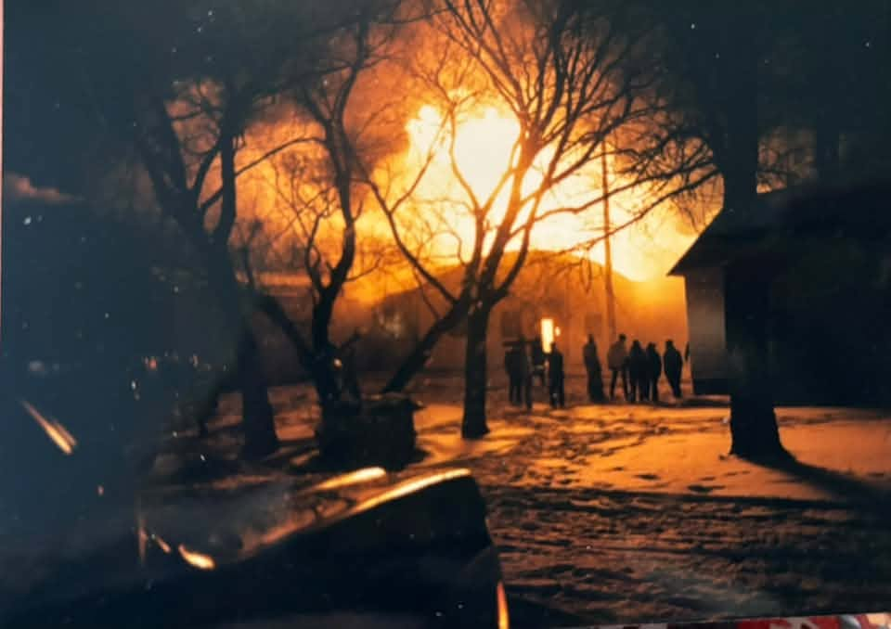

Slide 21
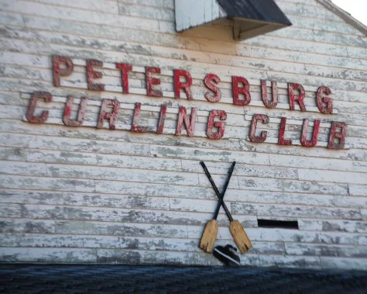
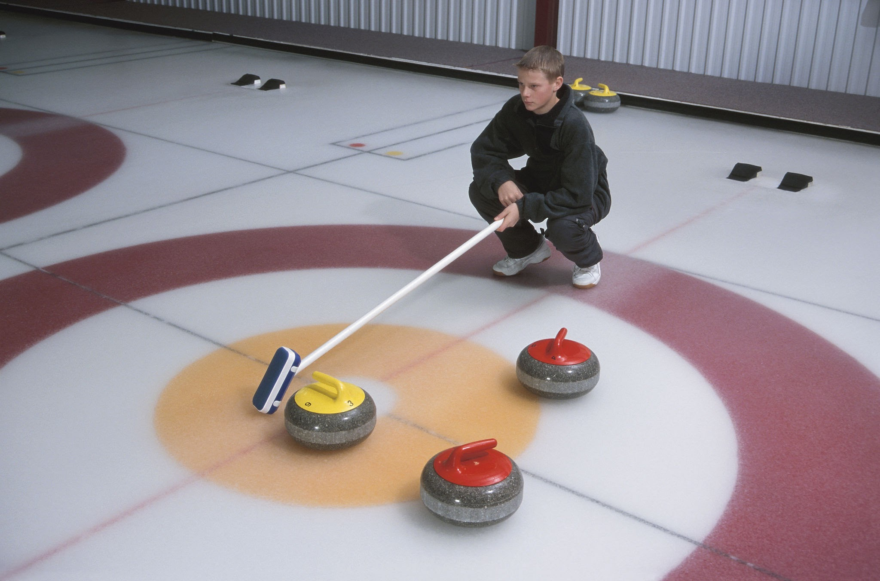
David Kravetz, Sumoflam Productions

Slide 23
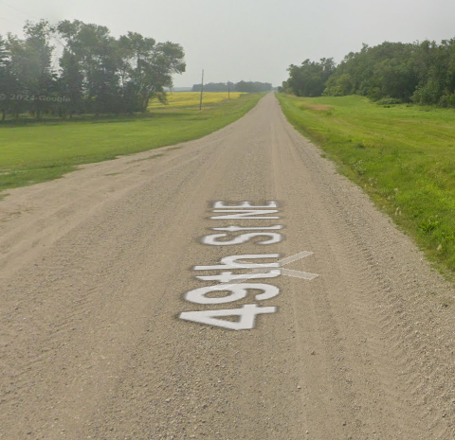
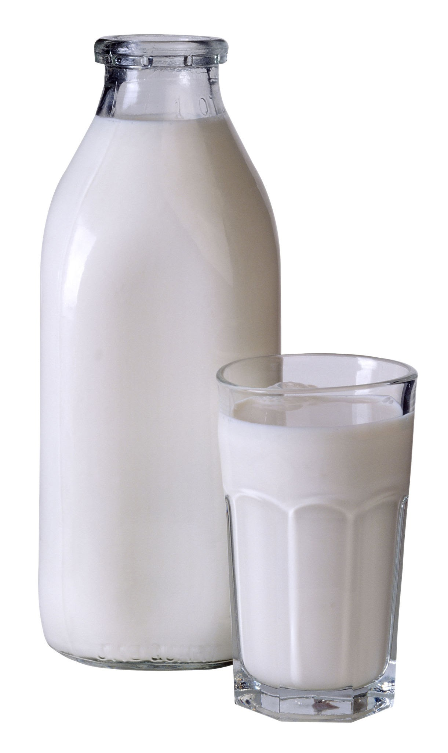


Betty

Slide 24
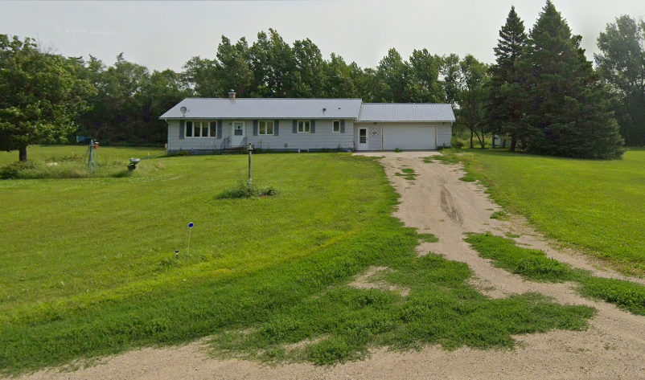
Image Capture: Jul 2024 © 2026 Google

Slide 25

Loretta

Slide 26
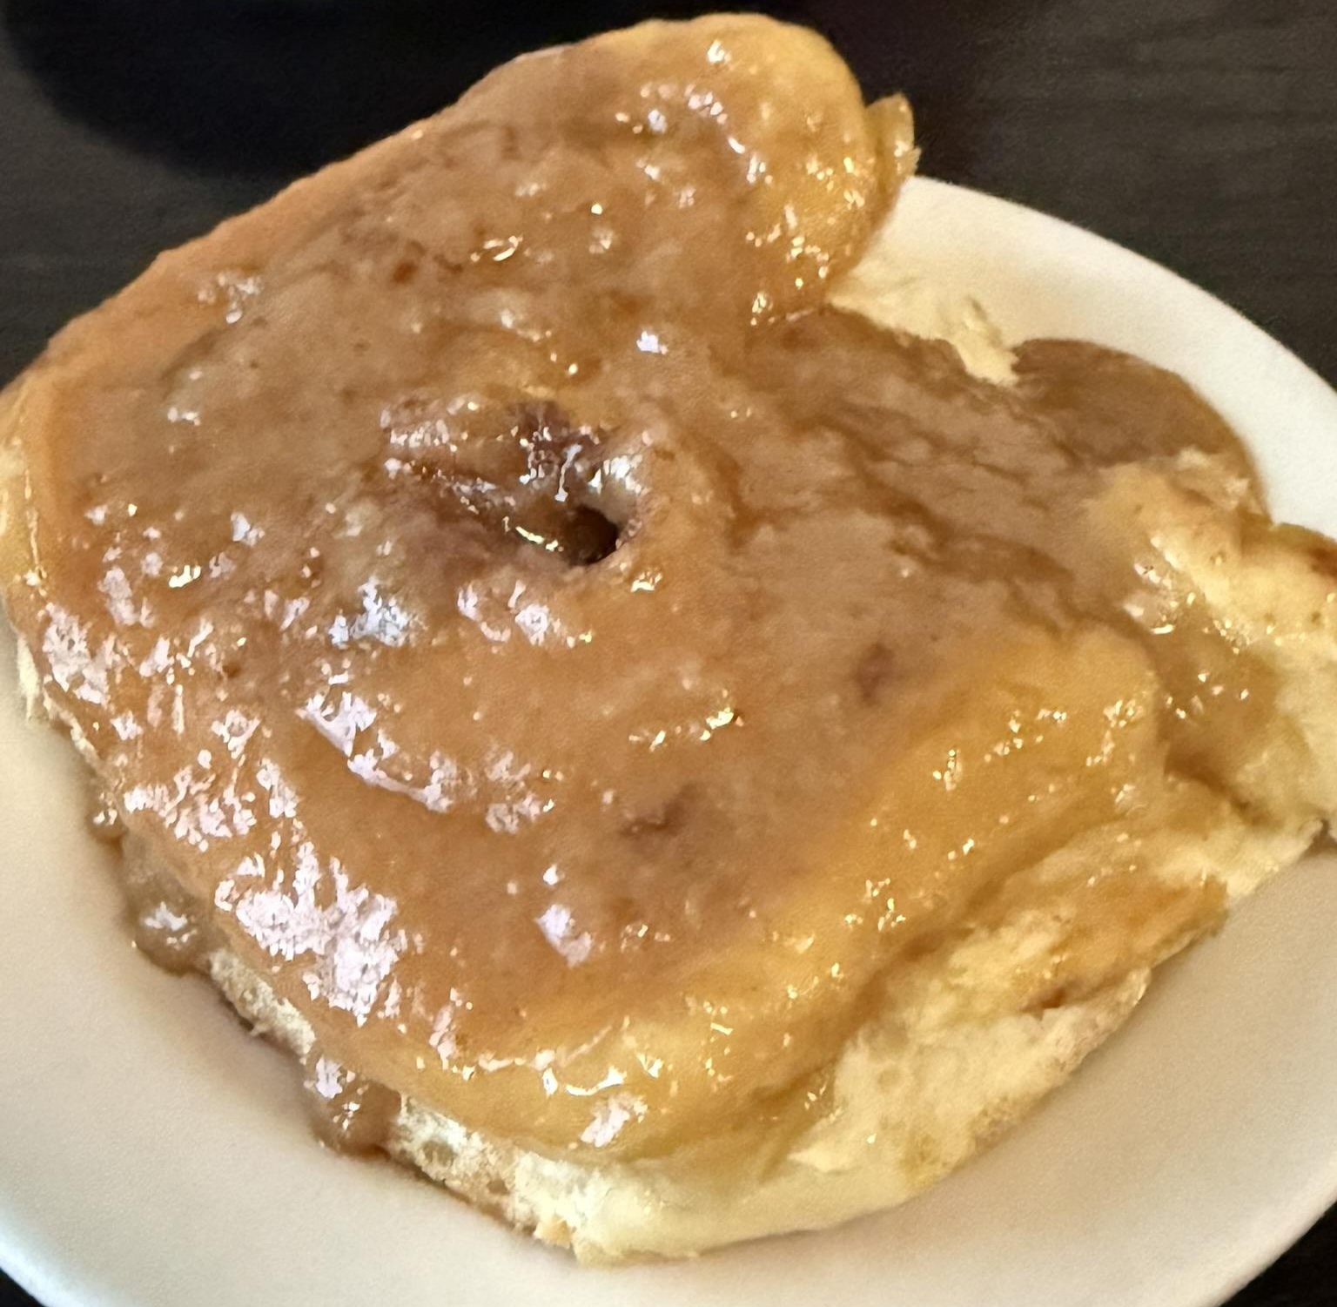
Gertie

Slide 27
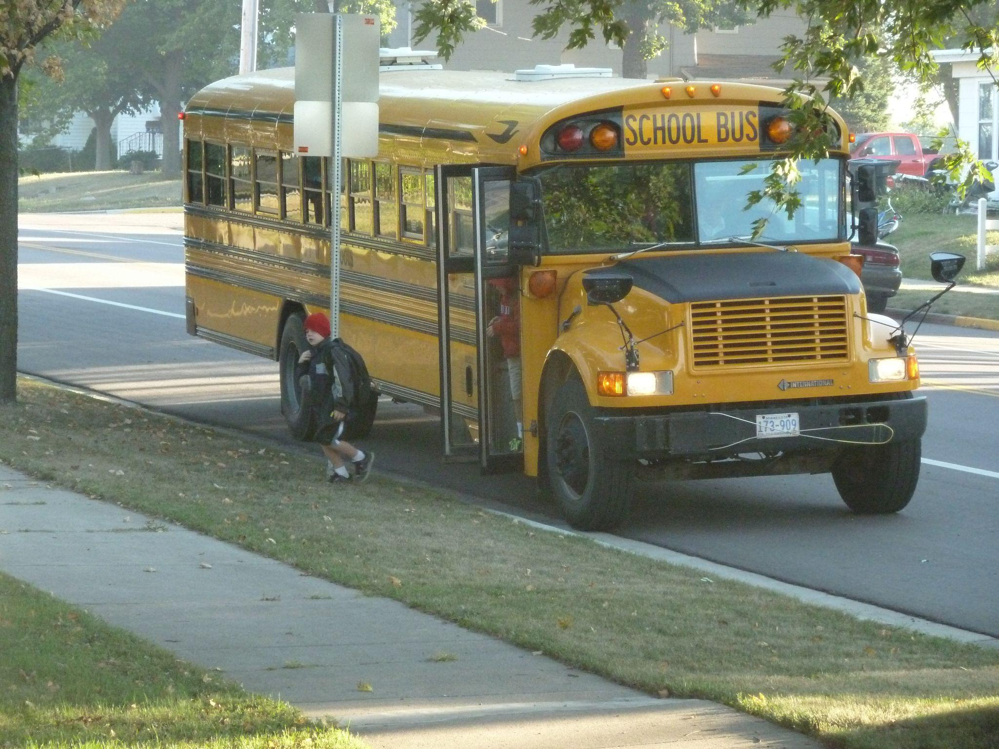
Molly

Slide 28
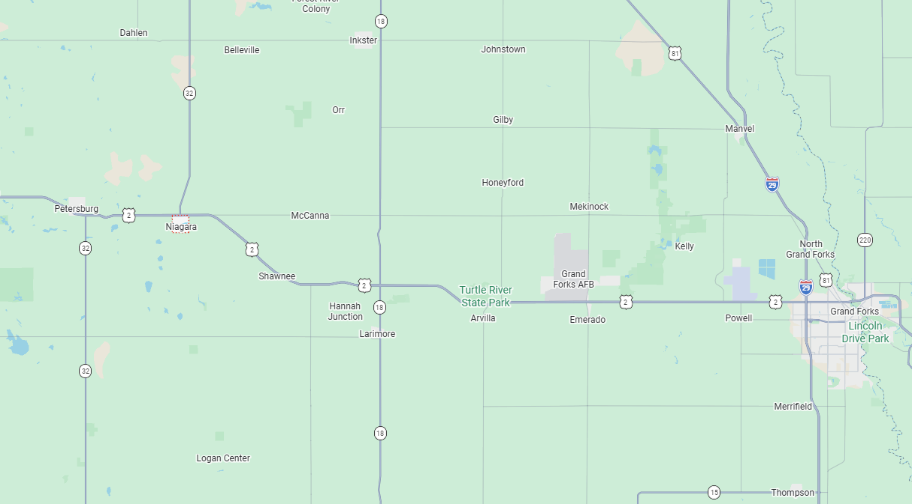
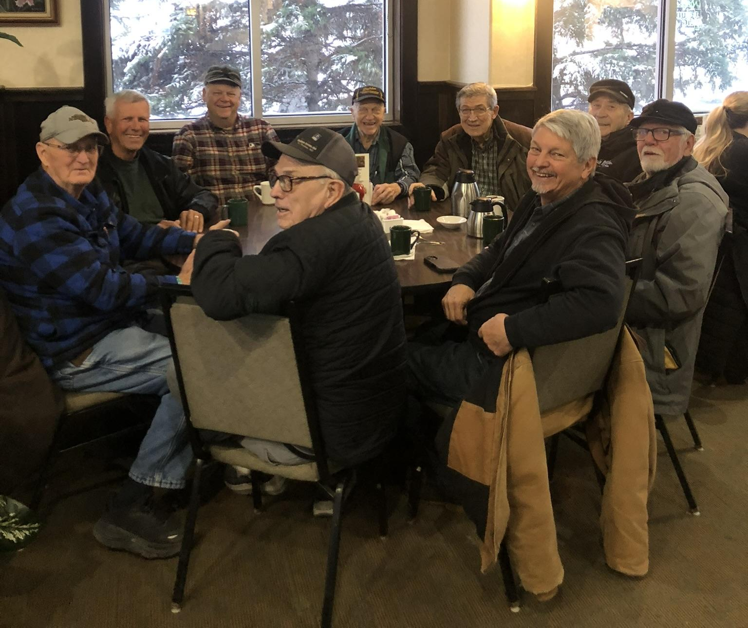

Slide 29
Library Community
Alexrk2, CC BY 3.0 <https://creativecommons.org/licenses/by/3.0>, via Wikimedia Commons

Slide 30
Aspen Land
Alexrk2, CC BY 3.0 <https://creativecommons.org/licenses/by/3.0>, via Wikimedia Commons

Slide 31
Aspen Community
Libraries
Developers
Support Vendors
Map Data © 2026 Google

Slide 32
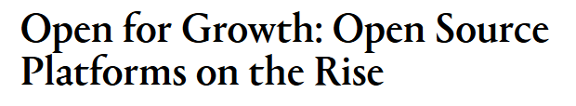


When brothers Leonard and Wesley Wolfgram finally decide to retire from the fields, they will be able to look back on many years filled with commitment to their vocation and their community.
Because of this, the 50-year-plus farmers...have been selected as Grand Forks County's co-honorees of the NDSU Agriculturist Recognition award.
It was through…hard times, though, that many communities banded together and actually became stronger. This same principle has been handed down through the Wolfgram family.
It is so second nature to them, in fact, that they were struggling to guess why they were nominated for this year's award. To their way of thinking, they just do what their family and community always have done. "Around here," he says, "everybody helps."
Even recently, this has been one of the hallmarks of a strong community, regardless of its size. The brothers feel that this is far from a fading tradition. "I personally think it is more common now than it was years ago." The brothers also have served on many local boards, helping to build their community.
https://www.agweek.com/news/commitment-to-community-commitment-to-agriculture
https://www.grandforksherald.com/newsmd/niagara-n-d-brothers-retire-after-decades-on-the-farm

Slide 33
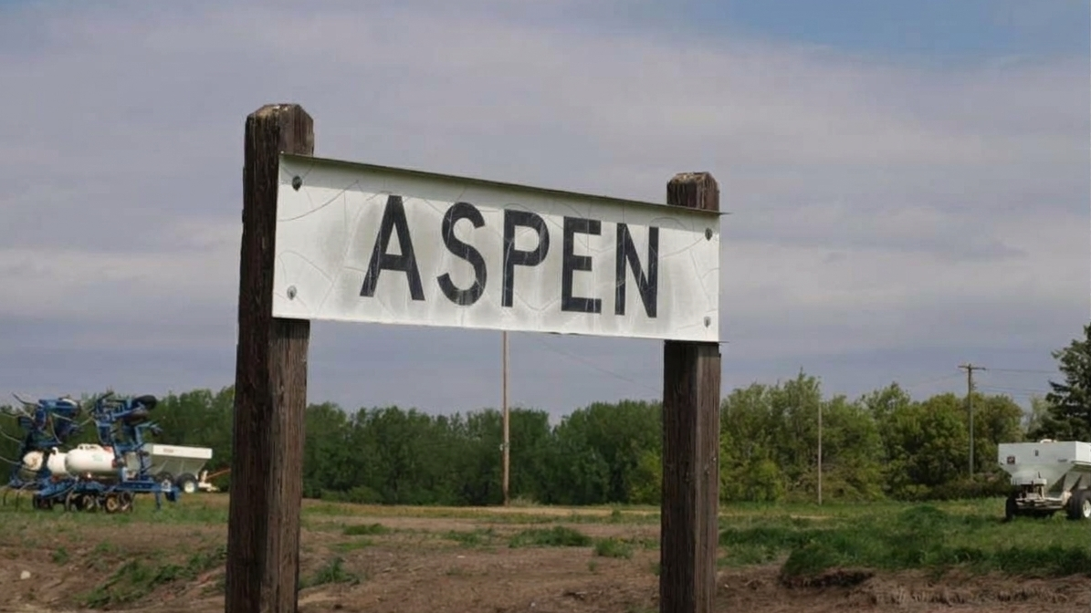
Documentation Committee
Evergreen
ALSF Board
Community Gathering
Consortia
Technical Committee
AspenCon Planning
Testing – Triage
Catalogers
Developers
Koha – Sierra – Symphony – Polaris
LiDA Users
Community Email List
Slack

Slide 34
Remember our history.
Look how far we’ve come!

Slide 35
Libraries have varying backgrounds and methods, but the end goal is the same:
Use Aspen to provide a good experience for their users.

Slide 36
Support Providers/ Vendors are critical
to the mission.

Slide 37
Developers know the product and
the community.

Slide 38
We are using different brands to accomplish the same goals.

Slide 39
“True, Schoenrock and Sons were the building consultants and architects, and the masonry, plumbing, and wiring work was hired, but everything else was done with volunteer labor. An incredible 12,000 man-hours of work was donated.”
Work together to get things done – (Documentation update)

Slide 40
Meetings for different groups –
ILS, type of work, etc.

Slide 41
AspenCon!

Slide 42
No one can do it on their own.

Slide 43
When difficulties arise ...

Slide 44
The community must work together.
David Kravetz, Sumoflam Productions

Slide 45
Rivals come together for the benefit of the greater community.

Slide 46
Betty
All the meetings
Committees
Help people out

Slide 47
Ask for and receive help –
But contribute as much as you can.
Image Capture: Jul 2024 © 2026 Google

Slide 48
Meeting Attendee
Developer
Tester
Slack (Asker or Responder)
Loretta

Slide 49
Gertie
Code Writer
Idea Generator
AspenCon Presenter
Problem Solver
Encourager
Note-taker or Moderator

Slide 50
Molly
Don’t let quirks and annoyances derail the community.

Slide 51
Grow the community

Slide 52
What Is Your Place
in the Aspen Community?

Slide 53
Talk to Someone New
I currently participate in . . .
I’d like to be involved in . . .
I want to learn more about . . .
Please don’t ask me to . . .
(Online – “Talk” in the chat?)

Slide 54
Be Part of the Community
Join Slack, Jira, Confluence
Sign up for Community emails
Attend meetings (some or all)
Apply for board positions
Do what you do well
Do what works for your time and responsibilities

Slide 55
Be Part of the Community
Aspen Community Calendar
Aspen Community Groups
Join the Aspen Google Group
Join the Aspen Slack Workspace
Learn about Jira and Confluence
More Aspen Community Information

