Slide 1
The Best
Features of Aspen
You Aren't Using
AspenCon 2026

Slide 2
Speakers
Kirsten Bryson, Metro Library
Ben Wolfe, CLiC
Joseph Salamon, Cuyahoga County Public Library
Lucas McKeever, SWAN
Tara Wood, SWAN
Amanda L. Goodman, Darien Library
Notes:
Our six speakers today will be sharing some features you may not know about or haven’t yet tried.
These are more advanced features, but you can choose to dip your toe or go all in. All fully supported and we’re (mostly) using these features in production. We hope you find something new to take home today.

Slide 3
Government Documents and Sideloads
Kirsten Bryson, Metro Library

Slide 4
Expanding Access to EPA Documents
Challenge
•Public access to EPA documents had to be maintained.
•Only one physical copy of each document was received.
•Limited availability reduced patron access and visibility.
Solution
•Added digital access through Side Loads.
•Created searchable catalog records that improved discovery.
•Expanded access beyond a single physical copy while preserving public availability.

Slide 5





Project phases
1
2
3
4
5
Upload to PDF
Create page in Web Builder
Create record in MARCEdit
Create Sideload settings
Discovery

Slide 6

Create Custom Page in Web Builder

Slide 7
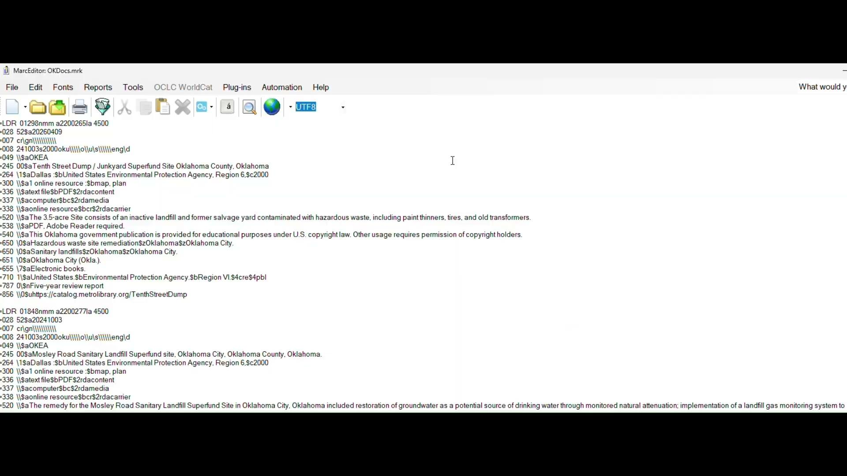
Create Record and Upload in Sideloads

Slide 8
Discovery

Slide 9
Aspen Events
Ben Wolfe, CLiC

Slide 10
Quick to get started
Essential building blocks are predefined
Dates
Times
Scheduling repeat occurrences
An optional text box for descriptions

Slide 11
Customizable to fit your needs
Make a template that work best for you
Have a template be ultra specific: “Dave’s Tuesday Night Gothic Romance Power Hour”
Have your template be super broadly defined: “Events With An In-person Component”
Nothing predefined in the template: start scheduling an event quickly
Private Events
For internal staff
Controlled by permissions

Slide 12
Integrated with the rest of Aspen
Doesn’t incur a cost like other calendar systems
Individual events can be added to a list with books
A list with events can be a browse category or a spotlight
Can search events only
Search results can be shown in the “Explore More” bar
Dedicated predefined search facets:
Age Group
Program Type
Category
Event Type
Three blank customizable facets

Slide 13
Event Registration
Custom form to capture the info you need
Event attendee caps
Wait list that shows how many slots remain
Can set a time limit in hours, to register after they’ve moved from waitlist
Attendee categories eg: adult or child
Can allow a patron to register as a group, only requiring the one library card number
Patrons have a “Your Events” section in “My Account”

Slide 14
Management for Registrations
See a list of registrants and mark them off
Can use your phone
Don’t need to save, it updates automatically

Slide 15
Extras if there’s time
Printing
Designed to be printed
Landscape for full calendar view
Portrait for agenda view
Can choose what gets printed
Reports
Tracks event type
Attendance
Locations
Printable

Slide 16
Custom Facets to build a Toy Catalog
Joe Salamon, Cuyahoga County Public Library

Slide 17
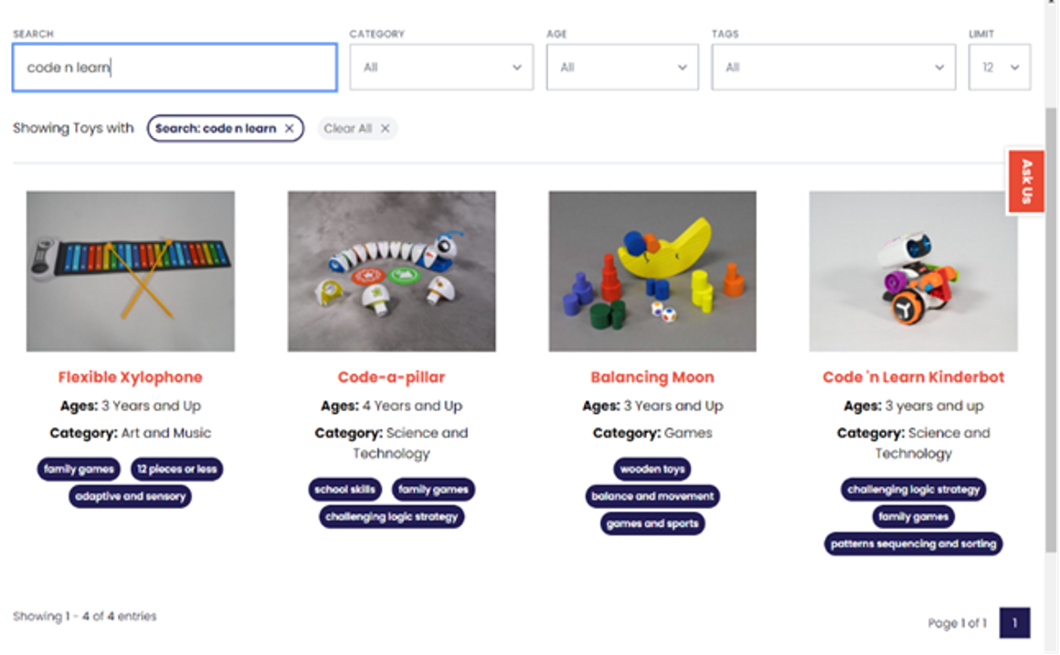
Before Aspen - A Beautiful Mess
Decent UX
Not discoverable
Complicated workflow

Slide 18
One Collection. Two Systems.
Lack of specialized indexes in the ILS
No support for image display and browsing in discovery
Separate database and website gallery to build and maintain
ILS records still required (for requesting)

Slide 19
Bringing Toy Discovery to Our Customers
Structure (Koha)
A dedicated MARC framework
Controlled values for age and category
Images attached to bibliographic records
Discovery (Aspen)
Browsing and filtering with facets
Visual results
Searching and requesting in one place

Slide 20
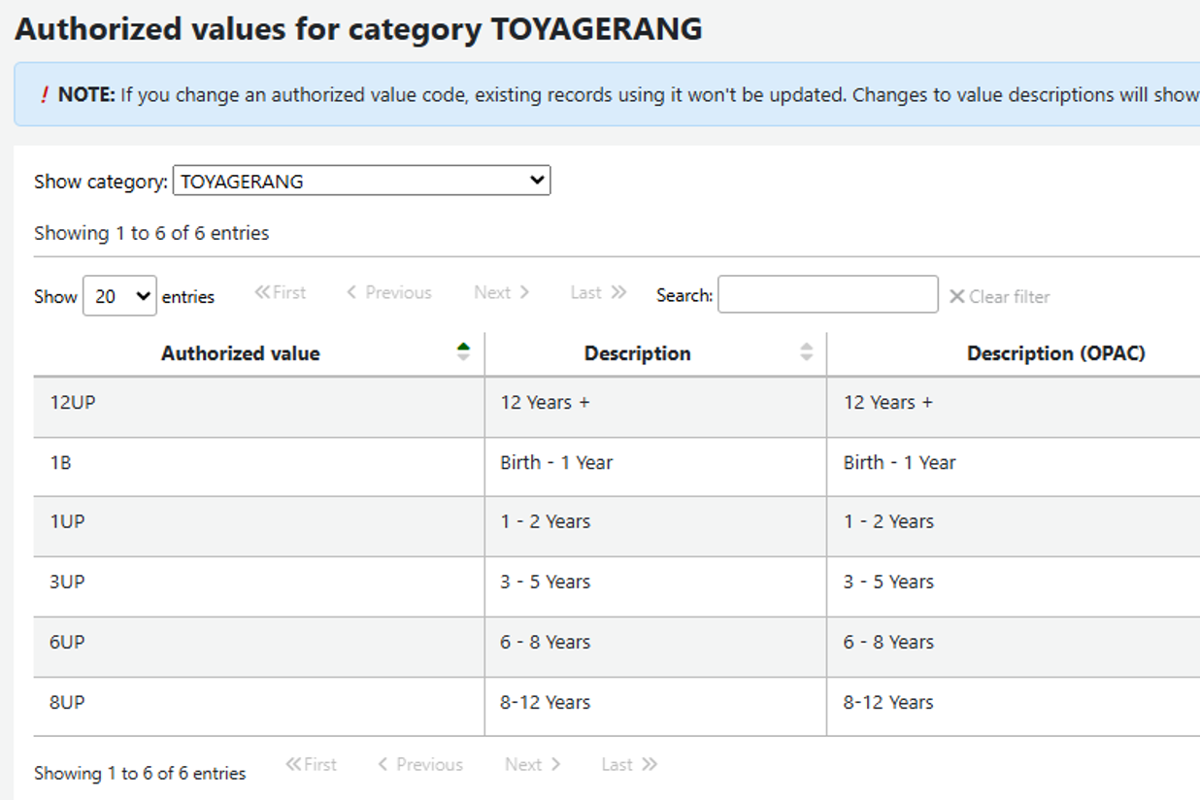
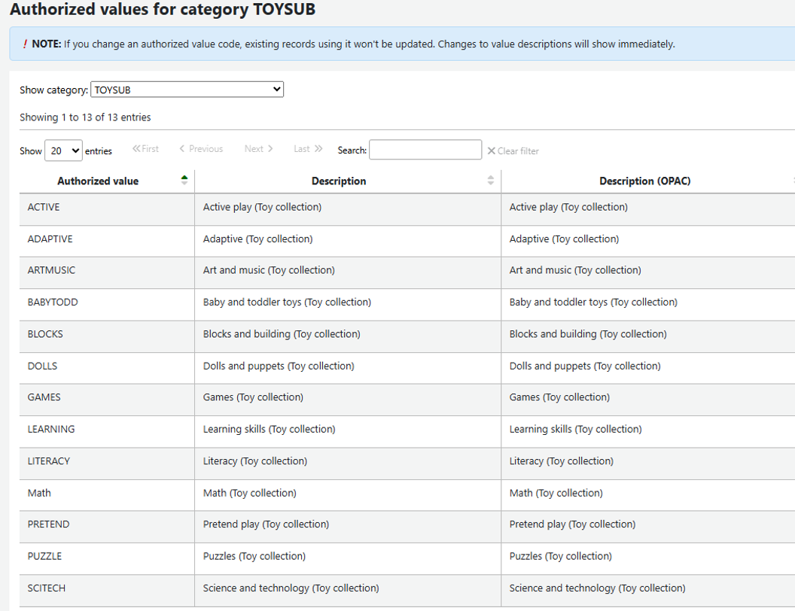
Building Facets via Authorized Values

Slide 21
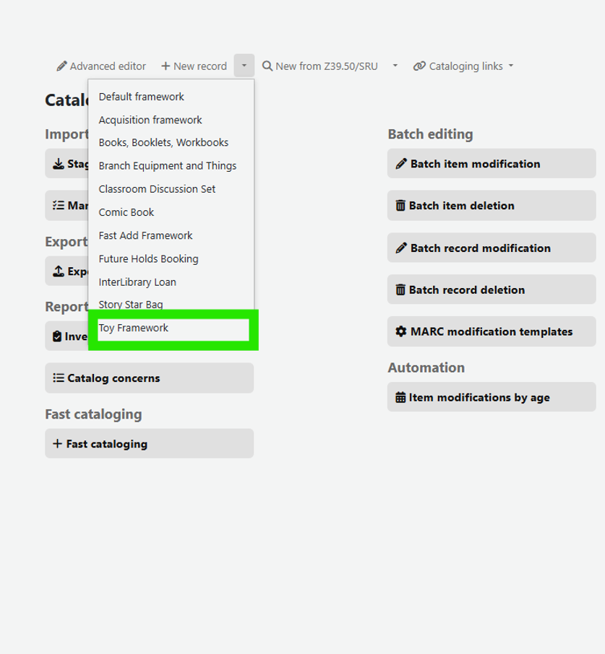
MARC Framework for Toys
Frameworks streamline cataloging!

Slide 22
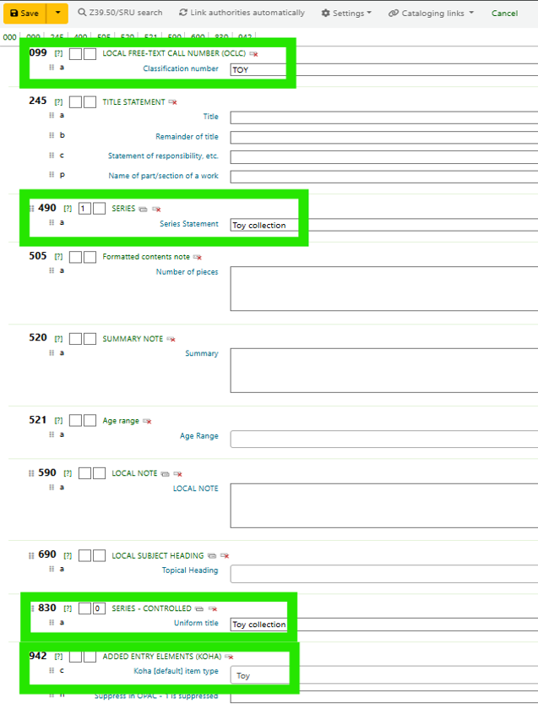
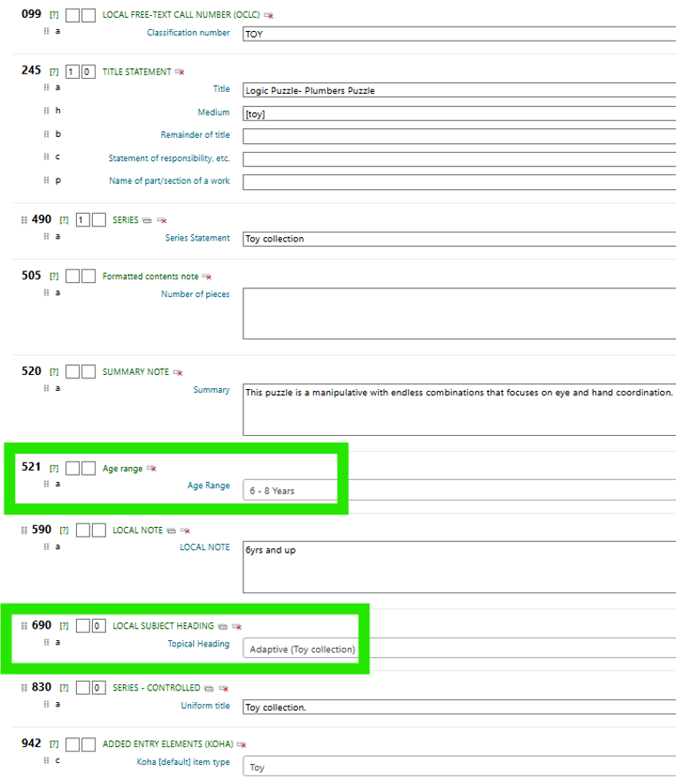
Capturing Discovery Metadata
521 - Age Ranges
690 - Topics (Subjects)

Slide 23
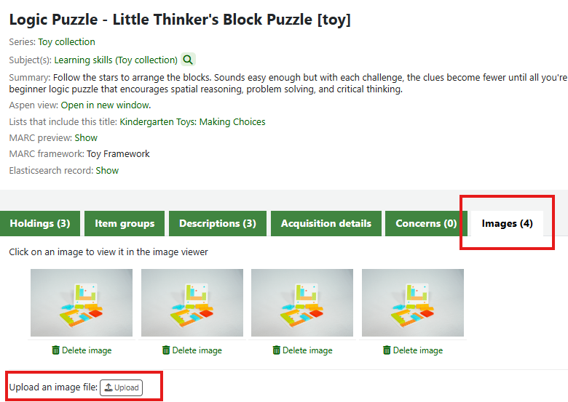
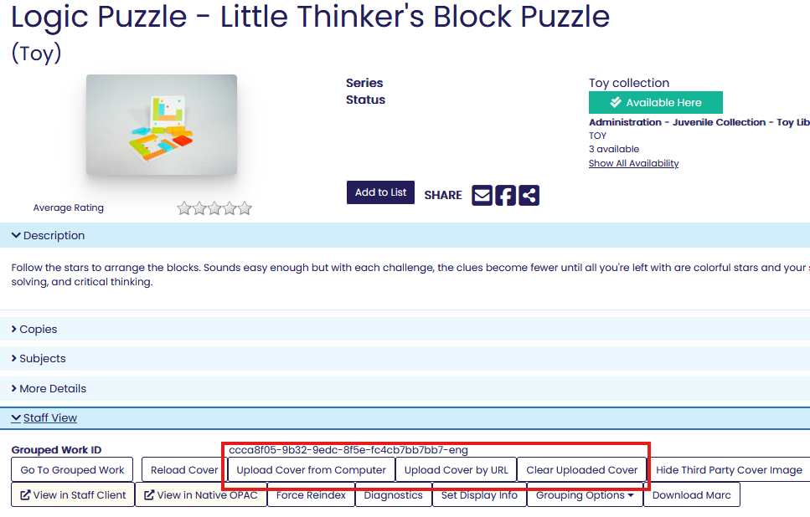
Capturing Discovery Metadata

Slide 24
Turning Metadata into Aspen Facets

Slide 25
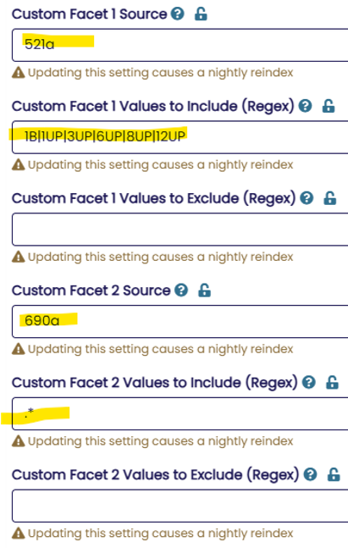
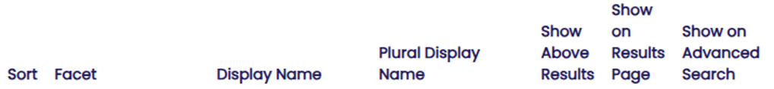
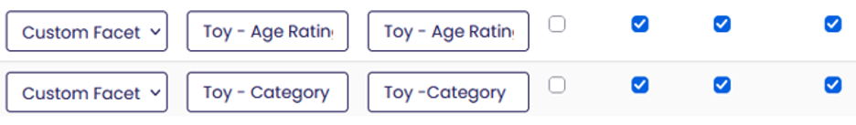
Turning Metadata into Aspen Facets
ILS Integration > Indexing Profiles > Custom Facets
Catalog > Grouped Works > Grouped Facets

Slide 26
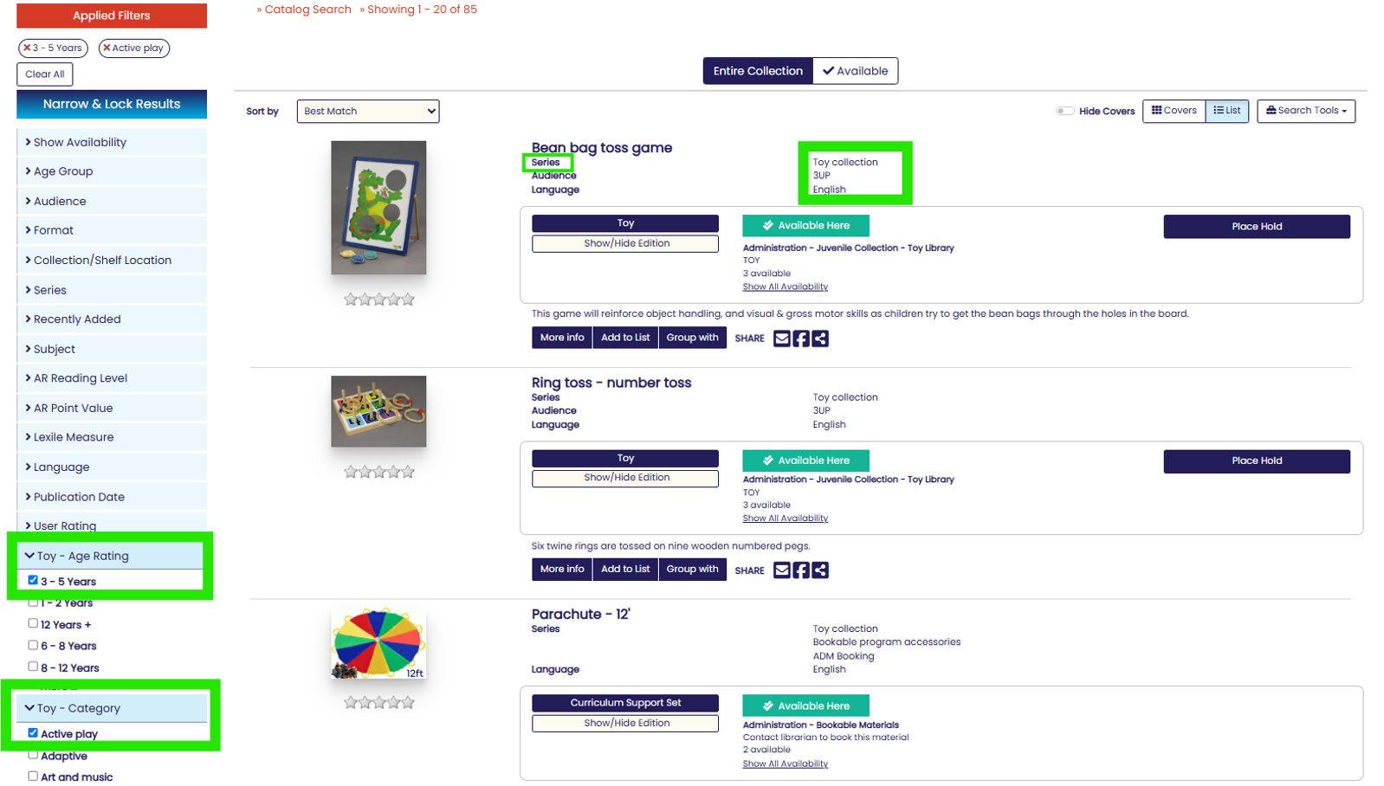
More Than One Way to Find a Toy
Age & Topic facets
Series linking
Menu linking

Slide 27
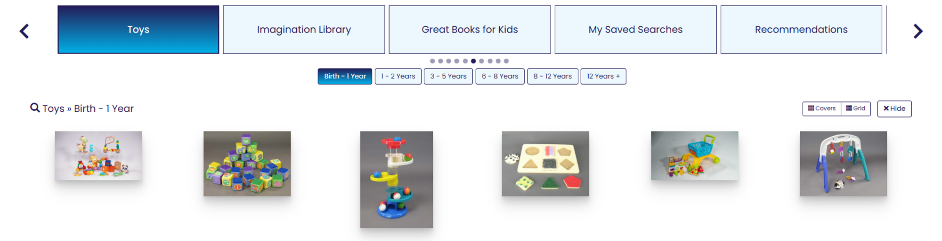
More Than One Way to Find a Toy
Faceting allows for saved searches which = Browse Categories!
Age & Topic facets
Series linking

Slide 28
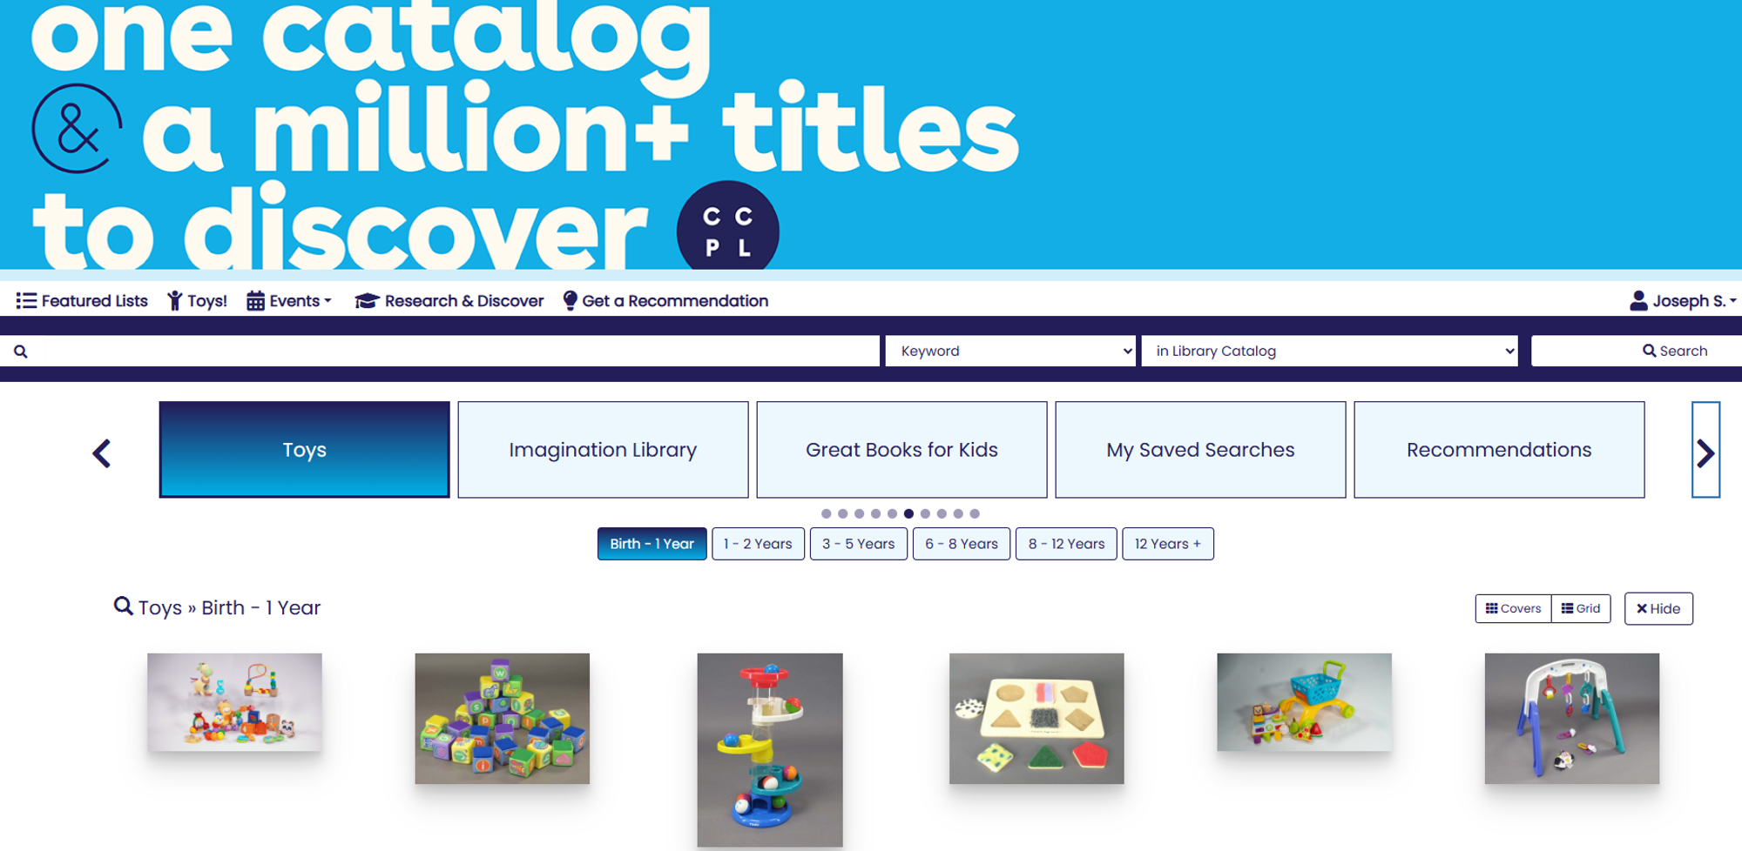
A Toy Gallery - Now Native to Aspen!

Slide 29
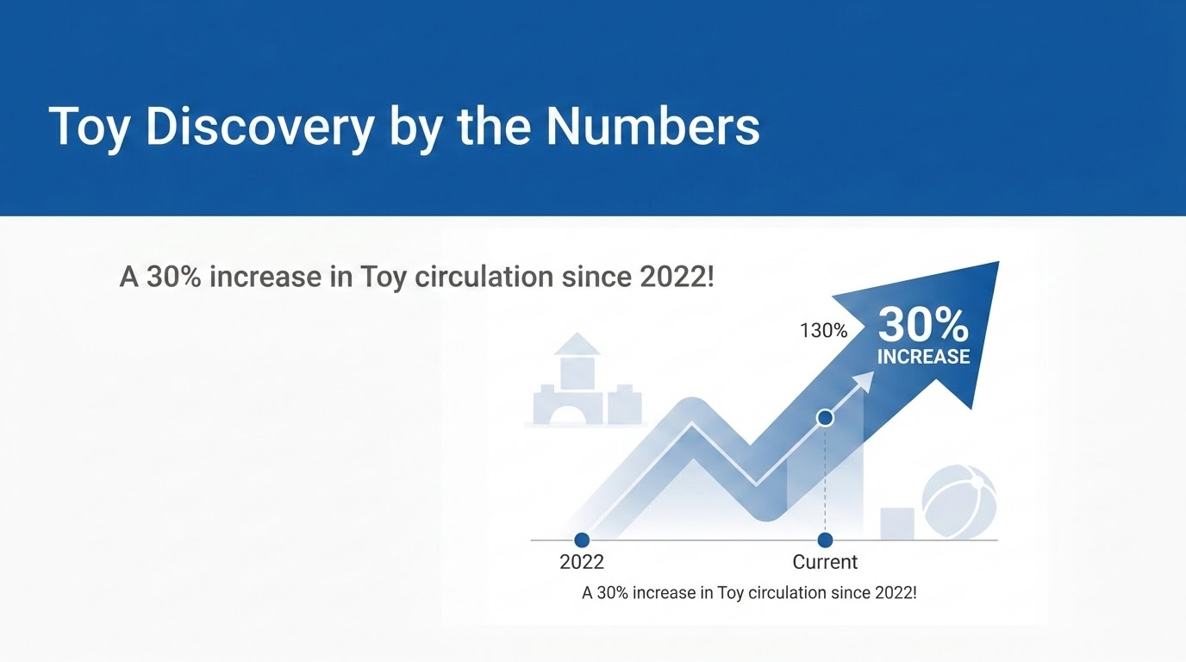
44,224 circs in 2025
33,921 circs in 2022

Slide 30
Series Module for Local Collections
Lucas McKeever, SWAN

Slide 31
Series Module - Local Series Pages
New way to highlight local collections
  Library of things, puzzles, local authors, local history, donated collections, etc.
Series Module must be enabled
  Administration Home > System Administration > Modules > “Series”
Uses 89x local series field(s) in ILS bib records
  896 - Local Series Added Entry - - Personal Name
  897 - Local Series Added Entry - - Corporate Name
  898 - Local Series Added Entry - - Meeting Name
  899 - Local Series Added Entry - - Uniform Title

Slide 32
897 Field - used most frequently at SWAN
Subfield a with library name keeps series pages separate, even with shared collection names
  897 2_ $a Addison Public Library. $t Library of things.
  897 2_ $a Tinley Park Public Library. $t Library of things.
Allows library name to be an effective search term in series or keyword searches

Slide 33
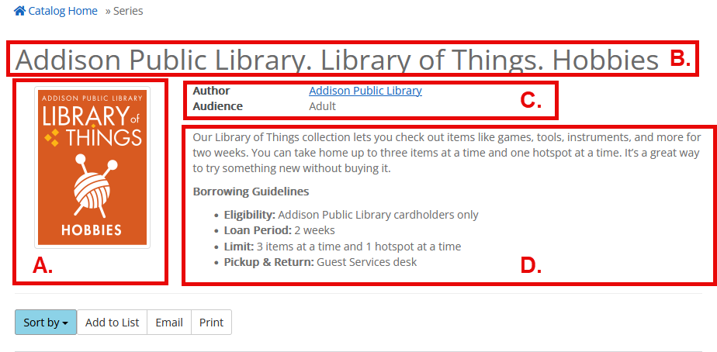
Customization on the Series page
Series cover image
Series Title Display
Author/Audience
Series Description

Slide 34
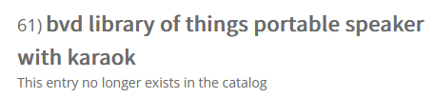
Series page functionality vs. curating a list
Adding items to the series
  Adding the corresponding 89x tag to a MARC record in the ILS is enough
    No extra step of manually adding record group to the page after it is added in the ILS
Removing an item from catalog
  Record group is no longer attributed to the series without the corresponding 89x tag; it is removed from the series
    Avoids empty entries that can be found in lists when an item is lost, damaged, or removed without warning

Slide 35
Search Interpreter
Tara Wood, SWAN

Slide 36
Makes keyword search results better
Problem:
Patrons often stuff a search with keywords that make their results worse.
Keywords = “Lego video games for kids”
Solution:
Strip some of these terms out and apply filters instead.
Keywords = “Lego”
Format filter = Video game formats
Audience filter = Juvenile
Notes:
Keyword stuffing with formats and audiences can sometimes make results worse.
Search interpreter can take some of those searches and give better results by applying filters.

Slide 37
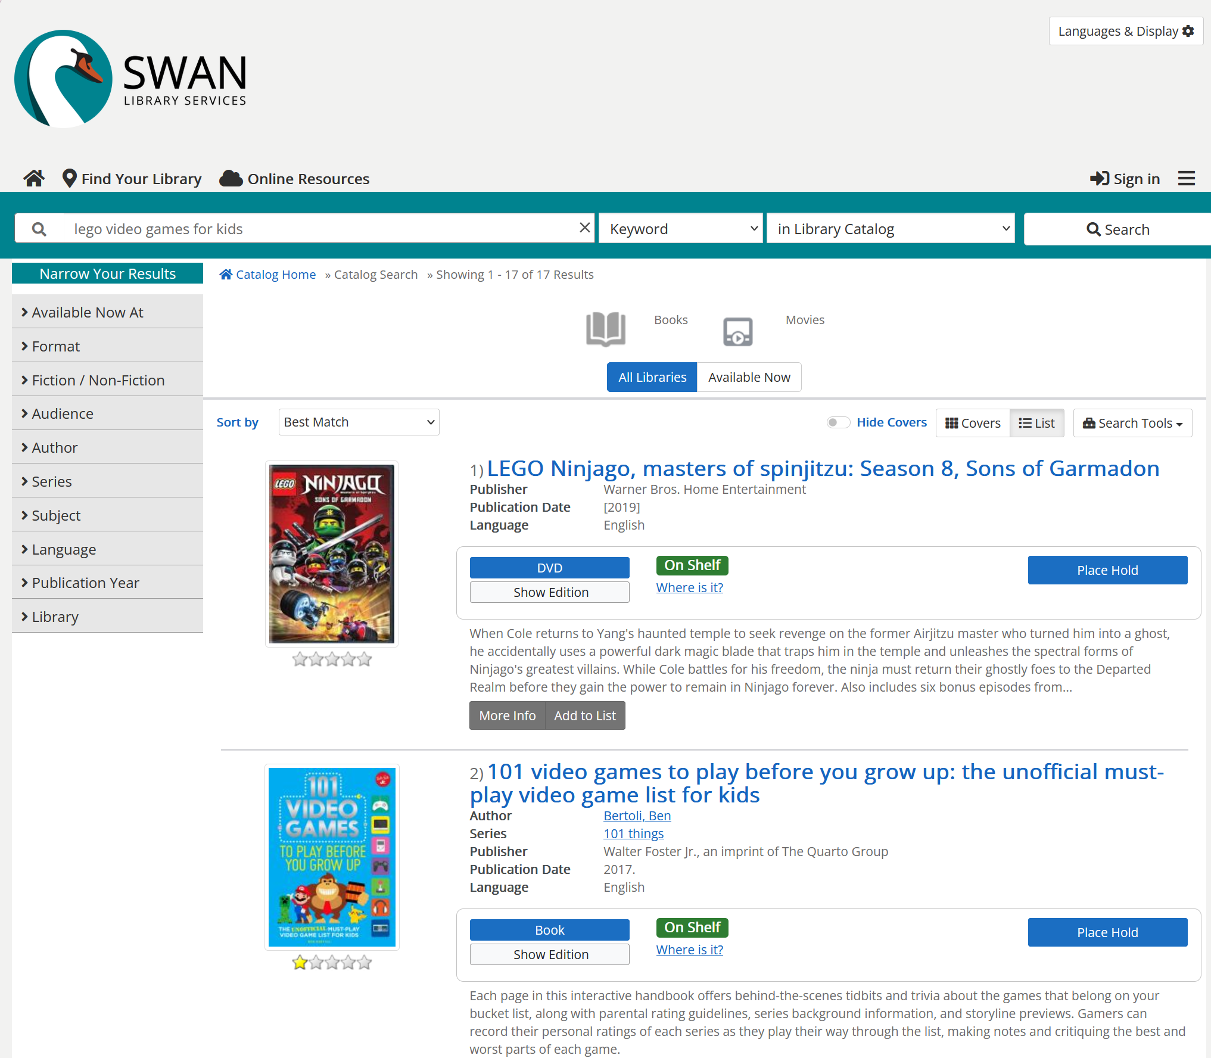
Notes:
17 results

Slide 38
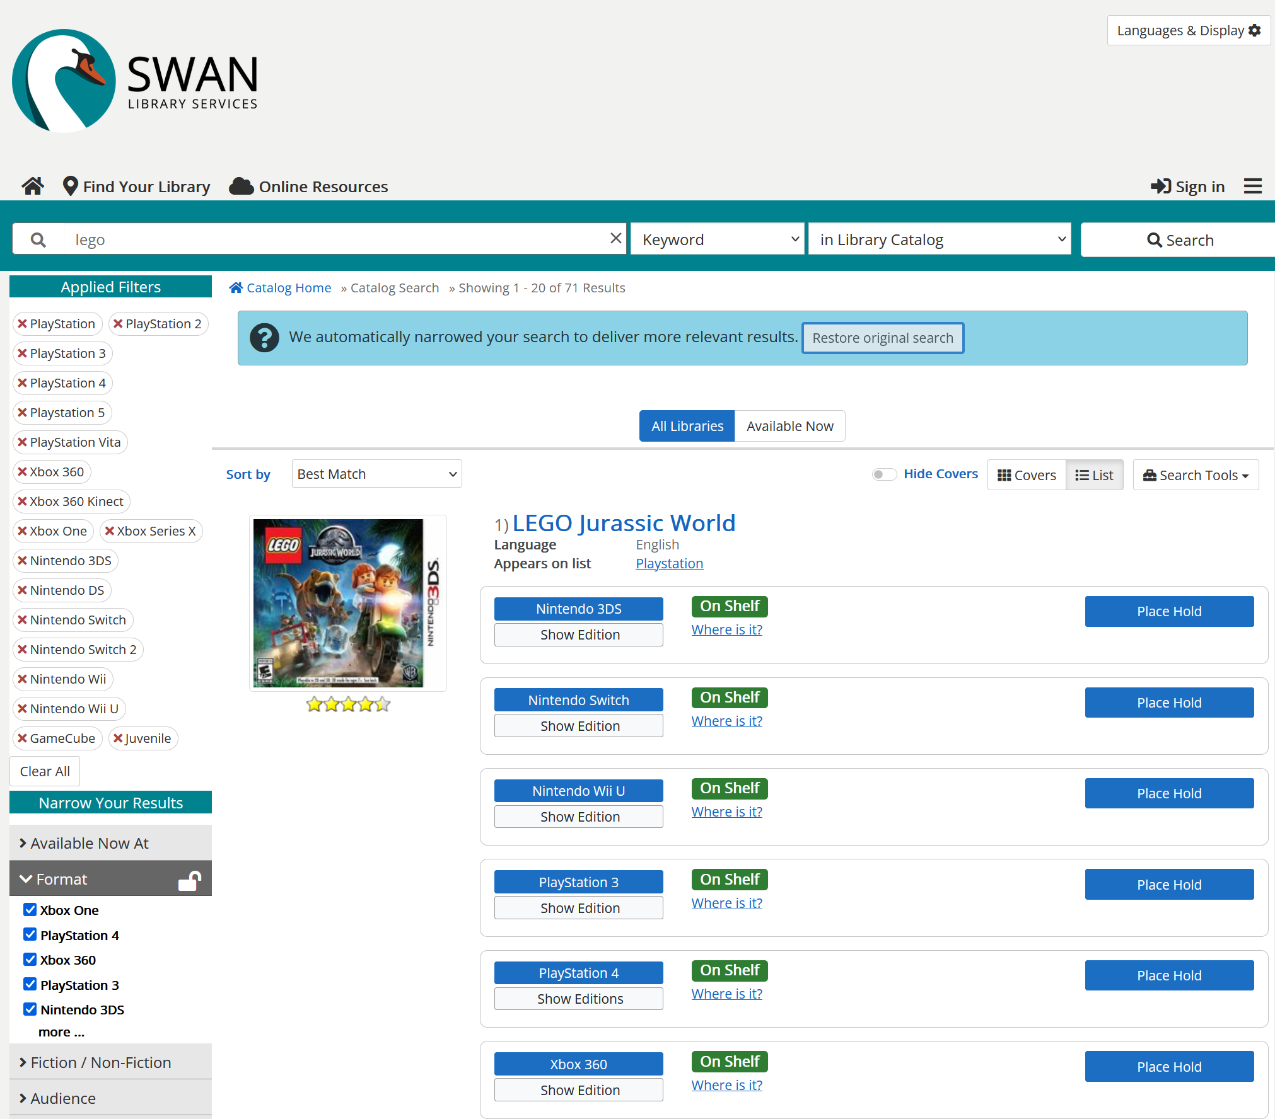
Notes:
71 results

Slide 39
It is super customizable
You have options to enable (or disable) filters for:
Format and Format Category
Audience
New
Series
Fiction/Non-fiction
You can set up custom terms and phrases for any filter in your catalog.
Or you can exclude some terms from applying filters.

Slide 40
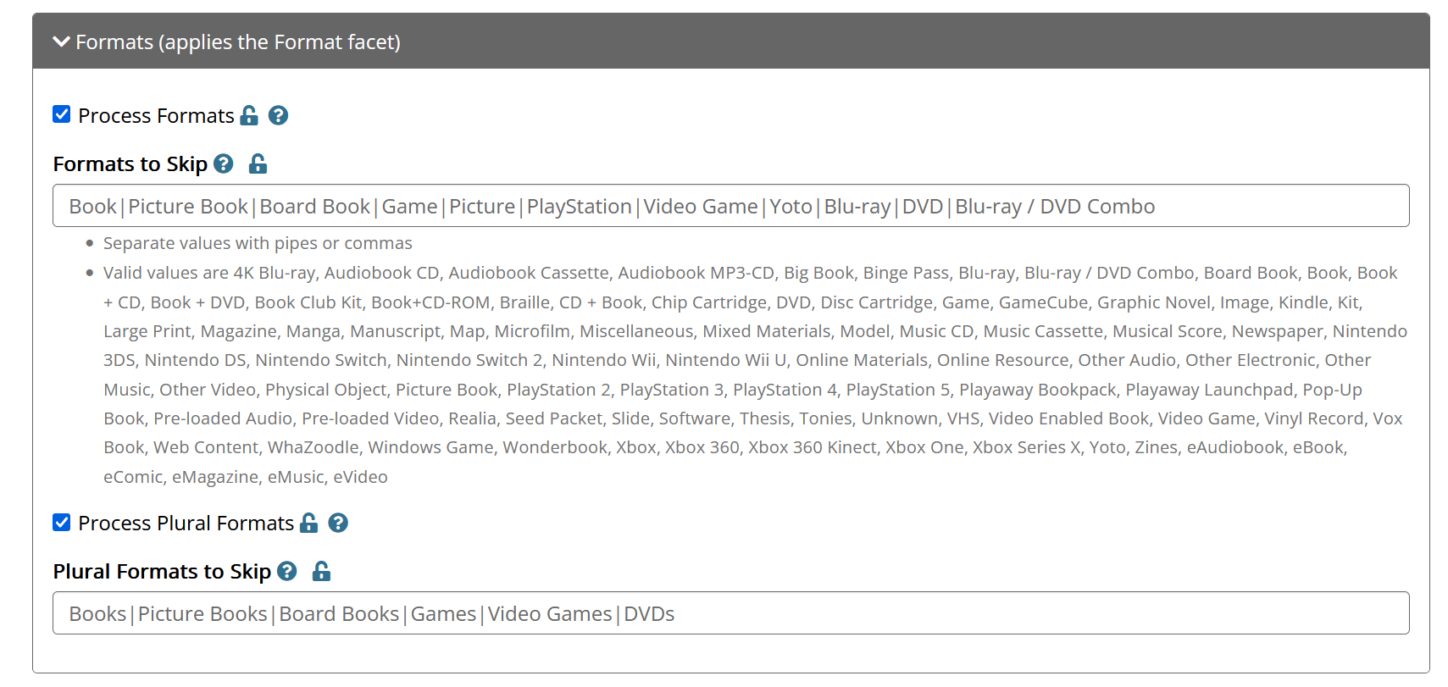
Notes:
In our configuration, we skip several out of the box formats, so we can customize and add more keywords to apply or not apply certain formats. As an example, Book is used in a lot of titles and is problematic if it is stripped out, but “books for kids” is clearer in the intent.

Slide 41
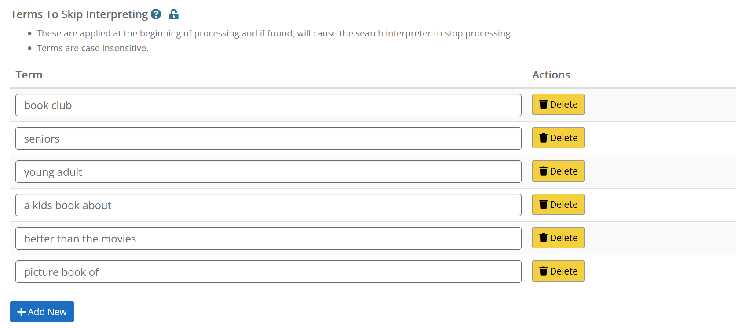
Notes:
Skip interpreting - “a kids book about” is a series

Slide 42
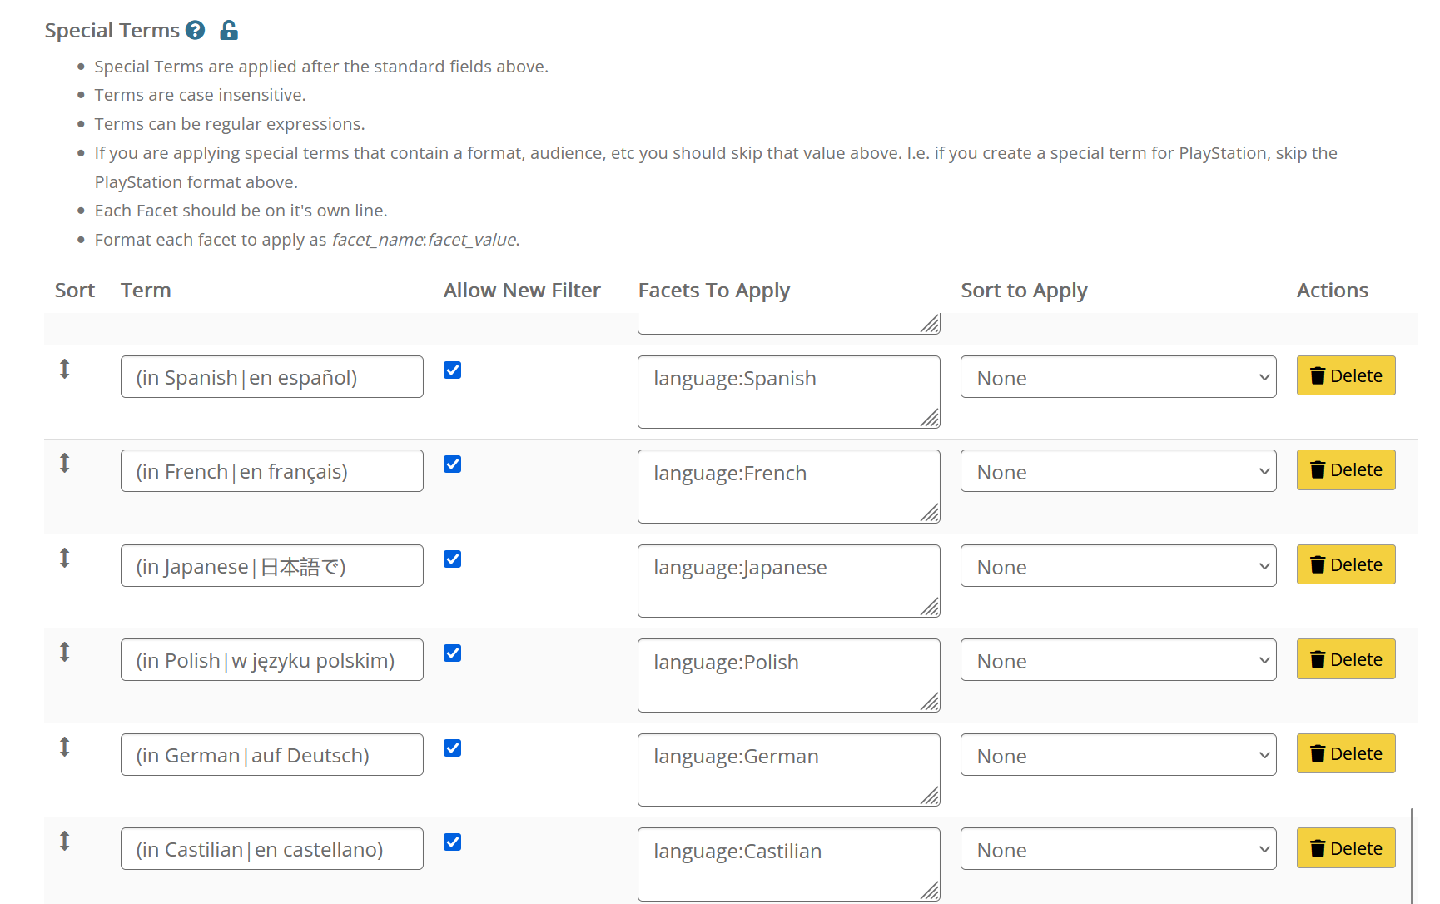
Notes:
Special terms are really powerful, and you can use regular expressions to get even more specific. Here are our language terms to apply our language filters.

Slide 43
Example of Special Terms: Video Games
Term | Facets to Apply
playstation | format:PlayStation format:PlayStation 2 format:PlayStation 3 format:PlayStation 4 format:Playstation 5 format:PlayStation Vita
ps5 | format:Playstation 5
xbox | format:Xbox 360 format:Xbox 360 Kinect format:Xbox One format:Xbox Series X
Xbox 1 | format:Xbox One
video gam(e|es) | (all the formats)
Notes:
If you type in Playstation, you get all the playstation formats. If you type in video games, you get all of our various video game formats - it really helps to make these searches work better. If you wanted to dip your toe into search interpreter, you could just set up your video game terms and that would be a big win.

Slide 44
JavaScript Snippets and Placards
Amanda L. Goodman, Darien Library

Slide 45
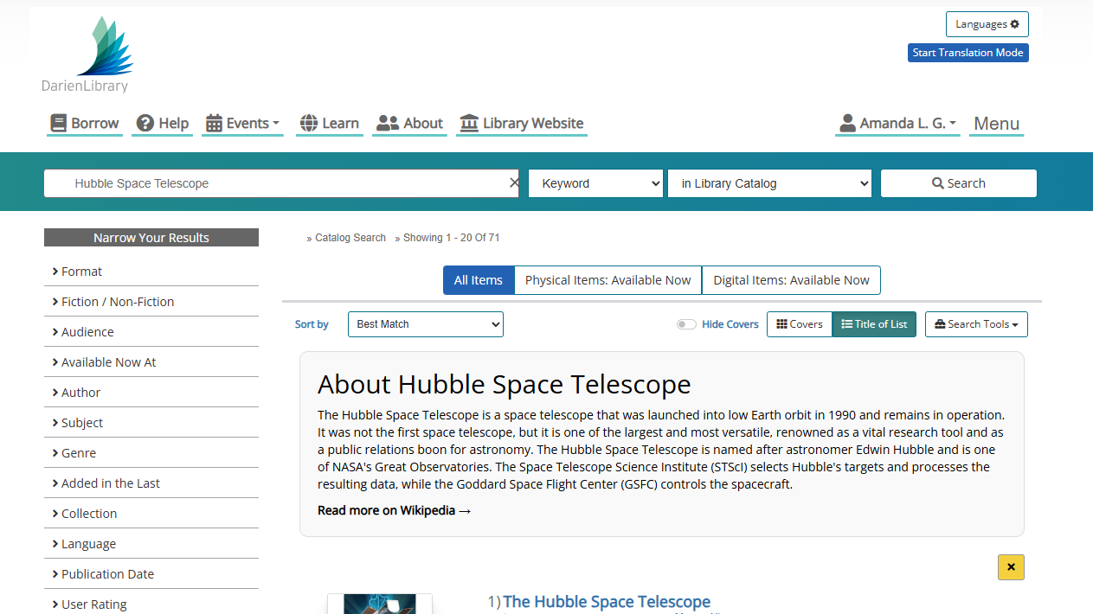

Slide 46
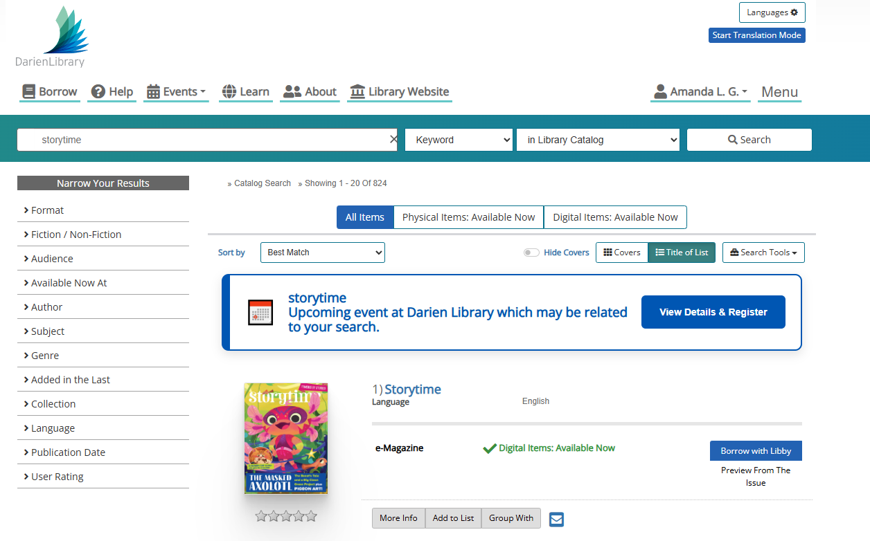

Slide 47
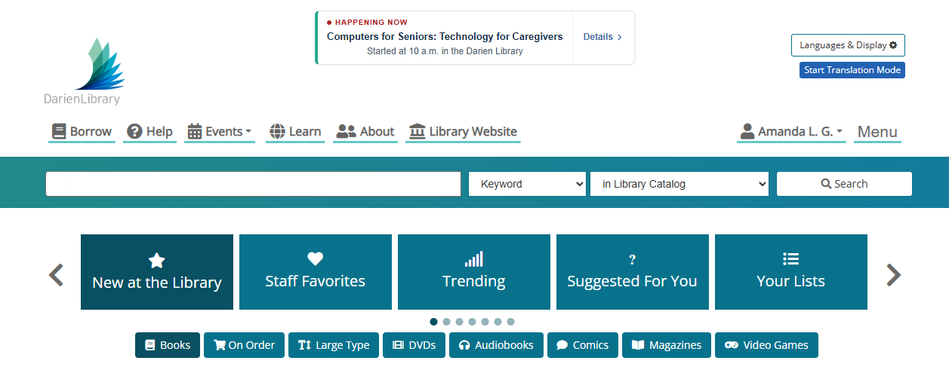

Slide 48
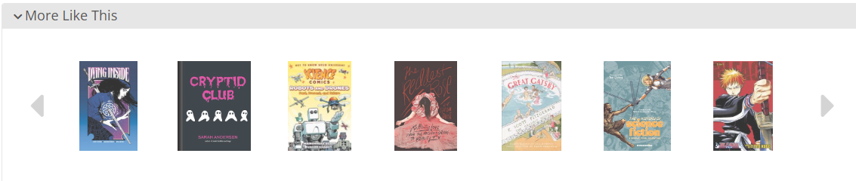
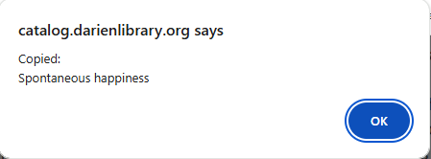

Slide 49
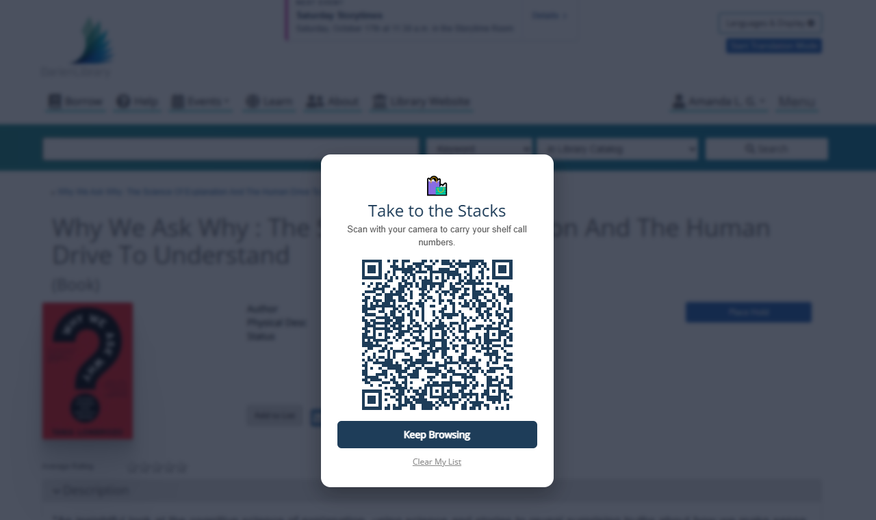

Slide 50
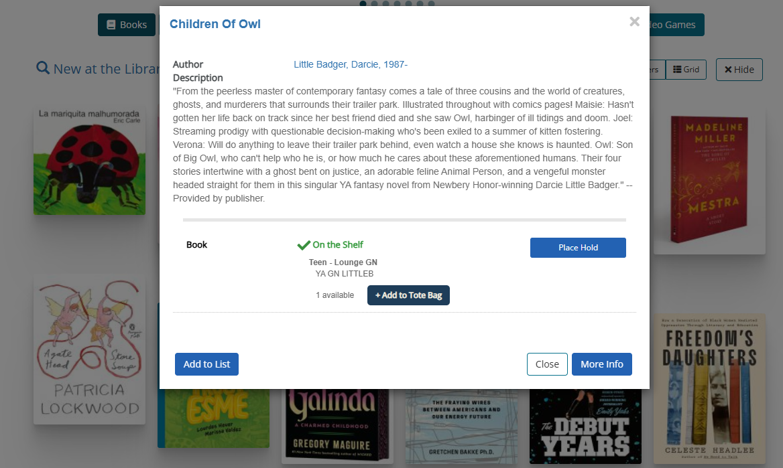

Slide 51
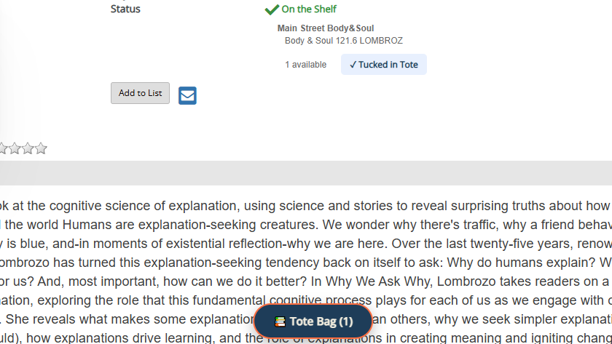

Slide 52
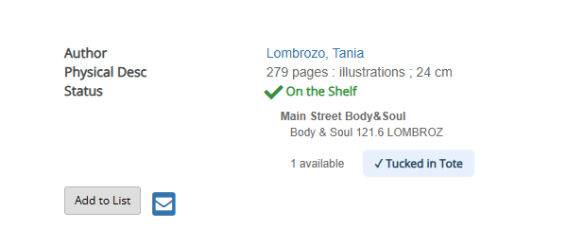

Slide 54
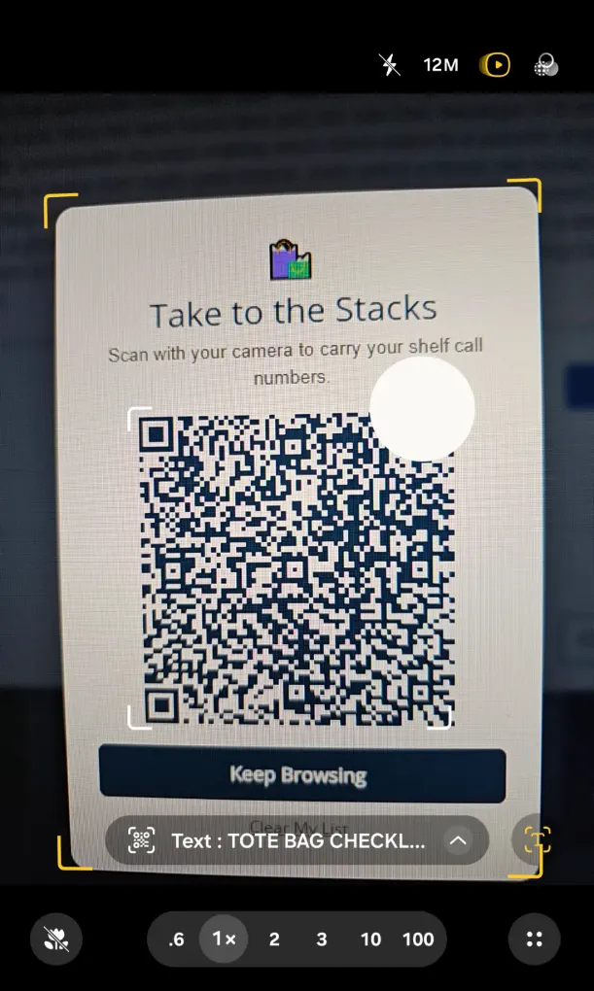
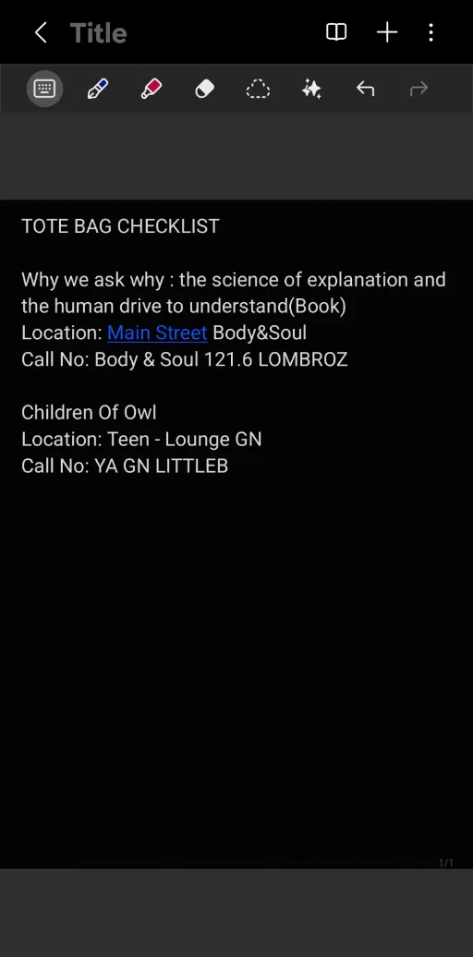

Slide 55
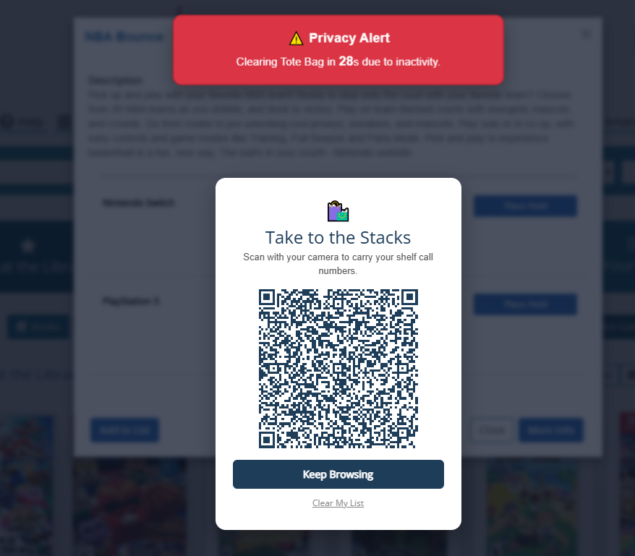

Slide 56
Questions?
Notes:
We are here for any questions, or you can find us on Slack or later in the conference!

