Slide 1
Getting Revved for Devs
Bob Bennhoff / Colorado Library Consortium
Daniel Barden / Cuyahoga County Public Library

Slide 2
Existing Mechanisms
Contact Vendors
Do your own Development
Connect with other libraries interested in doing devs
        Listserv
        Meetings
        Slack
        This very conference

Slide 3
Examples from Koha for Dev Collabs
Five Families of Koha
Development Committee via koha-US organization
Developer’s Forum

Slide 4
Moving Forward
How do you collect information from member libraries and/or patrons on desired features?
What are roadblocks to getting your ideas turned into developments?
How do you plan to share your ideas?

Slide 5
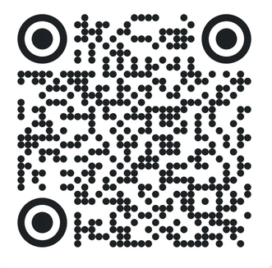
What would you like to see developed in Aspen?
pe.app/aspendev
The results will be revealed at What’s New and Next for Aspen Discovery and LiDA! on Thursday at 3:10 pm.

