Slide 1

AspenCon 2026
Build Your Brand
around Patron Demand
Elizabeth Hager
Collections Coordinator
ehager@pcpls.org
Inge Kokidko
Assistant Director
ikokidko@pcpls.org
Notes:
Hello everyone, I’m Inge, the Assistant Director of the Porter County Library, and this is Elizabeth, our Collections Coordinator. Today we are going to give an overview of our patron driven acquisitions workflow, which is powered by Aspens Materials Requests feature.

Slide 2


Think of Us First
THE GOAL
Library as your first stop
When your patrons want to read a book or watch a movie, where do they go first?
OUR BRAND PROMISE
If you want it, we’ll get it
Think of us before they think of Amazon or the bookstore.
OUR PATRON PARTNERSHIP
Patron-Driven Acquisition (PDA)
PDA: The public library's way of displaying affection for our community.
✘
🫶
Notes:
I want to start with a question: When your patrons want to read a book or watch a movie, where do they go first?
Our goal is simple: We want them to think of us before they think of a bookstore.
So, we’ve built our brand around a promise: If you want it, we’ll get it. Either through our consortium, purchasing it, or through ILL.
We want our patrons to feel our like content partners, and that we are responsive to their needs.
We do this through Patron Driven Acquisitions, or PDA. Elizabeth and I chuckled at first at the Acronym, but I think it’s appropriate. Afterall, we show our affection for our patrons by connecting them with the titles they want.
Transition: “To deliver on this promise, PDA makes up an important part of our selection strategy."

Slide 3
"Just in Time" Collection Building
BALANCING APPROACHES
The perfect blend
Balancing "Just in Case" with "Just in Time".
User involvement complements rather than replaces the librarian's role.
EVIDENCE & IMPACT
The research says…
Guaranteed use, higher circulation.
Suzanne M. Ward: PDA is cost-effective & yields high user satisfaction & circulation.
COMMUNITY ENGAGEMENT
Let’s build your library
The Patron as a Valued Partner.
Show our patrons that we view them as valued partners in building their library.
Notes:
Librarians spend a lot of time on 'just in case' purchasing—using our expertise to predict what patrons might want. PDA allows us to balance that with 'just in time' acquisitions—delivering exactly what they want, right when they need it.
Research by ALA and Susan Ward shows that PDA is incredibly cost-effective because it represents a guaranteed use. Patron-requested materials consistently circulate higher.
But, importantly, PDA doesn't replace the librarian. It’s one tool among several. Patrons help us discover sleeper demands and niche interests, while our librarians provide the expertise needed to build a comprehensive, inclusive collection for the future.
So this arrangement is mutually beneficial. It turns our patrons into valued partners in building their library.
Transition: “So, how do we put this partnership into practice on a daily basis?”

Slide 4
Shaping the Collection with Aspen Discovery
SELECTION CRITERIA
Flipping the Script
How good are your criteria if you reject lots of requests?
THE EXCEPTIONS
Outdated, Cost, Format
Patrons tell us what they want, we choose the fulfillment method (ILL, purchase, etc.)
POWERED BY
Aspen Discovery
There are many ways to implement PDA, and you’ve already got one!
Notes:
Locally, we embrace this by making materials requests highly accessible. When requests come in, we rarely reject them.
Afterall, if a large number of requests aren’t fitting our selection criteria... then our selection criteria probably isn't very good.
There are rare exceptions, of course. We will say no if an item is very outdated, prohibitively expensive, or just in a format that we simply can't support. But those are the outliers.
To execute this seamlessly, we rely on the Aspen Discovery layer’s materials request feature. Aspen provides the patron-facing engine that makes requesting incredibly easy, and it gives us the backend tools to manage those requests efficiently.
Transition: So, to show you exactly how that works under the hood, I'm going to hand it over to our Elizabeth, who will walk you through our workflow.

Slide 5
From Patron Request to
Library Shelf
Consistent process
1
Good acquisition decisions
2
Keep the patron informed
3
Notes:
I’m going to walk through our process for handling materials requests. From the moment a patron submits a request to the point where staff determine the best method to get it to the patron we have three goals: Keep it consistent, make good acquisition decisions for both the library & patron, and keeping the patron informed.

Slide 6
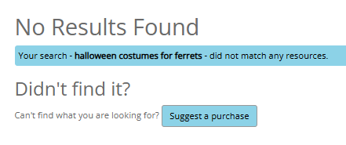
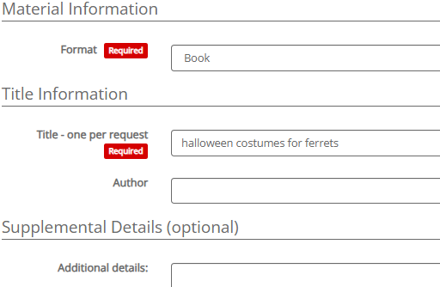
PATRON EXPERIENCE
Aspen’s Material Request Feature
Seamless Purchase Prompt
Customized Request Form
When a catalog search yields no items, patrons are immediately guided to submit a request.
Direct call-to-action button: Suggest a purchase
Reduces patron drop-off and frustration
Collects essential metadata including format, title, author, supplemental details, and hold preferences.
Notes:
When patrons search for an item in Aspen Discovery, they’ll see a “Suggest a Purchase” option at the bottom of the search results page. If a search returns no results, the option becomes more prominent, making it easier for patrons to find. Clicking the link takes patrons directly to our customized request form within Aspen.

Slide 7
BEGINNING-TO-END WORKFLOW
The Patron Experience
01
Request Submitted
02
Staff Review
03
Acquisition Decision
Patron places a materials request through the Aspen Discovery portal or library catalog.
Library staff evaluates the incoming queue, checks duplicates, and filters by request type.
Item is routed through the decision tree to determine purchase, ILL, or hold status.
04
Order / Fulfill
05
Status Update
06
Patron Receives
Order is placed with suppliers (Ingram, Amazon) or requested via Interlibrary Loan.
Staff logs progress notes, changes status, and triggers automated notifications.
Material arrives, is processed, and becomes ready for patron pickup or checkout.
Notes:
This is a summary of our workflow.
Patrons submit materials requests through Aspen Discovery, where library staff review each request for duplicates and determine whether to purchase the item, request it through Interlibrary Loan, or place it on hold. Staff track the request through each step, update its status, and send automated notifications to patrons. We attempt to complete steps 1-5 within 24 hours (excluding weekends).
Purchased materials typically get delivered and cataloged within 6-8 weeks. ILLs generally arrive within 2 weeks.

Slide 8
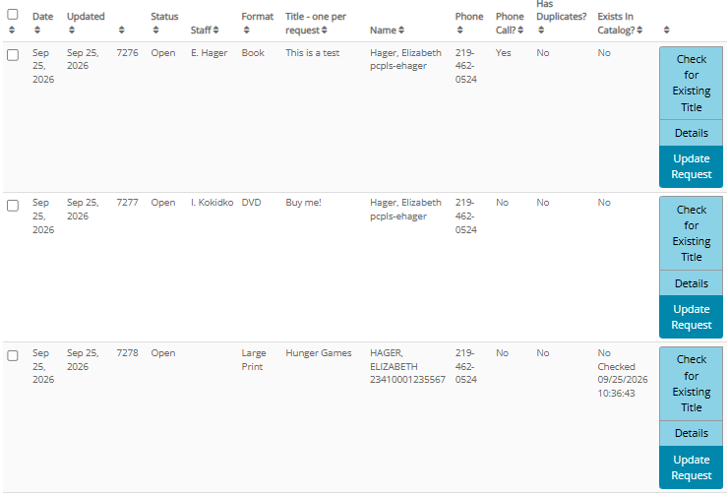
Managing the Aspen Queue
Notes:
This is an example of what our queue looks like. We check the “has duplicates” and “exists in catalog” columns to identify items we already own or have been requested previously that only need a hold placed for the patron but we always make sure to double-check requests marked “no” under “exists in catalog.” Misspellings and incorrect data are common, so verifying against our catalog helps prevent unnecessary duplicate purchases.
On busier days, multiple staff will work on the requests which are assigned in groups by format or patron. Whenever possible, we keep each patron’s requests with the same staff member to avoid duplicate follow-ups (such as phone calls or personalized emails) and to simplify status updates. Filters are very useful at this point to view a single format type or to display only your specific assignments.

Slide 9
The Tools We Use
INTAKE & PORTALS
Request Management
Internal procedures documentation
Collaborative inbox
Aspen Discovery materials requests portal
SEARCH & VENDORS
Finding Materials
Catalog Search
Ingram/iPage
Libraria
Midwest Tape
Amazon
Third Party Vendors
INTERLIBRARY LOAN
Sharing/ILL
Indiana Share
Internal ILL Request Spreadsheet
Indiana Share Outstanding Requests
Notes:
We organize our workflow into three main groups:
Intake - which includes procedures documentation, a shared “requests” email group that allows staff to view and respond to any request-related questions, and the Aspen discovery materials request portal.
Search tools & vendors which includes The Evergreen ILS catalog and a hierarchy of vendors.
Finally, Interlibrary loan which includes the Indiana Share request portal and tracking documents used internally and through the state library.

Slide 10
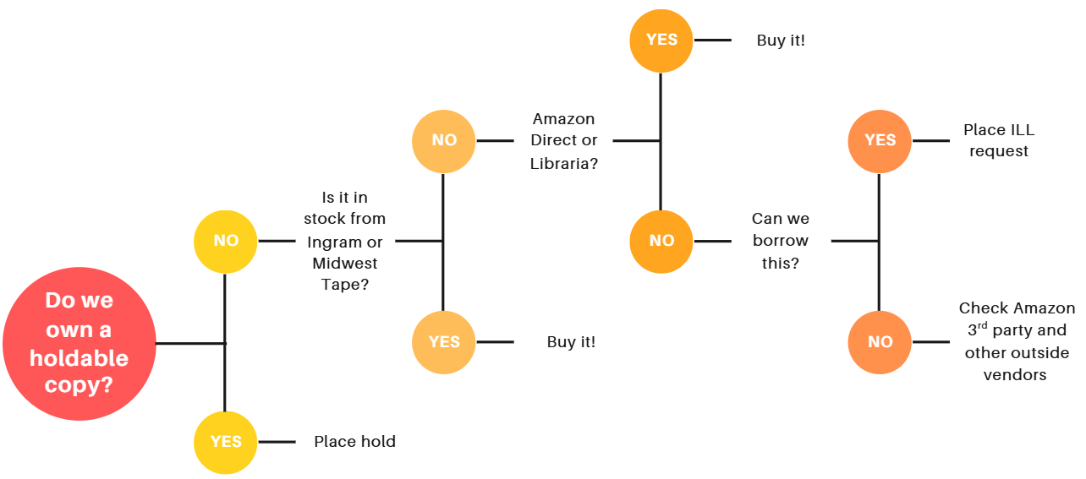
The Acquisition Decision Tree
Notes:
Here we have the acquisition decision tree. When reviewing a request, we focus on the best way to get the item to the patron. We follow this general workflow:
If we already own the item, place it on hold.
Next, we check our preferred vendors (Ingram or Midwest).
If unavailable, we check our secondary vendors (Libraria and items sold directly by Amazon).
Then if purchasing through our first or second tier vendors isn’t an option, we check whether the item is available through interlibrary loan.
As a last resort, we check our lowest-tier vendors. If the item is unavailable through all options, we mark the request as unavailable.

Slide 11
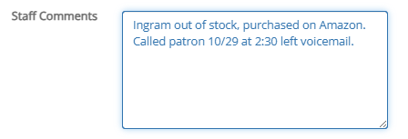
The Transaction Isn't Finished When We Find the Book
If You Did It, Document It
Make use of the Notes field
Documentation Example
1
How was it acquired? Purchased? ILL?
2
What will you need to know in the future?
3
Key Takeaway:
Always log specific vendor actions, purchase status, and timestamps for phone outreach to maintain seamless staff continuity.
Record patron contact attempts!
4
Notes:
Documentation is very important.
Determining whether an item can be purchased or borrowed is only part of the process. We also document the item's source, whether it was purchased or borrowed, and what vendor if purchased. When an item isn’t purchased, we may note why, such as being out of stock or temporarily unavailable.
We also timestamp all attempts to contact patrons through phone notifications so that we can troubleshoot if a patron states they did not receive a message.

Slide 12
AUTOMATED PATRON NOTIFICATIONS
Managing Statuses
Notification Preview — Status: Ordered
01
Dynamic Placeholders
Automatically populates patron details like {firstname} and {title} into outgoing templates.
Subject: Evergreen Indiana Aspen (no-reply@evergreenindiana.org)
Hi {firstname},
We have ordered the library material you requested, {title}. We usually get materials within 2-6 weeks, but sometimes it can take longer. We'll contact you again when it has arrived and is ready to check out, or if we encounter any problems receiving it.
Thanks for your request!
02
Clear Expectations
Communicates standard 2–6 week fulfillment windows and next steps upon arrival.
03
Direct Support Contact
Routes patron inquiries directly to requests@pcpls.org rather than unmonitored inboxes.
Please do not reply to this message. If you have questions or comments about requests, please reply to requests@pcpls.org.
Notes:
Once a request is processed and a decision is ready to share, we use one of about 15 statuses to trigger an automated email to the patron. Each email includes the patron’s name, the requested title, and a brief summary of the decision.
Our most common statuses are “Ordered Physical Material” (example on slide), “Unavailable,” “Current Holdings,” and “Email Personalized Reply,” which is handled through our shared requests inbox.
The Email Personalized Reply status is used when a request requires follow-up with a customized email. This may include providing specific acquisition updates or requesting additional information from patrons to help locate the requested materials.
Since Aspen does not currently support sending customized emails natively, staff send individualized messages through a shared Gmail account to communicate directly with patrons. Adding a built-in feature for personalized email communication would be a valuable enhancement for future development.

Slide 13
Questions?
Please reach out!
Elizabeth Hager
Collections Coordinator
ehager@pcpls.org
Inge Kokidko
Assistant Director
ikokidko@pcpls.org
Notes:
The goal isn't just to process requests quickly. It's to create a consistent process that helps us make thoughtful purchasing decisions, gives patrons a predictable experience, and keeps the library top of mind as their first choice when they're looking for a book, movie, or other material.
This is just a brief overview of our process. Please feel free to reach out if you have any questions or would like to discuss how this can work for your library.

