Slide 1
Aspen grows in the UK
and Europe too!
Challenges, changes and celebrations for
UK and European libraries

Slide 2



Introductions
Andrew Auld
Commercial Director, Open Fifth
andrew.auld@openfifth.co.uk
and…
Chair, imCode AB

Slide 3
Does Aspen grown in the UK?

Slide 4

Well, yes…but
The ‘tremlin tree’
Copyright:
Mark Hamblin
scotlandbigpicture.com

Slide 5
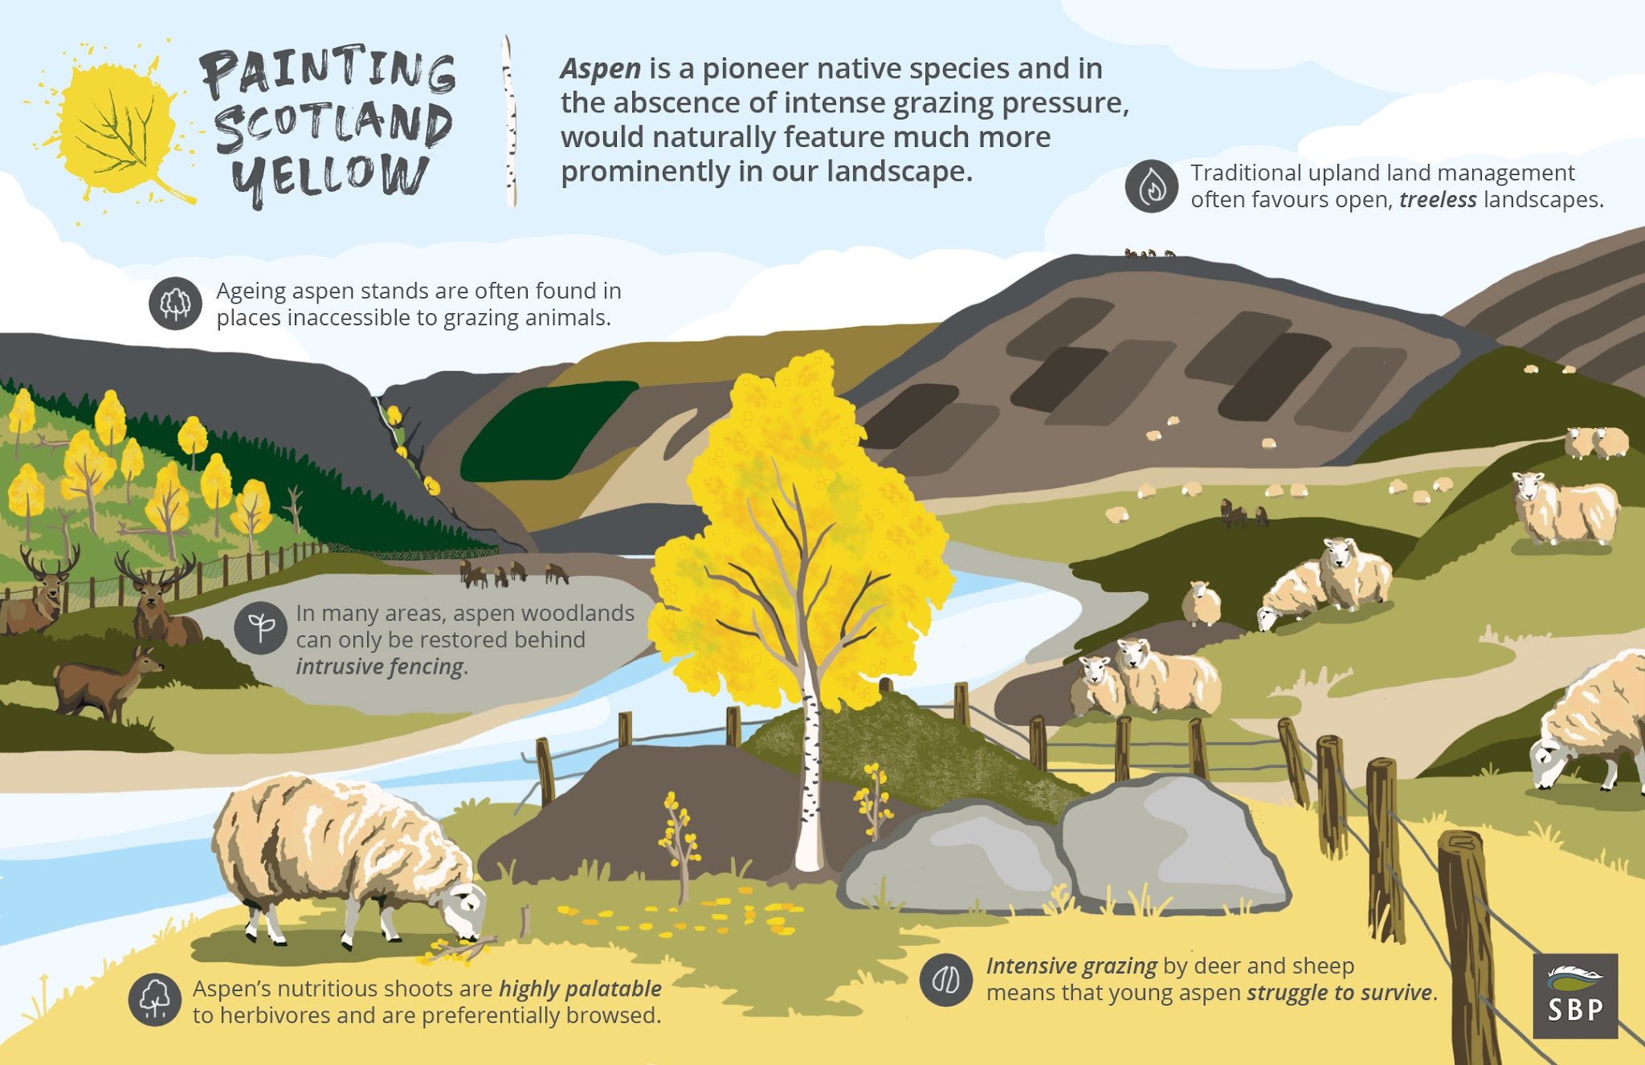
Painting Scotland Yellow - a campaign by Scotland - The Big Picture

Slide 6
UK and Europe context

Slide 7
How does Open Fifth support libraries where we are
Supporting library ecosystems with tailored open source solutions
local_library
Multi-Sector Support
Open Fifth supports libraries across all sectors.
Scale & Flexibility
From large consortia to tiny specialised libraries.
Budgets & Planning
Cost-effective solutions adapted to varying financial constraints.
Predictable value
Transparent financial models designed for public and private sector needs.
payments
event_repeat
Upgrade Schedule
Structured releases maintaining high system stability and compliance.
Continuous delivery
Regular maintenance cycles minimising operational disruption.
code
Development Requirements
Custom integrations and tailored feature enhancements for UK institutions.
Community impact
Contributing improvements directly back to the global Aspen Discovery codebase.

Slide 8
Tender requirements / constraints
Route to market
Budget
  Legacy system - data extraction
Social value
Library Services Platform (LSP)
Knowledge Base
Two discovery challenge
Natural language processing
AI tools for cataloguing
BIBFRAME / non MARC

Slide 9
Survey

Slide 10
Customer survey
Sent to entire customer base
  Responses anonymous (sector and size selected)
  Modest, representative response
Top 3 pressures library service facing
What key strategic goals is your library targeting over the next 1-3 years?
Have any Aspen Discovery features or integrations supported you in achieving goals?
What Aspen Discovery feature or function do you think needs improving and why?
Are there any Aspen Discovery functions that you use in unusual or creative ways that we won't find in the Aspen Discovery documentation?
Wishlist: What is the #1 feature or enhancement you want to see in a future Aspen Discovery release?
Any final comments you would like to share with Open Fifth or the Aspen Discovery community

Slide 11
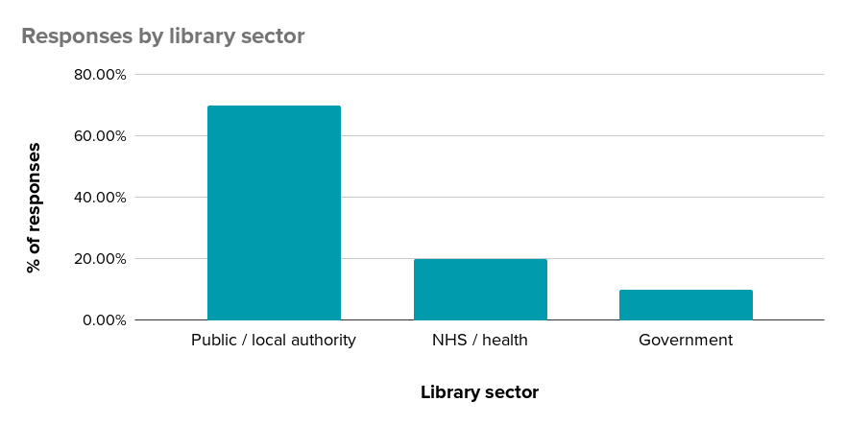
Responses

Slide 12
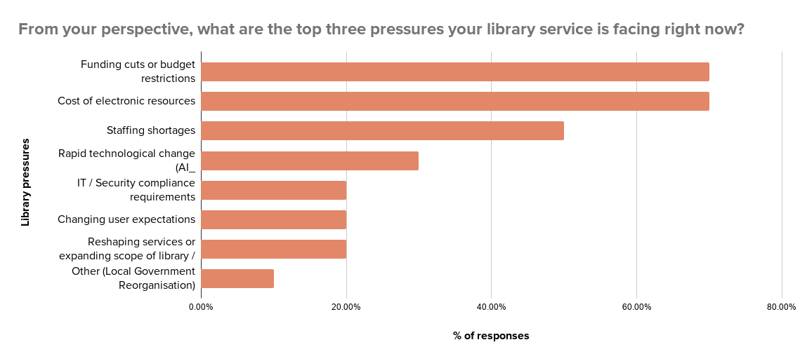
Responses
Notes:
“Others”:
Losing space/areas to curriculum areas - growth in student numbers reducing cross college areas.
A Merger, a new (and additional) Campus and New Management
Local Government Reorganisation

Slide 13
Responses - strategic goals
Key themes:
AI, AI, AI
Sustainability
Digital and Social inclusion
Reading and literacy
Information and signposting
Workflow automation / efficient working
Increasing library usage

Slide 14
Responses - Aspen Discovery helping to achieve goals
Event booking & impact reporting
Digital inclusion
Web builder & landing page tiles
Browse categories & Single Sign-On
Unified web & catalogue search
Online joining
“Aspen is the front door to many of our customers and partners for information about the library service and what we offer.”
“Event booking provides good reporting to demonstrate impact, while web builder and landing page tiles allow the service to be in charge of our own website and promote what we offer.”
“Aligns with our goal focused on digital inclusion”

Slide 15
Responses - favourite Aspen feature
manage_accounts
Account self-service & spotlights
Patrons easily update their own account details, paired with engaging collection spotlights.
language
Web builder & independence
Empowers the library service to manage and design its own web pages without corporate control.
theater_comedy
Masquerade mode for admin
Invaluable staff tool to view patron interfaces directly and troubleshoot user accounts.
local_library
Libby link & recommendations
Direct seamless access to Libby e-content alongside integrated title recommendations.
campaign
Malleable spotlights
Highly adaptable feature that promotes both physical/digital collections and library events.
edit_note
Staff view & MARC editing
Clean staff view makes reviewing and modifying catalogue MARC records fast and simple.
layers
Grouped works across clusters
Cleans search results and delivers a unified overview when searching across library consortia.
travel_explore
Unified web & catalogue search
Search websites and catalogue simultaneously, enhanced by visual landing page tiles.

Slide 16
Responses - Aspen feature needing improvement
schedule
Bookings module
Hourly & shorter booking periods, plus room and space hire functionality.
event
Event signup & sorting
Improve signup navigation and default event sorting to date rather than 'Best Match'.
thumb_up
Recommendations visual design
Enhance title recommendations appearance based on patron feedback.
admin_panel_settings
Admin UI & sandbox testing
Simplify administration navigation and provide local sandbox environments for testing.
smartphone
Mobile navigation & accessibility
Add labels or a hamburger menu for icon-only top menus on mobile and tablet views.
language
Web builder & breadcrumbs
Enable image search within Web Builder and improve linking across breadcrumbs.

Slide 17

RBKC - Community Forum
Knowledge the online catalogue even exists
Popups are disruptive
Accessibility poor
  Text and text boxes too small - tablet
  What is clickable, what isn’t?
Classification acronyms confusing

Slide 18
RBKC - Community Forum: Recommendations
Prepare simple guidance or training for new library users to make them aware of the library website and catalogue and how to undertake key activities. To meet different needs and preferences, this could be in the format of a simple written guide (physical and digital), as well as group library induction sessions, which is incorporated into the overall ‘digital help’ offer.
Review and improve the accessibility of the public library discovery system, including factors such as the text size across content, textboxes and drop-down menus, and making links clearer. Refer to the Web Content Accessibility Guidelines (WCAG) 2.2.
Review and improve consistency of user interface across device types, such as pop-ups on mobile devices, display settings across operating systems, clear colour-coding, and the use of icons for menu items.

Slide 19
Responses - Aspen wishlist & future ideas
meeting_room
Room & space bookings
Expand bookings for meeting rooms, hotdesks, and upfront payments (similar to LibCal space hire).
psychology
AI & natural language search
Introduce conversational AI and natural language search capabilities to enhance catalogue discovery.
phonelink_lock
Single Sign-On for LiDA
Implement seamless Single Sign-On (SSO) authentication for the Aspen LiDA mobile app.
science
Local sandbox testing
Provide dedicated staging / sandbox environments to test, preview, and save changes prior to pushing live.
hub
Collaborative development
Establish a shared framework for joint funding and focused development across Koha and Aspen libraries.
sort
Event sorting & mobile UI
Default event search sorting to date rather than 'Best Match', and improve mobile top menu icon clarity.

Slide 20
Yorkshire and Humber Health Libraries proof of concept
Over 90% of teaching hospital and other trust libraries use Koha already
Academic libraries
EDS is the current gateway to e-resources
Proof of concept ran for six months
  New integrations developed specifically - BMJ for Best Practice, Ovid, NICE
  Tested EDS and EBSCOHost integrations - challenge of multiple EBSCO subs for each Aspen
  Overwhelmingly positive feedback - staff and users
  Opportunity to regain localisation of web presence without additional site
  There’s an app for that!
Getting over the perception of ‘two discoveries’ is the challenge

Slide 21
imCode and Aspen Discovery
Open Fifth has implemented Aspen Discovery with one Swedish libraries with two more interested…will imCode adopt Aspen?
LOTS - VuFind and Wordpress - very successful with school libraries
Swedish/Norwegian/Finnish translations needed
Local integrations

Slide 22
Developments for UK and European libraries
And US libraries too!

Slide 23
Developments
GrapesJS web builder - allows for templates and more flexible layouts
Patron self renewal
Community Engagement - Cuyahoga, reading challenges
Events registration, waitlists and the staff UI for attendee registration management
Hyperholds - meta level holds. Koha functionality in Aspen
Bookings from Koha
ILL - exposing Koha new functionality for auto ILL - to come

Slide 24
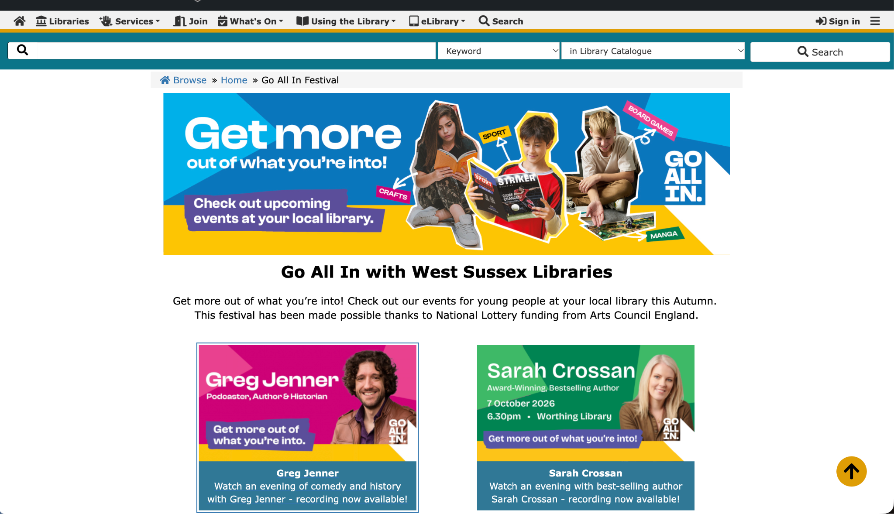

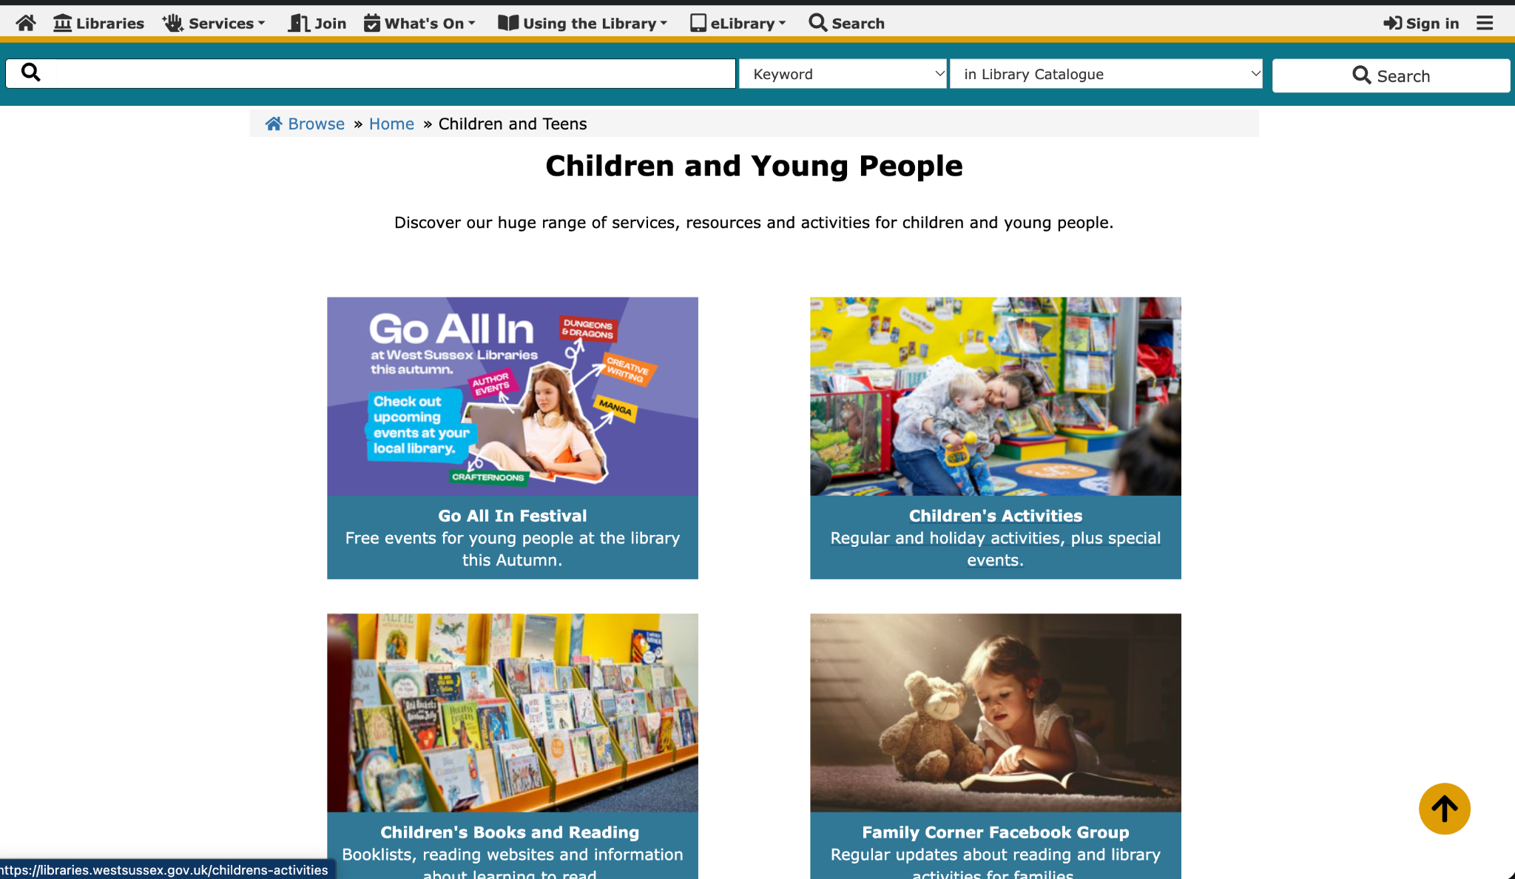
GrapesJS web builder

Slide 25
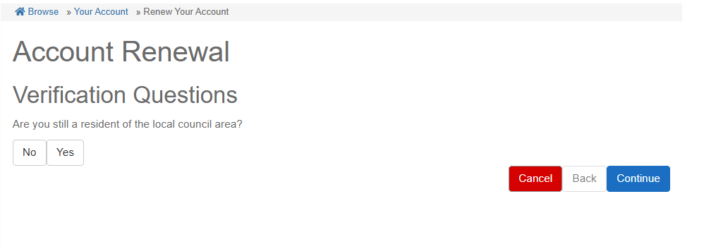
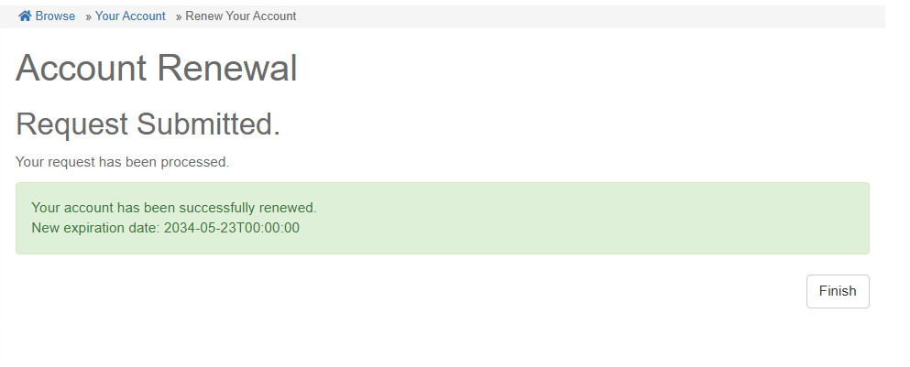
Patron self renewal

Slide 26
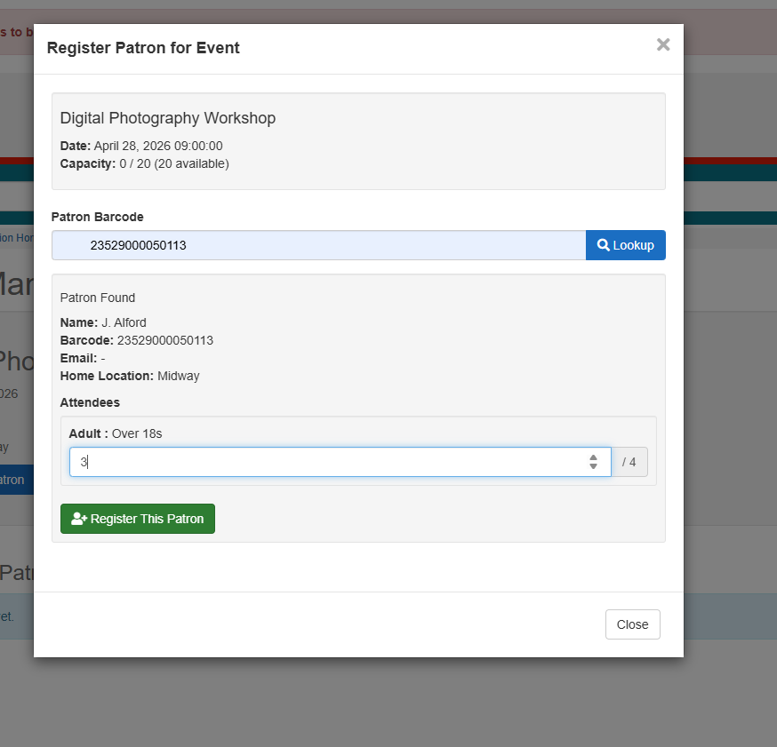
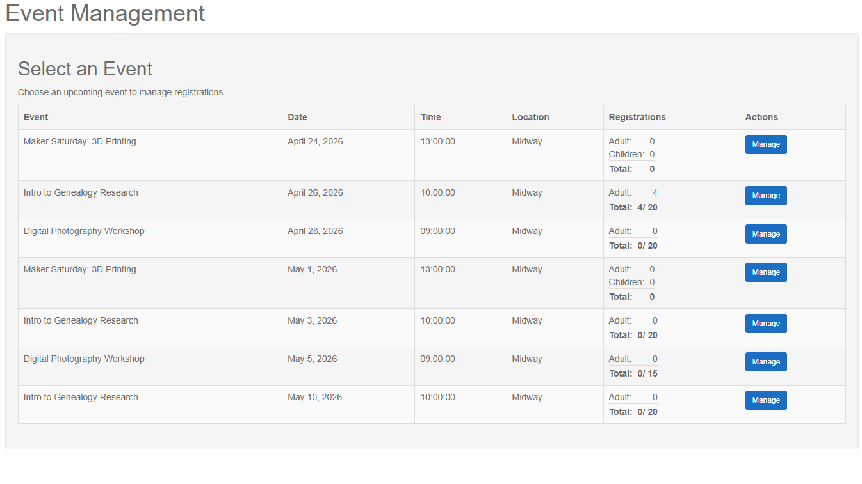
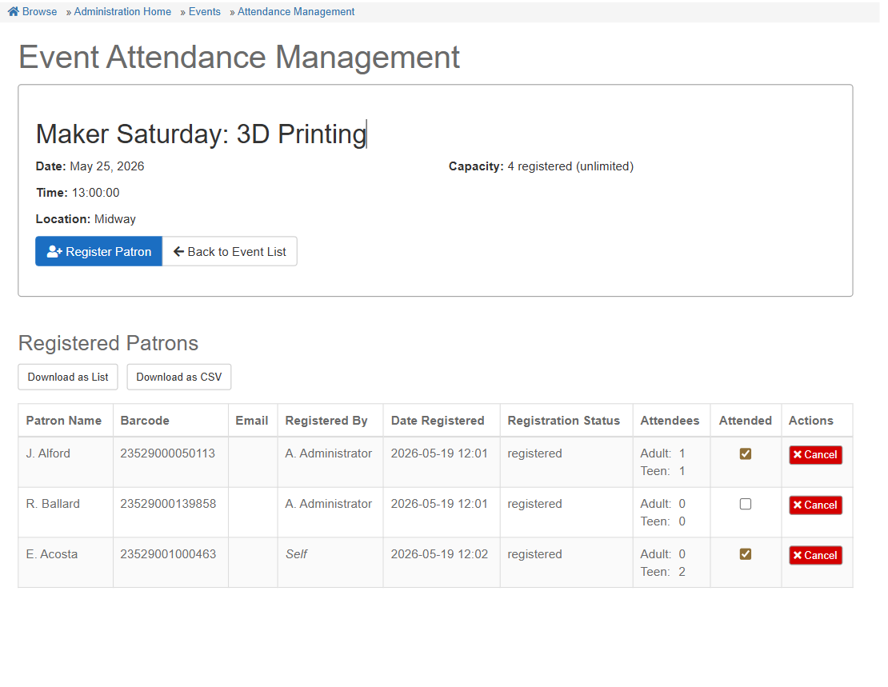
Event and user registration management

Slide 27
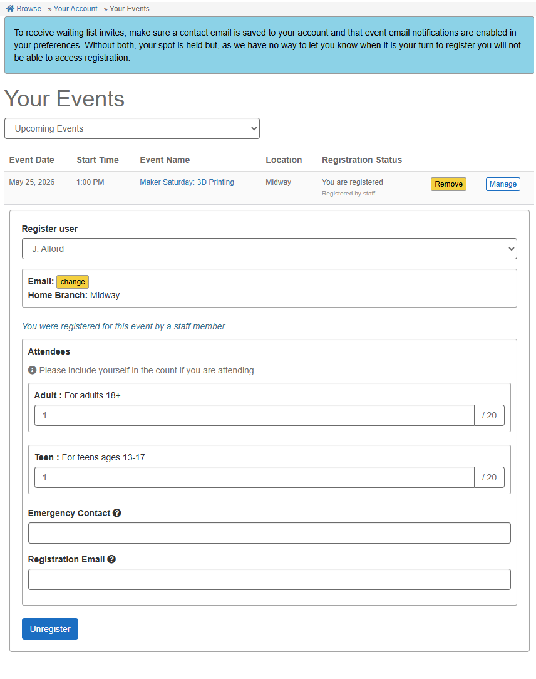
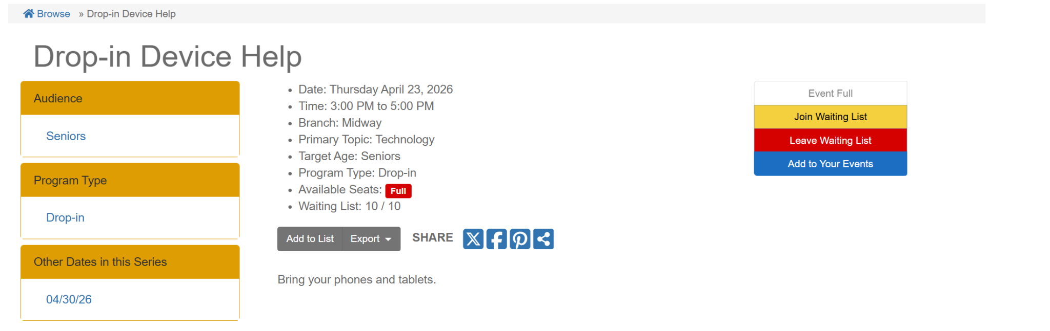
Events registration/waitlists - for the user

Slide 28
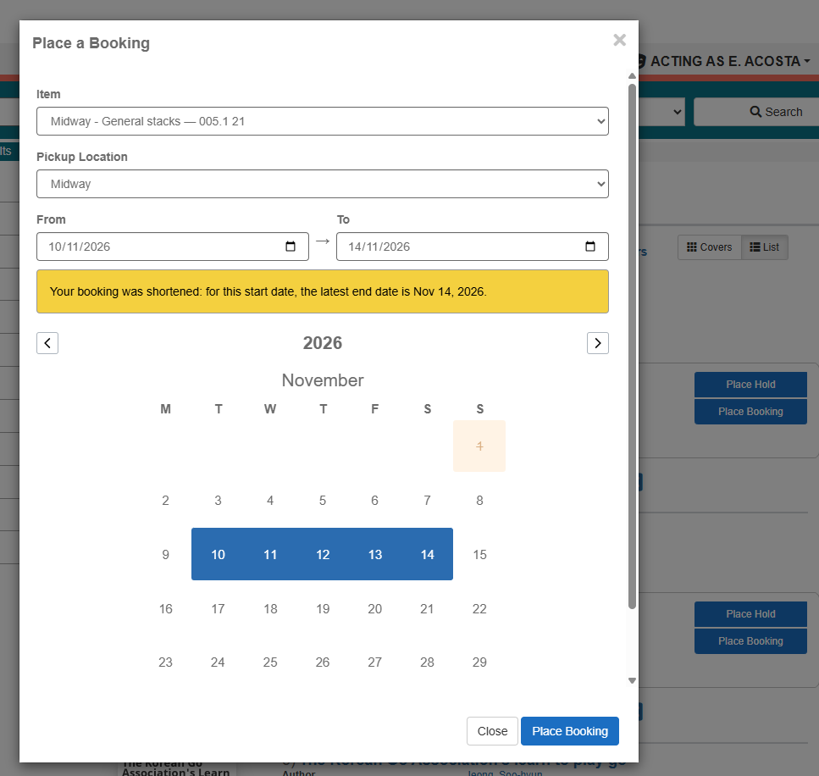
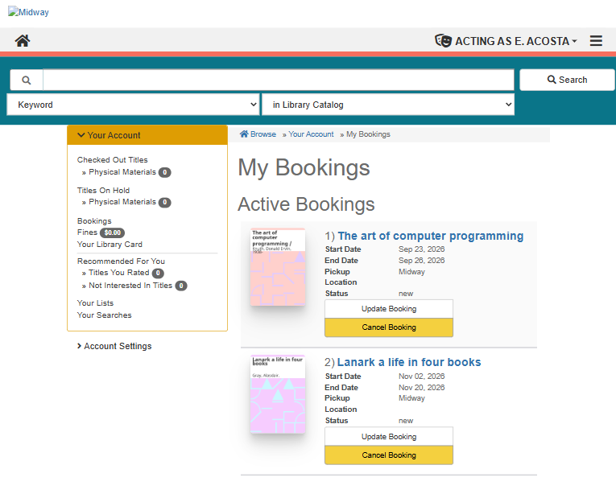
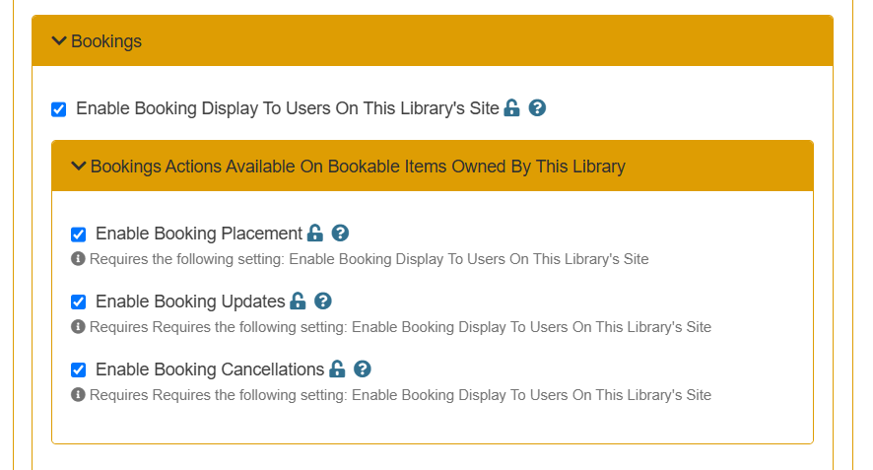
Koha bookings in Aspen Discovery and LiDA

Slide 29
Behind the scenes
Aspen Dev Box
Internationalisation - date formats, time formats, currency support
Security and bug fixing
Plugins and API revamp
Sandboxes

Slide 30
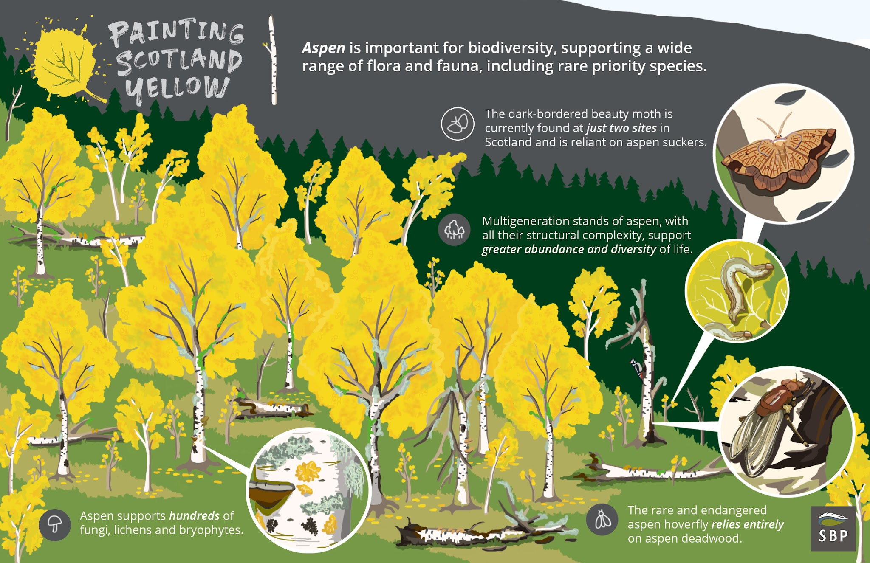
Painting Scotland Yellow - a campaign by Scotland - The Big Picture

Slide 31

Copyright
Mark Hamblin scotlandbigpicture.com

Slide 32
Thank you
Andrew Auld
Commercial Director, Open Fifth
andrew.auld@openfifth.co.uk

