Slide 1

Scaling Mobile Library Services
Lessons in Sustainability from the Westchester Library System
Allison Pryor · AspenCon 2026
Notes:
This really became a story about migrations in a library system that serves an incredibly diverse county: SirsiDynix to Evergreen, Evergreen plus Aspen, and then Aspen LiDa to SOLUS for mobile, and the steps that took us there. We love Aspen; it is the thread through this whole story.

Slide 2
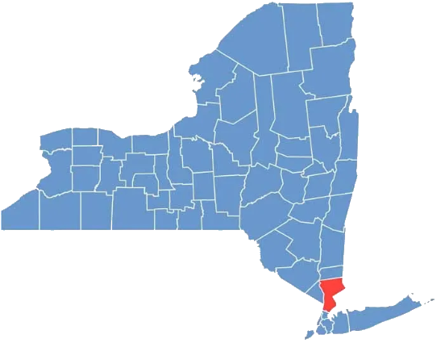
Our county, our libraries
Who we are as a county and as a library system
Westchester County, directly north of New York City
Notes:
Westchester County is located in New York, directly north of New York City, served by 38 very different libraries.

Slide 3
Westchester at a glance
1.02M
38
507,918
$118,976
residents (July 2025 estimate)
independent member libraries
library cardholders
median household income
New York City’s suburbs, where residents’ expectations are high and library service is held to the same standard as everything else.
Sources: U.S. Census Bureau QuickFacts (V2025 estimates; ACS 2020–2024); WLS Member Library Statistics 2023
Notes:
WLS is one of New York's 23 public library systems. Westchester sits directly north of New York City, bordering the Bronx. In the New York City suburbs, residents' expectations are high. When a service they rely on is disrupted, our frontline library staff absorb it. Our patrons’ high expectations are why we hold our tools to a high standard.

Slide 4
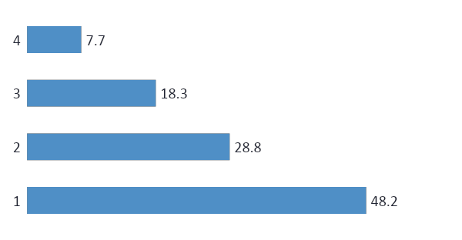
No single majority, many cultures and languages
26.1%
of residents were born outside the U.S.
34.8%
speak a language other than English at home
Why it matters: language access is a core requirement for a third of our residents, not a nice-to-have.
Source: U.S. Census Bureau QuickFacts, Westchester County (V2025; ACS 2020–2024). Hispanic residents may be of any race.
Notes:
More than a third of our county’s residents speak a language other than English at home, which is why multilingual support weighs heavily in our evaluations on ILS products. Why it matters: language access is a core requirement for a third of our residents, its not just a nice-to-have.

Slide 5
From our SCALE dashboard
Language spoken at home
629,287 residents speak only English at home; 184,717 speak Spanish; 72,408 speak Spanish with limited English.
Educational attainment (adults 25+)
380,000 adults hold a bachelor’s or graduate degree, while 71,800 never finished high school.
Why it matters: Spanish-language support and plain-language help reach patrons that a longer feature list never will.
Source: WLS SCALE Dashboard (Strategic Community Analytics for Library Evaluation), Westchester County demographics
Notes:
These snapshots come from SCALE, the WLS data dashboard our team built so WLS and member library staff can work from shared data. Westchester is a highly educated county overall, and has tens of thousands of residents who need Spanish support or plain-language help. This range is why we needed to bridge the language gap and reach patrons that may not be setting foot in the library. Why it matters: Spanish-language support and plain-language help reach patrons that a longer feature list never will.

Slide 6
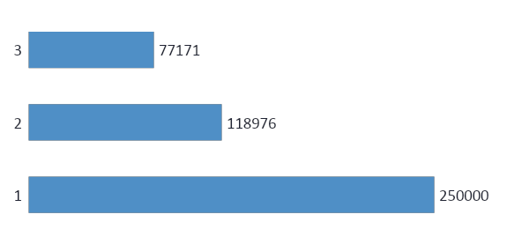
Two Westchesters
38%
of county households fell below the ALICE threshold in 2023: 10% in poverty plus 28% working but unable to cover basic costs.
Why it matters: one shared ILS has to work equally well for patrons no matter their zip code.
Sources: Census QuickFacts (ACS 2019–2023 municipal; 2020–2024 county; Scarsdale reported as $250,000+); United Way, State of ALICE in Westchester (2025)
Notes:
the Census tops out its reporting at $250,000-plus, so Scarsdale's real median is higher than the bar shows. The ALICE figure (Asset Limited, Income Constrained, Employed) from United Way's 2025 report is 144,612 households, the most since the study began in 2010. Poverty rate alone, 8.7%, undercounts hardship badly.

Slide 7
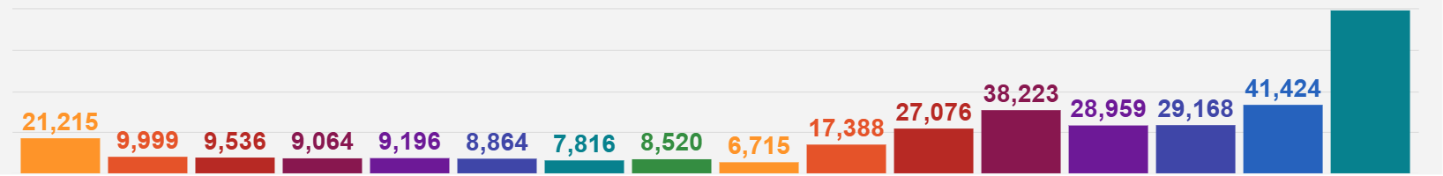
Household income across the county
Bars run from under $10,000 (left) to $200,000 or more (right)
67,874
households earn under $35,000 a year
21,215
households earn under $10,000 a year
Why it matters: for households on tight budgets, free e-content and easy and reliable access to library resources are essential.
Source: WLS SCALE Dashboard (Strategic Community Analytics for Library Evaluation), Westchester County demographics
Notes:
The left six bars (under $35,000) add up to 67,874 households. The largest single bracket is $200,000 or more, the tall bar at the right was cut off in the screenshot; equates to 98,573 households. Why it matters: for households on tight budgets, free e-content and easy and reliable access to are essential.

Slide 8
Different sizes, same access
Population served
4,432 Bedford Free
211,569 Yonkers
Paid staff (FTE)
3 Purchase
104 Yonkers
Operating budget
$242K Purchase
$11.2M Yonkers
Residents with a card
34% Purchase
77% Rye
Why it matters: 27 of our 38 libraries serve fewer than 25,000 people. Whatever the size of the service area, every patron gets the same access.
Source: WLS Member Library Statistics 2023 (published Nov. 2024); Mount Vernon data not yet reported
Notes:
Why it matters: 27 of our 38 libraries serve fewer than 25,000 people. Whatever the size of the service area, every patron gets the same access.

Slide 9
38 cultures, one common thread
Each library is its own place.
Its own board, budget, collections, and culture, shaped by the community it serves.
The ILS is the common thread.
One shared catalog and patron database connect all 38, so every library is part of something bigger.
Evergreen ILS + Aspen
one catalog, one patron database, 38 libraries
Why it matters: every migration had to strengthen the thread without erasing what makes each library its own.
Notes:
Each of our 38 member libraries is independent, with its own board, budget, collections and culture. The ILS is the common thread that holds everyone together: one shared staff client and one shared patron catalog. Every decision - Evergreen, Aspen, LiDa and SOLUS, was about strengthening that thread while letting each library stay itself.

Slide 10




What our communities need from us
Languages
Uneven margin
Age and ability
Uneven capacity
34.8% speak another language at home
38% of households below ALICE threshold
1 in 5 residents 65 or older
27 of 38 libraries serve <25K patrons
→ Multilingual access
→ No gaps during change
→ Simple, accessible design
→ Shared system, local control
Notes:
This is the thread through the rest of the talk. Each need comes back: language access in the SOLUS chapter, no gaps in the rollout and continuity slides, simple design in patron communication, and shared system with local control in everything Aspen made possible.

Slide 11
Our migration journey
Four platforms since 2019, one playbook
Notes:
Our migration journey; Every move since 2019 was about giving our libraries more control and our patrons a better experience, and each one taught us something we used in the next.

Slide 12
From SirsiDynix to SOLUS
Mar 2019
May 2023
Jan 1, 2025
Jan 29, 2025
Oct 2025
Oct 20, 2026
Evergreen ILS replaces SirsiDynix
Aspen Discovery becomes our discovery layer
Legacy Capira app retired
WLS Mobile launches on Aspen LiDA
WLS signs with SOLUS
WLS Mobile moves to SOLUS
Catalog & ILS
Mobile app
Each move built on the last: an open ILS made gowth possible, and that growth had to be sustainable in matching our patrons’ needs.
Sources: WLS board minutes and IT notices (2019, 2023); member library notices (2024–25); SOLUS press release (Oct. 7, 2025)
Notes:
Evergreen went live March 14, 2019, after a three-day system outage for the migration. Aspen Discovery soft-launched April 26, 2023 and went live for patrons May 1, 2023. In 2023 WLS kept the existing Capira app (through OCLC ). It stopped supporting account access on Jan 1, 2025, and WLS Mobile, built on Aspen LiDA, launched Jan 29, 2025. SOLUS went live October 20, 2026, about a year after signing, mainly because of repeated App Store rejections (see the speed-bump slide). Staff admin training for SOLUS follows in early 2027.

Slide 13

2019: Open source, with room to grow
399,438
patron records migrated
SirsiDynix → Evergreen
Replaced SirsiDynix Symphony at contract renewal
Open source gave our libraries room to grow
Live for all 38 libraries on March 14, 2019
959,561
bibliographic records migrated
Why it matters: open source let us grow. Aspen built on that with continued growth and even more access for our patrons.
Sources: Equinox press release (June 2019); WLS Circulation Committee minutes (May 2019); WLS IT notices (2019)
Notes:
In 2019, WLS leadership told the Circulation Committee the move to Evergreen was about open source and a future we could control, after we reached our ceiling with our previous ILS. Evergreen went live March 14, 2019, after a short system outage for the migration. Equinox reported 399,438 patrons and 959,561 bibliographic records migrated. We started open source with Evergreen because it allowed us to grow our relationship with our patrons and member libraries. Aspen, four years later, continued that growth and opened even more access for patrons.

Slide 14
Why we love Aspen
A discovery layer that lets every library shine
Notes:
We love Aspen! It brought our digital content together, and it gave each of our 38 libraries a way to promote and share what it specifically offers to its own patrons, and it made searching the catalog an intuitive process for our patrons.

Slide 15



2023: Why Aspen made sense
One destination for print and digital
Borrow without leaving
Every library’s own catalog
hoopla, Libby, Kanopy, Comics Plus and LinkedIn Learning in the same results
Check out e-content right from the catalog
Unique branding, subscriptions, and resources for its own patrons
Why it matters: patrons stopped needing to switch platforms. Now, they just searched their own library’s catalog.
Sources: WLS board materials and “Discover the New Catalog” Q&A (2022–23)
Notes:
The main selling point for Aspen was full integration of our digital content into the patron catalog: hoopla, Libby, Kanopy, Comics Plus, LinkedIn Learning and more, all in one place. Aspen's open-source framework and support for third-party integrations would allow our libraries to connect with their patrons in a way their websites couldn't. Previously, libraries had to access those subscriptions through library websites or separate apps.
The second, which turned out to matter just as much, was that every library got its own instance to showcase its own identity, subscriptions, resources while being able to promote and communicate directly with their patrons through placards and system messages.

Slide 16



How we rolled out Aspen
Town hall forum
Open test server
Real-time feedback
Soft launch, then live
Introduced Aspen to all 38 libraries together
Every library could try it before launch
Staff input shaped the configuration
Apr 26 soft launch; patrons May 1, 2023
Why it matters: the previous discovery layer stayed available until August 2023, so no one was left without a way in.
Sources: WLS board minutes (Apr. 2023); “Discover the New Catalog” Q&A (Apr. 2023)
Notes:
Aspen was a completely different visual experience than what our patrons had grown accustomed to with our previous discovery layer. It was a visual overhaul that came with very tangible upgrades.
Patrons could open the catalog and sign up for events that were promoted by placards based on their searches, or receive real time updates through system messages.
The rollout started with a town hall forum, and libraries were invited onto the test server to give real-time feedback. I hosted round-table sessions where staff browsed the new catalog and shared input. Soft launch was April 26, 2023, patron go-live May 1. The old OPAC stayed up until August 2023, which gave patrons the safety net to back up and download their readin history and any saved lists they may have had.
On the left is everything we own or subscribe to. Evergreen holds our records, our patron accounts, and our holds. Then we have our e-content partners: hoopla, Libby, Kanopy, Comics Plus, LinkedIn Learning, etc. Before Aspen, a patron looking for a title might search our catalog, then hoopla, then Libby, each one separately.
Aspen sat in the middle and pulled all of that into one place. One search covers print and digital. Format grouping puts the book, the e-book, and the audiobook together in one result. Patrons can borrow e-content without ever leaving the catalog. Evergreen still does the work behind the scenes, but for the patron, Aspen is the online library.
On the right is what comes out. First, 38 library catalogs, each with its own look, its own resources, and its own identity, all running on the same hub. Second, our app. And notice that the app is highlighted. Because everything flows through Aspen, the app is just one more doorway into the same hub. When we needed to change apps, we swapped that one piece, and nothing else moved. Our records, our accounts, and our integrations stayed exactly where they were. SOLUS plugs into Aspen’s search, so patrons get the same results on their phone as on the web.
That’s what open source and strong third-party integrations mean in practice. Aspen didn’t just give us a better catalog. It gave us the freedom to keep evolving everything around it.

Slide 17



38 libraries, 38 identities
Full admin
Themes, hours, holidays, contact and social links, system messages, placards, browse categories, spotlights
“This is yours.
Spend as much or as little time on it as you want. I’m here as backup to fill the gaps.”
Our message to every member library
Content admin
Browse categories and collection spotlights only
22 → 84
WLS-managed
For libraries without available staff, WLS runs the instance
Aspen admins since 2023: nearly 4×
Driven by ongoing training and libraries seeing their peers’ catalogs
Notes:
Training has been offered since 2023 to any interested staff, and it's ongoing. Full admins customize their instance theme, update library and location settings (holidays, hours, contact links, social media), and create system messages, placards, browse categories and collection spotlights. Over three years, Aspen administrators grew from 22 to 84, nearly quadrupling, driven by two things: ongoing training, and libraries asking for more admins once they saw what their peers had done with their catalogs.
Our libraries are choosing to take on more ownership, without WLS doing it for them. Where a library has no staff available, I manage their instance.

Slide 18
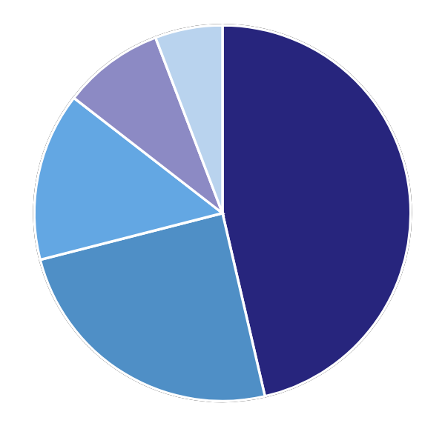
Showcasing what makes libraries shine
Share of member libraries offering each service
For example
Each library chooses what it offers its own patrons. A few examples:
Somers: cake pans, ukuleles, bongo drums, astronomy and birdwatching kits
New Rochelle: Spanish and English streaming, plus its own cloudLibrary e-books
Museum & park passes
94%
Library of Things
50%
Seed library
29%
Own NYT or WSJ access
18%
Own cloudLibrary e-books
12%
Why it matters: Aspen lets each library promote what it specifically offers to its own community.
Sources: WLS review of 34 member library websites (2026); Somers Library and New Rochelle Public Library websites

Slide 19
Aspen, the hub of our system for our patrons
Connects in
Front ends out
Evergreen ILS
Records, accounts, holds
Aspen Discovery
open-source hub
One search, print and digital
Format grouping
Open APIs for front ends
38 library catalogs
Each with its own identity
E-content partners
Syndetics Unbound, hoopla, Libby, Kanopy, Comics Plus, LinkedIn Learning
WLS Mobile
LiDA → SOLUS: the only piece we swapped
Why it matters: because Aspen is the hub for our patrons, we could later change our app without moving records, accounts, or integrations.
Sources: WLS catalog Q&A (Apr. 2023); SOLUS press release on Aspen integration (Apr. 28, 2025)
Notes:
Aspen, the hub; Here’s what Aspen actually changed for our patrons.
On the left is everything we own or subscribe to. Evergreen holds our records, our patron accounts, and our holds. Then we have our e-content partners: hoopla, Libby, Kanopy, Comics Plus, LinkedIn Learning, etc. Before Aspen, a patron looking for a title might search our catalog, then hoopla, then Libby, each one separately.
Aspen sat in the middle and pulled all of that into one place. One search covers print and digital. Format grouping puts the book, the e-book, and the audiobook together in one result. Patrons can borrow e-content without ever leaving the catalog. Evergreen still does the work behind the scenes, but for the patron, Aspen is the online library.
On the right is what comes out. First, 38 library catalogs, each with its own look, its own resources, and its own identity, all running on the same hub. Second, our app. And notice that the app is highlighted. Because everything flows through Aspen, the app is just one more doorway into the same hub. When we needed to change apps, we swapped that one piece, and nothing else moved. Our records, our accounts, and our integrations stayed exactly where they were. SOLUS plugs into Aspen’s search, so patrons get the same results on their phone as on the web.
That’s what open source and strong third-party integrations mean in practice. Aspen didn’t just give us a better catalog. It gave us the freedom to keep evolving everything around it.

Slide 20
Now, let’s talk about the app
Notes:
About 12 minutes. The mobile story: what worked, what didn't, why SOLUS, and how we managed the move for staff and patrons.

Slide 21






What Aspen LiDA gave us
Open source and built for Aspen
LiDA put all 38 libraries on mobile quickly, using the same catalog patrons already knew, with no separate integration to build.
Saved searches
Reading history
Reading lists
E-content holds & checkout
Fine payment
ISBN scan for availability
Features as announced to patrons by member libraries, Dec. 2024 – Jan. 2025
Notes:
Aspen gave every one of our libraries a catalog it could be proud of. But in today’s culture, libraries have to fight to stay relevant and accessible, and many of our patrons will never sit down at a computer to search a catalog. For them, the library lives on their phone. If that’s where they are, that’s where we need to show up.
Open source and built for Aspen - LiDA put all 38 libraries on mobile quickly, using the same catalog patrons already knew, with no separate integration to build.

Slide 22





Listening to our patrons and libraries
What we heard from patrons
What we heard from our libraries
Unexpected app closures
~1 in 10
help desk tickets were about the app at launch
Being signed out without warning
Frequent questions at service desks
Updates not always appearing
Requests for a more stable experience
LiDA offered features we valued. At our scale, our patrons and staff needed more consistent stability.
Source: WLS help desk records, 2025
Notes:
LiDA gave us the right features and a fast path onto a mobile app that would be visually consistent for our patrons that were now used to the Aspen Discovery OPAC. But we serve the New York City suburbs, where expectations are high and people expect things to just work. From launch, we heard from patrons about unexpected app closures, being signed out, and updates not always appearing. At launch, roughly one in ten help desk tickets was about the app, and our front desks were answering those questions every day. Our member libraries asked us for a more stable option, and within about eight months we had signed with SOLUS, citing stability. For a 38-library (high maintenance) consortium, we needed a dedicated, vendor-supported mobile product with the support model to match.

Slide 23



Why we chose SOLUS
Stability
Customization
Showcasing
Sources: SOLUS announcement of WLS agreement (Oct. 7, 2025); SOLUS Aspen integration release (Apr. 28, 2025)
Notes:
So the next step in our story wasn’t about replacing anything we loved. It was about pivoting to keep the expected continuity of good service going.
And this is where Solus enters our migration story-line.
SOLUS's reputation for stability is what first caught our attention. It already supports library systems our size and larger. SOLUS uses Aspen's search service and format grouping, so mobile results match the web. And crucially for us, it allows customization and showcasing of library-specific features, so each library's identity from Aspen carries over to mobile that feature each library’s own resources front and center.

Slide 24
Bridging the language gap
Our patrons
23 languages enabled in WLS Mobile
Chosen from 40+, with push notifications in each
34.8%
speak a language other than English at home
Amharic
Arabic
Bengali
Chinese
English
French
German
Hebrew
Hindi
Hmong
72,408
speak Spanish with limited English
Italian
Japanese
Korean
Norwegian
Pashto
Persian
Russian
Somali
Spanish (Latin America)
Thai
Ukrainian
Urdu
Vietnamese
Why it matters: Aspen showcases what each library offers; SOLUS helps patrons find it in their own language, including five right-to-left scripts.
Sources: Census QuickFacts (ACS 2020–2024); WLS SCALE Dashboard; SOLUS Aspen integration release (Apr. 28, 2025)
Notes:
Solus also offered us the opportunity to bridge the language gap and potentially reach residents that may have avoided libraries due to language barriers in greater ways that we previously could. More than a third of residents speak a language other than English at home, and tens of thousands speak Spanish with limited English. WLS enabled 23 languages in WLS Mobile: Amharic, Arabic, Bengali, Chinese, English, French, German, Hebrew, Hindi, Hmong, Italian, Japanese, Korean, Norwegian, Pashto, Persian, Russian, Somali, Spanish (Latin America), Thai, Ukrainian, Urdu and Vietnamese. Five of them (Arabic, Hebrew, Pashto, Persian, Urdu) read right to left, which SOLUS supports. Push notifications go out in the patron's language too. Why it matters: Aspen showcases what each library offers; SOLUS helps patrons find it in their own language, including five right-to-left scripts.

Slide 25
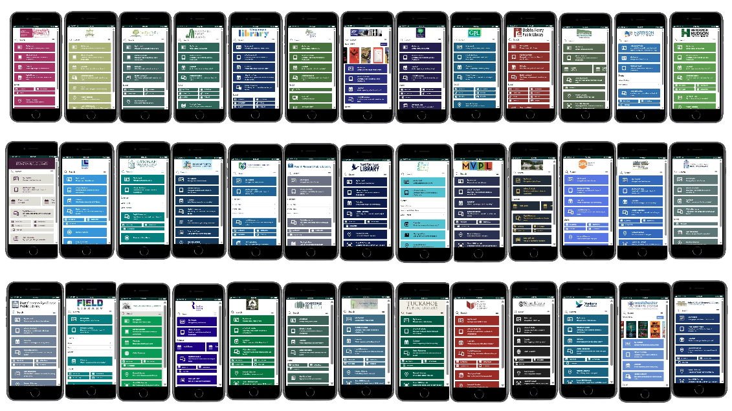
One app, every library’s identity
Same app, local look.
Each library’s template mirrors its Aspen instance: its own logo, colors, and resources.
Built by SOLUS and WLS. Libraries take over updates after training in early 2027.
Notes:
Just like with Aspen - every member library has its own WLS Mobile template, matched to its Aspen instance, so patrons will see their own library's identity in a shared, system-supported app.

Slide 26




Same model as Aspen: this is yours
Each library’s app looks like its own catalog.
With 3 to 104 paid staff per library, ownership has to be optional. Libraries that want control get it; WLS fills the gaps for the rest.
Templates per library
Built by SOLUS and WLS to match Aspen
Previews along the way
Shown at staff and committee meetings
Monthly updates
Progress shared with every library
Admin training, early 2027
Interested staff take over updates
Notes:
Same model as Aspen: this is yours; Previews were shown at staff and committee meetings, and updates went out monthly. Admin training in early 2027 lets interested staff make their own updates, with WLS as backup, the same deal as Aspen.

Slide 27


Our speed bump: the App Store
Android
Patron updates the existing WLS Mobile app
→
Now running on SOLUS, same name and icon
iPhone
Repeated Apple Developer rejections
→
Rather than keep delaying, we used the Solus Library App
→
Patron searches for WLSMobile and gets full access
Why it matters: every migration hits a speed bump. Ours added months, so we built instructions, social posts, and help guides for the detour.
Source: WLS rollout, 2025–26
Notes:
Our speed bump: the App Store; The Apple Developer program repeatedly rejected the WLS Mobile submission, which is the main reason go-live came about a year after signing with SOLUS. Android users only had to update their existing WLS Mobile app. For iPhone users, rather than keep pushing back go-live, WLS directed them to download the Solus Library App and select WLS, which gives full access. The process is clumsier, so WLS created step-by-step instructions, social media posts and help guides. It took so long to go live because of The App Store review, plus a choice not to keep iPhone users waiting.

Slide 28



Communicating with patrons
Focus on getting the app
Patrons learn a new interface; installing is where they stall
Separate steps by device
Android: update. iPhone: Solus Library App.
The second change costs more goodwill than the first
Patrons who had just learned LiDA needed a clear reason to switch again, and reassurance that it would be the last switch for a while.
Every channel, every library
Instructions, social posts, help guides
Lead with what stays the same
Same card number, PIN, and catalog
Notes:
Communicating with patrons; Change fatigue is very real and the key insight: patrons figure out new interfaces on their own all the time (social media and retail apps change constantly), and adopting an app isn’t as complicated as learning a new catalog. So this time the rollout focused on download instructions rather than feature tutorials. So this time the rollout focused on download instructions rather than feature tutorials.

Slide 29
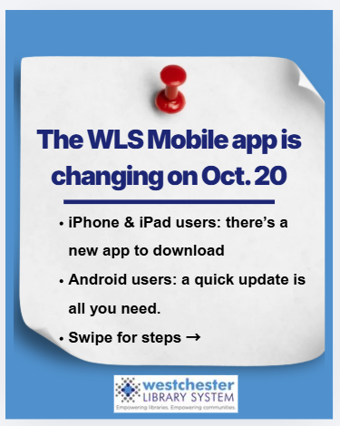
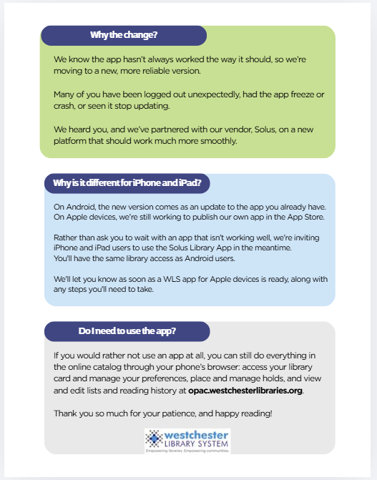
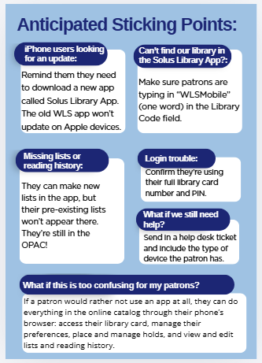
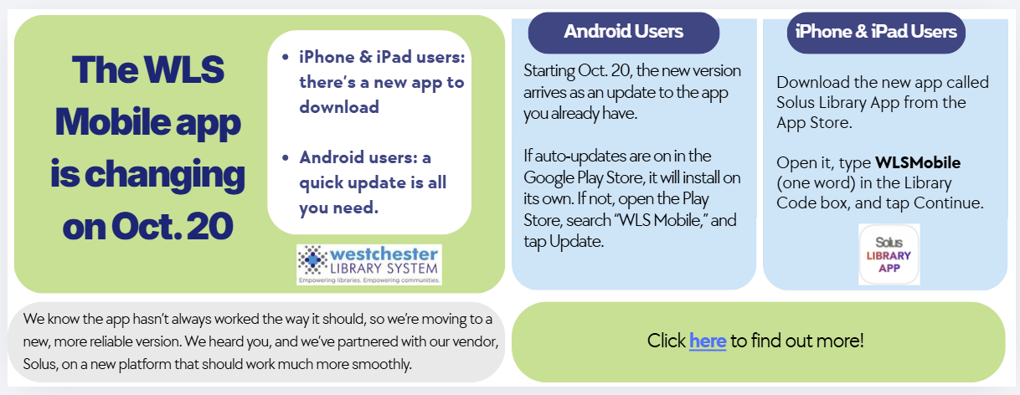

Slide 30
Lessons
What we’d tell another Aspen library
Notes:
Lessons; When people hear ‘four migrations in seven years,’ they sometimes assume that’s a sign of instability. For us, it’s the opposite. Each move made us more sustainable as a system.
Evergreen gave us an open-source foundation, so the future of our ILS was in our hands, not a vendor’s. Aspen built on that foundation. It brought our print and digital collections together for patrons, and it gave every library the tools to run its own catalog. We went from 22 staff Aspen administrators to 84, which means the work of keeping our catalogs current is shared across our libraries instead of resting on me. And SOLUS continues all of that to mobile.
None of these moves started over from scratch. Each one kept what was working and changed only what wasn’t. That’s what sustainability looks like for us: not standing still, but building a system that can keep adapting without breaking.”

Slide 31
Six lessons in sustainability
1
Start with who you serve Every library, and every language, needs to show up.
2
Separate the engine from the front end Aspen let us change apps without migrating the catalog.
3
Budget for change fatigue Every transition spends patron goodwill. Spend it deliberately.
4
Overlap, don’t gap, and plan a detour Keep the old app running; have a workaround ready.
5
Let every library shine Local identity in a shared system, with WLS as the safety net.
6
Plan mobile on a multi-year horizon Choose for year three, not just launch day.
Notes:
Some of what we learned, we learned the hard way, and we’d rather you didn’t have to. So here are the six lessons we’d pass on to any library system thinking about its next move. 1. Start with who you serve.
“Everything we did started with our county. More than a third of our residents speak a language other than English at home. Our libraries range from 3 paid staff to more than 100. So for us, the question was never ‘what features does this platform have?’ It was ‘does this work for every library and every language we serve?’ That’s why we turned on 23 languages in WLS Mobile.”
2. Separate the engine from the front end.: Remember the hub diagram? That’s this lesson in one picture.” We changed the one piece patrons tap on their phones and kept everything we loved underneath. If you’re on Aspen, you already have that flexibility. Use it.”
3. Budget for change fatigue: “Our patrons learned a new catalog in 2023, a new app in 2025, and another in 2026. Every change spends a little patron goodwill, and front-desk staff feel it first. So spend that goodwill on purpose. Lead with what stays the same, keep the instructions simple, and make sure every change is worth what it asks of people.”
4. Overlap, don’t gap, and plan a detour.: “When we moved to Aspen, the old catalog stayed up until August, and nobody was left without a way in. In January 2025, the Capira app lost account access (except for the digital barcode) four weeks before the new one launched, and we felt that gap. Then Apple rejected our app more than once. Instead of making iPhone users wait, we sent them to the Solus Library App and wrote the instructions to get them there. Keep the old thing running until the new thing is live, and have a plan B ready before you need it.”
5. Let every library shine.: “Our 38 libraries are not branches. Each location has its own board, its own budget, and its own culture. When we told them ‘this is yours, and I’m here to fill the gaps,’ our Aspen admins grew from 22 to 84. Training helped, but so did libraries seeing what their neighbors had built. A shared system works best when every library can still look like itself.”
6. Plan mobile on a multi-year horizon.: “It’s easy to choose an app based on launch day. Ask instead what it will look like in year three. Who maintains it? How fast do problems get fixed? Can it grow with you? We chose SOLUS because its reputation for stability held up when we asked those questions. Staff training comes in early 2027, so our libraries can take the reins themselves.”
1. Start with who you serve.
“Everything we did started with our county. More than a third of our residents speak a language other than English at home. Our libraries range from 3 paid staff to more than 100. So for us, the question was never ‘what features does this platform have?’ It was ‘does this work for every library and every language we serve?’ That’s why we turned on 23 languages in WLS Mobile.”
2. Separate the engine from the front end.
“Aspen is our engine. Our records, our accounts, and our integrations with hoopla, Libby, Kanopy and the rest all live there. When our app wasn’t working for us, we didn’t have to touch any of that. We changed the one piece patrons tap on their phones and kept everything we loved underneath. If you’re on Aspen, you already have that flexibility. Use it.”
3. Budget for change fatigue.
“Our patrons learned a new catalog in 2023, a new app in 2025, and another in 2026. Every change spends a little patron goodwill, and front-desk staff feel it first. So spend that goodwill on purpose. Lead with what stays the same, keep the instructions simple, and make sure every change is worth what it asks of people.”
4. Overlap, don’t gap, and plan a detour.
“When we moved to Aspen, the old catalog stayed up until August, and nobody was left without a way in. In January 2025, the old app lost account access four weeks before the new one launched, and we felt that gap. Then Apple rejected our app more than once. Instead of making iPhone users wait, we sent them to the Solus Library App and wrote the instructions to get them there. Keep the old thing running until the new thing is live, and have a plan B ready before you need it.”
5. Let every library shine.
“Our 38 libraries are not branches. Each has its own board, its own budget, and its own culture. When we told them ‘this is yours, and I’m here to fill the gaps,’ our Aspen admins grew from 22 to 84. Training helped, but so did libraries seeing what their neighbors had built. A shared system works best when every library can still look like itself.”
6. Plan mobile on a multi-year horizon.
“It’s easy to choose an app based on launch day. Ask instead what it will look like in year three. Who maintains it? How fast do problems get fixed? Can it grow with you? We chose SOLUS because its reputation for stability held up when we asked those questions. Staff training comes in early 2027, so our libraries can take the reins themselves.”
If you take one thing home, make it this: when you’re planning your next move, ask yourself these questions first.

Slide 32

Before your next mobile move, ask
Who maintains this app in year three, and how is it funded?
Does it use Aspen’s search, so mobile matches desktop?
What will patrons lose, even briefly, during cutover?
Can every member library explain the change in one sentence?
What is our exit path if this doesn’t work out?
Is the total cost sustainable at our scale?

Slide 33




Wherever a patron is, that’s where we need to show up.
In today’s culture, libraries have to fight to stay relevant and accessible. Not every patron will use the catalog or the app, so we evolve, grow, adapt, and sometimes migrate to new services.
In the catalog
In the app
At the desk
In the community
Notes:
Wherever a patron is, that’s where we need to show up. In today’s culture, libraries have to fight to stay relevant and accessible. Not every patron is going to use the OPAC or the app, but wherever we can meet a patron is where we need to show up. That means we keep evolving, growing and adapting, and sometimes migrating to new or different services.

Slide 34
Questions?
Allison Pryor · ILS Discovery Specialist
Westchester Library System
[apryor@wlsmail.org / 914-231-3235]
Notes:
Thank the audience, the Aspen community and SOLUS.

