Slide 1



AspenCon 2026
Hoopla Lightning Talk
Bridget Page
Caitlin Baumgartner
Sr. Product Manager
Business Systems Analyst

Slide 2

“I didn’t know our library had that!”
Closing the discovery gap in your Aspen Hoopla integration.
Today’s agenda
01
Uncover your Hoopla Flex collection
02
Make data-driven decisions
03
Align your catalog settings

Slide 3


Slide 4


01
Uncover your
Hoopla Flex collection

Slide 5
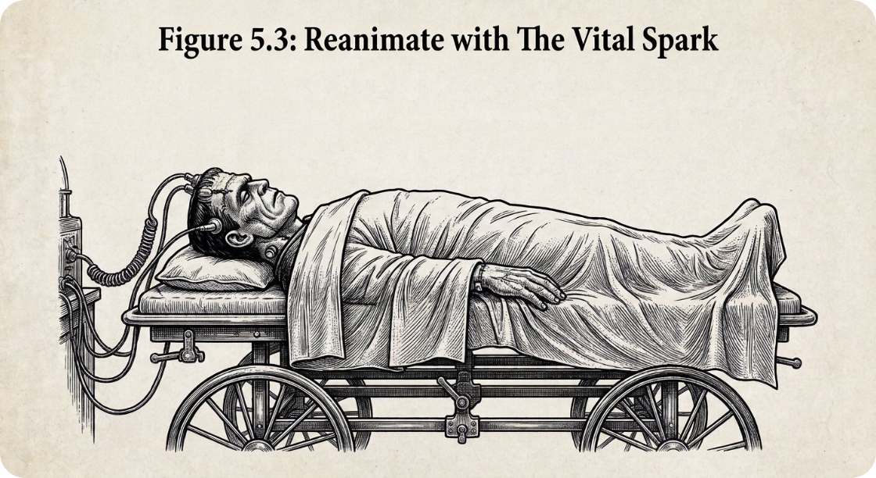

Are you integrating your Flex titles via API?
Why does this matter?
You’ve already paid for these titles.
Your patrons could be
missing out.
Flex is easy to turn on in Aspen!

Slide 6


More Flex in Aspen → More borrowers
As more libraries turn on the Flex integration, more patrons borrow Flex titles and come back for another
2.8x
more libraries with the Flex API integration
1.9x
unique patrons borrowing Flex through Aspen
Q3 2025
Q4 2025
Q1 2026
Q2 2026
Q3 2026
Q3 2025
Q4 2025
Q1 2026
Q2 2026
Q3 2026
2x
Flex API circs through Aspen
2.1x
patrons with 2+ Flex API borrows in a quarter
Q3 2025
Q4 2025
Q1 2026
Q2 2026
Q3 2026
Q3 2025
Q4 2025
Q1 2026
Q2 2026
Q3 2026
Source: Hoopla Partner API data, Aspen partners (ByWater, Equinox, Grove, Turning Leaf), Q3 2025 to Q3 2026. Patrons deduped across partners each quarter.

Slide 7
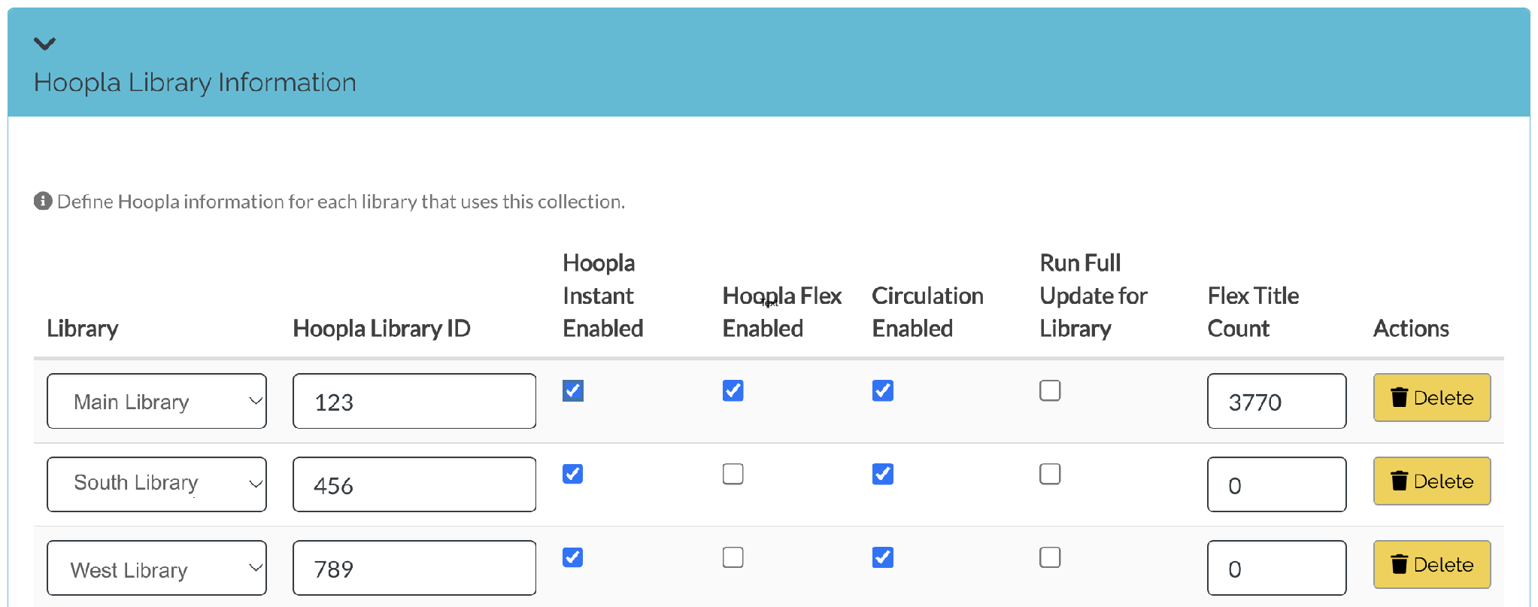
How do I turn on Hoopla Flex in my catalog?
Administration > Hoopla > Settings
Ongoing
Turn Flex titles on, then sync your catalog: check “Hoopla Flex Enabled” and “Run Full Update for Library”
Every night at 1 a.m. local time, the Hoopla indexer fetches titles from the API
Every 5 minutes, the indexer fetches Flex title availability
Once the update runs, your Flex title count will appear

Slide 8
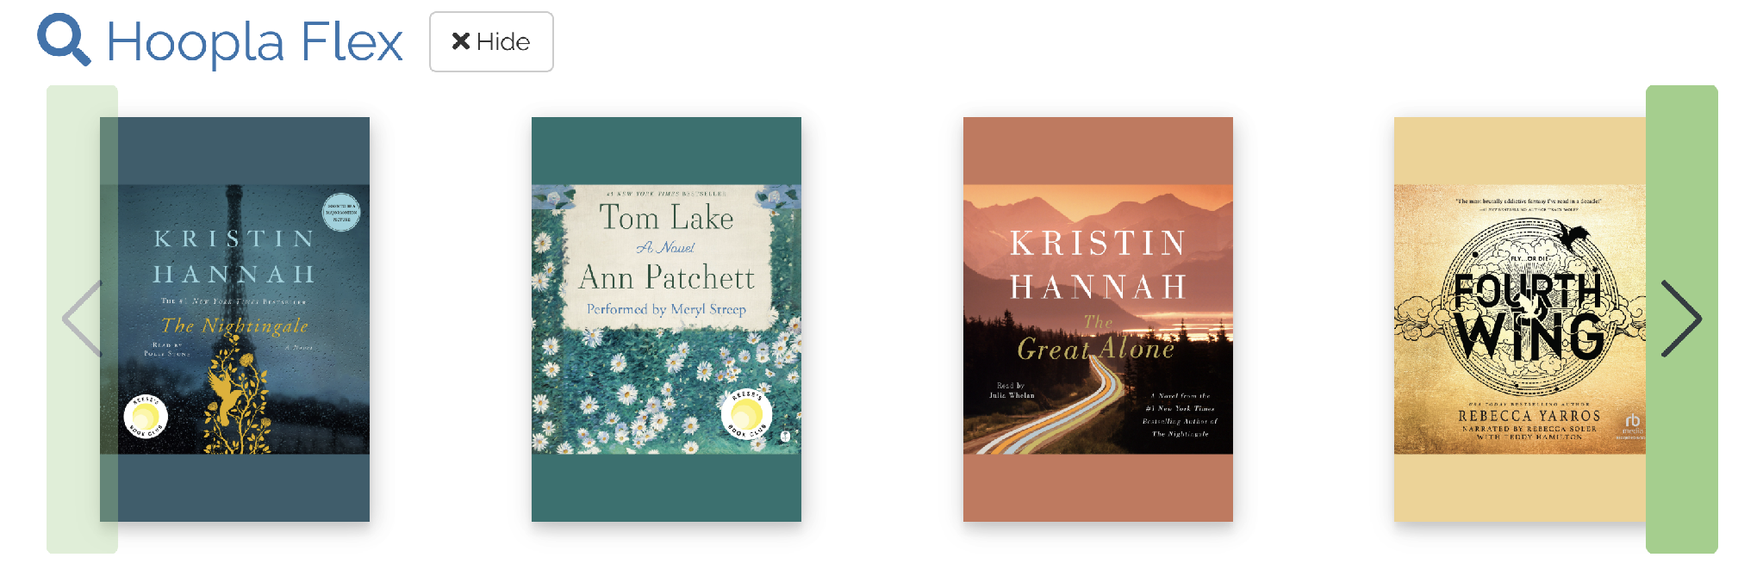
How can I showcase my Flex collection?
Browse categories support discoverability and full use
Browse categories can be created from a list or a search
Handy tip
Lists are stored in My Account > Your Lists
Export Flex ISBNs from the Hoopla overall circulations report, load them into a list, then add it to browse
Find every browse category you’ve created in Local Catalog Enrichment

Slide 9


02
Make data-driven decisions

Slide 10

Make data-driven decisions…
Get the whole story with Aspen and Hoopla reports
Aspen reporting covers catalog activity and points users to partners for everything else
Hoopla offers 20+ reports using your library’s data

Slide 11
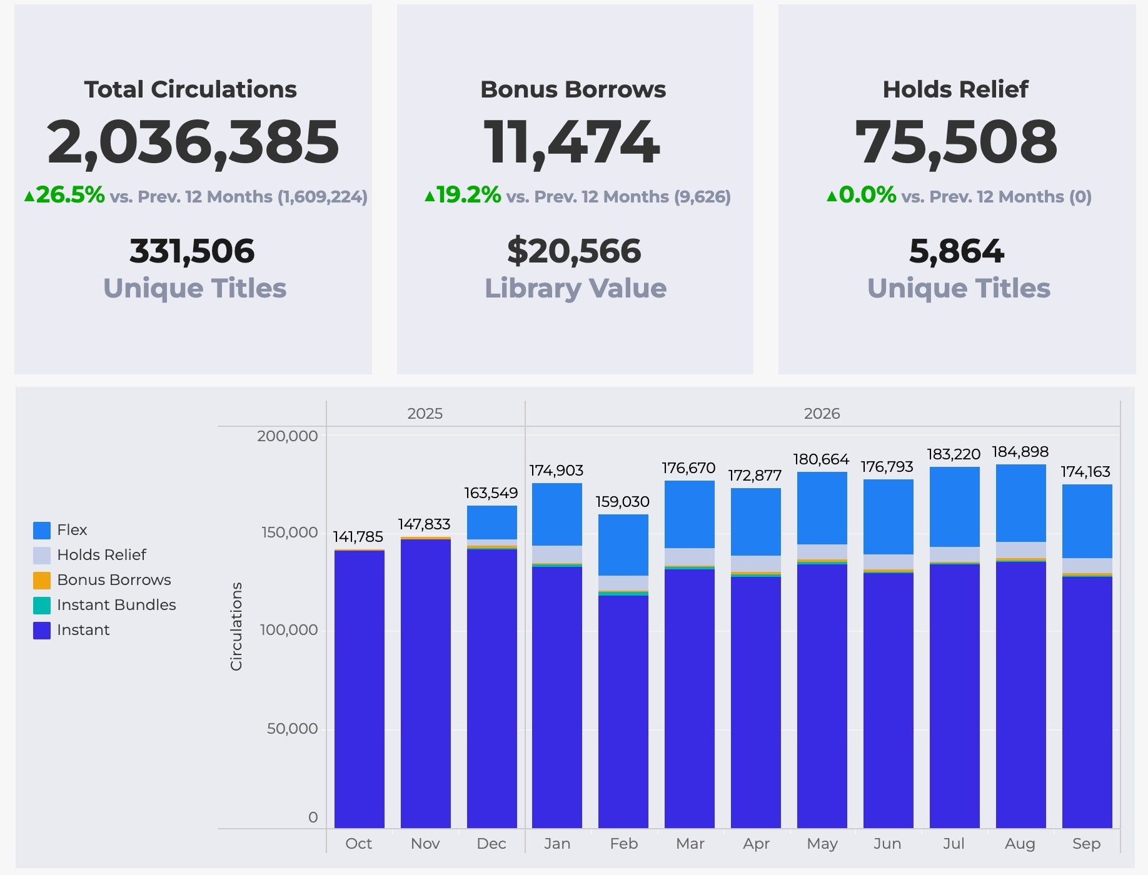
Make data-driven decisions…
…based on what’s circulating
Hoopla reporting: circulation reports
See how your digital collection performs with customizable circulation and title reports for Instant, Flex, holds relief, and Bonus Borrows
Rank circulations by title and spot trends by language, audience level, publisher, and more
Custom date ranges and filters, with CSV and PDF downloads

Slide 12
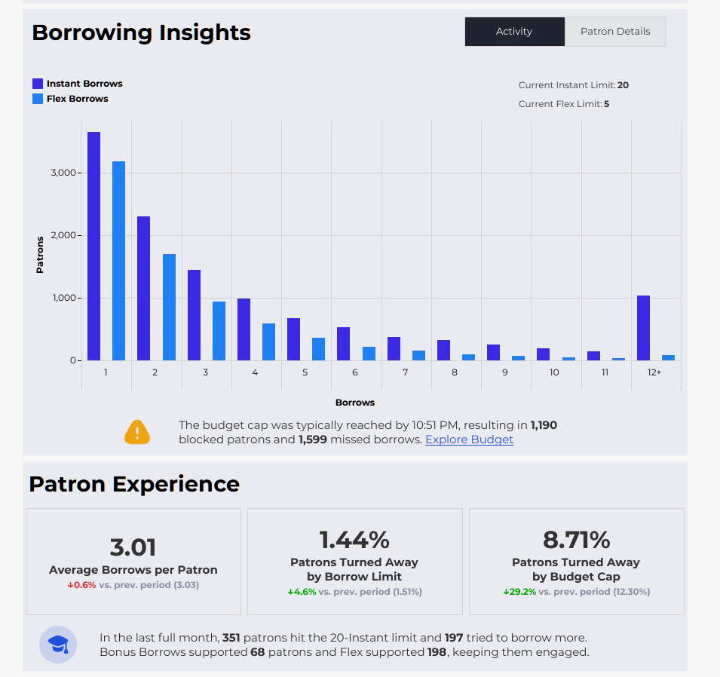
Make data-driven decisions…
…with patron borrow reports
Hoopla reporting: Patron Borrows report
New
Ties borrowing across Instant, Instant Bundles, and Flex to provide true cost per circ and per patron
Includes the cost calculations to help libraries make apples-to-apples comparisons with other platforms
Shows how many patrons hit borrowing limits or budget caps and how Bonus Borrows and Flex keep them connected

Slide 13
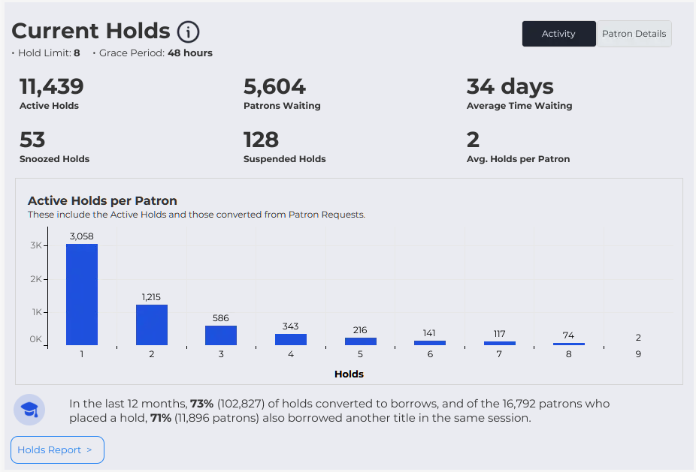
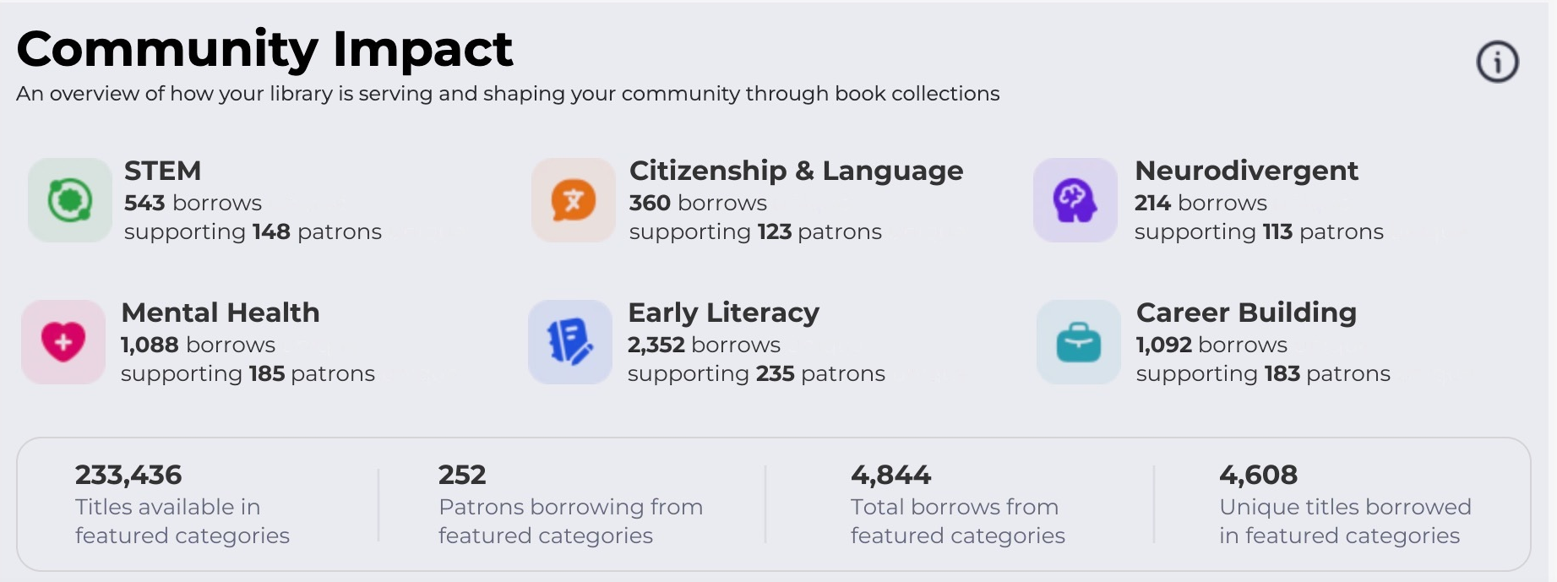
Make data-driven decisions…
…with patron behavior reports
Hoopla reporting: Patron Behavior report
New
A near-real-time view of what patrons borrow, when, and on which devices
Flags where holds pressure is building, and where an Instant Bundle could beat pay-per-use
Shows community impact in areas like STEM, early literacy, career building, and mental health (great for board conversations!)
Consortia can compare trends across member libraries

Slide 14


03
Align your catalog settings

Slide 15
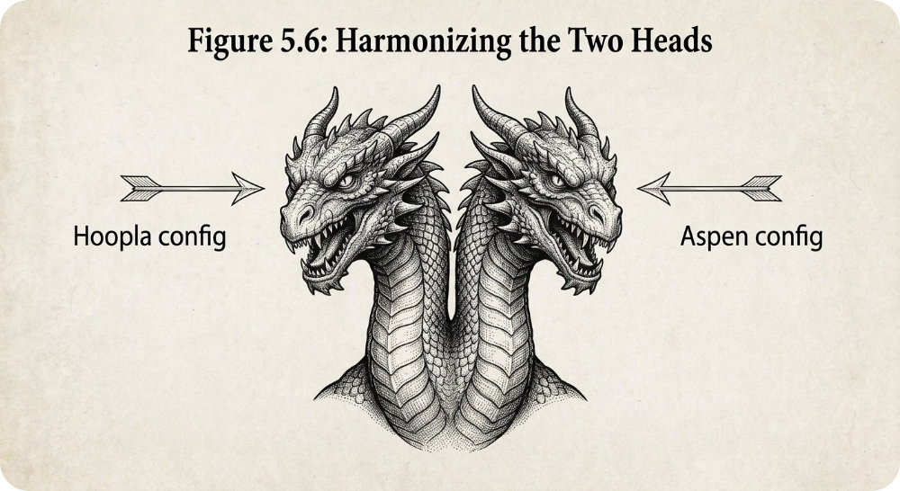
Aspen and Hoopla settings work together
Why does this matter?
Adjusting your settings improves discoverability
Which settings belong on the Hoopla side, and which on the Aspen side?
When should I adjust my settings?

Slide 16
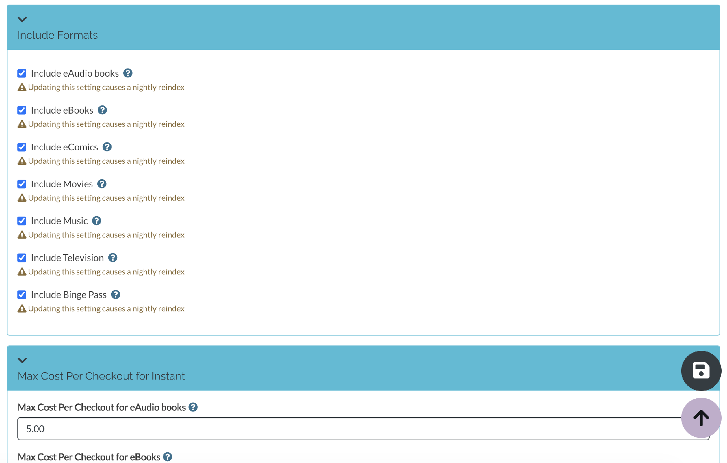
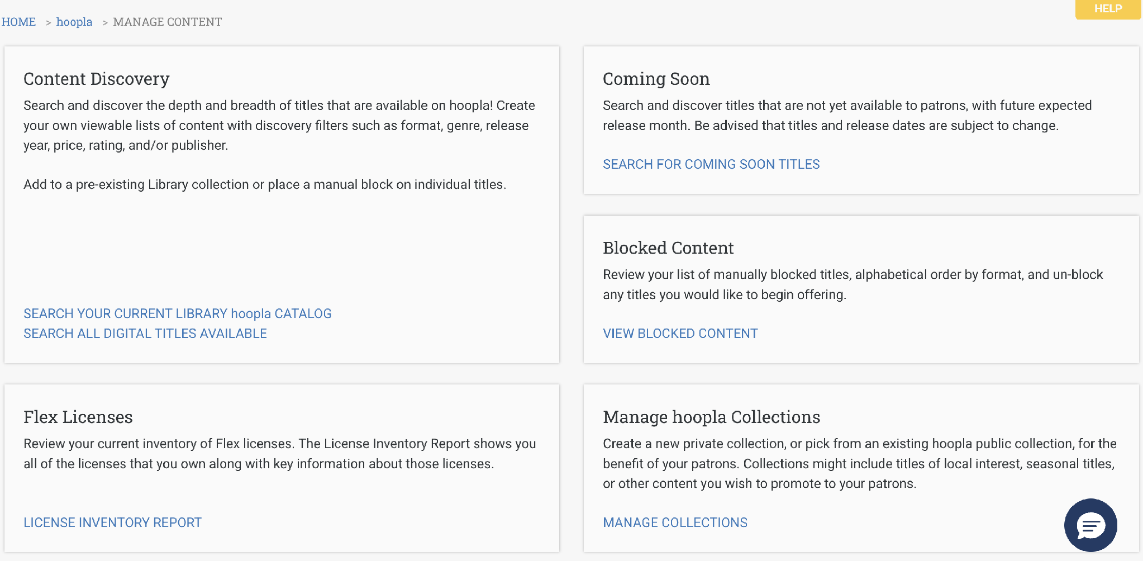

Which settings should I check?
Aspen scopes
Formats
Cost per checkout
Hoopla Admin
Formats and price caps
Reach out to your Hoopla Specialist
Titles can be blocked in eComm
Monitor your settings quarterly

Slide 17



