Slide 1
Classification of Anti/Pro Vaccination Images using OCR in Python
Colin Williams

Slide 2
Starting Data
Data set consists of various images gathered from the internet concerning the use of vaccinations
Images are classified as “pro-vaccination” or “anti-vaccination”
Goal is to extract the text from each image to use for classification

Slide 3


Preprocessing
Various text files included have been removed
Using cv2, image is read into Python
Image is then converted to Greyscale and smoothed
This image is then saved to a new file and PyTesseract is run
If text is found, it is added to a data frame
Final data frame includes the image path, text from PyTesseract, and the class label.

Slide 4
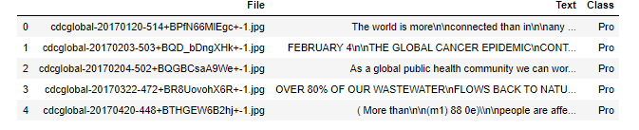
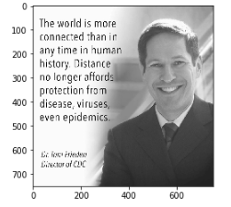
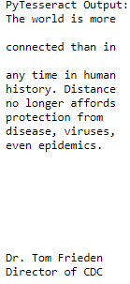
Data Entry
PyTesseract Output
Image

Slide 5
Preprocessing Continued
Transformation into feature vectors
Bag of words approach
Create a dictionary of words and the number of occurrences of that word
Term Frequency times Inverse Document Frequency
Data now consists of features to be used in classification

Slide 6

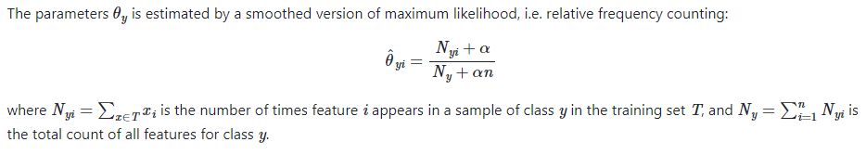
First Method
Sklearn Pipeline
Sends data through the CountVectorizer and TfidfTransformer to obtain features, then through MultinomialNB for classification
Multinomial Naïve Bayes method:

Slide 7
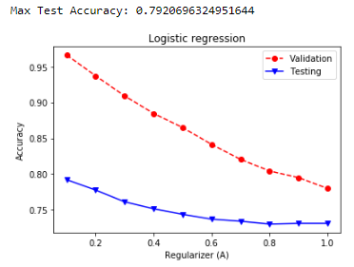
Result

Slide 8

Second Method
Sklearn Pipeline
Sends data through the CountVectorizer and TfidfTransformer to obtain features, then through Logistic Regression for classification

Slide 9
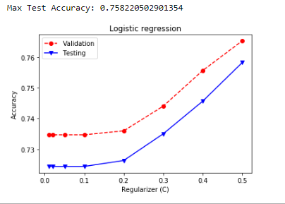
Result

