Slide 1
Thesis Prospects
By: William Poole

Slide 2
Main Concepts
MATLAB and Prediction
Power Supply {and its effects}
Solenoid properties {Cross section and effects}
Armature Properties {Shape and material}
# of stages
Parasitic parameterization

Slide 3
Aside on Initial Predictions
To begin this process I started by creating 3 matlab files:
B-Field calc | generates 3d map of B-field
Force calc | generates force at a distance from solenoid
Kinematics | uses a plot of data points of force to determine projectile timing

Slide 4
Assumed details
Projectile shape: Cylinder | This can be changed to Hoop to maximize Force to Mass ratio | [1/4 diameter x 3.25-inches iron {0.14in^3}, density 0.284lb/in^3 {0.0412lb or 18.7g}, magnetic moment 4.89J/T]
Barrel ID is 3/8 best shape would be 1/4in to 3/8in as to avoid uniform field in the center
Solenoid Design: Wire gauge 16awg, number of layers 5, 200 turns
Many issues to be optimized here, though the field needs to be as compact as possible to maximize Force output. Though, the issues is that a infinitely dense solenoid has the issue of infinite resistance.

Slide 5
MATLAB and Prediction
I believe this mill be the main crux of the capstone. This will use 2 software programs to determine the following:
Microcap: This will be for getting the current and circuit properties
As well as modeling parasitic if we get to measuring them
Inductor AC rejection,
MATLAB: This will be for modeling various aspects of a solenoids

Slide 6
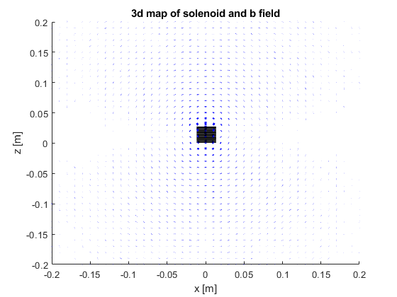
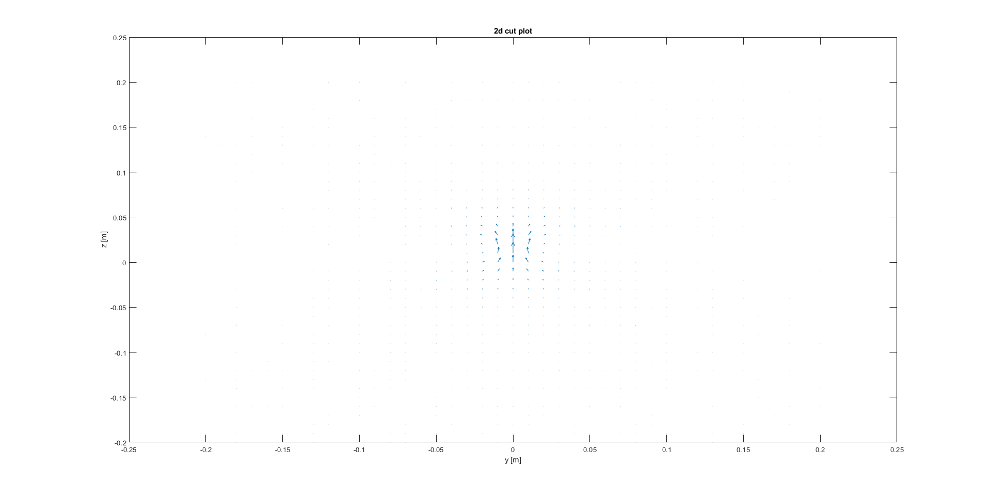
Current State of MATLAB Files
This initial model was done to get timing of the on-state of the circuit
The B-Field modeling needs to be optimized however, it generates an accurate model of the B field and a 2d profile for review.

Slide 7
Error Check B-field
Single Loop, 30a, at 0 at 10mm height, radius .5 inches
Equation Referenced 5.31 with u0 as a multiplier
Original Code had issue deriving new solution.
New files Shape_Maker and Field_Maker generated for doing math, Field_Maker has an issue of vector placement

Slide 8
Power Supply
Requirement DC source:
Options Initial
Battery Bank:
Issues of voltage delay due to Passivation {chemical reaction clogging}
Capacitor Bank:
Issues of total energy storage
E=C*(V^2)/2

Slide 9
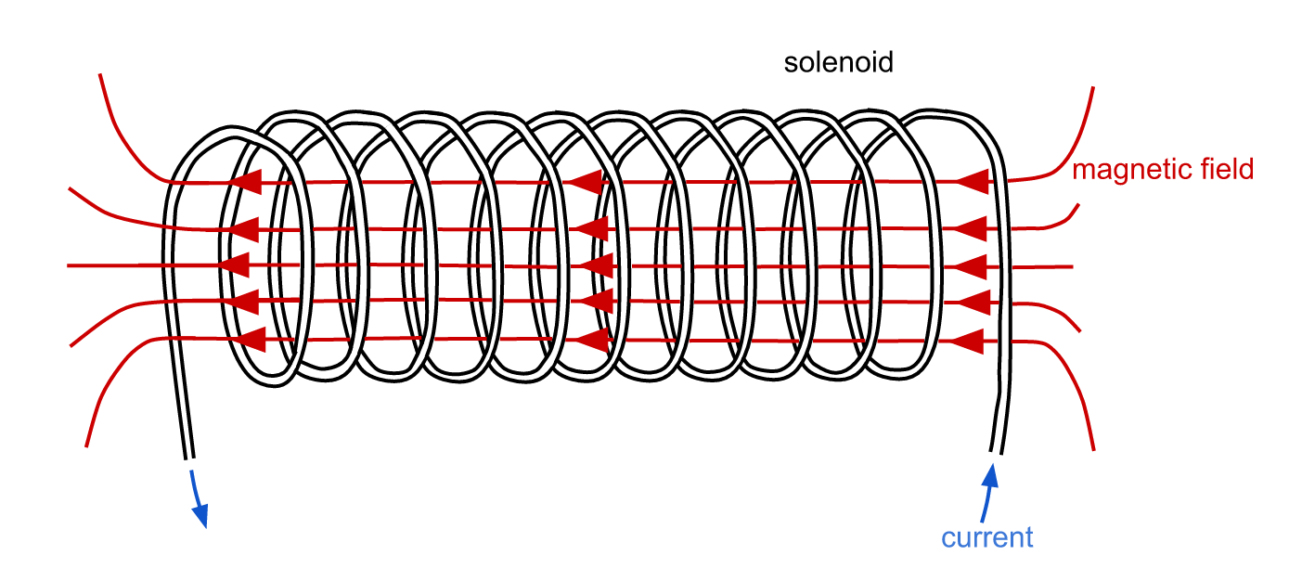
Solenoid B field
The main generation of force comes from the B-field through the Lorentz Force [F_m=qv-> x B->] however, knowing the charge per slice of material is difficult. So, a unit like magnetic moment is necessary, which is a material property which gives per slice J/T of a magnetic material. U=M->*B->cos(Theta). The derivative of this per unit distance is force which is then used to get acceleration.
The goal of this design is to get the most perpendicular B-Field, with the largest magnitude, to the smallest mass, for highest speed.

Slide 10
Armature
Shape:
To get maximum force the center of the solenoid is to be avoided as field parallel to the velocity does not generate lateral force.
Material:
Iron - 4.87 J/T or Am^2 -> {j=kg*m^2/s^-2/T=Wb/m^2}
Looking at something like Alnico 5 to determine its properties for this calculation \ Magnetization and determining magnetic moment
Using B=u0(H+M) and m= ∫ ∫ ∫Mdv
Based of this document as well

Slide 11
# of stages
This a simple concern as the effective things we could measure here are the following:
Speed boost per stage
Timing influence
Overall power draw per stage
Efficiency per solenoid added to speed outputted

