Slide 1
Power Supplies Decision Matrix
By: William Poole

Slide 2
How this Decision Matrix Works
Eliminatory Vs Ranking Only:
This is a category for determining if a solution can work [Eliminatory] or determining if one solution works better than another [Ranking Only]
Criterion:
These are aspects of the solution such as mass or cost that are tied to the final decision
Threshold
Max or minimum rating to allow a part
Score
Rating of solution in each criterion

Slide 3
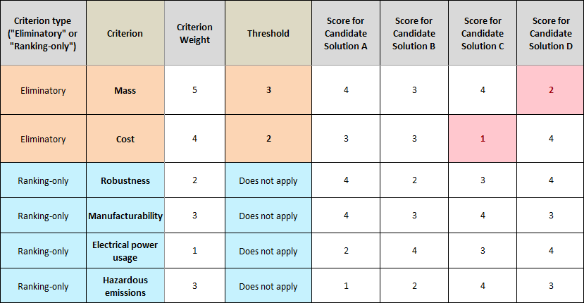
Example

Slide 4
Initial Criterion
Cost
Reaction Time
Voltage drops/Current Drops {capacitor voltage discharge or battery voltage delay}
Transient Effects
How bad does the reaction details affect the circuit
Simplicity
How easy will it be to install, fab, and operate
Charging
Charging time

Slide 5
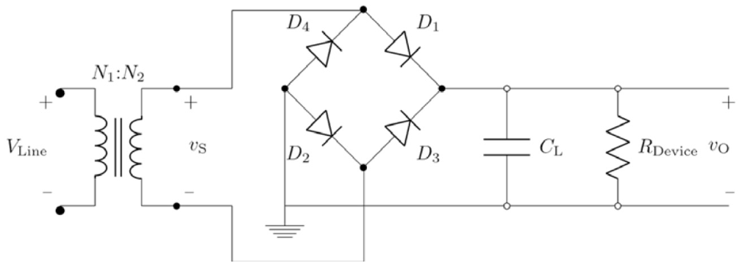
Choice 1 : AC-DC for Supply
AC-DC converter
AC power -> Through Full Bridge Recitifier -> Smoothing Capacitor -> Bleed Resistor -> ~DC Load
Not going to do linear regulator due to high current

Slide 6
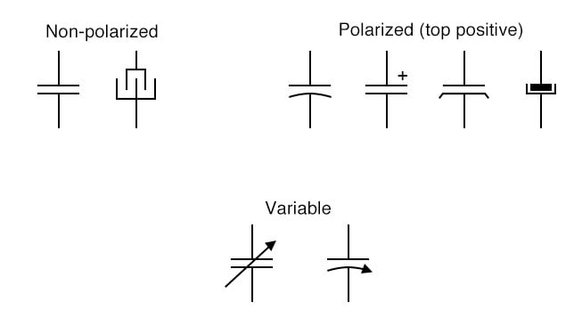
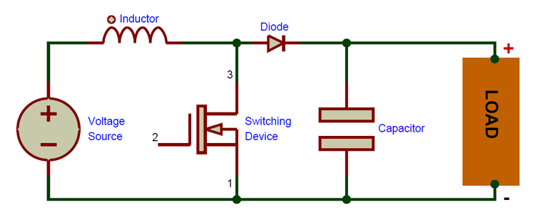
Choice 2: Capacitor Bank
This is an energy bank that uses a large effective capacitance value to store and supply energy out.
Likely would use boost converter to power device

Slide 7

Choice 3: Battery Bank
A large battery would be used to store and distribute energy out

Slide 8
Notes on Choices
Choice 1 and Choice 2 are similar:
Choice 1’s full bridge rectifier would be Choice 2’s boost converter
Choice 1 would simply use the capacitor bank as its smoothing capacitor
Main difference is that a boost converter would be power limited by design
A full bridge rectifier will blow itself easily if not protected or tied with an un-disconnect-able resistance
Choice 3 is unique due to its theoretical ability to supply near linear DC power

Slide 9
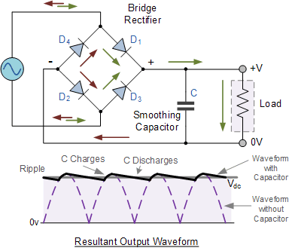
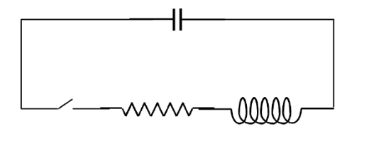
Choice 1: Properties
Full Bridge:
This device aims to use a smoothing capacitor to flatten the AC wave at the output
Capacitor Bank:
This is dependent on whether the supply is connected to the system.
Big decision there but will be an C discharging through an LR circuit
With or without the attached supply

Slide 10
Choice 1: Reviewed
Pros:
Supplied in operation
Theoretically never stop AS LONG AS supply power > Power Draw
Simple
Cons:
Large Capacitor Bank [$$$]
Ripple or drop is dependent on capacitor bank draw and power supplied
High Power diodes cause a voltage drop
Insignificant however at 2-10V

Slide 11
Choice 1: Problems
Full-Bridge Rectifier Price Vs Current
300A -> $79.14 100A -> $38
Reverse voltage concerns 1.6kV -> 1.6kv [Good here unless charging up to 1.6kv]
Vforward 1.7V->1.51V
Power/Heating P=VI | 2(1.7V)300A=1.02kW -> 2(1.5V)100A=300W
{Planning 30A@~60V} ~ 35A->600V->1.1V->66W
Capacitor Bank
Energy is based on voltage E={1/2}(c)(V^2), High Voltage costs more and more capacitance cost more
Low voltage is easier and safer but, leads to more capacitance [$$$]

Slide 12
Choice 2: Properties
Full Bridge:
This solution uses a boost converter to charge the capacitor bank
Capacitor Bank:
This is dependent on whether the supply is connected to the system.
Big decision there but will be an C discharging through an LR circuit
With or without the attached supply

Slide 13
Choice 2: Reviewed
Pros:
Supplied in operation
Theoretically never stop AS LONG AS supply power > Power Draw
Simple as boost converter will be purchased or based on existing design
Cons:
Large Capacitor Bank [$$$]
Ripple or drop depending on power supplied through boost-converter
Diode to capacitors do cause a voltage drop.

Slide 14
Choice 2: Problems
Boost converter Price Vs Current
Not terribly expensive but still around
Capacitor Bank
Energy is based on voltage E={1/2}(c)(V^2), High Voltage costs more and more capacitance cost more
Low voltage is easier and safer but, leads to more capacitance [$$$]

Slide 15
Choice 3: Properties
Battery would be used to simulate a pure DC source
Review problems from here

Slide 16
Choice 3: Reviewed
Pros:
Will most likely be a large energy source
So that charging will be done out of cycle
Simplest
Disconnect to charge
Connect to supply
Cheapest
Unless something needs to be added
Cons:
Large Battery [$$]
Drop is dependent on battery parameters
Diode to circuit causes a voltage drop

Slide 17
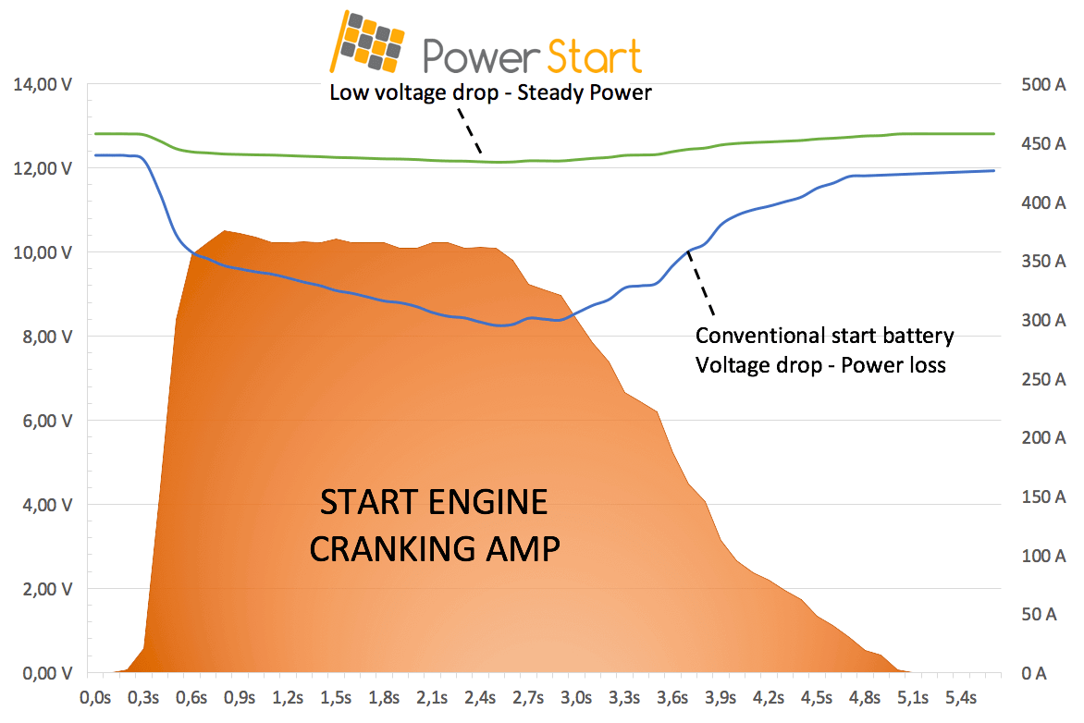
Choice 3: Problems
Batteries are a chemical system that uses reduction and oxidation to supply a load
I presume that this has a delay in its output power
It does and its solved by area in the battery
Ideally a starter battery {designed for short burst high current output}
Or somehow doing a hybrid setup [Battery+Cap]
Likely infeasible by themselves as response times on cranking batteries are 100s of mS

