Slide 1
High Speed High Power Circuit For Solenoid Control
By: William Poole

Slide 2
Why is this necessary?
When operating a coil gun there are 2 main faults:
The current damages the devices nearby {heat or arc}
The solenoid remains on to long {induction heater or backfires}

Slide 3
Overcurrent or Overload
In the event of overcurrent, like a capacitor bank discharging, the devices in the path receive an amount of current above their ratings causing overheating which may cause instantaneous damages.
Similar to what happens when you tap the leads of a charged capacitor with a screwdriver
Overload is similar, a device is outputting current above the devices rating however this long term current does not damage the device instantly rather over time causing damage to more parts in the system.
Similar to an air hose in a bottle, slowly expanding till it bursts, destroying the bottle and your ears.

Slide 4

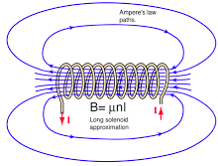
Timing
When a solenoid operates the B field that wraps around it cause the force generation by the Lorentz force. So, once the objects “center” passes the halfway point the force becomes opposing and the outcome of this becomes an issue.

Slide 5
Too Long and Way Too Long?
If the solenoid is left on for ~1ms too long past the center point, the solenoid will apply a force to opposite to the velocity slowing the projectile down.
Or, if it is left on way too long past ~1ms the projectile may be dragged back into the solenoid. If the solenoid releases at the worst time it fires backwards. If it doesn’t the worst outcome happens of turning the system into an induction heater.
This would pour power into the projectile and the solenoid causing both to heat effectively overloading.

Slide 6
How to prevent this
Slow timing and LONG projectiles
This is not an ideal solution as longer projectiles will generate more drag and require more energy to reach similar speeds ignoring inefficiency.
Also, the velocity will likely be reduced
Technically could determine position as it crosses the middle and disturb the solenoid windings. Also not good
Design a fast circuit
Technically complicated and harder to install. However, these will make the system theoretically better.

Slide 7
Design Theory
Solenoid is made of 16awg wire-> 200 wraps -> 5 layers
*16 awg offers the best of size, resistance, and heat stability out of the sizes at around 30amps for 100ms {solenoid excel sheet}
Going off of this the solenoid length is ~2inches long
0.00508in diameter*40=2.032
->choosing projectile length of 3inches to allow 1/2inch distance of detection

Slide 8
Estimates before entire process
Peak speed: 60m/s
Detection distance desired 1/4inch [6.35mm]{aiming short of sensor spacing}
Total allowed time: 6.35[mm] / 60 [m/s] -> 105uS

Slide 9
Timing devices
As the projectile is the object which determines the solenoid’s states it cannot maintain a signal to a device.
Like how a hand does not stay on a light-switch as it turns it on. This a latching circuit, which is to be replicated.
To make a device stay on from a pulsed input there needs to be a latching device. This device takes a signal and with that signal locks or powers itself into a state where it maintains a desired output.

Slide 10
Timing Design
To detect a solid object such as a coil gun’s ferrous projectile through a barrel an optical sensor was selected.
Through trial and error the chosen device was a photo-interrupter [LTH-301-32] not a photoelectric switch {to slow 0.5ms}
To interact with this device 2 other devices where used to communicate the pulses:
An inverting buffer [powers and resets the thyristor]
A thyristor as a latching device

Slide 11
Why a thyristor
Cheap at around 66cents
Fast around 20us
simple

Slide 12
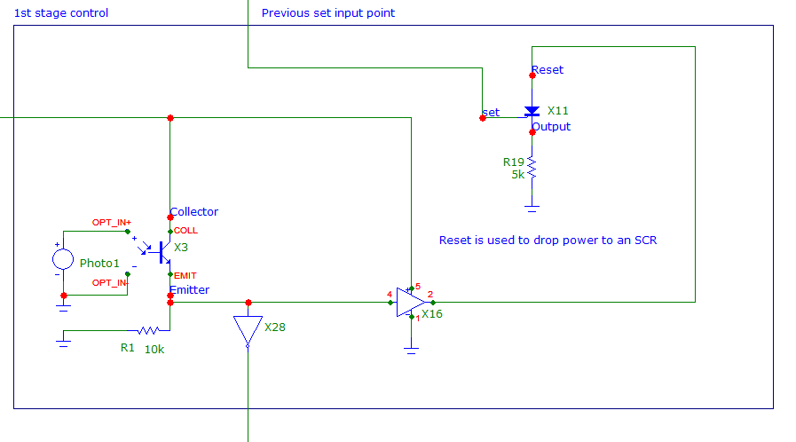
Circuit design
Optical sensor has become a photo interrupter and is shown below

Slide 13
Function
While circuit is normally on {light is not blocked} there is flow through the photo-transistor
This means the emitter is at a voltage >0V held there only by the Vbe drop of the bjt/phototransistor ~4v
Once the light is blocked {projectile in position} the circuit becomes an open the emitter voltage drops to 0V at the slew rate or response time of the BJT. [~90% drop is 4V to 400mV is 15us]
This drop then goes to the set and reset paths neccesary

Slide 14
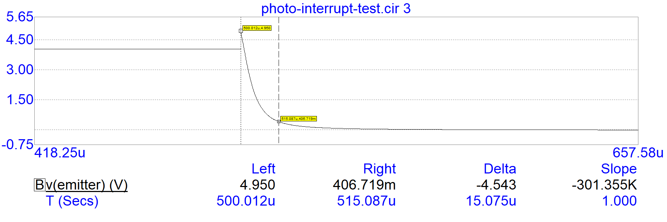
Photo-transistor Drop time

Slide 15
Set and Reset
This signal drop goes to buffers which have a response time in the nS range.
Set->1us
Reset emitter drop is at 500uS, reset dropped to 10% original at 515.37u
Likely slew rate for reset signal is the limiting factor

Slide 16
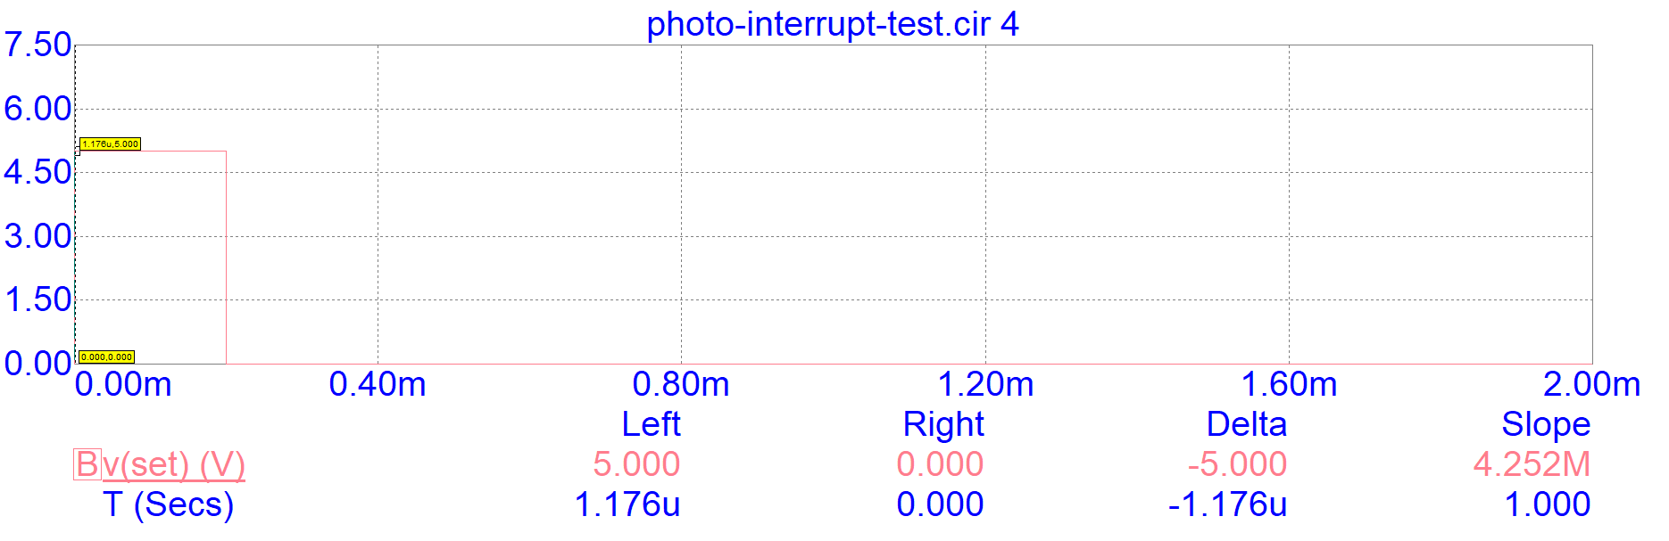
Set Signal

Slide 17
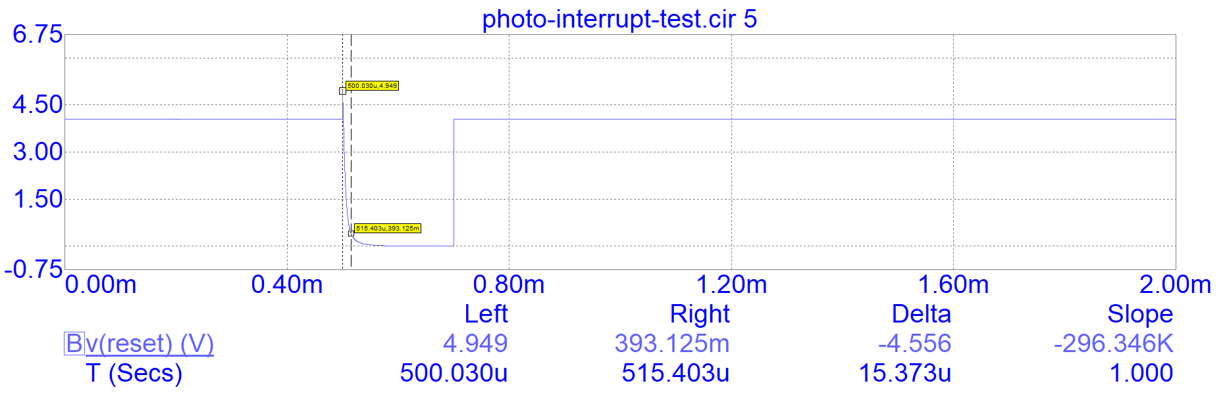
Reset Signal

Slide 18
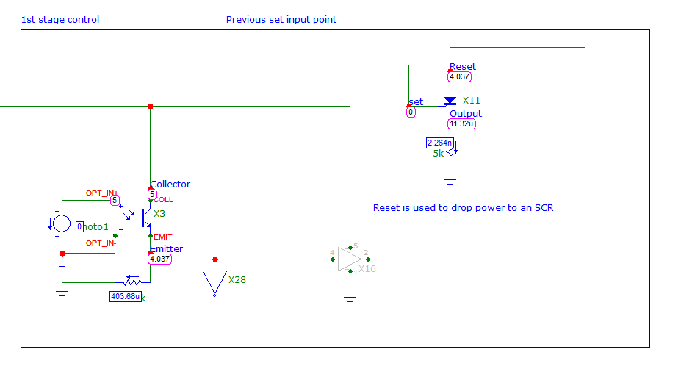
Reset speed increase

Slide 19
Drop the reset buffer
If the reset buffer is dropped the signal will propagate at the speed of the emitter resulting in a reset time to the thyristor of 15uS
CONCERN the current through the device may not be enough to latch the thyristor. Review Current Holding of the Device and Current allowed through Photo-Transistor

Slide 20
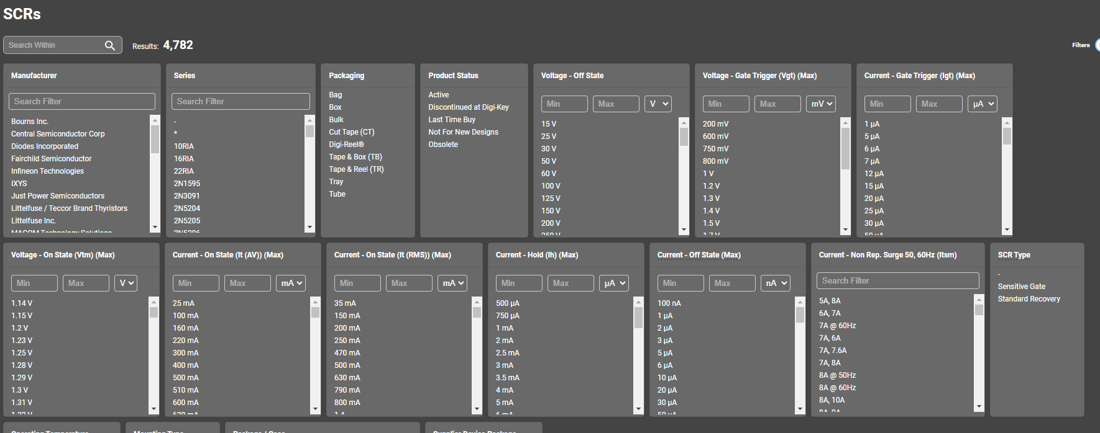
Holding Current

Slide 21
Set and reset now go to the latching device
Set goes to the gate of the thyristor and causes the device to become powered changes PNPN junction to PNNN junction effectively a diode
Reset is a signal that normally supplies the thyristor but once the projectile reaches the optical sensor
This resulting signal is the output
Set time is 2.61u
Reset time is 504.132u [10%]

Slide 22
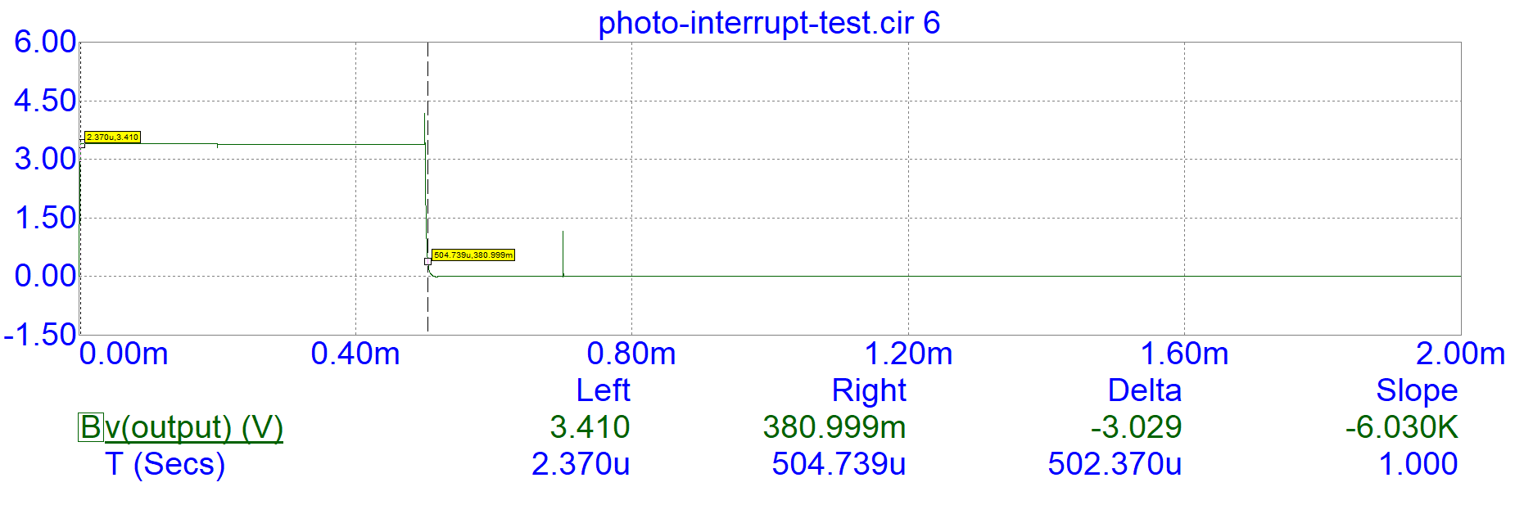
Output Waveform

Slide 23
Output noise
Previous noise signal was done without tying it to a power MOSFET or IGBT. When it is tied however there is a lot of noise.
This was fixed by dropping the resistance with the thyristor giving it more holding current.

Slide 24
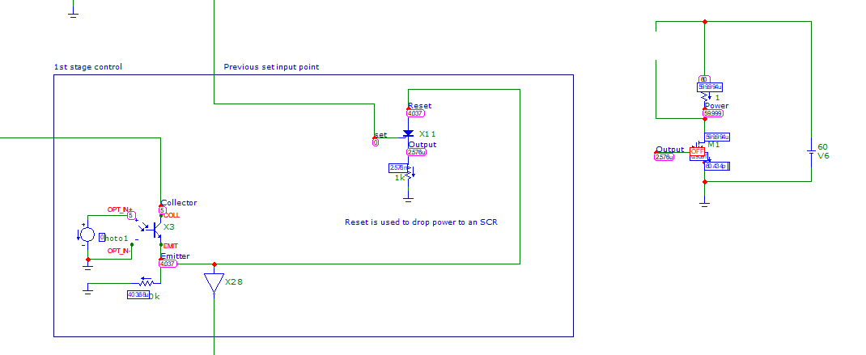
Issue with power mosfet
Vt0 is 3.5V output voltage is 3.48V
Power mosfets will not turn on

Slide 25
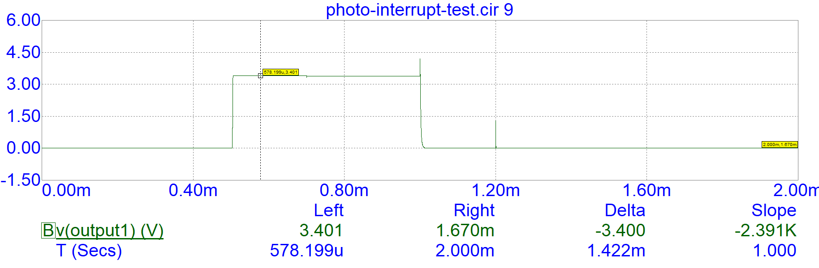
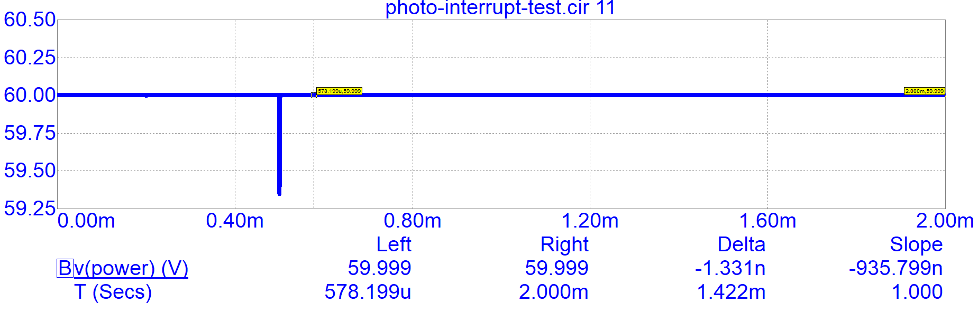

Slide 26
Feedback Issues
There was a spike in the signal in testing that may need fixing could use a high speed comparator to reduce this problem

Slide 27
Solved and Optimized
Dropped photo interrupter resistance:
Thyristor latches now
More current to supply devices
Power Mosfet Swapped to lower Vt0 model

Slide 28
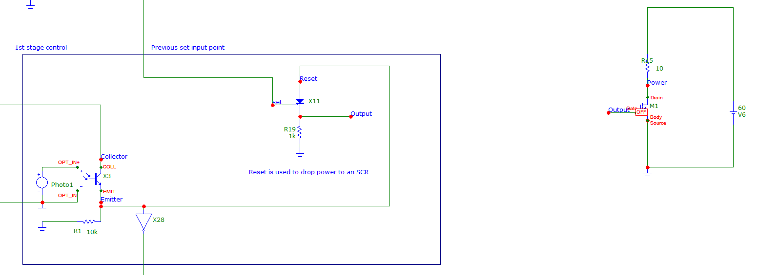

Slide 29
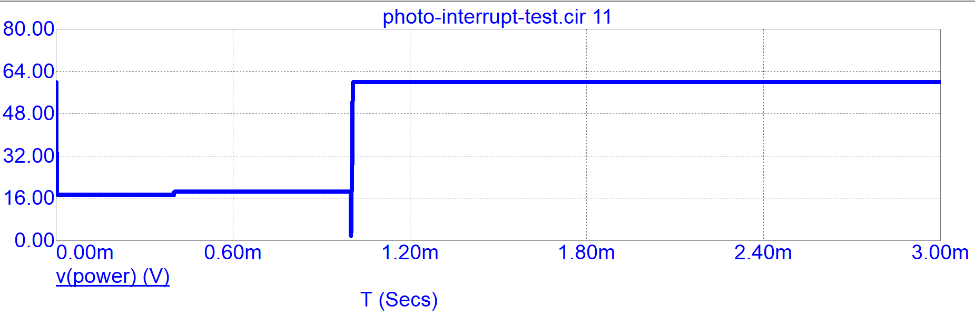
Power output [indicates current flow with V drop]

Slide 30
IGBT Issues
When I got the power-mosfet working
The IGBT also worked but here is a major issue:
They are power dependent at the input
A 120A model IGBT has a switching energy of 227µJ (on), 100µJ (off)
Power output of control circuit estimate peak is ~5v*20mA=0.1watt [J/s]
227uJ/0.1[J/S]=2.27ms which is too long
2 paths here, use power MOSFET or high current output device/add higher voltage [use a power MOSFET to turn on an igbt]

Slide 31
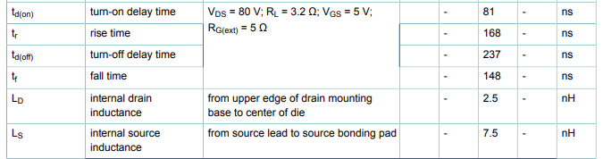
Power MOSFET
A Power-MOSFET at the same current rating of 120A
Lower voltage rating 100V vs 650V
Has a Vgs of 2.1V making acceptable to use here
Delay time of 81ns and rise time of 168ns -> 249ns

Slide 32
Power MOSFET to IGBT
Utilizing a cheap power MOSFET and some resistors a solution is approachable
Using a Power MOSFET
With Vgs<5V ideally <3V
VDSS >60V {battery concept check or low voltage}
The response time out is still ns but with higher current the energy requirement of a IGBT is solved
Issue becomes biasing as the voltage is higher but current starts becoming an issue and vgs

Slide 33
Power MOSFET
Bad idea as VGS is limiting here as if Vg=5v Vgs=2v only have 3v left to operate system
All IGBT VT ~>=5V
CMOS also doesn’t work

Slide 34
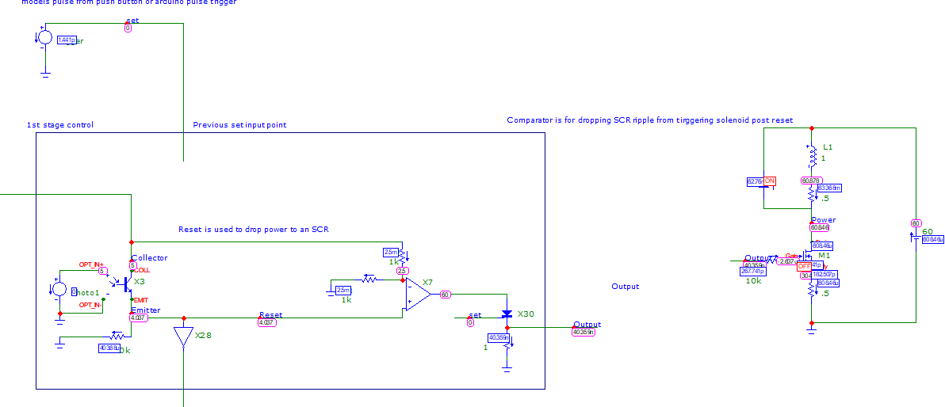
High Voltage amplifier
Using higher voltage through the SCR should allow more energy into the IGBT as well as allowing high current through an SCR
Theoretically do some PMOS shenanigans but probably SCR with resistor is the best

Slide 35
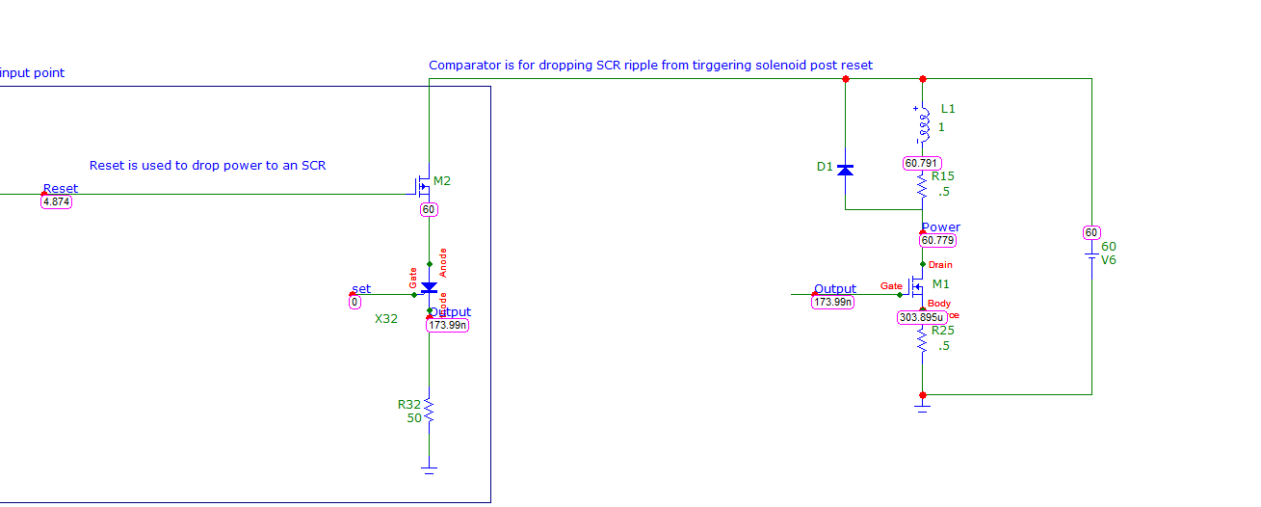
Thyristor at high power
Something here was limiting output voltage to ~5v

Slide 36
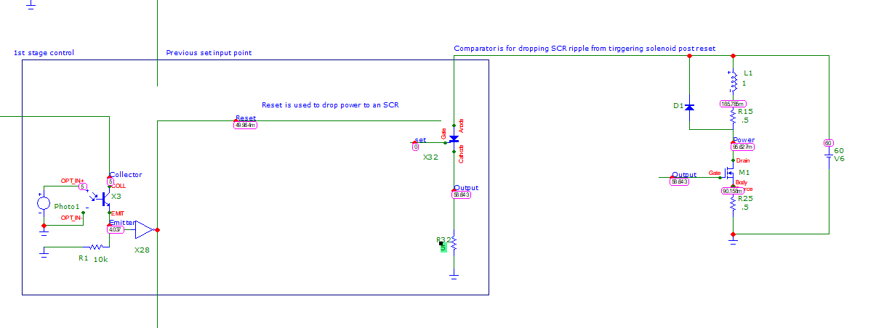
Attempt at fixing thyristor
Dropping the PMOS allows for high voltage only at high current

