Slide 1
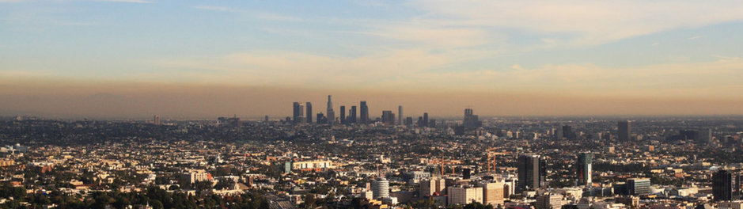
GENERAL ASSEMBLY – DC DATA SCIENCE 22
POLLUTING WEATHER
Will Rosenfeld
November 2017
Los Angeles, CA
Notes:
Note the grey layer lying above the skyline
Source: http://www.govtech.com/fs/perspectives/LA-Air-Pollution-May-Become-Worse-as-Partisanship-Overruns-Air-Quality-Panel.html

Slide 2
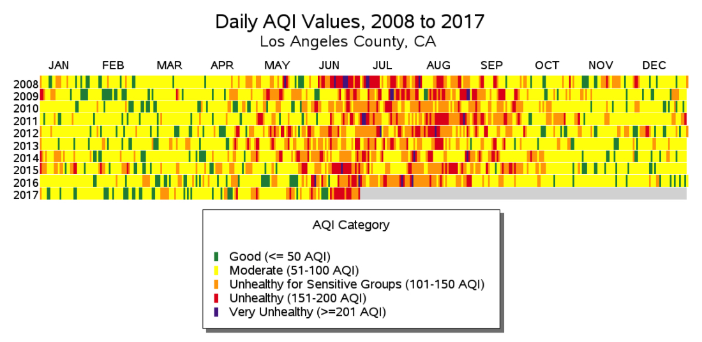
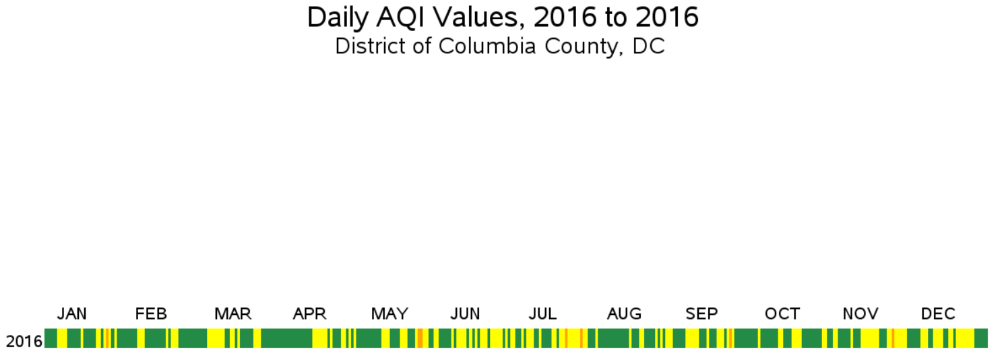
How predicable is air quality? Is it driven by weather?
Problem Statement
Poor air quality is a serious public health issue in Los Angeles
Key questions
How much does pollution (AQI) depend on weather?
How predictable is the Air Quality Index (AQI)?
Notes:
DC shown as an example of a more typical US city

Slide 3


Collected data from EPA and NOAA
Data Acquisition
Data used for this analysis came from publicly available government data resources
Category | Fields | Source
Target | Air Quality Index (AQI) | EPA
Pollution | Lagged AQI Lagged O3, NO2, CO, PM12, PM25 | EPA
Weather | Temperature Precipitation Wind | NOAA
Date | Year Day of Week | n/a
Sources
Environmental Protection Agency (EPA): Data Access | Documentation
National Oceanic and Atmospheric Administration (NOAA): Data Access | Documentation

Slide 4
Time series considerations
Cross Validation
Time series analyses require a specific type of cross validation
Process
Split 1: train on 2008, test on 2009…
Split 4: train on 2008 to 2011, test on 2012… (seen below)
Validate final model on 2016
sklearn.model_selection.TimeSeriesSplit
Notes:
Note: This is the process I used but shifted back 6 months. Explained this way for simplicity purposes.

Slide 5

What is the Air Quality Index (AQI) made up of?
AQI Components
O₃ : Ozone is caused by vehicles and factories
PM_{2.5} : Fine particulate matter such as soot
PM₁₀ : Large particulate matter such as dust
CO : Carbon monoxide is caused by vehicles
SO₂ : Sulfur dioxide is caused by power plants
NO₂ : Nitrogen dioxide is caused by vehicles
LA AQI Pollution Drivers
AQI Calculation
Normalize for health impact and select maximum
Notes:
http://www.economist.com/node/21666226/all-comments?page=1

Slide 6
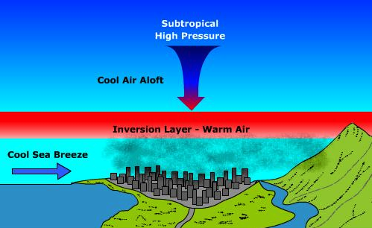
1. Impact of Weather on Pollution
Literature Review
Wind
Westerly sea breeze from the west traps pollution in place between Pacific Ocean and San Gabriel Mnts
Temperature
Sub-tropical high pressure system prevents clouds and creates a temperature inversion and smog
Precipitation
Rain droplets attract aerosols which improves air quality (and pollutes ground water)
Notes:
Diagram Source: http://www.earthonlinemedia.com/ebooks/tpe_3e/circulation/air_pollution_and_global_pressure.html
Precipitation Impact: http://news.mit.edu/2015/rain-drops-attract-aerosols-clean-air-0828

Slide 7
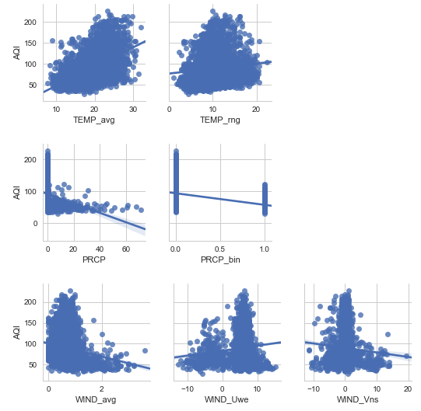
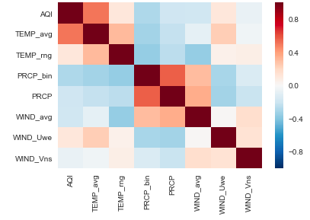
1. Impact of Weather on Pollution
Feature Selection
High temperatures lead to worse pollution (omitted variable issue!)
Rain leads to less pollution (in air not ground water)
Temperature
Correlation Heat Map
Importance
Precipitation
Wind
Notes:
Omitted Variable Bias Issue: Lack of atmospheric temperature data leads to the faulty conclusion that warm air causes pollution. In fact, summer leads to warm air and the movement of the eastern Pacific subtropical high. In summer, temperature inversions actually lead to relatively colder air and smog.
VARIABLE DESCRIPTIONS
TEMP_avg = Average of maximum and minimum temperature (Celsius)
TEMP_rng = Range of maximum and minimum temperature (Celsius)
PRCP = Daily precipitation fall (Inches)
PRCP_bin = Binary indicator of precipitation (1 = yes)
WIND_avg = Average daily wind speed
WIND_Uwe = West to East component of wind for peak 5 seconds
WIND_Vns = North to South component of wind for peak 5 seconds

Slide 8
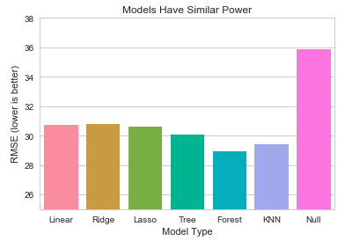
1. Impact of Weather on Pollution
Model Selection
Optimized models
Utilized piping, grid / randomized search, and standardization
Selected decision tree
W/ max_depth of 17 and min_leaf of 28
Due to dynamics of predictability vs explainability tradeoff
Lift

Slide 9
2. How Predictable is Pollution?
Feature Engineering
Historical Air Quality Index (AQI)
Lagging the target variable (AQI) and its components serve as extremely useful predictors
Exponentially smoothed versions were not useful
Historical Weather
Due to lack of historical weather forecasts I use non-lagged historical weather since 24hr weather forecasts are accurate (not ideal)
Date Features
Year, Day of Week, Week, Month
Multicollinearity
Not a serious issue since we only want predictability not explainability

Slide 10
2. How Predictable is Pollution?
Feature Selection
Lagged AQI dominated
Ozone is the most common pollutant
Weather still useful
Particularly temperature
Weekday relevant
Vehicle pollution
Importance
Importance

Slide 11
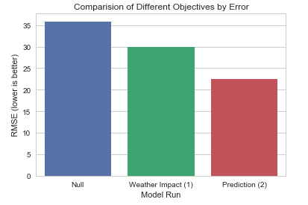
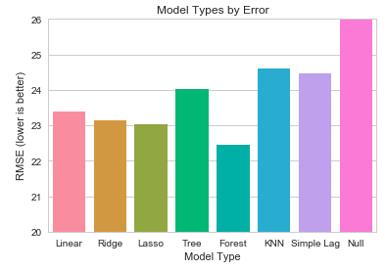
2. How Predictable is Pollution?
Model Selection
Simple AQI lag is powerful
Selected random forest for maximum lift
n_est = 51, max_depth = 7, min_leaf = 11
Prediction enables far lower error
Lift
Notes:
Simple lag does a lot of the work

Slide 12
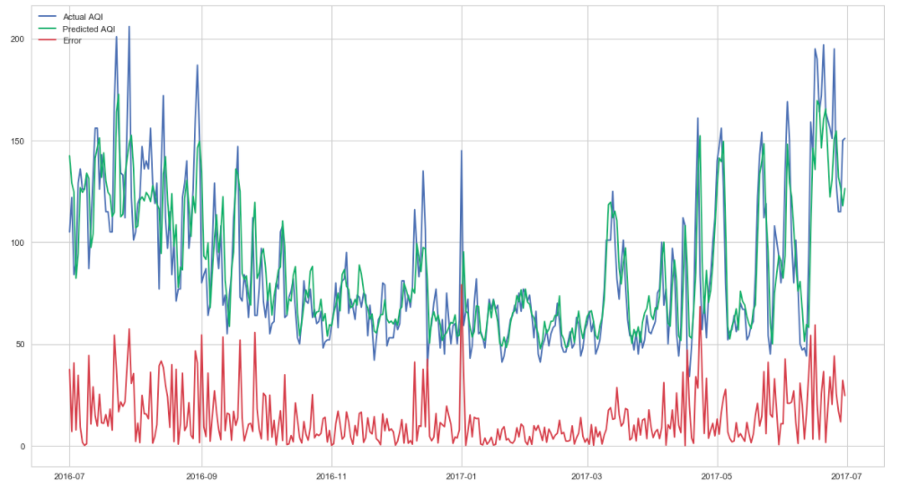
2. How Predictable is Pollution?
Model Evaluation
Model closely tracks AQI, yet error remains high…
Model Performance over Validation Period
Notes:
Model looks like it does exceptionally well until you notice error. It is like a slow dance partner always in about the right place but a step too late

Slide 13
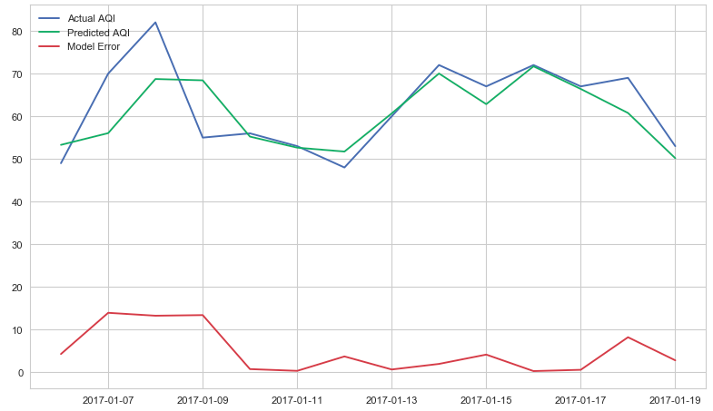
2. How Predictable is Pollution?
Model Evaluation
Model works well with low variance periods
Model Performance over Validation Period
Notes:
Model looks like it does exceptionally well until you notice error. It is like a slow dance partner always in about the right place but a step too late

Slide 14
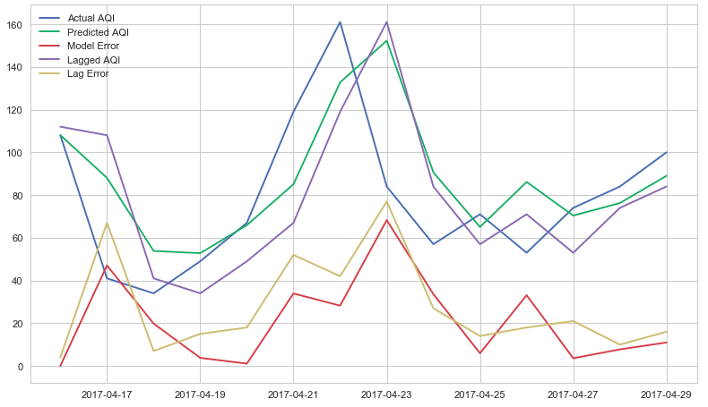
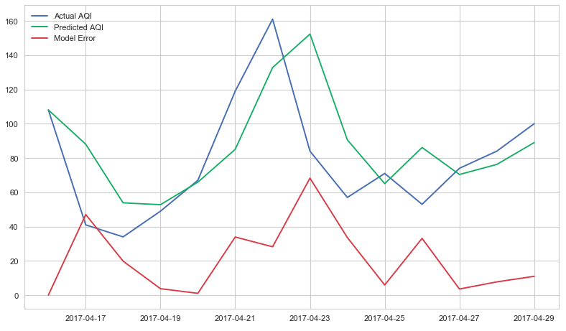
2. How Predictable is Pollution?
Model Evaluation
Overreliance of lag feature in high variance periods
Model Performance over Validation Period
Notes:
Model looks like it does exceptionally well until you notice error. It is like a slow dance partner always in about the right place but a step too late

Slide 15
2. How Predictable is Pollution?
Model Evaluation
However, random forest still outperforms simple lag model
Model Performance over Validation Period
Notes:
Model looks like it does exceptionally well until you notice error. It is like a slow dance partner always in about the right place but a step too late

Slide 16
Further Efforts
1. Weather and Pollution
Obtain historical atmospheric mixing data from NOAA
https://www.esrl.noaa.gov/psd/data/gridded/data.ncep.reanalysis.pressure.html - GRIB files located here
2. Pollution Forecasting
Obtain better historical AQI forecasts from EPA
Data previously obtained is systemically inaccurate
Obtain historical 24 hour weather forecasts
Compare performance to ARIMA model
Auto-Regressive Integrated Moving Averages (ARIMA) models are built specifically for forecasting
Notes:
TEMP_avg = Average of maximum and minimum temperature (Celsius)
TEMP_rng = Range of maximum and minimum temperature (Celsius)
PRCP = Daily precipitation fall (Inches)
PRCP_bin = Binary indicator of precipitation (1 = yes)
WIND_avg = Average daily wind speed
WIND_Uwe = West to East component of wind for peak 5 seconds
WIND_Vns = North to South component of wind for peak 5 seconds

Slide 17
Questions or comments?
Notes:
Note the grey layer lying above the skyline

